Slide 1
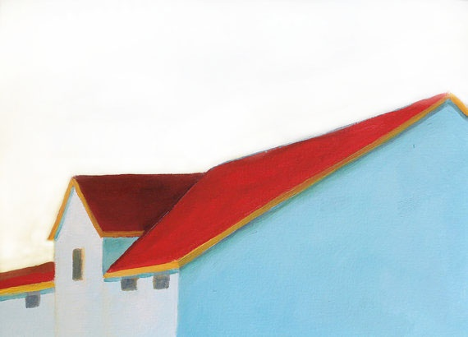
The REDTOP Detector
REDTOP
Rare Eta Decays with a
Tpc for Optical Photons
Corrado Gatto
INFN Napoli and Northern Illinois University

Slide 2

The REDTOP Program
REDTOP
REDTOP is more than an experiment: it is a program of BSM physics exploration through multiple running phases
Phase – Ia: Untagged 10¹³ η mesons (Delivery Ring)
Medium energy low intensity proton beam: ~2 GeV - 30 W
Near-4π central detector
Phase – Ib: Untagged 10¹¹ η’ mesons (Delivery Ring)
Medium energy low intensity proton beam: ~4 GeV - 60 W
Same detector as in Phase-Ia
Phase – II: Tagged 10¹³ η mesons (PIP-II)
Low energy high intensity proton beam: ~0.9 GeV - 1 MW
Same detector as in Phase-Ia + fwd tagging detector
Phase – III: Tagged 10¹³ η ’ mesons (Booster upgrade)
Low energy high intensity proton beam: ~2 GeV - 1 MW
Same detector as in Phase-II
Possible More Phases
Reuse REDTOP detector with different beam species (K, μ, π)

Slide 3
REDTOP Beam Requirements
REDTOP
Delivery ring
Phase – I: Untagged 10¹³ η/η’ mesons
CW beam: ~2 GeV (η)– ~4(η’) GeV
Low intensity : 10¹¹ POT/sec or 10¹⁸ POT/yr on solid target
Multiple (10) thin Li or Be targets to disentangle event pileup
vs LHCb@40 MHz
Inelastic interaction rate: ~ 0.5 GHz
Average event multiplicity ≈
4 charged + 4 neutral
η/η’ production rate: ~ 2.3 MHz
PIP-II
Phase – II: Tagged 10¹² − 10¹³ η/η’ mesons
CW beam: ~0.9 GeV (η) and ~1.7(η’) GeV
High intensity beam : 10²¹-10²² POT/yr on De gaseous target
Inelastic interaction rate: ~ 13 - 130 GHz
η/η’ production rate: ~ 0.1 - 1 MHz

Slide 4
Detector Requirements and Technology
REDTOP
Calorimetric σ(E)/E ~ 5%/ √ E
High PID efficiency: 98/99% (e,γ), 95% (μ), 95% (π), 99.5%(p,n)
σ_{tracker}(t) ~ 80psec, σ_{calorimeter}(t) ~ 80psec, σ_{Rich}(t) ~ 80psec
Low-mass vertex detector
Near 4π detector acceptance (as the η/η’ decay is almost at rest).
  charged tracks detection
  Option 1: Optical-TPC
  Barions and most pions are below threshold
  Electrons and most muons are detected and reconstructed
  Option 2: LGAD Tracker
  4D track reconstruction for multihadron rejection
  Complemented with outer quartz tiles for TOF measurements
  γ detection
  Use ADRIANO2 calorimeter (Calice+T1604)
  PFA + Dual-readout+HG
  Light sensors: SiPM or SPADs
  96.5% coverage
  Fiber tracker (LHCB style) for rejection of background from γ-conversion and reconstruction of secondary vertices (~70μm resolution)

Slide 5
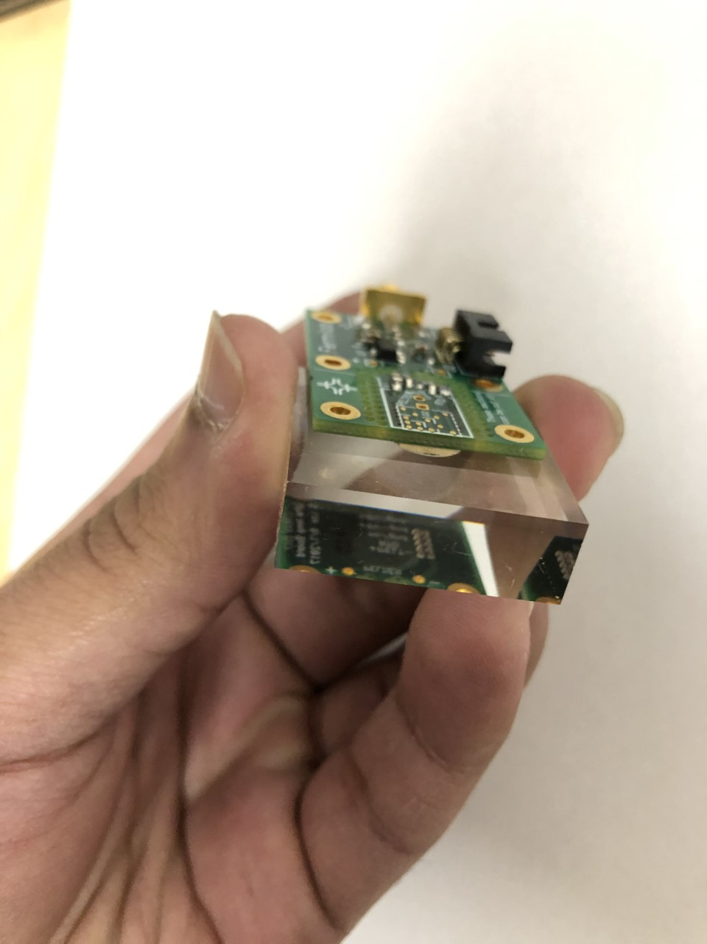
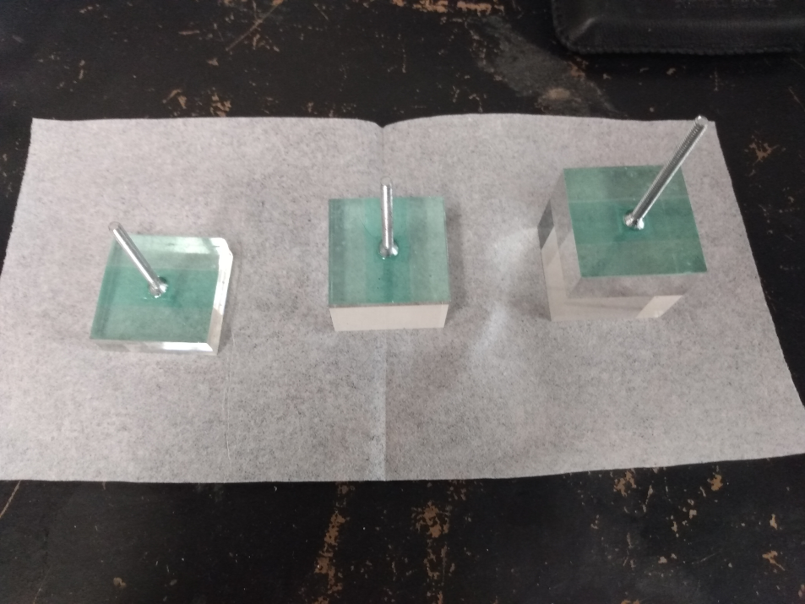
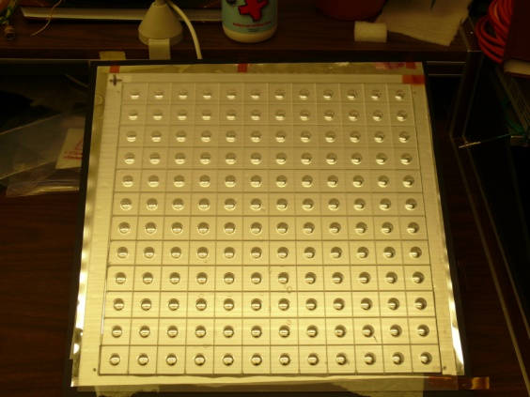
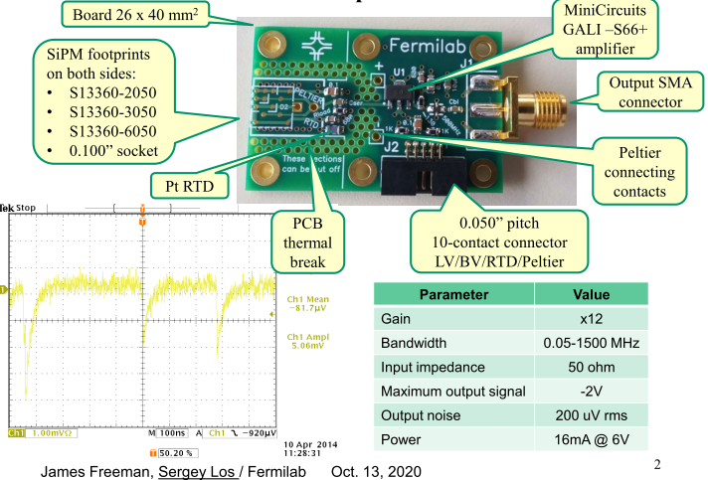
ADRIANO2 R&D: T1604 and CALICE
REDTOP
  Sandwich of Pb-glass and scintillating tiles for dual-readout technique
  First ADRIANO2 protoype being tested at FTBF in June 2021

Slide 6
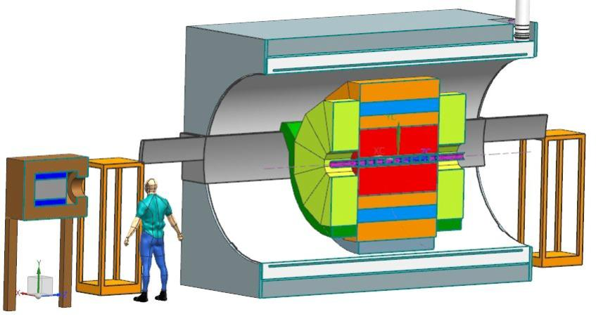
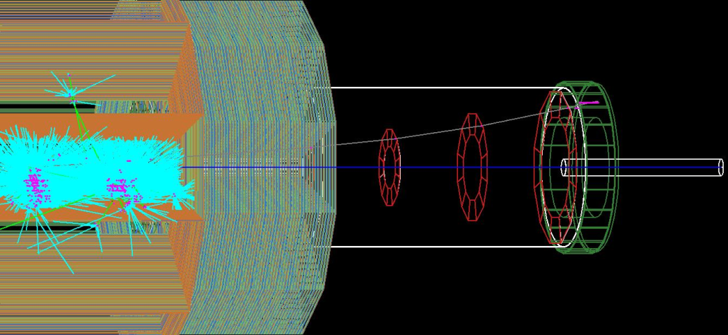

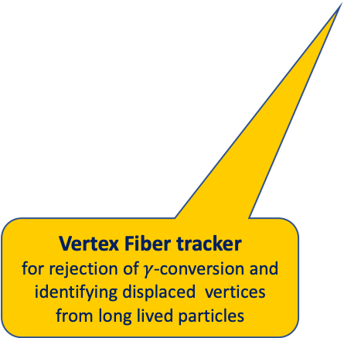
REDTOP detector
REDTOP
Optical-TPC
For slow background rejection
or
LGAD Tracker surrounded by Quartz cells
For 4D track reconstruction and TOF measurements
5D- Calorimeter: ADRIANO2
(Dual-readout +PFA)
Sci and Cer light read by SiPM or SPAD
For excellent energy , position resolution and PID
$μ$-polarimeter (optional)
sandwich of fused silica and Si-pixel
for measurement of muon polarization
Vertex Fiber tracker
for rejection of $γ$-conversion and identifying displaced vertices from long lived particles
Forward Detector for Phase-2
for tagging ³He⁺⁺ ions
10x Be or Li targets

Slide 7
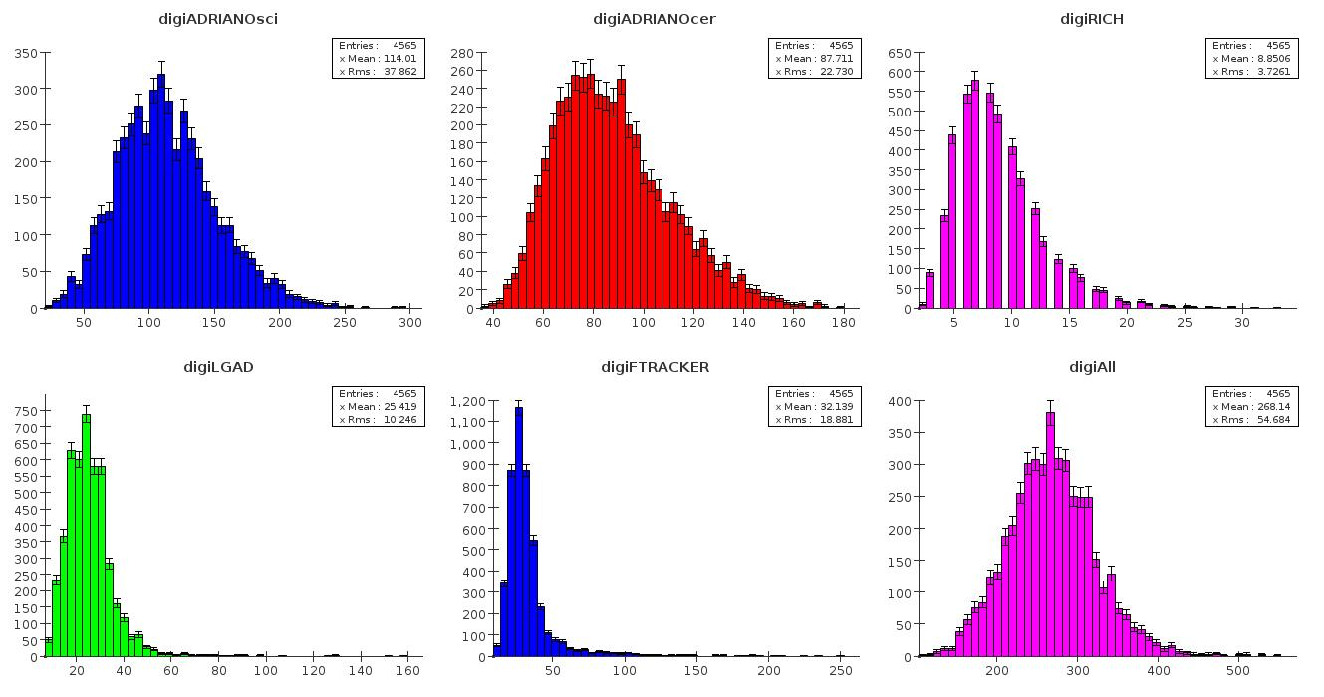
REDTOP Trigger Requirement
REDTOP
Phase – I: Untagged 10¹³ η/η’ mesons
  Hits from subdetectors
Total channel occupancy:
270 +/- 50 /evt
  Trigger requirements (L. Ristori, A. Kotwal)
Level | Algo | Detectors | Hardware | Rejection factor
L0 | Σ LGAD, RICH & ADRIANO-Cer | LGAD, RICH, ADRIANO | Fast sum | 100
L1 | identification of a pair of leptons, γ-conversion rejection, TOF | LGAD, RICH, ADRIANO Fiber Tracker | FPGA | 100
L2 | Reco | All | 2000 CPU-cores | >100

Slide 8
Storage & CPU
REDTOP
  Expected data rates from the experiment
  About 100 Hz to be stored on tape
  ~0.25 MB/sec from L2
  ~2.5 PB/year to tape (assume 2.5 kb event size)
  Data from DAQ and Montecarlo
  Data from experiment: ~2.5 PB/year to tape
  Processed data (reco, calib. Analysis, etc) : ~2.0 PB/year (tape and disk)
  Montecarlo (~10¹¹ events): ~0.5 PB/run (tape and disk)
  Total: 5 PB/year
  CPU for Reconstruction Analysis and Montecarlo
  55 million core-hours for Monte Carlo jobs
  35 million core-hours for data reconstruction jobs
  Total: ~ 90 million core-hours /year
  (estimate by projecting current OSG usage)

Slide 9
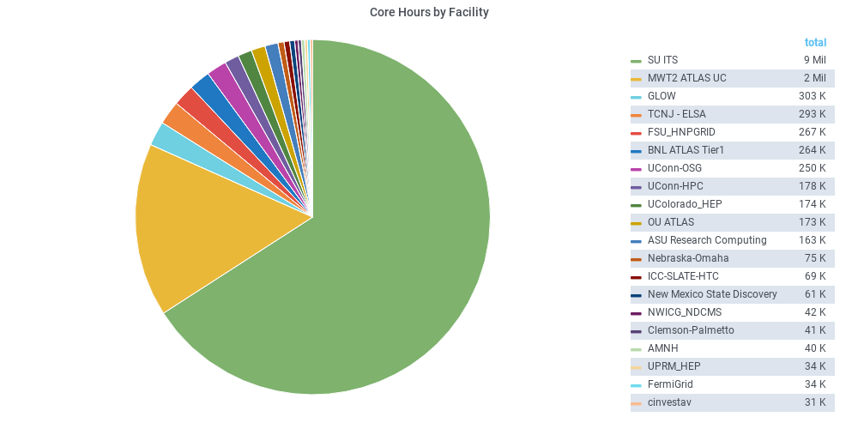
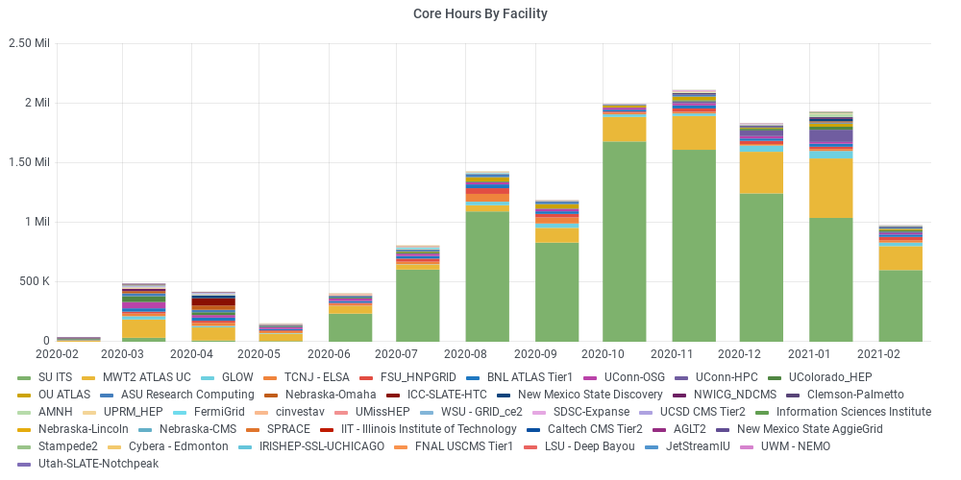
REDTOP OSG Yearly Usage Statistics
REDTOP
● Time range: Feb 2020 – Feb 2021
● Total Core Hours: 13.8 million
● Total jobs: 7.15 million

Slide 10
REDTOP Collaboration
REDTOP
11 Countries, 35 Institutions, 92 Collaborators
J. Comfort, P. Mauskopf, D. McFarland, L. Thomas
Arizona State University, (USA)
I. Pedraza, D. Leon, S. Escobar, D. Herrera, D Silverio
Benemérita Universidad Autónoma de Puebla, (Mexico)
A. Alqahtani
Georgetown University, (USA)
F. Ignatov
Budker Institute of Nuclear Physics – Novosibirsk, (Russia)
A. Kotwal
Duke University, (USA)
M. Spannowsky
Durham University, (UK)
J. Dey, V. Di Benedetto, B. Dobrescu, E. Gianfelice-Wendt, E. Hahn, D. Jensen,
C. Johnstone, J. Johnstone, J. Kilmer, G.Krnjaic, T. Kobilarcik, A. Kronfeld,
K. Krempetz, M. May, A. Mazzacane, N. Mokhov, W. Pellico, A. Pla-Dalmau,
V. Pronskikh, E. Ramberg, J. Rauch, L. Ristori, E. Schmidt, G. Sellberg, G. Tassotto,
Y.D. Tsai
Fermi National Accelerator Laboratory, (USA)
P. Sanchez-Puertas
IFAE – Barcelona (Spain)
C. Gatto^{1†}
Istituto Nazionale di Fisica Nucleare – Sezione di Napoli, (Italy)
W. Baldini
Istituto Nazionale di Fisica Nucleare – Sezione di Ferrara, (Italy)
R. Carosi, A. Kievsky, M. Viviani
Istituto Nazionale di Fisica Nucleare – Sezione di Pisa, (Italy)
W. Krzemień, M. Silarski, M. Zielinski
Jagiellonian University, Krakow, (Poland)
D. S. M. Alves, S. Pastore
Los Alamos National Laboratory, (USA)
M. Berlowski
National Centre for Nuclear Research – Warsaw, (Poland)
G. Blazey, A. Dychkant, K. Francis, M. Syphers, V. Zutshii, P. Chintalapati, T. Malla, M. Figora
Northern Illinois University, (USA)
D. Egaña-Ugrinovic
Perimeter Institute for Theoretical Physiscs – Waterloo, (Canada)
Y. Kahn
Princeton University – Princeton, (USA)
P. Meade, S. Homiller
Stony Brook University – New York, (USA)
A. Gutiérrez-Rodriguez, M. A. Hernandez-Ruiz
Universidad Autónoma de Zacatecas, (Mexico)
B. Fabela-Enriquez
Vanderbilt University, (USA)
J. Jaeckel
Universität Heidelberg, (Germany)
C. Siligardi, S. Barbi, C. Mugoni
Università di Modena e Reggio Emilia, (Italy)
L. E. Marcucci⁴
Universita’ di Pisa, (Italy)
M. Guida³
Università di Salerno, (Italy)
S. Charlebois, J. F. Pratte
Université de Sherbrooke, (Canada)
L. Harland-Lang
University of Oxford, (UK)
S. Gori
University of California Santa Cruz, (USA)
R. Gardner, P. Paschos
University of Chicago, (USA)
J. Konisberg
University of Florida, (USA)
M. Murray, C. Rogan, C. Royon, Nicola Minafra, A. ​Novikov, F. Gautier, T. Isidori
University of Kansas, (USA)
S. Gardner, J. Shi, X. Yan
University of Kentucky, (USA)
M. Pospelov
University of Minnesota, (USA)
D. Gao
University of Science and Technology of China, (China)
K. Maamari
University of Southern California, (USA)
A. Kupsc
University of Uppsala, (Sweden) S. Tulin
York University, (Canada)
Notes:
10

Slide 11
Summary
REDTOP
All meson factories: LHCb, B-factories, Dafne, J/ψ factories - have generated a broad spectrum of nice physics
Existing world sample not sufficient for breaching into decays violating conservation laws or searching for new particles
REDTOP goal is to produce >10¹³ untagged η mesons/yr and ~10 ¹¹ η’ /yr in Phase-I and ~10¹³ tagged η mesons in Phase-II
No similar experiment being proposed worldwide
Novel detector techniques are required to cope with high interaction rate and background. Sub-nsec timing is essential
Relatively low beam requirements could be met by several laboratories in US and Asia
Fermilab only laboratory with beam for Phase-I (Delivery Ring) and Phase-II (PIP-II). Compatible with a p-EDM experiment in MC4 (see Y. Semertzidis talk yesterday)
More details: http://redtop.fnal.gov

Slide 12
Backup slides

Slide 13
Present & Future η Samples
REDTOP
 | Technique |  | η → 3πº | η → e⁺e⁻γ | Total η
CB@AGS | π⁻⁻p→η n |  | 9×10⁵ |  | 10⁷
CB@MAMI-B | γ⁻p→η p |  | 1.8×10⁶ | 5000 | 2×10⁷
CB@MAMI-C | γ⁻p→η p |  | 6×10⁶ |  | 6×10⁷
KLOE | e+e-→Φ→ηγ |  | 6.5×10⁵ |  | 5×10⁷
WASA@COSY | pp→η pp pd→η ³He |  |  |  | >10⁹ (untagged) 3×10⁷ (tagged)
CB@MAMI 10 wk (proposed 2014) | γ⁻p→η p |  | 3×10⁷ | 1.5×10⁵ | 3×10⁸
Phenix | d Au→η X |  |  |  | 5×10⁹
Hades | pp→η pp p Au→η X |  |  |  | 4.5×10⁸
Near future samples
GlueX@JLAB (just started) |  | γ_{12 GeV}p → η X → neutrals |  |  | 5.5×10⁷/yr
JEF@JLAB (recently approved) |  | γ_{12 GeV}p → η X → neutrals |  |  | 3.9×10⁵/day
REDTOP@FNAL (proposing) |  | p_{1.8 GeV}Li → η X |  |  | 2.5×10¹³/yr

Slide 14
Overall Computing Usage
REDTOP
Computing resources for REDTOP are from three sources:
  OSG: CPU and stash storage
  NICADD/NIU: CPU and permanent storage
  Fermilab (private farm hosted by AD) : CPU and permanent storage
  Summary of computing
Source | Storage | #core available | Jobs/yr | Wall hr/yr | Fraction
OSG | 100 TB (with peaks of 140 TB) | opportunistic | 7x10⁶ | 14x10⁶ | 72%
NICADD | 15 TB | 500-690 | 4x10⁶ | 5x10⁶ | 26%
Fermilab-AD | 200 TB | 350 | 300K | 600K | 2%

Slide 15
REDTOP Computing Model
REDTOP
Model architecture:
  Single-core computational workflow has proven to be well suited for the distributed High Throughput Computing (DHTC) environment of the OSG.
  Model already adopted by other small Collaborations (IceCube, XENON, et. al.)
Storage:
  DataStream from the L-2 farm will be staged at (FNAL) dCache storage and sent to tape (or wherever is cheaper when the experiment runs: FNAL at present)
  Stratum-0 server hosts a CVMFS repository of the REDTOP software
CPU:
  Any (dedicated or opportunistic) OSG working node
  Member institutions can join the OSG federation and accept jobs from OSG’s GlideinWMS job factory via a HostedCE deployment.

Slide 16
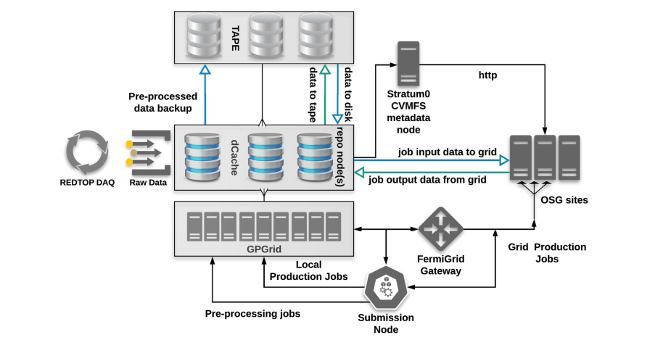
REDTOP Baseline
Computing Model
REDTOP
For more details: http://redtop.fnal.gov/wp-content/uploads/2020/05/redtop-compute_v3.pdf

