Slide 1
Underground Physics in India 1951-1992
Naba K Mondal
Saha Institute of Nuclear Physics, Kolkata, India
Tangled Web of Quantum Sensors
International Symposium, Fermilab
30th April, 2021

Slide 2
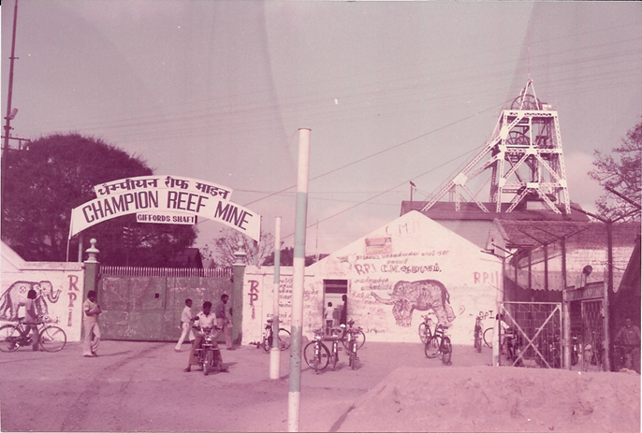
1951 Start of KGF activities
First set of measurements were carried out at Nundydurg Mines

Slide 3
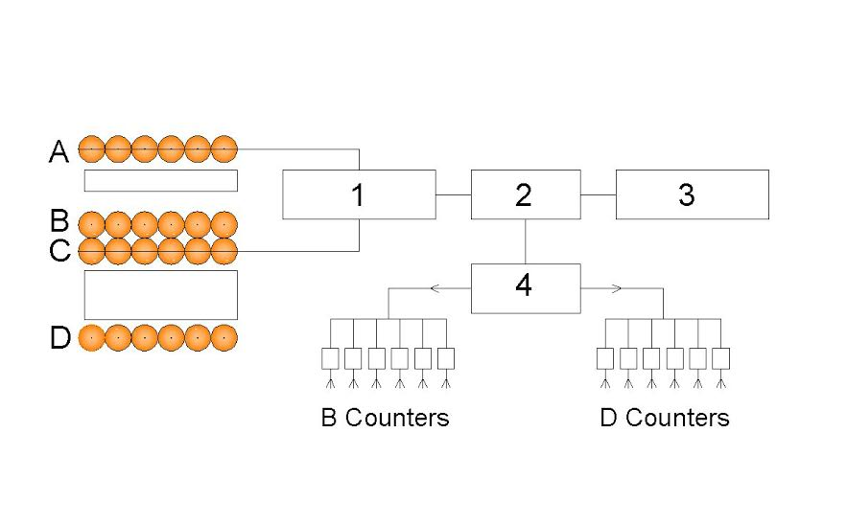
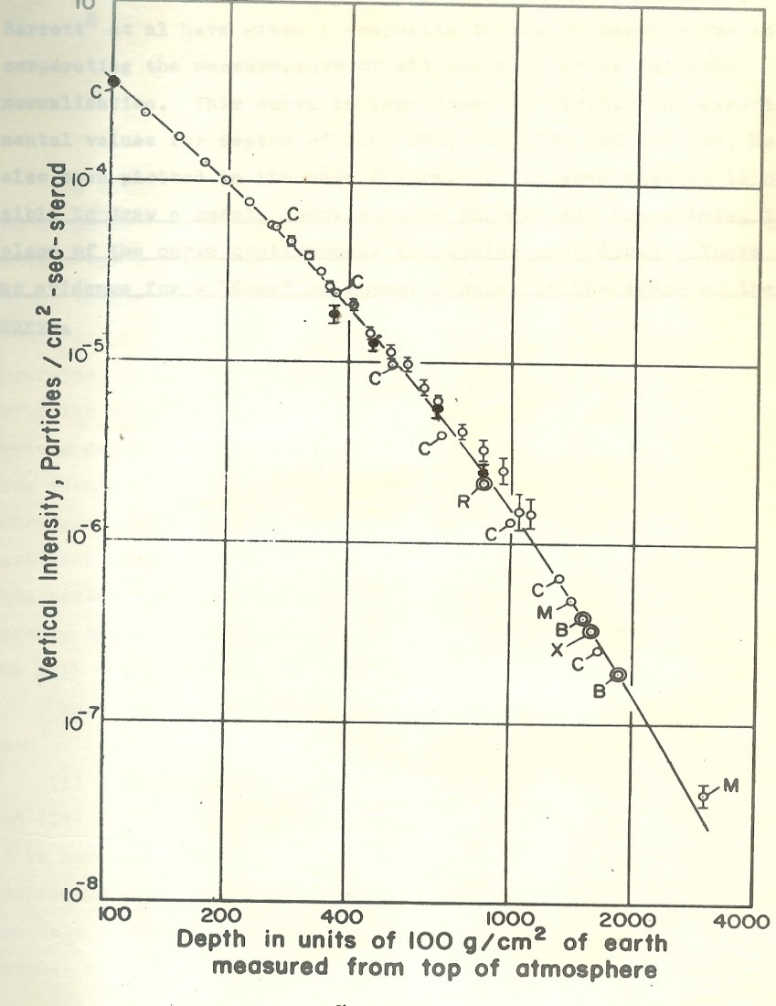
KGF 1951-1954 - GM Counter array upto a depth of 900 ft (E_{μ} ~ 200 GeV)
Double coincidence circuits.
Cathode follower.
Film advancing circuits.
Inverter.

Slide 4
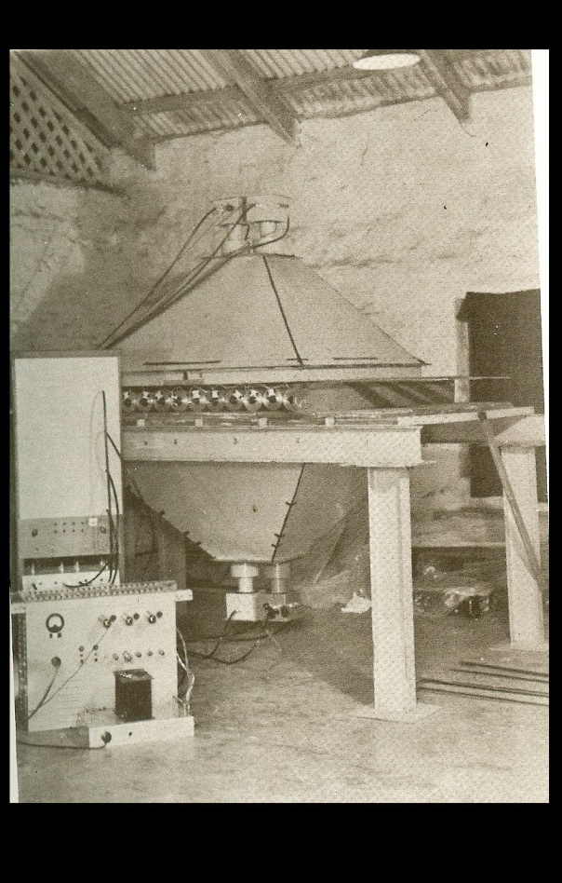
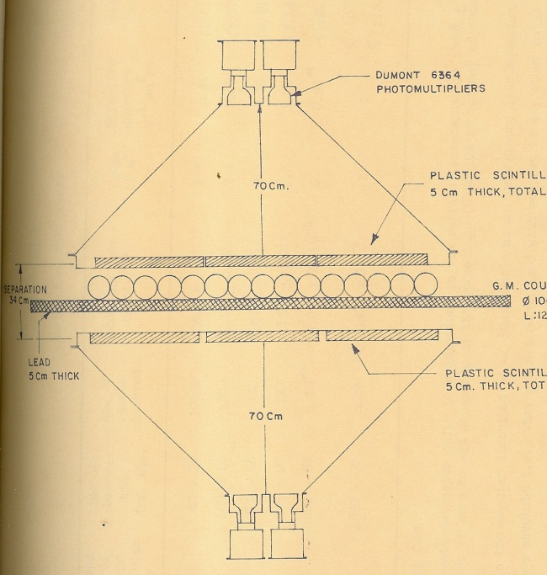
KGF 1960-1963 Up to a depth of 2.7 km. ( 800 – 8400 mwe)

Slide 5
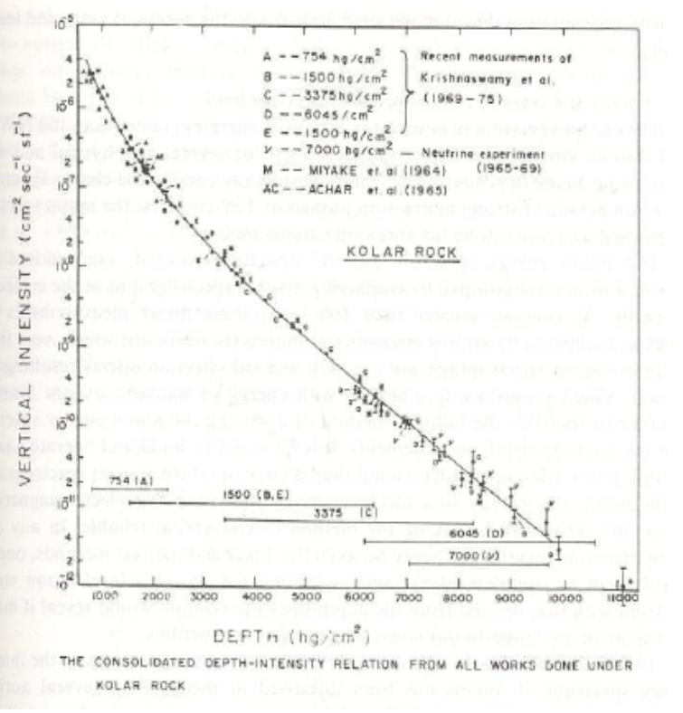
Most comprehensive Depth-intensity curve

Slide 6
Tata-Durham-Osaka Neutrino Experiment
It was already known that high energy cosmic ray particles interact with the Earth’s atmosphere and produce pions and kaons. These in turn, decay into muons and neutrinos.
Georgy T. Zatsepin and Vadim A. Kuzmin from Soviet Union had already made careful calculations of the flux and angular distribution of these neutrinos.
In 1962, an accelerator based neutrino experiment at Brookhaven had established the existence of a muon neutrino v_{μ}, distinct from the electron neutrino v_{e}, and measured the neutrino-nucleon cross-section to be about 10⁻³⁸ cm².
These inputs allowed KGF group to estimate the expected rates of neutrino interactions underground and to optimise the size and type of detectors required to detect them.
A long tunnel at 2300 m depth in Heathcote shaft in the Champion Reef mines was chosen as the site for the experiment.

Slide 7
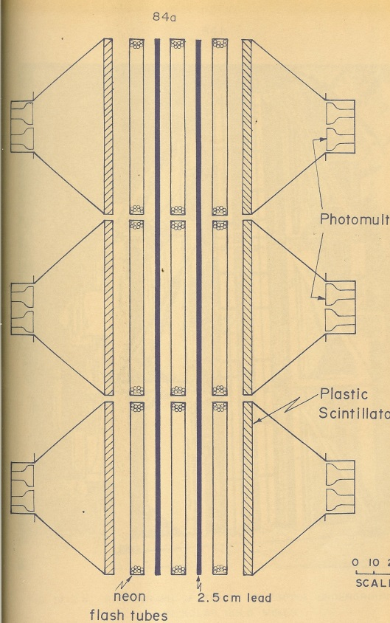
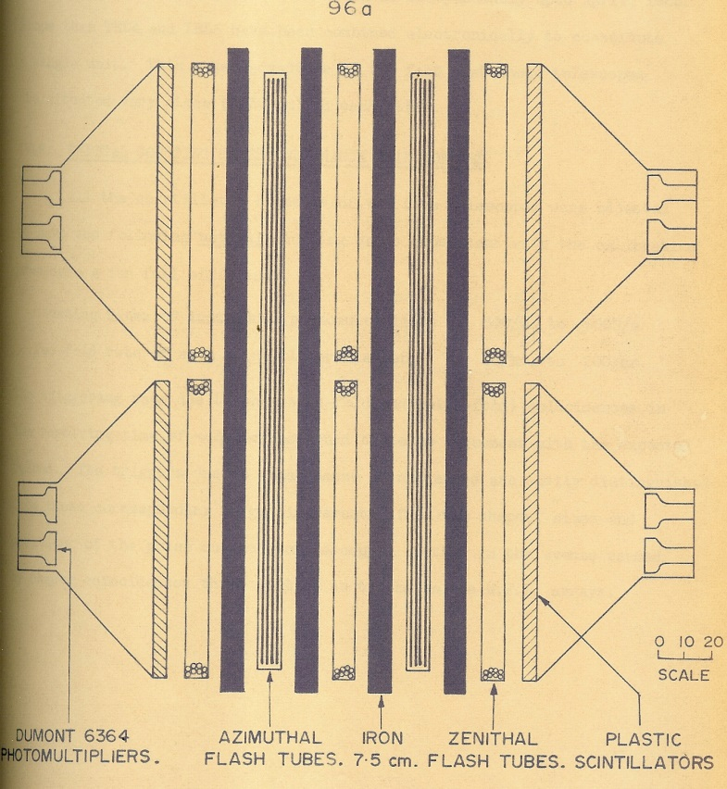
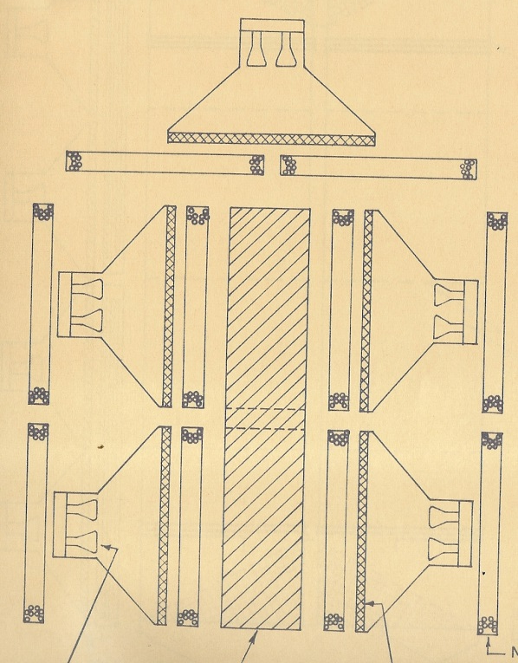
Neutrino Experiment at KGF 1965 onwards

Slide 8
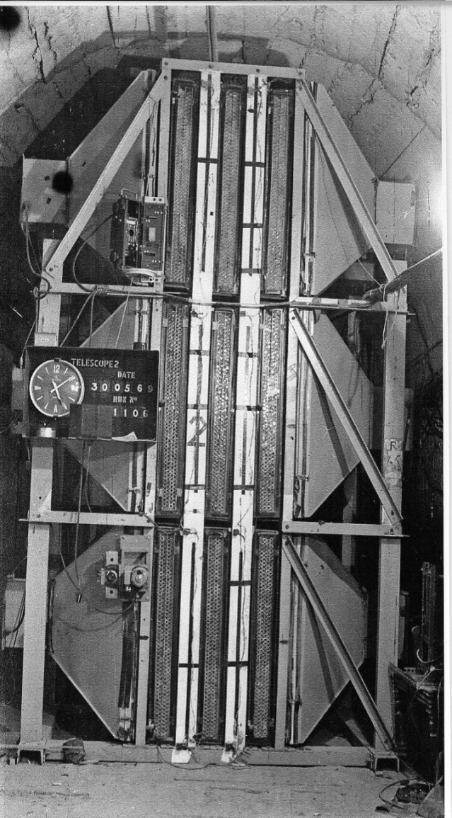
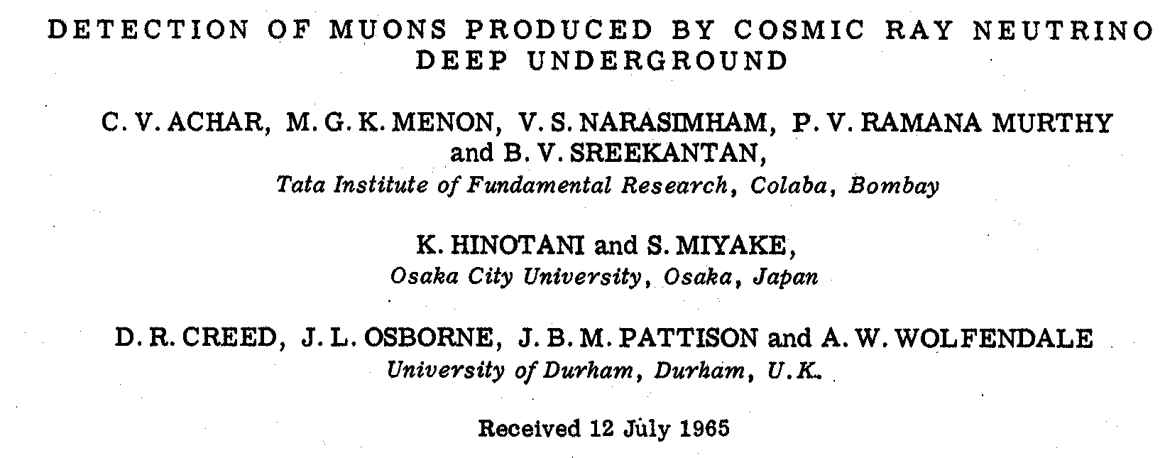
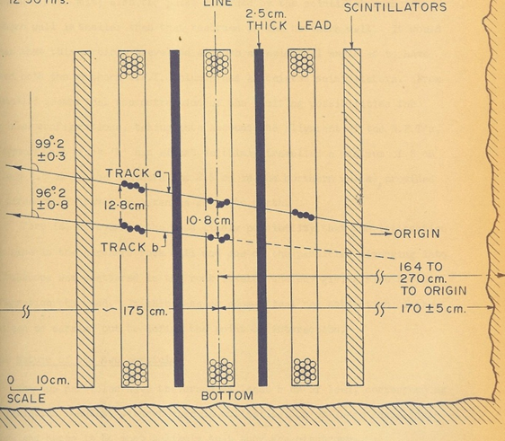
Atmospheric neutrino detection in 1965
Physics Letters 18, (1965) 196, dated 15th Aug 1965
Atmospheric neutrino detector
at Kolar Gold Field –1965

Slide 9
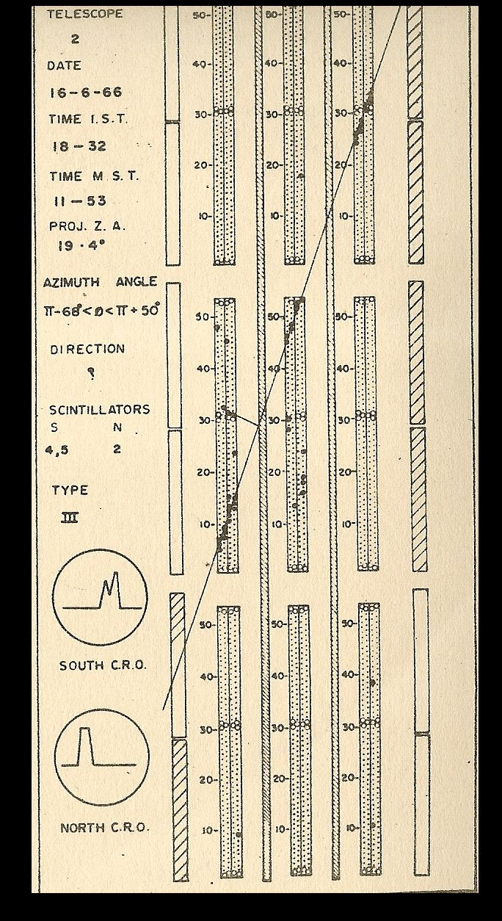
Neutrino Events at KGF

Slide 10
Study of atmospheric neutrinos underground became an important area of research in the field of particle physics around the world later and several Nobel Prize-winning discoveries were made using neutrinos underground.

Slide 11
Beginning of Neutrino Astronomy

Slide 12
KGF Phase –I Nucleon Decay Experiment 1980-1992

Slide 13
KGF Phase-II Nucleon Decay Experiment 1984-1992

Slide 14
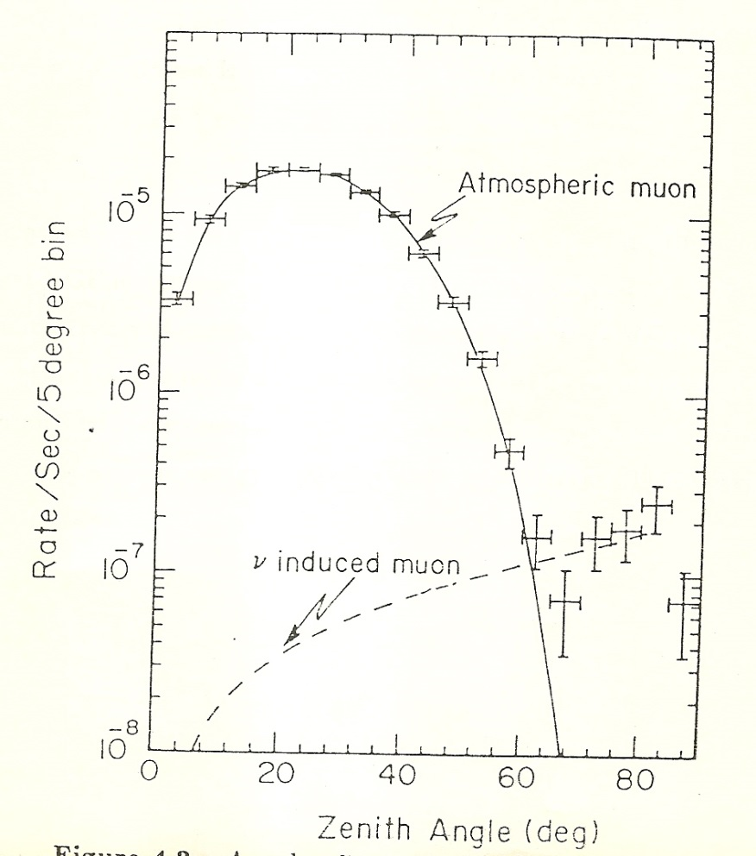
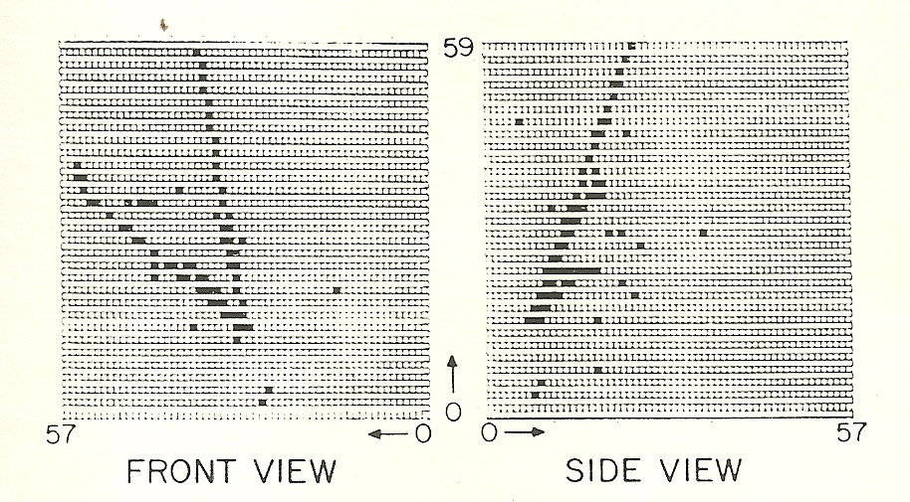
Neutrino Events

Slide 15
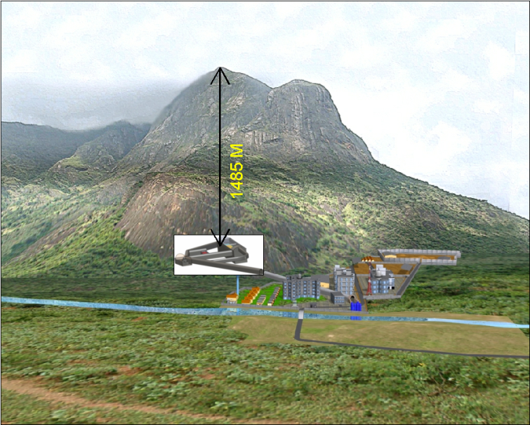
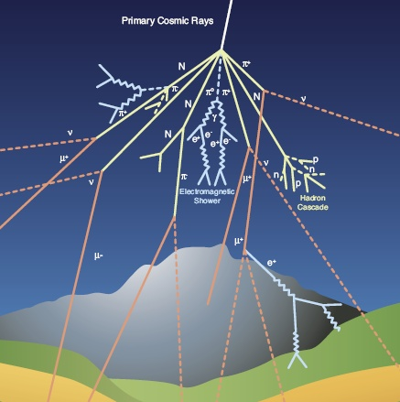
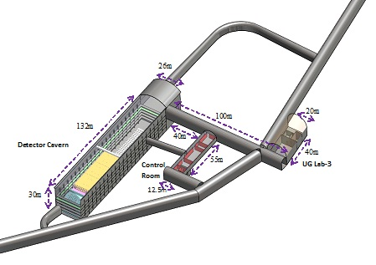
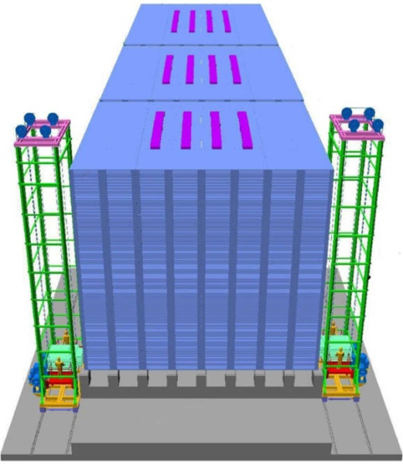
Waiting for India-based Neutrino Observatory
Atmospheric neutrinos
Underground complex
50 Kton ICAL neutrino Detector

Slide 16
Best Wishes Swapan for the next innings

