Slide 1
Building for Discovery: Protons for Long Baseline Neutrino Oscillation Studies
Lia Merminga
Symposium Celebrating Swapan Chattopadhyay's Retirement
30 April 2021

Slide 2
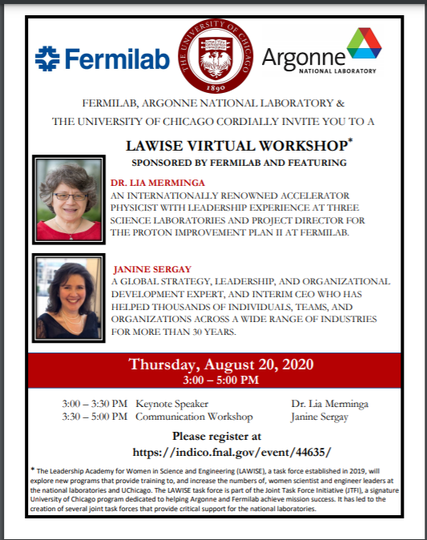
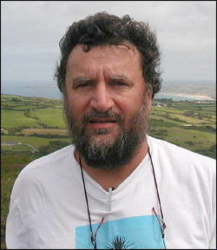


Mentors
In the work environment, it takes enlightened colleagues who feel secure about themselves to mentor young women and influence their careers positively.
Work with the best in the field!
Steve Peggs
BNL
Swapan Chattopadhyay
NIU & Fermilab
Nigel Lockyer
Fermilab

Slide 3

  Build a world-class neutrino program
  Host it as a global project
  Upgrade Fermilab accelerator complex to provide >1 MW proton beam
Recommendation 13: Form a new international collaboration to design and execute a highly capable Long-Baseline Neutrino Facility (LBNF) hosted by the U.S. To proceed, a project plan and identified resources must exist to meet the minimum requirements in the text. LBNF is the highest priority large project in its timeframe.
Recommendation 14: Upgrade the Fermilab proton accelerator complex to produce higher intensity beams. R&D for the Proton Improvement Plan II (PIP-II) should proceed immediately, followed by construction, to provide proton beams of >1 MW by the time of first operation of the new long-baseline neutrino facility.

Slide 4
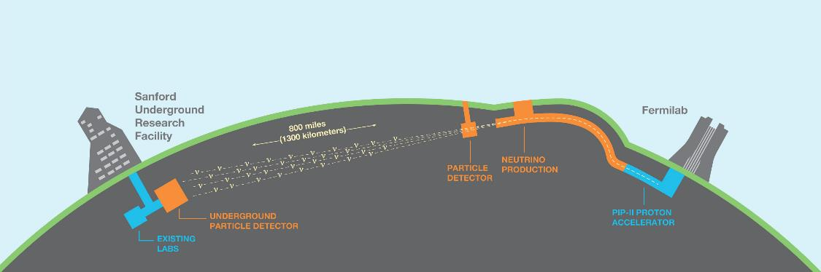

PIP-II / LBNF / DUNE
~1,214 collaborators from 202 institutions in 33 countries (including CERN)
Proton Improvement Plan – II (PIP-II): The upgrade of Fermilab accelerator complex to >1 MW proton beam
Long Baseline Neutrino Facility (LBNF): Dual-site detector facility and neutrino beam
Deep-Underground Neutrino Experiment (DUNE): The next generation neutrino experiment
The PIP-II/LBNF/DUNE project will be the first internationally conceived, constructed and operated mega-science project hosted by the Department of Energy in the United States.

Slide 5




DUNE Science Objectives
Neutrinos – most ubiquitous matter particle in the universe, yet the least understood. Opportunities for game changing physics discoveries:
Origin of matter
Investigate leptonic CP violation, mass hierarchy, precision oscillation physics
  Discover what happened after the big bang: Are neutrinos the reason the universe is made of matter?
Neutron Star and Black hole formation
Ability to observe supernovae events
  Use neutrinos to look into the cosmos and watch the formation of neutron stars and black holes in real time
Unification of forces
Investigate nucleon decay targeting SUSY-favored modes
  Move closer to realizing Einstein’s dream of a unified theory of matter and energy

Slide 6
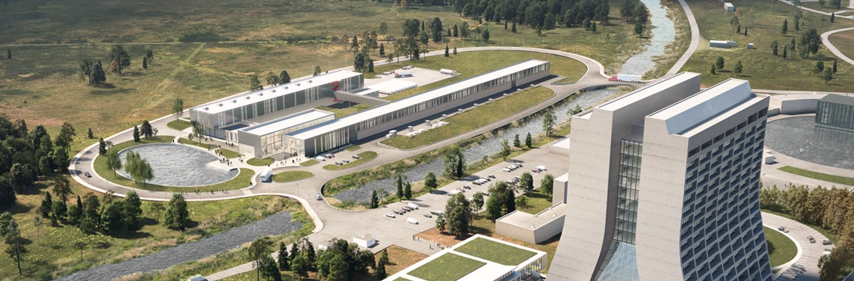






PIP-II….a new accelerator to generate neutrinos

Slide 7

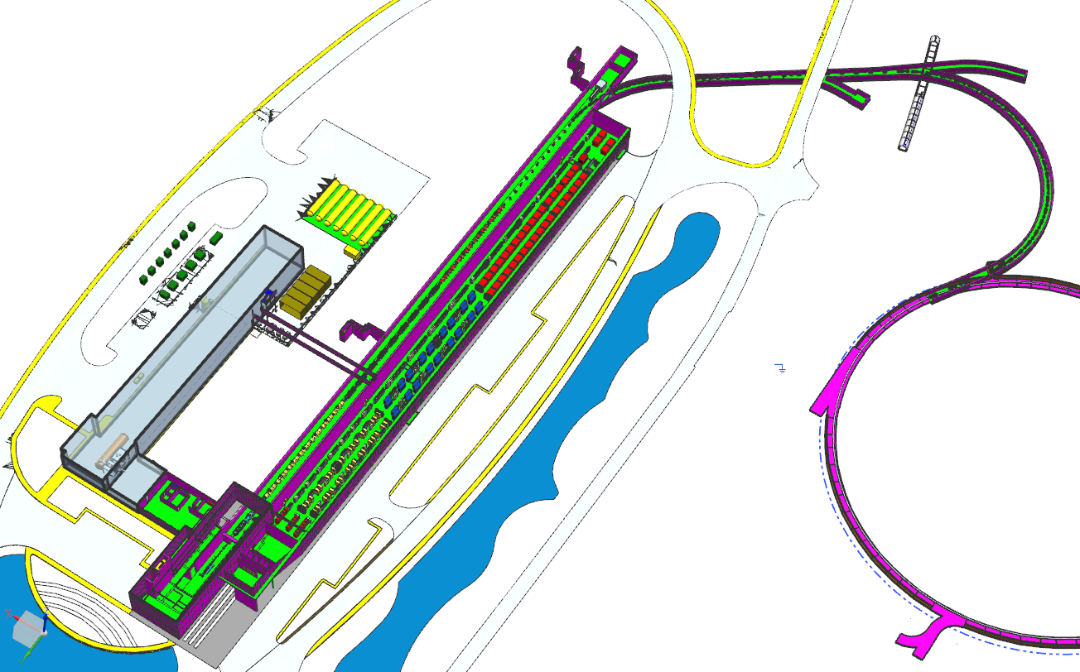
PIP-II Mission
PIP-II will enable the world’s most intense beam of neutrinos to the international LBNF/DUNE project, and a broad physics research program, powering new discoveries for decades to come.
PIP-II linac capabilities
Beam Power
1.2 MW proton beam
Upgradeable to multi-MW
Flexibility and multi-user capability
Compatible w/ CW-operations
Customized beams
Multi-user delivery
Reliability
PIP-II Scope
800 MeV H− linac
  Warm Front End & SRF section
Linac-to-Booster transfer line
  3-way beam split
Upgraded Booster
  20 Hz, 800 MeV injection
  New injection area
Upgraded Recycler, Main Injector
  RF in both rings
Conventional facilities, incl.
  Site preparation
  Cryoplant Building
  Linac Complex
  Booster Connection
The PIP-II scope enables the accelerator complex to reach 1.2 MW proton beam on LBNF target.

Slide 8
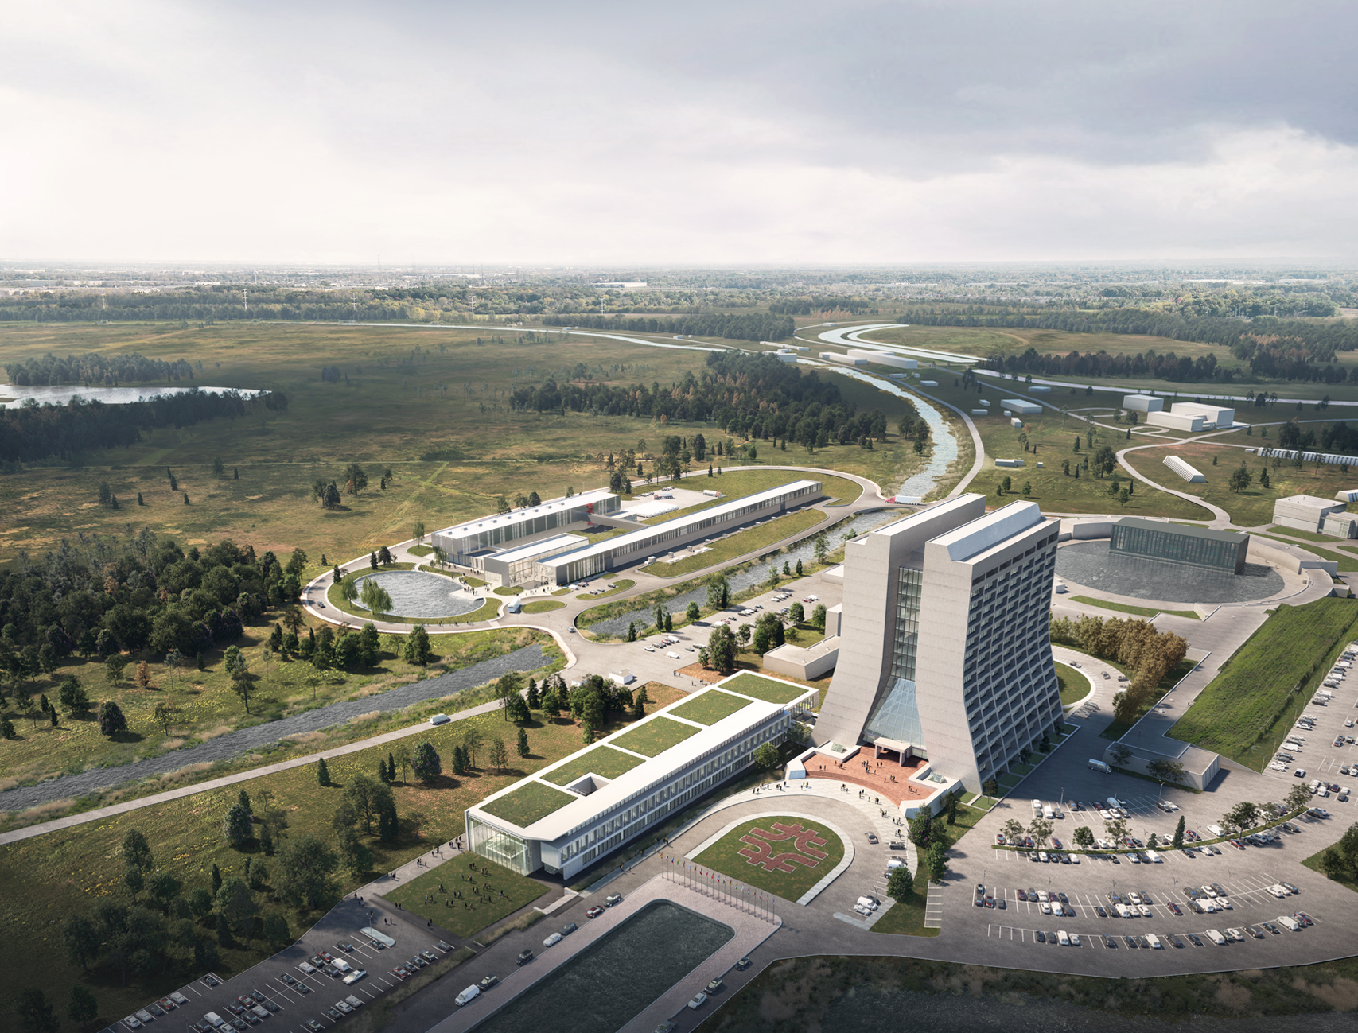
Main Injector
Transfer Line
PIP-II
SRF Linac
Booster

Slide 9
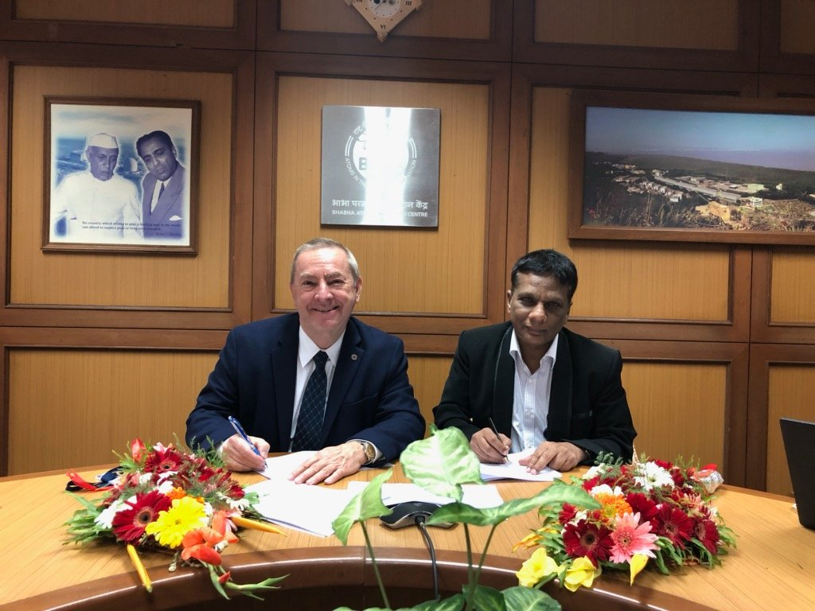
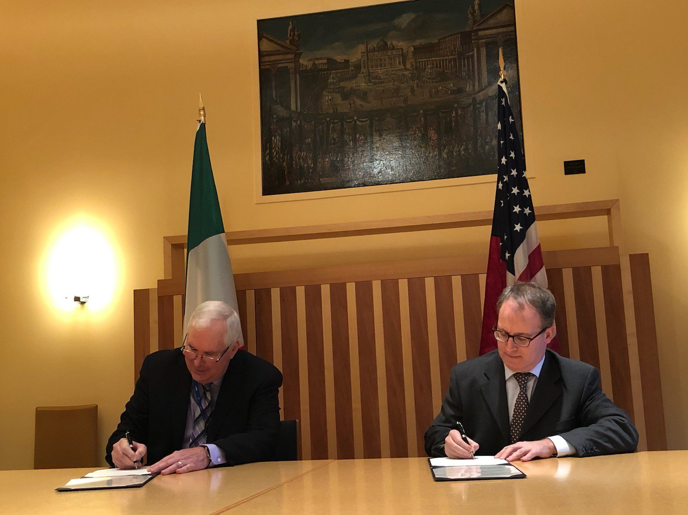
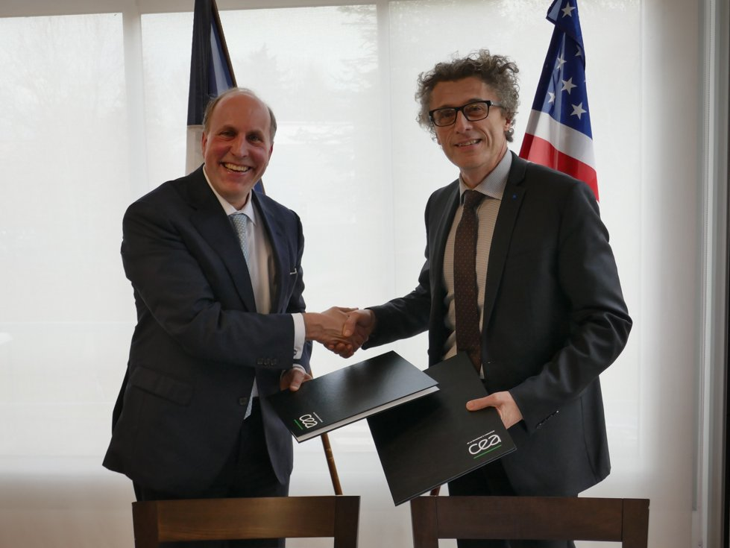
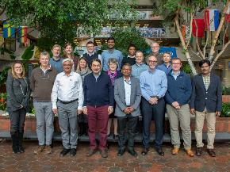
PIP-II International Partners, Expertise and Capabilities
India, Department of Atomic Energy (DAE) (started 2009)
BARC, RRCAT, VECC; also IUAC
    Substantial engineering / manufacturing experience; Superconducting magnets for LHC; 2 GeV synch light source
Italy, INFN (started 2016)
  Internationally recognized leader in superconducting RF technologies
  SRF cavity and cryomodule fabrication for XFEL; SRF cavities for ESS
UK, STFC UKRI (started 2017)
  Substantial engineering and manufacturing experience; Construction, operation of synch light & neutron sources SRF cavity processing and testing for ESS
France, CEA, CNRS/IN2P3 (started 2017)
  Internationally recognized leader in large-scale CM assembly
  CM assembly for European XFEL and ESS; SSR2 cavities and couplers for ESS
Poland, WUST, WUT, TUL (started 2018)
  Substantial engineering / manufacturing experience; CDS, LLRF, QC for XFEL, ESS
PIP-II Project benefits from world-leading expertise, facilities.
“Timing is perfect”

Slide 10

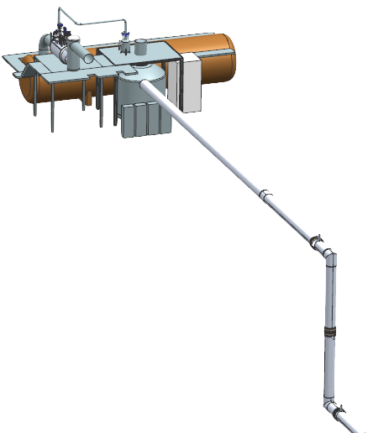
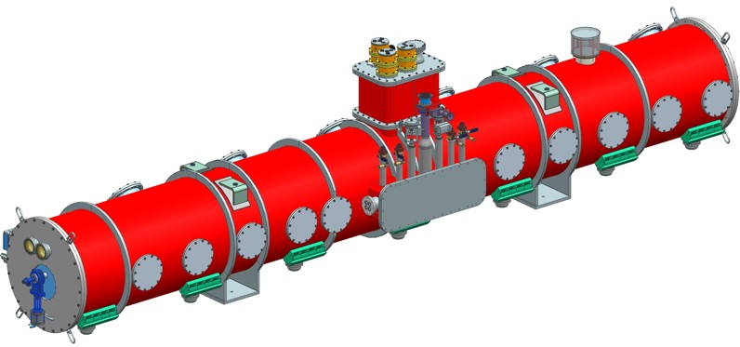
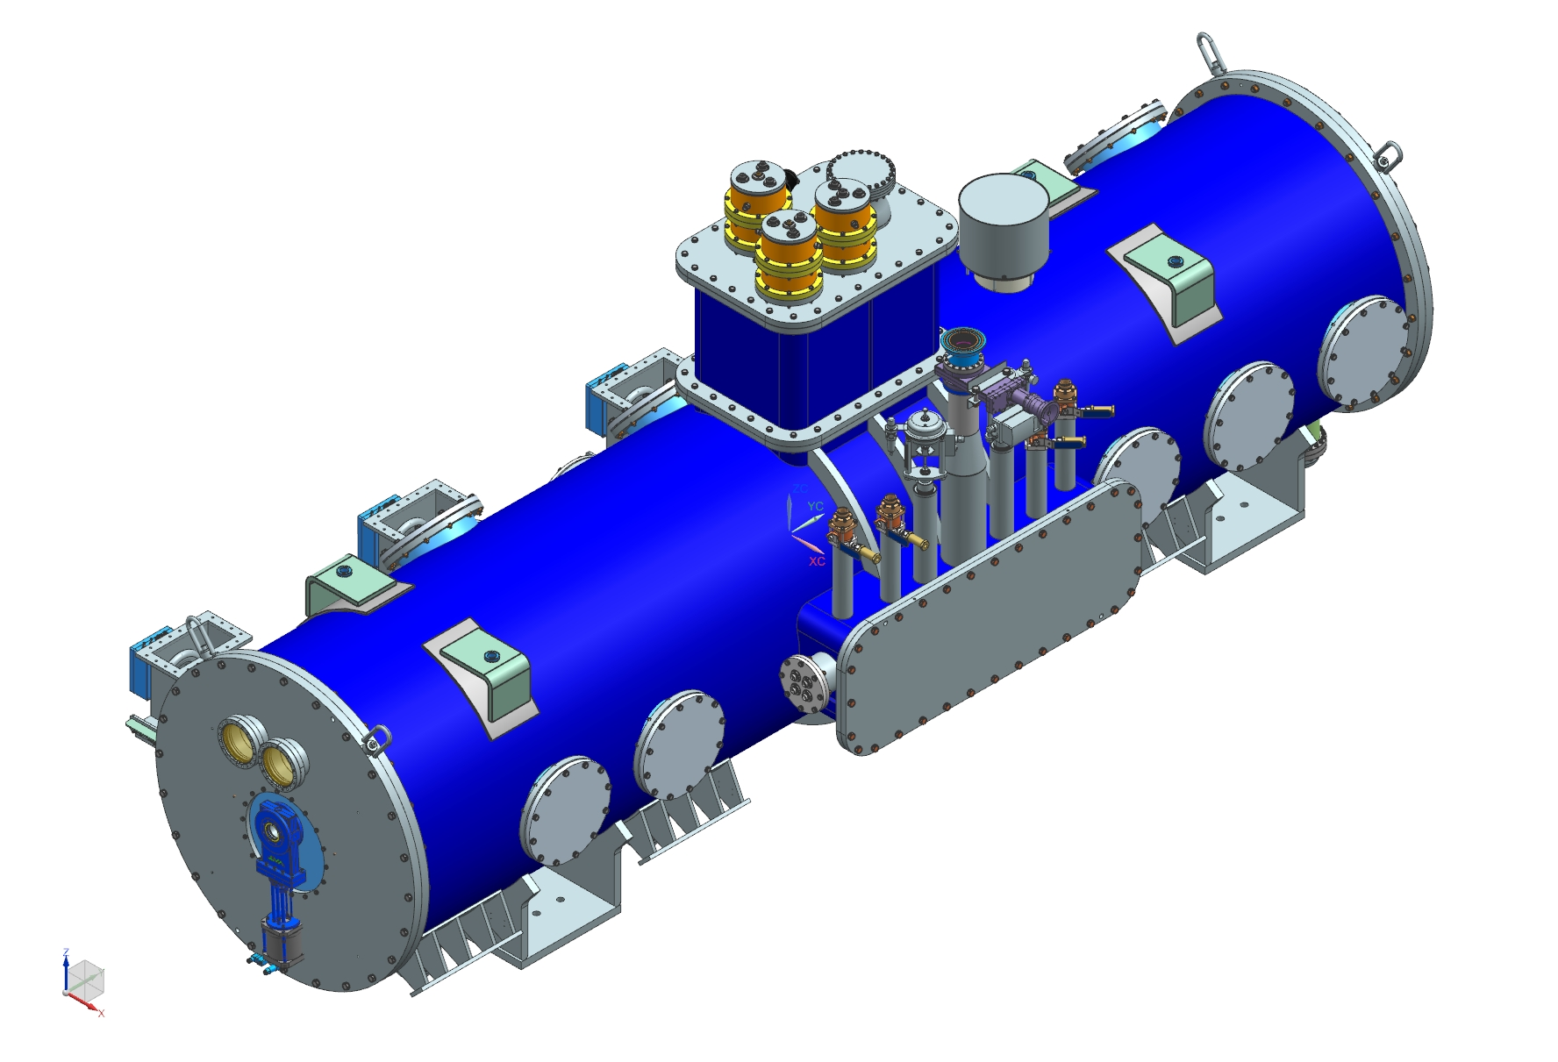

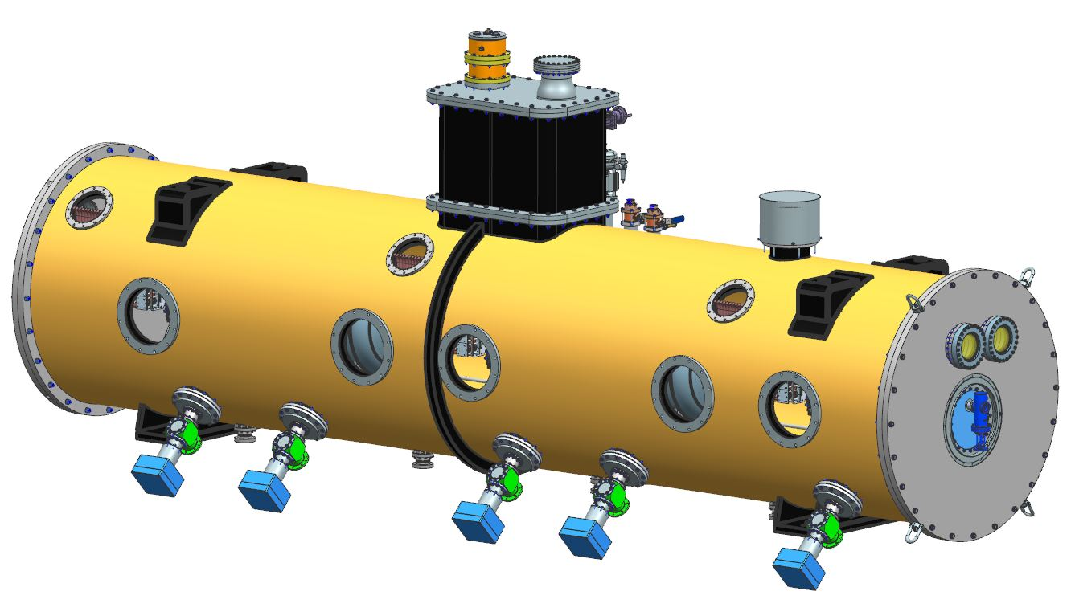
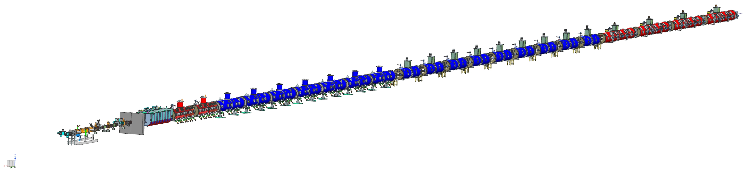
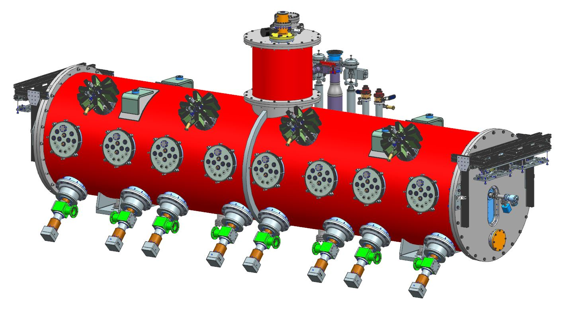
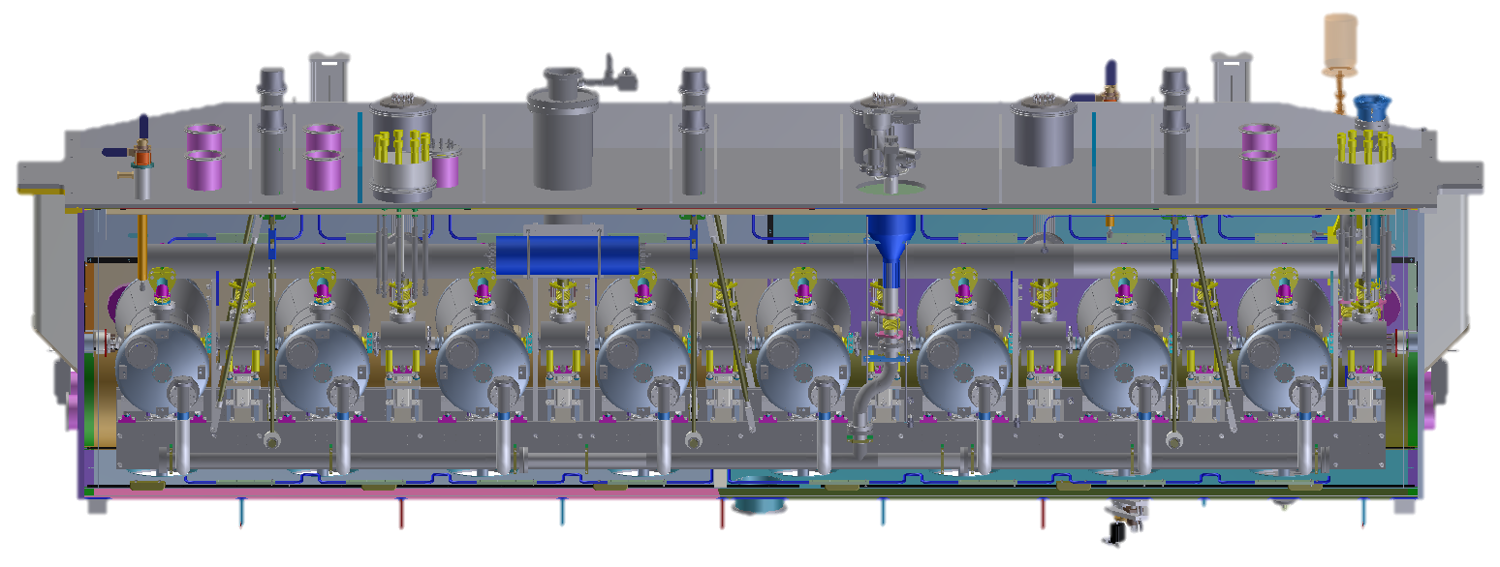
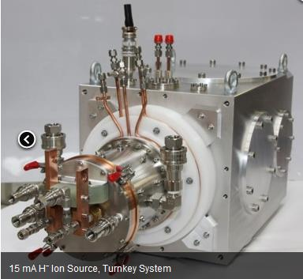
PIP-II Superconducting RF CW Linac, 800 MeV Consists of
Five Types of Cryomodules
Elliptical
HB650 X 4
24 Cavities
650 MHz
Cryoplant
Elliptical
LB650 X 9
36 Cavities
650 MHz
Single Spoke
SSR2 X 7
35 Cavities
325 MHz
Single Spoke
SSR1 X 2
16 Cavities
325 MHz
HWR
8 Cavities
162.5 MHz
CDS
833 MeV
H- Ion source
516 MeV
177 MeV
Superconducting
RFQ
32 MeV
10 MeV
PIP-II Linac is technically complex, state of the art superconducting RF accelerator
2.1 MeV
Room Temperature
PIP-II is the world’s highest energy and power CW proton linac, and the U.S. first accelerator project to be built with major international contributions

Slide 11


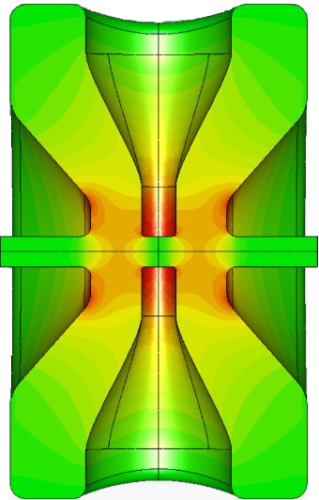
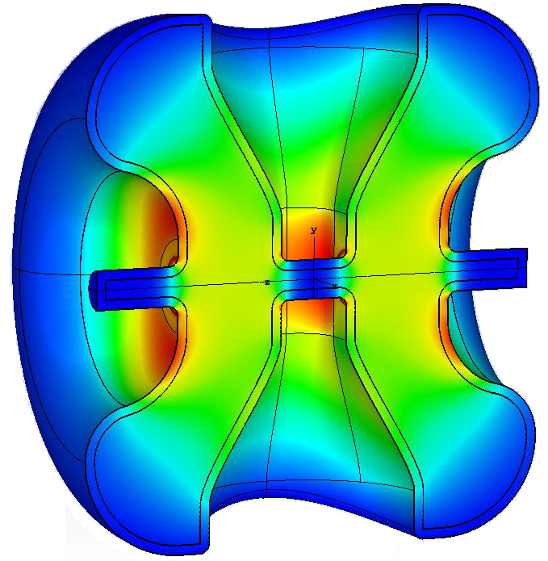
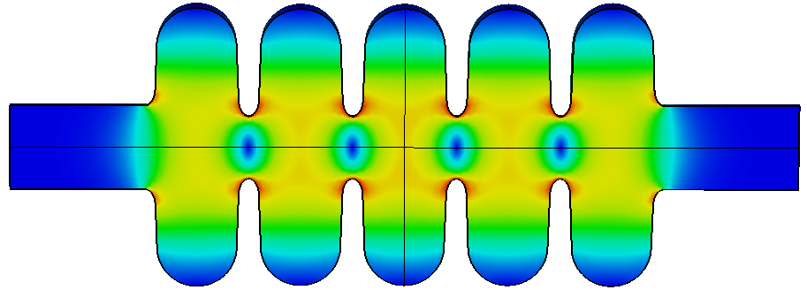
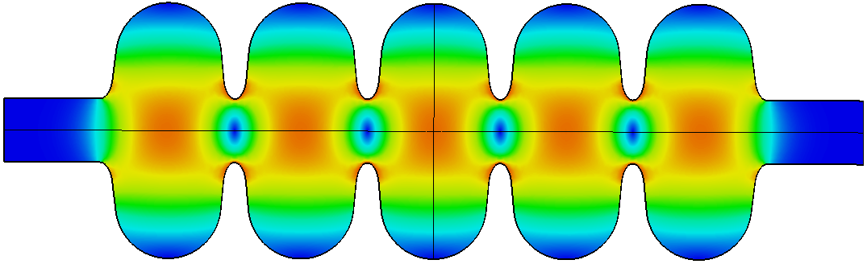
The state-of-the-art PIP-II Superconducting RF Systems
2023
2023
2021-22
5.9 m
5.3 m
5.5 m
9.9 m
6.5 m
2022
Single Spoke
SSR1
β=0.22 Q₀ =0.82x10¹⁰
Single Spoke
SSR2
β=0.47 *Q₀ =0.82x10¹⁰
Half Wave Resonator
β=0.11 Q₀ =0.85x10¹⁰
Elliptical
LB650
β=0.61 *Q₀ =2.4x10¹⁰
Elliptical
HB650
β=0.92 *Q₀ =3.3x10¹⁰
Performance validated
Testing in progress
Dates: component built
*state-of-the-art performance requirement

Slide 12
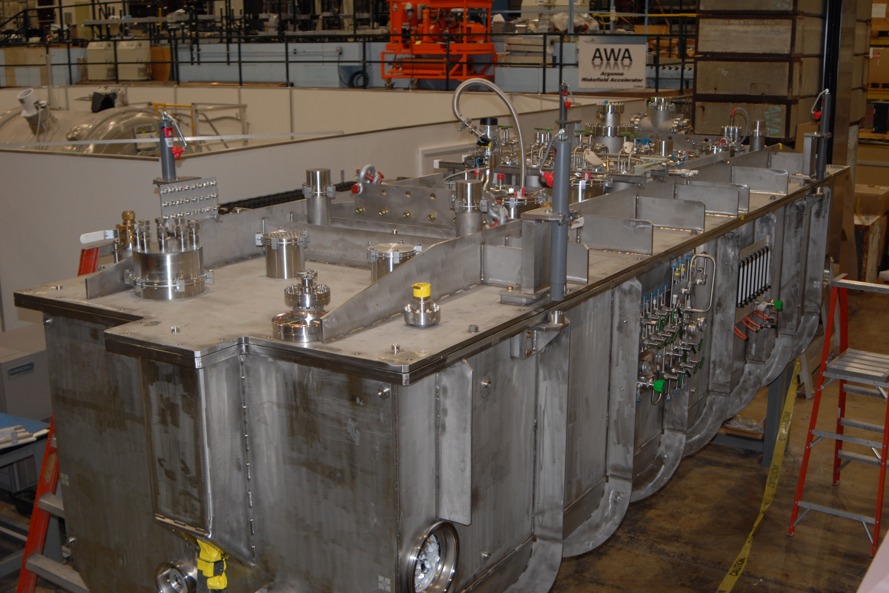


Half-Wave Resonator (HWR) Fabrication by
HWR cryomodule at 2K, RF tests complete,
accelerated beam
HWR cryomodule installed at PIP2IT;
2K RF tests complete, accelerated beam

Slide 13
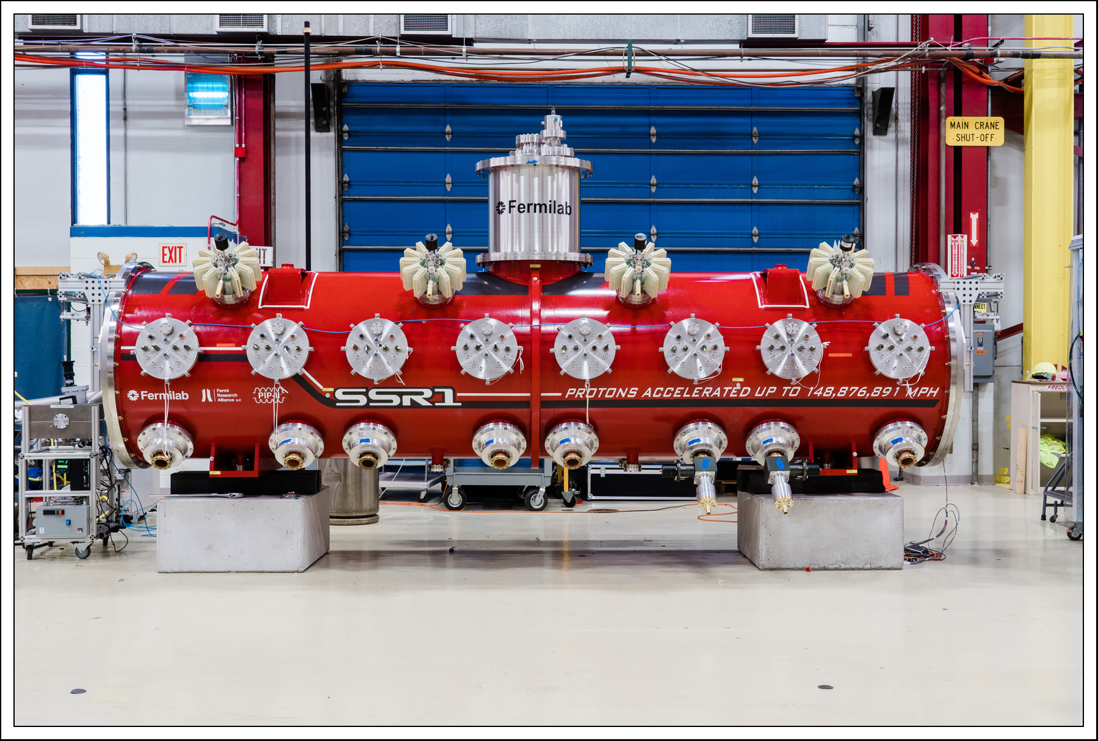
Single Spoke prototype cryomodule fabricated by Fermilab; successfully accelerated beam

Slide 14
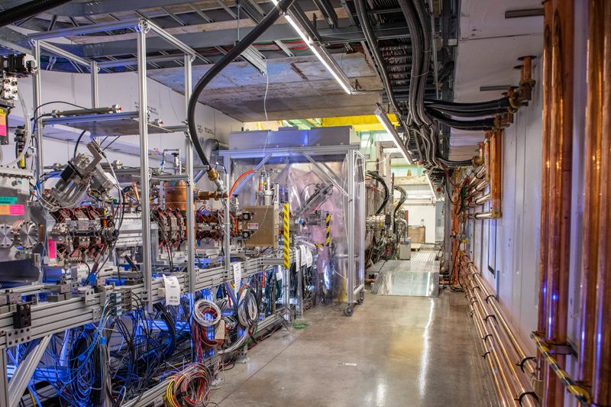


PIP-II Cryomodules accelerate beam to 17 MeV!
Significant Milestone: SRF cryomodules and accelerator systems demonstrate solid performance. International partners’ deliverables seamlessly integrated.
New era of SRF proton acceleration at Fermilab

Slide 15
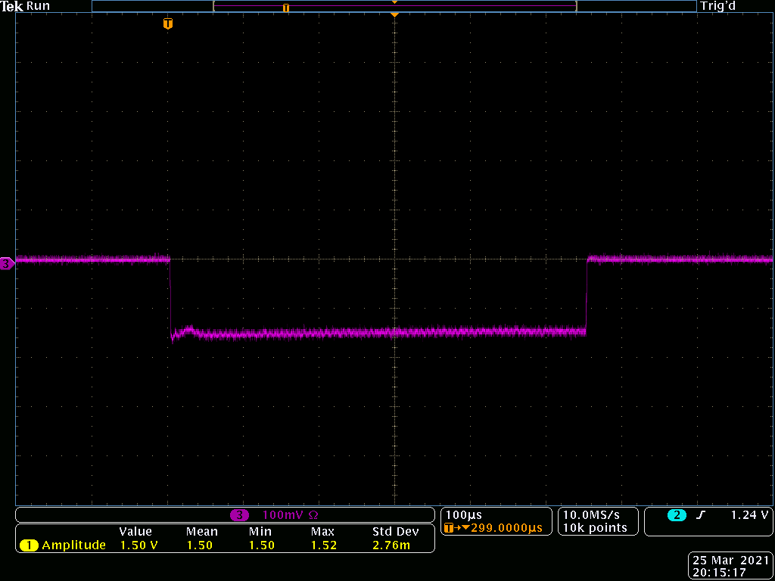
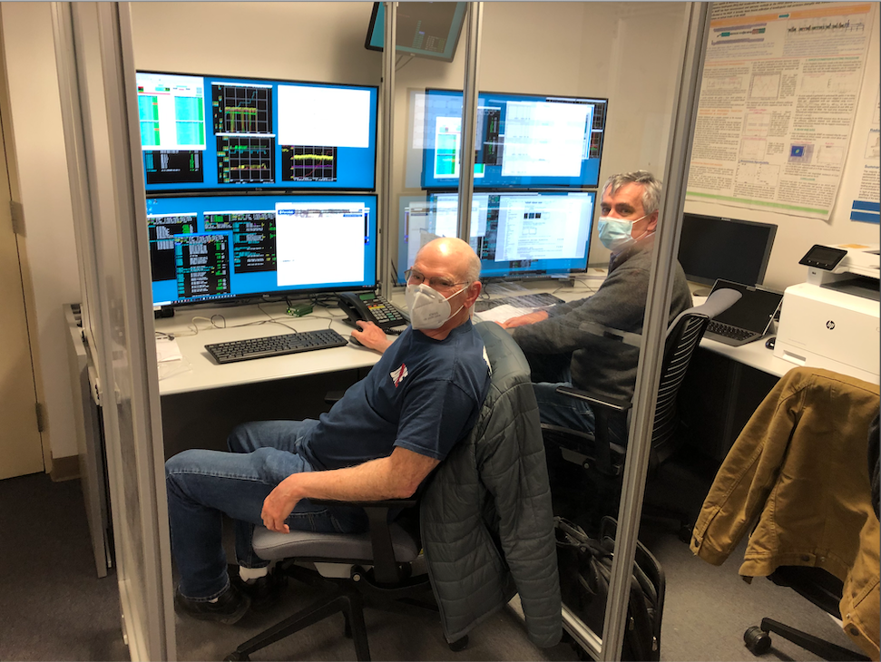
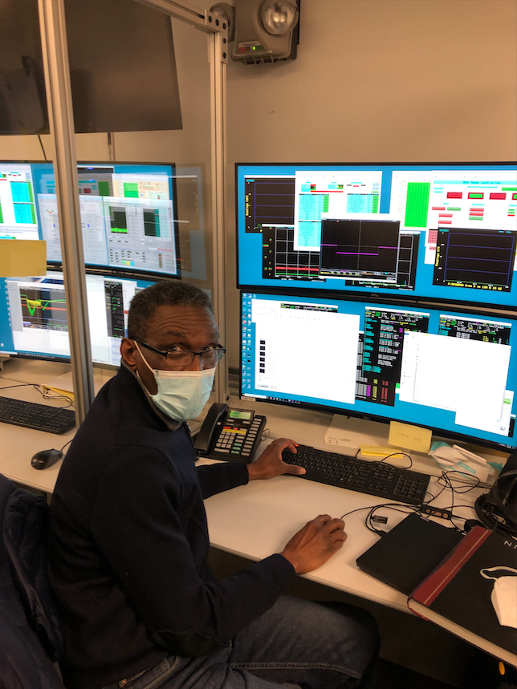
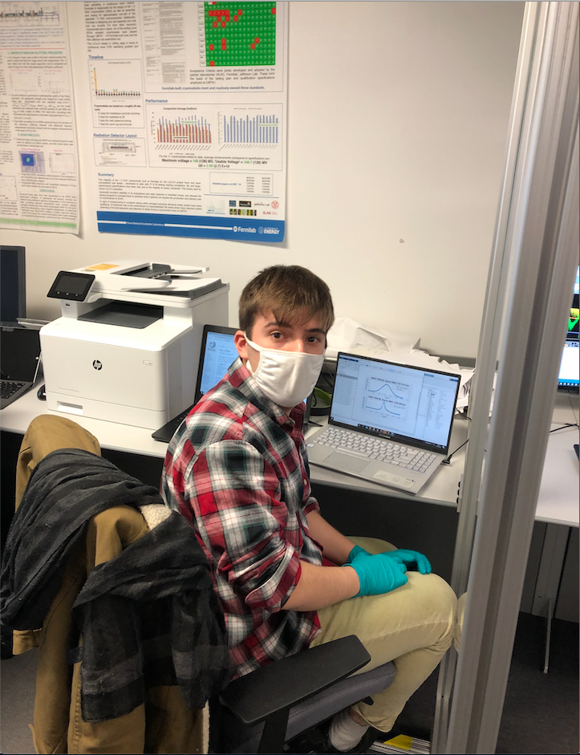
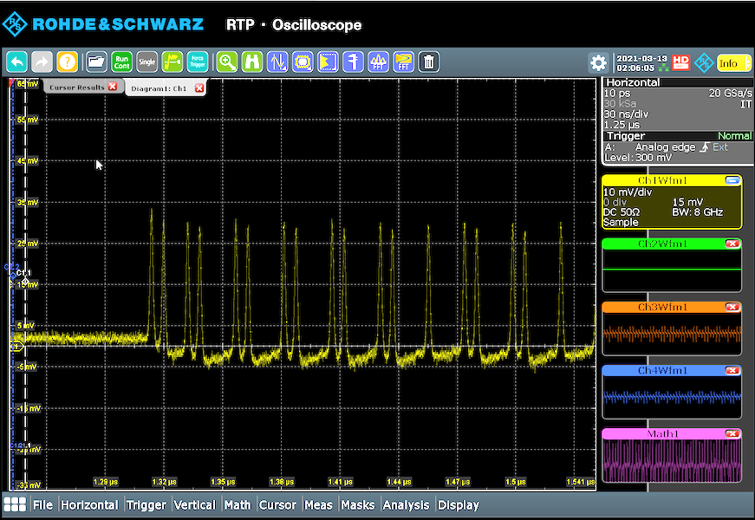
PIP-II Design Beam Parameters demonstrated at PIP2IT!
Project demonstrated LBNF Booster Beam
  E = 16.5 MeV
  I_{b} = 2 mA
  Pulse length = 550 us
  Rep. rate = 20 Hz
  Chopped, “Booster Injection” pattern
  100% transmission through CMs

Slide 16
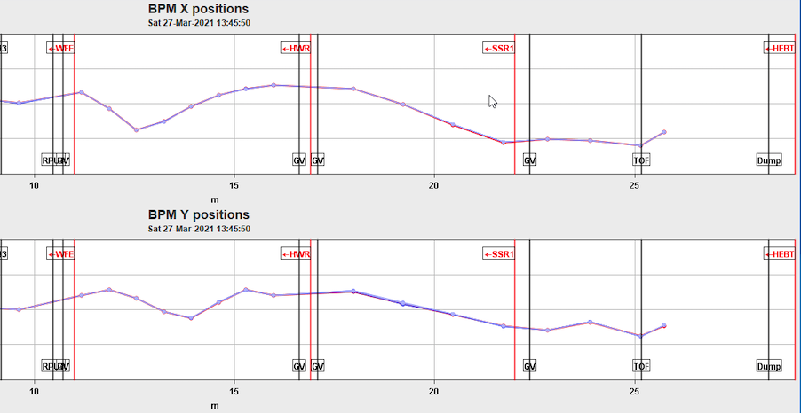
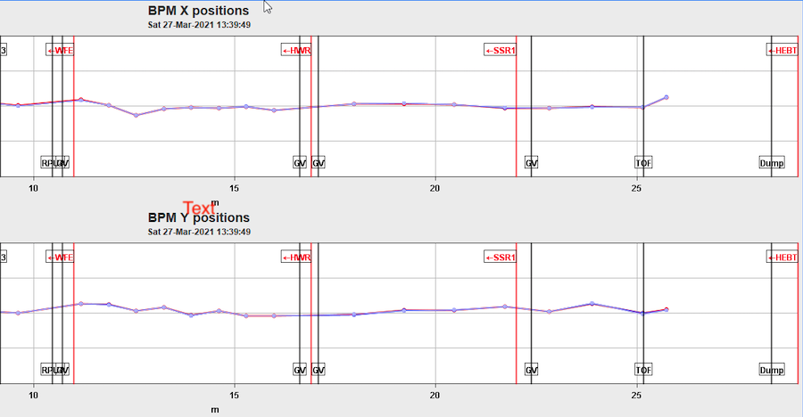
Successful Machine Learning Tests at PIP2IT
Orbit alignment using Bayesian Model-less optimization with Gaussian Processes
Limited scope experiments to test the code: 10 BPMs + 10 correctors (5H + 5V) in coupled, solenoidal system. It takes the code ~20 iterations
ML algorithm was applied successfully for orbit alignment sequentially, in HWR and then SSR1 CMs
Implementation in PIP-II: use the method to tune and monitor optics transverse and longitudinal. Need transfer function measurements (difference orbit)

Slide 17

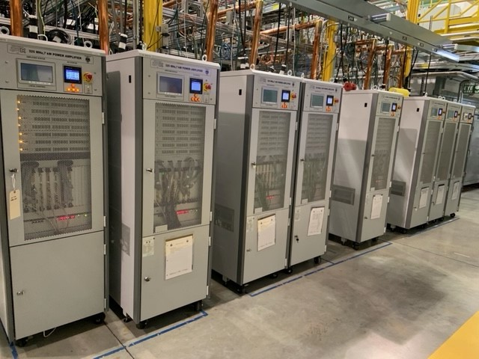
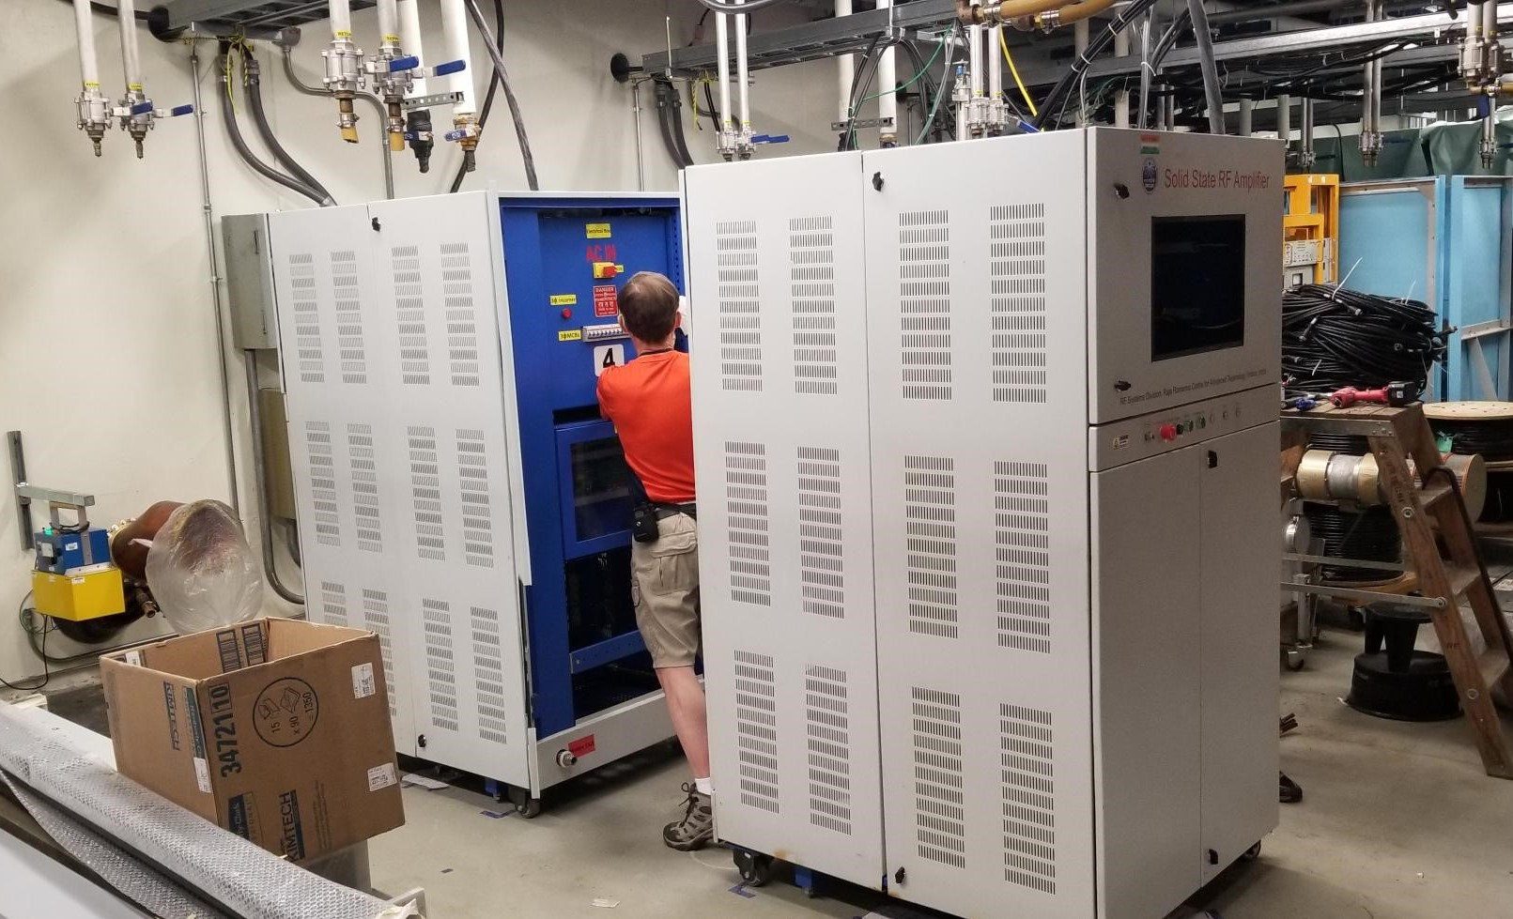
International Partnerships: DAE Solid-State Amplifiers
RRCAT 40 kW 650 MHz prototype amplifier just arrived, being assembled, in preparation for testing
ECIL/BARC 7 kW 325 MHz amplifiers powering
SSR1 cavities at PIP2IT

Slide 18
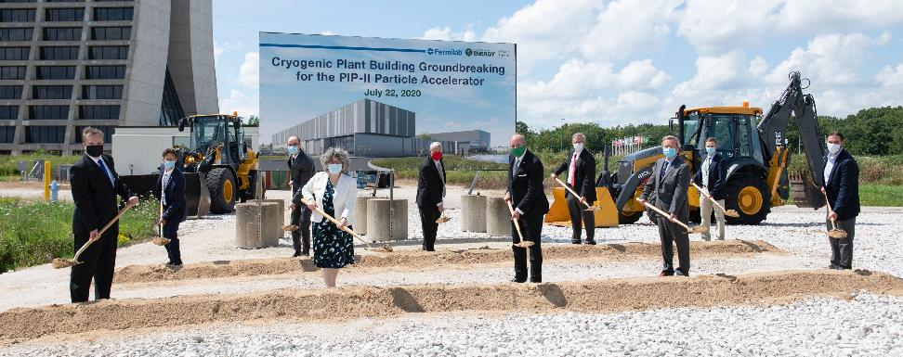
Cryogenic Plant Building Groundbreaking – July 2020

Slide 19
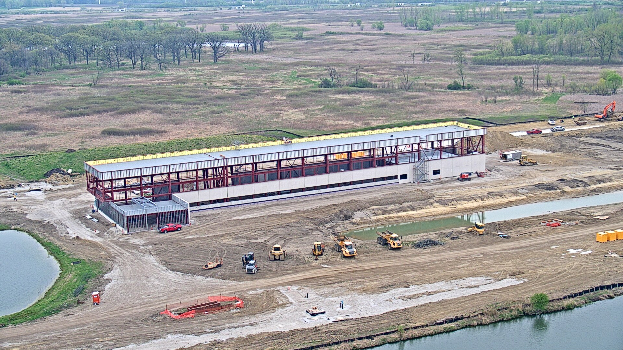
PIP-II Cryogenic Plant Building – 28 April 2021
https://app.truelook.com/?u=fc1599677013#tl_live
https://app.truelook.com/?m=16002500832205565503647

Slide 20
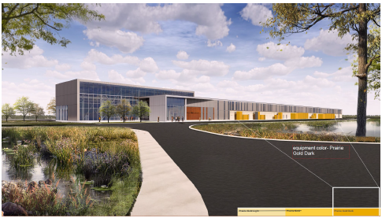

Conventional Facilities
Cryoplant Building Construction underway
  Precast concrete wall panel installation completed in February 2021
  Structural steel mostly completed
  Completion ~ December 2021
Site Work
  - DOE approved RFP in April 2021
Linac Complex Design integrated with technical systems
  Final design complete in April 2021
Booster Connection
  Started final design in April 2021

Slide 21

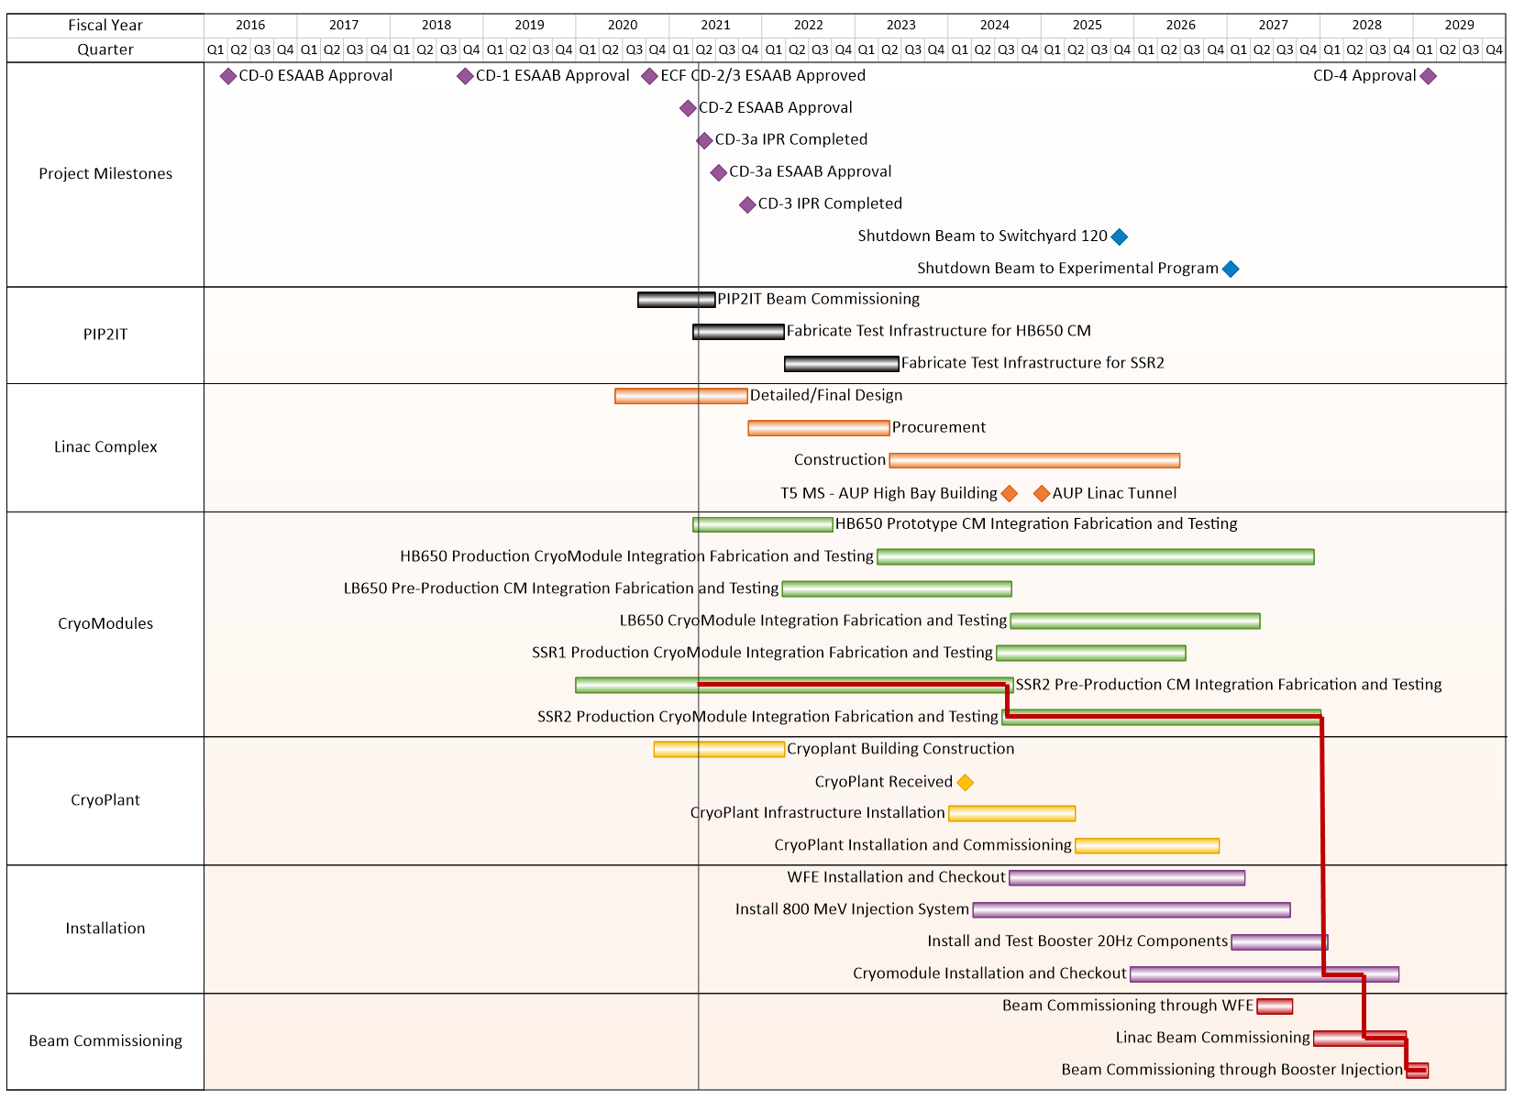
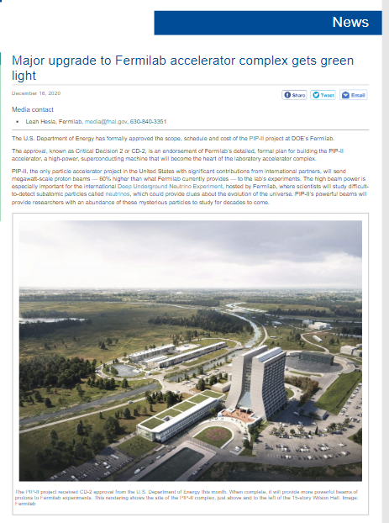
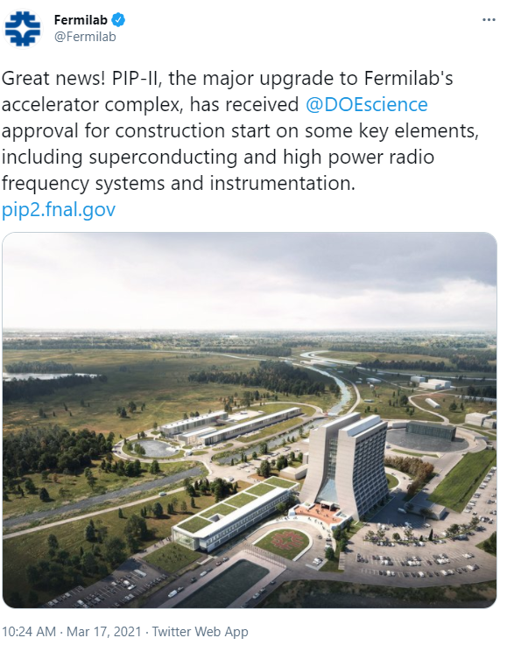
PIP-II baseline approved – 14 December 2020
PIP-II long-lead procurement approved – 17 March 2021
“This approval marks a significant milestone for the project and the start of a new era
for Fermilab and the global HEP community. ”

Slide 22
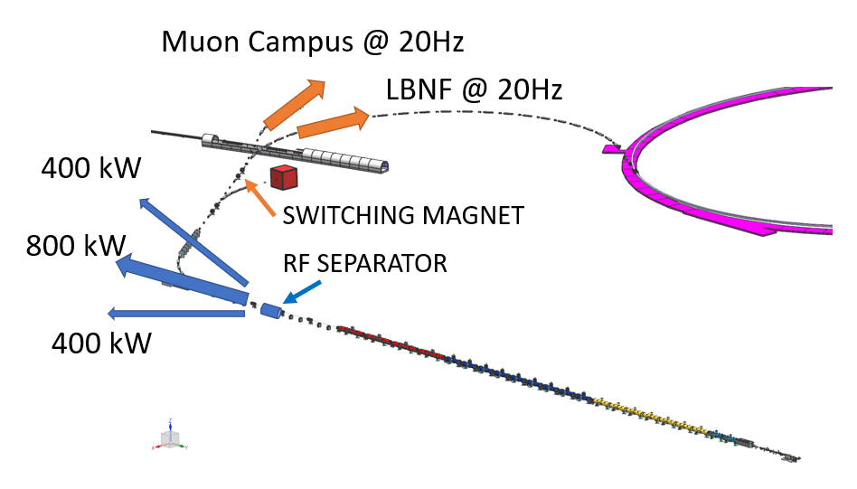
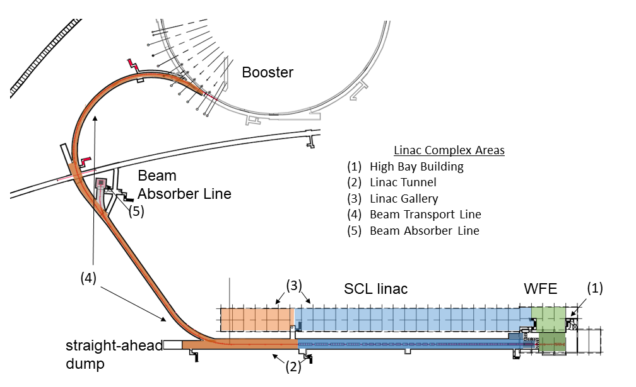
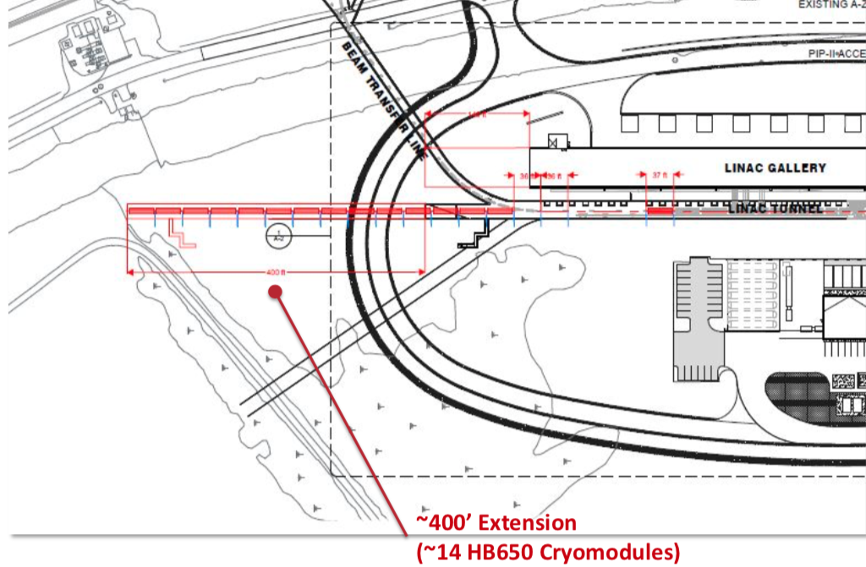
PIP-II Design Is Compatible With Future
Science-Driven Upgrades
PIP-II is designed for >1 MW over 60 – 120 GeV and 1.2 MW at 120 GeV
Provides platform for upgrade to >2 MW
Linac beam power of 1.6 MW (CW), programmable bunch patterns
Facility enables multi-user, simultaneous, high beam power operations
  Switch yard to provide beams to Muon Campus in multiuser mode with LBNF
Linac tunnel includes space and infrastructure to reach 1 GeV and space to add RF separator for beam sharing
Tunnel extension (by 120 m) compatible with energy 2–2.5 GeV
Beam current can be increased by a factor of a few by upgrading amplifiers

Slide 23
Summary
PIP-II is a leading-edge SRF linear accelerator critical to the success of the LBNF/DUNE international neutrino program
International partnerships are essential for the success of the PIP-II project
Excellent, experienced project team and strongly committed partners ensure continued technical progress despite pandemic challenges
  PIP-II baseline is approved
  Cryoplant building construction is well underway
  Beam has been accelerated by first two PIP-II cryomodules
We are building a highly capable accelerator that will power the world’s best neutrino experiment!
We greatly appreciate the commitment and strong support from our stakeholders, DOE, and our International Partners!

Slide 24
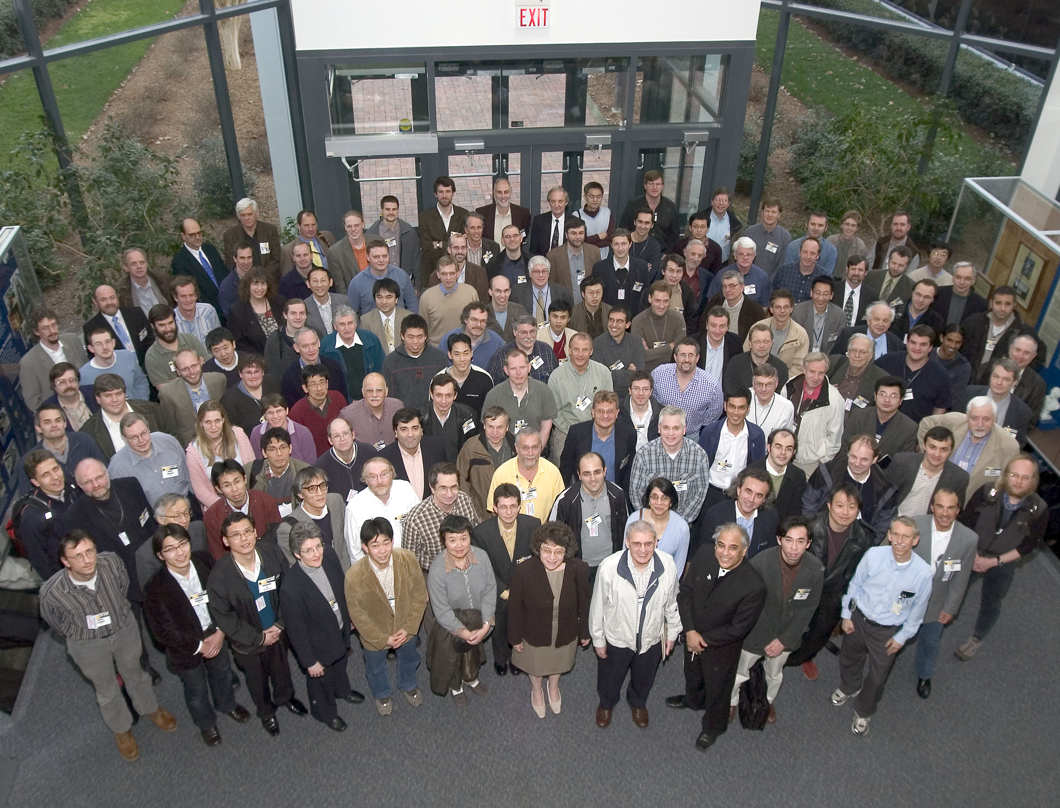


Thank you, Swapan,
for your mentorship, leadership,
and friendship!
I wish you to never stop
Charting New Territories!

Slide 25
Thank you!

