Slide 1
DUNE Cryogenic Optical Links
Dave Christian (FNAL)
Greg Deuerling (FNAL)
Jason Greskoviak (FNAL)
Jason Keyzer (SMU)
Andy Liu (SMU)
Alan Prosser (FNAL)
Jingbo Ye (SMU)
March 31, 2021

Slide 2
Introduction
Tx Channels:
We have ordered some laser drivers for LN2 testing (AD, TI, MAXIM).
TOSAs have been found and some received with fiber pigtails.
Rx Channels:
Some limiting amplifiers are also part of vendor portfolios so we will see about ordering
some of these for Rx channels.
Have yet to search and order ROSAs (one supplier, Vitex, has been queried).
Other:
We have obtained guidance on discrete component part selection from BNL. No word
similar information from JPL so we are going ahead with designs with our best information.
Awaiting NDA from one supplier (Semtech) of multiple components. FNAL and Semtech
legal teams are in communication.
Greg Deuerling is developing the first test PCB for the ADN2526 laser driver.

Slide 3
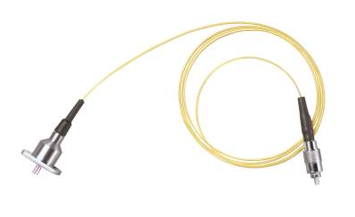
Newport 1310 nm Fabry-Perot Laser Diode (pigtailed)
CW Test Configuration
Handheld Power
Meter
Power Supply
62 Ohms
+
Laser Diode
-
SMF
Pigtail
62 Ohms
Laser Diode
FC terminated SMF

Slide 4
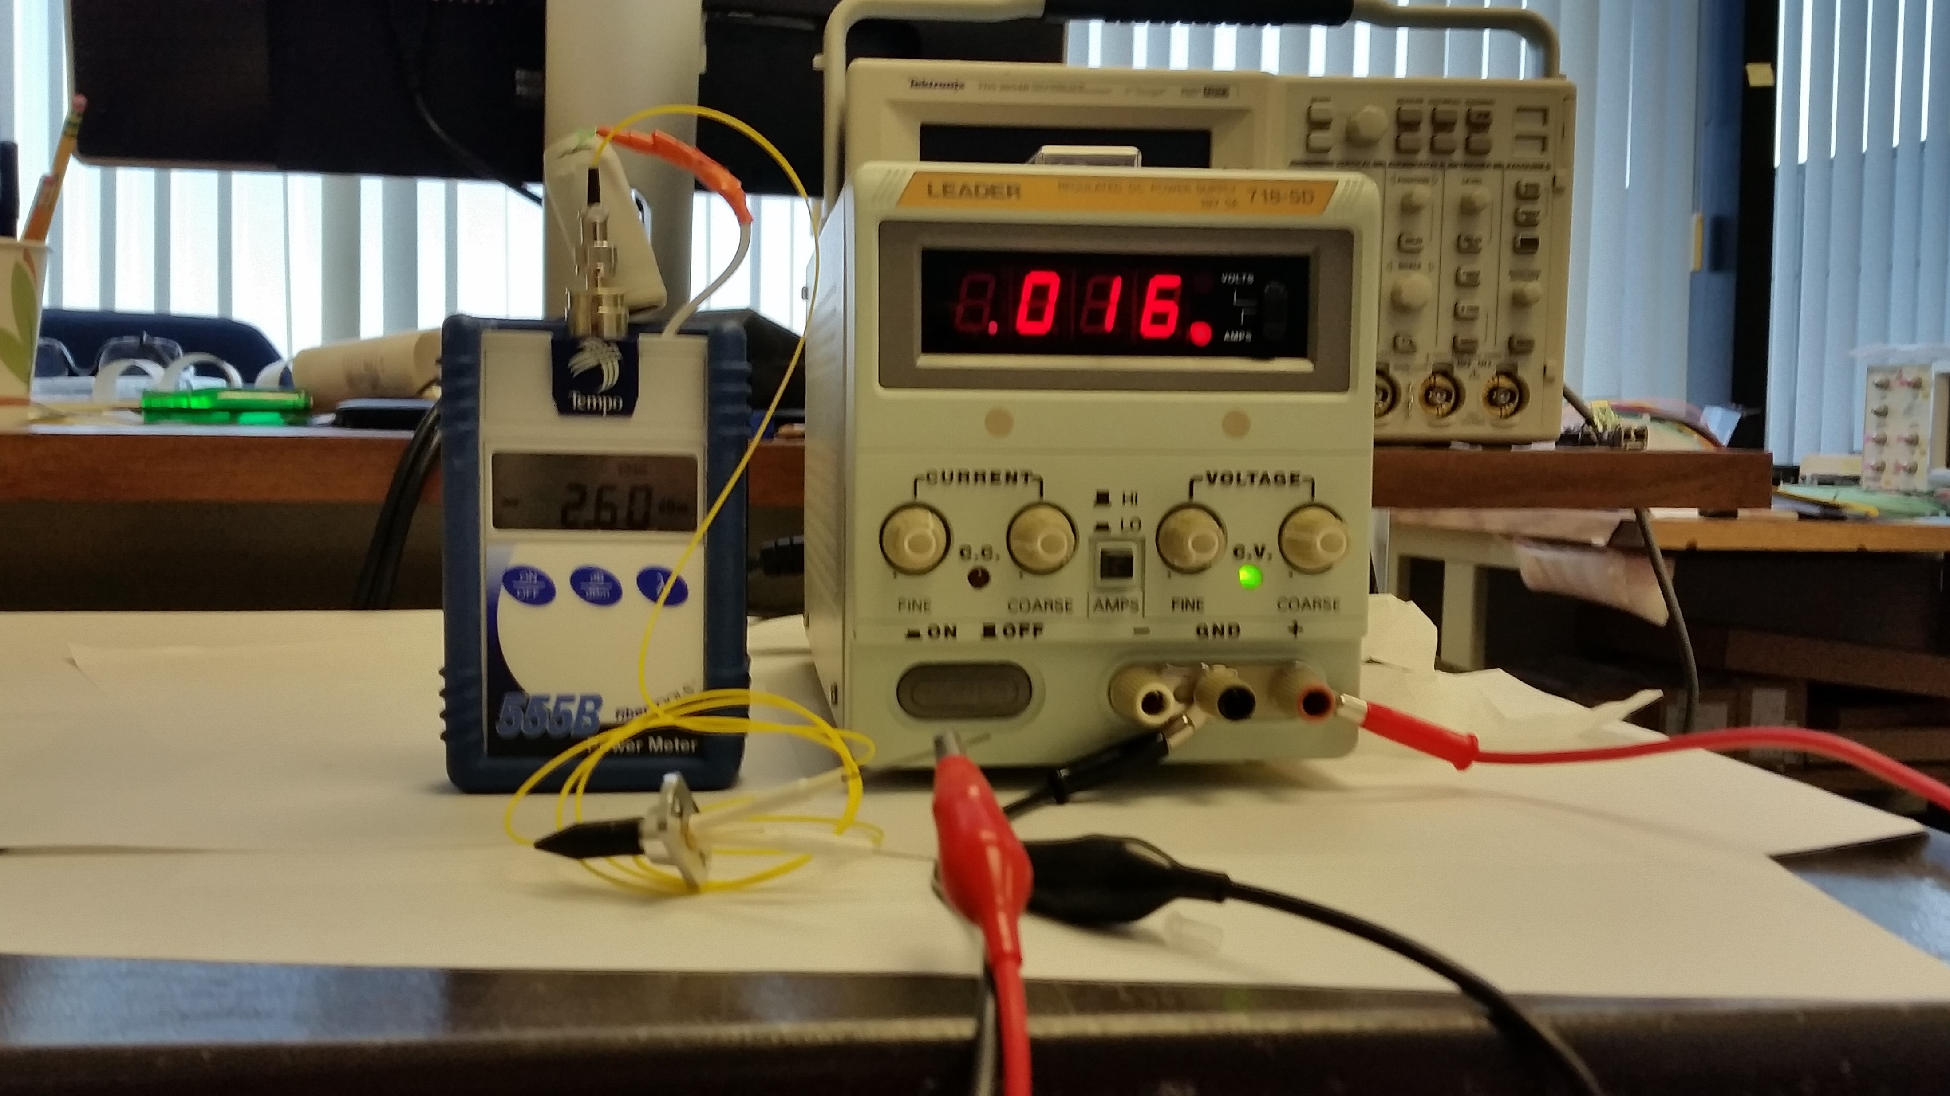
Newport 1310 nm Fabry-Perot Laser Diode (pigtailed)
CW Test Configuration

Slide 5
Newport 1310 nm Fabry-Perot Laser Diode (pigtailed)
Room Temperature
Next…
Repeat this measurement
at PAB in LN2
Optical Diode Power
(μW)
Diode Current (mA)
Ith ~= 10 mA
Slope Efficiency ~= 72 microwatts/milliamp

Slide 6
Laser Driver Electrical Eval Board/LN2 Test Setup
50 Ohm coax
Configuration/
Monitoring Header
DSA8200
Dewar (top)
50 Ohm coax
50 Ohm differential
BSA286CL
35 ohms
Ch8
Data-
50
Ohm
coax
Laser
Driver
75
ohms
Ch7
Data+
100
Ohm
differential
Input
Electrical
Pair
35 ohms
Power Header
DC Block
Dewar (bottom)

Slide 7
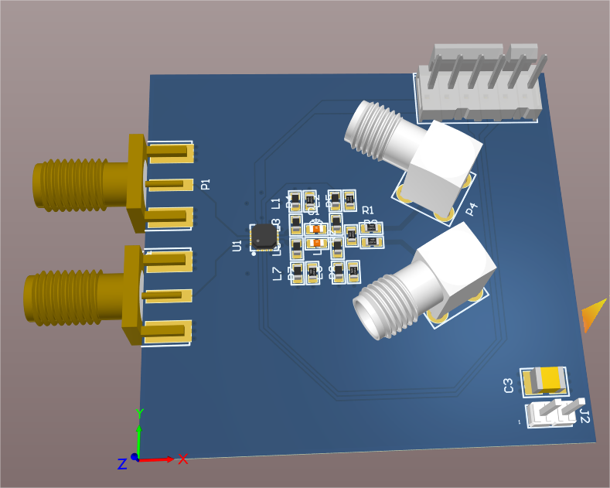
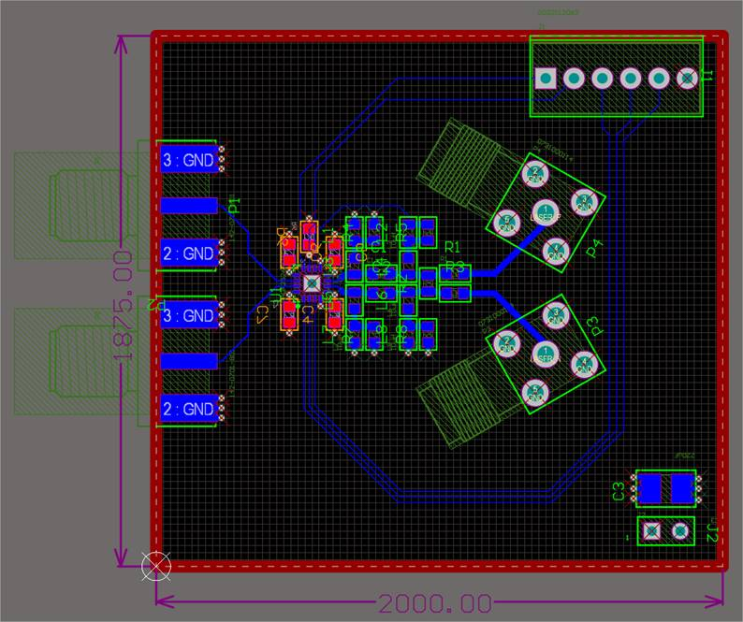
Laser Driver Electrical Eval Board/LN2 Test Setup
Engineer: Greg Deuerling
Concept
Layout

Slide 8
Laser Driver Electrical Eval Board/LN2 Test Setup – Dual Footprint
50 Ohm differential
Laser
Driver
35 ohms
75
ohms
35 ohms
Through holes for laser
diode anode, cathode

Slide 9
Laser Driver Electrical Eval Board/LN2 Test Setup – electrical configuration
50 Ohm differential
Laser
Driver
35 ohms
75
ohms
35 ohms

Slide 10
Laser Driver Electrical Eval Board/LN2 Test Setup – optical configuration
50 Ohm differential
Laser
Driver
Through holes for laser
diode anode, cathode

Slide 11
Extra Slides

Slide 12
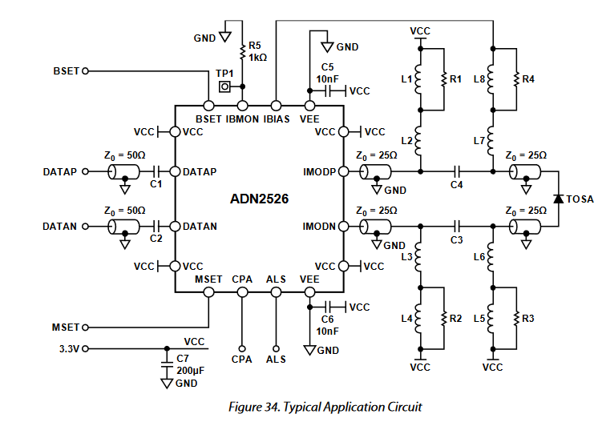
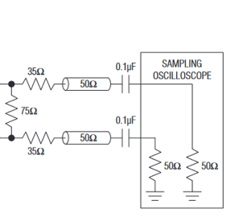
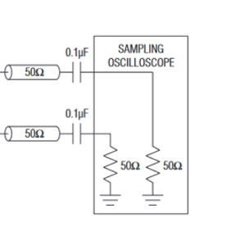
Simple Evaluation Board for Analog Devices ADN2526 Laser Diode Driver
Electrical Tests
All components will be
tested in LN2.
Power, configuration,
electrical excitation, and
electrical diagnostics
will be outside the dewar
Vibias_adj
SMA pair
SMA
pair
SMA pair
Coax
cable
DC
Block
Vimod_adj
Will Route Cross Point Adjust and Automatic Laser Shutdown to header.

Slide 13
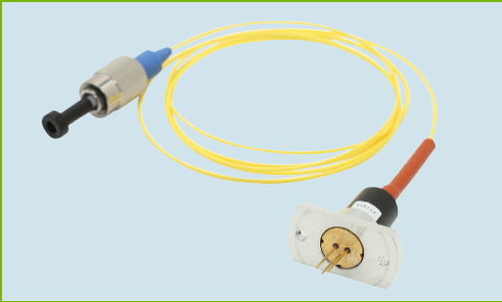
Simple Evaluation Board for Analog Devices ADN2526 Laser Diode Driver
Optical Tests
Vibias_adj
Optical signal
(to eye, jitter
measurements)*
SMA pair
SMA
Pair (disconnected from circuit)
SMA pair
All components will be
tested in LN2.
Power, configuration,
electrical excitation, and
optical diagnostics
will be outside the dewar
Vimod_adj
*After L-I tests of pigtailed laser diode
have demonstrated suitability in the cold.
Will Route Cross Point Adjust and Automatic Laser Shutdown to header.

