Slide 1
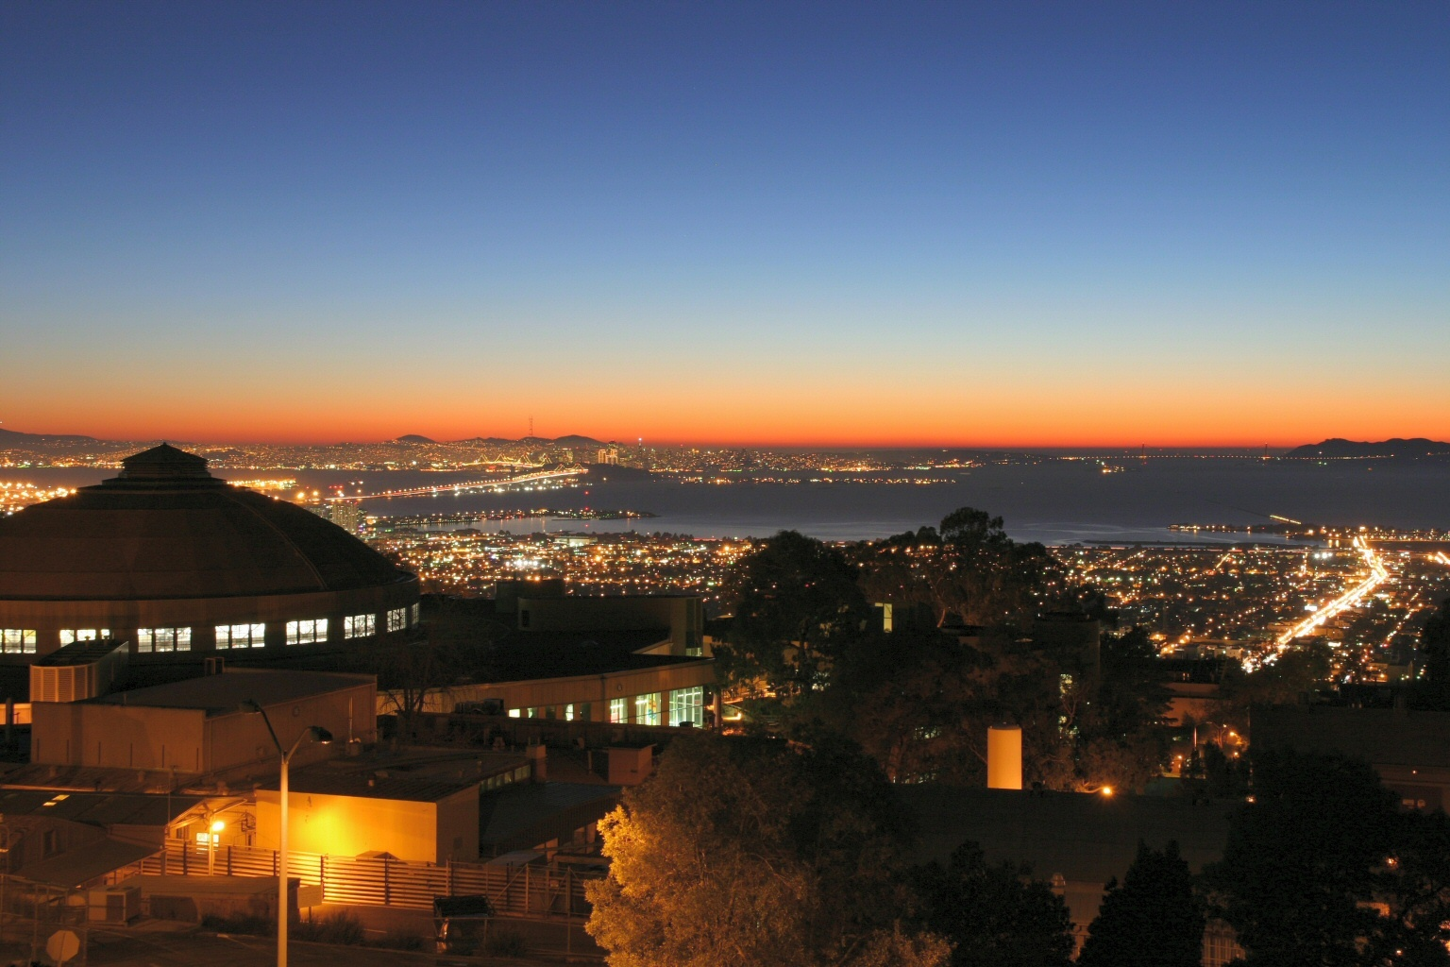

MAP PMG
September 21, 2011
Spectrometer Solenoid Modification Plan
Review of the review
S. Gourlay
Office of Science

Slide 2
Spectrometer Solenoid Overview
Key magnet requirements:
Each of the five coils must be trained to 275 amps
The cryocoolers must maintain the LHe in closed system (Minimal boil-off)
Not yet achieved for either magnet

Slide 3
History
A number of problems with first magnet design and fabrication
  Operational
    Frozen N₂
    HTS leads too warm
  Design
    Current lead feed thru
    Inadequate cooling of HTS leads
    Excessive heat load – unable to maintain equilibrium temperature without He boil-off
    Internal quench resistors overheated

Slide 4
Subsequent Actions
Focus on
  Heat load analysis
  Reduce load to 4.2 K
  Increase cooling (add cryocoolers, improve shield . .)
  Quench protection analysis
Apply additional resources

Slide 5
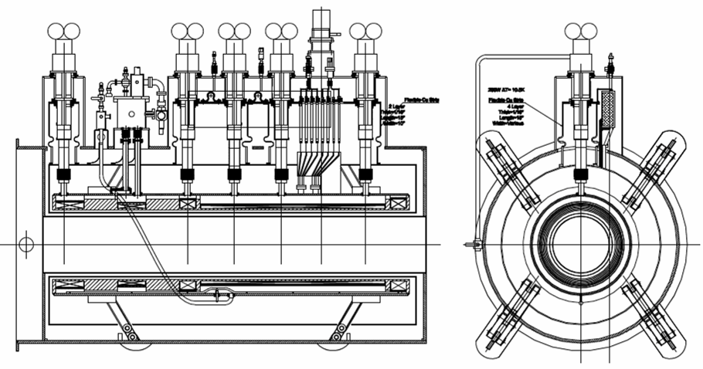
Spectrometer Solenoids
Latest design
5 + 1 Cryocooler Layout

Slide 6
Current Status
A complete set of as-built drawings has been compiled
Heat loads reassessed
  Focus on heat leak to 4.2K
  Shield and vacuum insulation
EM calculations redone for testing and operation
Mechanical supports of internal components have been reassessed
Much more instrumentation
Quench calculations completed
  Passive protection only for coils
  Active for HTS leads
Add heat sinks on by-pass resistors
New shield design – outer and end shield out of pure Al, inner shield will be 6061 to reduce eddy current forces. Added slits to end shields

Slide 7
Other Considerations
Design changes implemented through careful assembly – enhanced QC
  RAL engineer and LBNL tech on-site
  As-built CAD drawings used to laser cut MLI
Improved vacuum system with instrumentation
Still need to work on test plan details

Slide 8
Resources

Slide 9
Spectrometer Solenoid Resources
Wang – core assembly team, design implementation
  Machinist X 2
  ME, EE, Eng/Phys
  Welder – Certified welder
LBNL/MICE
  Steve Virostek – Lead Engineer - Overall coordination, fill in the gaps
  Roy Preece (RAL) – Onsite supervision/coordination
  Dennis Calais – Onsite tech

Slide 10
Spectrometer Solenoid Resources cont’d
LBNL Support team
  Soren Prestemon – QP, assembly
  Tapio Niinikoski – Cryo design/assembly
  Heng Pan – QP/Cryo
  Adrian Hodgkinson – Cryo assembly
  Jon Joseph – Power supplies/interlocks
  Mike Zisman – Project management/technical assistance
  Allan DeMello – Engineering/CAD
  Steve Gourlay – Technical assistance, resources, overall responsibility
Fermilab
  QP
  Sensor calibration
  Short-sample measurements
  Improved vacuum system
  Participation in testing
2.4 FTEs

Slide 11
Resource Breakdown

Slide 12
Schedule
Detailed schedule has been produced by Roy Preece
  First magnet shipped to RAL February 2012
  Second – May 2012
Given what we know now, this seems reasonable
We have a plan and the means to execute it

