Slide 1
APA Mechanical Analysis
  Charge question
  Current status
  Introduction
  Nomenclature
  Design codes
  APA frame analysis
    Loading and Load Cases
    Group 1 - Factory Preparation, Lifting, and Installation
    Group 2 - APA Under Gravity and Thermal Load
    Group 3 - Static Transport Cases
    Group 4 - Dynamic Transport Cases
  APA support system
    APA yoke
    APA 25mm pin
    APA structural tee
    APA link
  Work left to do
  Conclusion

Slide 2
Charge question
  The completeness of the documentation of mechanical specifications, the 3D model and 2D drawings for standard and custom components, and the Compliance Office review of the design covering safety and proper application of design codes and standards.

Slide 3
Current Status of Analysis
  APA Analysis plan is recently updated for review by the compliance office.
  APA analysis report
    The APA frame is subject to a variety of load cases during the sequence of events from initial frame assembly at the factory to final cool-down in the installed state.
    A total of 42 different FEA analysis have been run and subsequent analytical analyses using methods defined by AISC-360-16 and design guide 27 have been performed.
    Several load cases need some additional work and the analysis of the yoke connection under thermal load still needs to be done.
    The report is posted, but is not complete
  The Compliance Office report
    The compliance office will provide their report several weeks after the final analysis report is complete.
The DUNE APA Analysis Plan can be found on EDMS at: https://edms.cern.ch/document/2512420/2
The DUNE APA Analysis can be found at:
https://edms.cern.ch/document/2100877/2

Slide 4
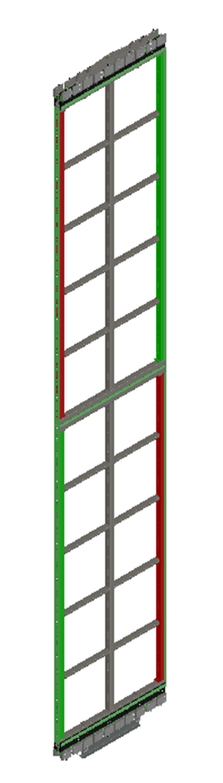
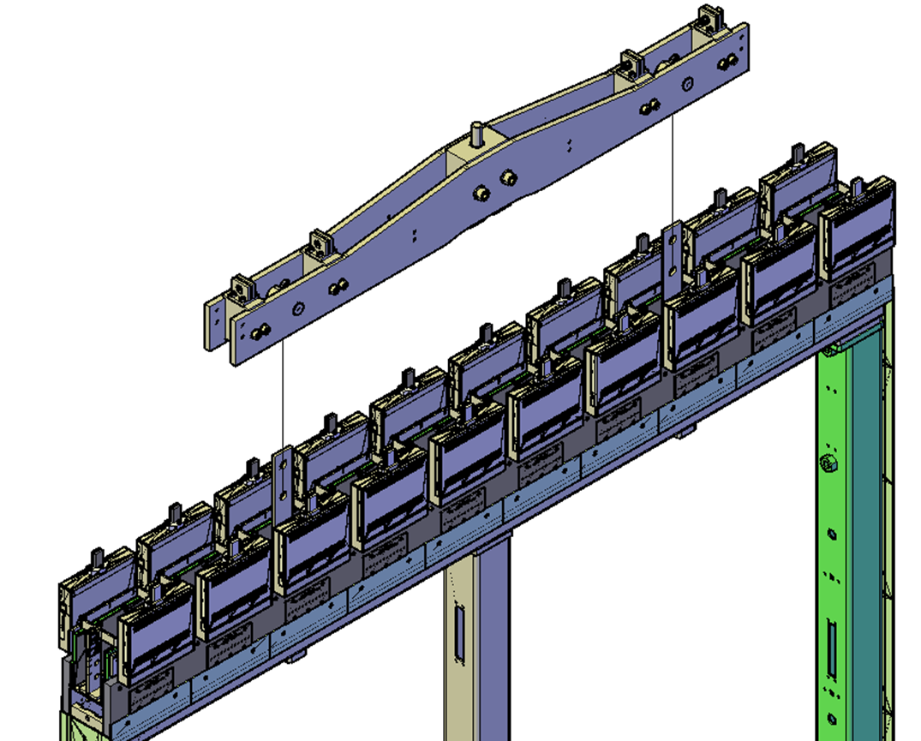
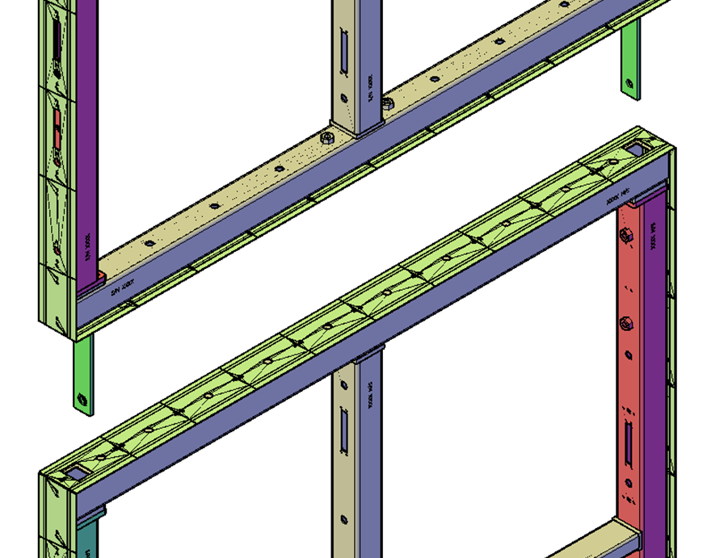
yoke
Introduction
The analysis of the APA Frame and APA support system for all significant load cases will be presented.
The load factors and resistance factors used for Load Factor Resistance Design (LFRD) method will be identified.
The APA structural members, welded connections and bolted connections will be checked.
Structural tees
Links
Integrated APA with yoke structural tees and links

Slide 5
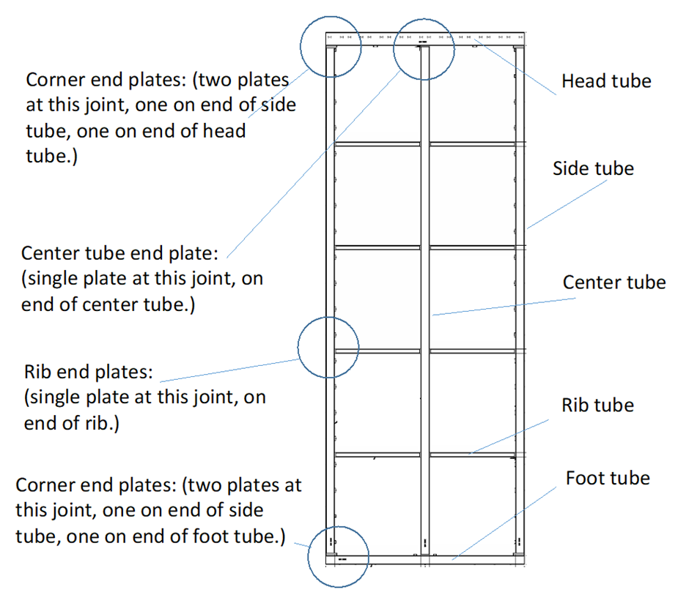
Nomenclature

Slide 6
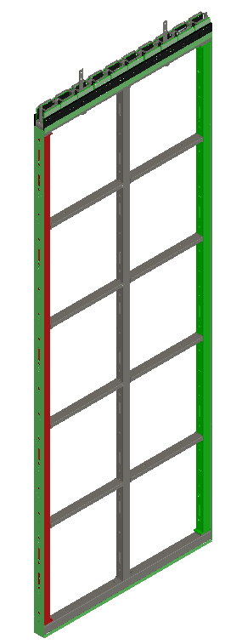
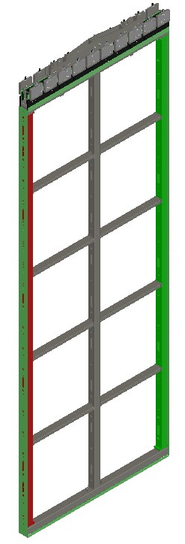
Nomenclature
Integrated APA (PDs not shown)
Factory APA (Ships from factory)
APA Pair

Slide 7
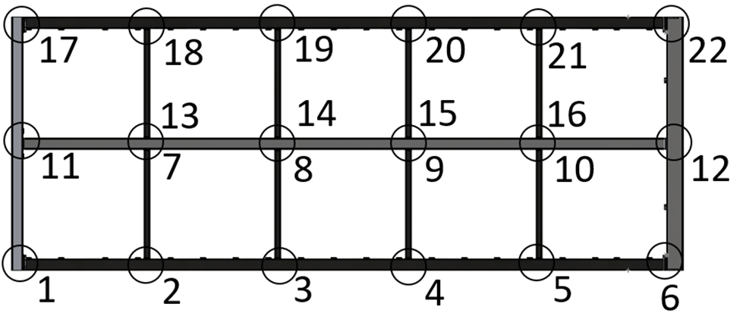
Nomenclature
PD slot (near head tube)
Labels used for frame joints
High slot tube
Low slot tube
PD slot

Slide 8
Design codes
AISC’s Specification for Structural Steel Buildings (AISC document 360-16)
Design Guide 27: Structural Stainless Steel
Load and Resistance Factor Design (LRFD) method for Stainless steel structures
  Load Factor = 1.4
  Load Factor = 1.0 for Transport cases
  Member Resistance factor = 0.9
  Weld nominal strength factor for shear = 0.6
  Weld shear resistance factor = 0.55
  Bolt resistance factor = .75
JRC Science for Policy Report “Prospect for New Guidance in Design of FRP” as a guide for designing fiber reinforced plastics (FRP) structures
  Safety factor of 3.75 for all effects of temperature, humidity, creep and material variation.

Slide 9
Load cases
Analysis Groups:
Factory Preparation, Lifting, and Installation
APA under Thermal load
Static Transport cases
Dynamic Transport cases
Note: Some cases defined in the Analysis Plan had the same boundary conditions and loading so they have been combined into one load case for analysis.

Slide 10
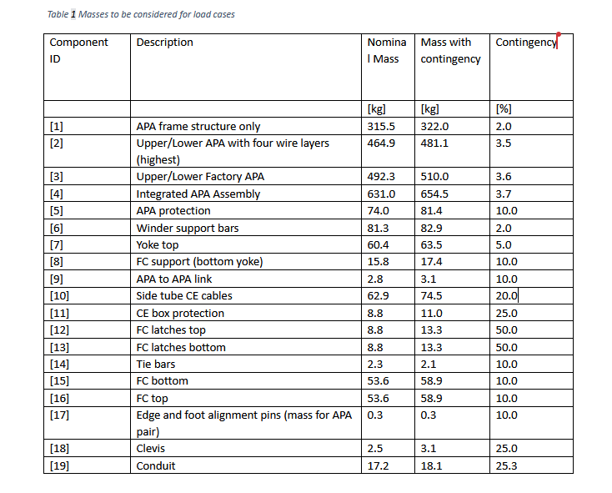
Masses and contingency of components
For the different load cases, the masses of various components need to be considered.

Slide 11
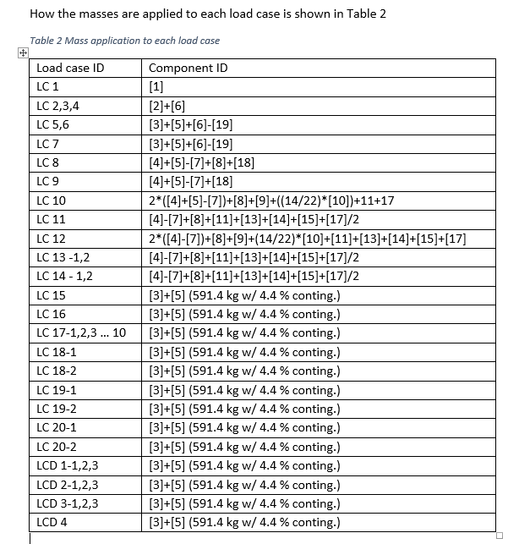
Loads applied to each load case

Slide 12
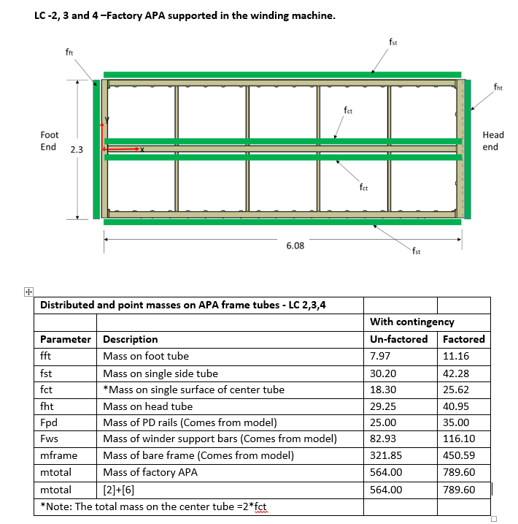
Application of masses carried by the Frame
Mass of many components like boards are distributed on the frame.
This load is assigned to each frame member
The summation assigned load is checked against the summation of the component loads
Sum of mass assigned to frame
Sum of component loads

Slide 13
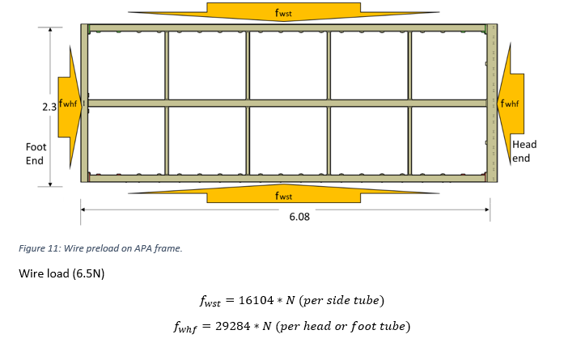
Wire Load carried by frame
Includes 1.4 load factor

Slide 14
FEA Model
A 3D representative model was built and Finite Element Analysis (FEA) was used to evaluate the frame.
Primary software was ANSYS Simulation.
ANSYS TET10 and HEX20 elements were used.
Stresses in frame members were calculated by FEA
Forces and moments on the joints were extracted from the FEA for use in code calculations for bolts and welds.
Buckling was checked for all frame members.

Slide 15
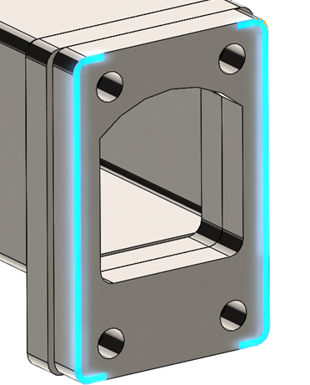
Analysis of welded connections
The weld joints are identified and reported by their joint location.
There are four different types of welds
  Pad to head or foot tube
  Endcap to side tube
  Endcap to center tube
  Endcap to ribs
Forces and moments on each joint were pulled from the FEA
The weld stresses were calculated for each weld joint per the AISC -360-16 code.
The resistance factor of .55 for welds from Design Guide 27: Structural Stainless Steel was used.
View of pad to head tube weld. Head tube not shown.

Slide 16
Analysis of welded connections
The contribution of stresses from each of the 3 forces and 3 moments applied to the joint was used to determined the contribution to stress from each.
The stresses from each force and moment are summed directly or vectorially (as appropriate) to arrive at the maximum value of force per unit length applied to the weld (N/m).

Slide 17
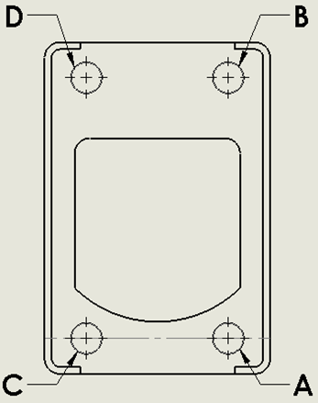

Analysis of bolted connections
Individual bolts were labeled using the joint and bolt locations with respect to the Coordinate system
Forces and moments on each joint were pulled from the FEA
The tensile and shear forces were calculated for each bolt for each load case
The available strengths of the M10 and M12 bolts were determined based on bolt size and materials (A2 Class 70 304 SS bolts and 0.75 resistance factor)
Note: It is not necessary to evaluate combined stresses because the shear loads never exceed 30% of the available strengths. (See User Note in Section J3.7)

Slide 18
Frame stresses for Factory, Lifting, and Installation cases
Results from FEA
In some cases, the FEA stresses in joint 11 are higher than the available stress. The available stress is intended for use with analytical methods defined in AISC and not for FEA checks. In cases with high localized FEA stresses, an analytic check was done. See page 21 and Appendix 15.
Case | Maximum Von Mises Stress (MPa) | Available Stress (MPa) | Utilization Ratio
LC 1 | 112.48 | 189 | 0.60
LC 6 | 176.66* | 189 | 0.93
LC 8 | 180.42 | 189 | 0.95
LC 9 | 87* | 189 | 0.46
LC 10 | 164.8 | 189 | 0.87
LC 11 | 187.2 | 189 | 0.99
LC 12 | 166.9 | 189 | 0.88
LC 11 Highest stress for cases checked with FEA. UR<1 is ok.
*stress artifacts are ignored (see appendix 6)

Slide 19
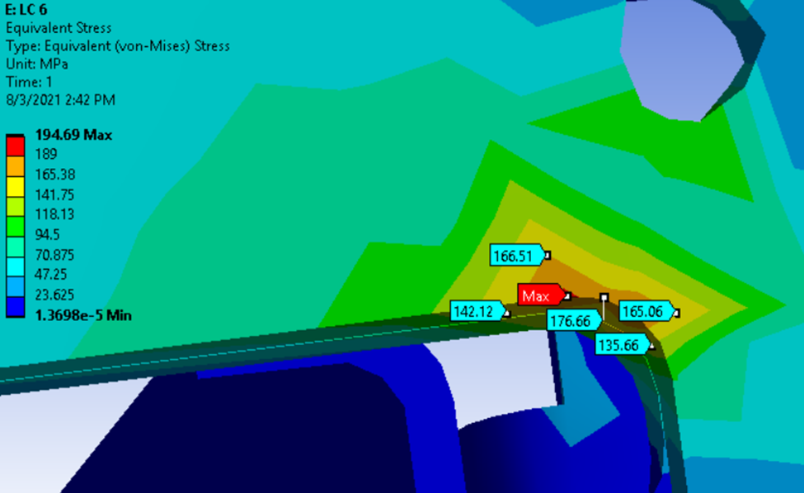
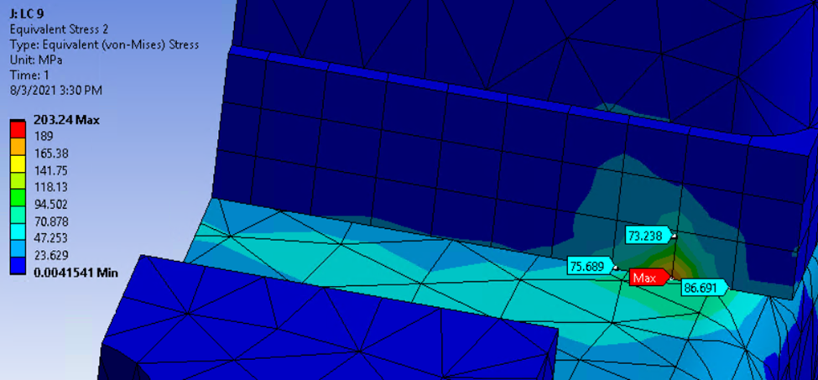
Frame stresses for Factory, Lifting, and Installation cases
Examples of FEA singularities that are ignored
LC 6 singularity on edge of PD slot cutout
LC 9 Singularity on corner of joint 11 endcap

Slide 20
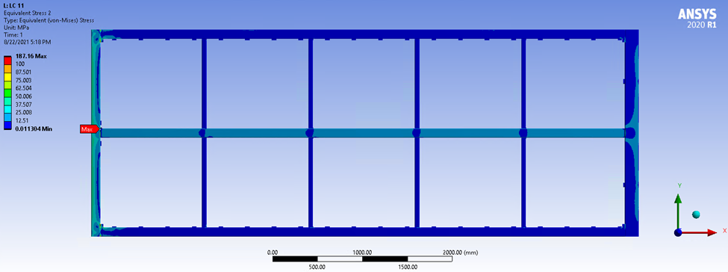
Frame stresses for Factory, Lifting, and Installation cases
Results from FEA
Localized high stress at joint 11
Stress plot for load case 11

Slide 21
Frame stresses for Factory, Lifting, and Installation cases
Results from analytical method - 360-16 AISC Chapter K HSS-to-HSS truss connection
The truss connection method is intended for welded vs. bolted connections.
The wire load is putting the joint 11 in compression and this compressive load is driving the utilization ratio. It is expected that the a bolted joint and welded joint under compression will experience similar stresses.
LFRD
Load case number | Axial Force [kN] | Bending Moment y [N-m] | Bending Moment z [N-m] | LFRD - UR
LC 2 | 15.8 | 0.9 | 592 | 0.24
LC 3 | 15.8 | 1.2 | 757.7 | 0.29
LC 4 | 15.8 | 0.6 | 596.9 | 0.24
LC 5 | 15.8 | 1.4 | 884 | 0.33
LC 7 | 15.8 | 1.3 | -590.1 | 0.24
Highest Utilization Ratio (UR). For a welded connection, a UR under 1 is ok.
Note: Load Case 5 has the highest stress in joint 11 and was studied in more detail. See Appendix 15.

Slide 22
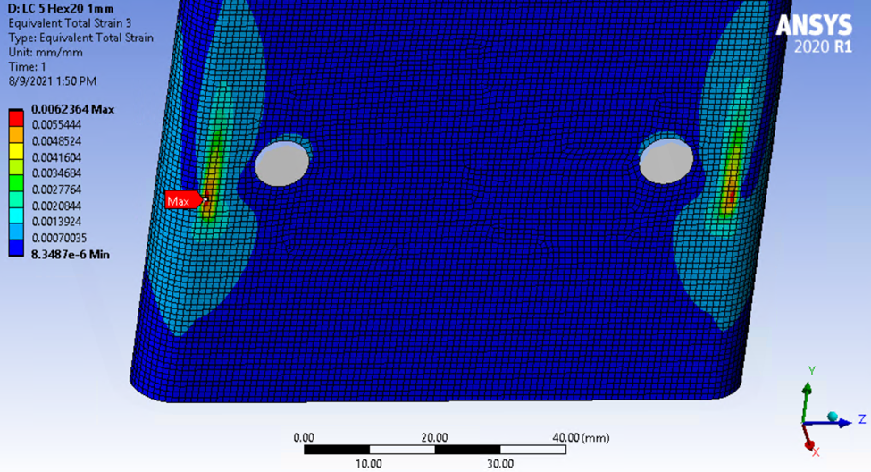
Frame stresses for Factory, Lifting, and Installation cases
Elastic plastic analysis of Joint 11 for the most highly stressed case, LC 5
The strain on the inside radius of the foot tube is calculated by elastic plastic analysis to be 0.6%. Annex C of Eurocode EN1993-1-5 section C.8 recommends a limiting value of principle strain of 5% for regions. Annex C gives guidance on the use of FE-methods
Total strain plot of Joint 11 for load case 5

Slide 23
Bolt results for Factory, Lifting, and Installation cases
M12 bolts with Maximum Axial force for each case
Case Number | Description | Joint | Bolt | Bolt Type | Axial Force (N) | Shear Force (N) | Available Axial to Calculated | Available Shear to Calculated
LC 1 | Maximum M12 Axial | 22 | C | M12 | 1500 | 52 | 20.9 | 368.5
LC 2 | Maximum M12 Axial | 17 | A | M12 | 7500 | 886 | 4.2 | 21.4
LC 3 | Maximum M12 Axial | 17 | A | M12 | 8000 | 377 | 4 | 50.5
LC 4 | Maximum M12 Axial | 17 | A | M12 | 7600 | 807 | 4.2 | 23.6
LC 5 | Maximum M12 Axial | 17 | A | M12 | 8600 | 335 | 3.7 | 56.7
LC 6 | Maximum M12 Axial | 17 | C | M12 | 4400 | 1000 | 7.2 | 19
LC 7 | Maximum M12 Axial | 1 | B | M12 | 7000 | 562 | 4.5 | 33.8
LC 8 | Maximum M12 Axial | 1 | B | M12 | 5500 | 663 | 5.8 | 28.7
LC 9 | Maximum M12 Axial | 1 | B | M12 | 4300 | 546 | 7.3 | 34.8
LC 10 | Maximum M12 Axial | 1 | B | M12 | 6100 | 673 | 5.2 | 28.2
LC 11 | Maximum M12 Axial | 1 | B | M12 | 6000 | 659 | 5.3 | 28.8
LC 12 | Maximum M12 Axial | 1 | B | M12 | 6000 | 665 | 5.3 | 28.6
Load case 5 has the highest axial load. A ratio > 1 is ok.
Note: Maximum shear force for of all cases and joints is less than 30% of available, Therefore it is not necessary to consider combined loading. (See User Note in Section J3.7)

Slide 24
Bolt results for Factory, Lifting, and Installation cases
M10 bolts with Maximum Axial force for each case
Case Number | Description | Joint | Bolt | Bolt Type | Axial Force (N) | Shear Force (N) | Available Axial to Calculated | Available Shear to Calculated
LC 1 | Maximum M10 Axial | 18 | A | M10 | 2300 | 73 | 9.5 | 181.7
LC 2 | Maximum M10 Axial | 12 | A | M10 | 7300 | 220 | 3 | 60
LC 3 | Maximum M10 Axial | 12 | A | M10 | 7400 | 236 | 3 | 56
LC 4 | Maximum M10 Axial | 12 | A | M10 | 7400 | 226 | 3 | 58.4
LC 5 | Maximum M10 Axial | 12 | A | M10 | 8000 | 272 | 2.8 | 48.5
LC 6 | Maximum M10 Axial | 12 | B | M10 | 4900 | 324 | 4.5 | 40.7
LC 7 | Maximum M10 Axial | 12 | B | M10 | 7800 | 113 | 2.8 | 116.7
LC 8 | Maximum M10 Axial | 12 | A | M10 | 4300 | 5 | 5.1 | 2490.2
LC 9 | Maximum M10 Axial | 12 | A | M10 | 4900 | 2 | 4.5 | 7924.4
LC 10 | Maximum M10 Axial | 12 | A | M10 | 2900 | 31 | 7.5 | 421.3
LC 11 | Maximum M10 Axial | 12 | A | M10 | 4500 | 8 | 4.9 | 1761.2
LC 12 | Maximum M10 Axial | 12 | A | M10 | 3000 | 30 | 7.3 | 442.5
Load case 5 and 7 have the highest axial load and are ok
Note: Maximum shear force for of all cases and joints is less than 30% of available, Therefore it is not necessary to consider combined loading. (See User Note in Section J3.7)

Slide 25
Weld results for Factory, Lifting, and Installation cases
Case | Weld Location (by Joint Number) | Available Strength to Calculated
LC 1 | 6 | 17.9
LC 2 | 22 | 3.9
LC 3 | 22 | 3.8
LC 4 | 22 | 3.9
LC 5 | 22 | 3.5
LC 6 | 6 | 7.1
LC 7 | 6 | 3.8
LC 8 | 17 | 6.1
LC 9 | 22 | 6.4
LC 10 | 1 | 5.2
LC 11 | 1 | 5.4
LC 12 | 1 | 5.3
Load Case 5 has the highest weld load and is ok.

Slide 26
Wire Tension results for Factory, Lifting, and Installation cases
Case | Max 0° (N) | Max -36° (N) | Max +36° (N) | Minimum Safety Margin
LC 1 | 6.51 | 7.09 | 7.16 | 2.71
LC 2 | 6.48 | 7.56 | 7.10 | 2.57
LC 3 | 6.51 | 7.46 | 7.35 | 2.60
LC 4 | 6.48 | 7.58 | 7.09 | 2.56
LC 5 | 6.48 | 7.68 | 7.13 | 2.53
LC 6 | 6.83 | 8.31 | 8.31 | 2.34
LC 7 | 6.47 | 7.60 | 7.94 | 2.44
LC 8 | 6.48 | 6.54 | 6.55 | 2.96
LC 9 | 6.44 | 6.60 | 6.59 | 2.94
LC 10 | 6.49 | 6.65 | 6.72 | 2.89
LC 11 | 6.48 | 6.53 | 6.56 | 2.96
LC 12 | 6.49 | 6.62 | 6.69 | 2.90
LC6 has the minimum safety margin and is ok
Note: Minimal safety margin is based on a design strength of 19.4N (actual minimum yield is 23.3N) divided by Maximum tension.

Slide 27
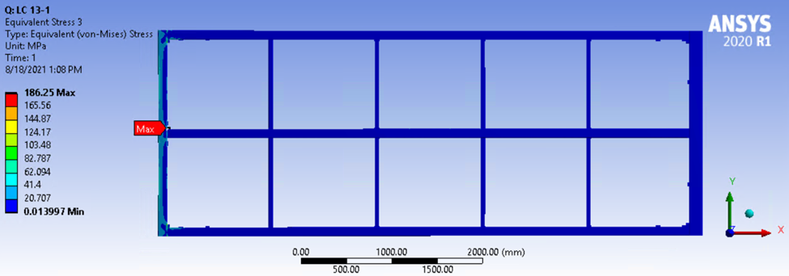
Frame Stresses for APA under Thermal load
Results from FEA
For cases LC14 -1 and LC14-2 an analytic check will be done.
Load case 13-1 has the highest peak stress for cases checked with FEA.
Case | Maximum Von Mises Stress (MPa) | Available Stress (MPa) | Utilization Ratio
13-1 | 186.3 | 189.0 | 0.99
13-2 | 161.8 | 189.0 | 0.86
Localized high stress at joint 13-1
Stress plot for load case 13-1

Slide 28
Frame Stresses for APA under Thermal load
Results from analytical method - 360-16 AISC Chapter K HSS-to-HSS truss connection
Load case number | Axial Force [kN] | Bending Moment y [N-m] | Bending Moment z [N-m] | LFRD - UR
LC 14-1 | 23.9 | 0 | -33.5 | 0.12
LC 14-2 | 22.1 | -1.1 | -50.2 | 0.12
LC 14-1,and -2 have a UR that is less than 1

Slide 29
Bolt Results for APA under Thermal load
M12 and M10 bolts with Maximum Axial force for each case
Case Number | Description | Joint | Bolt | Bolt Type | Axial Force (N) | Shear Force (N) | Available Axial to Calculated | Available Shear to Calculated
LC 13-1 | Maximum M12 Axial | 1 | B | M12 | 6210.9 | 562.0 | 5.1 | 33.8
LC 13-2 | Maximum M12 Axial | 1 | D | M12 | 6121.2 | 552.2 | 5.2 | 34.4
LC 14-1 | Maximum M12 Axial | 1 | D | M12 | 7930.4 | 775.6 | 4.0 | 24.5
LC 14-2 | Maximum M12 Axial | 1 | D | M12 | 7867.9 | 775.5 | 4.0 | 24.5
Load case LC 14-1 and 2 have the highest axial load and are ok
Case Number | Description | Joint | Bolt | Bolt Type | Axial Force (N) | Shear Force (N) | Available Axial to Calculated | Available Shear to Calculated
LC 13-1 | Maximum M10 Axial | 12 | A | M10 | 4393.3 | 5.5 | 5.0 | 2396.0
LC 13-2 | Maximum M10 Axial | 12 | A | M10 | 2858.8 | 8.3 | 7.7 | 1585.8
LC 14-1 | Maximum M10 Axial | 12 | A | M10 | 6516.0 | 9.0 | 3.4 | 1471.0
LC 14-2 | Maximum M10 Axial | 12 | A | M10 | 5274.2 | 16.2 | 4.2 | 812.9
Load case LC 14-1 has the highest axial load and is ok
Note: Maximum shear force for of all cases and joints is less than 30% of available, Therefore it is not necessary to consider combined loading. (See User Note in Section J3.7)

Slide 30
Weld Results for APA under Thermal load
Case | Weld Location (by Joint Number) | Available Strength to Calculated
LC 13-1 | 1 | 5.1
LC 13-2 | 1 | 5.2
LC 14-1 | 1 | 4.1
LC 14-2 | 1 | 4.1
Load Case LC14--1 and -2 have the highest weld load and are ok.
Wire Tension Results for APA under Thermal load
Wire Tension Template will be modified for thermal cases to account for wire temperature. For load cases 14-1 and 14-2, it is assumed that the APA wires cool quickly and experience 50% extra preload. This will result in the wires tension being approximately 9.75N. Therefore the safety margin will be approximately 2.0

Slide 31
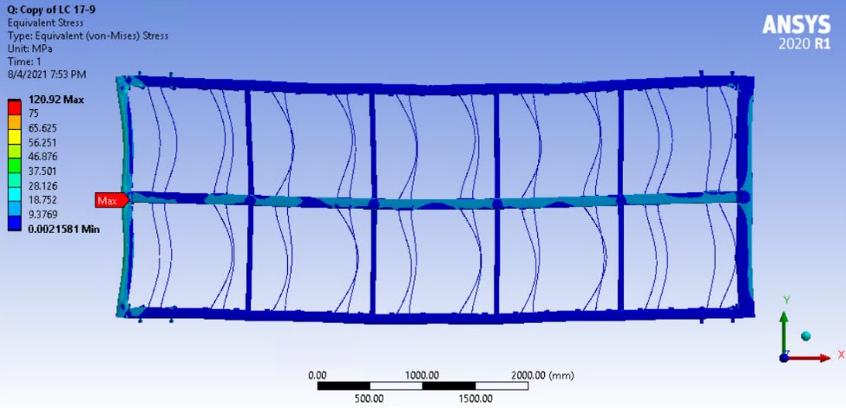
Note: All static transport cases were done using ASD and should have been done using LFRD. This will be corrected and will increase available stress and safety margins.
Frame Stresses for Static Transport Cases
Results from FEA
See following page for cases checked with Analytical method
Case | Maximum von Mises Stress (MPa) | Available Stress (MPa) | Utilization Ratio
LC 17-9 | 120.92 | 126.00 | 0.96
LC 17-10 | 110.89 | 126.00 | 0.88
LC 18-1 | 116.33 | 126.00 | 0.92
LC 18-2 | 119.81 | 126.00 | 0.95
LC 19-1 | 115.87 | 126.00 | 0.92
LC 19-2 | 116.66 | 126.00 | 0.93
LC 17-9 Highest peak stress for cases checked with FEA. UR < 1 is ok.
Localized high stress at joint 17-9
Stress plot for load case 17-9

Slide 32
Frame Stresses for “Static” Transport Cases
Results from analytical method - 360-16 AISC Chapter K HSS-to-HSS truss connection
Load case number | Axial Force [kN] | Bending Moment y [N-m] | Bending Moment z [N-m] | ASD - UR
LC 15 | 10.9 | 0.29 | 207 | 0.17
LC 16 | 10.9 | 0.25 | 168 | 0.15
LC 17-1 | 10.9 | 0.3 | 271 | 0.19
LC 17-2 | 10.88 | 0.3 | 262.9 | 0.19
LC 17-3 | 10.84 | 0.3 | 252 | 0.18
LC 17-4 | 10.8 | 0.3 | 232 | 0.175
LC 17-5 | 10.77 | 0.3 | 205.7 | 0.16
LC 17-6 | 10.74 | 0.2 | 172.9 | 0.15
LC 17-7 | 10.72 | 0.2 | 135.5 | 0.13
LC 17-8 | 10.71 | 0.1 | 94 | 0.12
LC 20-1 | 11.2 | 0.24 | 126.5 | 0.13
LC 20-2 | 10.9 | -46.1 | 125.9 | 0.15
Highest Utilization Ratio (UR)

Slide 33
Bolt results for Static Transport Cases
M12 bolts with Maximum Axial force for each case
Case Number | Description | Joint | Bolt | Bolt Type | Axial Force (N) | Shear Force (N) | Available Axial to Calculated | Available Shear to Calculated
LC 15 | Maximum M12 Axial | 17 | A | M12 | 4100 | 573 | 5.1 | 22.1
LC 16 | Maximum M12 Axial | 17 | A | M12 | 3900 | 568 | 5.5 | 22.3
LC 17-1 | Maximum M12 Axial | 17 | A | M12 | 4500 | 557 | 4.7 | 22.7
LC 17-2 | Maximum M12 Axial | 17 | A | M12 | 4500 | 582 | 4.7 | 21.8
LC 17-3 | Maximum M12 Axial | 17 | A | M12 | 4600 | 609 | 4.6 | 20.8
LC 17-4 | Maximum M12 Axial | 17 | A | M12 | 4600 | 634 | 4.6 | 20.0
LC 17-5 | Maximum M12 Axial | 17 | A | M12 | 4500 | 657 | 4.7 | 19.3
LC 17-6 | Maximum M12 Axial | 17 | A | M12 | 4400 | 684 | 4.8 | 18.5
LC 17-7 | Maximum M12 Axial | 17 | A | M12 | 4300 | 704 | 4.9 | 18.0
LC 17-8 | Maximum M12 Axial | 17 | A | M12 | 4200 | 726 | 5.1 | 17.5
LC 17-9 | Maximum M12 Axial | 17 | A | M12 | 4000 | 740 | 5.3 | 17.1
LC 17-10 | Maximum M12 Axial | 17 | A | M12 | 3800 | 749 | 5.6 | 16.9
LC 18-1 | Maximum M12 Axial | 17 | A | M12 | 2800 | 539 | 7.5 | 23.5
LC 18-2 | Maximum M12 Axial | 17 | A | M12 | 2200 | 433 | 9.6 | 29.2
LC 19-1 | Maximum M12 Axial | 17 | A | M12 | 2800 | 482 | 7.5 | 26.3
LC 19-2 | Maximum M12 Axial | 1 | B | M12 | 2800 | 541 | 7.5 | 23.4
LC 20-1 | Maximum M12 Axial | 17 | A | M12 | 3200 | 494 | 6.6 | 25.7
LC 20-2 | Maximum M12 Axial | 17 | C | M12 | 3700 | 676 | 5.8 | 18.7
Load case 17-3 and 4 have the highest axial load and are ok
Note: Maximum shear force for of all cases and joints is less than 30% of available, Therefore it is not necessary to consider combined loading. (See User Note in Section J3.7)

Slide 34
Bolt results for Static Transport Cases
M10 bolts with Maximum Axial force for each case
Case Number | Description | Joint | Bolt | Bolt Type | Axial Force (N) | Shear Force (N) | Available Axial to Calculated | Available Shear to Calculated
LC 15 | Maximum M10 Axial | 12 | A | M10 | 4200 | 17 | 3.5 | 526.5
LC 16 | Maximum M10 Axial | 12 | A | M10 | 4000 | 14 | 3.7 | 617.0
LC 17-1 | Maximum M10 Axial | 12 | A | M10 | 4600 | 47 | 3.2 | 188.5
LC 17-2 | Maximum M10 Axial | 12 | A | M10 | 4500 | 48 | 3.2 | 184.1
LC 17-3 | Maximum M10 Axial | 12 | A | M10 | 4500 | 44 | 3.3 | 202.3
LC 17-4 | Maximum M10 Axial | 12 | A | M10 | 4400 | 38 | 3.3 | 230.0
LC 17-5 | Maximum M10 Axial | 12 | A | M10 | 4200 | 32 | 3.5 | 271.4
LC 17-6 | Maximum M10 Axial | 12 | A | M10 | 4000 | 25 | 3.6 | 348.8
LC 17-7 | Maximum M10 Axial | 12 | A | M10 | 3800 | 17 | 3.8 | 523.3
LC 17-8 | Maximum M10 Axial | 12 | A | M10 | 3500 | 8 | 4.1 | 1108.3
LC 17-9 | Maximum M10 Axial | 12 | A | M10 | 3300 | 1 | 4.5 | 7524.9
LC 17-10 | Maximum M10 Axial | 12 | B | M10 | 3100 | 12 | 4.8 | 766.3
LC 18-1 | Maximum M10 Axial | 12 | B | M10 | 2600 | 1 | 5.6 | 13585.3
LC 18-2 | Maximum M10 Axial | 12 | B | M10 | 2400 | 0 | 6.2 | 57322.2
LC 19-1 | Maximum M10 Axial | 12 | B | M10 | 2600 | 4 | 5.7 | 2390.8
LC 19-2 | Maximum M10 Axial | 12 | B | M10 | 2600 | 0 | 5.7 | 50121.3
LC 20-1 | Maximum M10 Axial | 12 | A | M10 | 3600 | 38 | 4.1 | 231.8
LC 20-2 | Maximum M10 Axial | 12 | A | M10 | 4600 | 70 | 3.2 | 125.5
Load cases 17-1,4 LC have the highest axial load and are ok
Note: Maximum shear force for of all cases and joints is less than 30% of available, Therefore it is not necessary to consider combined loading. (See User Note in Section J3.7)

Slide 35
Weld results for Static Transport Cases
Case | Weld Location (by Joint Number) | Available Strength to Calculated
LC 15 | 22 | 5.2
LC 16 | 17 | 5.6
LC 17-1 | 22 | 4.6
LC 17-2 | 17 | 4.7
LC 17-3 | 17 | 4.6
LC 17-4 | 17 | 4.6
LC 17-5 | 17 | 4.7
LC 17-6 | 17 | 4.8
LC 17-7 | 17 | 5.0
LC 17-8 | 17 | 5.2
LC 17-9 | 17 | 5.4
LC 17-10 | 17 | 5.8
LC 18-1 | 6 | 5.9
LC 18-2 | 6 | 4.7
LC 19-1 | 6 | 5.8
LC 19-2 | 6 | 5.9
LC 20-1 | 22 | 5.3
LC 20-2 | 17 | 6.0
Load Cases 17-1, -2, and -4 have the highest weld load and are ok.

Slide 36
Wire Tension results for Static Transport Cases
Case | Max 0° (N) | Max -36° (N) | Max +36° (N) | Minimum Safety Margin
LC 15 | 6.48 | 6.95 | 6.97 | 2.79
LC 16 | 6.48 | 6.91 | 6.93 | 2.80
LC 17-1 | 6.48 | 7.02 | 7.01 | 2.77
LC 17-2 | 6.48 | 7.00 | 7.00 | 2.77
LC 17-3 | 6.48 | 6.97 | 6.98 | 2.78
LC 17-4 | 6.48 | 6.93 | 6.94 | 2.80
LC 17-5 | 6.48 | 6.87 | 6.88 | 2.82
LC 17-6 | 6.48 | 6.81 | 6.80 | 2.85
LC 17-7 | 6.48 | 6.73 | 6.72 | 2.88
LC 17-8 | 6.48 | 6.65 | 6.63 | 2.92
LC 17-9 | 6.48 | 6.56 | 6.55 | 2.96
LC 17-10 | 6.47 | 6.52 | 6.53 | 2.97
LC 18-1 | 6.47 | 6.58 | 6.58 | 2.95
LC 18-2 | 6.47 | 6.61 | 6.61 | 2.93
LC 19-1 | 6.47 | 6.58 | 6.58 | 2.95
LC 19-2 | 6.47 | 6.58 | 6.59 | 2.95
LC 20-1 | 6.47 | 6.87 | 6.88 | 2.82
LC 20-2 | 6.44 | 6.85 | 6.87 | 2.82
LC 17-1 and -2 have the minimum safety margin and are ok
Note: Minimal safety margin is based on a design strength of 19.4N (actual minimum yield is 23.3N) divided by Maximum tension.

Slide 37
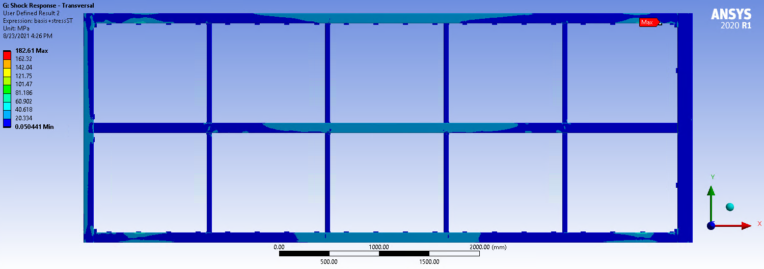
Frame Stresses for Dynamic Transport Cases
Results from FEA
See following page for cases checked with Analytical method
Case | Maximum Stress (MPa) | Available Stress (MPa) | Utilization Ratio
LCD 1-1 | 159.25 | 189.0 | 0.84
LCD 1-2 | 167 | 189.0 | 0.88
LCD 1-3 | 180.3 | 189.0 | 0.95
LCD 2-1 | 149.4 | 189.0 | 0.79
LCD 2-2 | 148.4 | 189.0 | 0.79
LCD 2-3 | 148.4 | 189.0 | 0.79
LCD 3-2 | 182.6 | 189.0 | 0.97
LCD 3-3 | 151.9 | 189.0 | 0.80
LCD 3-2 Highest peak stress for cases checked with FEA. UR < 1 is ok.
Localized high stress
Stress plot for load case LCD 3-2

Slide 38
Frame Stresses for Dynamic Transport Cases
Results from analytical method - 360-16 AISC Chapter K HSS-to-HSS truss connection
Load case number | Axial Force [kN] | Bending Moment y [N-m] | Bending Moment z [N-m] | LFRD - UR
LCD 3-1 | 11 | 0.5 | 483.8 | 0.19
Utilization Ratio (UR) is less than 1.

Slide 39
Bolt Results for Dynamic Transport Cases
M12 bolts with Maximum Axial force for each case.
Case Number | Description | Joint | Bolt | Bolt Type | Axial Force (N) | Shear Force (N) | Available Axial to Calculated | Available Shear to Calculated
LCD 1-1 | Maximum M12 Axial | 17 | A | M12 | 3711.3 | 545.5 | 8.6 | 34.8
LCD 1-2 | Maximum M12 Axial | 17 | C | M12 | 4303.6 | 1326.0 | 7.4 | 14.3
LCD 1-3 | Maximum M12 Axial | 17 | C | M12 | 5063.8 | 829.8 | 6.3 | 22.9
LCD 2-1 | Maximum M12 Axial | 17 | A | M12 | 5397.7 | 802.1 | 5.9 | 23.7
LCD 2-2 | Maximum M12 Axial | 17 | C | M12 | 5403.8 | 811.1 | 5.9 | 23.4
LCD 2-3 | Maximum M12 Axial | 17 | C | M12 | 5403.8 | 811.1 | 5.9 | 23.4
LCD 3-1 | Maximum M12 Axial | 17 | C | M12 | 4457.3 | 613.1 | 7.1 | 31.0
LCD 3-2 | Maximum M12 Axial | 17 | C | M12 | 3904.8 | 782.6 | 8.1 | 24.3
LCD 3-3 | Maximum M12 Axial | 17 | C | M12 | 4463.7 | 716.7 | 7.1 | 26.5
Load cases LCD 2-2, and -3 have the highest axial load and are ok
Note: Maximum shear force for of all cases and joints is less than 30% of available, Therefore it is not necessary to consider combined loading. (See User Note in Section J3.7)

Slide 40
Bolt Results for Dynamic Transport Cases
M10 bolts with Maximum Axial force for each case
Case Number | Description | Joint | Bolt | Bolt Type | Axial Force (N) | Shear Force (N) | Available Axial to Calculated | Available Shear to Calculated
LCD 1-1 | Maximum M10 Axial | 12 | A | M10 | 3670.8 | 86.5 | 6.0 | 152.5
LCD 1-2 | Maximum M10 Axial | 12 | A | M10 | 5638.4 | 970.9 | 3.9 | 13.6
LCD 1-3 | Maximum M10 Axial | 5 | A | M10 | 3789.9 | 16.7 | 5.8 | 792.1
LCD 2-1 | Maximum M10 Axial | 12 | A | M10 | 6178.7 | 112.9 | 3.6 | 116.9
LCD 2-2 | Maximum M10 Axial | 12 | A | M10 | 6137.0 | 110.1 | 3.6 | 119.8
LCD 2-3 | Maximum M10 Axial | 12 | A | M10 | 6137.0 | 110.1 | 3.6 | 119.8
LCD 3-1 | Maximum M10 Axial | 5 | A | M10 | 6332.3 | 79.2 | 3.5 | 166.7
LCD 3-2 | Maximum M10 Axial | 12 | A | M10 | 5345.0 | 153.1 | 4.1 | 86.2
LCD 3-3 | Maximum M10 Axial | 12 | A | M10 | 3658.6 | 74.2 | 6.0 | 177.8
Load case LCD 3-1 has the highest axial load and is ok
Note: Maximum shear force for of all cases and joints is less than 30% of available, Therefore it is not necessary to consider combined loading. (See User Note in Section J3.7)

Slide 41
Weld Results for Dynamic Transport Cases
Case | Weld Location (by Joint Number) | Available Strength to Calculated Load
LC 1-1 | 17 | 8.8
LC 1-2 | M20 foot-high-far | 4.4
LC 1-3 | 17 | 6.3
LC 2-1 | 17 | 6.0
LC 2-2 | 17 | 6.1
LC 2-3 | 17 | 6.1
LC 3-1 | M20 head-low-far | 7.0
LC 3-2 | M20 foot-high-far | 6.0
LC 3-3 | 17 | 7.2
Load Case LCD 1-2 has the highest weld load and is ok.

Slide 42
Wire Results for Dynamic Transport Cases
Case | Max 0° (N) | Max -36° (N) | Max +36° (N) | Maximum Available (N) | Minimum Safety Margin
LCD 1-1 | 6.48 | 7.38 | 7.22 | 19.40 | 2.63
LCD 1-2 | 6.47 | 6.84 | 6.90 | 19.40 | 2.81
LCD 1-3 | 6.47 | 6.78 | 6.80 | 19.40 | 2.85
LCD 2-1 | 6.47 | 6.87 | 6.88 | 19.40 | 2.82
LCD 2-2 | 6.50 | 8.74 | 8.83 | 19.40 | 2.20
LCD 2-3 | 6.47 | 6.87 | 6.88 | 19.40 | 2.82
LCD 3-1 | 6.47 | 7.07 | 7.02 | 19.40 | 2.74
LCD 3-2 | 6.48 | 6.85 | 6.92 | 19.40 | 2.80
LCD 3-3 | 6.48 | 6.87 | 6.94 | 19.40 | 2.79
LCD 2-2 has the minimum safety margin and is ok
Note: Minimal safety margin is based on a design strength of 19.4N (actual minimum yield is 23.3N) divided by Maximum tension.

Slide 43
Buckling
Design Guide 27 section 5.3 provides design guidance for the buckling verification method.
To assess the buckling of all the box beams:
The available axial and flexural strength was calculated for all the structural members in the APA.
The actual loads and moments for all connection joints and all load cases where assumed to be applied to the structural member with the lowest strength.
All load cases show a UF smaller than 1 so all the box beams meet the buckling requirements.

Slide 44
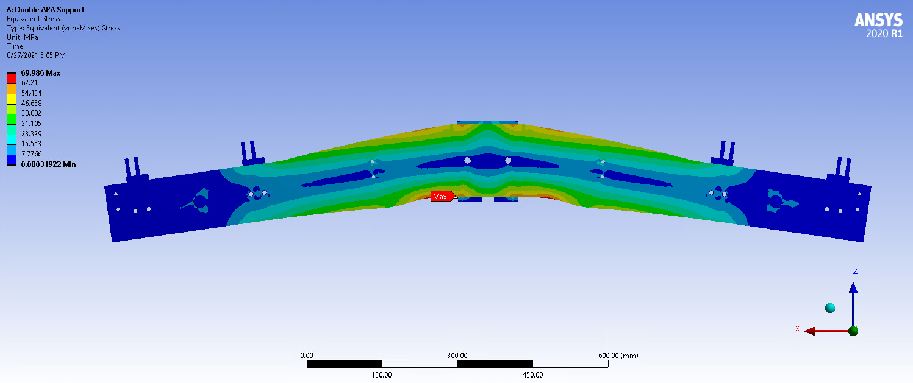
APA Yoke Stress – Installed case under gravity load
Peak yoke stress is approximately 70 MPa. Well below the available of 189 MPa.

Slide 45
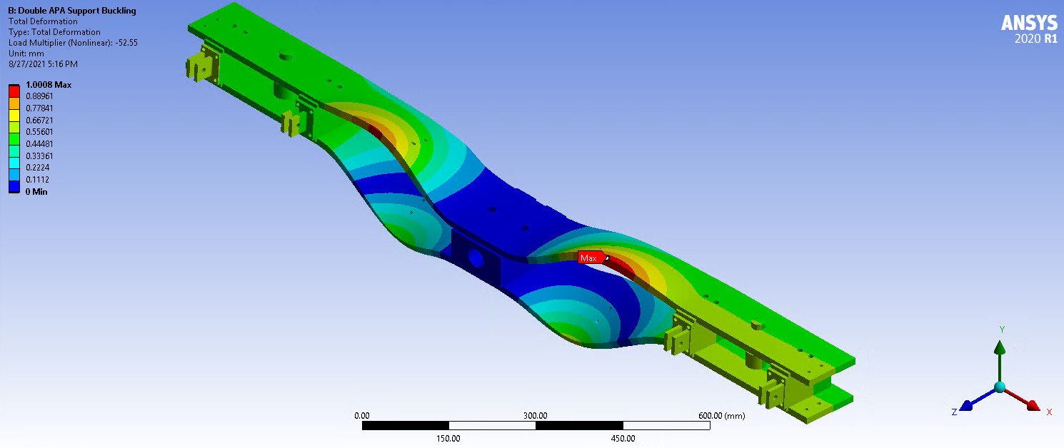
APA Yoke Stress – Installed case - Buckling
The yoke was analyzed for buckling under the loading in the installed case. The load factor of 52.55 is less than 10 and is acceptable.

Slide 46
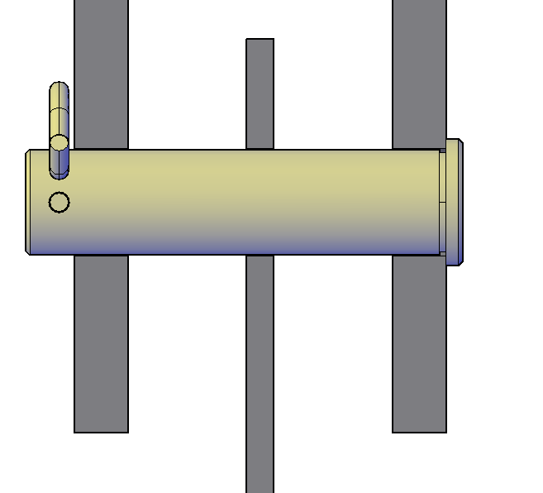


APA 25mm pin – Installed case
Based on the analysis method recommended by DESIGN GUIDE 27 and AISC, the combined bending and shear force factor shows the 25mm PIN to be safe.
Yoke Bars
25mm pin
Combined Bending and Shear Forces
=0.89
AISC Eq.(H3-6)*
Value < or = to 1
*Equation adapted due to no axial or torsion load
Structural Tee
9500N

Slide 47
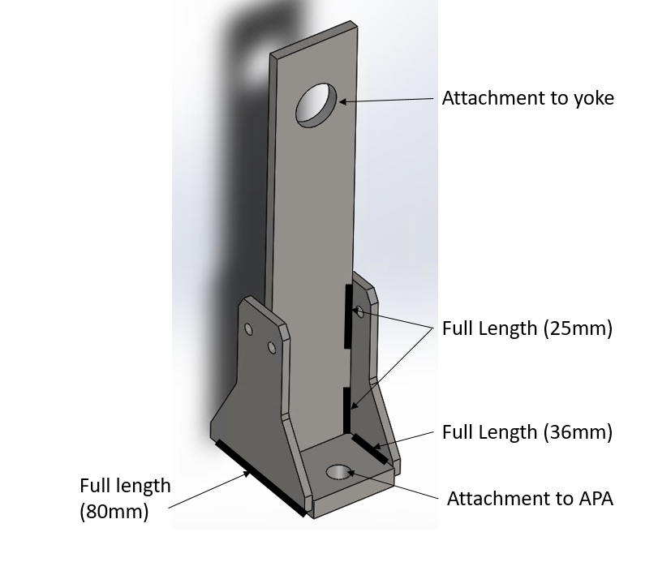
Structural Tee Analysis – Installed case
Required Strength = 9,663N
Results for pinned connection
Tensile rupture on net section
  Available = 61,920N
Tensile yielding on gross section
  Available = 50,080N
Tensile yielding on net section
  Available = 29,750N
Shear rupture on effective area
  Available = 77,340N
Bearing stress between pin and hole
  Available = 44,360N
Welds
Available strength = 350N/mm
Unit load on vertical link to gusset welds = 49N/mm
Unit load on gussets to base plate welds = 32N/mm

Slide 48
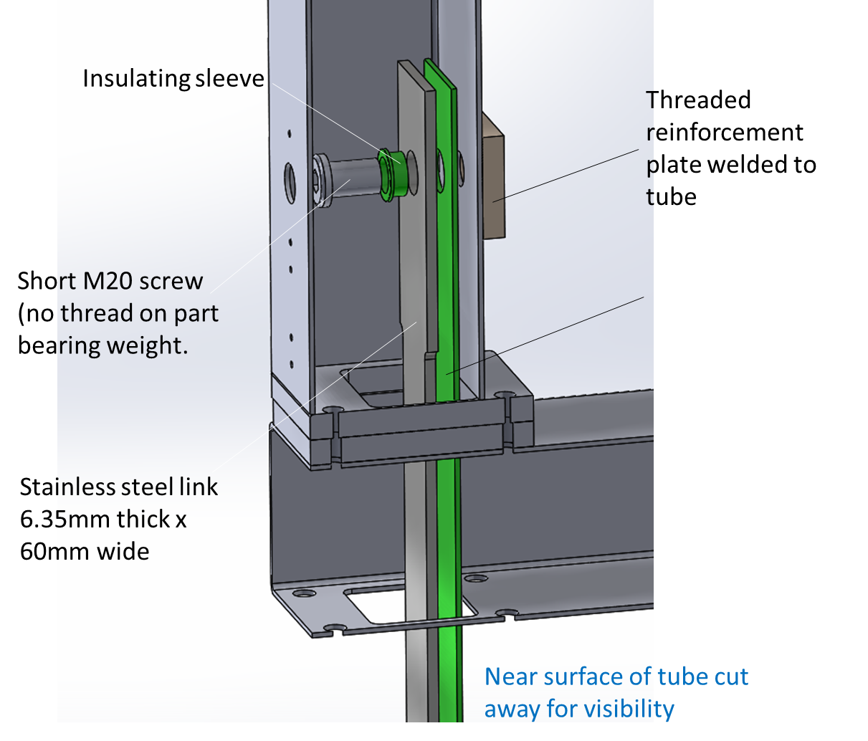
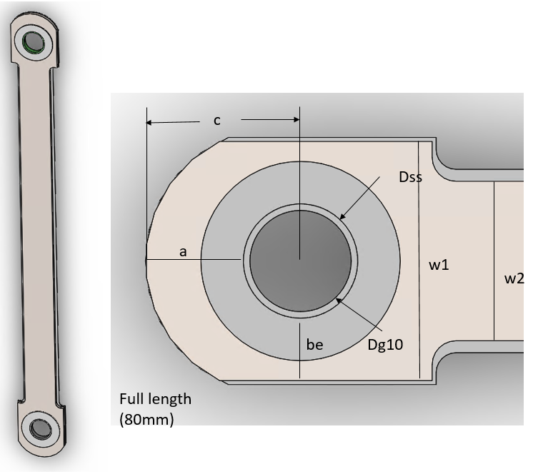
APA to APA link– Installed case
APA to APA link hardware
Link end detail

Slide 49
APA to APA link– Installed case
Required Strength = 4,785N
Results for pinned connection
Tensile rupture on net section
  Available = 40,790N
Tensile yielding on gross section
  Available = 44,340N
Tensile yielding on net section
  Available = 27,760N
Shear rupture on effective area
  Available = 54,370N
Bearing stress between 28.7mm sleeve OD and 28.7mm hole
  Available = 38,180N
Bearing stress of FR4 sleeve between 25.2mm pin and 25.4mm hole (ASD)
  FS=262MPa/28.5MPa=9.2 (Required is 3.75)

Slide 50
APA to APA link– Thermal considerations
Evaluation of stresses in the link due to the foot tube in the bottom APA cooling faster than the foot tube in the top.
Temperature assumptions:
Thermal vertical gradient of GAr at 17K/m
Head end of the bottom APA in LAr and bottom APA foot tube at 88K (Very conservative)
Top APA foot tube at temperature Gar 9 m above the LAr = 241K
Difference in shrinkage between the top and bottom foot tube = 4.6mm (2.3mm per link)
Shrinkage is based on a temperature difference of 153K. Thermal gradient of GAr at the foot tubes is 2.3K. It is unlikely this temperature difference will be more than 10K.
Results:
Using equations for the flexure of guided beams, the moment on the end of the link is determined. This moment is used to calculate the resulting stress distribution across the contact area of the pin/sleeve interface.
Total stress = Bearing stress + bending stress = 28.5 + 33.8 = 62.3MPa
FS = 262MPa/62.3MPa = 4.2 (3.75 is required).

Slide 51
Work left to do:
Revise the results for the Static Transport cases to use the LFRD rather than ASD method of checking strength. This will increase the safety margins.
For the Dynamic Drop Case, the check of welds and bolts needs to be revised to use the LFRD method.
Complete the check of wire tension for the thermal load cases.
Complete the check of connections between the yoke and the APA frame for gravity and thermal loading.
Complete the analysis of the APA link bolt.
Provide written justification that all installation load cases are covered.
Provide conclusions on the acceptability of the frame deformations for the various load cases.

Slide 52
Conclusion:
Bolts and welds
  For the analyses completed so far, the available/design strength of the joints exceed the required strength.
Structural members
  For the load cases completed so far, except for near joint 11, the available/design stress exceeds the elastic FEA calculated stresses. Near joint 11, available stresses sometimes are less than FEA stresses. However, due to stress concentrations (and singularities) it can be very conservative to compare available stresses to elastic FEA stresses. Joint 11 is ok when checked with the analytical method.
The available strength of the yoke, the 25mm pin, and the structural tees exceed the required strength when subject to gravity load. The pins and structural tee connection will be checked under gravity and thermal load.
The available strength of the link exceeds the required strength when subject to gravity loads and thermal strain between the upper and lower foot tubes.

