Slide 1
High-Level Electrical Review
DUNE APA Final Design Review
September 2021

Slide 2
Electrical Topics Covered
Grounding
Geometry Boards
CR and G-Bias Boards
Component Selection and Qualification
Bias Voltage Distribution
APA Wire Electrical Tests

Slide 3
APA Grounding and Shielding

Slide 4
EDMS 2095958 “Dune Grounding and Shielding Guidelines”
Circuit common [VSS] of the front-end ASICs and the Common plane of the cold readout PC board shall be connected to the enclosure of the CE module → VSS = V(CE Enclosure)
The APA frame shall be connected to the circuit common of all FE ASICs → VSS = V(APA Frame)
The last stage of the sense wire bias filters and grid bias filters shall be connected to the frame → V(Filter Commons) = V(Frame)
Connecting Filter Commons to VSS satisfies these requirements

Slide 5
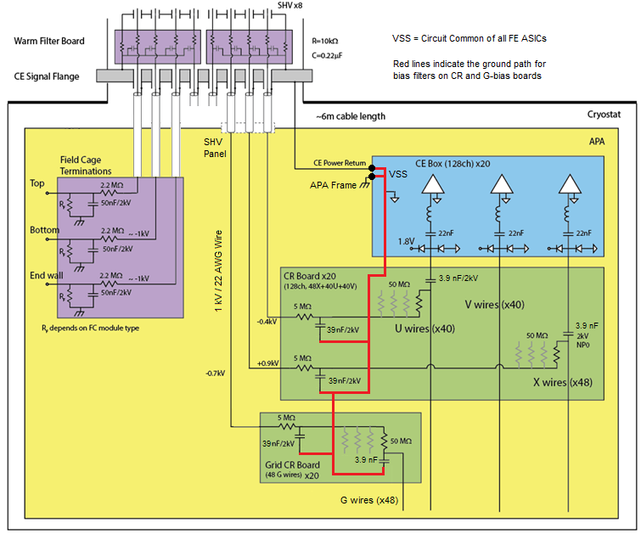

Slide 6
Geometry Boards
Orientation and board count
Design considerations
Wire Mapping

Slide 7
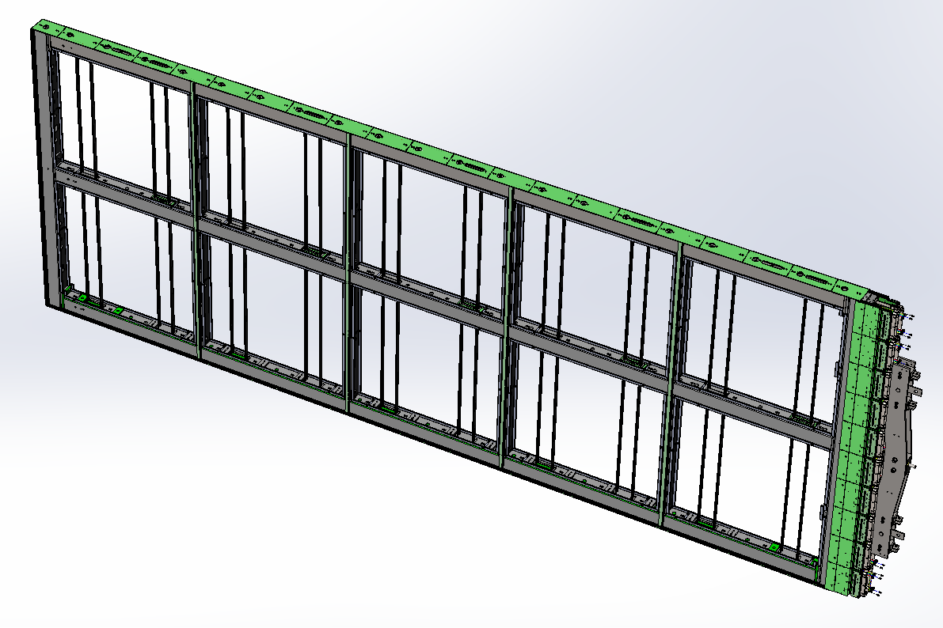
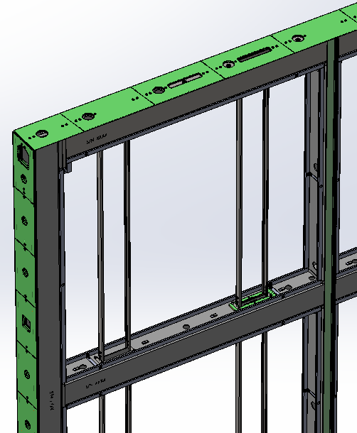
APA landmarks
Electronics are mounted on the head end of APA
PD insertion slot
Side boards
PD rails
Head boards
Foot boards
Yoke
All wires have one end terminated on a head board and the other end on a foot board. Some wires go straight from head to foot and some wind around an edge, either once or twice.

Slide 8
Board types
On each APA there are:
80 head boards
84 side boards
40 foot boards
A total of 204 boards in one APA
There are different variations of boards in each layer
Ends
Middles
Special openings for photon detectors and cables
There are 29 different geometry board designs

Slide 9
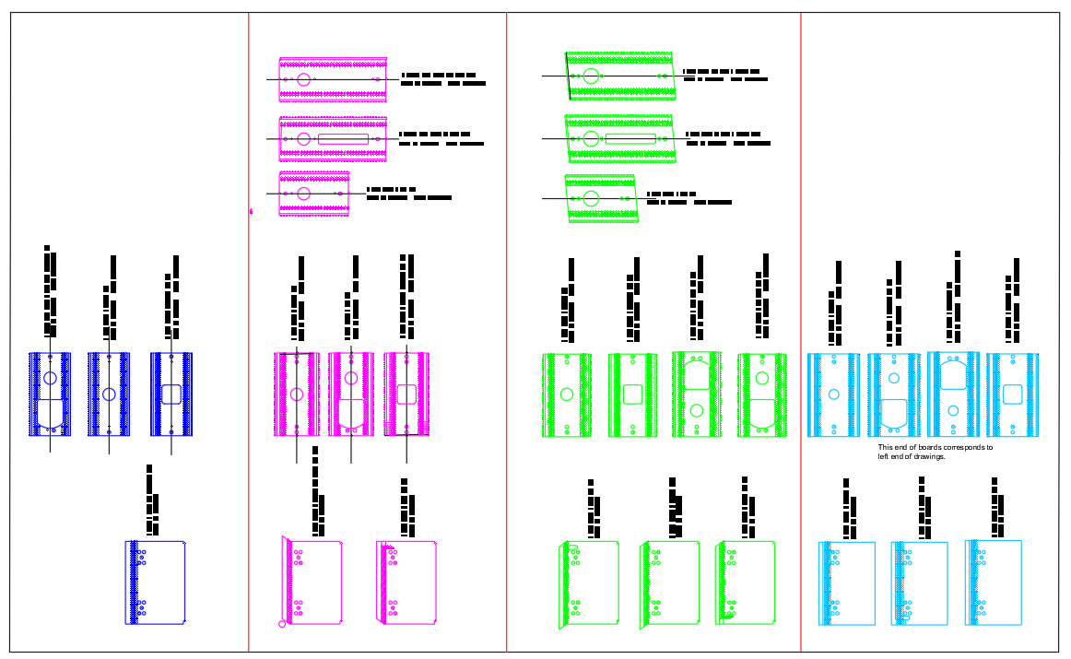
Board types (https://edms.cern.ch/file/2619625/1/Pictorial_guide_to_DUNE_boards_2019Aug15.pdf)
X layer
V layer
U layer
G layer
Side boards
Foot boards
Head boards

Slide 10
Geometry Board Designs
Foot boards: Used by all wire layers, all are 3.2 mm thick
Include solder pads for wires and test pads for electrical probes
Single-sided with machined features, some with large cut-outs
No wire traces connecting solder pads
Side boards: V and U layers only, all are 3.2 mm thick
Solder pads for wires
Machined features and large cut-outs on some boards
Wire traces connect pads along two edges of the boards
A few boards are multi-layered to enable densely packed traces
Head boards: Used by all wire layers, all are 4.8 mm thick)
Solder pads for wires and test pads for electrical probes
Double-sided, with machined features and plated through-holes
Wire traces connect solder pads to plated through-holes
Mill-Max pins and receptacles are pressed into plated through-holes
The pins and receptacles provide board-to-board connectivity

Slide 11
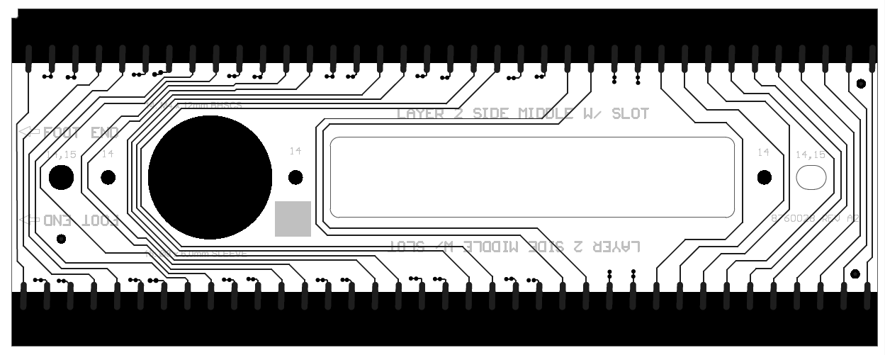
Geometry Board Designs
Layout goals for conductor traces
Meet or exceed IPC-2221 for the spacing of embedded & coated traces
IPC-2221 is a guideline for trace spacing verses voltage differentials
The IPC standard is met for voltages expected during APA operation and during electronic tension testing
For crowded layouts, traces were strategically assigned to different layers to minimize voltage differentials between traces on the same layer

Slide 12
Geometry Board Designs
Other Design Goals
Maximize trace spacing to minimize the capacitance between traces
Widen traces near solder pads to tolerate small nicks when wires are trimmed during winding operations
Avoid routing traces too close to board edges
Factor in board manufacturing tolerances
Adhere to component manufacturer guidelines
Design documentation status
Mechanical drawings are managed in SW PDM and copied to EDMS
Computer-Aided Manufacturing files including Gerbers, NCM drill files, and board manufacturing instructions are also copied to EDMS
Sharing of PCB designs is through the Altium 365 portal

Slide 13
Geometry Board Designs
PCB Layout and Manufacturing Information in EDMS
/ SP APA consortium / Printed Circuit Boards / PCB – Vendor Specs
Download: PartNo_RevNo.zip (contains all manufacturing info)
Navigate to: / Fabrication / Fabrication.pdf (Altium-generated plots)
Navigate to: / Assembly / Schematic Prints.pdf
Navigate to: / Assembly / BOM / Bill of Materials PartNo.xls
PCB Mechanical Drawings in EDMS
/ SP APA consortium / Printed Circuit Boards / PCB – Assembled Boards

Slide 14
Wire segment to channel mapping
There are 6,526 wire segments in an APA
Of these 5,565 are assigned to CE channels
The geometrical coordinates of the start and end points for each wire segment, and a cross-reference between channel numbering and wire segment numbering, can be found in EDMS
An explanation of nomenclature is included.
/ SP APA consortium / Wiring Diagrams /

Slide 15
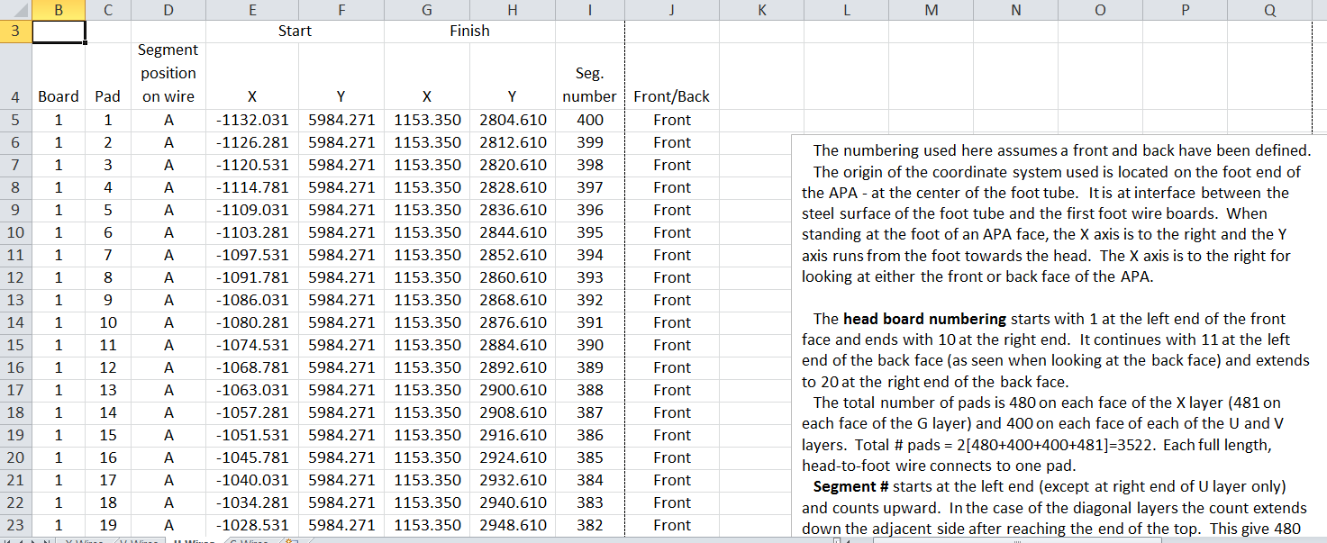
Wire segment to channel mapping
For every wire segment in each layer, the XY coordinates of the wire’s end points are given, as well as the corresponding board number (1 through 20) and the solder pad (1 through 40 or 48)

Slide 16
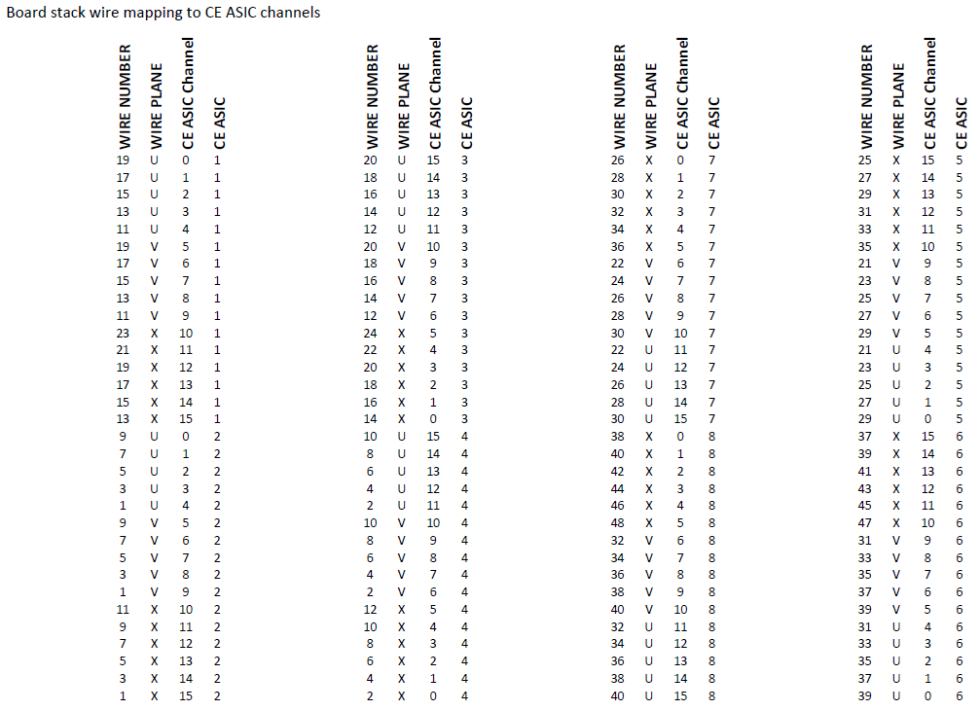
For every solder pad in a board stack, the Cold Electronics Front-End ASIC channel is known

Slide 17
CR and G-Bias Boards

Slide 18
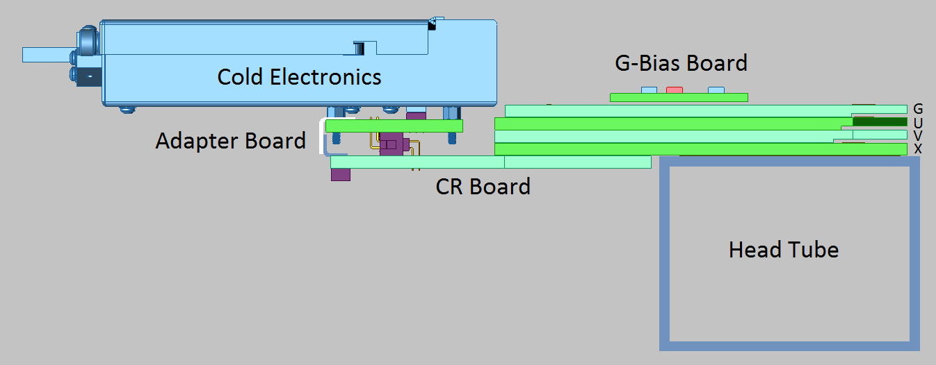
CR Boards Provide Bias to X and U Wires, and Route Signals from X, V and U wires to CE Modules

Slide 19
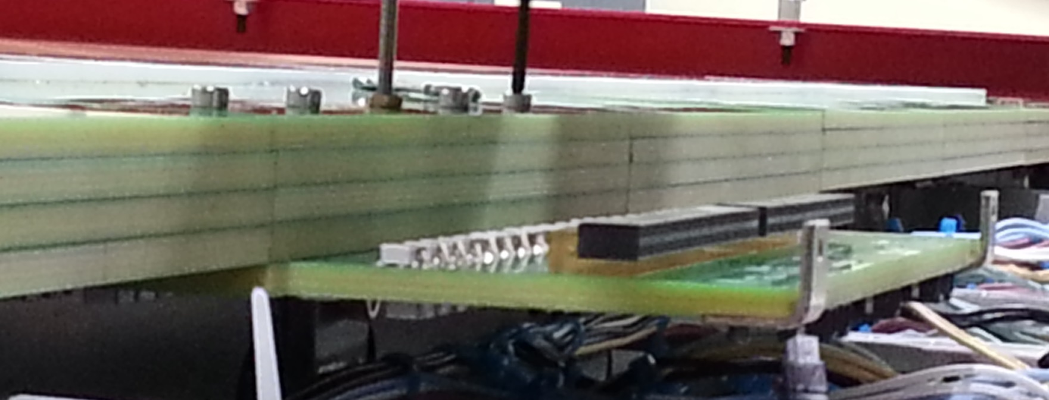
CR boards plug into X-layer head boards. Five screws are gradually tightened to mate pins with receptacles. The mating force has been reduced by a factor of 4 using improved Mill-Max pins and receptacles.

Slide 20
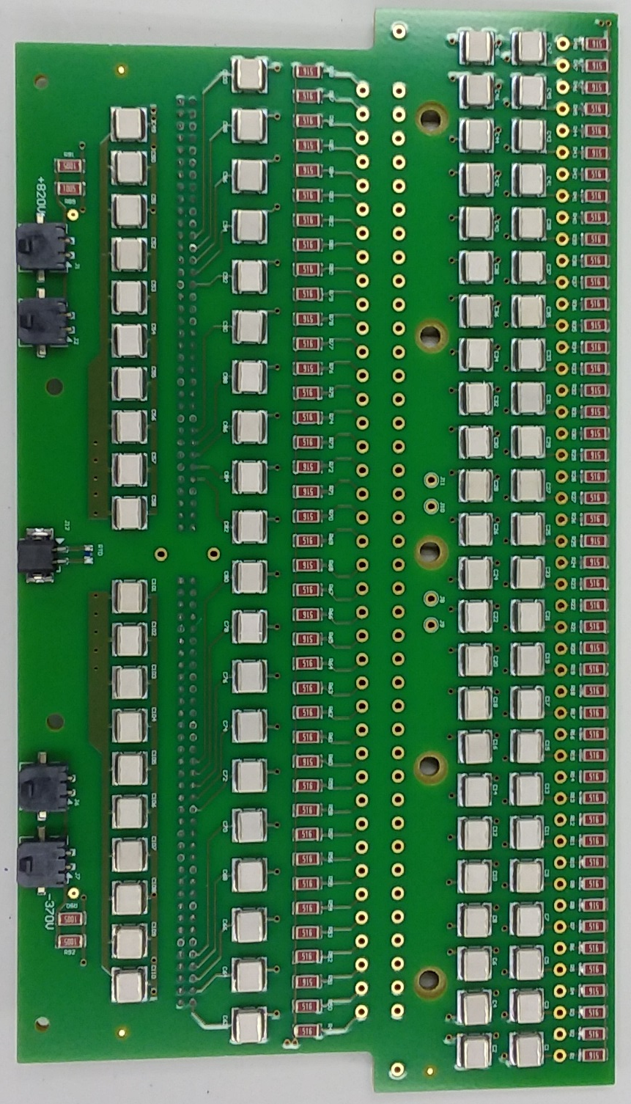
The CR board “bottom” side carries most of the electrical components. The six-layer board has 48 coupling capacitors for the X layer and 40 for the U layer. Ten capacitors are used for each of the X and U bias filters.
Half of the U-layer coupling capacitors are on the top side.

Slide 21
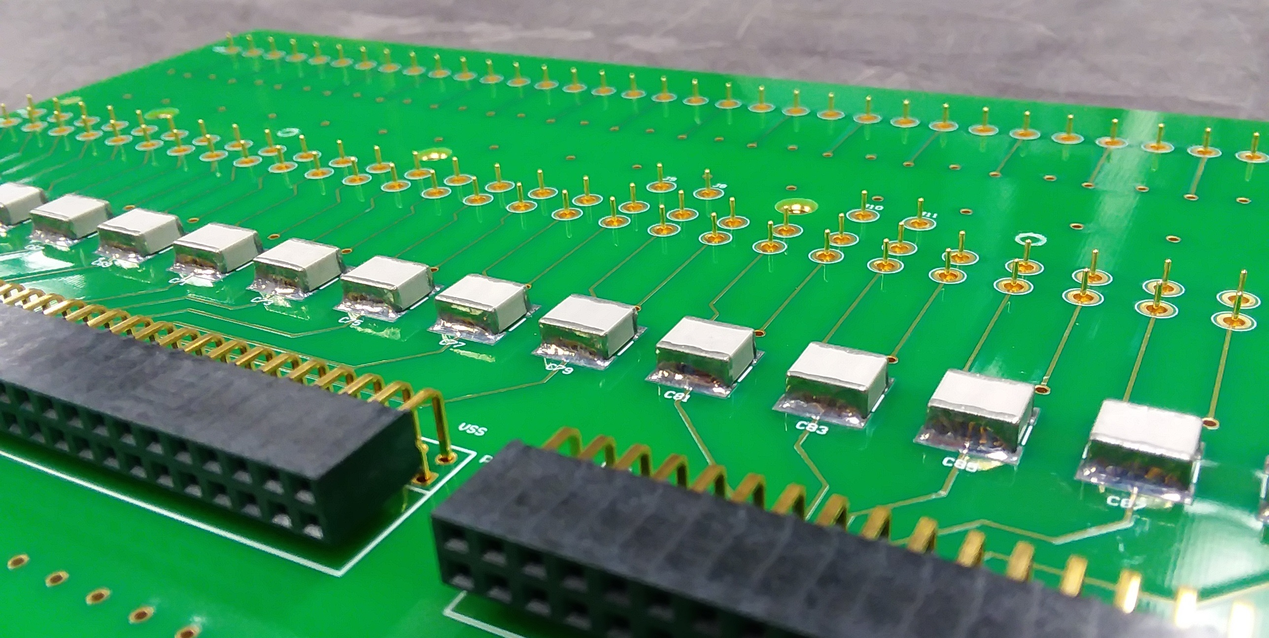
The CR board’s top side carries two right-angle connectors that are mounted 2.0 mm above the board surface. Mill-Max pins mate with receptacles in the X-layer head board to provide connectivity with all wires terminating on the board stack.

Slide 22
CR Board Manufacturing Challenges
Leakage current across coupling capacitors must be less than 0.5 nA
Solder flux residues trapped beneath capacitors can be difficult to clean and may result in excessive leakage currents
All capacitors must have leakage current tested to ensure successful cleaning

Slide 23
CR Board Lessons Learned
Solder flux residues are easier to clean when pre-heat and solder reflow temperatures are lower, and are sustained for shorter periods
Thicker boards and larger components can require higher pre-heat temperatures, longer pre-heat periods, and longer exposures to reflow temperatures (equipment-dependent)
Competing requirements for levels of heat complicate the development of successful soldering and cleaning methods

Slide 24
Soldering Process Goals
Use a process that raises and lowers the temperature of the board surface quickly
Limit the maximum temperature of the PC board and electronic components
Provide enough copper thickness to yield adequate clearances for washing below components
Select compatible solder products and cleaning processes

Slide 25
CR Board Manufacturing Approach
Solder top-side capacitors using a Vapor-Phase reflow oven, tin/lead solder paste, and water-soluble flux
Solder bottom-side capacitors, resistors, and bias connectors using the same process
Hand-solder or wave-solder through-hole connectors
Wash boards using a high-flow cleaning system
Test all coupling capacitors for leakage current
Replace capacitors as needed, re-clean and test
Press Mill-Max pins into boards after final cleaning
Functionally test all components

Slide 26
G-Bias Boards
Same resistors, capacitors, and bias input connectors as used in CR boards
Spring-loaded pins mate with contact pads on G head boards
Same basic design as ProtoDUNE except each wire is biased individually
Larger G-bias boards now span the width of head boards

Slide 27
G-Bias Boards

Slide 28
G-Bias Boards
A soldering process similar to that used for CR boards is recommended
Leakage current tests are less stringent (50 nA would cause a 2.5 V bias drop)
Boards are 3.2 mm thick, and easier to solder and clean successfully compared to CR boards

Slide 29
Component Qualification

Slide 30
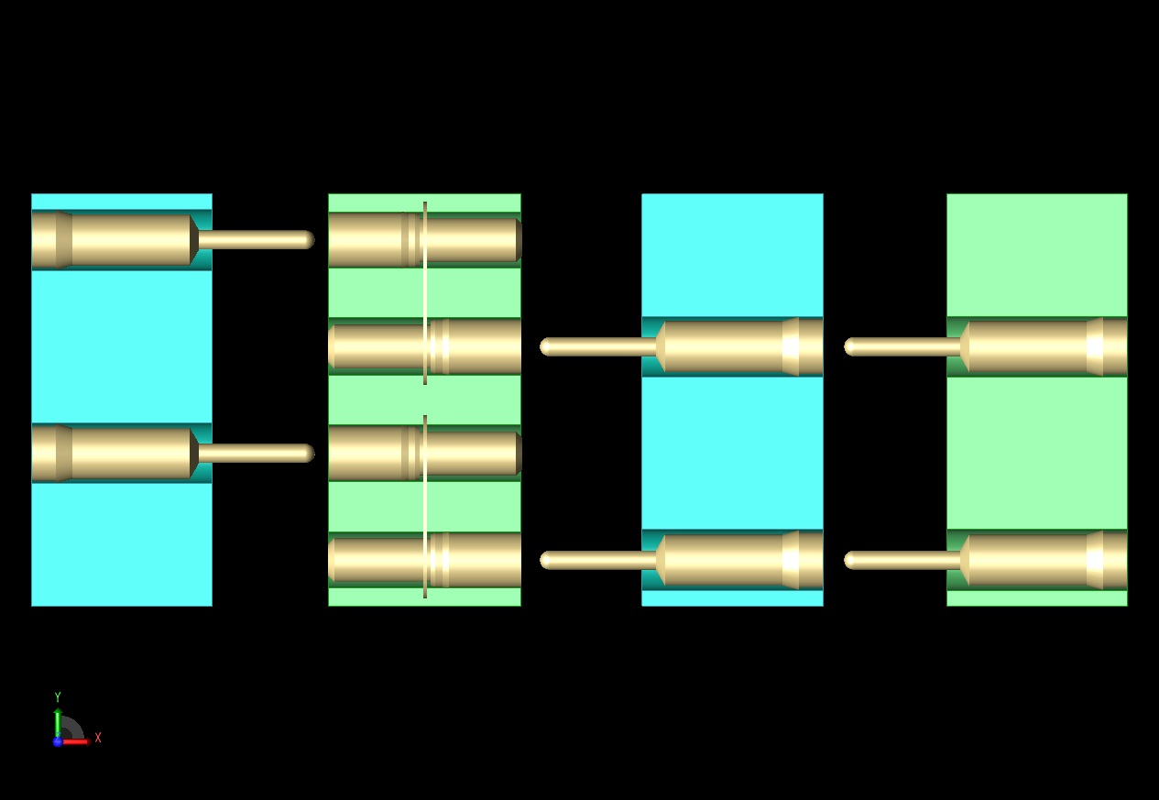
Board Interconnects (Mill-Max)
CR
X
VV
U
Receptacles with tails
Receptacles sans tails
Receptacles with tails
Receptacles with tails
Mill-Max receptacles, with and without “tails”, form a network of pins and sockets to electrically connect head boards and CR boards. All pins point toward X head boards.

Slide 31
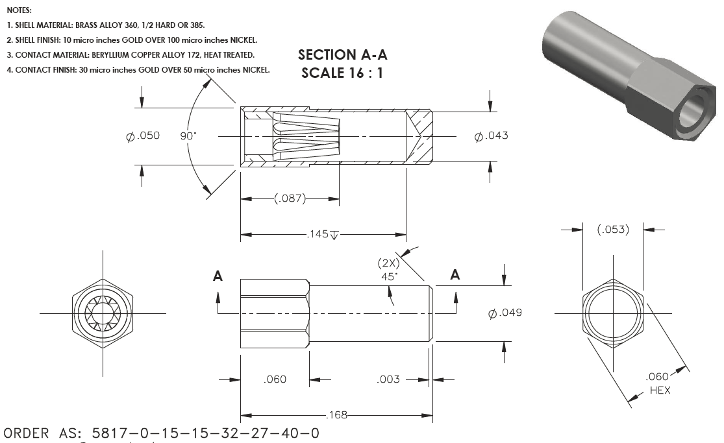
Board Interconnects (Mill-Max)
Mill-Max receptacles without tails are used exclusively in X head boards. The custom design was developed with the help of Mill-Max engineers.

Slide 32
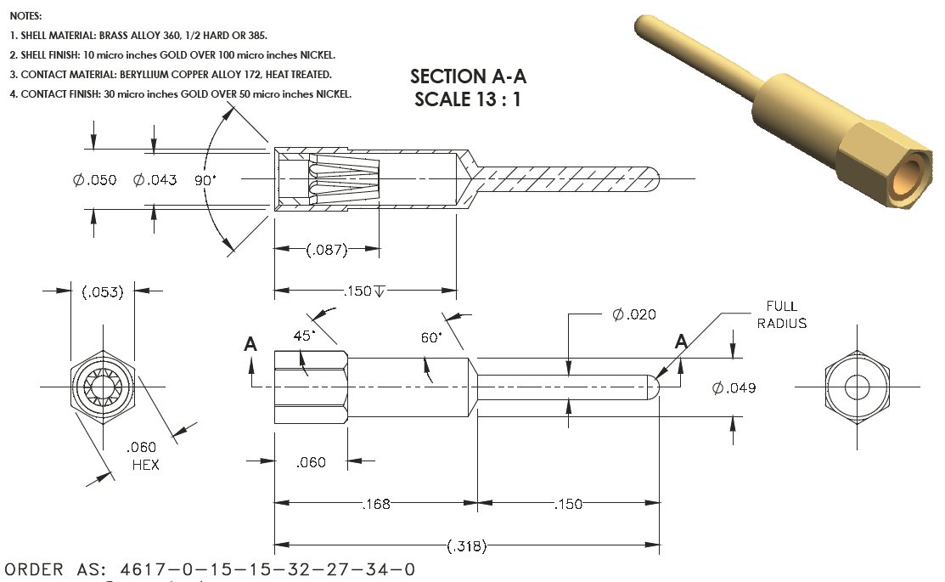
Board Interconnects (Mill-Max)
Receptacles with tails are also a custom design. Existing designs were not compatible with the thickness of DUNE PC boards. New design were developed by elongating existing designs.

Slide 33
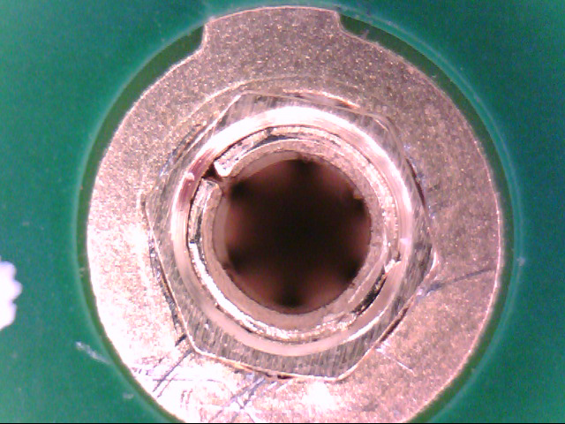
Board Interconnects (Mill-Max)
Mill-Max components are pressed into plated through-holes. Points on the hexagonal profile displace hole plating longitudinally to retain connectivity between board layers.

Slide 34
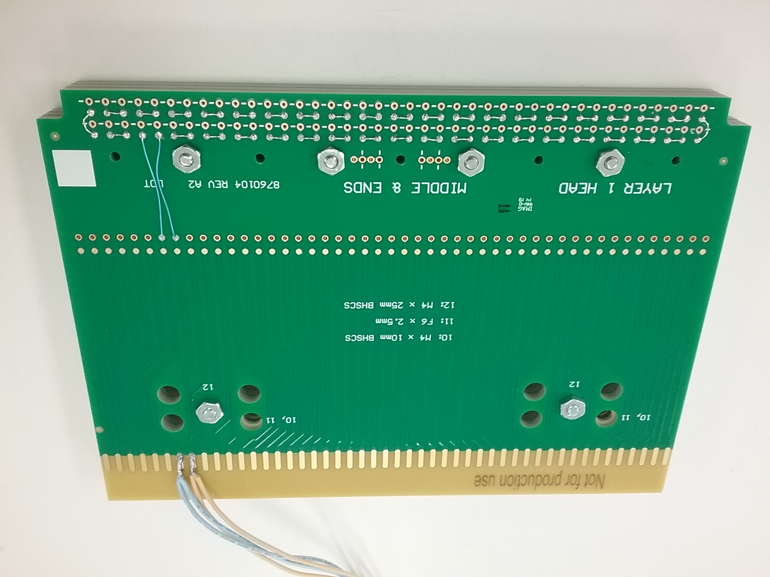
Board Interconnects (Mill-Max)
Daisy-chained arrays of mated Mill-Max components were temperature cycled to liquid argon temperatures multiple times. No measureable changes in resistance were observed.

Slide 35
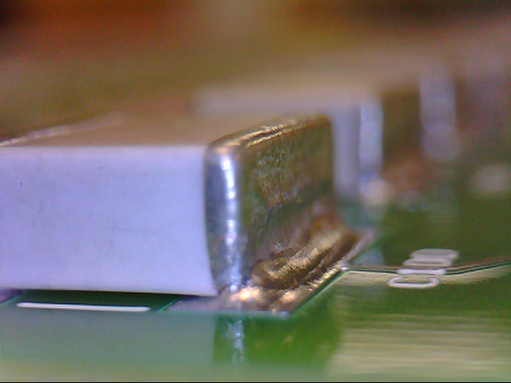
Surface-Mount Capacitors
Ceramic surface-mount capacitors are used to AC-couple X and U wires to the front-end detector inputs. The components are designed to withstand temperature extremes.

Slide 36
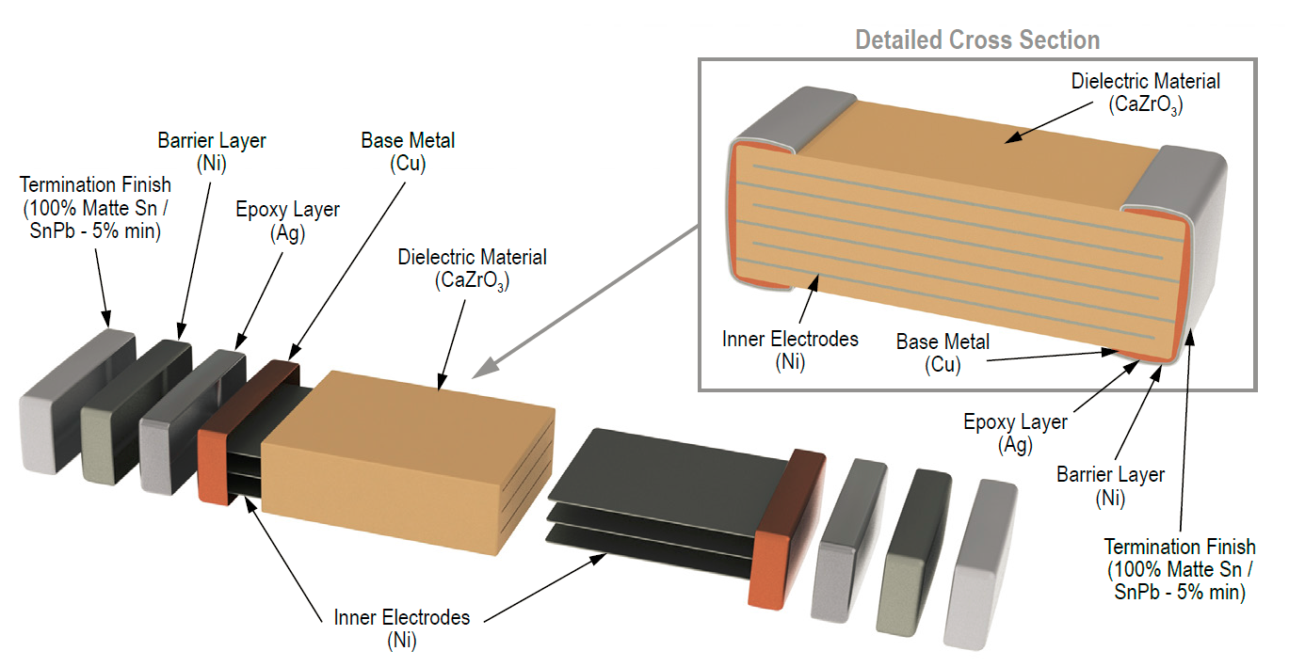
Surface-Mount Capacitors
Mechanical stresses caused by extreme temperature excursions are greatly reduced by terminals that include a compliant epoxy layer. Cyrogenic tests of more than 10,000 capacitors during ProtoDUNE CR board manufacturing did not yield any failures.

Slide 37
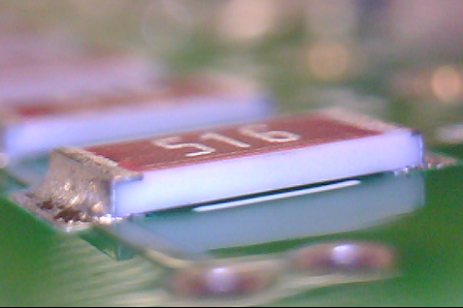
Surface-Mount Resistors
Thick-film resistors perform bias filtering and apply bias voltages to wires. Cyrogenic tests of more than 10,000 resistors during ProtoDUNE CR board manufacturing did not yield any failures.

Slide 38
Summary
All electronic components are evaluated for expected performance when subjected to cryogenic temperatures
Initial tests include repeated temperature cycling to liquid argon temperatures with electrical and mechanical performance evaluated at high and low temperature extremes
Electronic assemblies built with new component types or with modified manufacturing procedures should be subjected to full functional tests at room temperature and at liquid argon temperature
Testing can be relaxed when statistics support it

Slide 39
Bias Distribution Assembly

Slide 40
Bias Distribution System
Supplies bias voltages to CR boards and G-bias filter boards on the APA
Redundancy tolerates single-point failures
Three coax cables feed bias to the SHV panel
New for DUNE:
Connectors more securely lock when mated
Wire bundles are supported by the CR boards
Wire bundles plug into the SHV panel
Schematics: EDMS/ SP APA consortium / Wiring Diagrams

Slide 41
Bias Connectors
Surface-mount bias connectors on CR and G-bias boards are compact and mount securely to circuit boards. The insulation material is Nylon.
Molex part number: 43650-0212
Wire bundle connectors have locking clips to prevent separation. A lever must be pressed to pull connectors away from the circuit board.
Molex part number: 43645-0208

Slide 42
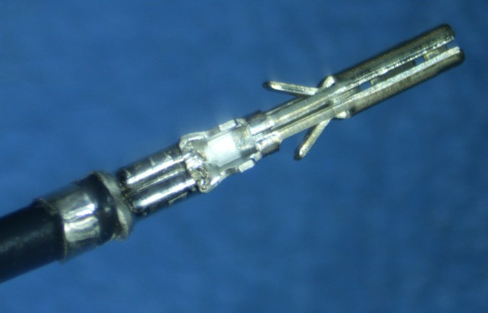
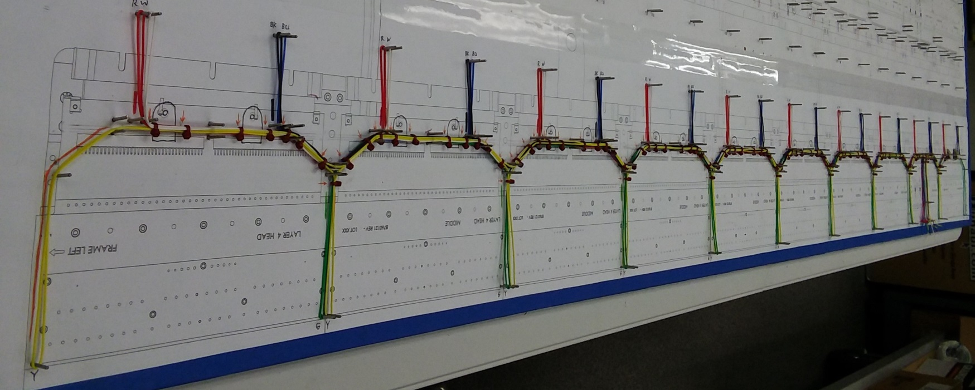
Bias Wire Assemblies
Connector terminals are securely crimped to bias wires.
Molex part number: 43030-0009
Wire assemblies are constructed using PEEK cable ties and cable clamps

Slide 43
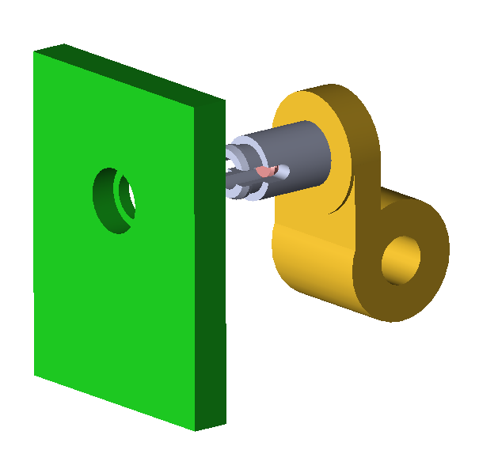
Wire assembly supports
Cable clamps are installed when wire bundles are assembled.
Snap-in standoffs are attached to the clamps.
Clamp assemblies are snapped into mounting holes on CR boards
CR boards have counter-bored mounting holes to prevent standoff heads from extending above the board surface

Slide 44
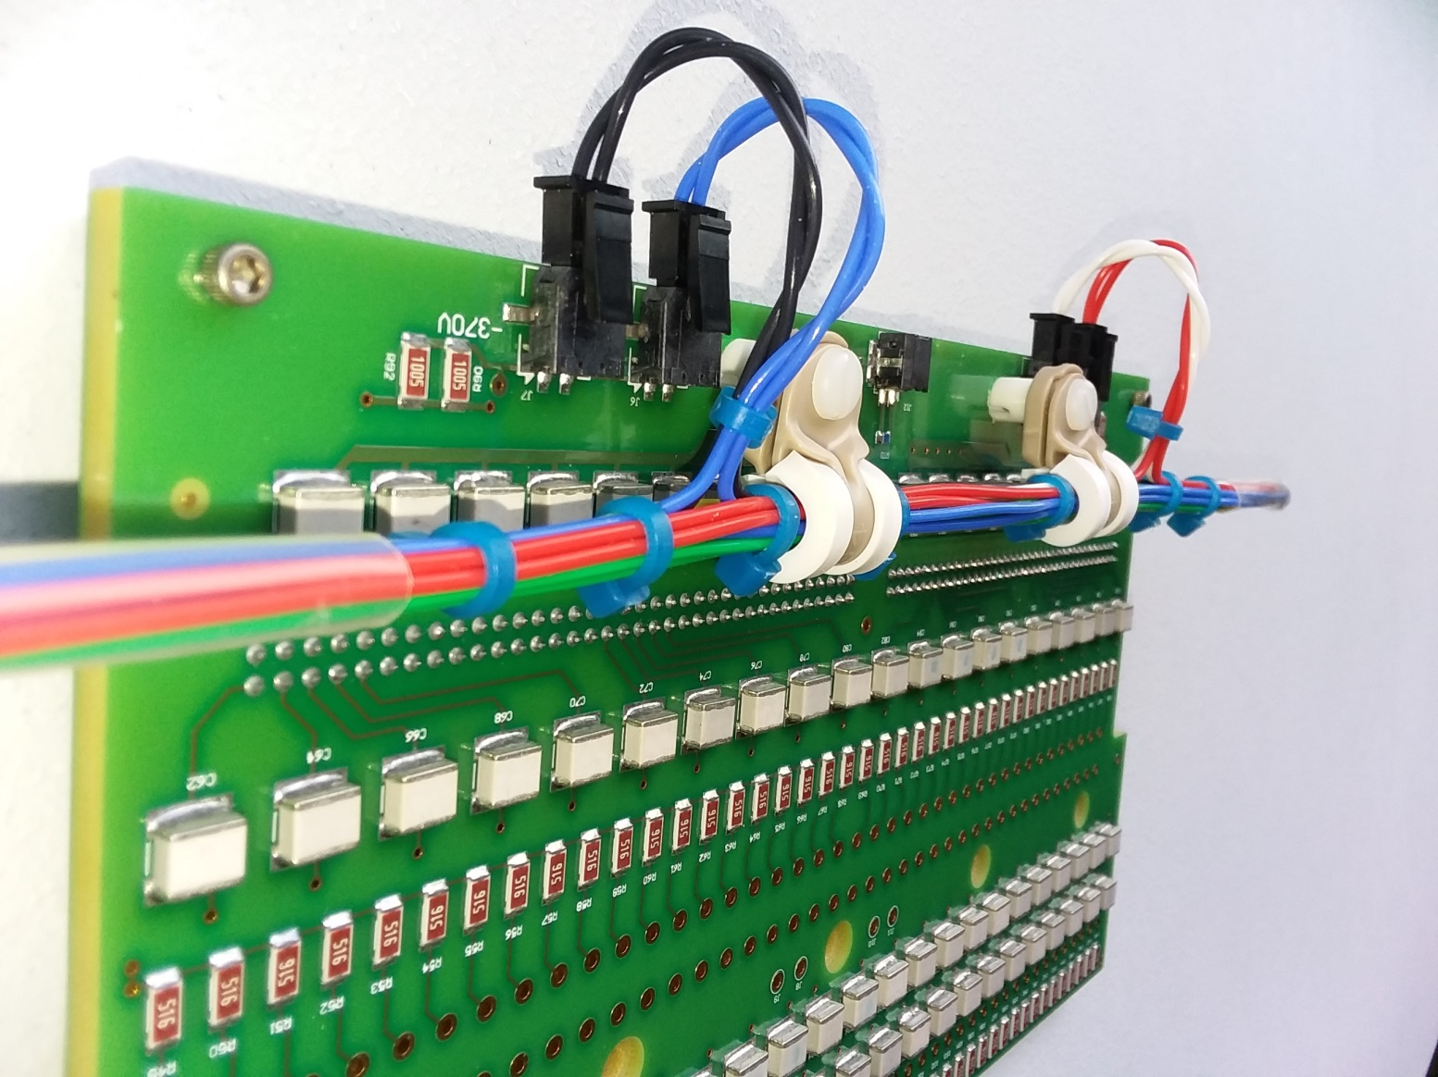
Wire assembly supports

Slide 45
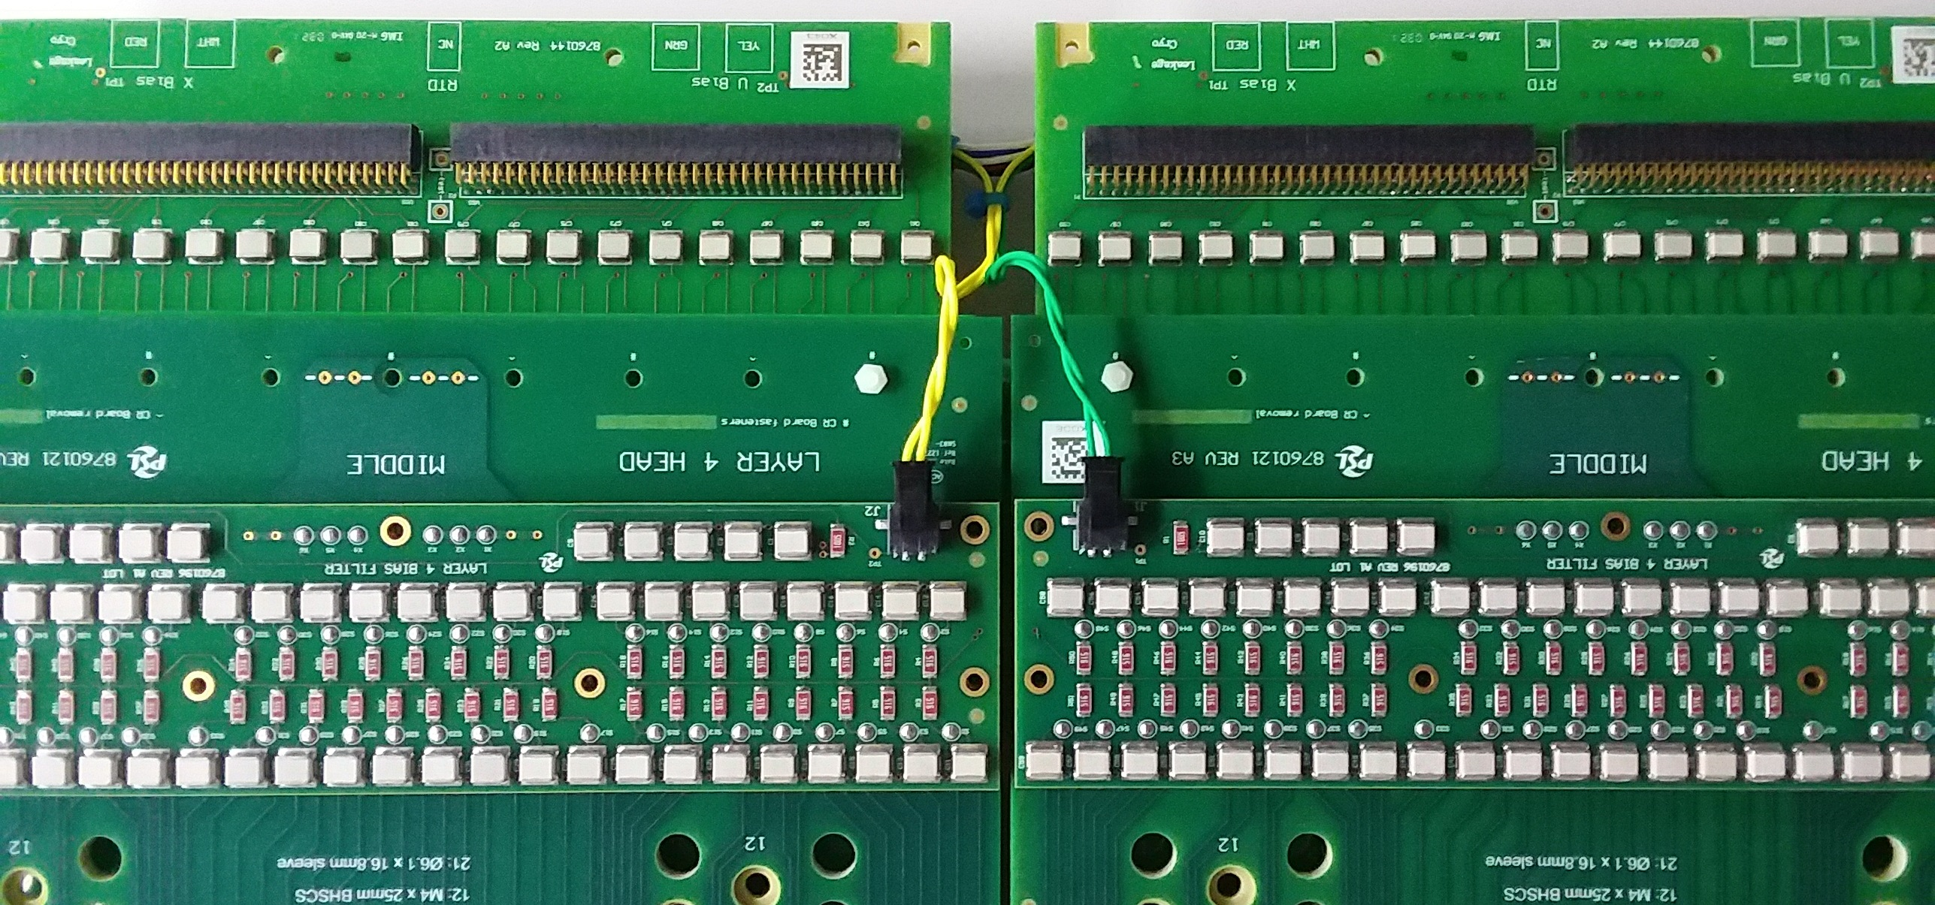
G bias pigtails are less likely to be pinched during CE installation

Slide 46
Wire Bundle Test Plans
Visual inspection
Pull tests of all connector wires
Electrical continuity
High-voltage leakage (Hi-Pot)

Slide 47
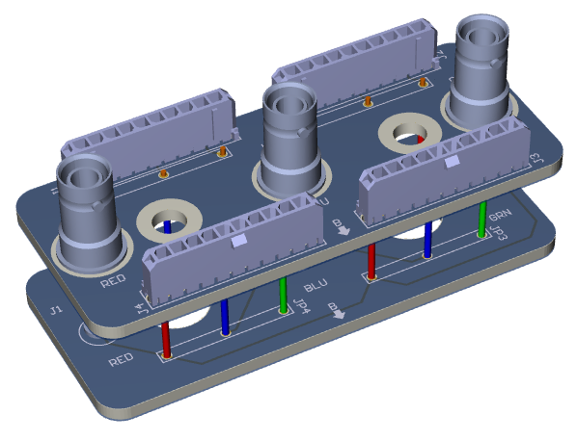
SHV Assembly

Slide 48
SHV Assembly
Terminates X, U and G bias cables
Two boards are stacked
The top board holds SHV receptacles and is supported by two stainless steel standoffs attached to the head tube
The bottom board distributes voltages and is supported by the SHV receptacle center pins
Cable shields are isolated and ungrounded
Each wire bundle has two connectors that plug into the top SHV board
Connectors and wires are the same types used elsewhere in the bias distribution system

Slide 49
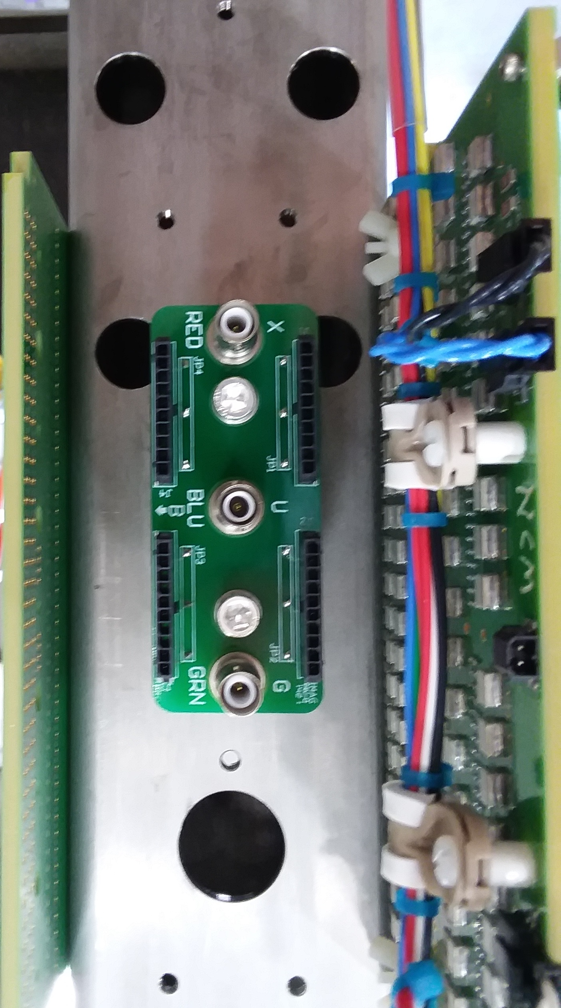
SHV Assembly

Slide 50
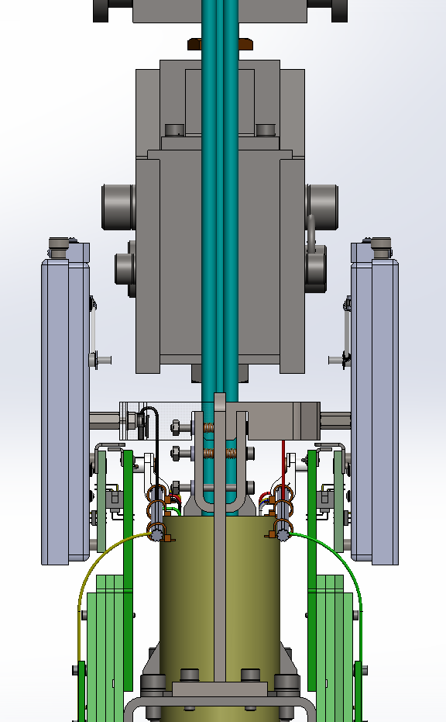
Side View, 8760075
CE Cable Bundle Grip Support Hidden
Half of CE brackets (8760085) transparent

Slide 51
APA Wire Tests
Electrical continuity through board stacks
Detect missing or damaged Mill-Max parts
Electrical continuity from Head to Foot
Detect opens caused by broken PCB traces
Electrical isolation of wires
Detect shorts to frame or to adjacent wires
Wire tension, etc. using DWA
51

Slide 52
APA Wire Tests, sans DWA
Probe cards similar to those developed for the DWA can be used to more efficiently apply signals to wires at the head end (replacing hand-held probes)
Groups of wires can be tested simultaneously to speed up testing
Failures at the group level can be further tested and analyzed to isolate problems to individual wires (failures are rare)

Slide 53
Backup Slides

Slide 54
→

