Slide 1
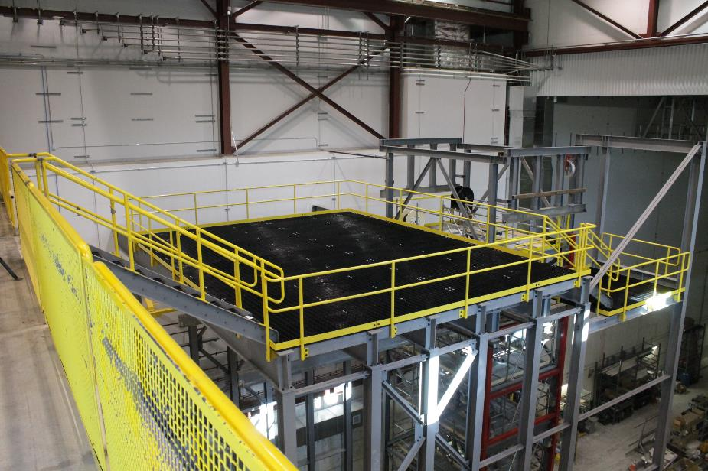
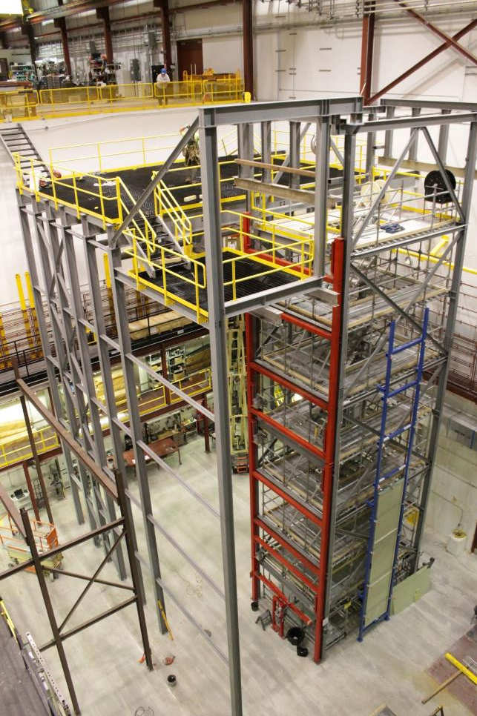
APA Installation Procedures
September 1, 2021
Tom Wieber
University of Minnesota
APA assembly tower and phase 2 DSS support structure @ Ash River

Slide 2
Outline
ProtoDUNE II Installation plan
  Upper APA extraction → Cleanroom
  Lower APA extraction → Cleanroom
  Cleanroom → Cryostat
  Changes from ProtoDUNE
APAs at SURF
  Getting underground
  Assembling the doublet
  Transfer to the cryostat
Focus of this presentation pertains to charge #4:
  If the design of the APA shipping frame and plans for installation of the APAs in both ProtoDUNE-II and the DUNE Far Detector are mature enough to provide assurance that APAs, as currently designed, can be safely transported and installed within the detectors.

Slide 3
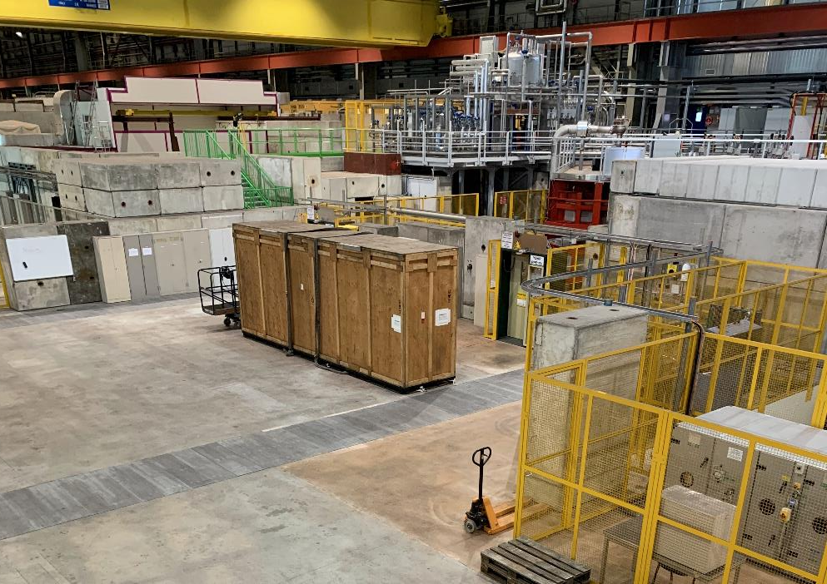
ProtoDUNE II Upper APA
Ships in the ProtoDUNE style shipping box
Involves several people and groups
  Team to open up box
  Overhead lifting crew for heavy items
  Special truck crane for crate extraction
~1 day to open box and attach lifting gear
~1/2 day to hang on cleanroom rails
  NB – Assumes all HSE documents are complete and signed off on
This process has been done 7 times

Slide 4
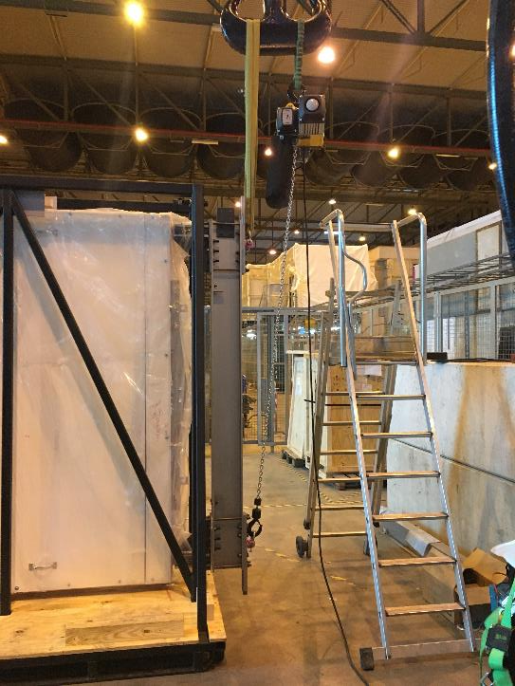
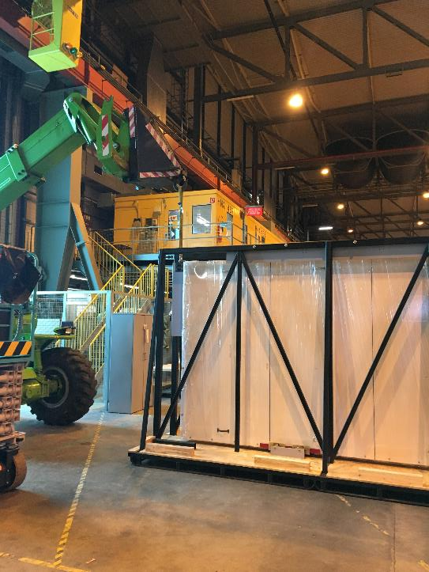
Upper APA → Cleanroom 1
APA lifting fixture – tool manual link
  Tool for lifting a horizonal APA out of a shipping crate and rotating vertical
  EDMS PPSPS APA Insertion into clean room
Use crane to connect lifting fixture to APA
Mobile crane connects to foot tube lifting fixture
Remote controlled hoist
Solid connections
Slight modifications for pDUNEII
- Longer bars
- Additional mass added to APA test load
In progress and well understood
The trolley should also be installed on the APA at this point

Slide 5
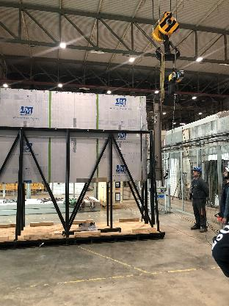
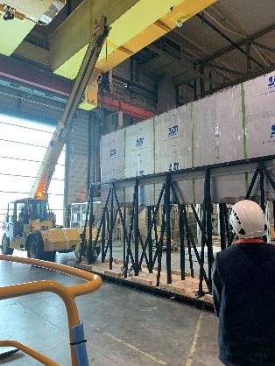
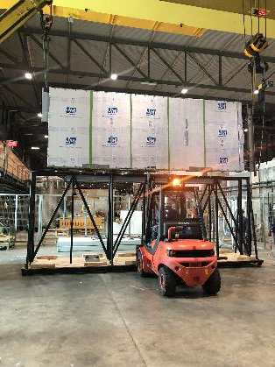
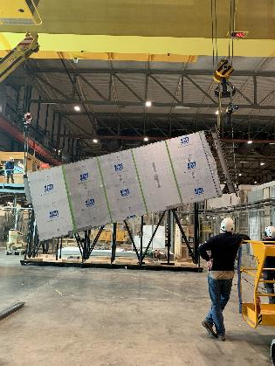
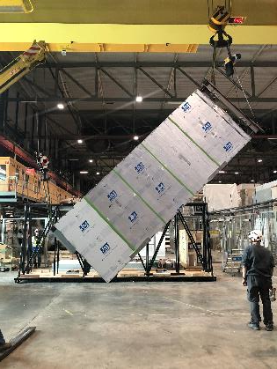
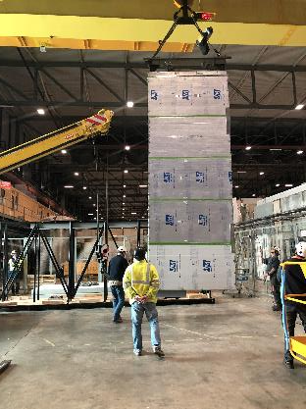
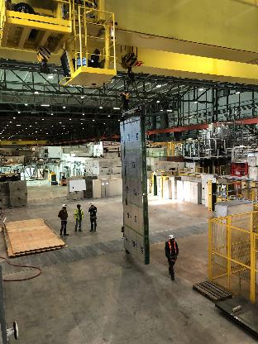
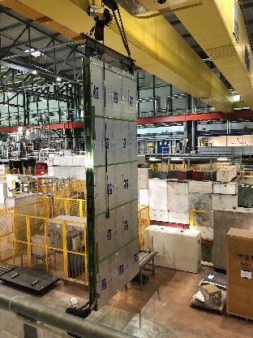
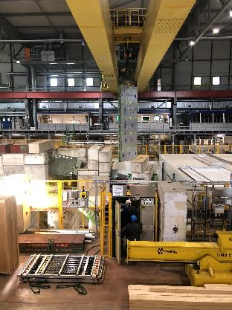
Upper APA → Cleanroom 2
Bottom lifting fixture is removed once the APA is vertical

Slide 6
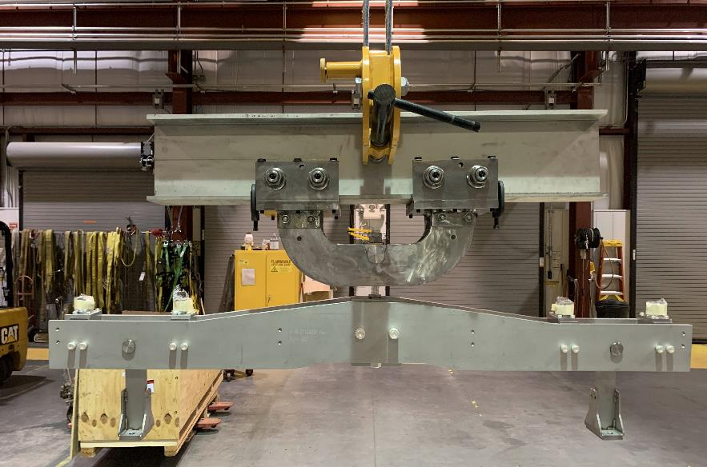
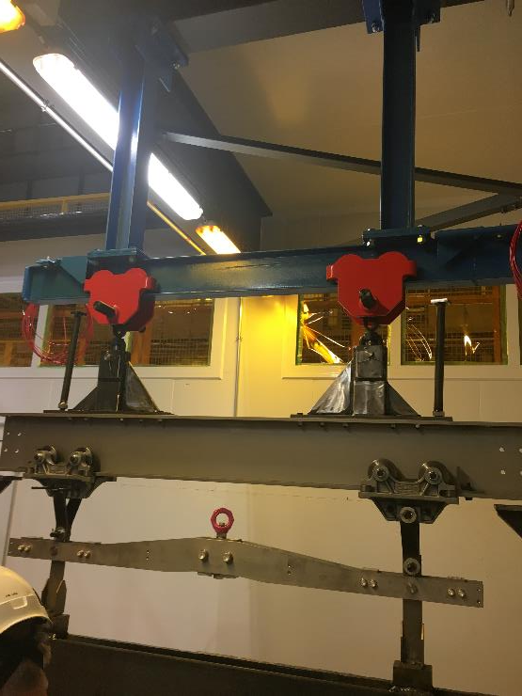
Upper APA Trolley Difference
ProtoDUNE II trolley
ProtoDUNE trolley
Lesson learned: All pins were not loaded, redesigned

Slide 7
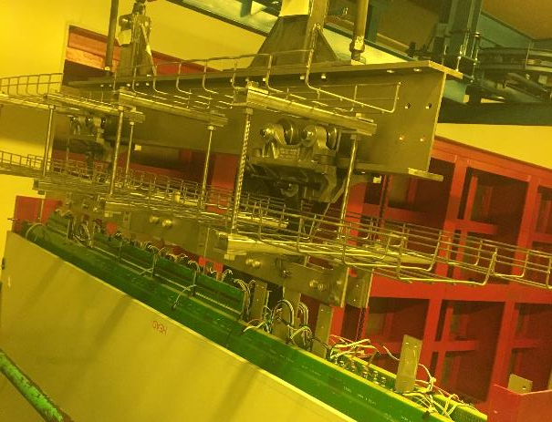
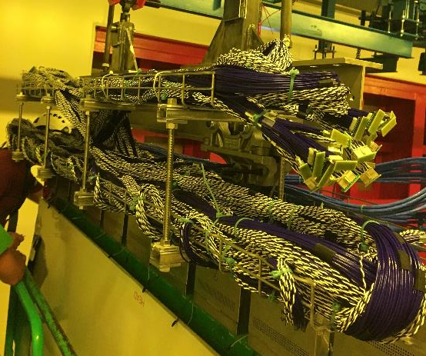
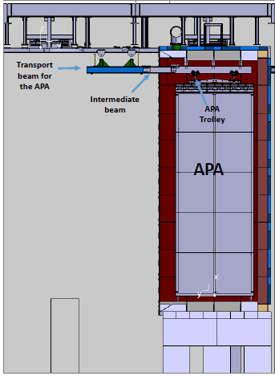
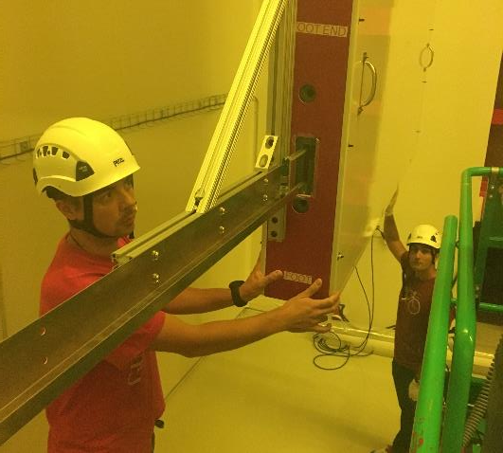
Cleanroom activities
Survey – 1-2 days
  Includes protection removal and installation
Install cable tray – 1 day (if not assembled)
Install/test CE boxes and cabling – 1 week
Photon detectors – 3 days
Coldbox testing – varies
Replace any CE – varies
Roll into cryostat
  Cryostat beams on trolleys
  Align DSS beam with TCO opening
  Travel to DSS via intermediate beam connection
Total cleanroom time ~11 days

Slide 8
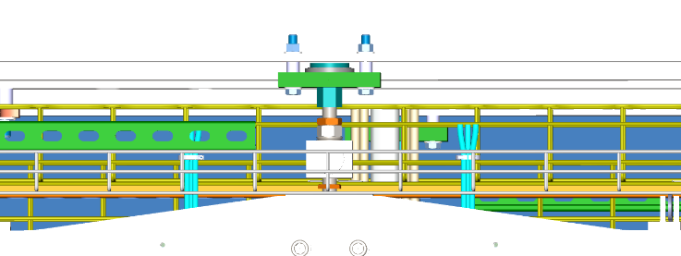
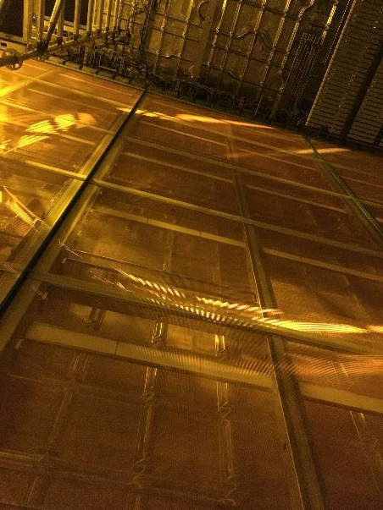
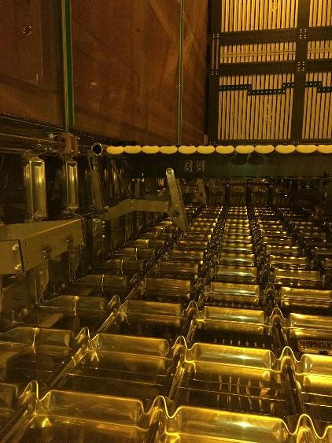
ProtoDUNE II Cryostat Activities
APA → DSS connection
First APA idles on the DSS until second APA rolls onto DSS beam
DSS beam is rolled into position
DSS beam is bolted into position
  Remove DSS beam trolleys
APA is positioned and bolted to DSS
  Remove APA trolley
Install APA → penetration cable trays
Route APA cables to feedthrough
  Connect and test connections
Install top/bottom field cage latches
Deploy field cages
Make final connections endwall/APA & field cage/APA
Bottom field cage supports
APA → feedthrough cable trays
Significant activities

Slide 9
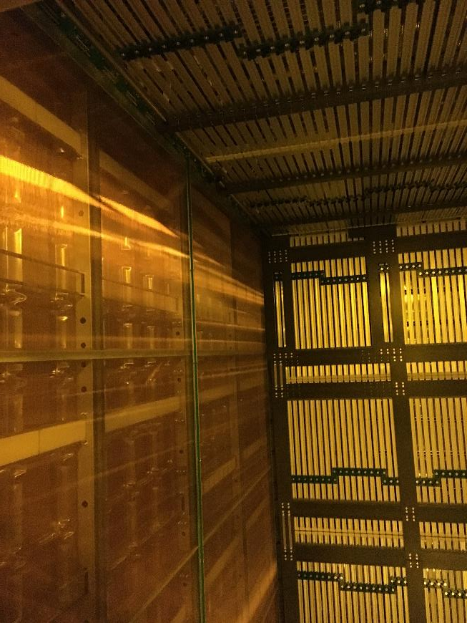
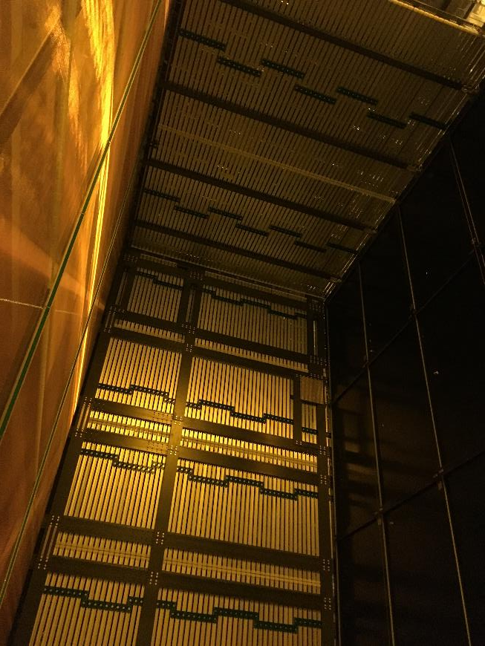
Upper APA complete

Slide 10
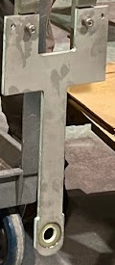
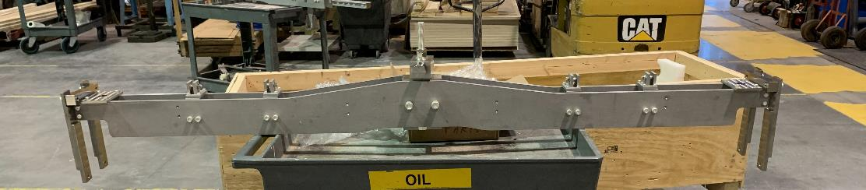
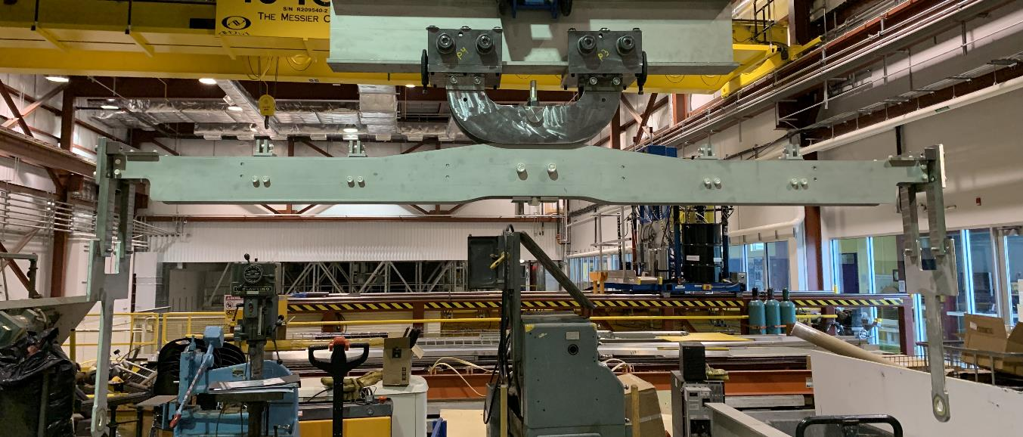
ProtoDUNE II Lower APA
Yoke differs from upper
  Carries APA via “wishbone link” (top left) vs structural tees
  Yoke has multiple elevation configurations by using the APA lowering system
Yoke connected to APA
  “Highest” position for cold box clearance
Crane raises to neutralize the load
Disconnect from box
Roll box away
Deliver to cleanroom

Slide 11
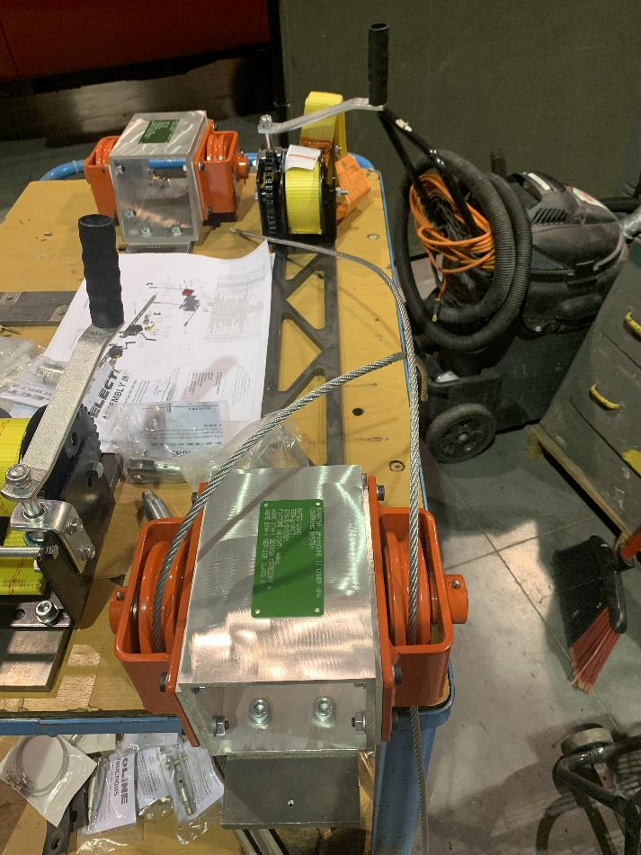
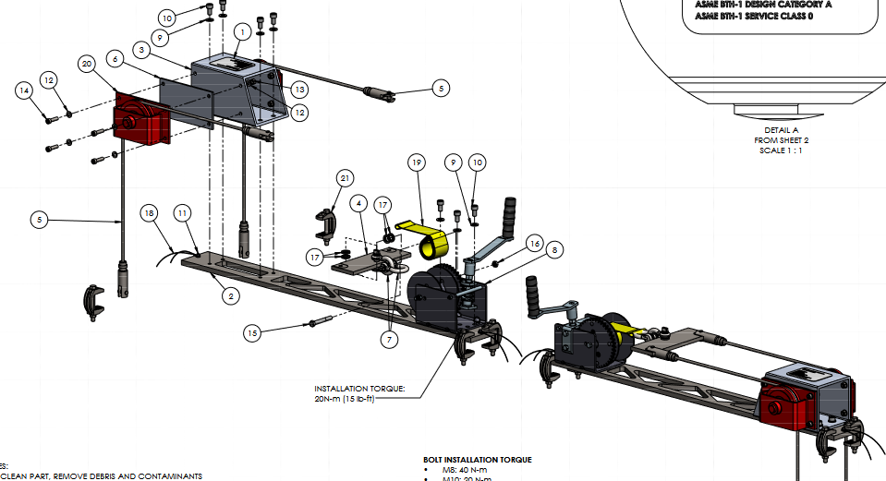
ProtoDUNE II Lower APA Lowering System
Fabrication in progress at Ash River
Testing soon
APA stays in highest position until inside cryostat and floor is removed

Slide 12
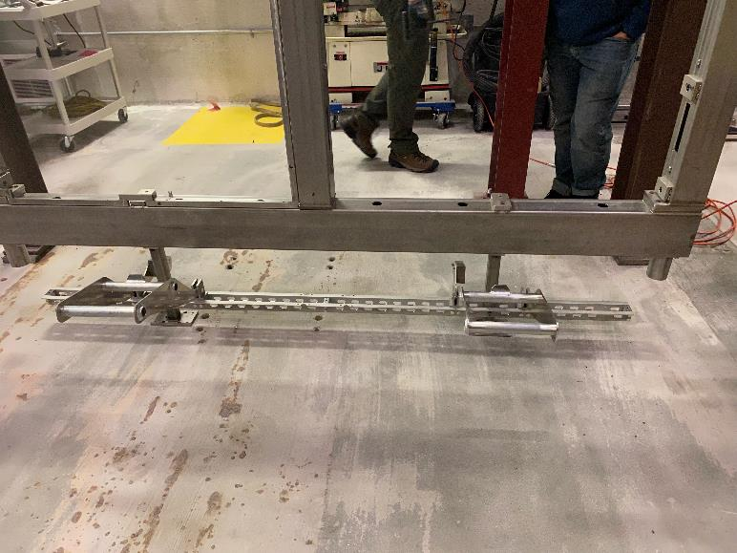
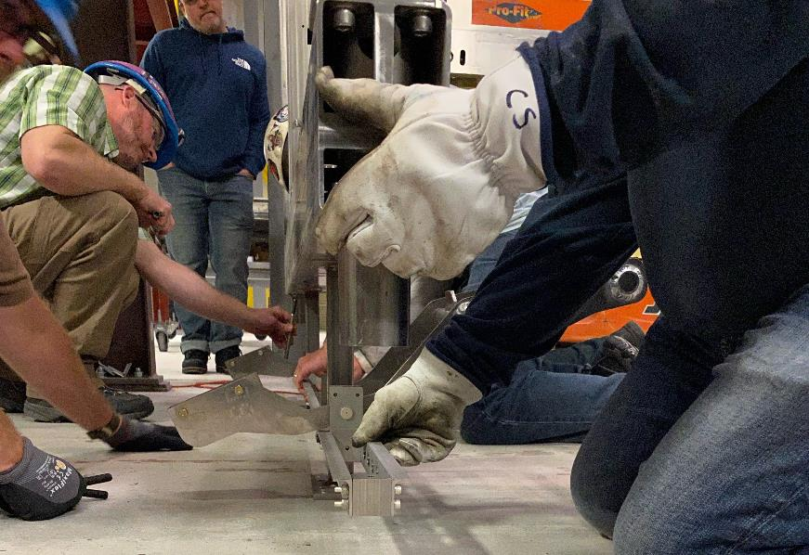
ProtoDUNE II Lower APA Cleanroom
Survey – 1-2 days
  Includes protection removal and installation
Install cable tray – 1 day (if not assembled)
Install/test CE boxes and cabling – 7 days
  Cables fed through conduit tube to foot end
Photon detectors – 3 days
Coldbox testing – varies
Replace any CE – varies
Roll into cryostat
  Cryostat beams on trolleys
  Align DSS beam with TCO opening
  Travel to DSS via intermediate beam connection
Total cleanroom time ~13 days (vs 11)

Slide 13
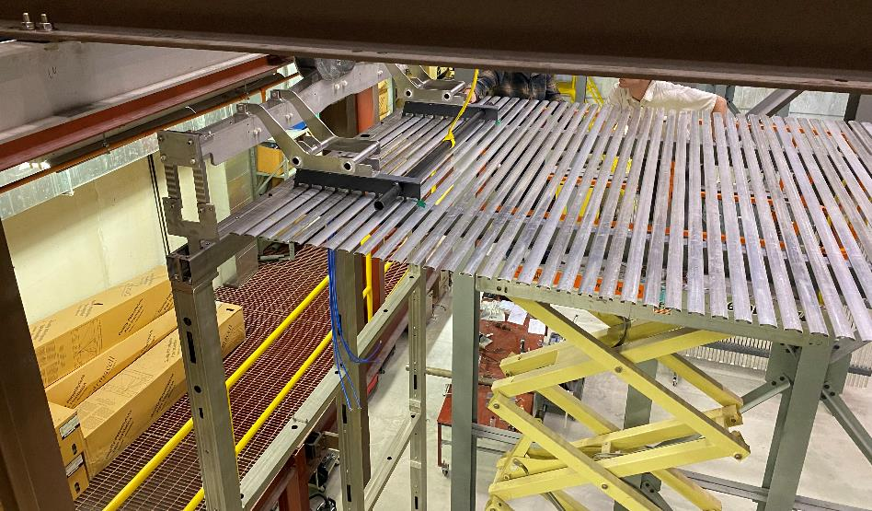
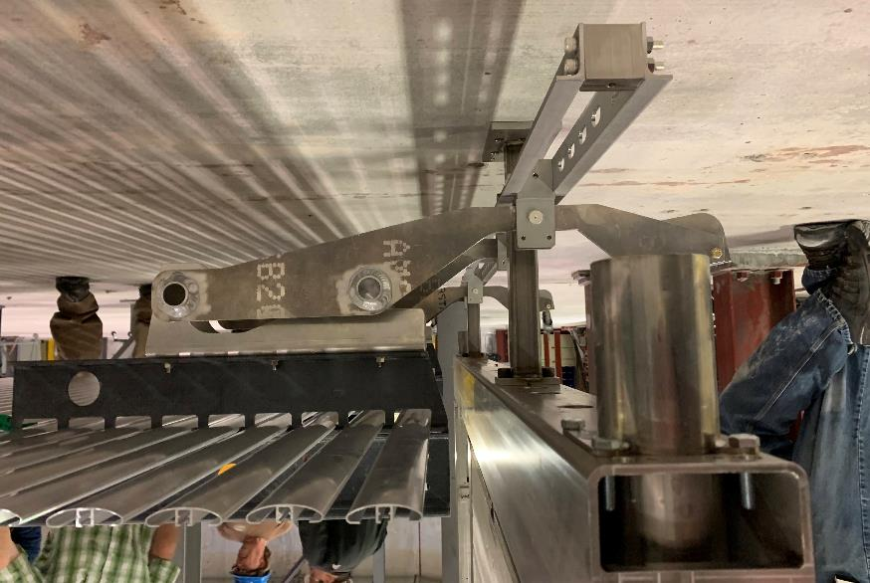
ProtoDUNE II Lower APA Cryostat Activities
First APA idles on the DSS until second APA rolls onto DSS beam
DSS beam is rolled towards its position
  Stop one floor width away from cryostat wall
Remove floor underneath APAs, preserving floor near cryostat wall
Lower APA is lowered using the lowering system
APA is positioned and bolted to DSS
  Remove APA trolley
Remove floor along cryostat wall
Roll DSS beam to final position
Replace floor section away from cryostat wall
DSS beam is bolted into position
  Remove DSS beam trolleys
Install APA → penetration cable trays
Route APA cables to feedthrough
  Connect and test connections
Install top/bottom field cage latches
Deploy field cages
Make final connections endwall/APA & field cage/APA
Differences vs upper APA
well understood

Slide 14
DUNE APAs @ SURF
Installation-Integration path from the factory to its final position inside the cryostat
Relevant APA life cycle steps
APA factory
ITF
Ross shaft
Underground

Slide 15
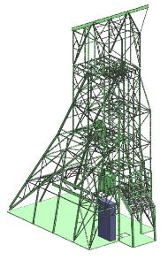

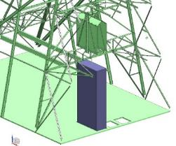
Ross Shaft
APA frame hung below the cage/ 90 degrees rotation
Transport box arrives at the surface
Slung load under the cage
Arrives down below and is placed on horizontal cart for travel to the cavern
Makes 180-degree rotation in this process
APA frame underground moved out of the cage on a cart/ -90 degrees rotation
APA frame
APA frame
APA frame
APA frame

Slide 16
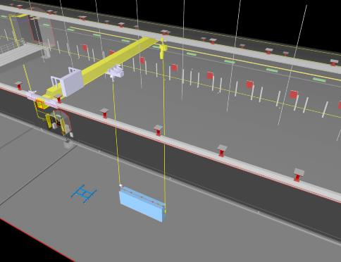
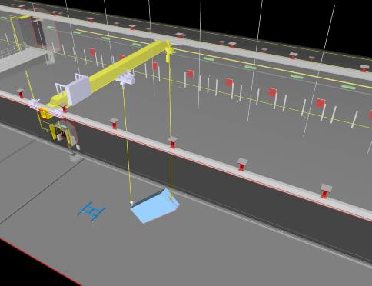
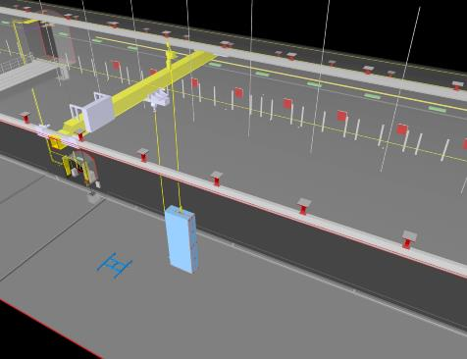

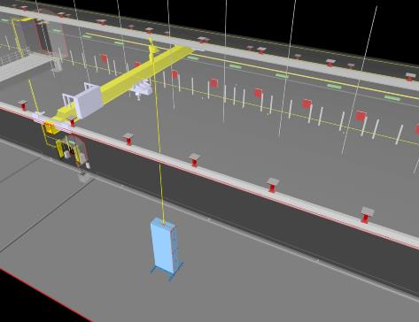
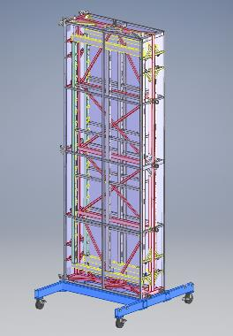
DUNE APAs → Cavern
Process from this point well understood
  Details in SP Detector #1 Installation Plan
Box arrives at the West entrance of the north cavern at the 4850 level
Using the crane and monorail, the box is rotated and lowered to the 4910 level
Placed on vertical transport cart

Slide 17
DUNE Cleanroom
Cleanroom
PD Area
SAS
Assembly towers

Slide 18
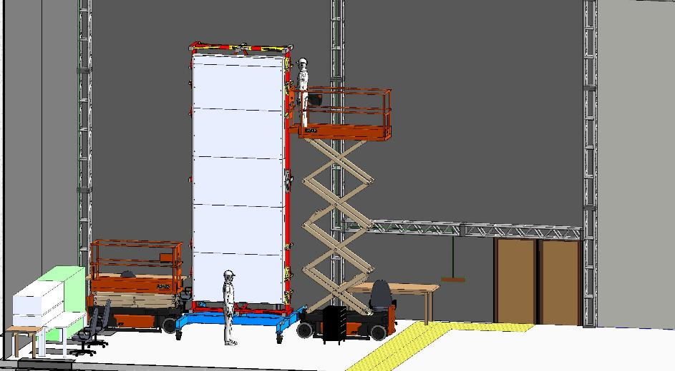
DUNE APA PD
Use the tugger to position in the PD installation area
Scissor lifts on either side are used to access the PD slots
Top access to the PD connectors for testing
Also installed:
  T-brackets
  C-brackets
  cable harness for wire bias on the APA

Slide 19
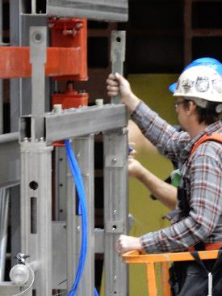
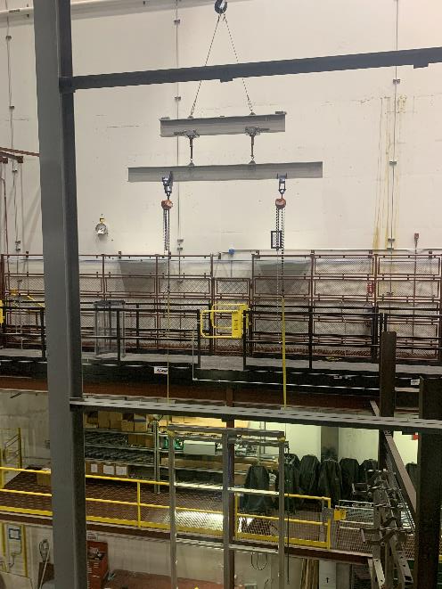
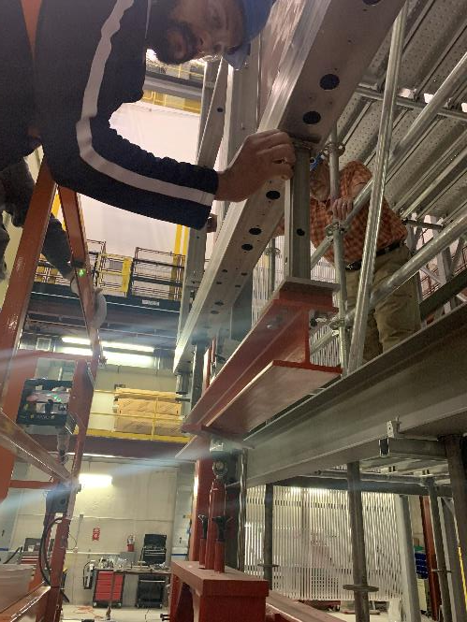
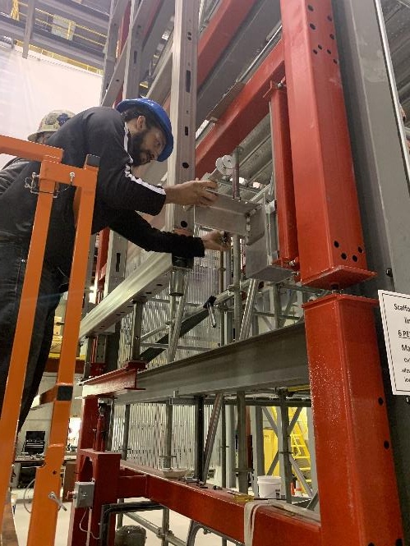
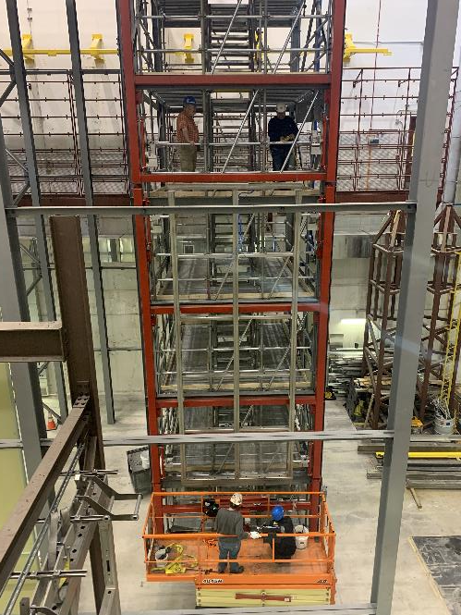
DUNE APA Assembly Area 1
The APA connecting links should be installed after the APA is pinned to frame
Vertical cart positioned near assembly tower
Picked up by crane and cart moved out of the way
The lower APA is translated over to the assembly frame
Bottom standoffs are installed and actuator raised and takes the APA load
Stabilizer pins are engaged
Concept is well understood at Ash River

Slide 20
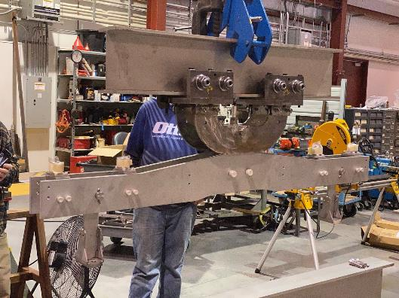
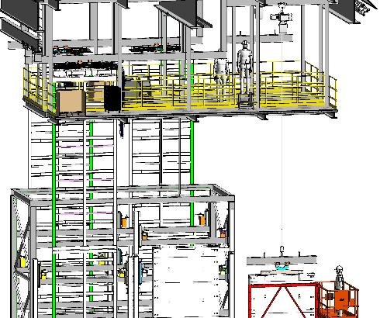
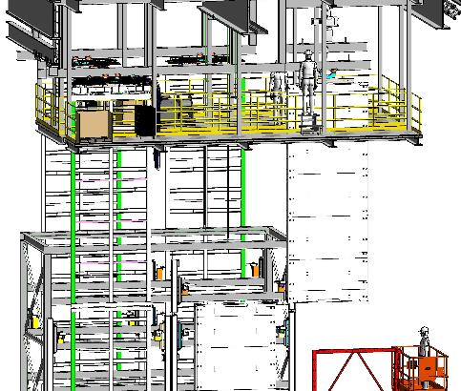

DUNE APA Assembly Area 2
Upper APA yoke is centered over vertical cart on the lifting beam
Yoke and trolley are connected to APA
Beam is lifted up and connected (bolts removed similar to lower APA when load cell indicates)
APA is translated and pinned to assembly frame
Procedure is well understood at Ash River

Slide 21



DUNE APA Assembly Area 3
Making a doublet
  EDMS link to procedure @ Ash River
Actuator raises lower APA
Partial lift → Hold to connect and test PD cables
Continue raising until bolts can be connected
Actuator beam is disconnected (stand offs remain on APA)
Several brief electrical checks
Reinstall stabilizer pins or translate to next station
Procedure is well understood at Ash River

Slide 22




DUNE APA Assembly Outfitting 1
Wire tensions are tested at this point
CR boards installed
SHV board
FC termination board
APA cable harness are mounted
FEMBs can be installed
Cable trays installed
Cable spools are raised and fed into the conduit tube
a
Cable spooling has been tested at at Ash River

Slide 23




DUNE APA Coldbox
Protective panels removed
Survey is completed
APA is transferred to the telescoping beam
Translated over to a cold box
Inserted into coldbox
Wires routed
After testing
  Back to assembly tower for repairs
  Enters cryostat via TCO beam

Slide 24





DUNE APA Inside Cryostat
Procedure for motions starting on the TCO beam and delivery to final DSS position detailed in DSS Load Test Procedure at Ash River
TCO beams
Shuttle and DSS beams

Slide 25


DUNE APA Cryostat Position
APA is bolted to DSS at final position
Trolley is carefully dismantled and removed
Final cabling to the CE crosses
Remove vertical cable tray (only needed during transport)
Ground planes installed
Field cages deployed
APA installation is completed

Slide 26
Backup

Slide 27




ProtoDUNE II Upper APA
Begin removing bolts to free the top
  Various techniques used
Use crane or forklift to remove the top
Remove the top bracing
Remove wall pieces
  Various methods used

Slide 28
ProtoDUNE II Upper APA Lifting Fixture
APA lifting fixture – tool manual link
  Tool for lifting a horizonal APA out of a shipping crate and rotating vertical
  EDMS PPSPS APA Insertion into clean room
Lifting fixture attaches directly to cleanroom rails where the APA is transferred to the transport beam inside the cleanroom
Bottom lifting fixture
Top lifting fixture

Slide 29


ProtoDUNE II APA Lifting Fixture
All yokes were load tested prior to use with the APA dummy test load
Slight modifications for pDUNEII
  Longer bars
  Additional mass added to APA dummy
In progress and well understood

Slide 30


Upper APA → Cleanroom 1
Long bars
Long bars are slid into the APA
  Bars are connected to APA with 20mm bolt
  Top bar is levelled and held with a bolt
  Gravity pulls the bottom bar down until the lifting fixture sets the proper distance
Yoke is installed on the APA
Bottom fixture attaches to third long bar
Yoke
Bottom lifting fixture

Slide 31



Upper APA → Cleanroom 3
Unbolt the suspension system when cranes take the load
  Several minor adjustments needed to remove bolts
Forklift carries suspension out
Suspension system holds APA during transit
Both cranes begin lifting slowly to neutralize suspension

Slide 32




Upper APA → Cleanroom 5
Transport beam is moved to the SAS opening
Lifting fixture connected to transport beam with bolts
Use the crane to ensure level
Begin slowly lowering the APA from the lifting fixture to the trolley by loosening the bolts evenly on each end
Once trolley has the complete APA load, remove the lifting fixture legs and plates
Remove the mechanical stops on fixture, roll onto transport beam, replace mechanical stops

Slide 33


ProtoDUNE II Lower APA
Lower APA must hang at two different elevations:
  Cold box position
  Final detector position
Adjustment made with the APA lowering system
  EDMS link

Slide 34



ProtoDUNE II Lower APA
Lower APA will arrive in DUNE style transport box
Transport box (left) is rotated vertical and placed on the cart (center)
Yoke is connected to lower APA
Lifting fixture positioned above APA
Trolley is installed
Crane takes the APA load
Box disconnected from APA
Box rolls out of the way
Carried to the cleanroom with lifting fixture and delivered like upper APA

Slide 35




DUNE APA → Cleanroom
The transport box covers are removed
Using a tugger, the cart is pulled into the SAS
The air in the SAS is purified every 15 minutes

Slide 36




DUNE APA Assembly Area 1
The cart is moved over to the assembly line using the tugger
The lower APA is delivered to the tower first
Lifting beam has two trolleys with long lifting straps connected to clevis on the APA side tubes
Load is transferred to the lifting beam
  Load cell indicates when bolts can be removed
Transport cart is tugged out of the way
Lifting beam raised and connected to rail
asdf

Slide 37







DUNE APA Assembly Outfitting 2
Some additional testing at Ash River needed to determine optimum timing
Cable tray can be installed before cables are routed through the tubes
  May have to attach vertical cable tray after cable is routed
Cable spools are craned up to top level
Transferred to deployment spools
Deployed
Routed to FEMBs
Cables dressed
  Affix the vertical cable tray at this point

