Slide 1
APA Frame Compliance Office Response to Analysis¶
Olga Beltramello, DUNE Compliance Office
LBNF/DUNE FDR: APA
31 August - 2 September 2021

Slide 2
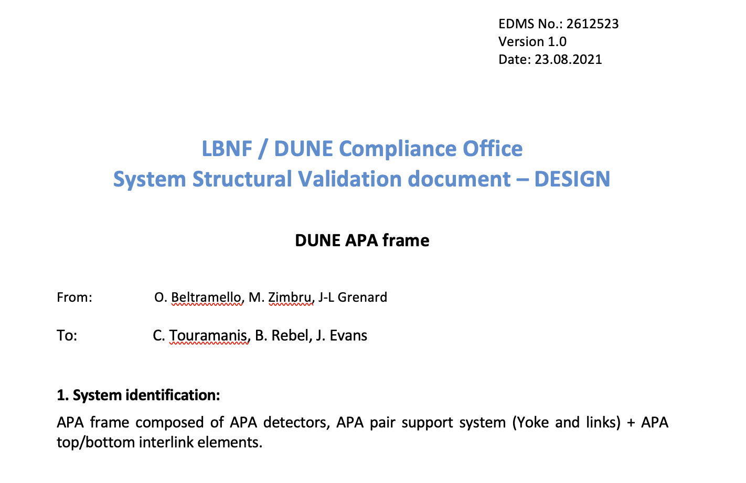
Compliance Office System structural validation document - Status

Slide 3
Compliance Office requirements and applicable documentation:
EDMS 2172998 - Validation of the DUNE/LBNF structures and mechanical components for equipment and detectors.
EDMS 2371281 - Compliance Office - APA detector memorandum
Applicable Standards and additional relevant applicable documentation:
Pre-Standard for Load & Resistance Factor Design (LRFD) of Pultruded Fiber Reinforced Polymer (FRP) - EDMS 2377862
ANSI/AISC 360-16 - EDMS 2380171
AISC Design Guide 27 - Structural Stainless Steel EDMS 2337460
AWS D1.6/D1.6M - Structural welding code Stainless steel
DOE 10 CFR851 - Work Safety and Health Program EDMS 2324090

Slide 4
System Operational requirements:
EDMS 2517892: APA frame and Yoke project requirements.
EDMS 2612582: APA dynamic loading extracted from CERN APA Shipping Frame model.
Provided documentation:
EDMS 2512420 v.2 – Analysis plan for the APA frame
EDMS 2100877 v3 – DUNE APA frame and Yoke engineering report
EDMS 2607623 - Integrity verification of the DUNE APA shipping frame (ASF)
EDMS 2617816 – RT 131 - AVRM DUNE APA Transport Frame - 2021 update

Slide 5
Current status of the CO assessment
Remaining Comments / Request | Immediate correction | Correction with deadline | Validated | Status
Update of the Analysis plan |  |  |  | Updated version received – under assessment
Structural analysis shall be performed and the structure compliance with the Standards shall be demonstrated before the final design review.
Static load cases |  |  |  | Incomplete
Dynamic load cases |  |  |  | Missing
Demonstration of the structure compliance with the Operational and Project Requirements for the APA frame |  |  |  | To be clarified
The FEA models associated to the analyses shall be delivered to the CO for additional checks and for the record. |  |  |  | Missing

Slide 6
Main conclusions at the time of the review (related to design)
The APA frame engineering note and appendixes received from the APA project team, the 23rd of August, is under detailed assessment.
Several sections are still missing, the main ones being:
- majority of the dynamic load cases
- complete assessment of the APA pair support system (Yokes, links,..)
- conclusions on the acceptability of the highest levels of deformations.
The compliance with the installation load cases has to be justified based on the detailed DUNE installation procedure.

Slide 7
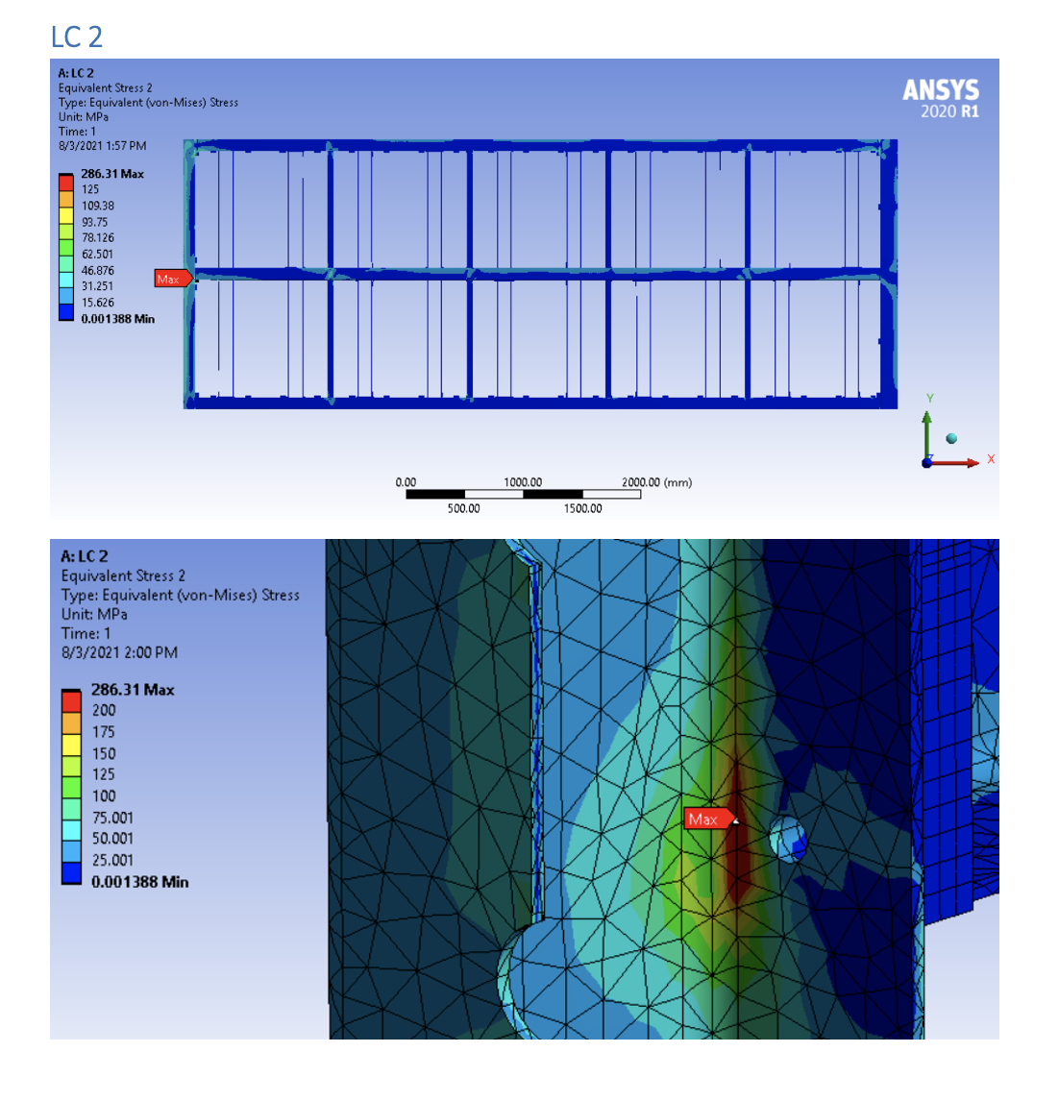
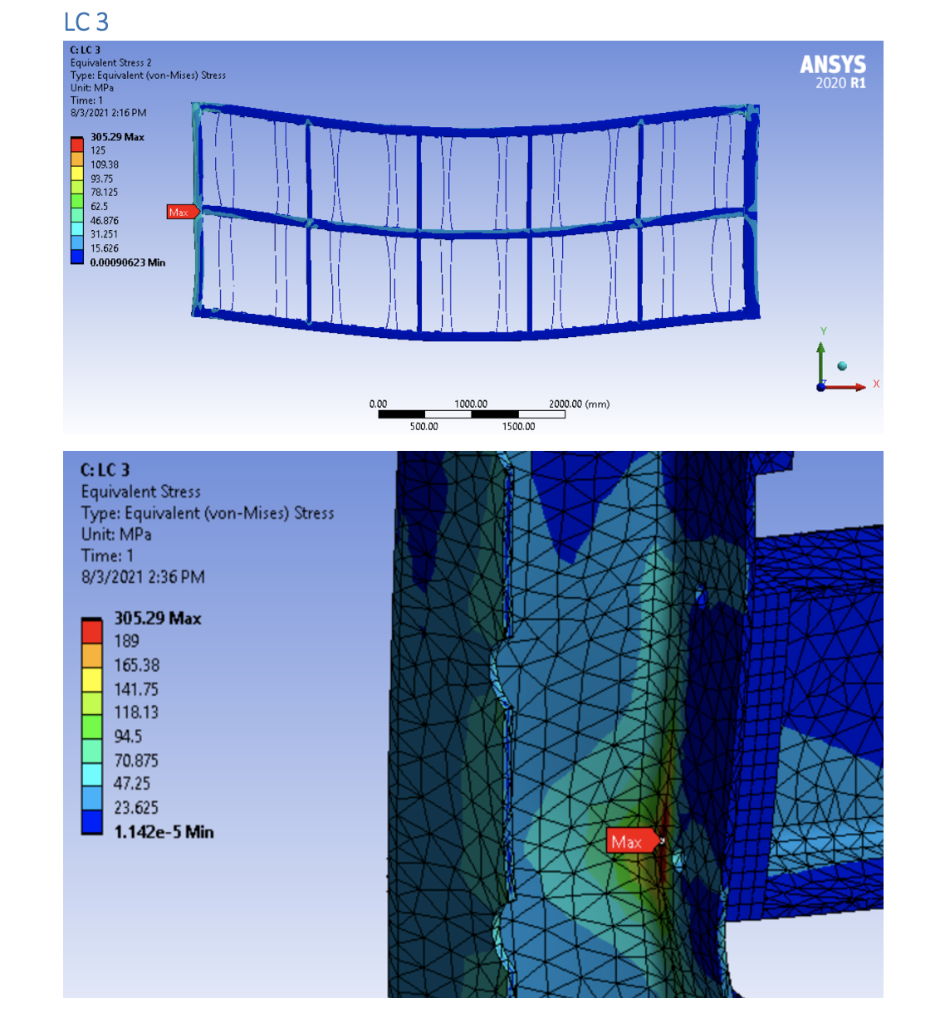
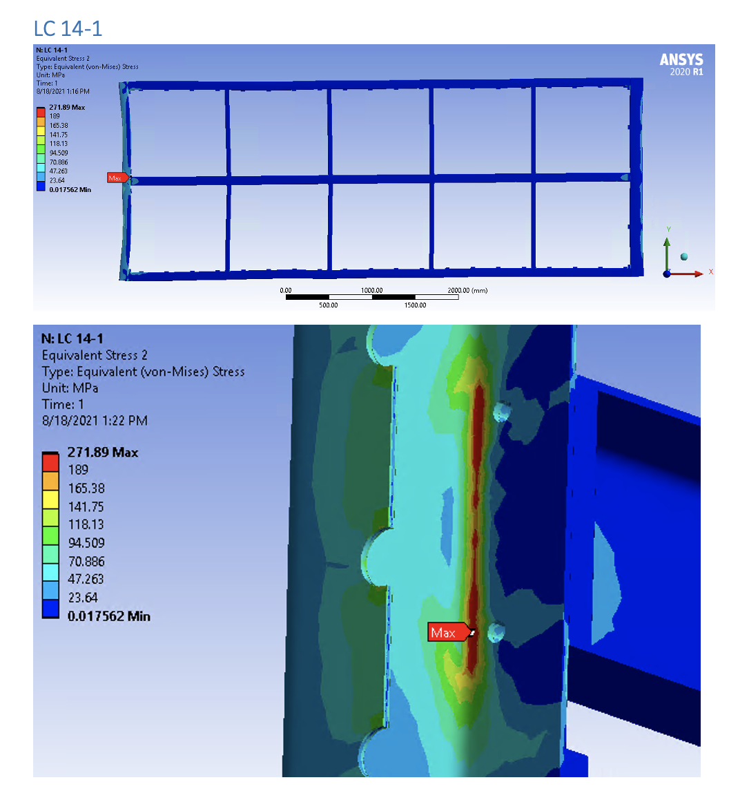
Main conclusions at the time of the review (related to design)
One method analysis proposed by the AISC360 standard (ASD or LRFD) must be selected and then applied consistently through the analysis.
High stresses concentrations are identified in a specific area of the APA frame for several static load cases. Additional investigations are required and waiting dynamic loads results.
Envelopes should be checked in all configurations (transport, installation, operation)
APA supported on the winding machine
Thermal load case – 50 % extra wire pre-load (cool down)

Slide 8
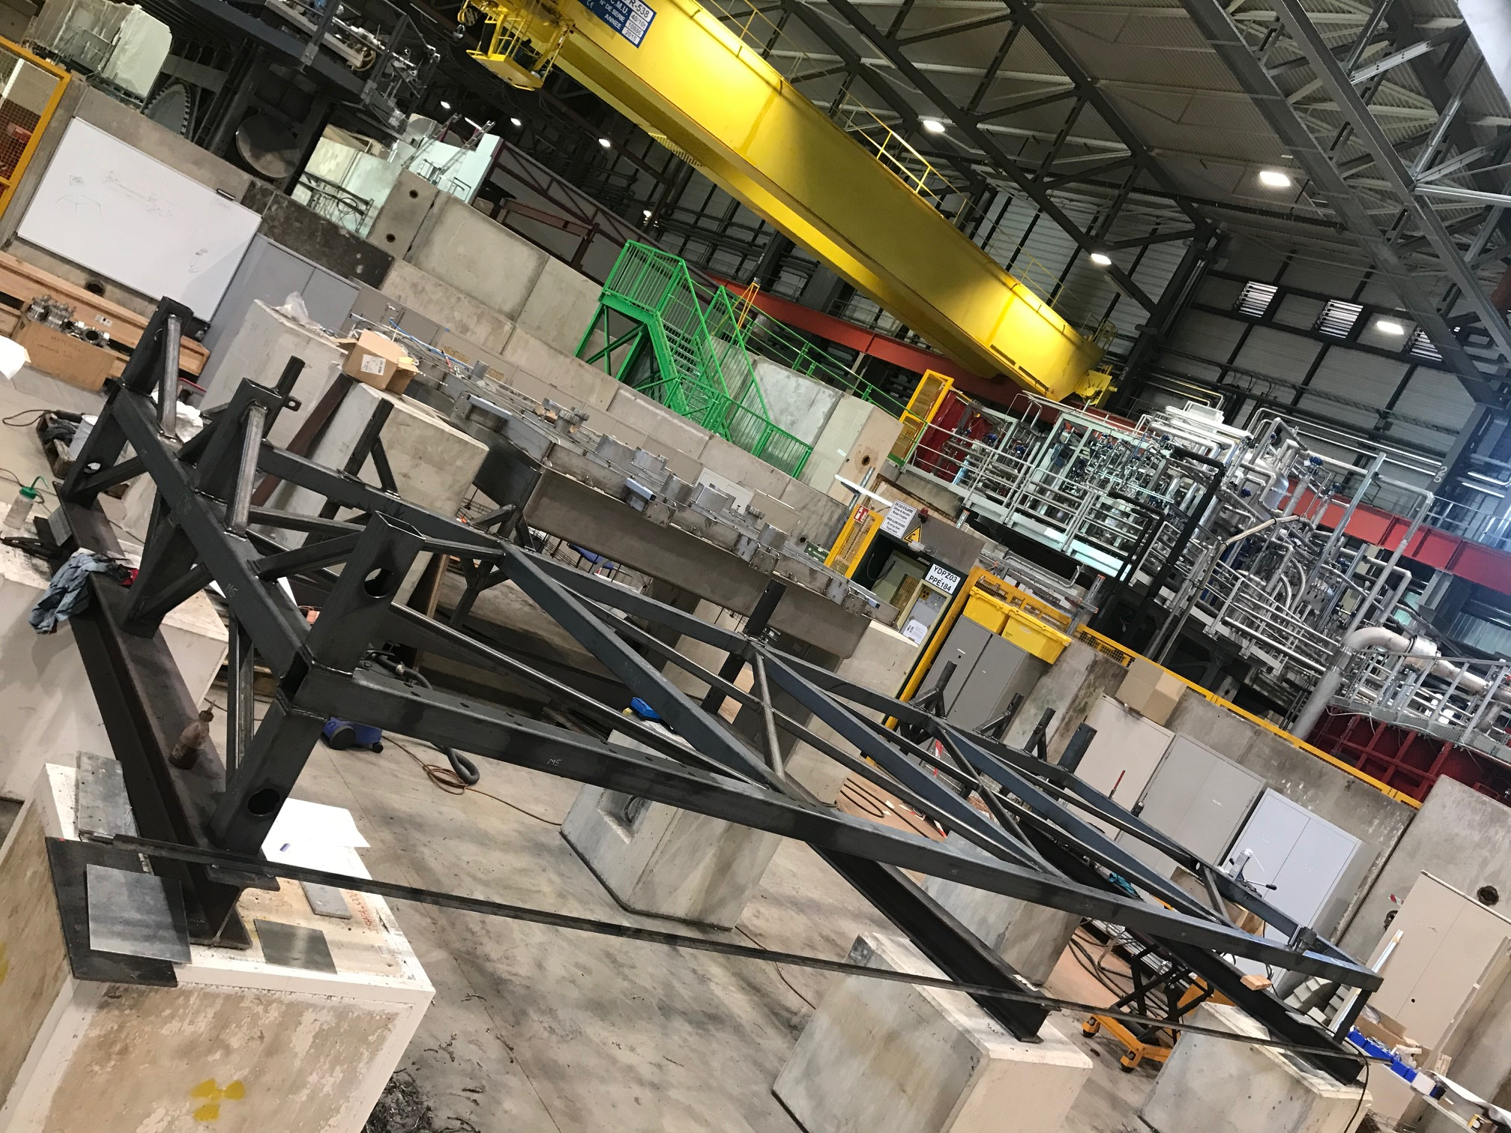
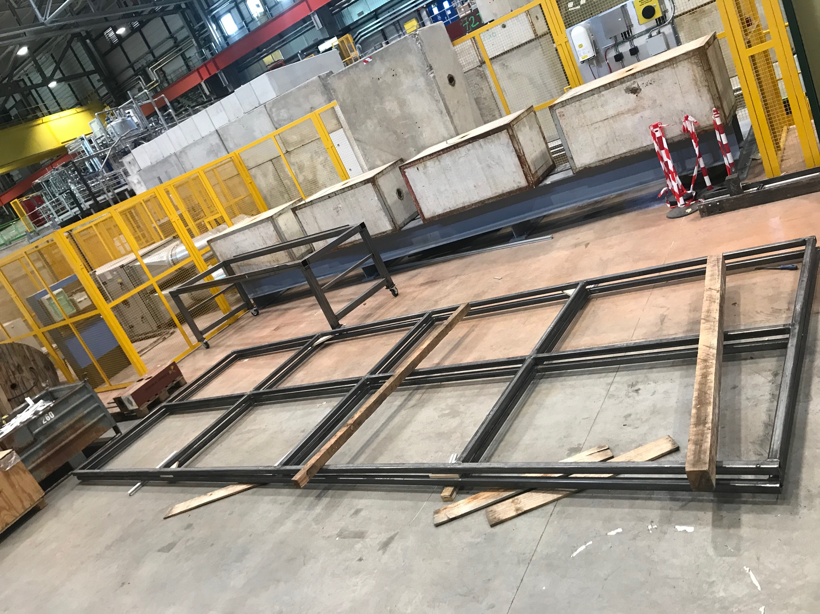
Preliminary CO conclusions at the time of the review (related to QC and Testing)
- A list of QC checks at all stages of fabrication and installation to demonstrate compliance with the US/EU standards to be agreed with the QA/QC responsible
A common APA frame / Shipping Frame testing plan (static and dynamic) to be defined (on going).
APA shipping frame is currently under construction at CERN (in paralel to the procurement process in the UK), for integration with the ”old APA” and testing.

