Slide 1



Measurement of Spontaneous Undulator Radiation Statistics Generated by a Single Electron (URSSE) Run 3 Proposal
Ihar Lobach (UChicago)
AST Department Meeting
I. Lobach, S. Nagaitsev, G. Stancari, A. Romanov, A. Valishev, J. Jarvis, V. Lebedev (Fermilab),
A. Halavanau, Z. Huang (SLAC)

Slide 2
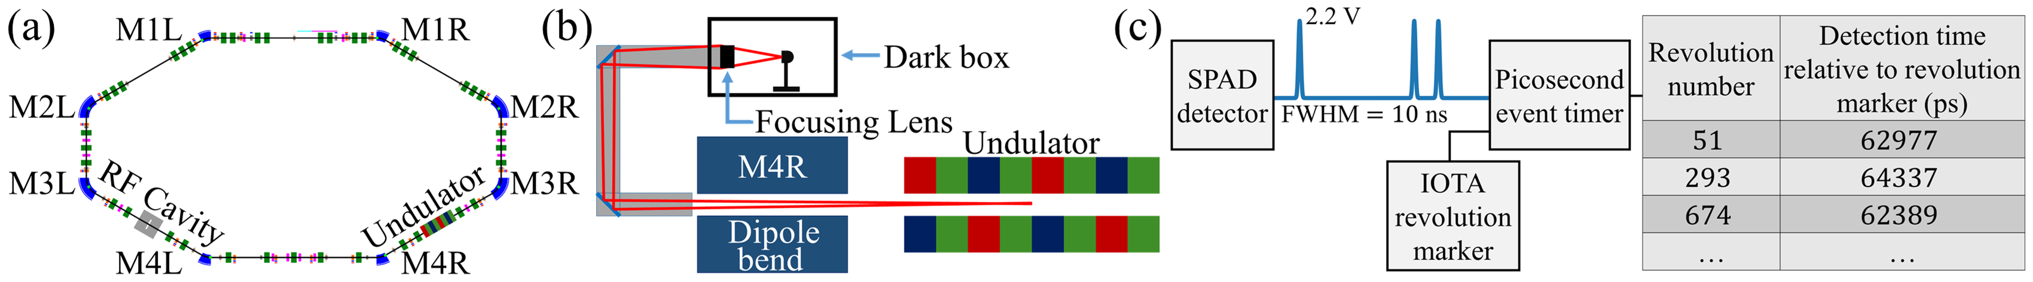

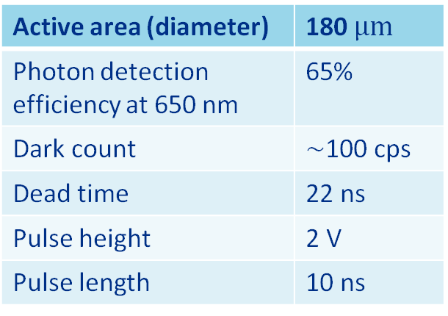
Recap of Run 2 experiment with one SPAD
On average one detection per 304 revolutions
Detector: Single Photon Avalanche Diode (SPAD)
Excelitas SPCM-AQRH-10
Active area (diameter) | 180 $μm$
Photon detection efficiency at 650 nm | 65%
Dark count | $∼$100 cps
Dead time | 22 ns
Pulse height | 2 V
Pulse length | 10 ns
*can be reduced by using a gate ($∼5 ns$)
*IOTA revolution: 133 ns

Slide 3
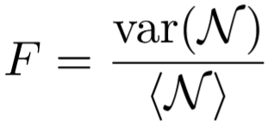
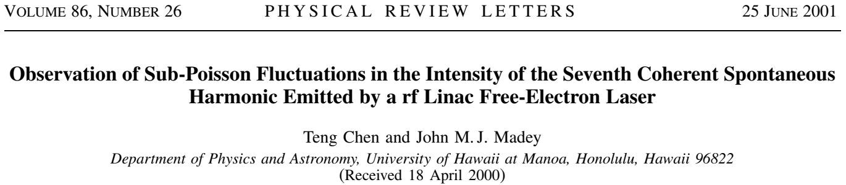

The goal of the experiment from Run 2 was to see if there are any anomalies in the photon statistics
Collected data:
000001000001100000000001000100000001110000000…
1 – IOTA revolution with a detection event, 0 - no detection.
On average one detection per 304 revolutions
Probability to detect a photon(s) in one revolution: $p=0.00330$
F=1 – Poissonian light (very common)
F>1 – Super-Poissonian light (very common)
F<1 – Sub-Poissonian light (unusual!)
Similar previous experiment, where the Sub-Poissonian photon statistics was reported:
Notes:
OK. We’re done with the photon rate. Now we can get back to the design of the photostatistics study. The data that we collect can be represent as a sequence of zeros and ones, where zero means that there was no photon detection in that IOTA revolution, whereas 1 means that there was a detection event. We want to determine if what we see obeys the classical prediction, i.e., Poisson statistics. The quantity that distinguishes different kinds of photon statistics is the Fano factor, which is defined as the ratio of variance and mean of the number of photons detected in a time window. The window can be one IOTA revolution or several. Click. For Poissonian light F=1, for F<1 and F>1 the light is called sub- and super-Poissonian. The latter is pretty common, for example we saw it in our previous experiment with many electrons. However, sub-Poissonian statistics implies some interesting quantum state of radiated field. And, surprisingly, such statistics was reported in this paper studying 7th harmonic of FEL radiation in a very similar measurements configuration to ours. It further motivated us to carry out our experiment in IOTA. ###You can see that the higher the efficiency of the detector, the more likely we are to see deviation from Poisson statistics. And in the limit of very low efficiency, any light will be seen as Poissonian. This is why we chose the detector with the highest efficiency on the market. The efficiency of our detector is much larger than what was used in this paper.

Slide 4
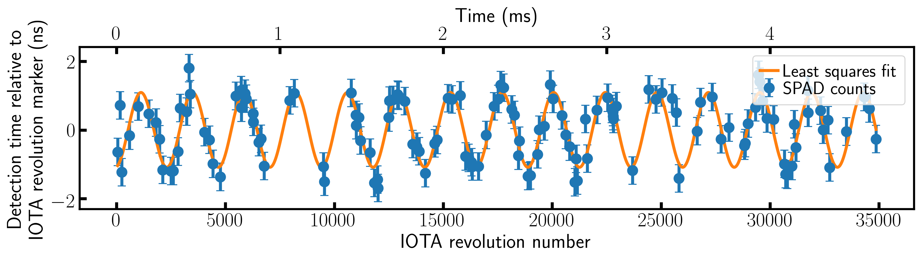
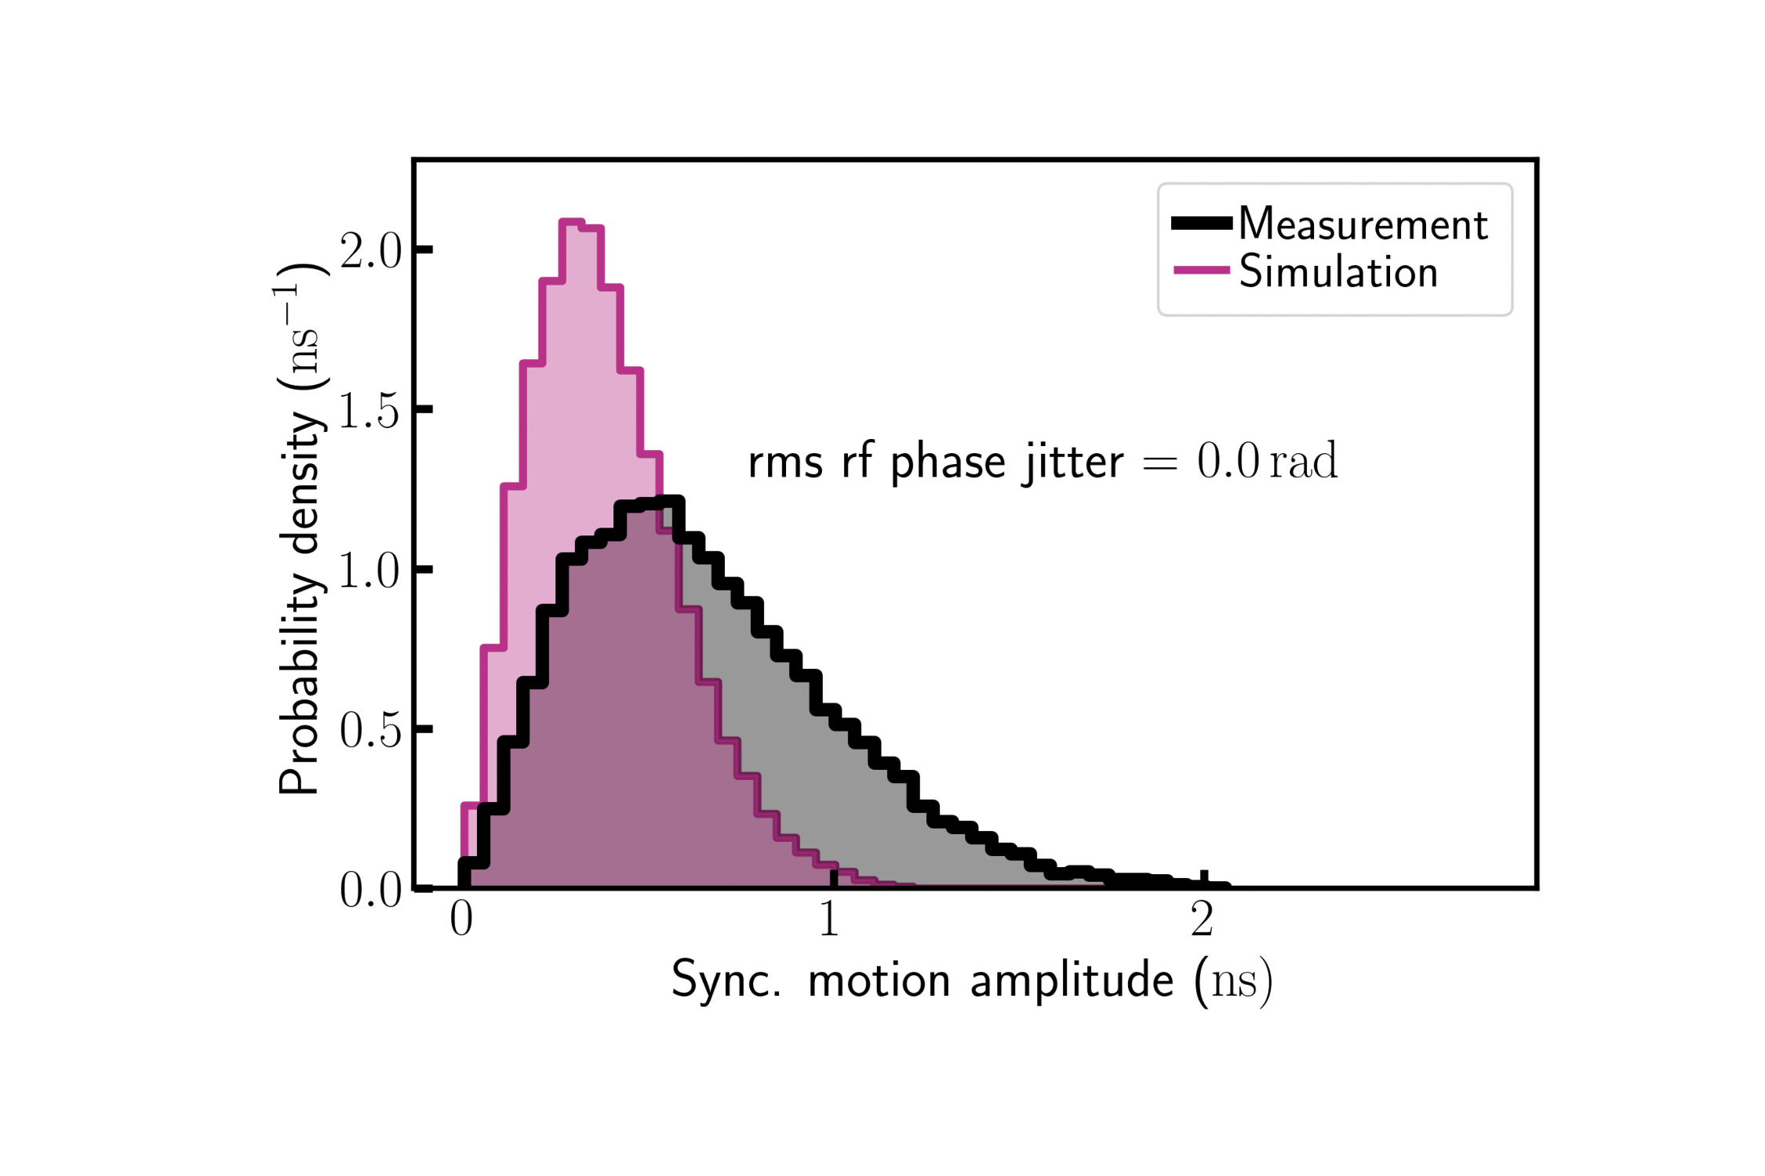
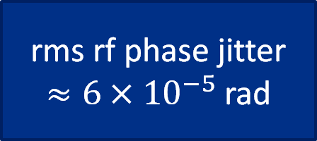
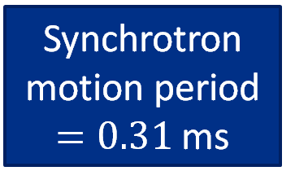
Results of the experiment from Run 2
No observable deviations from classical predictions
However, the collected data can be used for diagnostics:
Synchrotron motion period $=0.31$ms
rms rf phase jitter
$≈6×{10}^{−5}$ rad
Working on a paper for JINST or EPJ Plus, focused on the single electron synchrotron motion

Slide 5
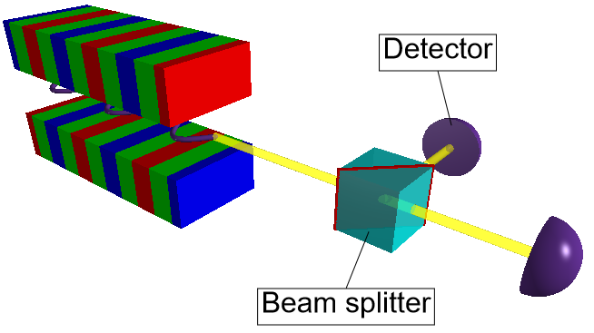
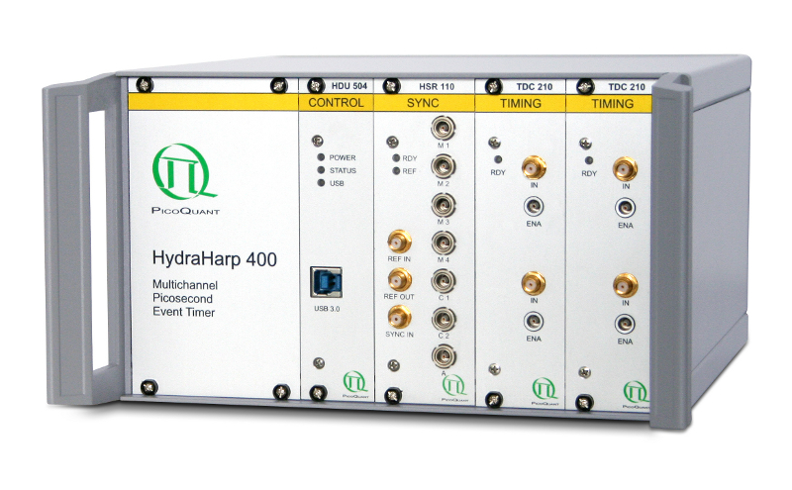
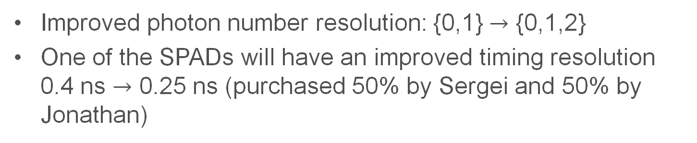
Proposal for Run 3: two SPAD detectors
Picosecond event timer
(dead time < IOTA revolution period)
provided by G. Stancari
Single electron
SPAD2
SPAD1
Improved photon number resolution: {0,1} $→$ {0,1,2}
One of the SPADs will have an improved timing resolution
0.4 ns $→$ 0.25 ns (purchased 50% by Sergei and 50% by Jonathan)

Slide 6
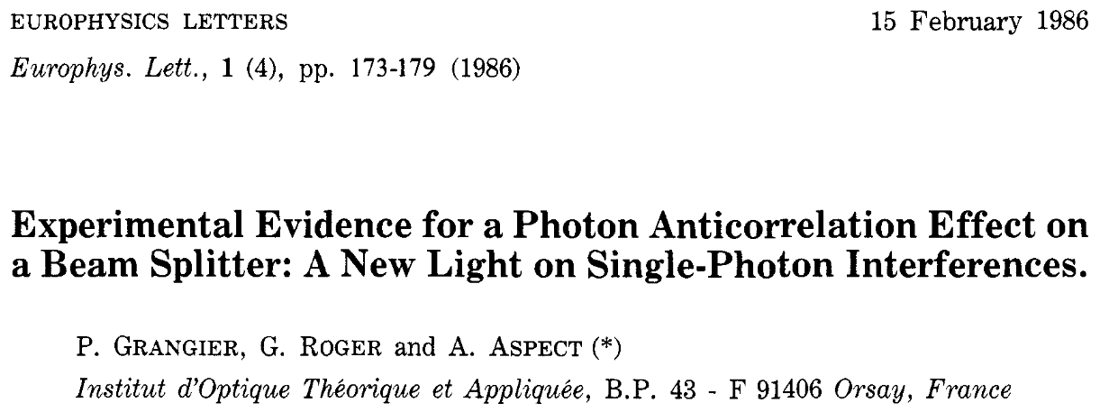
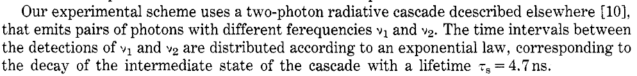
Proposal for Run 3: two SPAD detectors - continued
Motivation and goals:
Will be able to measure the ratio of “single-photon” events and “two-photon” events and compare with predictions:
000001000001100000000002000100000001210000000…
Will be able to measure correlation (or anticorrelation) between SPAD1 and SPAD2.
Will be able to take measurements with the new (faster) SPAD to obtain data of higher quality for the paper about the synchrotron motion of a single electron.
Will prepare and fine-tune the SPAD stages for the single-electron OSC experiment.

Slide 7
Beam requirements
Good beam lifetime at vanishing currents (>30 min, preferably for up to about 2 hours).
Bunch length about 30 cm and synchrotron motion period about 0.3 ms. Variable by changing RF voltage.
Transverse beam size on the order of 1 mm in the undulator.
Experiment regimes:
Single electron circulating in the ring for a long time.
Small number of electrons circulating in the ring, 1-1000. Preferably, all in one bucket.
Nominal injection current for rough alignment (≈2 mA)
150 MeV is desirable, but 100 MeV is sufficient too.

Slide 8
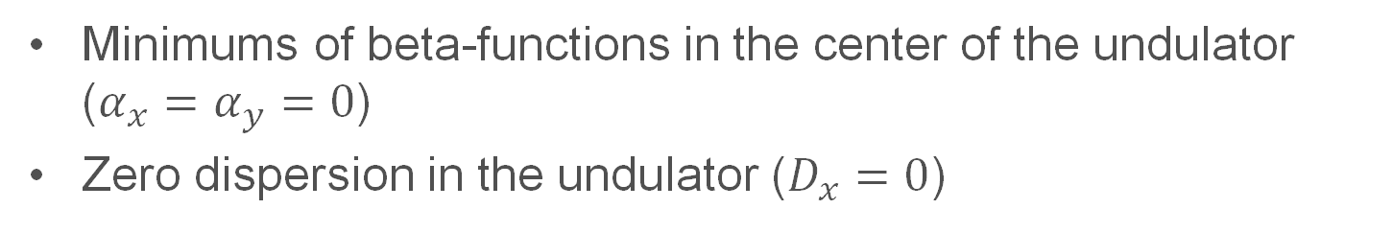
Beam requirements - continued
If the lattice, created for this experiment, will be used for other experiments with the SLAC undulator in the future, we recommend:
Minimums of beta-functions in the center of the undulator ($α_{x}=α_{y}=0$)
Zero dispersion in the undulator ($D_{x}=0$)
However, this is not required for URSSE.

Slide 9
Run plan
Controlled access (3-5 hrs) to install the dark box with the new apparatus. Need two Heliax and two Ethernet cables at M4R. Also, different mirrors and a different vacuum-chamber window adapter.
Shift 1 (8 hrs). Re-establish procedure to obtain 1,2,3,4,5 electrons in the ring (need Giulio). Perform alignment of the two SPADs.
Shift 2 (8 hrs). Record 10-min-long data sets for 1,2,3,4,5 electrons in the ring (12000 two-detection events for 1 electron). Vary RF voltage and record data sets with 1 electron and one fast SPAD for the synchrotron motion paper.
Shift 3 (8 hrs). (a few days after Shift 2) Repeat some measurements from Shift 2 if necessary. Possibly: (1) take measurements with different edge filters with undulator radiation and with bending magnet radiation (to measure spectral distribution), (2) try to record a bremsstrahlung event.
*we will require controlled accesses to move the undulator in and out.

Slide 10
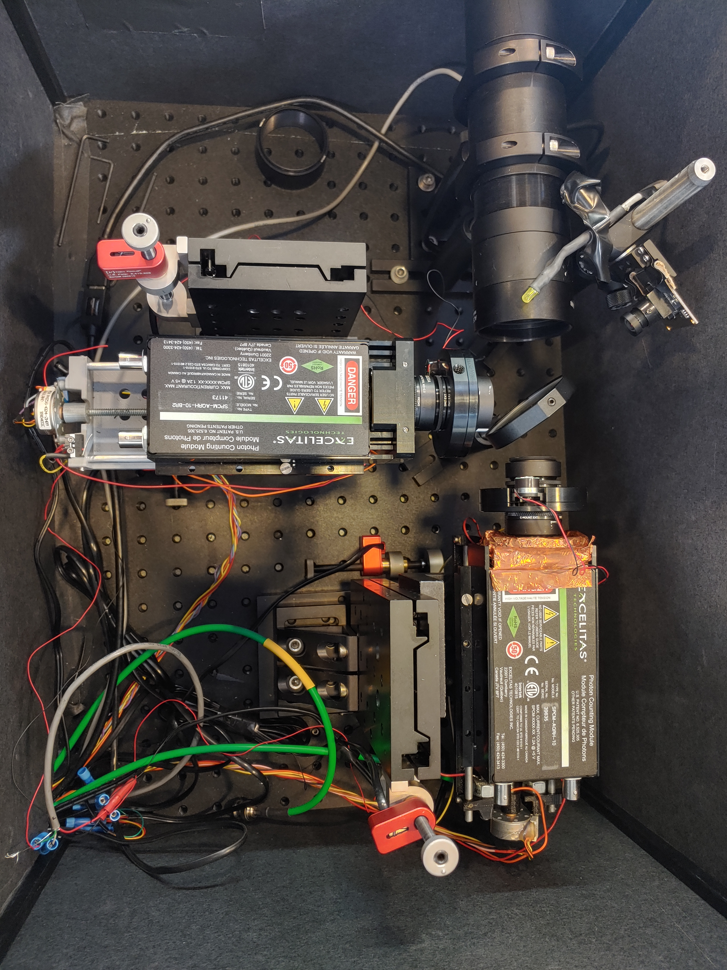
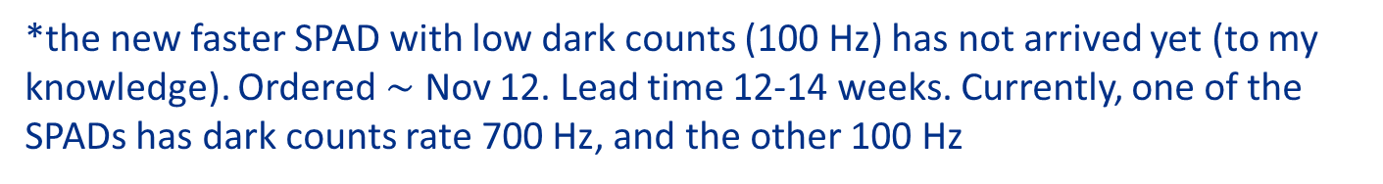
Current status of the apparatus
Beam splitter
It's in the Amber room now
2 Heliax ¼" cables
2 Ethernet cables
Focusing lens
We will need to set up two rate meters for the two SPADs (Giulio, I might need your help with this).
*the new faster SPAD with low dark counts (100 Hz) has not arrived yet (to my knowledge). Ordered $∼$ Nov 12. Lead time 12-14 weeks. Currently, one of the SPADs has dark counts rate 700 Hz, and the other 100 Hz

Slide 11
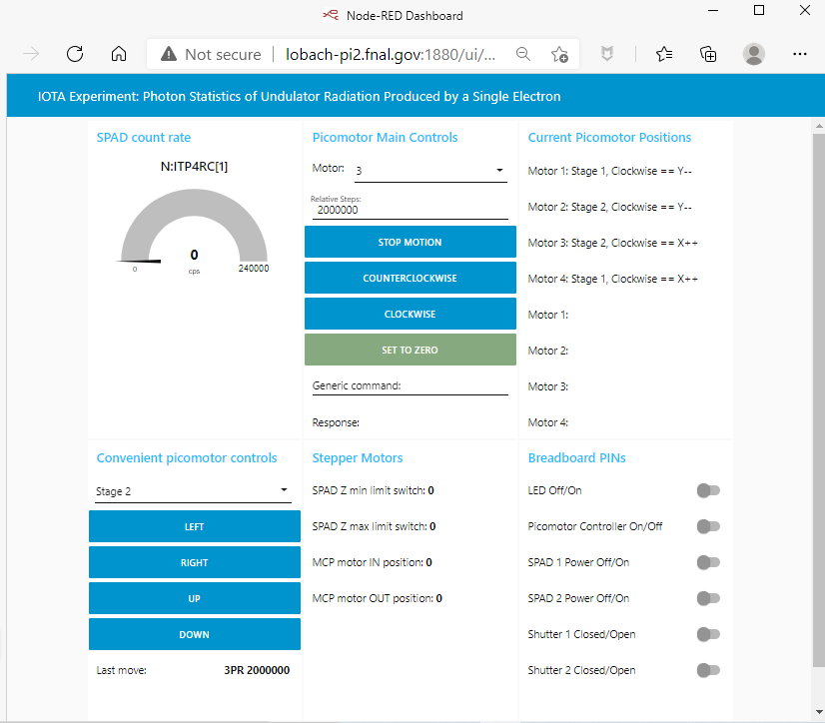
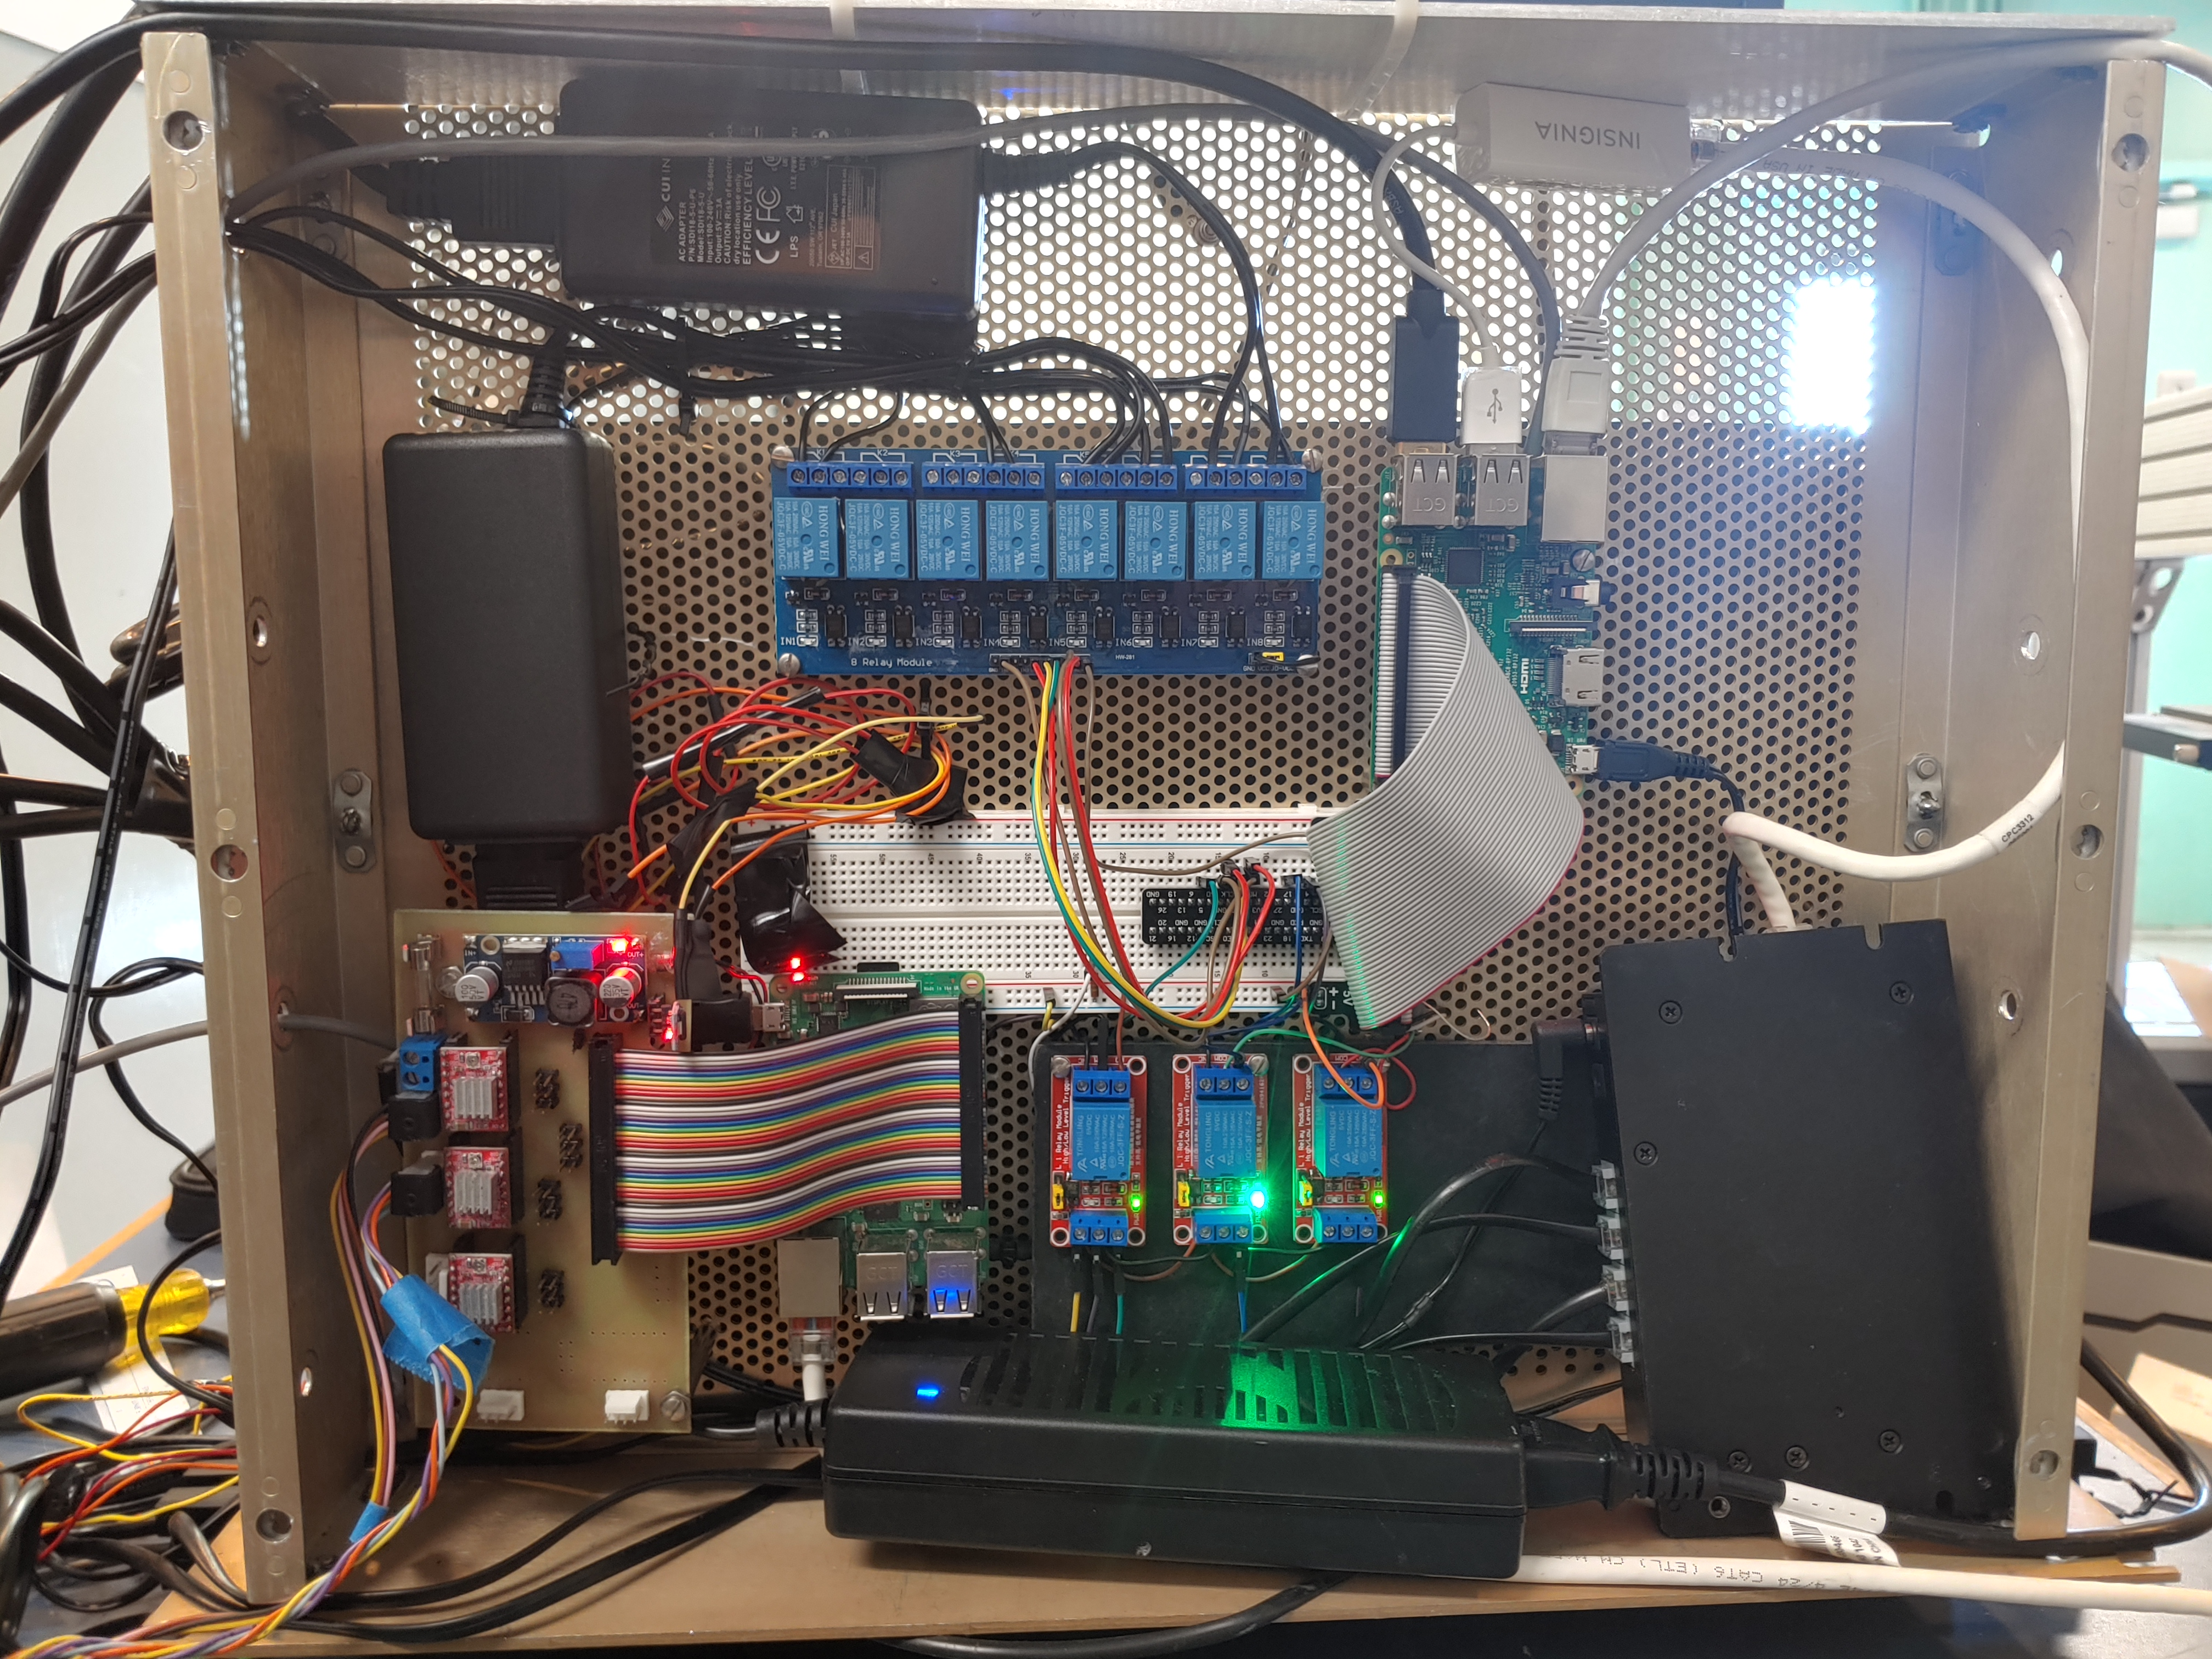
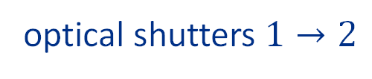
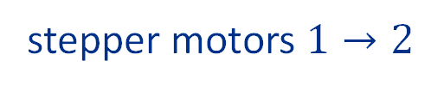
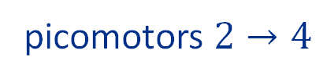
Current status of the apparatus - continued
The controls had to be upgraded to facilitate two SPADs:
picomotors $2→4$
stepper motors $1→2$
optical shutters $1→2$
The stepper motors’ controller is now housed in the same chassis. The controller was kindly provided by Sasha Romanov, as well as the two stepper motor stages.

Slide 12
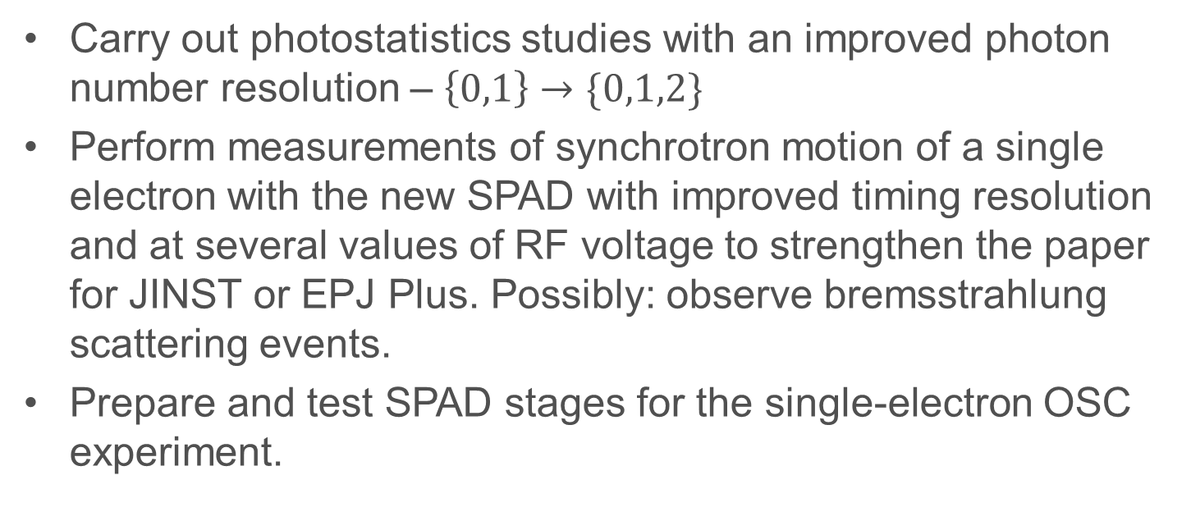
Summary
If approved, the requested beam time will be used to
Carry out photostatistics studies with an improved photon number resolution – $\left\{0,1\right\}→\{0,1,2\}$
Perform measurements of synchrotron motion of a single electron with the new SPAD with improved timing resolution and at several values of RF voltage to strengthen the paper for JINST or EPJ Plus. Possibly: observe bremsstrahlung scattering events.
Prepare and test SPAD stages for the single-electron OSC experiment.
Thank you for your consideration.

