Slide 1
Radiation Safety at Fermilab
Matt Quinn, Maddie Schoell, Wayne Schmitt & Adam Olson
DOE RPP Review
2 April 2021

Slide 2
Radiation Safety Organization
Fermilab is an accelerator facility, governed primarily by 10 CFR 835 Occupational Radiation Protection, and DOE Orders 458.1 Radiation Protection of the Public and the Environment, and 420.2c Safety of Accelerator Facilities.
  10 CFR 835 requires a Radiation Protection Program (RPP) to demonstrate facility means of compliance to be signed by DOE. Fermilab’s most recent RPP was approved by FSO 12/3/2018.
  O 420.2c requires
    Accelerator Safety Envelope (ASE), approved by FSO (9/29/2020)
    Safety Assessment Document (SAD), approved by Director & Chief Safety Officer (CSO) (10/2020)
      SAD Review Subcommittee reviews changes to SAD. FSO is a participant.
    Unreviewed Safety Issues (USI) process
    Accelerator Readiness Review (ARR) program
      Peer review of new or modified facilities

Slide 3
Radiation Safety Organization
Shielding Assessments are a main component of the SAD
  Assessments are:
    Prepared by line organizations with ESH assistance
    Reviewed by the Shielding Assessment Review Panel (SARP)
    Approved by the Senior Radiation Safety Officer
SARP is a constituent of the Radiation Safety Subcommittee, with members from ESH and line organizations, and an observer from FSO
Shielding assessments are reviewed for appropriate methodology, completeness, and compliance with Fermilab Radiological Control Manual (FRCM)

Slide 4
Radiation Safety Organization
Fermilab ES&H manual (FESHM)
  FESHM 2010 “Planning and Review of Accelerator Facilities and Their Operations” is the primary implementation of DOE O 420.2c.
Fermilab Radiological Control Manual (FRCM)
  Specified as part of FESHM by FESHM 11001
  Principal document for implementing 10 CFR 835 “Occupational Radiation Protection” as well as DOE Order 458.1 “Environmental Radiation Protection”.
  Much of FRCM deals with routine radiation protection procedures familiar at most radiological installations.
    Chapters 1-7 are based on the original DOE Radcon Manual.
    Chapters 8-11 deal with accelerator specific considerations and environmental protections.
    Specifies Fermilab imposed administrative dose limits

Slide 5
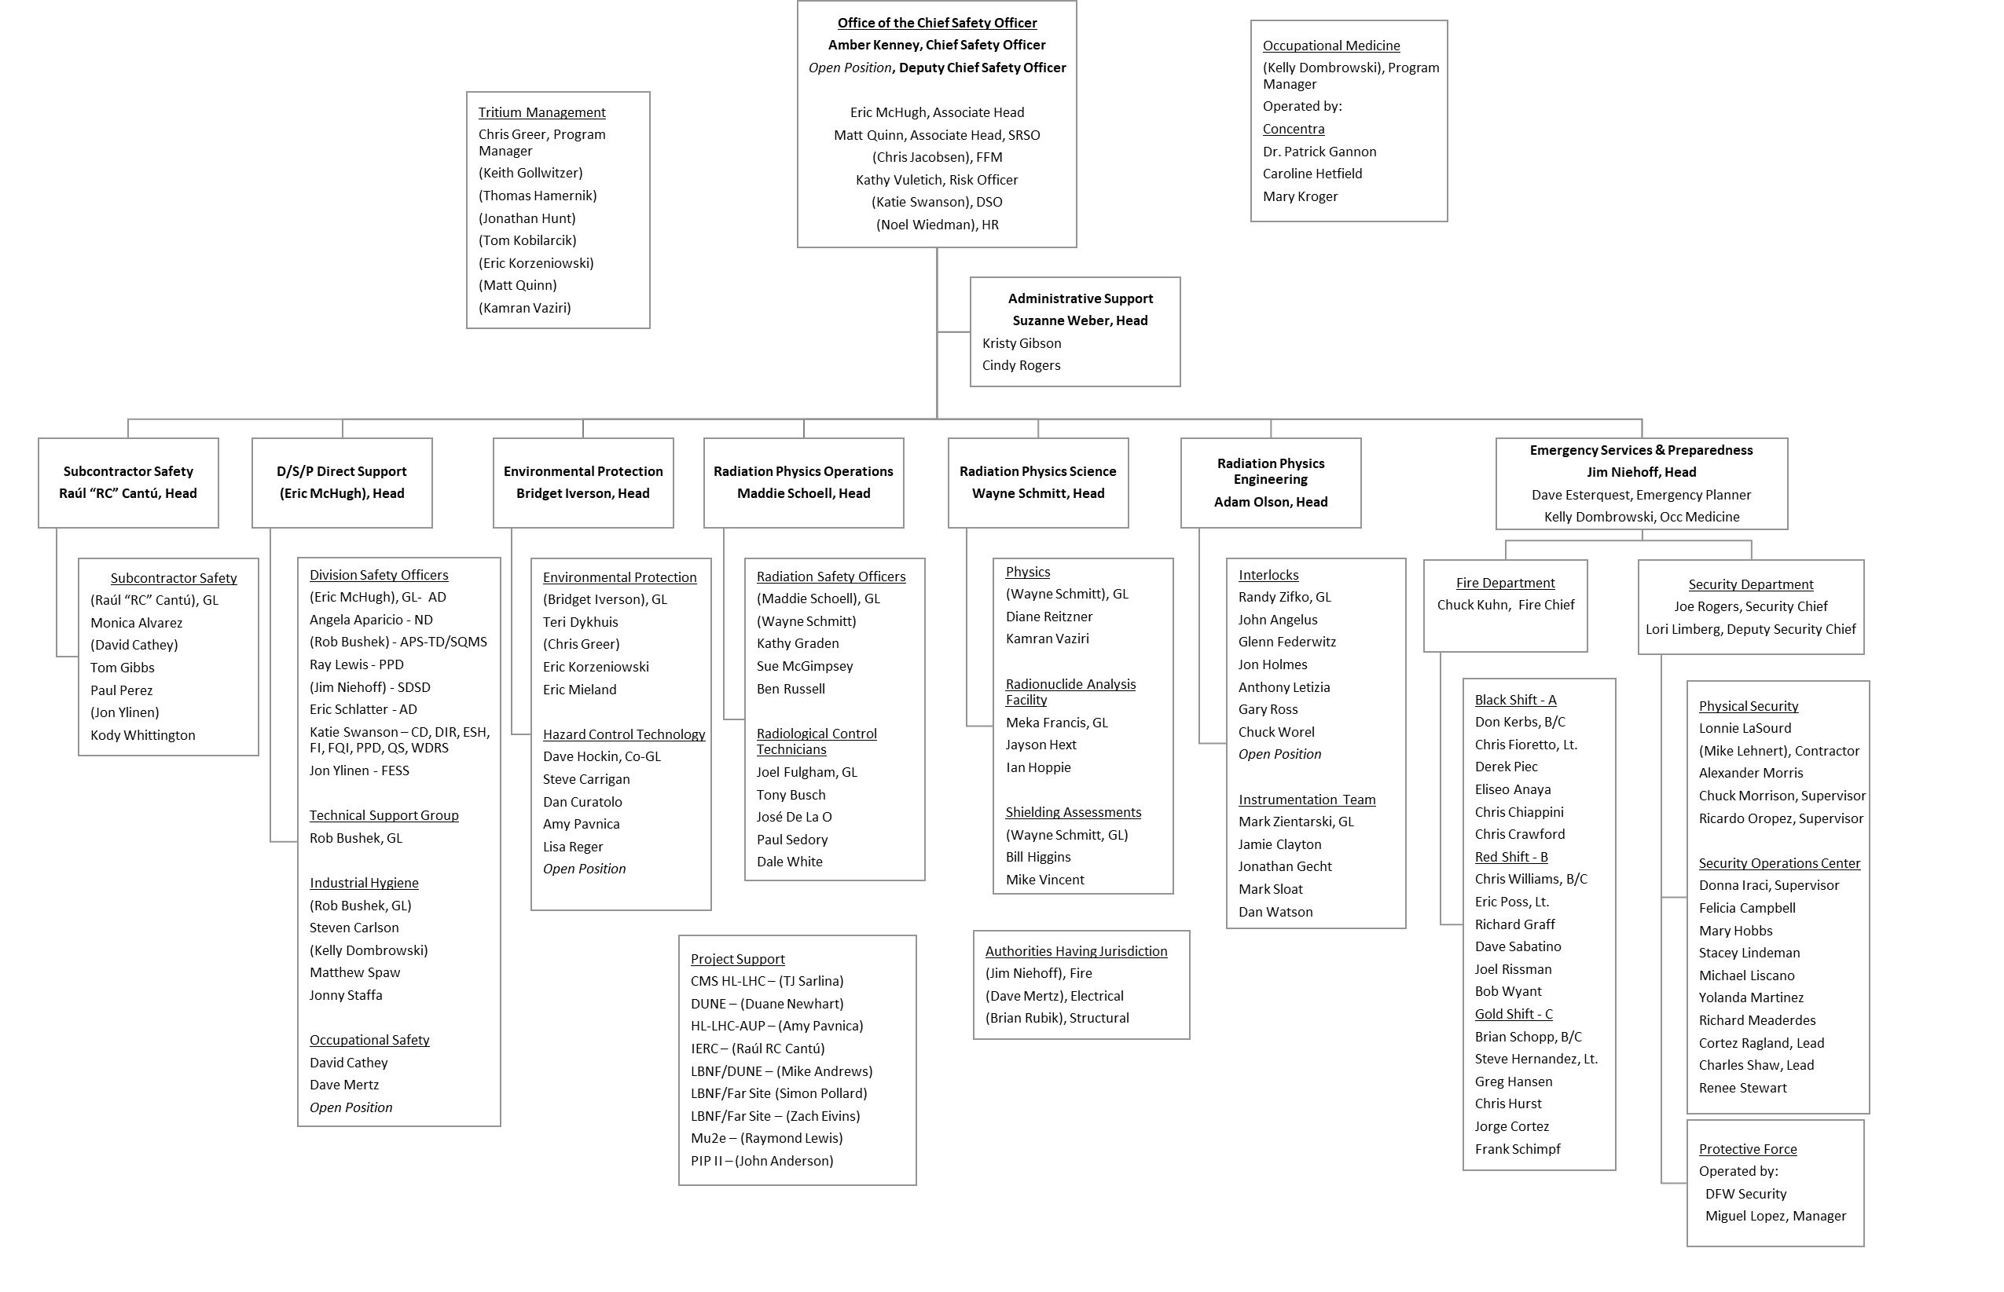
Radiation Safety Organization – Org. Charts

Slide 6
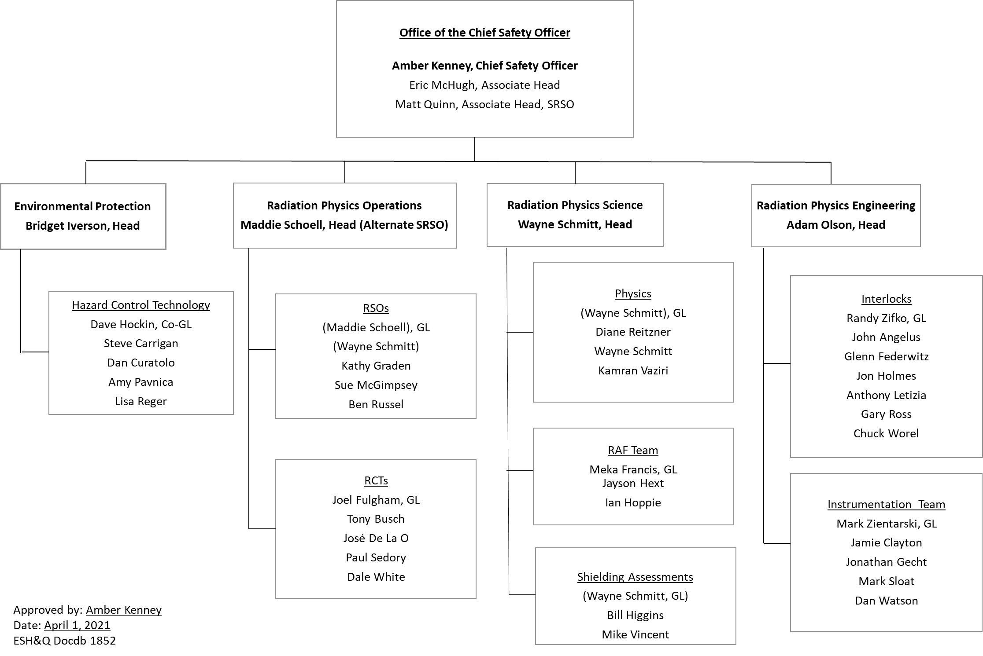
Radiation Safety Organization – Org. Charts

Slide 7
Radiation Physics Engineering (RPE)
Safety systems installations and interlocks
Safety system and radiation protection instrumentation tests and calibrations
Safety systems and radiation protection instrumentation development
MUX System operation, installations, and maintenance
Area, portable, and specialized radiation protection instrumentation inventory and service process
Environmental radiation monitoring equipment maintenance and installations

Slide 8
Radiation Physics Science (RPS)
Shielding design
Radiation dose, energy deposition calculations
Shielding assessment review & assistance
JULIE shielding requirement review
Shielding verification studies
Radioactive air/water emission calculations
Radionuclide analysis
Dosimetry
  DOELAP Accredited External Dosimetry Program
    Provide dosimeters across the Lab
  GetDose program to keep records of pocket dosimeter (real-time) dose – used for personnel dose oversight & job planning

Slide 9
Radiation Physics Operations (RPO)
JULIE
  Assigned RSO inhibits beam & RCTs provide coverage and perform surveys as needed
  Post-dig review of shielding (visual, GPS, topographic survey)
TSW/ORC
  Assigned RSOs review beam ORCs, RPO Dept. Head signs
  Source Physicist reviews all ORCs involving sources along with assigned RSO
Routine Monitoring
  Building/fence posting
  List of Facilities Containing Radioactive Material
  “Snoop” Survey: routine surveys of buildings on site
  Sump, LCW & RAW sampling

Slide 10
Radiation Physics Operations (RPO)
Source work
  Sources issued to qualified individuals using Source Loan Form
  Source storage and requirements based off dose rate at 1 foot:
    < 5 mrem/hr may be stored in source boxes, use documented on Source Access Log
    > 5 mrem/hr require RWPs and additional postings, sources issued by Source Physicist and delivered by Source Technician
Generate RWPs and provide RCT coverage for work as needed across the Lab

