Slide 1
Commissioning of the Icarus detector
A. Fava
SBN Oversight Board meeting 06/11/2021

Slide 2
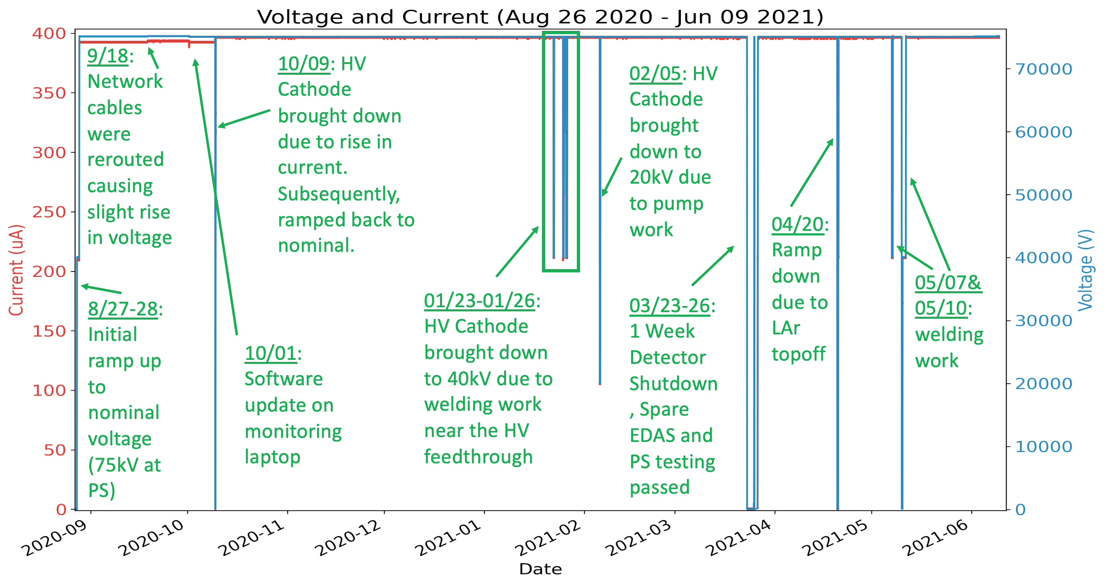
Detector status and stability
Stable detector operations for both TPC and PMTs since Aug 27th.
Networking upgraded to the final configuration with redundancy.
  Slow controls performing steadily and continuously upgraded to add more components. Remote-only shifts.
Steady data taking with neutrino beams overnight and during weekends since mid March, in parallel with continuing commissioning activities during working hours. Full time (24/7) neutrino beam run since May 30th.
Stability of the cathode
voltage and current,
at nominal drift field 500 V/cm

Slide 3
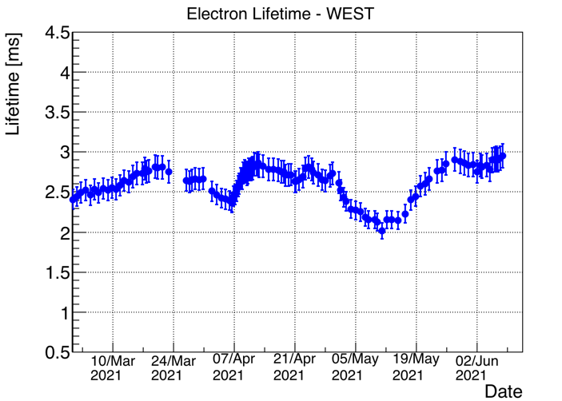
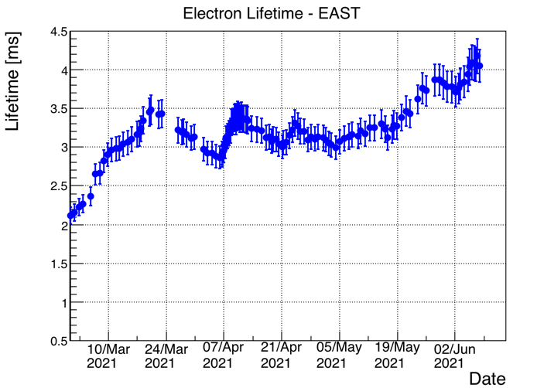
Cryogenics and electron lifetime
Cryogenic system overall stable and fully operational! All GAr filters regenerated and LN₂ and LAr pumps maintained.
The two South GAr recirculation units modified, to increase performance. All 4 units performing well and steadily. LAr refills on March 24th (≈ 5000 l) and April 19th (≈ 2500 l) to bring the level 1.5 cm above the nominal level: smooth operations.
April 7th to April 9^{th:} 1 day of continuous venting at 20 g/s/module and 2 days at 15 g/s/module to check the effect on the purity.
SW condenser
modified
LAr refills
Continuous venting

Slide 4
TPC electronic noise mitigation
Increase of TPC electronic noise by ~30% after LAr filling, well above expectations from dielectric effect. However not preventing neutrino events collection.
Intervention in Dec ‘20 allowed to mitigate in the West cryostat a 120 kHz noise detected in several boards, disentangling contributions of front-end electronics from external ancillary devices and restoring some ground connections.
Several potential external noise sources (TT-Link trigger/clock, cathode HV, wire bias and test-pulse distribution systems) excluded through investigations in situ. Deep investigation of coherent noise on all signal flanges needed but extremely difficult within the pandemic; test-bench in Padova studying the issue.

Slide 5
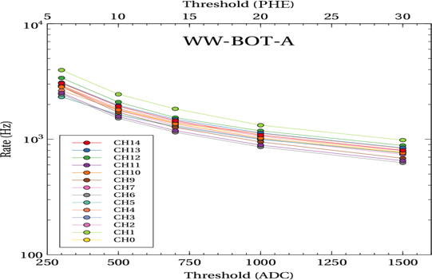
Status of the scintillation light system
Excellent stability of the light detection system (PMTs) since activation. PMT HV system remotely controlled during regular shifts by means of a GUI interface allowing PMT voltages monitoring/setting.
The PMT system has been extensively employed for calibration purposes and now being integrated in the trigger system.
Ongoing PMT calibration activity to equalize the gain to G = 10⁷ using both laser light pulses and single photoelectron (phe) from background (~50 kHz per PMT).
PMT timing calibration under study.
PMT rates measured as a function of signal discrimination threshold :
uniform behavior across PMTs;
being compared with expectation from MC simulation.
  Example of counting rates for 15 PMTs. Threshold values are in ADC (0.122 mV/ADC) corresponding to 50 ADC/phe.

Slide 6
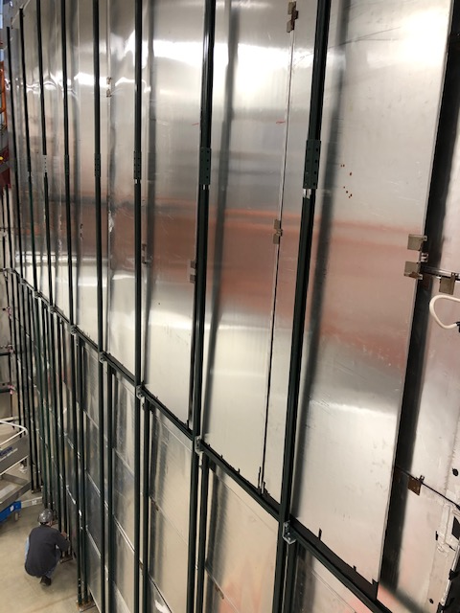
CRT status
Installation of the last wall of the side CRT completed, including readout and cabling.
Several ongoing activities:
chasing the origin of noise sources;
side CRT data/MC comparison;
optimization of thresholds for CRT hits identification;
deep investigation of relative timing between PMT and CRT systems;
work on CRT hits reconstruction.
CRT South wall complete

Slide 7
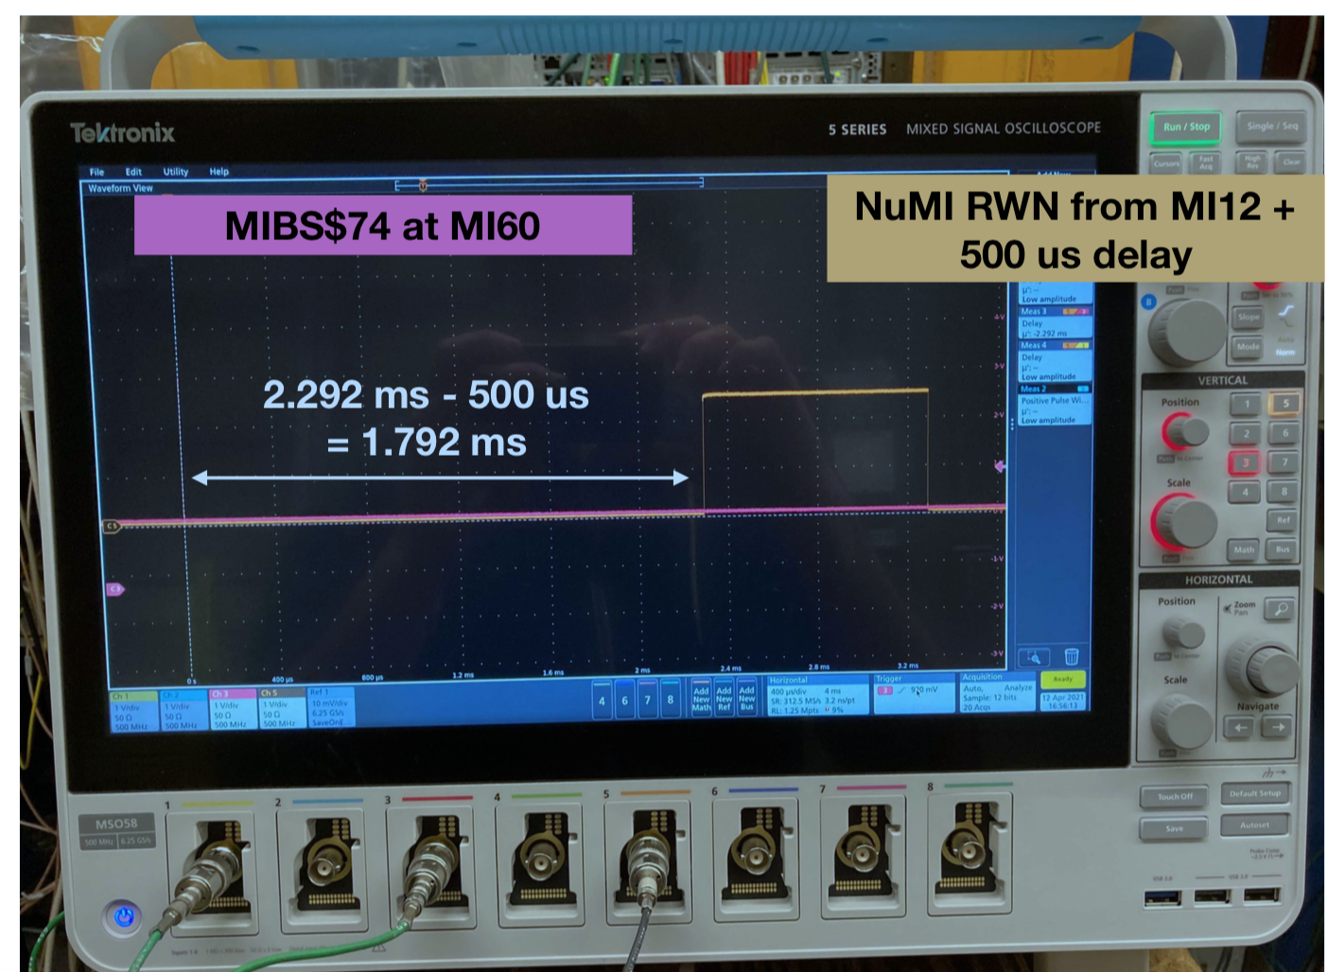
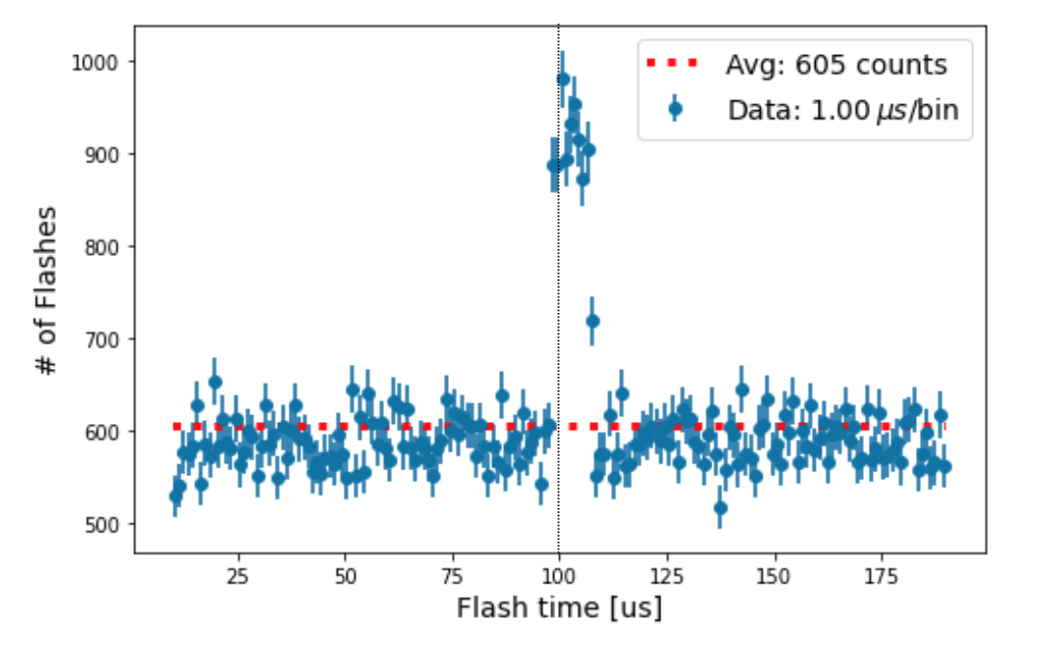
Activation of the NuMI beam trigger
After verifying correct timing of BNB signals, similar procedure adopted for NuMI:
time interval between Early warning signal (MIBS$74) and proton extraction signal (RWM counters at target) measured at oscilloscope;
excess of PMT light flashes (>5 fired PMTs within 200 ns window in coincidence in both left and right TPCs) over the cosmic background rate at the expected time verified in dedicated test run recording only PMT components;
setup of minimum-bias NuMI trigger to record all components (PMT, TPC and CRT) at each beam extraction.
Trigger time

Slide 8
Example of NuMI 𝜈_{μ}CC candidate
Five particles produced at vertex (red arrows), E_{DEP} ~ 2.5 GeV:
Track 1: downward going μ, crossing the cathode and exiting downstream, L= 4.2 m, p~ 1.3 GeV/c by MCS;
Track 2: upward going p candidate, L=31 cm;
Two photons 𝛾1, 𝛾2 pointing to the primary vertex, E₁ ~ 200 MeV, E₂~ 240 MeV, converting at 18 cm, 58 cm distance;
Track 3: hadron that produces a secondary vertex (yellow arrow) where a short proton, another hadron (Track 5) and two photons 𝛾3, 𝛾4 are also clearly visible;
Track 4: charged pion with visible Michel electron produced in the 𝜋 -> μ -> e decay chain.

Slide 9
Example of NuMI 𝜈_{e}CC candidate
QE electron neutrino candidate with two particles at the primary vertex (indicated by red arrows):
Track 1 is the upward going proton candidate stopping inside L= 13 cm
The electron shower is downward going: the beginning of the shower is clearly visible in particular in Induction 2 view (in Collection the e⁻ and track 1 are overlapped).

Slide 10
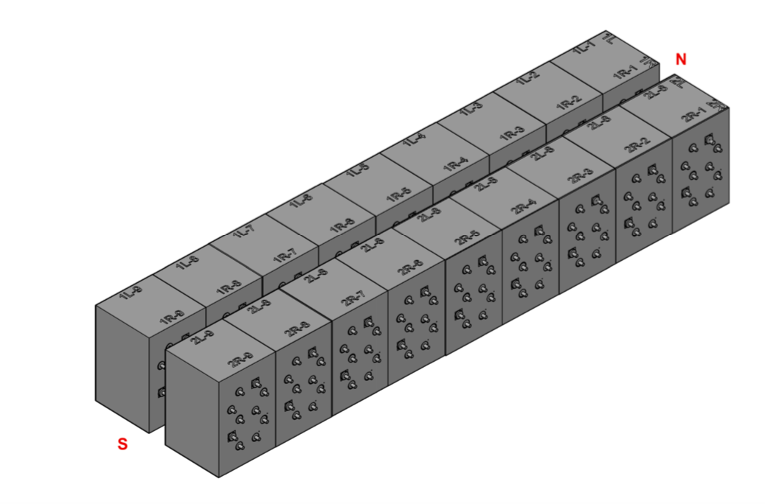
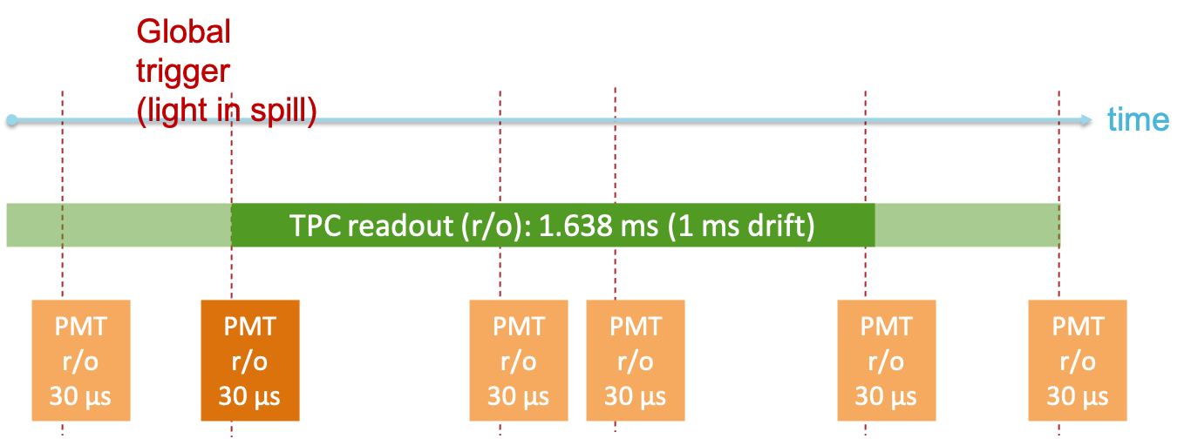
First beam trigger based on scintillation light
Activation of beam trigger requesting scintillation light in coincidence with beam gate, for both BNB and NuMI:
PMTs in each cryostat grouped in 3 ”slices”,
6m size along beam direction, 60 PMTs/slice;
request of signal ≳ 10 phe in at least
10 pairs of adjacent PMTs in at least
one slice.
Slice 1W
beam
Slice 2W
Slice 3W
Slice 1E
Slice 2E
PMT waveforms readout at any scintillation light activity in 2 ms
around the beam gates.
Allows recording of
information on cosmics
during TPC drift time
for offline matching of
light and charge.
Slice 3E

Slide 11
Initial neutrino data taking
Advancement in the detector commissioning process, nominal free electrons lifetime and detector operational stability recognized at the last ICARUS Collaboration meeting (March 16-17, 2021) allowing to initiate data taking collecting steadily neutrino beam events with the full PMTs + TPCs.
Since end of March BNB neutrinos collected overnight with minimum bias trigger (data collected for every spill), while commissioning activities (trigger development, PMTs calibration, CRT, ...) continued during the day. NuMI minimum bias beam trigger added in the second half of April.
Very stable running conditions. Average run duration > 9 h.
Raw data written to tape. Simple light filter used to down-select events that contain light activity in coincidence with the beams spill gate for higher level processing (e.g TPC reconstruction): reduction factor in the data load ~1/30.
Collected events used to setup the software infrastructure for data processing/storage and workflow management.

Slide 12
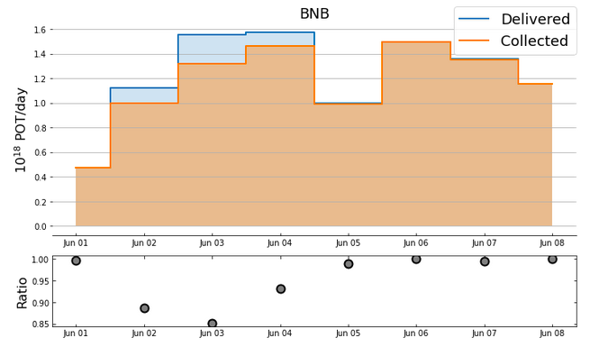
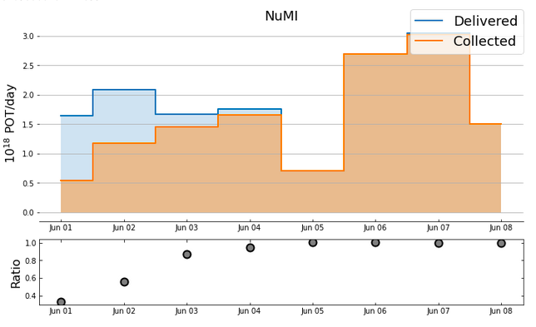
Test of physics run
Since May 30th full-time beam run to emulate the physics run that will start in the next Fall:
trigger based on scintillation for both BNB and NuMI;
run coordination structure with A. Scarpelli Run Coordinator, A. Fava Deputy;
ICARUS is now the primary BNB user.
All episodes of unplanned interruption of data taking investigated and lessons learned informing improvement of the operation procedures.

Slide 13
Plan for the summer shutdown
Collected data being analyzed and used for tuning of event reconstruction software tools. First results will be presented at summer conferences.
Commissioning activities (calibrations, trigger development, ...) will be restarted with cosmic ray data.
Upgrades of the PMTs HV system and interventions on the TPC readout electronics (noise reduction) are planned.
Upgrade of the GAr recirculation system (insertion of warm filters with H₂O removal) will be implemented.
Main installation activity will be the installation and commissioning of the Top CRT to be followed by the installation of the overburden.
Deploy a stable data processing, storage and related workflow.
Complete the automatic data transfer by RUCIO system from FNAL to CNAF (Italy), at present in preparation with FNAL and CNAF Computing Centers support.
A suitable book-keeping database exploiting run metadata will be also prepared.

Slide 14
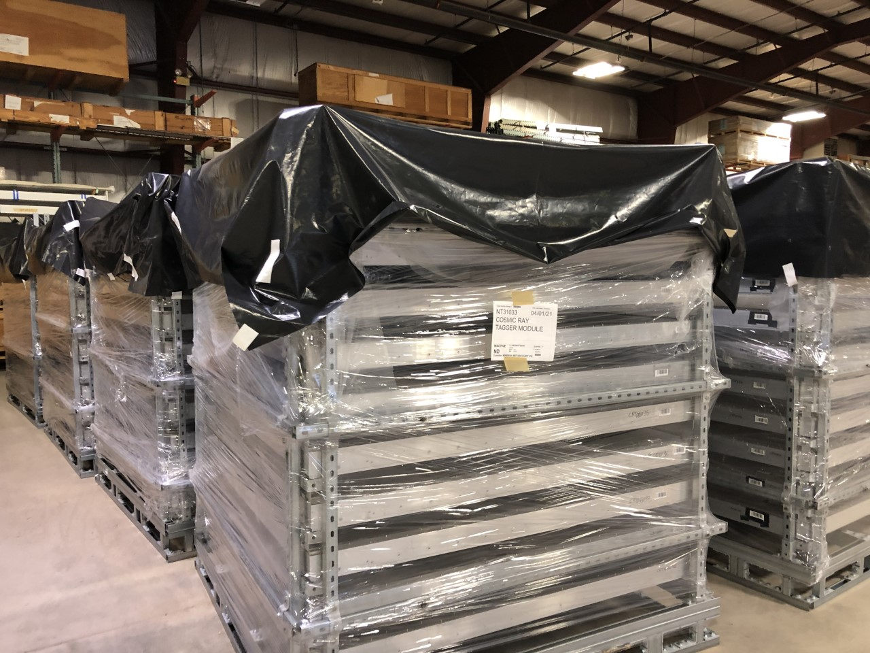
Top CRT installation
CRT modules delivered from CERN and stored in the warehouse.
Mounts for vertical modules:
mount design modified for more rigidity and easier CRT module installation;
grinding/welding above the detector;
installation to start after beam run.
Module installation planning:
18 INFN collaborators identified to come to Fermilab in teams over a period of ~ 4 months;
support from PPD and ND technicians;
preparing for first team of four in July.
Module installation schedule:
May-early July: modify and install vertical mounts
July: vertical modules
July-Aug: support beams, fire protection, and lighting
Aug-Oct: horizontal modules
Oct-Nov: commissioning

Slide 15

High-level planning of commissioning activities
First 𝜈 candidates!
BNB off
BNB on
Jan
Feb
Mar
Apr
May
Jun
Jul
Aug
Sep
Ventings
LAr purity
SE condenser modif.
2 x LAr
re-top
SW condenser modif.
Installation of warm filters
Regeneration of filters
Gain stability/fine tuning
Calibration/optimization of digitizers
PMT
HV upgrade
Laser upgrade
PMT adders
TPC
To be defined
Investigation of noise sources
PMT-TPC timing
Min. bias BNB trigger
BNB trigger scintillation light + BNB gate
To be defined
Trigger
Multi PMT readout windows per trigger
Run 0
Min. bias NuMI trigger
Trigger Fragment
Trigger Inhibit
DAQ
PMT Config
TPC Compression
To be defined
Monitoring
Full Detector Dataflow / Event sync
TPC slow controls
Trigger monitor
DCS
Determination of alarm limits
To be defined
DAQ integration / GUI development
Vertical support
Top CRT installation & commissioning
to follow
CRT
South wall installation
South wall commiss.
Noise investigation of bottom/side CRT

Slide 16
Summary
Both detector and cryogenic systems running steadily since several months.
Free electrons lifetime now at the level of 3 ms and stable.
ICARUS data taking collecting steadily BNB neutrino beam events with the full PMTs + TPCs since mid-March. NuMI beam added in mid-April.
Since end of May full-time neutrino beam run ongoing with trigger based on scintillation light information. ICARUS primary BNB user.
Installation of the Top CRT and of the overburden needed in order to fulfil the requirements for sterile neutrino search:
side CRT completely installed and commissioned;
top CRT modules at Fermilab, to be installed during the summer shutdown;
installation of the overburden to follow at the beginning of the next neutrino run.

Slide 17
Backup

Slide 18
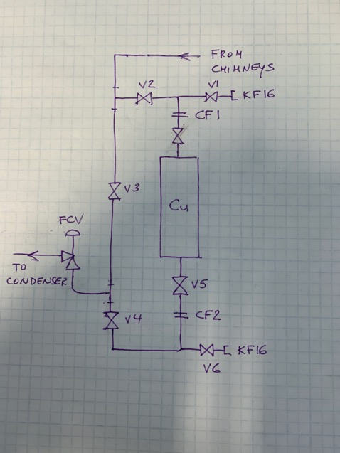
Plans to improve the electron lifetime
Improvement in the purity after activation of SE condenser confirms that limited electron lifetime currently achieved possibly caused by insufficient GAr flow.
4 larger (up to 20L) external warm filters, 2 per cryostat, being constructed at CERN to be added to the gas collection system tentatively in late May.

Slide 19
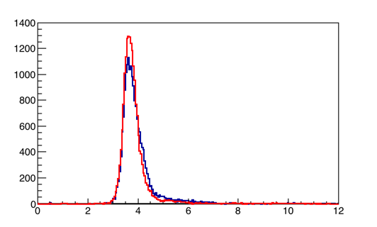
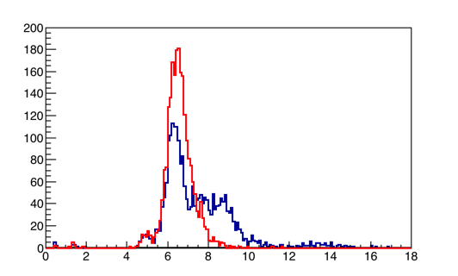
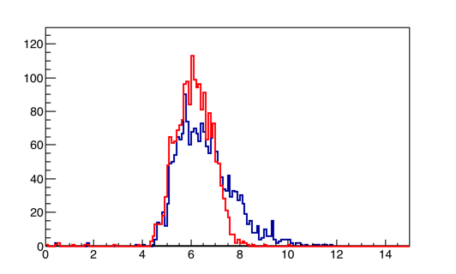
Studies of TPC electronic noise in West cryostat
Thorough test campaign performed at FNAL in Dec ‘20 to study/mitigate abnormal noise detected in the TPC read-out electronics after LAr filling, focus on West cryo.
Partial success in mitigating the 120 kHz noise component in 10 (out of 48) mini-crates by adding 2 “filter” 100 Ohm resistors in the offset line.
Coll/Ind2 standard
wires (3.9 m). Average RMS
4.1 → 3.9 #ADC
Middle flanges
Ind 1 wires (9 m). Average RMS
7.4 → 6.6 #ADC
RMS (#ADC)
Top flanges
Ind 1 wires (9 m). Average RMS
6.6 → 6.1 #ADC
RMS (#ADC)
RMS (#ADC)

Slide 20
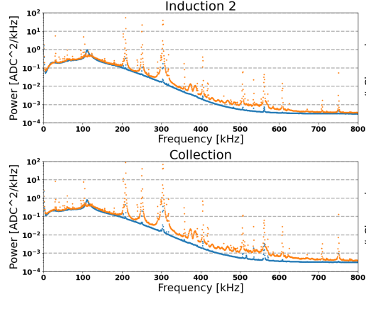
Effect of ground strap on TPC noise
Investigation of the effect of the ground strap (connecting the mini-crates to the feed-through signal wire flanges) on TPC noise performed in January ’21.
Removal of the ground straps causes substantial increase in TPC noise, at particular frequencies prominent in some of the noisier mini-crates.
This is additional evidence of some grounding-related noise source.
Sample FFT for one mini-crate (WW05)

Slide 21
“Spill-only” trigger
Simplest beam trigger implemented “spill-only”: early warning signal of the extraction of protons for the BNB (gated-BES) used to generate a trigger signal common to TPC and PMTs in the EAST cryostat only.
Duration and pre/post-sampling (i.e. positioning compared to trigger time) of the PMT readout window varied in different runs for commissioning purposes.
Gated-BES
generated
𝜈 arrival time
≃ PMT trigger
TPC trigger
time
TPC readout: 1.638 ms (1 ms drift)
pre
post
PMT readout ≤ 200 μs
335 μs
1.3 ms

Slide 22
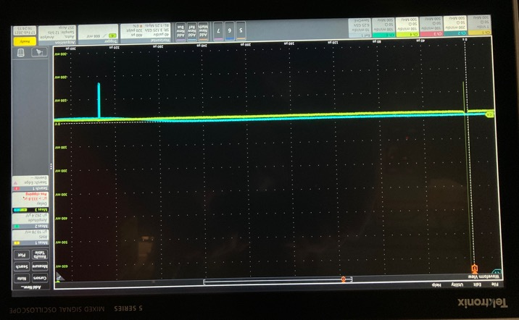
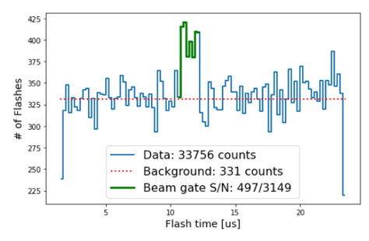
Commissioning of the timing of the beam signal
Offset added to the gated-BES for the PMT trigger generation ~ 335 μs:
time difference between gated-BES and neutrino extraction (RWM) signals + 𝜈 time of flight from MI-12 to ICARUS.
Time of PMT light flashes (>5 fired PMTs within 150 ns window in coincidence in both left and right TPCs) in 25 μs PMT readout window with 60% post-trigger shows excess over the cosmic background rate at the expected 𝜈 arrival time.
𝜈 arrival time
Gated-BES
333.8 μs
RWM

Slide 23
Study of TPC-PMT signal association
Data collected with “spill only” trigger used also to check the timing/read-out of both TPC and PMTs signals, a prerequisite for the trigger deployment.
Anode-to-cathode cosmic μ tracks selected
as analysis sample:
occupy the full ~ 1 ms drift time corresponding
to the 1.5 m distance between the anode and
the cathode;
the time of the first hit signal in the track
provides the time t_{TPC} at which the particle
crossed the wire plane, with ~μs resolution;
light signals on PMTs inside the corresponding
detector slice are reconstructed with ns
resolution, providing the time t_{PMT} measured
by the PMT.

Slide 24
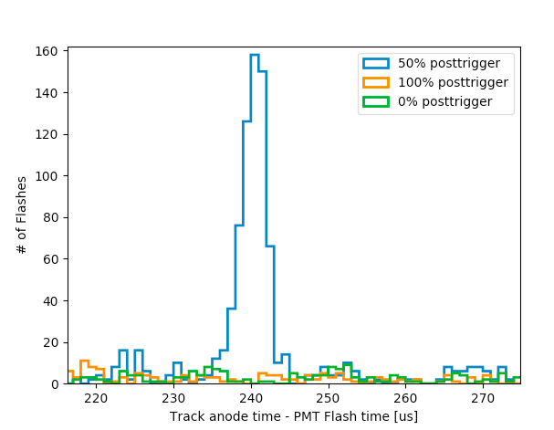
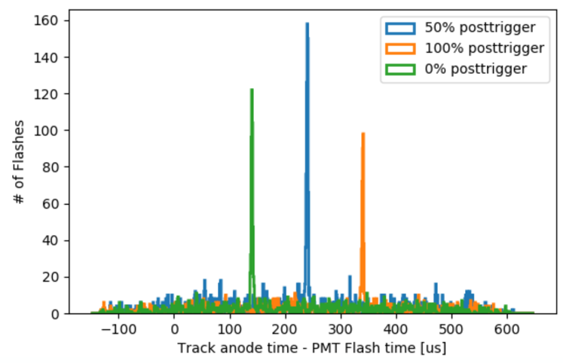
Study of TPC-PMT signal association (cont’d)
Clear ~2 μs peak in t_{TPC} – t_{PMT} confirming the correct relative TPC - PMT timing.
Absolute timing of the peak perfectly compatible with expectations for different PMT post-sampling settings.
PMT trigger
t_{TPC}: 338 μs
TPC readout (ro)
PMT ro
50% post-sample: t_{PMT} 100 μs
PMT ro
100% post-sample: t_{PMT} 0 μs
PMT ro
0% post-sample: t_{PMT} 200 μs

