Slide 1
SBN Program Status
Peter Wilson – SBN Program Coordinator
Oversight Board
11 June 2021

Slide 2
Outline
Fermilab COVID 19 Work Status
SBND technical progress

Slide 3
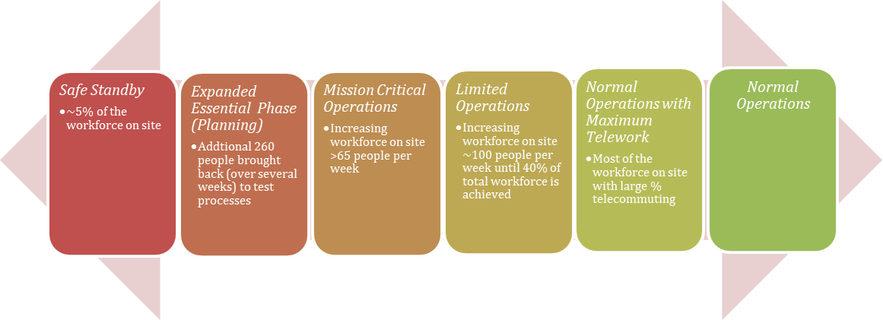
COVID 19: Fermilab Status
Work continues on-site with the same access restrictions and safety protocols of the past year
Access limited to essential personnel list and day access passes
Standard masking and social distancing requirements
Any work at close proximity (<6ft) requires extra PPE, written Hazard Analysis and approval by Neutrino Division Head
We anticipate an update of the work rules in the next 1-2 weeks
For planning we are assuming that these access restrictions and work rules will remain in place at least through the summer of 2021
We continue to operate in this state

Slide 4
COVID 19 Site Access
To access the Fermilab site: must be on either the Essential Personnel list or Daily Access List*
Peter Wilson (pjw@fnal.gov) coordinates the Essential Personnel list for the Neutrino Division
Additions take several weeks to plan – contact me early and ask questions!
Sam Zeller (gzeller@fnal.gov) coordinates the Daily Access requests for the Neutrino Division
Please make requests one week in advance, if at all possible
Emergency requests can be no later than noon of the previous business day
Priorities are set based on input from spokespeople (or deputies), commissioning, run/technical coordinators and/or relevant Fermilab experiment representatives
Access is granted to work in a specific facility not anywhere on-site
Do NOT go to the High-Rise unless specifically approved
*Additional access lists for limited access to the Daycare Center and Village Housing for people not on the Essential Personnel list

Slide 5
Travel Guidance
Requirements for Users and Business travellers can be found at: Fermilab COVID Travel Requirements
These provide rules for both domestic and international travel.
Please note that these rules are updated as state and/or DOE rule are updated
Most recently updated on April 8
Note that international travelers still require special approval by the Directorate/DOE.
Will provide letters of invitation demonstrating national interest for visa appliations
This process can take many weeks

Slide 6
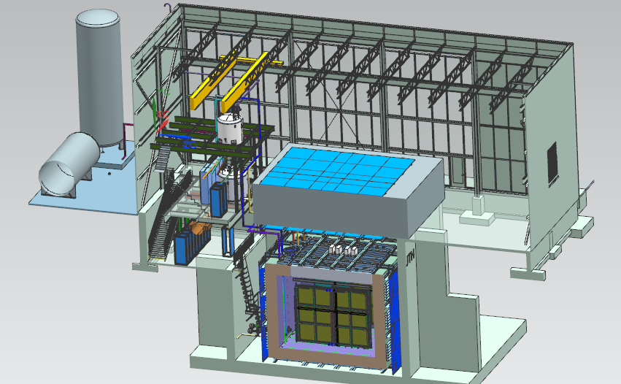
Near Detector - SBND
20 ton crane
Top CRT and Overburden
Cryogenic Dewars
Proximity Cryogenics
Readout racks
Top CRT
TPC
Cryostat
Side CRT

Slide 7
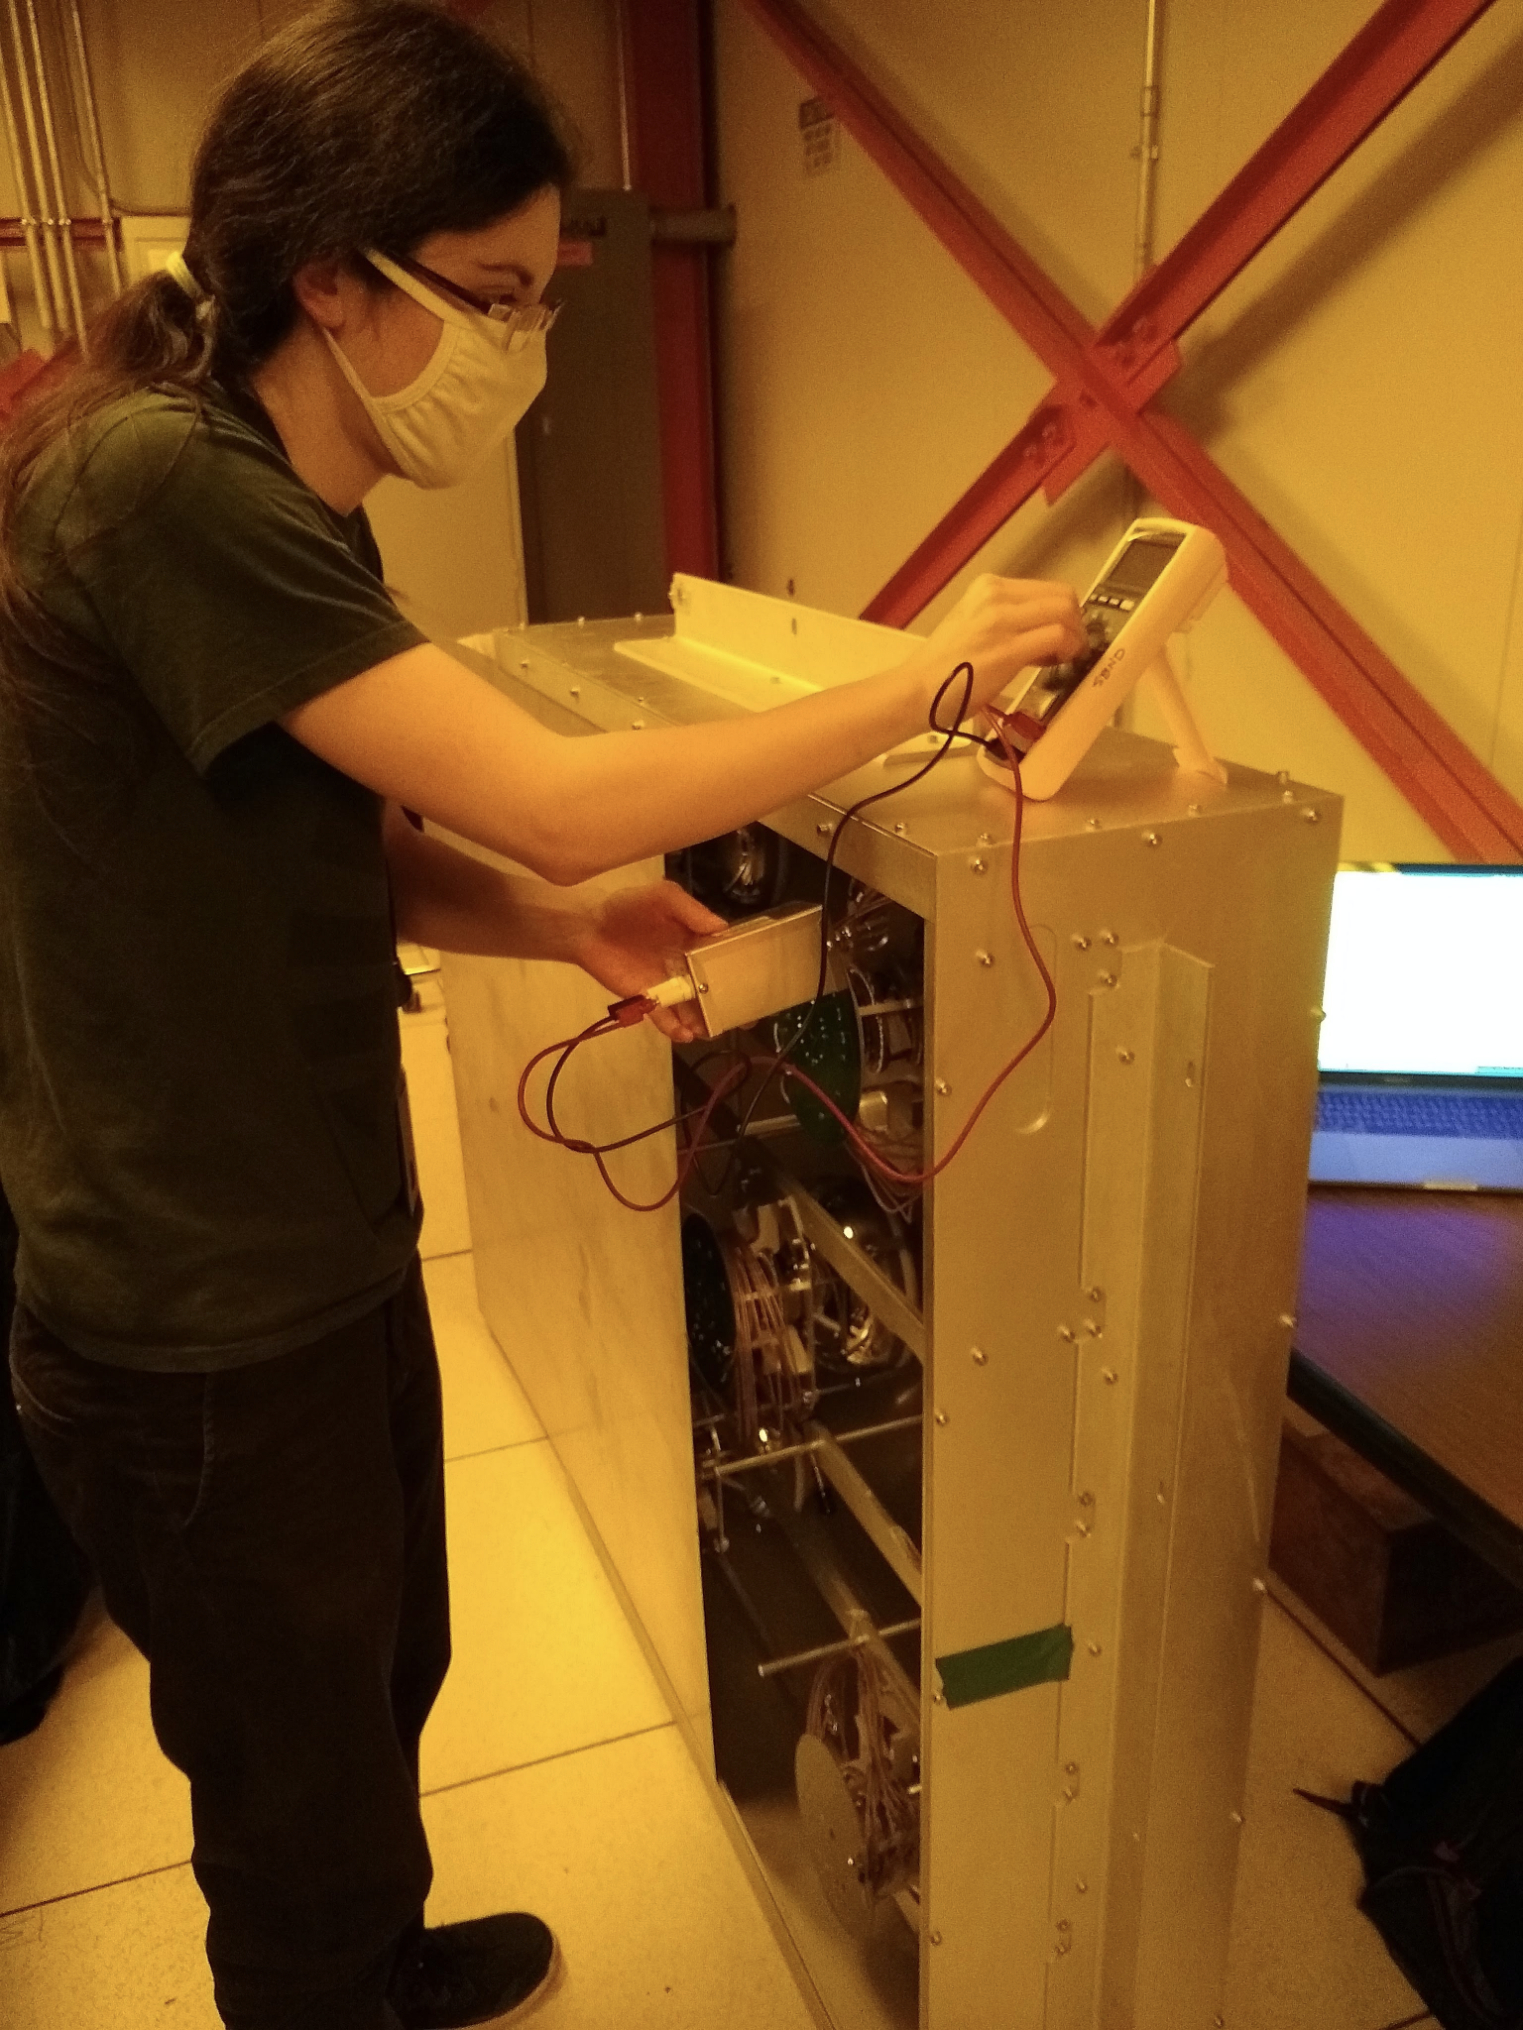
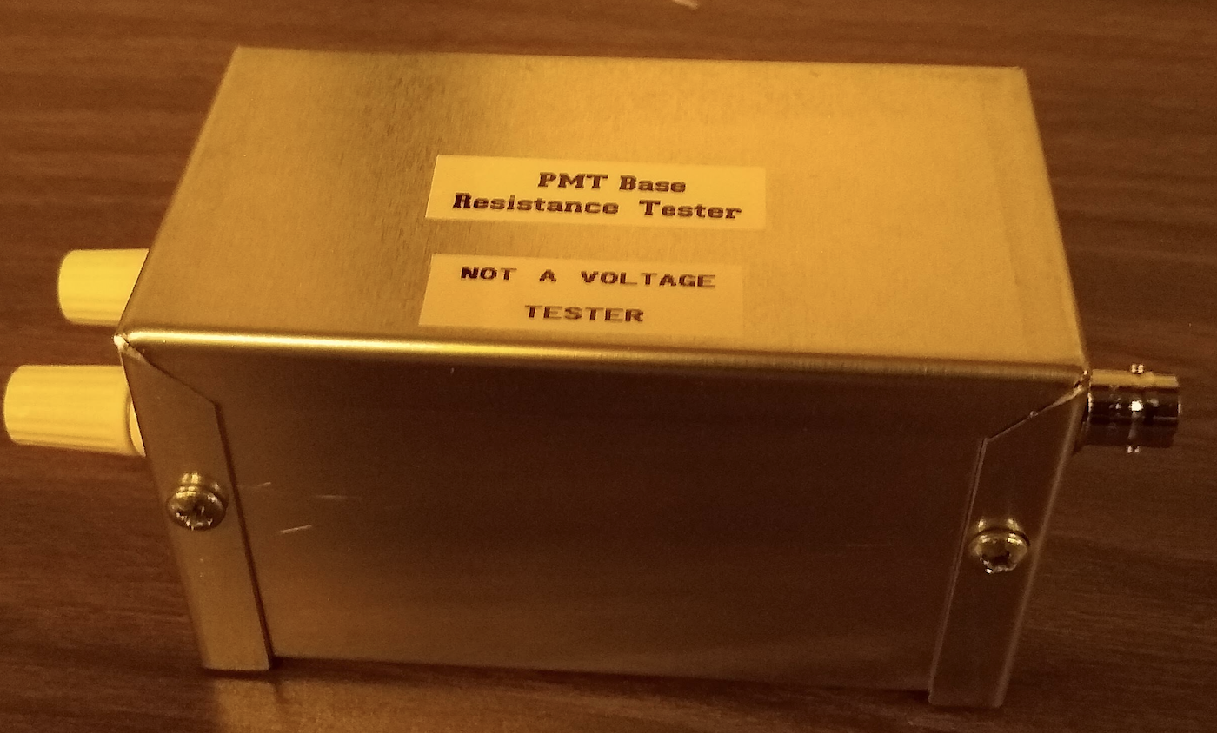
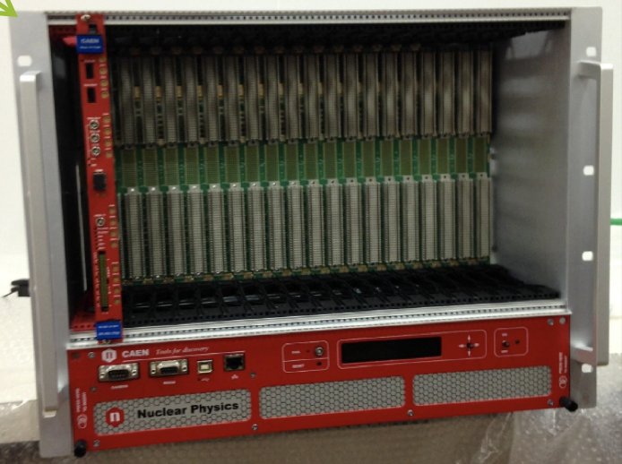
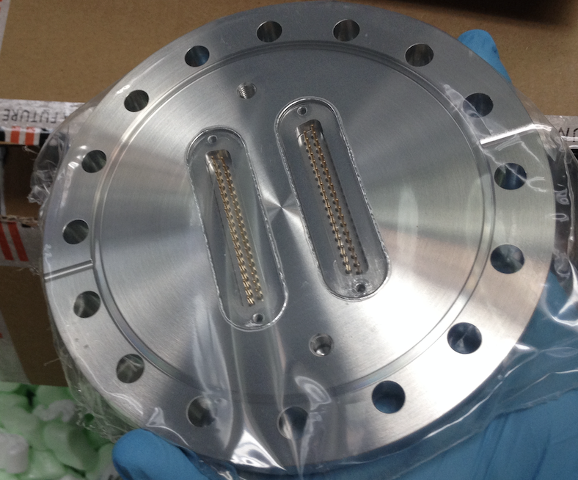
Light Systems (WBS 2.04)
from Vishvas Pandey
PMT System
Reception Tests
All 24 PMT boxes are tested and ready.
PMT QA/QC benchmark database is created from the reception tests.
All (10) diffusers and diffuser mounts are fully assembled at LANL and are ready to be shipped.
X-ARAPUCA System
Shipping from Brazil
APSAIA read out boards (V1730s) arrived at FNAL. The CAEN crate is already at FNAL.
X-ARAPUCA feedthrough Tee and APSAIA feedthrough are being prepared to be shipped to FNAL.
PMT resistance tester (made by Paul/Linda)
CAEN crate and readout board
APSAIA feedthrough

Slide 8
DAQ and Electrical Installation (WBS 2.07)
from Bill Badgett
Began TPC Detector and Cold Electronics Power rack installation
Planning PDS readout and power racks installation
Set up and configured DCS (Slow Controls) production network
Installed production DCS server and moved DCS processes to their final home
Installed production Timing interface server
Set up production 10 gigE DAQ production network, begin testing TPC readout there
Continue TPC readout stress tests and continue trigger integration
Planning cable tray layout for top of the detector

Slide 9
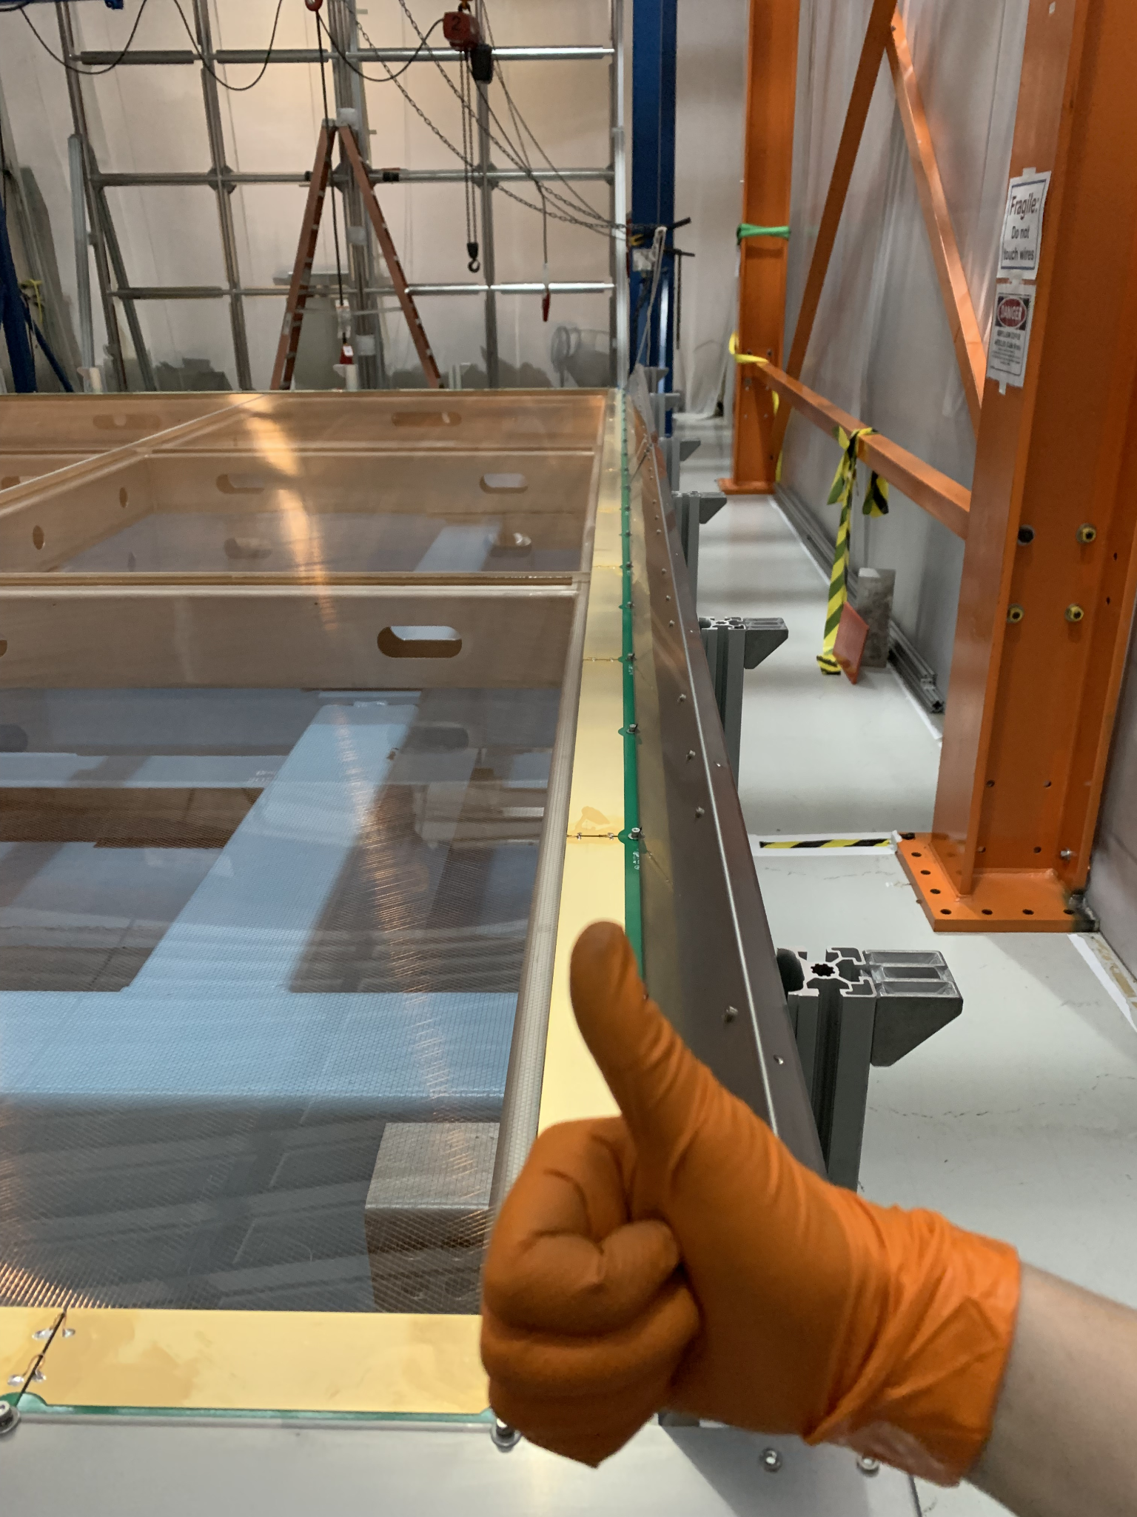
SBND Assembly (WBS 2.08)
from Nicola McConkey & Roberto Acciarri
Clean tent is complete and cleaned
APA hangers are being fabricated in the Fermilab machine shop – APA critical path
~2 month delay - supply issues for large cross-section SS bar
APA support beams completed and being cleaned onsite
Preparing for test installation in atf today or next week
Test installation of CPA beam in atf two weeks ago
good practice for CPA installation
Unfortunately, the FR4 H-brackets that are part of the CPA hanger system were fabricated with wrong fiber alignment – CPA critical path
sending back to company for replacement
~1 month schedule delay
Maintaining two parallel plans for assembly with either CPA or APA going first
fabrication schedule for APA hangers and H-brackets will decide
CPA could be installed in June pending on H-bracket replacement
All CE hardware (Faraday shields, cable trays, ... ) arrived
test fitted several pieces around the APA plane in the clean tent
cable tray assembly started in the Hurricane deck
Thumbs up for the Faraday shield test fit

Slide 10
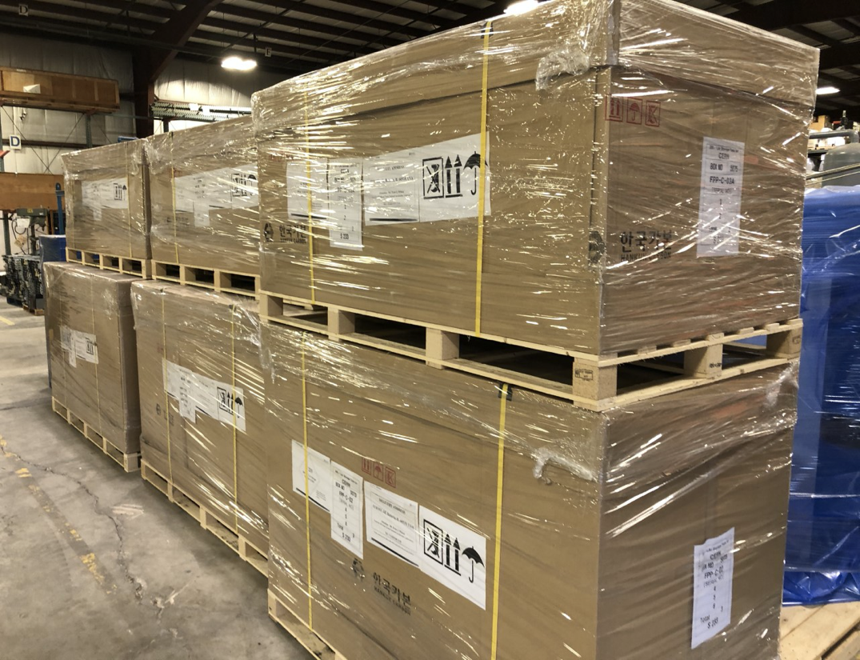
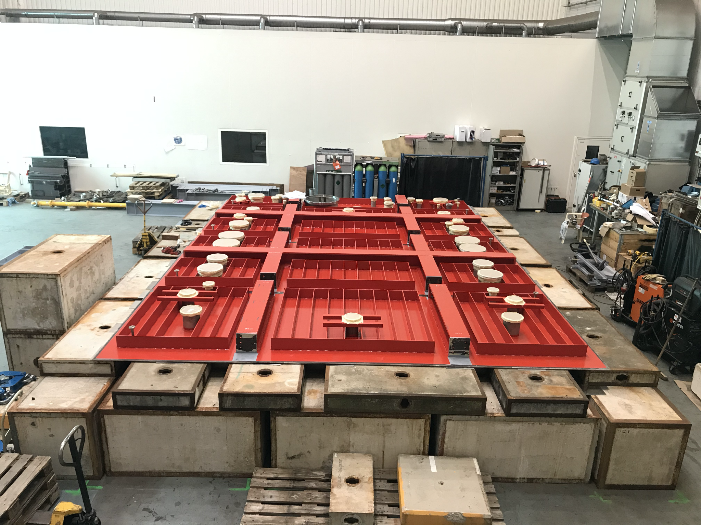
SBND Cryostat (2.09)
Top cap was test assembled at CERN before shipping
Mockup of exact cryostat dimensions
date of shipping and test fitting/ installation sequence to be worked into the cryostat installation schedule
Stairs and decking installation started on the warm vessel
Last shipment of membrane cryostat materials arrived
Cryostat installation plan
contract almost ready to be placed by CERN
Installation is foreseen in phases (see next slide for details)
Detail planning meetings between FNAL & CERN started in late May
Cryostat material in the warehouse
Top cap test assembly at CERN

Slide 11
Cryostat Installation Plan - outline
Installation is foreseen in four phases
stud positioning (short, ~ 2 weeks) – CERN + Contractor + FNAL
insulation panel and secondary membrane installation (long, ~ 6 weeks) – Contractor + CERN + FNAL
primary membrane installation (long, ~ 6 weeks) – Contractor + CERN + FNAL
testing (short, ~ 2 weeks) – CERN + FNAL
Total work time is ~ 4 months, calendar time about 6 months
Team returns home to Europe for several weeks (tbd) between phases
some overlap between team members for each installation phase, eg CERN supervisors
Start date driven by completion of travel/Visa approvals for first team and delivery of tools to Fermilab
Earliest installation start: end of July 2021
Expect to finalize the schedule around the end of June
Will implement the phased installation approach into the project schedule in June/July

Slide 12
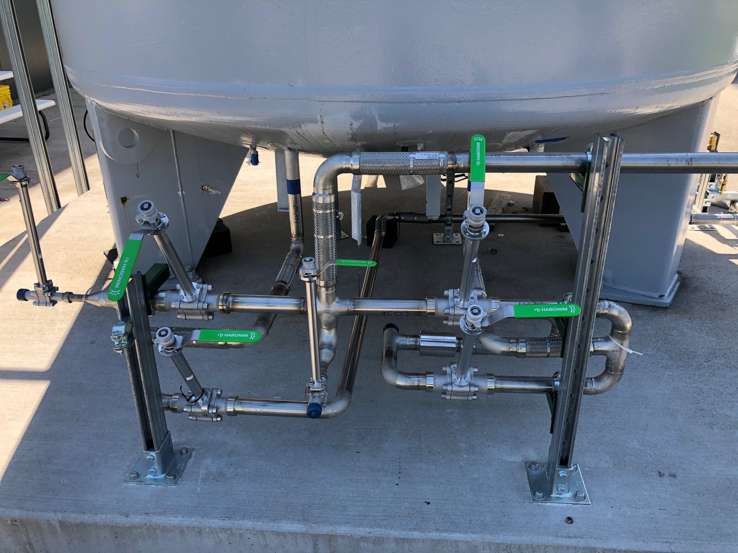
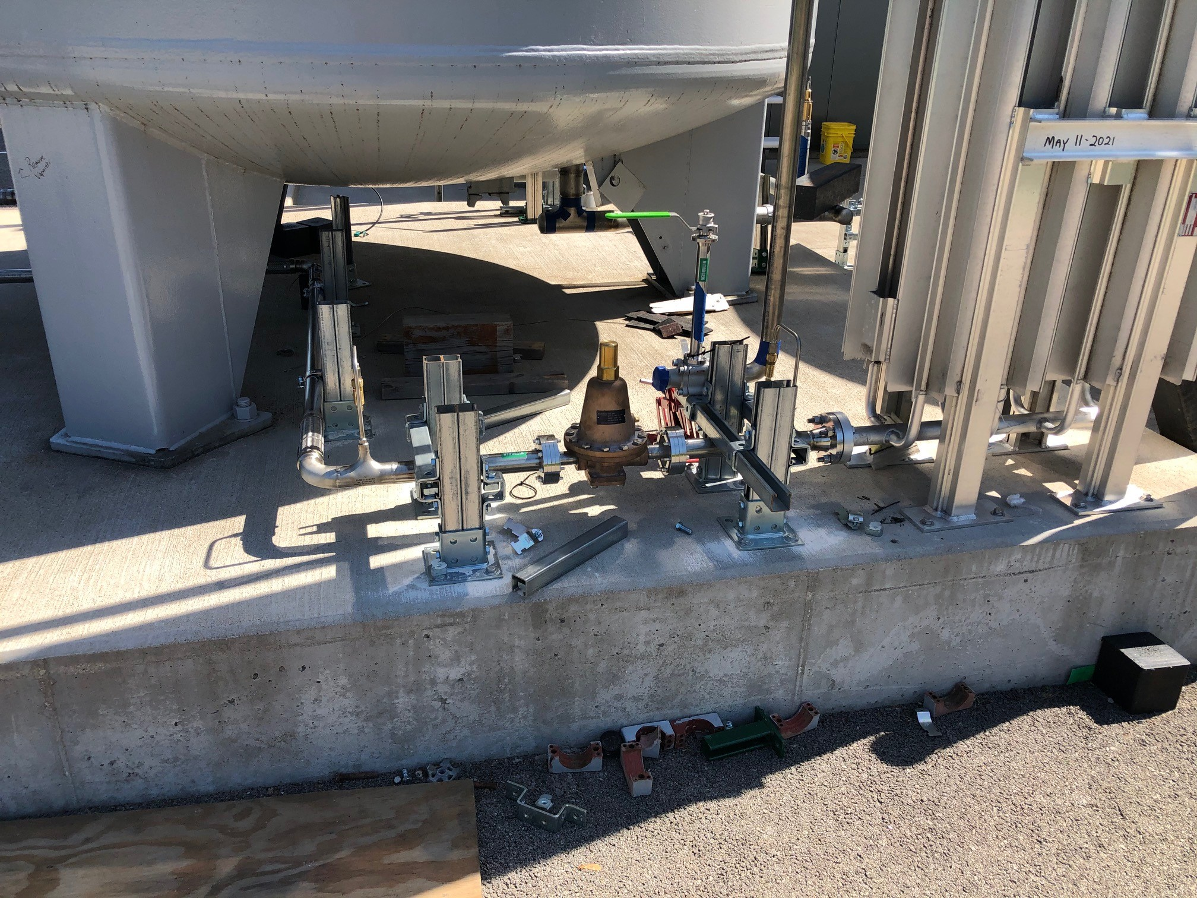
SBND Cryogenics (4.03)
Installation work of dewar piping outside SBND has started
Working to complete LN2 dewar
All subassemblies ready for LAr dewar
Controls panel installation and wiring progressing inside SBN ND building
Primary relief vent design being finalized between engineers and designer
started work on installation plan, procurement to follow when design is final
cryogenics piping installation on the outside LN2 dewar.

Slide 13
SBND Schedule
Expect to complete the cryostat in early CY 2022 – currently critical path
Expect to have detector ready to move to SBN ND building in early CY 2022
Final installation of the detector in the cryostat, completion of cryogenics and top of detector installation will take several additional months
Detector ready to fill in late summer or fall of CY 2022
Will update milestone projections once the cryostat schedule has been finalized with CERN

