Slide 1
CRP consortium meeting: 7/04/2021
General news: WBS, CDR, April technical reviews....
Status of activities preparing CRP of cold box tests
CRP Assembly operations for first CRP in 2021

Slide 2
General News:
Matt Worcester (BNL) has agreed to serve as the manager for the US contributions to the Vertical Drift CRP
He will work closely with Cheng-Ju Lin the US manager for FD-2 Bottom CRP Electronics and responsible for delivering electronics to the bottom CRP factories
WBS and CDR
Activities on WBS and costs estimates ongoing, (needed to consolidate the project on the US side):
First draft exists
To be completed by mid- May 2021.
Editing activities of the CDR evolving from proposal document:
Should describe the baseline and alternatives with a version to submit to LBNC by July
Editorial team A. Heavey, S. Palestini, M. Marshak
Persons of contact for the different chapters => consortia representatives
CRP chapter has to be reviewed for outline, modifications and updates: discussion with Anne, Sandro and Marvin probably next week (after April 12th)
https://wiki.dunescience.org/wiki/DUNE_FD_Vertical_Drift_Proposal-Report

Slide 3
General News:
April reviews:
CRP Conceptual Design Review: April 20th from 8:00-12:00 (CT) (15h-19h CERN time)
This will be in front of an internal audience. It will serve as a sort of rehearsal for the material to be presented at LBNC review on April 28th
We should also make sure that the requirements are understood and reasonably complete

Slide 4
What to prepare and present on CRP for Vertical Drift FD module:
For the CD Review on April 20th details of all the following topics have to be addressed:
Requirements: => specifications, key design parameters in connection to physics requirements (to complete by April 11th)
Scope and team (similar to what was described on Jan 25 consortium meeting, use the same material)
FD CRP conceptual design and progress since the proposal
Anodes (Bo/Serhan)
Mechanics (Benjamin, D.D.)
Interfaces (electronics, cathode, detector support…) (Serhan, DD + other consortia)
Assembly factories (Benjamin, Matt)
Installation (CERN/LAPP…)
Plan for R&D and prototyping: activities going on and first CRP preparation (CERN, LAPP….)
50L, Cold Box, Module 0
Risks register to fill

Slide 5
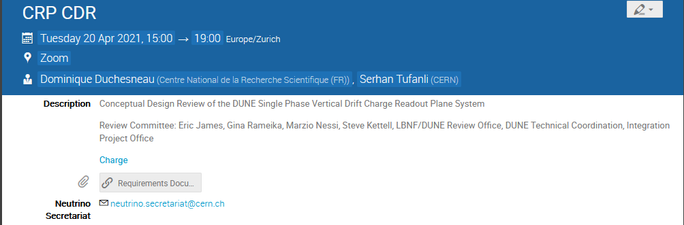
An indico page is setup and ready to fill the agenda:
April 20th from 8:00-12:00 (CT) (15h-19h CERN time)
Proposal for the main talks: (to be refined in the coming days with sub topics + suggestions):
- CRP overview and requirements - CRP design status and progress since the proposal - Plan for R&D and prototyping: activities going on, first CRP preparation and towards Module0 + potentially something on CRP Assembly factories and Installation

Slide 6
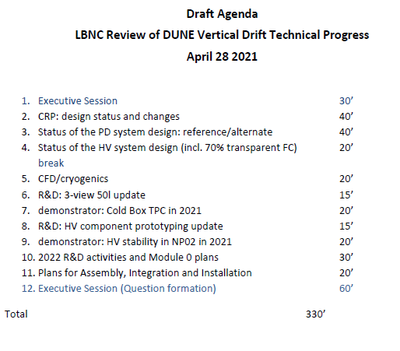
General News:
April reviews:
On April 28th: 1-day technical review of SPVD by the LBNC
CRP will have 40mn presentation on design status and changes (3 first bullet points of previous slides)
The contributions on R&D and prototyping activities will be included in 2 other talks

Slide 7
Key steps for CRP project
Small scale tests of CRP components
2021
Cold box test of a first CRP with anodes (0,90,48)
Cold box tests of complete top and bottom CRPs
2022
NP02 module 0: full CRPs
2023
Production
CRP assembly and installation for a DUNE FD

Slide 8
CRP Assembly sites general view:
The organization and detailed understanding of the activities foreseen in the assembly sites to be developed in coming months
Some basic assumptions used for the WBS initial version
Components arriving in assembly sites:
Anode PCB (1.7m x 3m)
Adapter boards
Connectors (edge or to solder) for the anodes
Spacers and screws
Support frame
Steps of assembly:
For each anode put on a table:
solder the connectors
Connect the adapter boards
Insert the spacers on each PCB « collection layer »
Attach the anode PCB layer with the adapter board on the composite frame
Attach the second anode PCB « shield layer »
Connect the strips (use edge connectors)?
Electrical tests
Install on temporary frame for cold box tests
Perform cold test
Pack the CRP in its transport box
Tests to foresee in assembly sites:
Electrical continuity
Noise measurement for CE
Cold ‘open bath’ test: mechanical and electrical

