Slide 1
DUNE Vertical Drift CRP production 04/2021 B.Aimard, G.Deleglise, D.Duchesneau, N.Geffroy

Slide 2
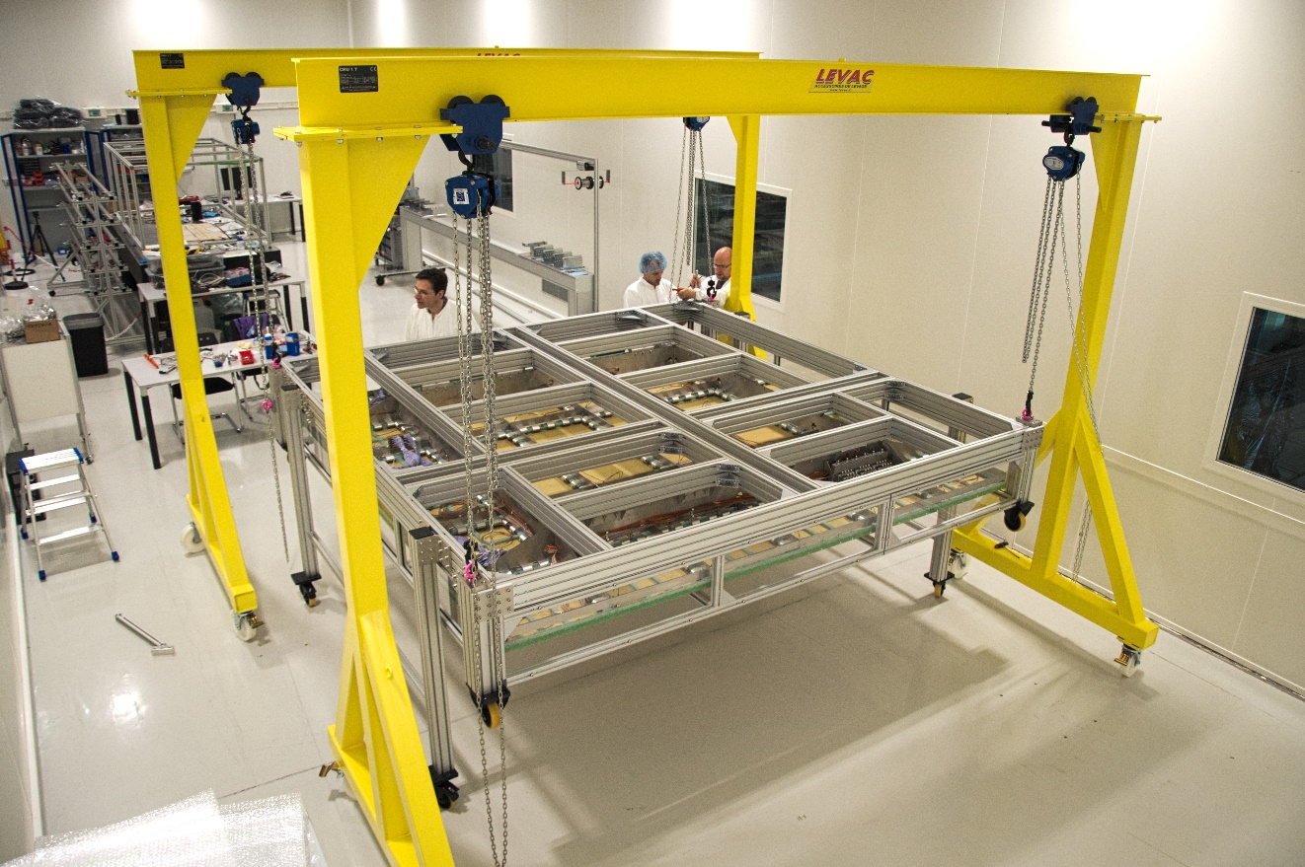
ProtoDUNE DP installation
Overview of the ProtoDUNE Dual Phase CRPs is available here :
https://lapp-owncloud.in2p3.fr/s/fPC2Sb8KfesLMoS
Clean room dimensions : 20m x 6m x 5m

Slide 3
Clean room 185 tooling
Optical table
Elcom structure

Slide 4
Anode production
Anode panels are glued together on the optical table (in a vacuum bag)
Connections are printed
Done by Rui’s team
Once glued, panels can be safely moved and fliped by hand by 4 persons (confirmed by Rui)
1686
500
Optical table
Elcom supporting structure
Detachable centering « ears »

Slide 5
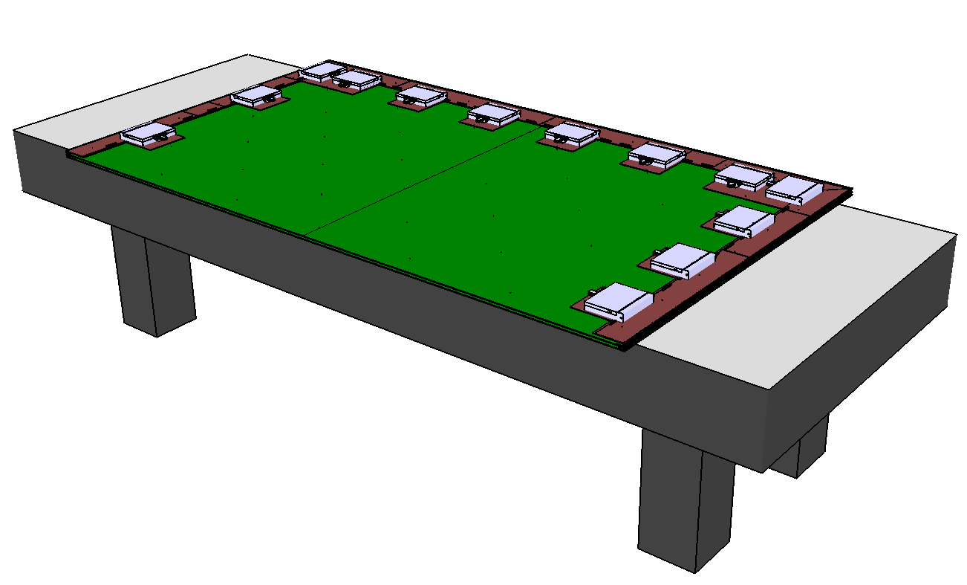
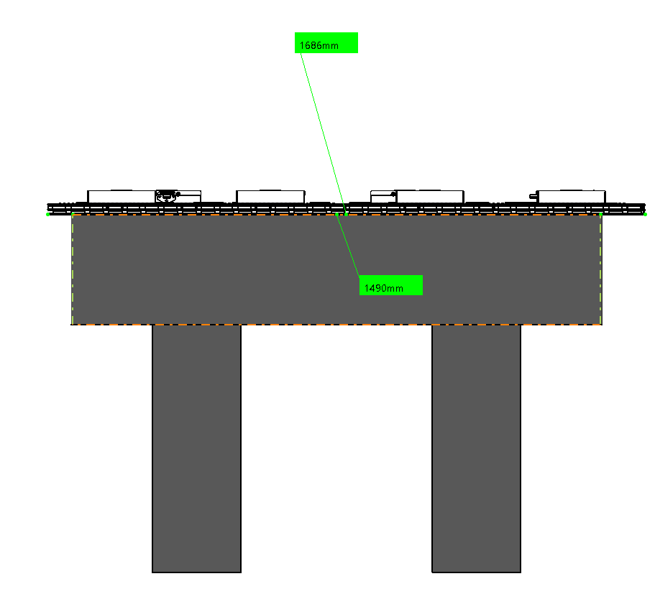
Necessary to enlarge optical table?
1686
1490
2998
3990
Is it necessary to extend the table to cover the whole anode surface?
Should we foresee a smooth covering to avoid scratches when sliding the anode?

Slide 6
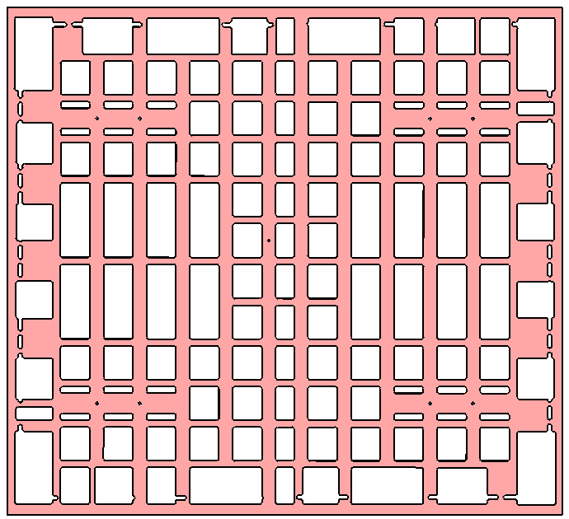
Composite frame transparency
Last version of the composite frame, under mechanical studies
Transparency : ~56%
To be validated with manufacturer (bid will be proposed soon)
Estimated planarity in specs, results will be presented in details soon

Slide 7
Spacers geometry
Composite frame
Adapter board
Anode Collection
Anode Shield

Slide 8
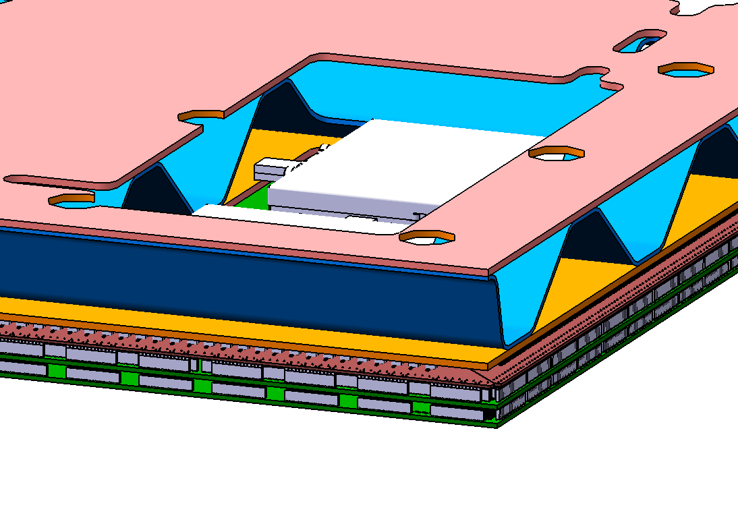
Are Anodes spacing ok?
M4 nut + washer
Ok?
M3 screw
Dimensions are from CAD files, can we consider them final ?

Slide 9
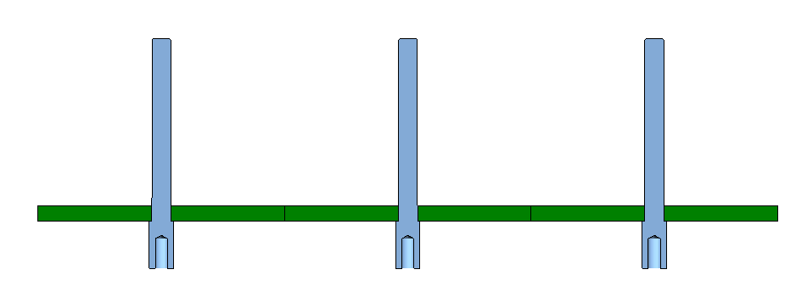
Anodes assembly
The 58 plastic spacers are placed in the panel
best solution following Rui, in development by LAPP
PEEK or Nylon should be suitable (support 50 or 30 kg by spacer in traction)
Performed on Elcom structure to access from below
Tightening must be insured here
Anode collection

Slide 10
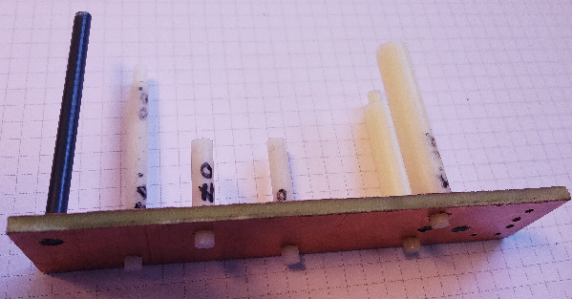
Adjustment sizing tests
Adjustment between +20µm and +80µm are suitable
If adjustment is betwenn -10µm and 0, insertion is possible manually
Liquid Ar/N cooling of the pin induces a -40µm contraction on the diameter
Eltos provides very good tolerances on 2,5mm holes (<10µm), is it possible to get the same for 4mm fixation holes ?

Slide 11
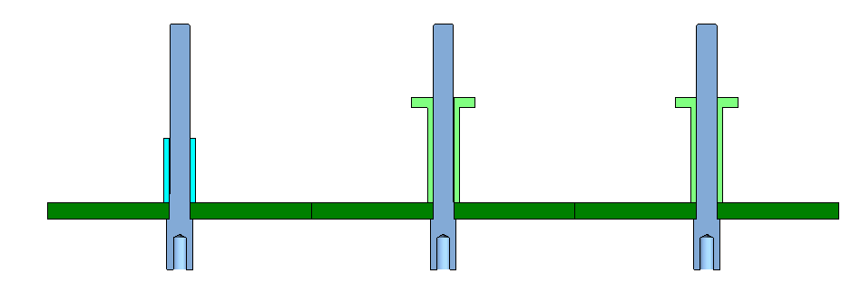
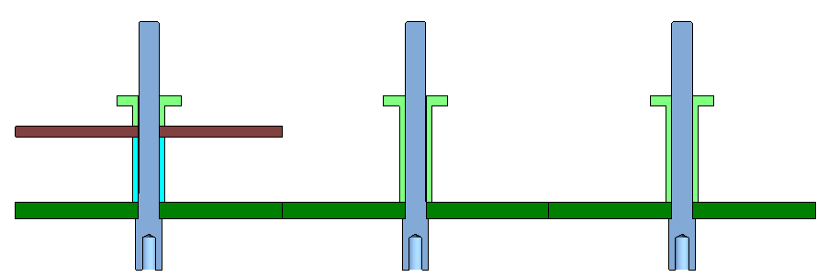
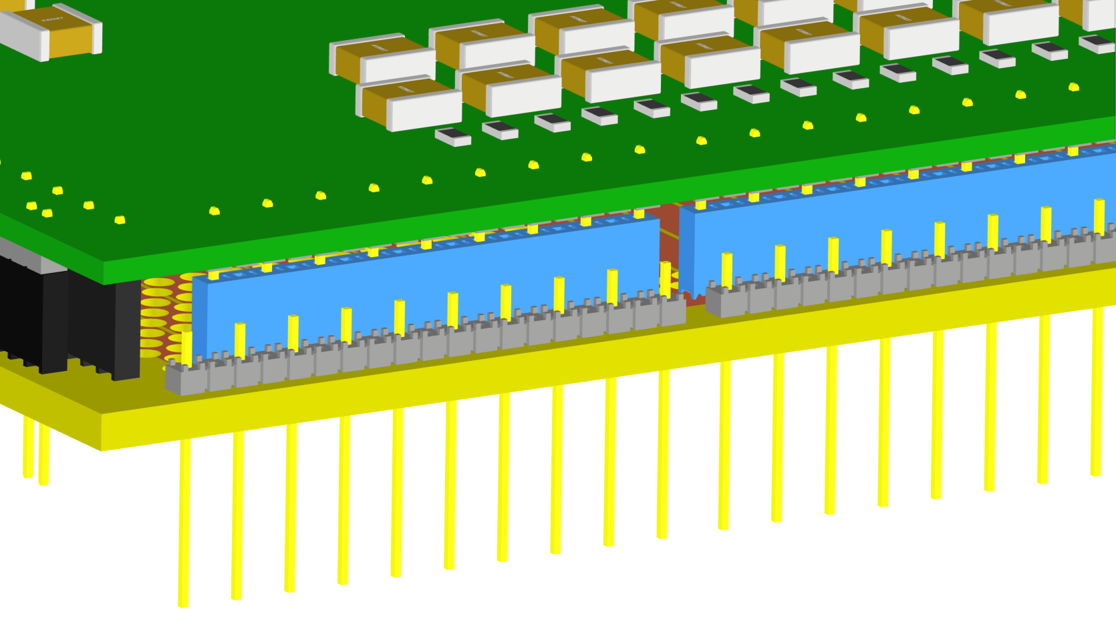
Next steps
Step A
Spacers insertions
Electrical connections + Adapter boards mounting by CERN team
See Bo’s slides, 17/03/2021
Step B
Step C

Slide 12
Connection to composite frame
Optical table
Elcom supporting structure

Slide 13
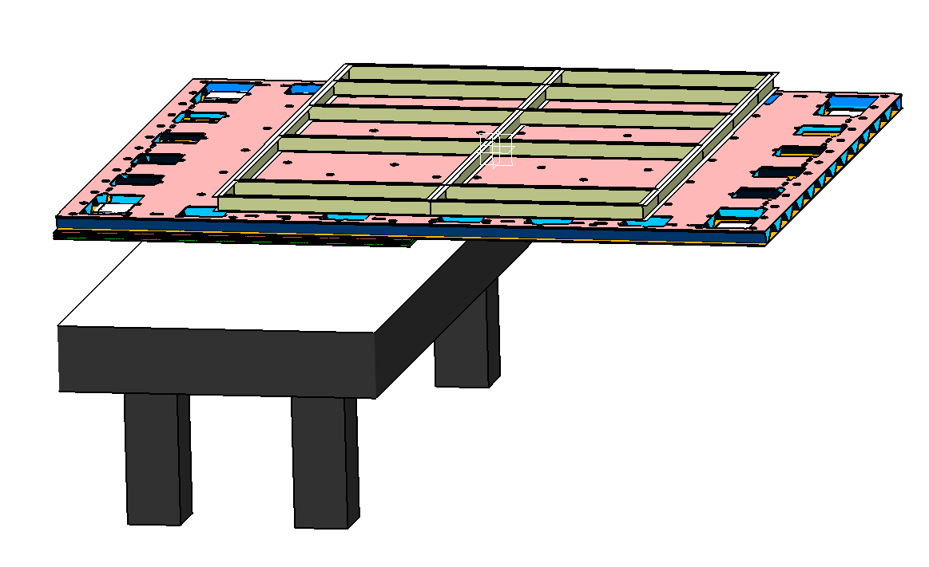
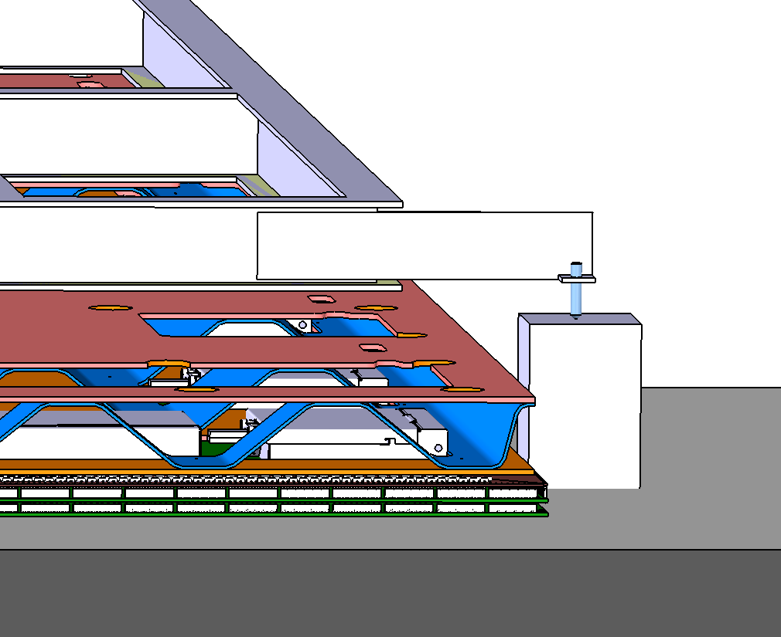
Composite frame is brought above anode with the crane, then laid on adjustment arms
Precise vertical positionning thanks to ball-screws

Slide 14
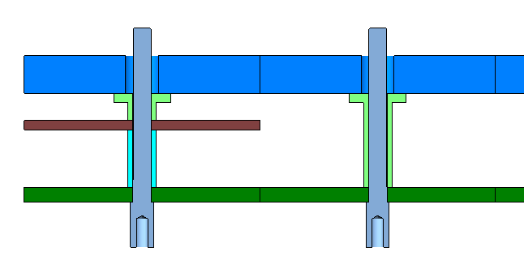
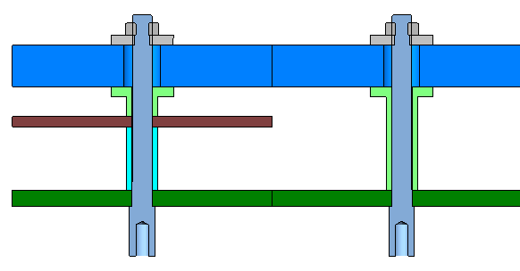
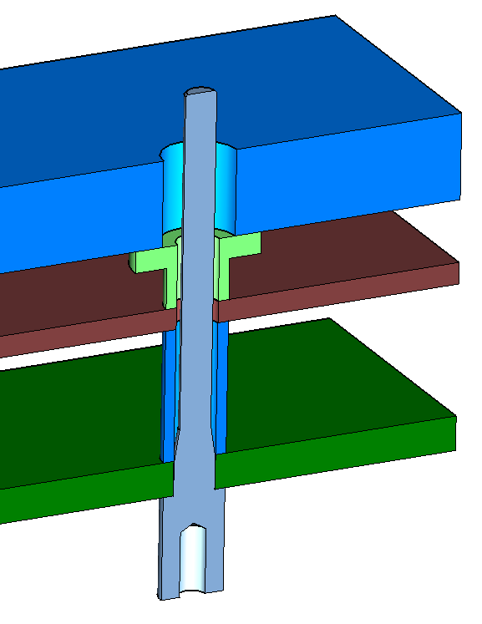
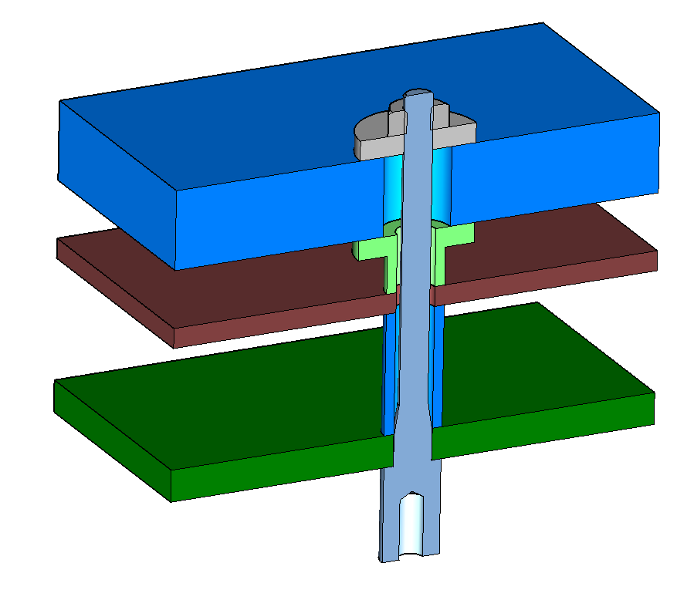
Composite frame – Anodes connection
Special tooling is used to access the top of the composite frame (even the middle) and place the washers + nuts
Step D
Step E

Slide 15
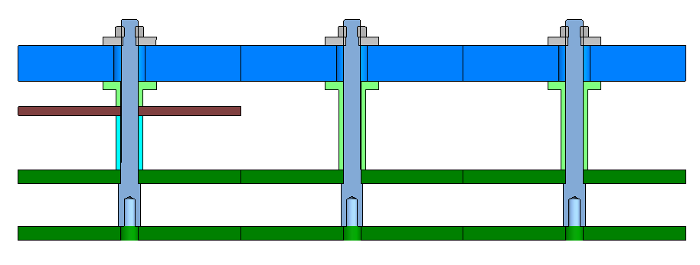
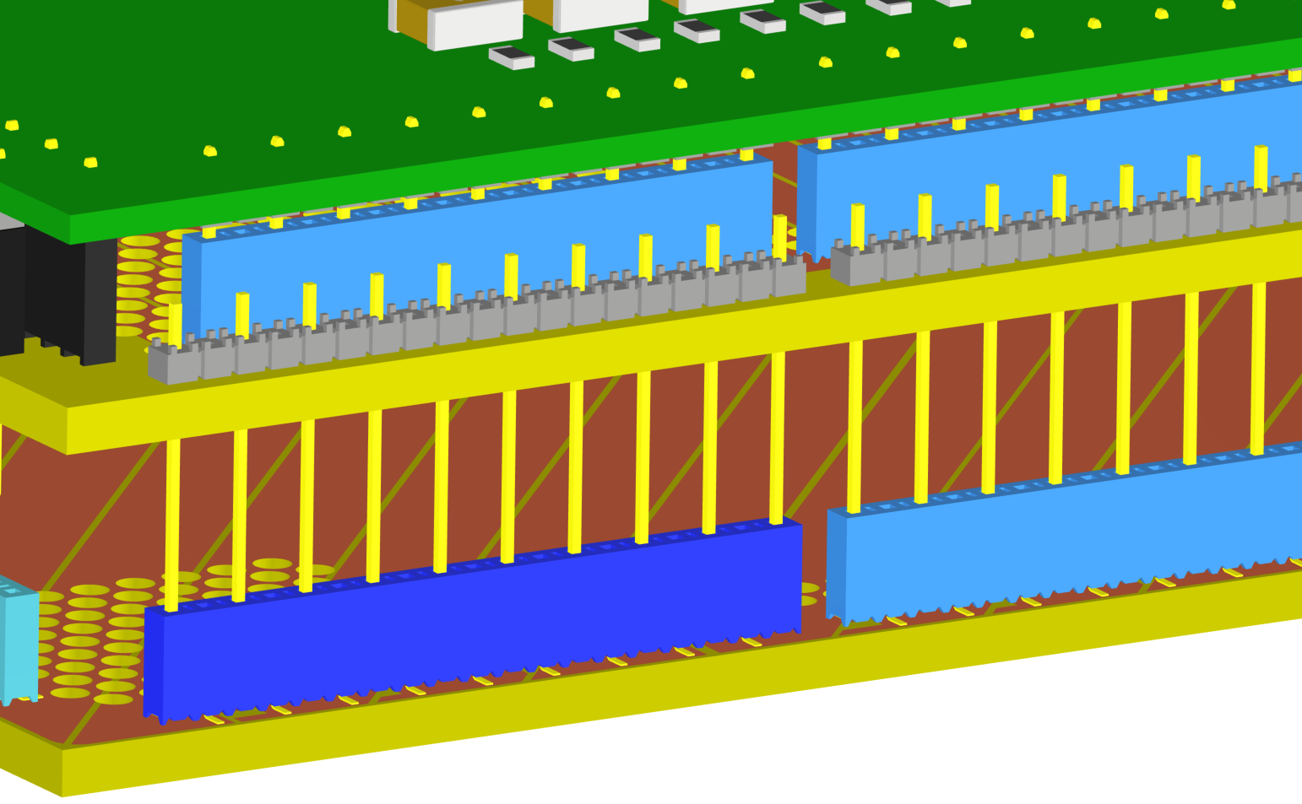
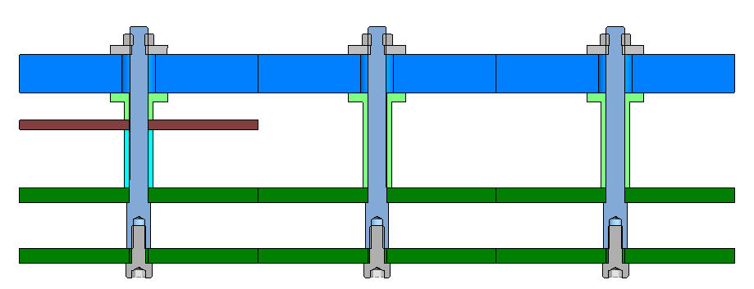
Anode : Shield layer connection
Step F
Optical table
Step G
Elcom supporting structure

Slide 16
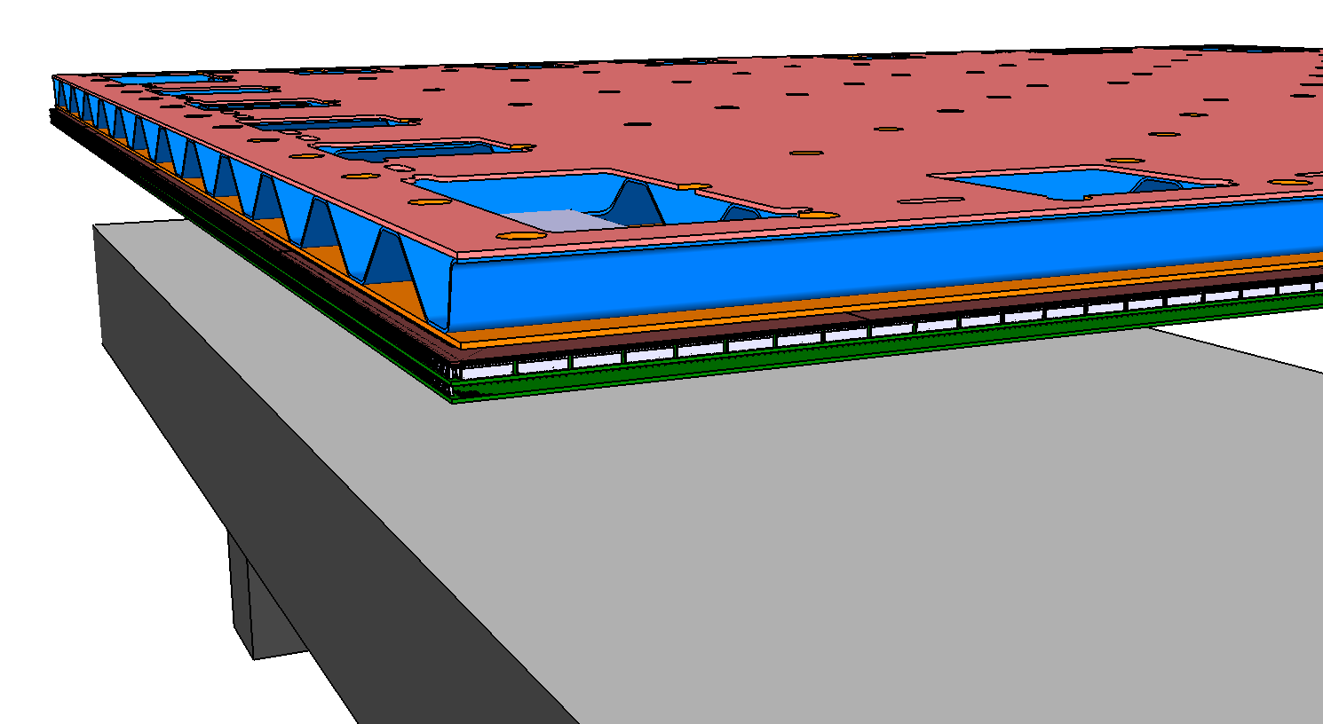
Optical table
Elcom supporting structure

Slide 17
Optical table
Elcom supporting structure

Slide 18
Material studies - Cryolab
CTE measurements have been performed by Cryolab on Anode material and Glass fiber from manufacturer

Slide 19
Material studies : Cryolab
Anode material
CTE 0° = 11,47
CTE 90° = 9,76
Glass fiber from composite frame manufacturer
CTE = 8,87
Little dependance on fiber orientation
Data are included in mechanical simulation to evaluate differential thermal shrinkage impact on deflection

Slide 20
Material studies – CERN Metrology
Measurement of CTE by photogrammetry have been performed with CERN metrology team.
Anodes samples have been included and will provide redundancy with Cryolab’s measurements.
Results available soon.

Slide 21
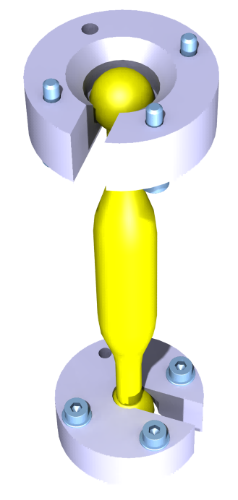
Next steps
Spacers validation
dimensions and mechanical tests
Composite frame final design & thermal simulations
Decoupling system production and tests
Links between metallic and composite frames
Metallic frame final design (+ transport box)
CRP instrumentation integration
Cable routing definition for coldbox test
Suspension feedthrough design modifications for coldbox

