Slide 1
BNL Capabilities to Support Advanced Material Studies
C.S. Cutler, D. Kim, T. Mehmet, N. Simos, L. Ecker,
June 17, 2021

Slide 2
Outline of Presentation
Overview of the Isotope Program
Present capabilities at BNL in irradiation and post-irradiation characterizing accelerator and nuclear materials on materials in utilizing its unique experimental facilities
Discuss some of the previous work
Outline a path forward in both irradiation damage capabilities, an exciting array of micro-characterization techniques at the NSLS-II synchrotron beamlines
Present future capabilities at the Material in Radiations Environment MRE for Post Irradiation examination of radioactive materials

Slide 3
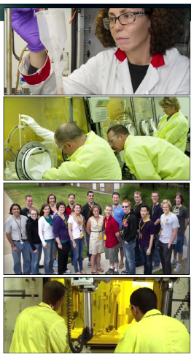
Isotope Program Missions
Produce and/or distribute radioactive isotopes that are in short supply, including valuable by-products, surplus materials and related isotope services, mitigate reliance on foreign supply
Maintain the infrastructure required to produce and supply isotope products and related services
Conduct R&D on new and improved isotope production and processing techniques which can make available new isotopes for research and applications
Attributes:
Core R&D where there are programmatically stewarded activities
Competitive R&D
SBIR/STTR, Early Career Award Program
Nuclear and Radiochemistry Summer School, Workforce Development

Slide 4
DOE Isotope Program Production Sites
Univ. of Washington Supplier of research isotopes (e.g., At-211)
PNNL
Sr-90 Y-90 generator for cancer therapy
BNL
Accelerator (BLIP):
Ac-225 Targeted cancer therapy
Ti-44 Sc-44 generator for PET imaging
Y-86 PET imaging
Cu-67 Targeted cancer therapy
Cyclotron (TR-19)
Univ. of Wisconsin
Supplier of research isotopes (e.g., Mn-52)
ANL Accelerator (LEAF)
Cu-67 Targeted cancer therapy
Michigan State Univ.
FRIB isotope harvesting development
Cyclotron (TR-19)
INL
ATR Reactor:
Co-60 Stereotactic radiosurgery, industrial NDA
Y-12 (NNSA Facility)
Li-6 Neutron detection
Li-7 Radiation dosimeters
Rad EMIS
ORNL
HFIR Reactor:
Ac-227 Cancer therapy
Se-75 Industrial NDA
Cf-252 Industrial sources
W-188 Cancer therapy
Radioisotopes Inventory:
Ac-225 Cancer therapy
Ra-223 Cancer therapy
LANL
Accelerator (IPF):
Ac-225 Targeted cancer therapy
Ti-44 Sc-44 generator for PET imaging
Cd-109 X-ray fluorescence analyses
As-73 Environmental tracer
Si-32 Oceanographic research
Plutonium Facility (PF-4):
Am-241 Oil and gas exploration
Univ. of Missouri (MURR)
Supplier of research isotopes (e.g., Se-75, Lu-177)
Stable Isotopes Inventory:
E.g., Ca-48, Ga-69, Rb-87, Cl-37
Stable Isotope Production:
ESIPP
SIPF
SIPRC
Univ. of Alabama Birmingham
Supplier of research isotopes (e.g., Mn-52)
SRNL (NNSA Tritium Facility)
He-3 Neutron detection
Fuel source for fusion reactors
Lung testing

Slide 5








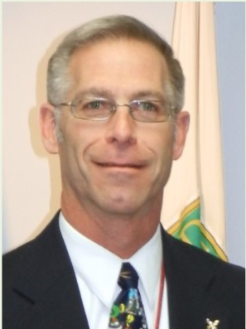
Office of Isotope R&D and Production SC-24.3
Jehanne Gillo, Director
Valerie Mocca, Admin Assistant (CONT)
Luisa Romero, Financial Management Specialist
Andrea Condrad, Financial Management Analyst
Subcontract Support, Bill Newton (CONTR), Leonard Mausner (CONTR)
Isotope Program Operations
Vacant
Technical Advisor, IPA
Radioisotope Production R&D
Ethan Balkin
Stable Isotopes
April Gillens
Isotope Accelerator Facilities
Arne Freyberger
Isotope Reactor Facilities
Jon Neuhoff
Alternative Isotope Production
David Bivans
Isotope Projects
Khianne Jackson

Slide 6
Office of Principal Deputy Director (SC-2)
Principal Deputy Director (SC-2)
J. Stephen Binkley
Office of Budget (SC-21)
Kathleen Klausing
Office of Management (SC-22)
Paul Shlesinger
Office of Project Assessment (SC-23) Kurt Fisher
Office of Engineering & Technology (SC-24)
Office of Diversity, Inclusion & Research Integrity
(SC-2.1)
Julie Carruthers (A)
Financial Analysis (SC-21.1)
Alessandra Pham
Business Operations (SC-22.1)
Alexis Bunn
Office of SBIR/STTR Programs
(SC-24.1)
Manuel Oliver
Office of Strategic Planning & Interagency Coordination
(SC-2.2)
Susannah Howieson
Resource Analysis (SC-21.2)
Michael Osinski
Performance Management (SC-22.2)
Nicole Wright
Office of International S&T Cooperation and Trusted Research (SC-2.3)
Helena Fu
Office of Accelerator R&D and Production (SC-24.2)
Eric Colby (A)
Office of Isotope R&D and Production
(SC-24.3)
Jehanne Gillo
Office of Crosscutting & Special Initiatives
(SC-2.4)
Ashley Predith

Slide 7
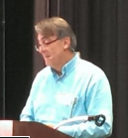
Material Evaluations
Need for materials for high power targetry and accelerator components
Targetry for physics experiments and as IP needs are increasing need for targets that can survive multi-MW irradiations with particle beams.
As has been demonstrated components that have been used for other applications are not always suitable and evaluations are necessary.
Necessary to evaluate the long-term accumulated radiations damage as well as the short bursts that result in thermo-mechanical shock.

Slide 8
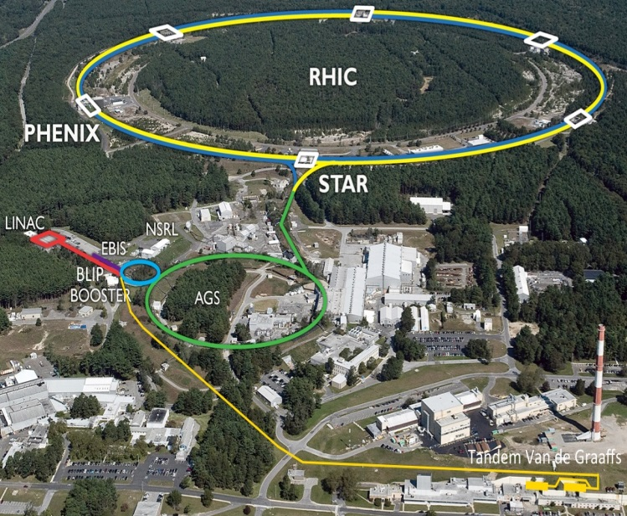
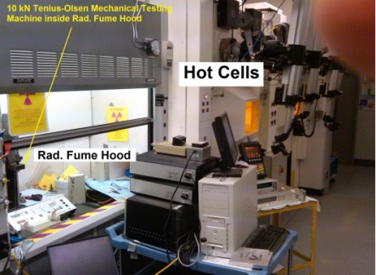

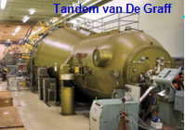
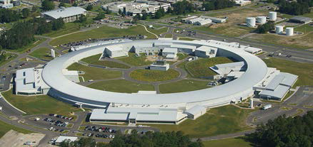
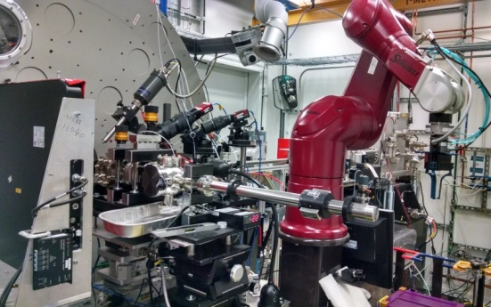
Irradiation and Post-Irradiation

Slide 9
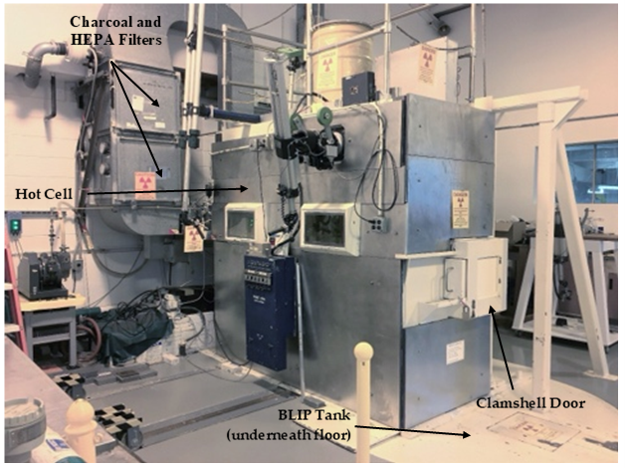
Brookhaven Linear Isotope Producer

Slide 10
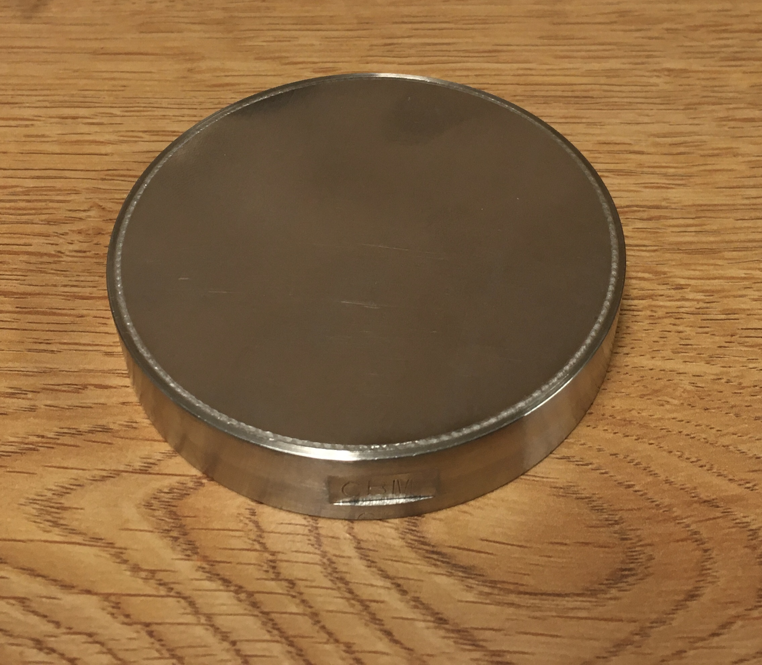
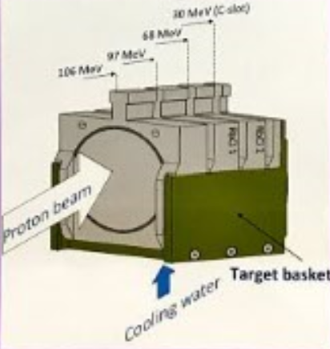
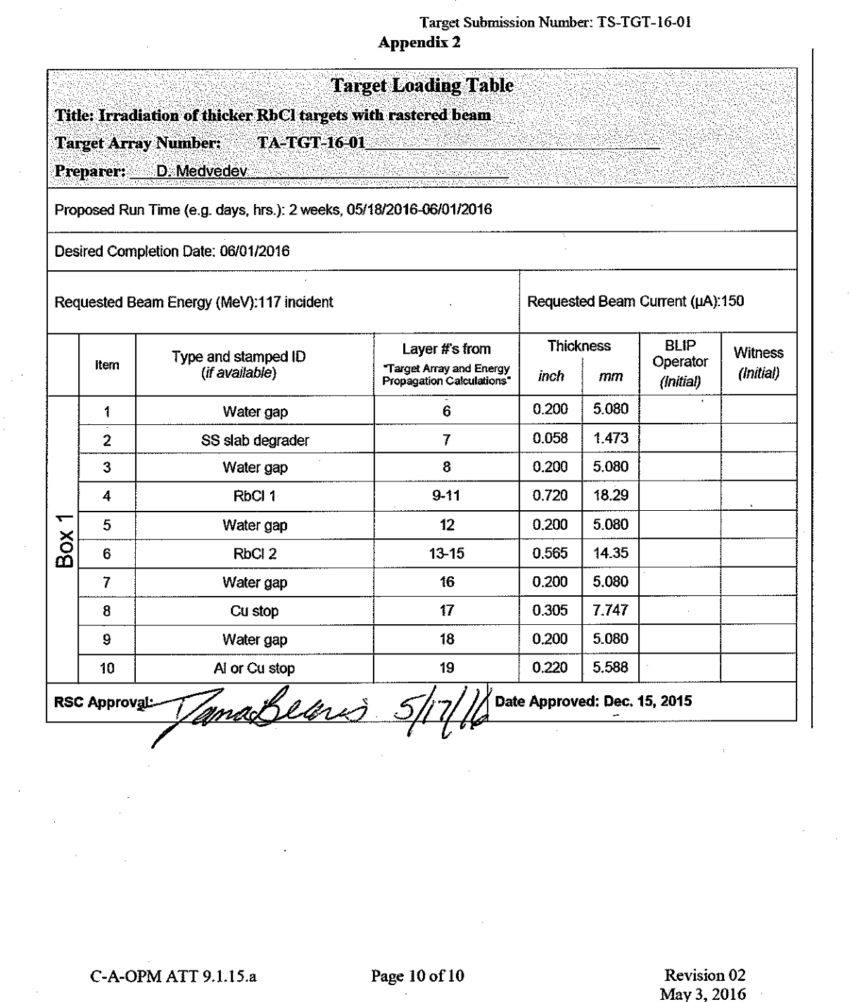
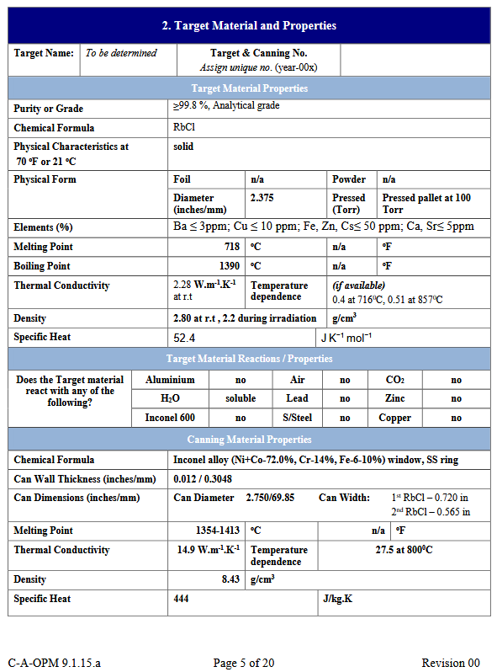
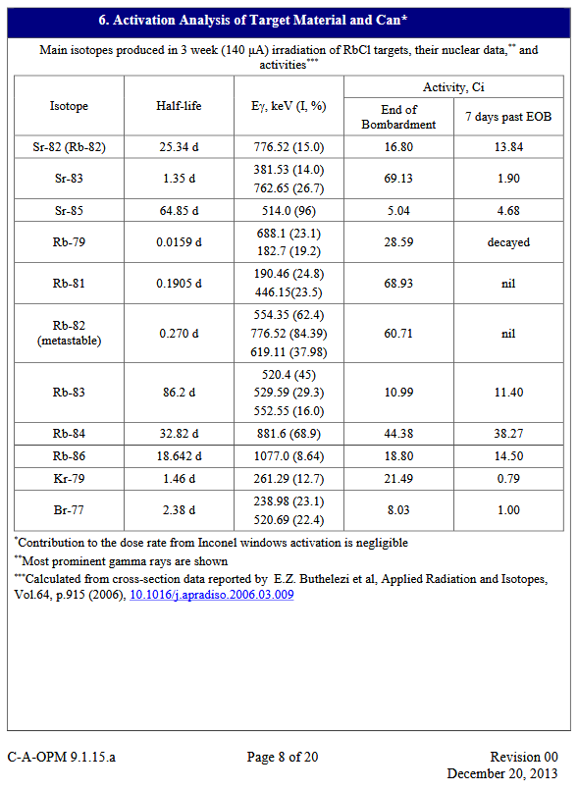
BLIP Targets
Targets are irradiated by the proton beam
  Production targets for Sr
  R & D targets
  LINAC beam intensity: 50-165 uA
  Beam raster lowers power density on target to
  minimize risk of target failure enabling higher current
  and higher production yields
  BLIP equipment allows as many as two target boxes
  per irradiation
Targets undergo review process by Radiation Safety
Sub-Committee including:
  Radionuclides and activity expected after irradiation
  Heating profile and heat transfer calculations
Documentation maintained in “canning record” kept by RSC
Metal foils used for R & D also reviewed against
similar criteria as production targets
Target arrays are configuration managed and checked before irradiations against target loading table
Target

Slide 11
200 MeV H- beams LINAC/BLIP
First beam: fall 1972
85-100% of all Linac pulses go to BLIP
Target irradiation with 66 – 200 MeV, 165 μA
Radioisotope production for diagnostic
(e.g. ⁸²Sr, ⁶⁸Ge) and therapeutic (²²⁵Ac) use
Contact: D. Raparia
Linac Intensity Upgrade Phase II (shovel-ready)
Why : 2x increase in beam current and significant increase
in isotope production capacity
Scope : Linac pulse length doubling to 900 ms for I_{avg} 250 mA
Schedule: ~3-4 years (with cost minimization)
Cost : ~$17.4M (depending on scope and schedule)

Slide 12
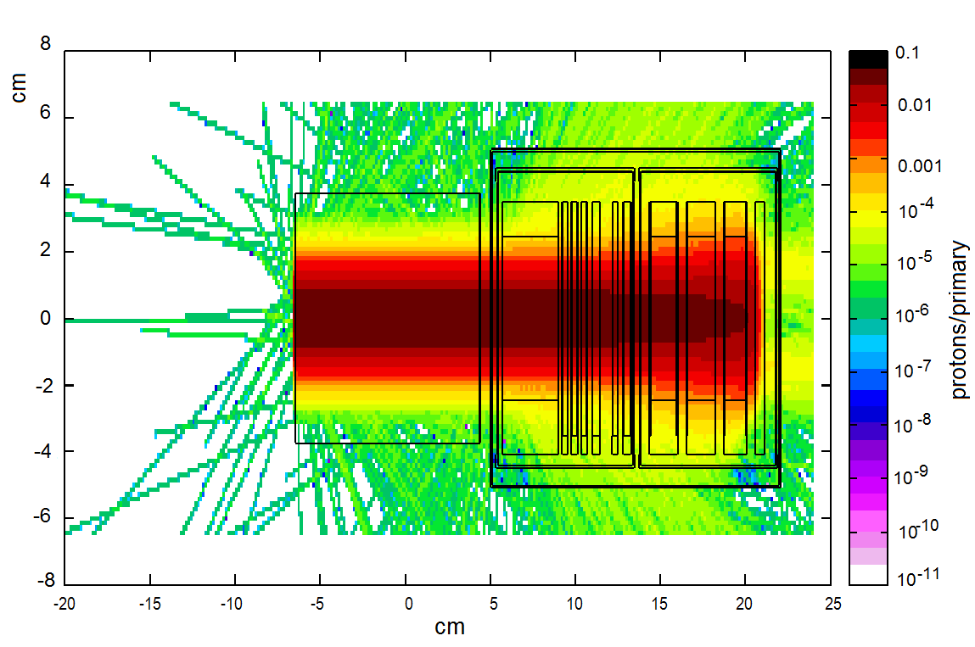
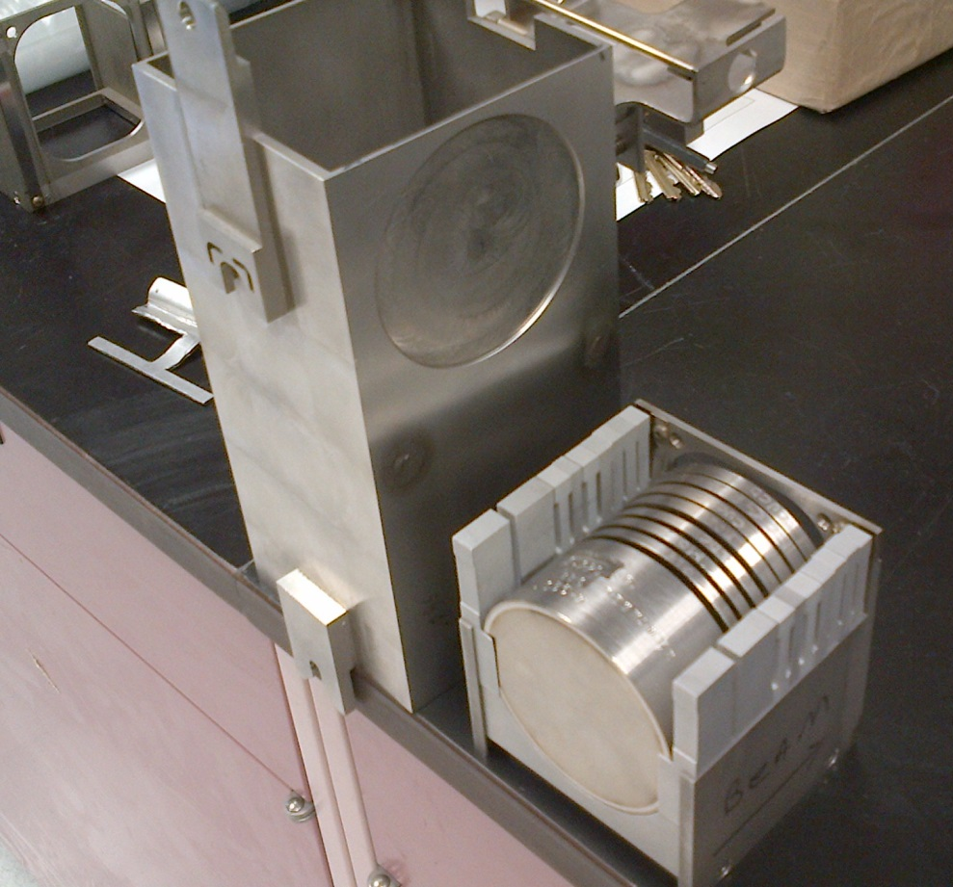
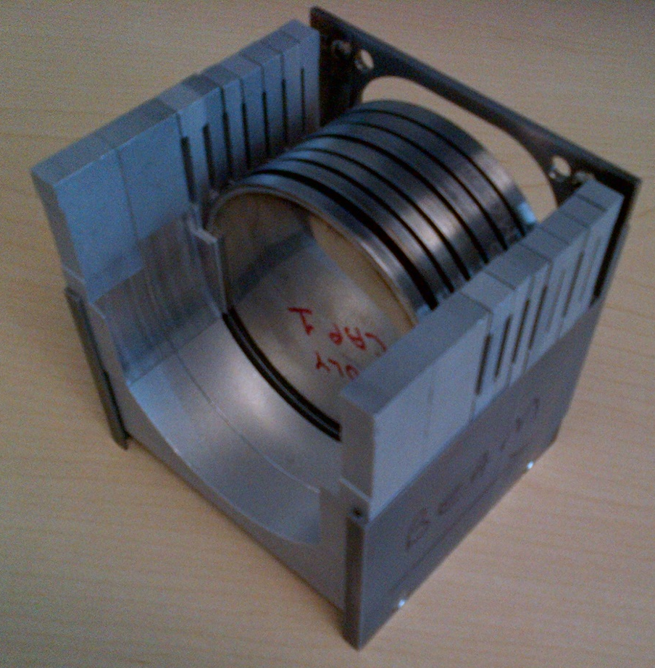
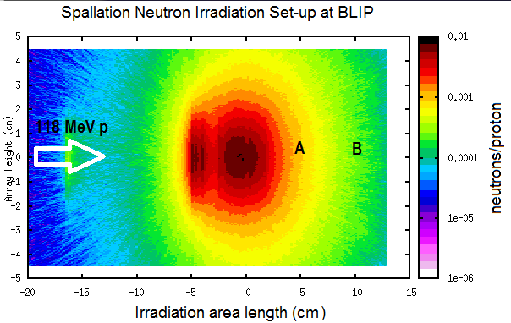
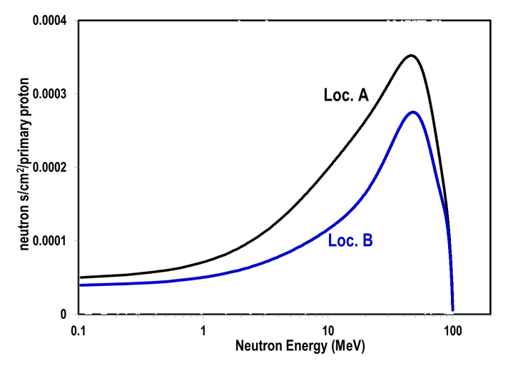
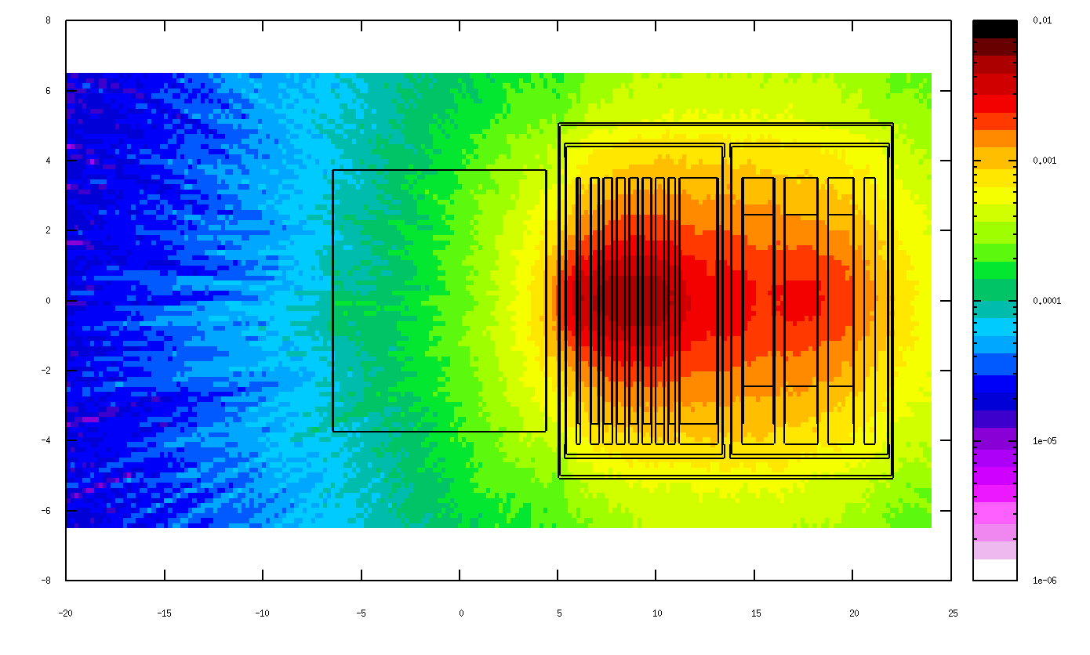
BNL Irradiation Facilities and Capabilities
Linac Protons (up to 200 MeV)
Beam
Fast Neutron Spectra and Nuclear Materials at BNL/BLIP

Slide 13
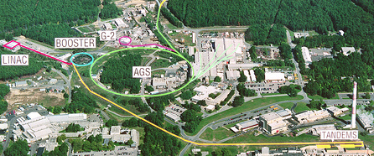
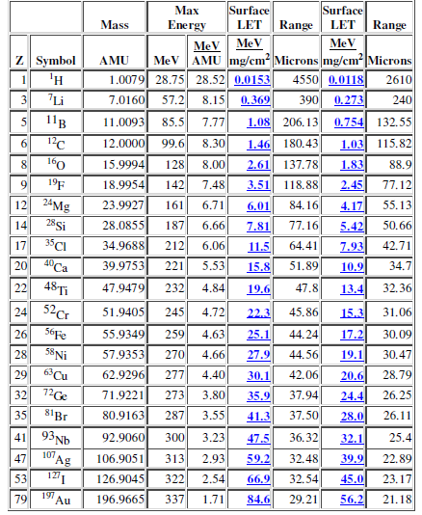
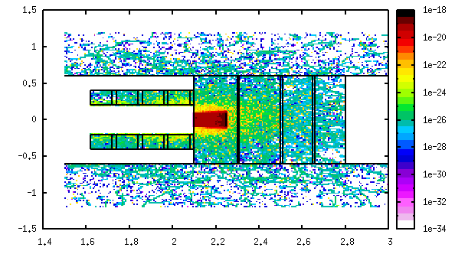
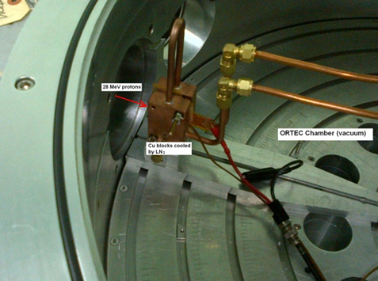
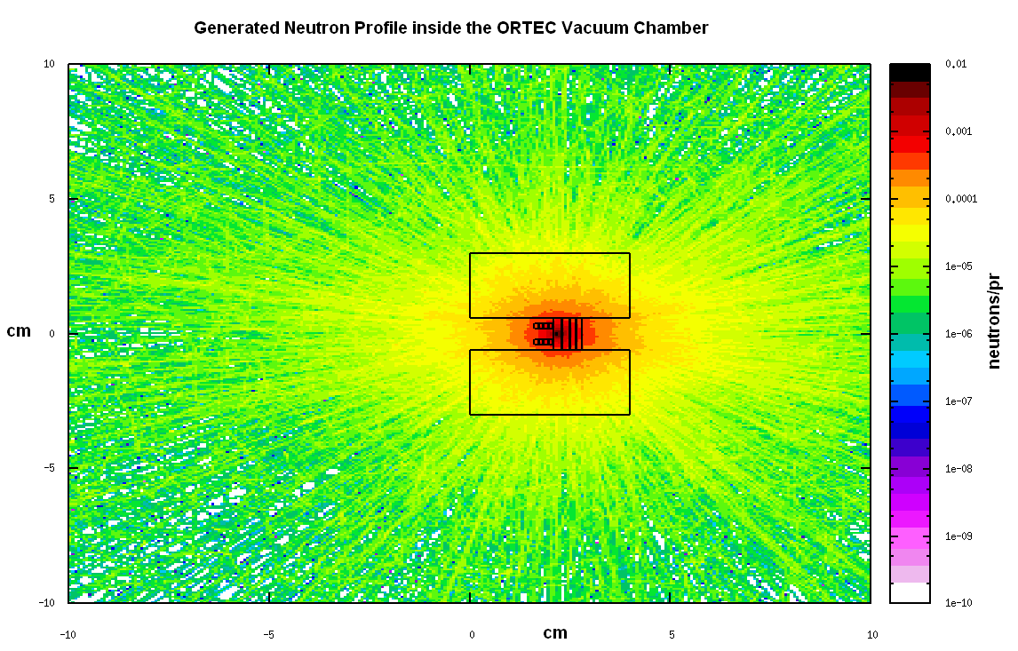
Ion irradiation at BNL Tandem
28 MeV irrad. at sub-zero temp.

Slide 14
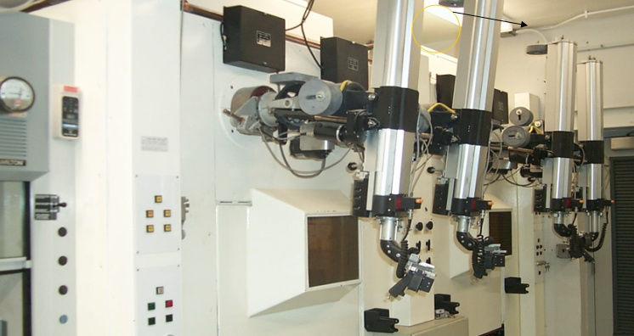
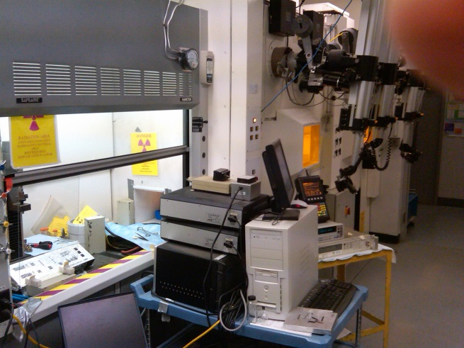
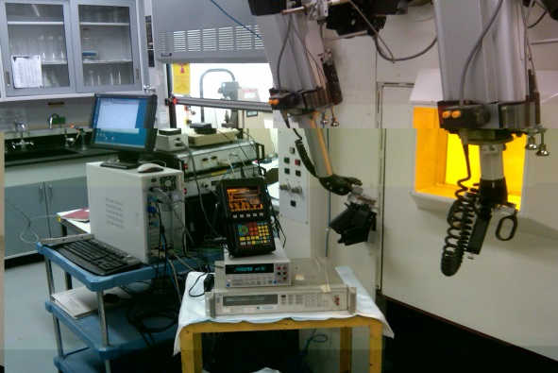
BNL Post-Irradiation Facilities
Isotope Extraction and Processing
Experimental Facility occupies 2 hot cells and a HEPA-filtered fume hood
PLUS
Photon spectra and isotopic analysis
Activity measurements
Weight loss or gain

Slide 15
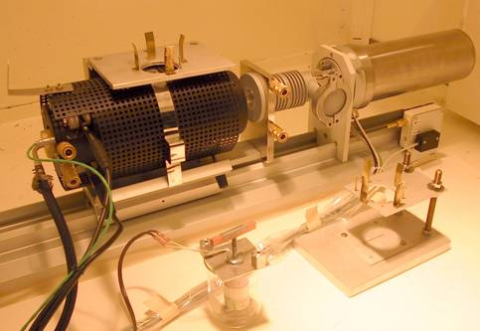
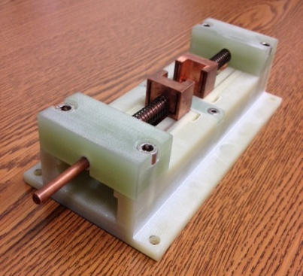
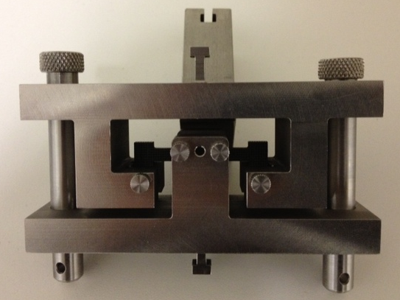
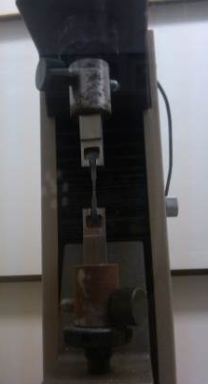
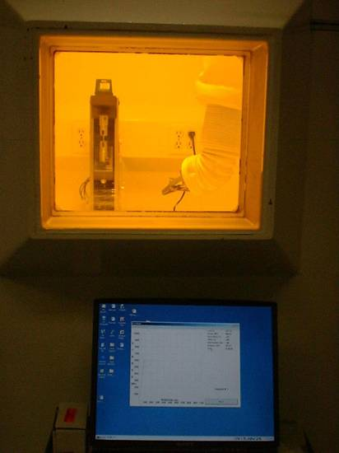
BNL Post-Irradiation Facilities
Isotope Extraction and Processing at BNL
Macroscopic PIE analyses performed are:
Stress-strain (tension, 3-point and 4-point bending)
Thermal Expansion and annealing (sensitive dilatometer, Linseis)
Thermal Conductivity (electrical resistivity)
Magnetic Whole probe
Ultrasonic measurements

Slide 16
Post-Irradiation Characterization
at BNL Synchrotrons

Slide 17
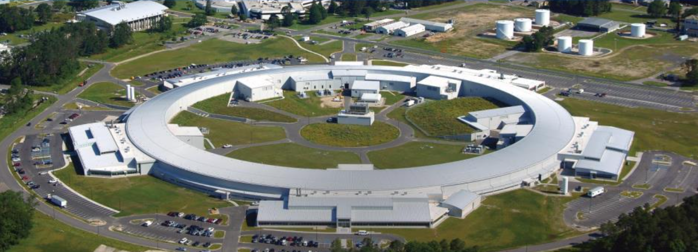
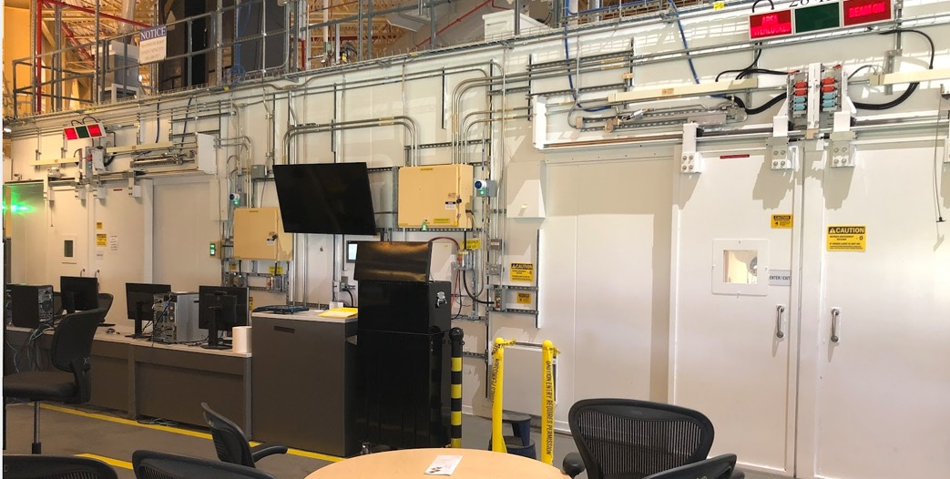
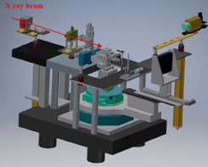
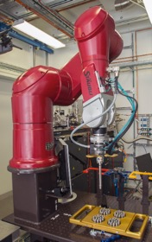
PIE: X-ray diffraction of irradiated materials
D-hutch
(in comm.)
High-resolution X-ray diffraction
beamline (XPD) at NSLS-II
C-hutch
(in production)

Slide 18
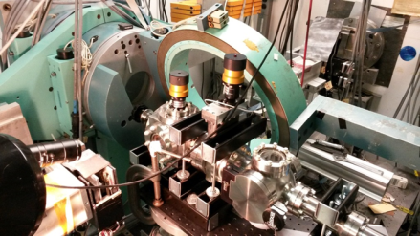

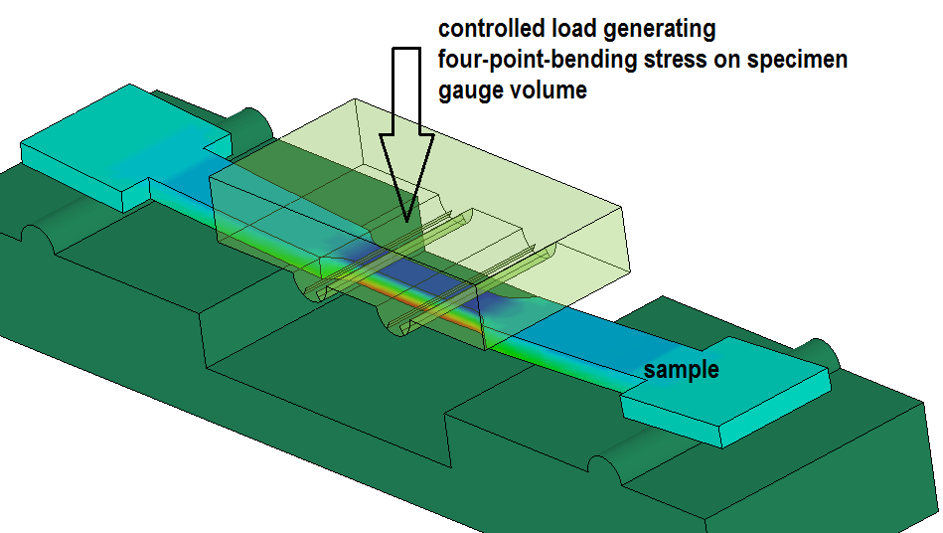
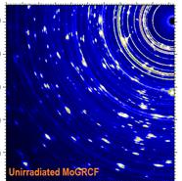
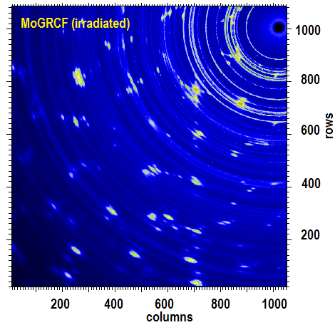
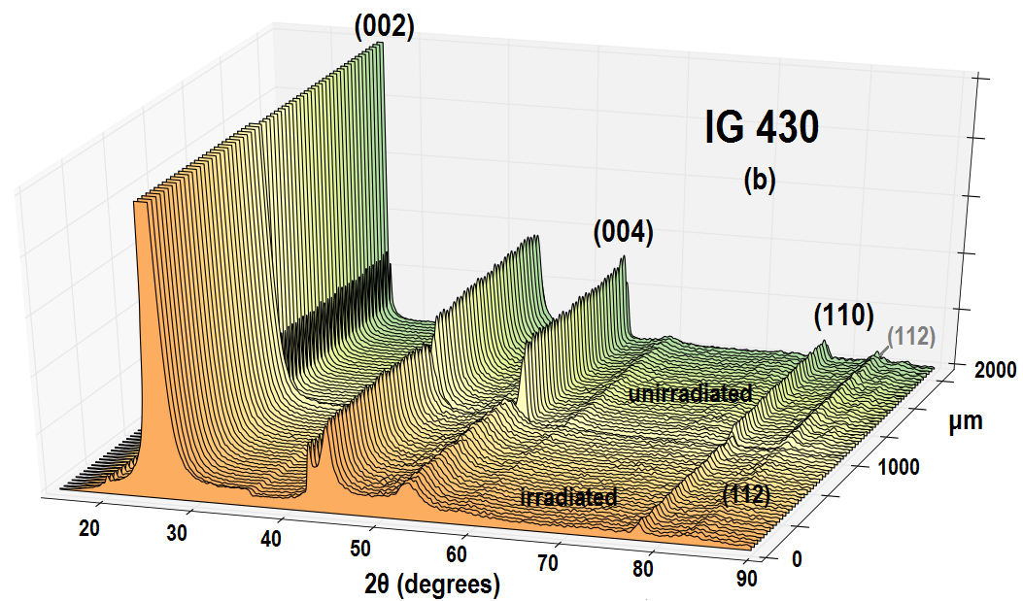
NSLS (end of life)
X17B1 Beamline (200 keV, polychromatic beam, EDXRD)
X17A (70 keV, monochromatic X-rays, XRD)
NSLS II (XPD) Beamline
XRD
PDF
X-Ray Tomography*

Slide 19
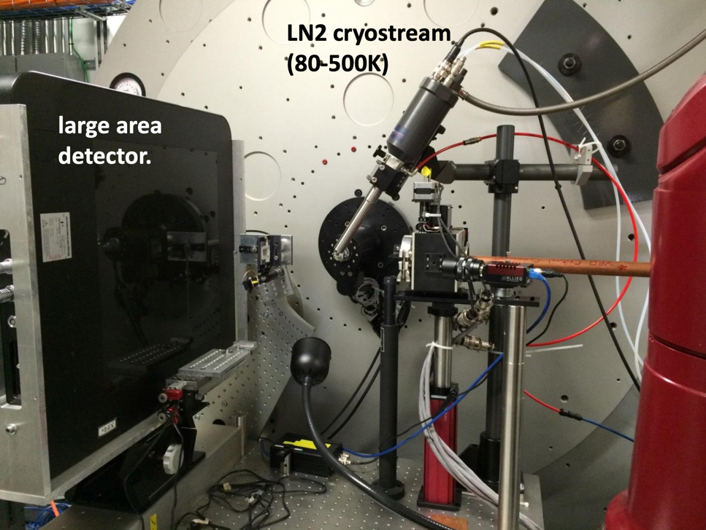
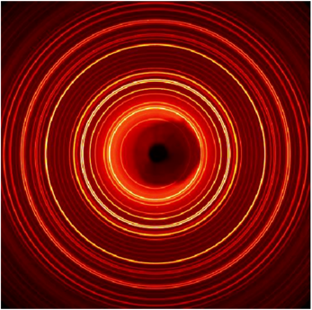
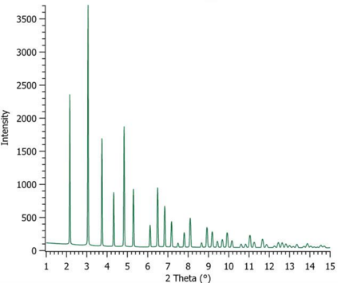
One-slide on X-ray diffraction method
A typical X-ray diffraction setup with area detector
2D image
1D pattern
Azimuthal
integration
x-ray beam
Phase information
Micro strain
Lattice parameters
Crystalline size
Phase mass fraction
Stacking faults

Slide 20
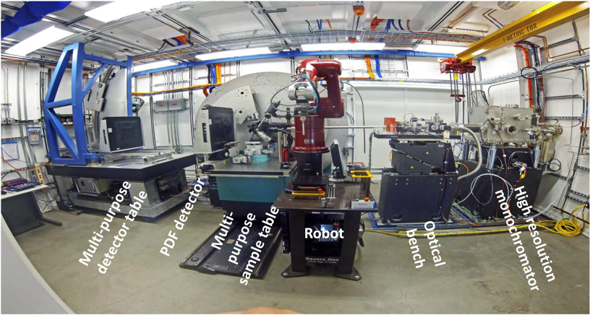
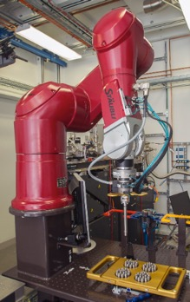
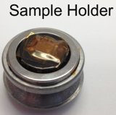
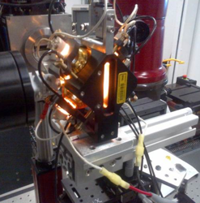
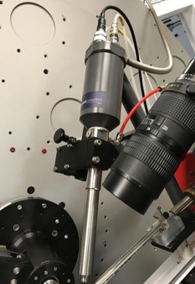



C-hutch
Robot for high-throughput
sample changing
Heating up to 1500C
Cryostream (80K-500K)
Corrosion cell

Slide 21




We are experienced with radioactive materials at NSLS-II

Slide 22
Overview of nuclear material studies at BNL
Radiation damage effects – from Graphite to Tungsten
Linking macrostructure to radiation-induced lattice defects

Slide 23







Research on Graphite: Irradiation ➔ Post-irrad
J-PARC Muon target – BNL Studies
Correlating damage in GRAPHITE between neutrons and protons at BNL
FIXED IG-43
N. Simos, et al., “Solid Target Studies for Muon Colliders and Neutrino Beams,” Nuclear Physics B, 155, pp. 288-290, 2006
N. Simos, H. Ludewig, et al., “Multi-MW accelerator target material properties under proton irradiation at Brookhaven National Laboratory linear isotope producer,” Physical Review Accelerators and Beams (2018) 21 (5)
N. Simos, et al., “Proton Irradiated Graphite Grades for a Long Baseline Neutrino Facility Experiment,” Physical Review Accel. and Beams 20, 071002 2017

Slide 24




HCP Beryllium (S 200F) at BNL
Microscopic analysis
Macroscopic closer view

Slide 25




CFC Materials
Graphitization issue/comparison
N. Simos, et al., “Radiation damage and thermal shock response of carbon-fiber-reinforced materials to intense high-energy proton beams,” Phys. Rev. Accel. Beams 19, 2016

Slide 26
Super Alloys
  The (α + β) Ti-6Al-4V alloy
  The β-titanium alloy Gum metal (Ti-21Nb-0.7Ta-2.Zr-1.2O)
  Super-Invar
  Inconel 625 and 718
Refractory Metals
  Tantalum
  Tungsten
  Molybdenum
LHC Collimation Materials
  Glidcop
  Mo-carbide-Graphite
  Copper-Diamond
Nuclear steels and nano-structured materials (coatings), including SiC, SiC/SiC

Slide 27



Enhancing EXTREME conditions during X-ray Characterization
Under way with upcoming experiments at NSLS-II beamlines
X-ray characterization under extreme, multi-dimensional stress states
High energy X-rays and creep of irradiated materials
High energy X-rays and fracture toughness/crack propagation
High energy X-rays and high temperatures, aggressive environments

Slide 28


BNL Microstructural Analysis Capabilities - X-ray Characterization
X-ray Diffraction, X-ray tomography, small angle scattering with in-situ multidirectional loading.
Including 3-point, 4-point bending
Tension (to fracture), compression and twisting in addition to the 4-point and 3-point bending
ENABLES observation of the microstructural evolution of the IRRADIATED bulk samples as the material is taken to its limits and eventual fracture.

Slide 29






Forward – Spallation Process optimization for fission/fusion reactor materials
A*
Neutron energy spectra generated by the 200 MeV protons of the BNL beam at various irradiation locations within the irradiated volume
Reproduction of the MaRIE (LANL) produced neutron spectra using 800 MeV LANCE protons prior to completing the BNL option study.
B
BNL, due to the potential of arranging the irradiated (fast neutron) material volume very close to the spallation target (W) CAN in the closest position match both the spectra and flux (trace A*)
Spallation target can be studied as accelerator material under proton (200 MeV) flux.
BNL reproduction at position B

Slide 30




Forward: Fast Neutron Spectra for Fusion Reactor Materials
Current capability in irradiating with fast neutrons (constrained by isotope production with beam at 118 MeV, thus fast spectra at 0-degree downstream peaking at ~30 MeV)
Future (explored): Proton beam at 66 MeV with W-Be spallation target
Future capability of the BNL Linac/BLIP to generate spectra peaking around 14 MeV!!
Capability stemmi
Fusion energy relevant

Slide 31
Section Break
Materials in Radiation Damage

Slide 32









Materials in Radiation Environment
A unique opportunity identified by INL and BNL to enhance DOE mission delivery
Providing a critical tool for Post Irradiation Examination of materials and actinide chemistry in support of the DOE mission to address America’s nuclear energy and security challenges
Irradiated Materials Characterization Laboratory
NSLS-II
Characterization
Testing
Modeling
November 19, 2020
Titan Supercomputer
Nuclear Materials Development Cycle
Advanced
Test Reactor

Slide 33










MRE
DOE-NNSA
Addressing Questions Across the Mission of the Entire DOE
High x-ray energy
High photon flux
Separate building
Separate access and ESH envelope from NSLS-II
Operated as a radiological facility
Nuclear Forensics
Corrosion
Resistance
DOE-NE
Improved Structural Materials
Phase diagrams for transuranics
Studies on Spent Fuel
Radiation
Resistance
Fusion Energy
Science
Separations
Actinide Chemistry
DOE-BES and DOE-FES

Slide 34



Complementary tools for PIE
NE Materials Research Challenges involve a range of processes with length scales spanning orders of magnitude
Electron microscopy and synchrotron techniques provide a complementary tool set to address these challenges
Electron Microscopy
Synchrotron-based Techniques

Slide 35






MRE Expands Scope of SC Research on Radioactive Materials
In situ experiments with actinides
DOE-SC research interests where cutting-edge characterization of radioactive materials is critical to success
Formation of self-organized microstructures
Role of grain boundaries in irradiation response
Design of radiation-resistant alloys
Crack initiation
Actinide chemistry / f-electron challenge
Actinide-ligand bonding
Interaction of actinides at interfaces (liquid-liquid and liquid-solid)
Advanced materials for waste forms
Materials degradation in complex environments across broad timescales
Aqueous chemistry far from equilibrium due to ionizing radiation
Plasma-facing materials development for fusion energy systems
Nanopatterning due to radiation damage
Spectroscopy of actinides

Slide 36
Looking Forward at BNL
Utilizing the potential of NSLS II and establish/complete the spectrum of extreme conditions at the beamlines (high temperature, high and complex stress states, fatigue, oxidation/corrosion kinetics)
  In-situ multi-dimensional stress capabilities with X-rays adding to the 3- and 4-point bending to include, Tension to failure, Compression, Torsion, High temperature, Oxidizing and other environments within the chamber
  X-ray Tomography, Small Angle Scattering
  and with upcoming HEX beamline: EDXRD and X-ray imaging once HEX beamline is commissioned
Bring into the suite of characterization capabilities electron microscopy for irradiated materials.
  The introduction of scanning electron microscopy (SEM) in the TPL laboratory is currently under study in coordination with the BNL Center of Functional Nanomaterials (CFN), a capability that will enhance the characterization of materials at TPL.
LINAC/BLIP upgrade: reached 205 μA current ➔ UPGRADE goal 300 μA
Materials in Radiation Environment

Slide 37
Novel materials, alloys and composites for next generation reactors and/or accelerators require assessment under extremes. Key to such assessment is the ability for post-irradiation characterization of materials of interest
BNL over the decades has maintained infrastructure for macroscopic characterization (hot cells, etc.)
Availability of the NSLS-II synchrotron with high energy X-rays and the commissioned techniques
at the beamlines provide an excellent means of micro-characterizing BLIP irradiated materials.
While currently Electron Microscopy has been integrated into the characterization process only for unirradiated materials under extremes (at Center of Functional Nanomaterials facility)
Protons and other ions as surrogates to emulate the damaging effects of fast neutrons have been
used at BNL . Also, BNL Linac/BLIP has provided to-date modest means to increase
availability of fast neutrons to test materials for fast reactors
Proposal is moving forward at BNL to utilize the 200 MeV Linac and the 300 μA peak current it can
deliver after its upgrade (peak current achieved to-date 200+ μA) for usable fast neutron spectra
for fission and fusion materials
MRE facility will allow for more through testing of irradiated materials.

Slide 38
Questions?

