Slide 1
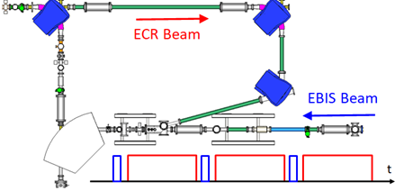
The ATLAS Material Irradiation Station
(amis)
Irradiation Stations and Alternatives
Workshop at FermiLab (virtually)
JUne 17-18, 2021
erhtjhtyhy
Jerry Nolen
This work used the resources of the Argonne Tandem Linac Accelerator System (ATLAS), which is a U.S. Department of Energy, Office of Science User Facility supported under contract DE AC02 06CH11357.
The design and construction of the new AMIS facility is supported by the U.S. Department of Energy, National Nuclear Safety Administration (NNSA), under contract DE-AC02-06CH11357.
The AMIS project is managed by Brahim Mustapha of the Physics Division and the Chief Engineer is Albert Barcikowski of the Experimental Operations and Facilities Division.
The materials irradiation research program is led by Abdellatif Yacout manager of the Fuel Development and Qualification group within the Chemical and Fuel Cycle Technologies Division.
Physics Division
Argonne National Laboratory

Slide 2
Outline
Overview of the Argonne superconducting heavy ion linac ATLAS
The ATLAS Multi-User Upgrade
The ATLAS Material Irradiation Station (AMIS)
  Advantages of heavy ion beams for high DPA studies
  Examples of studies to date at the stand-alone irradiation station
  Design and Status of AMIS
  Prospects for increased beam time for materials irradiation using AMIS
Concept for a dedicated heavy ion linac for in-situ studies at the Argonne APS: XMAT

Slide 3
the Argonne Tandem Linear
Accelerator System (ATLAS)

Slide 4
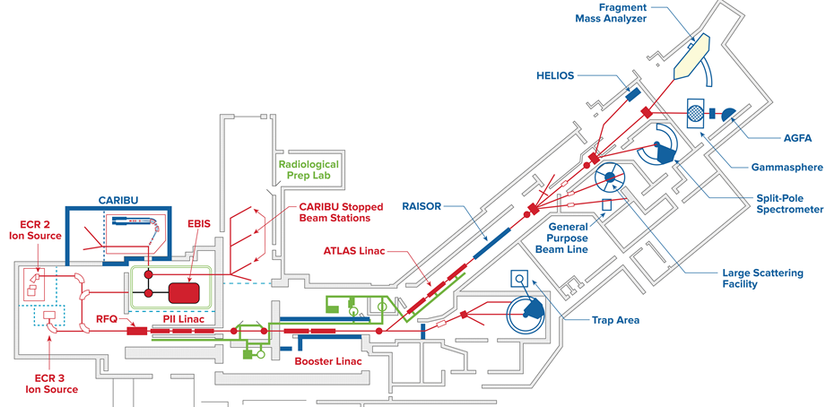
ATLAS: Argonne Tandem Linear Accelerator System
1st Superconducting ion linac in the world
It has been operating for over 35 years
National user facility serving ~ 400 users per year
1st Multiple charge state acceleration demonstrated in 2000
CARIBU: Pulsed beams of short-lived fission fragments beginning 2016
4

Slide 5
Simultaneous Multi-Charge State Acceleration
Simultaneous acceleration of multiply charged U-238 ions through a superconducting linac (ATLAS), P. Ostroumov et al, PRL 2001
²³⁸U from PII, stripped and injected to Booster
Emittances & Twiss parameters for # Q’s
²³⁸U Intensity distribution of accelerated Q’s
The broad acceptance of ATLAS together with pulsed beams from a charge breeder
makes possible the delivery of “similar” m/q ion beams to 2 simultaneous users
5

Slide 6
the concept of the
ATLAS Multi-user upgrade

Slide 7
The Need & Purpose of the ATLAS MUU
The Need
  Significant competition & increased pressure on ATLAS beam time
  Increasing demand for longer experiments (> 1 week)
  Examples: Low intensity radioactive beams & low cross section reaction channels
  Requested beam time significantly exceeds ATLAS’s ~ 6000 hours/year
  ATLAS PAC is typically over-subscribed by a factor of 2-3 …
The Purpose
  Relieve pressure on beam time and accomplish more physics by serving two users at a time, allow more time for some applications (such as AMIS)
  When running CARIBU Beams, the machine is “empty” ~ 90% of the time while operating CW → Take advantage of that time (Economical!)

Slide 8
The Opportunity with Pulsed CARIBU-EBIS
Radioactive ions from CARIBU-EBIS
~ 3% Duty Factor
t
Stable ions from ATLAS-ECR
~ 90 % Duty Factor
t
Combined beam structure
t
EBIS beam is typically ~1 ms pulse up to 30 Hz repetition rate → ~ 3 % DF
DC beam from ECR could be injected into ATLAS in the remaining ~ 97% DF
Considering 2 x 1 ms switching time, the useful ECR duty cycle can be ~ 90%
CARIBU beams are typically charge-bred to corresponding A/q ≥ 4, ATLAS accelerates beams with A/q ratios ≤ 7 → The useful range of A/q overlap is 4-7

Slide 9
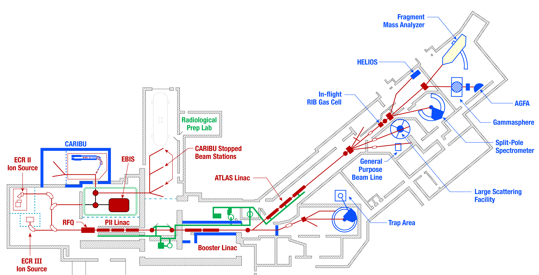
ATLAS Multi-User Upgrade
EBIS beams represents 1-3% duty factor
Interleave pulsed EBIS beam with continuous ECR beam
  Enables delivery of beams to 2 users with nearly no loss of intensity
ECR stable beam, ~95 ms
EBIS pulse, ~1 ms @ 10Hz
t
Combine beams
4-15 MeV/u
Separate beams
4-7 MeV/u

Slide 10
Combining ECR Stable beams with CARIBU RIBs
A/Q | Stable beams | CARIBU beams
4.000 | ²⁰Ne⁵⁺, ²⁸Si⁷⁺, ³⁶Ar⁹⁺ | ⁸⁴Se²¹⁺, ⁸⁸Kr²²⁺, ⁹²Sr²³⁺, ¹⁰¹Mo²⁵⁺, ¹⁰⁵Ru²⁶⁺
4.143 | ⁵⁸Ni¹⁴⁺ | ⁸³As²⁰⁺, ⁹⁵Y²³⁺, ¹⁰⁴Tc²⁵⁺, ¹¹²Pd²⁷⁺, ¹¹⁷Cd²⁸⁺
4.364 | ⁴⁸Ti¹¹⁺, ⁷⁴Ge¹⁷⁺ | ⁹²Kr²¹⁺, ¹⁰⁵Nb²⁴⁺, ¹⁰⁹Tc²⁵⁺, ¹¹⁹Pd²⁷⁺, ¹⁴⁹Nd³⁴⁺
4.538 | ⁵⁹Co¹³⁺ | ⁹¹Rb²⁰⁺, ¹⁰⁵Zr²³⁺, ¹²³Cd²⁷⁺, ¹³¹Te²⁹⁺, ¹⁴⁶Pr³²⁺
4.875 | ⁷⁸Kr¹⁶⁺ | ⁹³Y¹⁹⁺, ¹⁰²Mo²¹⁺, ¹³²Sn²⁷⁺, ¹⁴¹I²⁹⁺, ¹⁶²Eu³⁴⁺
5.000 | ⁴⁰Ar⁸⁺,⁶⁰Ni¹²⁺, ⁹⁰Zr¹⁸⁺ | ⁸⁵Se¹⁷⁺, ¹¹⁰Mo²²⁺, ¹²⁴In²⁵⁺, ¹⁴¹I²⁸⁺, ¹⁵⁹Pm³²⁺
5.280 | ¹³²Xe²⁵⁺ | ¹⁰⁵Ru²⁰⁺, ¹²⁶In²⁴⁺, ¹³⁷I²⁶⁺, ¹⁵³Pr²⁹⁺, ¹⁶⁵Tb³¹⁺
5.600 | ⁸⁴Kr¹⁵⁺ | ¹⁰⁰Nb¹⁸⁺, ¹¹¹Tc²⁰⁺, ¹¹⁷Cd²¹⁺, ¹⁴¹Xe²⁵⁺, ¹⁴⁷La²⁶⁺
5.643 | ⁷⁹Br¹⁴⁺, ¹⁰⁷Ag¹⁹⁺ | ⁹⁶Rb¹⁷⁺, ¹⁰⁷Nb¹⁹⁺, ¹¹⁹Cd²¹⁺, ¹³⁵Te²⁴⁺, ¹⁵¹Nd²⁷⁺
5.714 | ⁸⁰Se¹⁴⁺ | ⁹¹Kr¹⁶⁺, ⁹⁷Zr¹⁷⁺, ¹⁰⁹Ru¹⁹⁺, ¹³¹Sb²³⁺, ¹⁴³Ba²⁵⁺
6.432 | ²³⁸U³⁷⁺ | ⁸³Se¹³⁺, ⁹⁰Kr¹⁴⁺, ⁹⁷Sr¹⁵⁺, ¹⁰³Zr¹⁶⁺, ¹⁴¹I²²⁺
6.709 | ²⁰⁸Pb³¹⁺ | ⁸⁸Se¹³⁺, ⁸⁸Br¹³⁺, ⁹⁴Rb¹⁴⁺, ¹⁰⁰Y¹⁵⁺, ¹⁰⁷Nb¹⁶⁺
6.792 | ¹⁹⁷Au²⁹⁺ | ⁸⁹Se¹³⁺, ⁸⁹Br¹³⁺, ⁹⁵Rb¹⁴⁺, ¹⁰²Y¹⁵⁺, ¹⁰⁸Nb¹⁶⁺
7.000 | ¹³³Cs¹⁹⁺ | ⁸⁴As¹²⁺, ⁹⁸Rb¹⁴⁺, …
Table shows beams within 1% of A/q ratio
Overlap between stable and RIB beams offers a lot of flexibility
Study of a recent run period showed ~40% potential overlap, limited only by the number of days of CARIBU beams

Slide 11
Adding a 3rd switchyard to enable AMIS

Slide 12
Material Irradiation Studies for Nuclear Energy
Radiation damage mechanisms Damage as function of depth Previous Irradiation Station
Low-energy heavy ion beams ~ 1 MeV/u effectively emulate material damage in nuclear reactors, in both fuel and structural materials at DPA rates of 2000 per day or more
Irradiations at ion rates up to 1E12/s or more at 1 cm² – generally limited by sample heating
Irradiation studies that would have taken years at a reactor have been accomplished in a few hours or days at ATLAS: see publications of the Reactors Materials group of Latif Yacout over the past 5 years at a stand-alone station
Ref: M. Pellin et al, Journal of Nuclear Materials 471 (2016) 266-271
Based on this initial success, NNSA has funded an addition to the ATLAS MUU

Slide 13
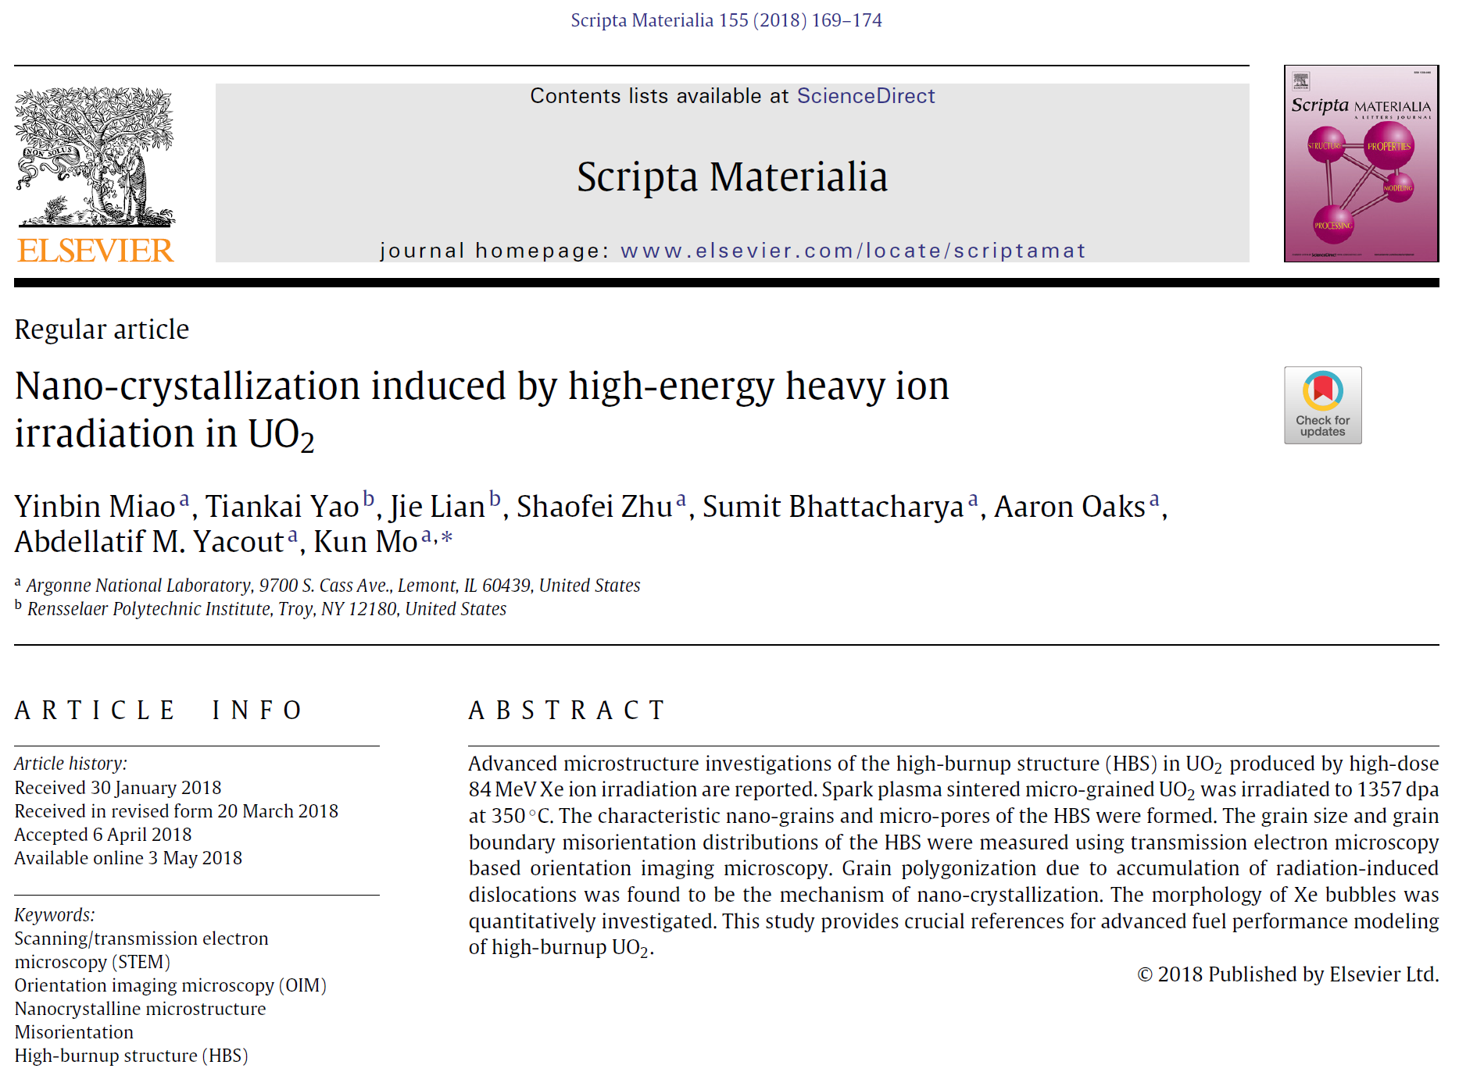
Typical result from the previous stand-alone irradiation station at ATLAS
UO₂ sample irradiated to 1357 dpa at 350 ºC with 84-MeV Xe beam
See separate list of publications of this reactor materials group

Slide 14
Summary of advantages of heavy ion beams for materials irradiation
Ions from protons to uranium are available at ATLAS at energies with ranges of ~10 microns at sample densities ~10 g/cm³
DPA ~2000 per day are easily achieved with either cooled or heated samples and without activation – i.e. immediate PIE is possible
Heavy ions within the range of 10 microns have a large nuclear damage to ionization heat ratio, e.g. the ionization heat per DPA scaled to uranium beam on uranium oxide = 1:
  Uranium 1, Krypton 2, Helium 6, Protons 7
  Heavier ions have both higher dpa rates per ion and less heating per dpa
Beams of all fission fragment elements with appropriate energies ~100 MeV are available, e.g. gases such as Xe and refractories such as Zr
Beams of elements of structural components such as Fe to mimic effects of neutron damage via irradiations such as Fe on Fe
Recent interest expressed for study of W for the SNS second station and the higher power ESS: e.g. W on W irradiations

Slide 15
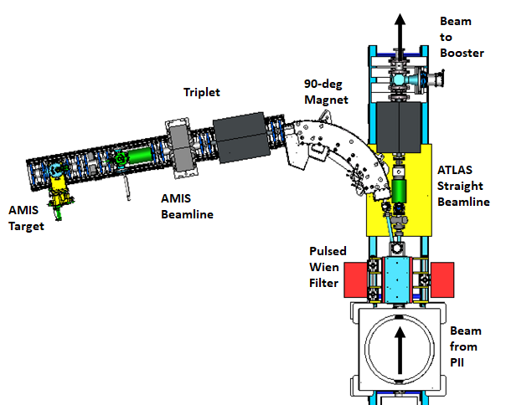
AMIS: ATLAS Material Irradiation Station (New)
A dedicated material irradiation station after PII
AMIS
Pulsed switching using a pulsed Wien filter magnet will allow more beam time by taking advantage of the ATLAS multi-user upgrade
The new beamline is currently under development, will be commissioned in FY2022
Funded by NNSA’s Office of Defense Nuclear Nonproliferation

Slide 16
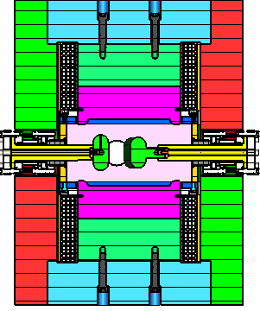

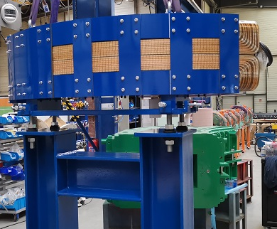
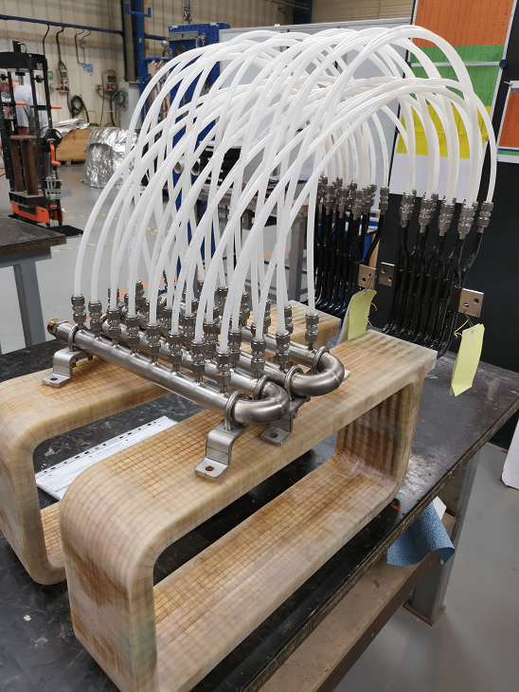
AMIS Beamline: Key Components
10-deg Pulsed Wien filter magnet 90-deg Septum magnet
Combines E&B fields
Pulsed E-field, DC B-field
E&B add-up to deflect beam to AMIS target
E changes sign to cancel B-field for straight beam
Thick Septum ~ 5 cm for beam separation
Magnetic shielding to limit effect on straight ATLAS beam

Slide 17
XMAT: a concept for a future dedicated linac at the Argonne aps for in-situ irradiation/examination

Slide 18
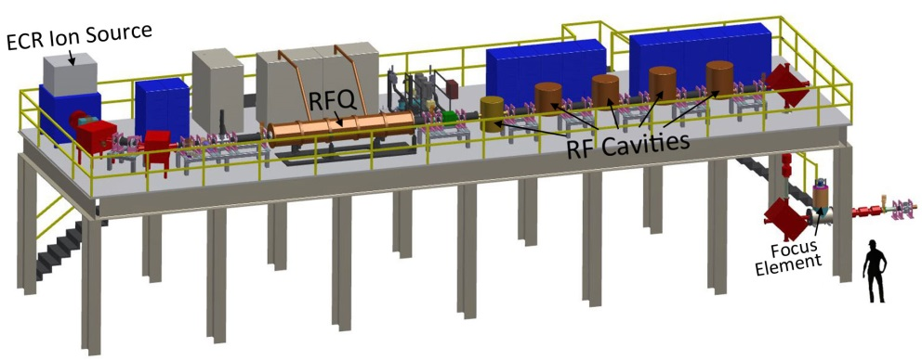
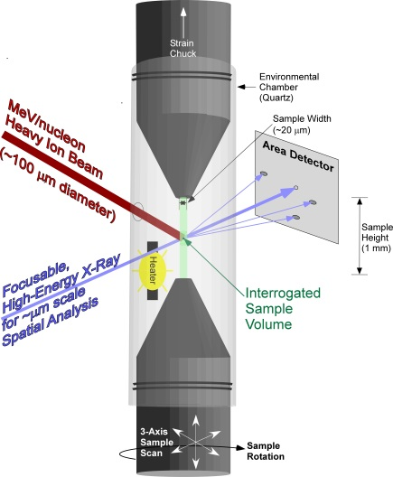
XMAT Layout: beam directed to a sample/target in an x-ray hutch at the Argonne APS for in-situ irradiation & examination via 3D x-ray imaging
Kutsaev, Sergey V., Brahim Mustapha, Peter N. Ostroumov, Jerry Nolen, Albert Barcikowski, Michael Pellin, and Abdellatif Yacout. "Heavy ion linear accelerator for radiation damage studies of materials." Review of Scientific Instruments 88, no. 3 (2017): 033302.
Notes:
Note that the APS hutches sit underneath the Ion Source. ANL has built already and recently both an energetic ion beam line (XMAT would utilize the front end of this design) and a hard xray beam line.

Slide 19
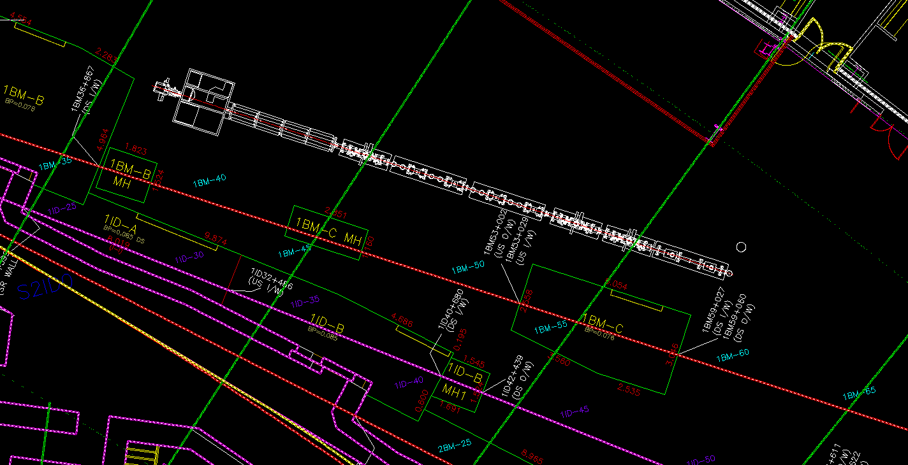
Scale model of XMAT near an APS beam line

Slide 20
Summary and outlook

Slide 21
Summary and Outlook
The ATLAS Multi-User Upgrade will relieve the pressure on beam time at ATLAS and enhance the capabilities of the facility
High DPA irradiations by the Argonne Nuclear Engineering group led by Latif Yacout at a dedicated station over the past 5 years have demonstrated the value of heavy ion beams with ranges ~10 microns at DPA rates ~2000 per day or more
NNSA is funding AMIS, a dedicated irradiation station at ATLAS
  AMIS will operate first stand-alone in 2022 and later as part of the ATLAS MUU
  Beam time at AMIS will be allocated when synergistic with the basic nuclear physics research mission of ATLAS on an incremental cost-recovery basis
  Samples are not activated by these heavy ion beams
Pending the success of AMIS, XMAT, a concept for a dedicated heavy ion linac-based irradiation capability located at the Argonne APS with in-situ diagnostics has been developed
  Rough cost estimate 20-30 M$ on the time horizon ~5-10 years

Slide 22
supplemental slides
See the attached list of publications by the
Argonne nuclear materials research group

