Slide 1
Cryogenic Digital Optical Link Testing
DUNE Internal Review
Some Detailed Results for Discussion
April 12, 2021
FNAL: D. Christian, G. Deuerling, J. Greskoviak, A. Prosser, R. Rivera
BNL: H. Chen, S. Gao, V. Radeka
LBNL: M. Turqueti
CERN: J. Troska, F. Vasey
SMU: J. Keyzer, T. Liu, J. Ye, W. Zhang

Slide 2
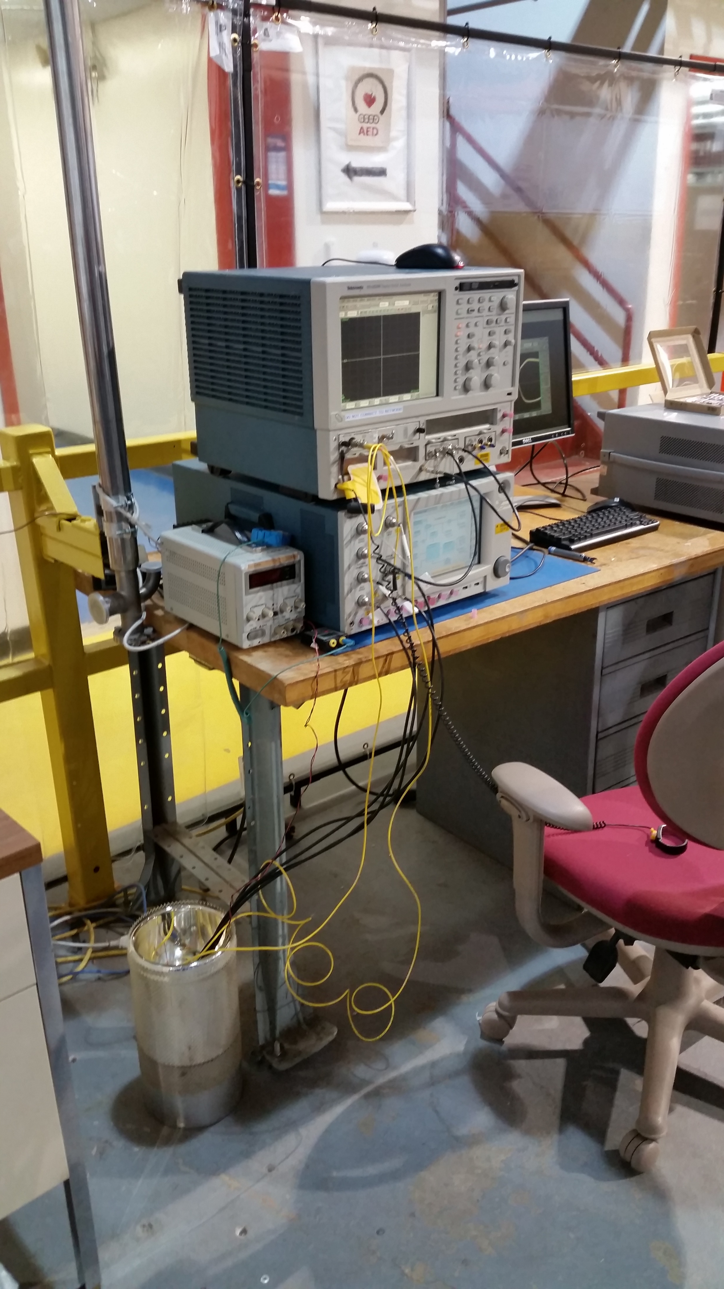
Test Stand at PAB
Digital Signal Analyzer
(Eye pattern and jitter
analysis)
Optical Spectrum Analyzer
Power Supply
Bit Error Rate tester
(Pattern Generation and
Error Checking)
Dewar
(Containing
Evaluation Board
and Test Device)
Single Mode Optical Fibers (yellow)
Coaxial cables for electrical pattern (black)
Notes:
This slide shows the test stand (that was employed at the Feynman Computing Center for all of the measurements above) which has now been relocated to the
Proton Assembly Building. On March 2, the test stand was moved, reconfigured to operate with the test devices in the dewar shown, and tested (again at room temperature) to verify that it is operating correctly.

Slide 3
SFP+ Testing Summary
The following 9 slides illustrate room temperature measurement results from selected 1310 nm SFP+ transceivers as well as comparative measurements on the same devices at liquid nitrogen (LiN2) temperatures. Devices tested employed Fabry-Perot (F-P) lasers and Distributed FeedBack (DFB) lasers.
The results include measurements obtained from:
Optical eye pattern analysis
Optical jitter analysis
All measurements were made with PRBS7 data patterns or OMA Patterns (repetitions of …1111000011110000… delivered at the data rates indicated on the slides
All of the data illustrated here were captured at the Proton Assembly Building.

Slide 4
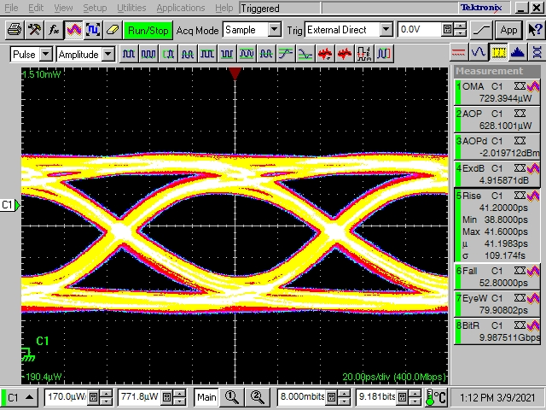
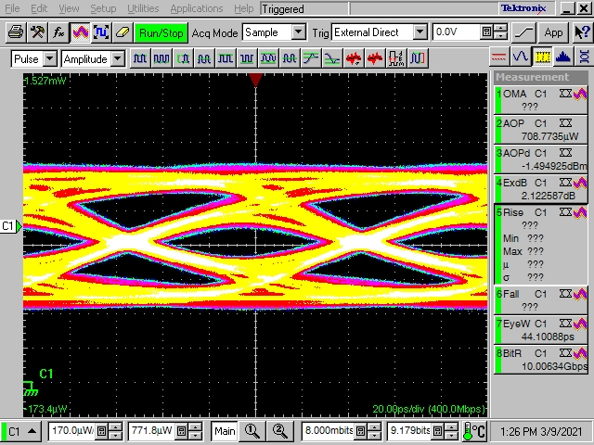
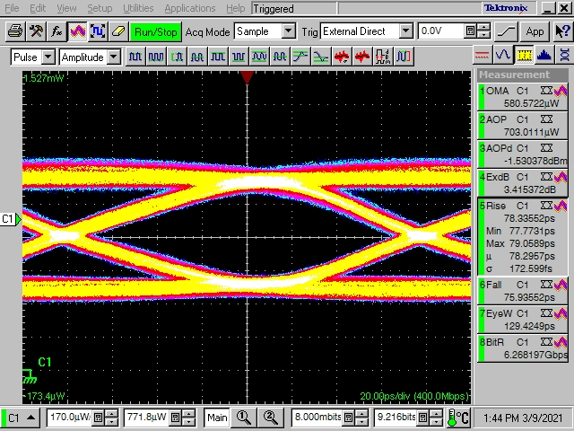
Sample: DFB2
Eye Pattern Analysis
Pattern: PRBS7
Bit Rate: 10 Gbps
Room Temperature
Pattern: PRBS7
Bit Rate: 10 Gbps
LiN2
Pattern: PRBS7
Bit Rate: 6.25 Gbps
LiN2
Bit Error Rate tests at
10 Gbps and 6.25 Gbps
resulted in no errors
in 10e12 transmitted bits
Power cycle test while cold
failed

Slide 5
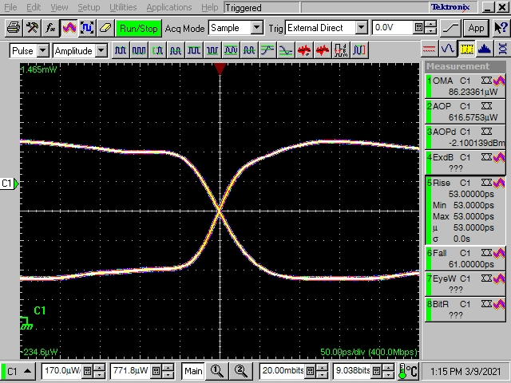
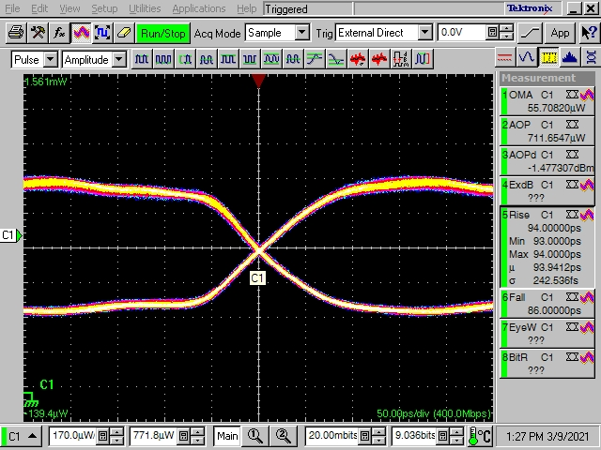
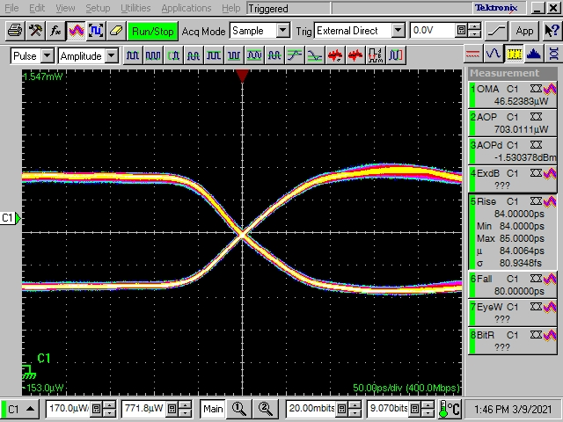
Sample: DFB2
Eye Pattern Analysis
Pattern: OMA Pattern
Bit Rate: 10 Gbps
Room Temperature
Pattern: OMA Pattern
Bit Rate: 10 Gbps
LiN2
Pattern: OMA Pattern
Bit Rate: 6.25 Gbps
LiN2
Substantial amplitude obtained
even cold

Slide 6
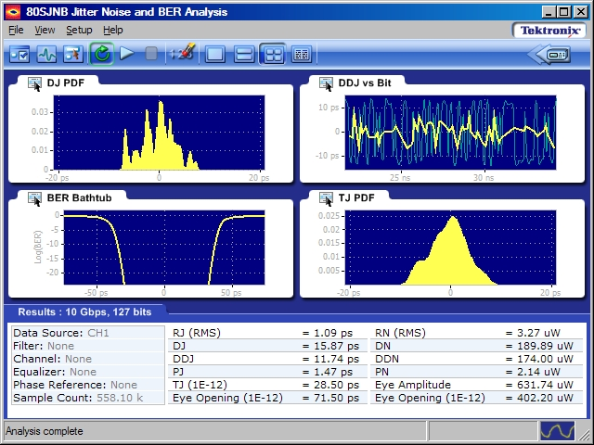
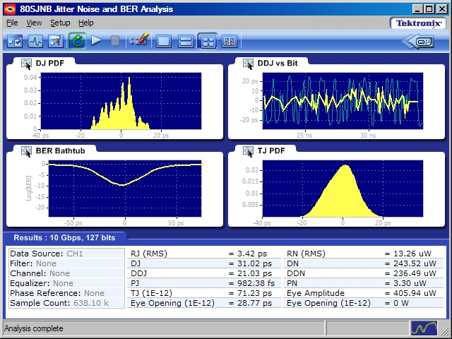
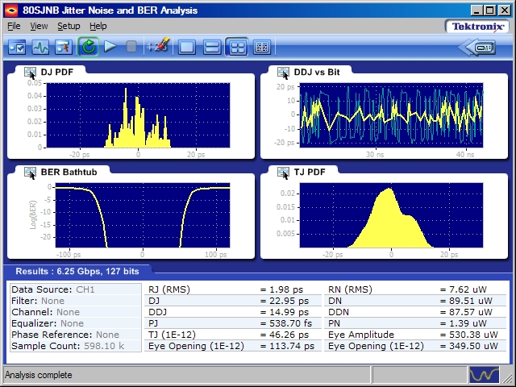
Sample: DFB2
Jitter Decomposition
Pattern: PRBS7
Bit Rate: 10 Gbps
Room Temperature
Pattern: PRBS7
Bit Rate: 10 Gbps
LiN2
Pattern: PRBS7
Bit Rate: 6.25 Gbps
LiN2
Wouldn’t expect 10 Gbps
test to pass
BER bathtub much more
open at 6.25 Gbps

Slide 7
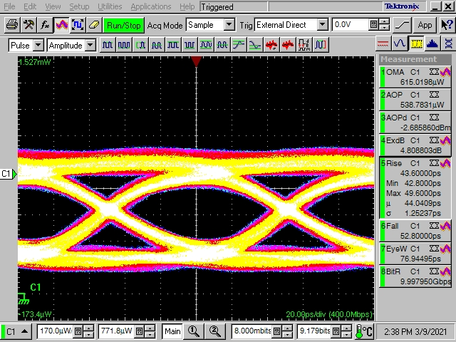
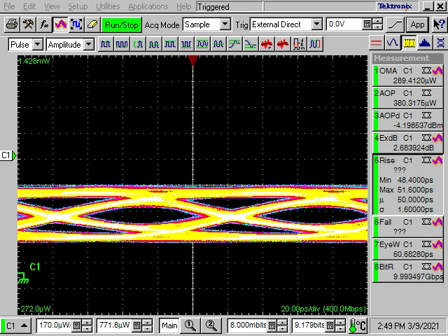
Sample: DFB3
Eye Pattern Analysis
Pattern: PRBS7
Bit Rate: 10 Gbps
Room Temperature
Pattern: PRBS7
Bit Rate: 10 Gbps
LiN2
Bit Error Rate tests at
10 Gbps resulted in no errors
in 10e12 transmitted bits
Power cycle test while cold
failed

Slide 8
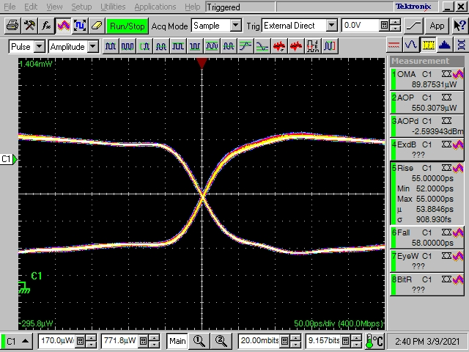
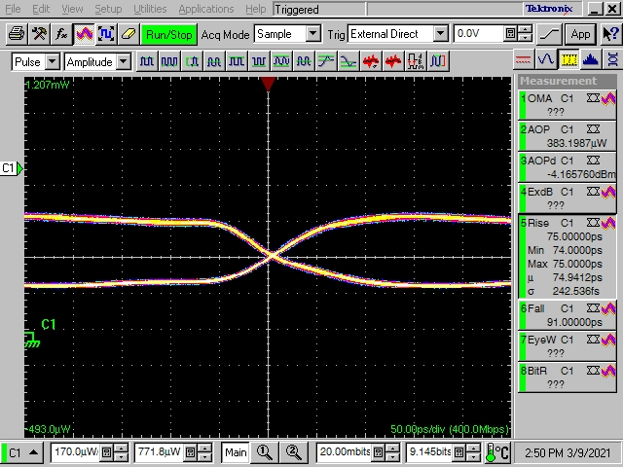
Sample: DFB3
Eye Pattern Analysis
Pattern: OMA Pattern
Bit Rate: 10 Gbps
Room Temperature
Pattern: OMA Pattern
Bit Rate: 10 Gbps
LiN2
Reduced amplitude obtained
in cold. Even so, BER tests succeeded.

Slide 9
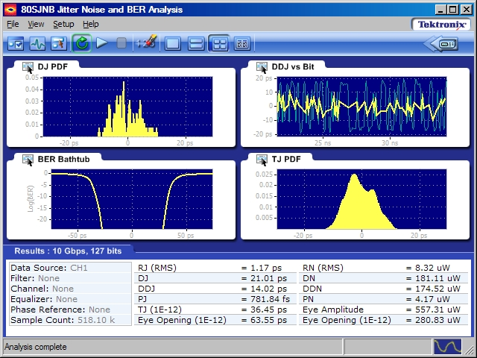
Sample: DFB3
Pattern: PRBS7
Bit Rate: 10 Gbps
Room Temperature
Pattern: PRBS7
Bit Rate: 10 Gbps
LiN2

Slide 10
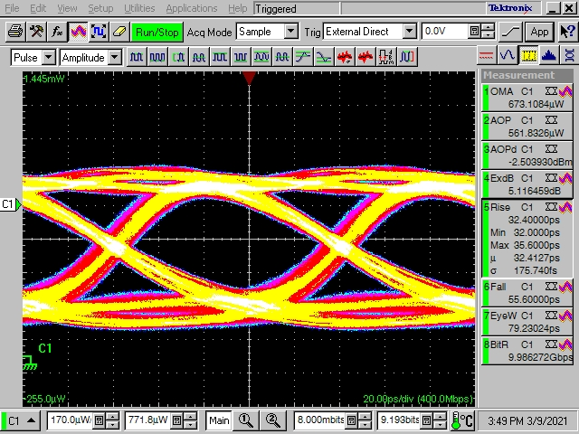
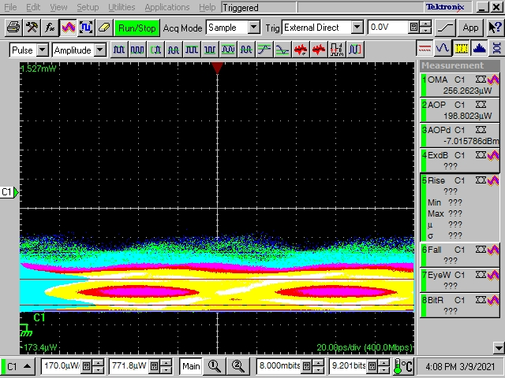
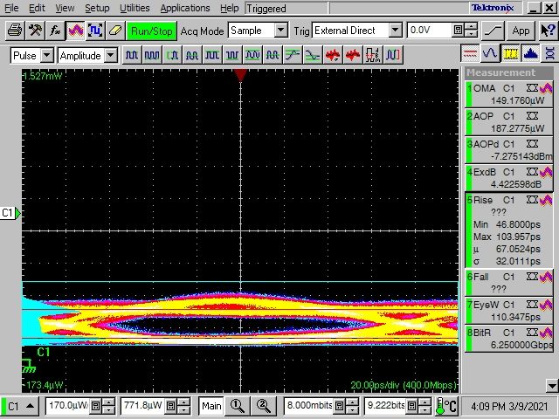
Sample: FP2
Pattern: PRBS7
Bit Rate: 10 Gbps
Room Temperature
Pattern: PRBS7
Bit Rate: 10 Gbps
LiN2
Pattern: PRBS7
Bit Rate: 6.25 Gbps
LiN2
Bit Error Rate tests at
10 Gbps and 6.25 Gbps
failed.
Power cycle test while cold
failed

Slide 11
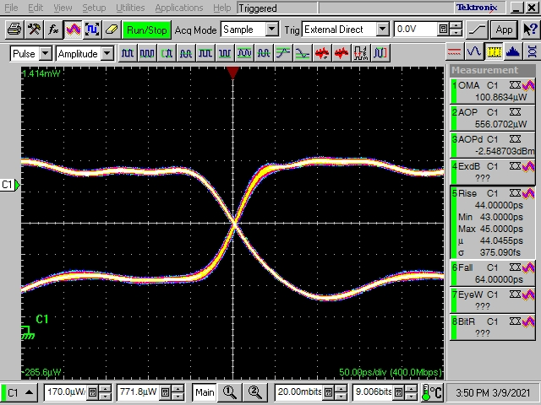
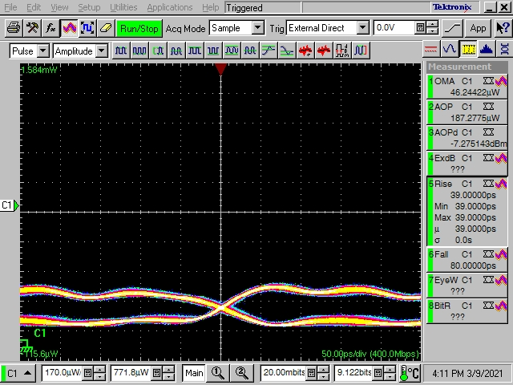
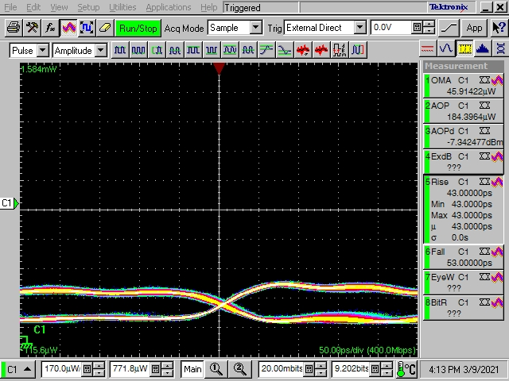
Sample: FP2
Pattern: OMA Pattern
Bit Rate: 10 Gbps
Room Temperature
Pattern: OMA Pattern
Bit Rate: 10 Gbps
LiN2
Pattern: OMA Pattern
Bit Rate: 6.25 Gbps
LiN2
Reduced amplitude obtained
in cold. BER tests failed.

Slide 12
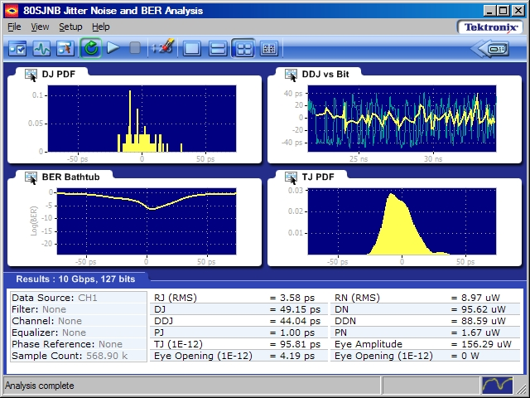
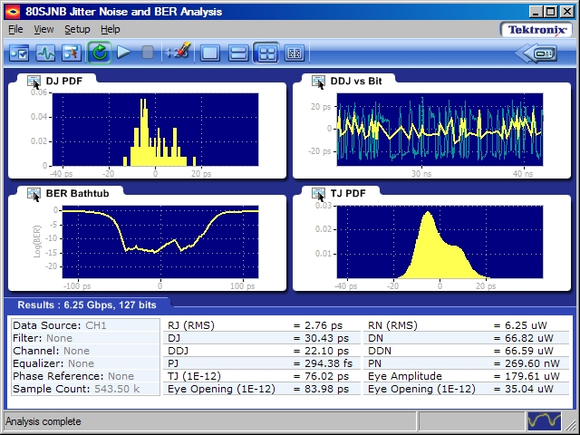
Sample: FP2
Pattern: PRBS7
Bit Rate: 10 Gbps
Room Temperature
Pattern: PRBS7
Bit Rate: 10 Gbps
LiN2
Pattern: PRBS7
Bit Rate: 6.25 Gbps
LiN2

Slide 13
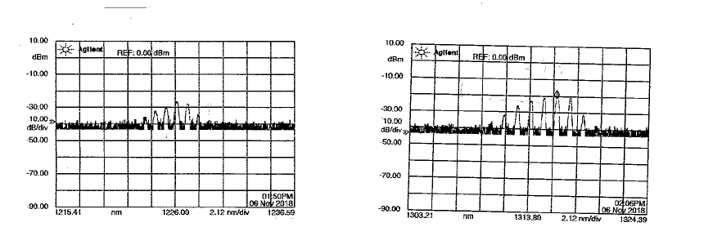
Sample: FP2
Optical Spectra (RT and LN2)
Multiple tests have illustrated a shift of about 80-90 nm (towards shorter wavelength in LN2)
Material: InGaAsP (?)
Room Temperature (PAB)
Peak Wavelength: 1316 nm
Optical Power at Peak: -18.6 dBm
Original Measurement (FCC, Room Temperature)
Peak Wavelength: 1319 nm
Optical Power at Peak: -18.4 dBm
LN2 Temperature (PAB)
Peak Wavelength: 1226 nm
Optical Power at Peak: -26 dBm

Slide 14
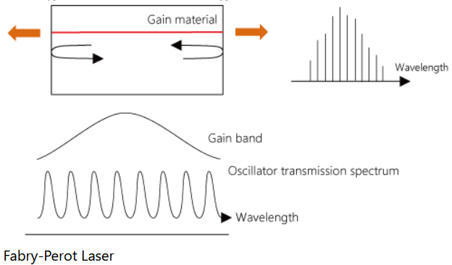
Optical Spectra in LN2
“VCSEL operation relies on a tuned coincidence of semiconductor gain spectrum and Bragg mirror reflection spectrum. These two parameters have different temperature dependencies, and coincidence is achieved by design for a given narrow temperature range. If not designed for cryogenic operation, a VCSEL will not operate at 80K.”
“An edge emitter would be the only solution in my opinion, since the Fabry-Perot mirror reflection spectrum is periodic and will eventually coincide with the gain spectrum over a wide temperature range. You should thus look for a SM TOSA, not a MM one.”*
The available cavity modes are modulated by
a temperature dependent gain envelope which moves
as the device warms (see embedded video).
** Image Ref.
Moves right with increasing T
* Email exchange with Francois Vasey (CERN)
** https://www.anritsu.com/en-AU/sensing-devices/guide/light-emitting-device

Slide 15
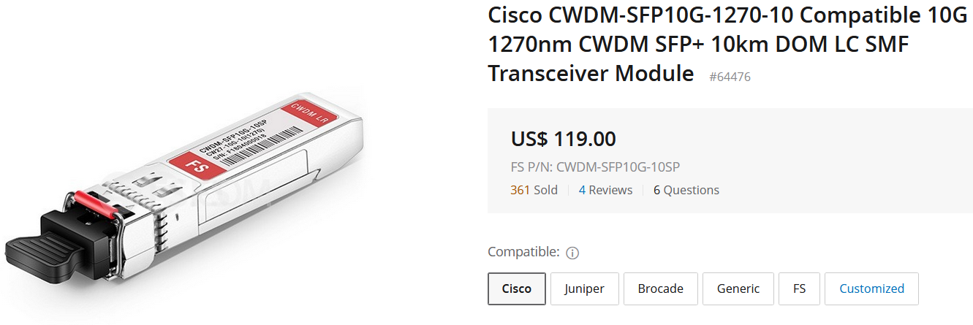
Optical Spectra in LN2
… and this as Rx, Δλ = 40 nm
With a 1310 nm laser diode transmitting
from the detector in 77 K (assuming a 80-
90 nm shift)…
We have to understand the responsivity of the Rx
photodiode to understand what to expect on the
off-detector end.
The same issue must be dealt with on the Rx channel (Rx at 77 K on detector).
It also applies to the interpretation of measurement results.
Some instruments are “tuned” to selected wavelengths (850 nm, 1310 nm, 1550 nm) and
there is a question about the accuracy of results when the actual light being measured
is not close to these wavelengths (e.g. 1228 nm)
Δλ = λ(Tx) – λ(Rx)

Slide 16
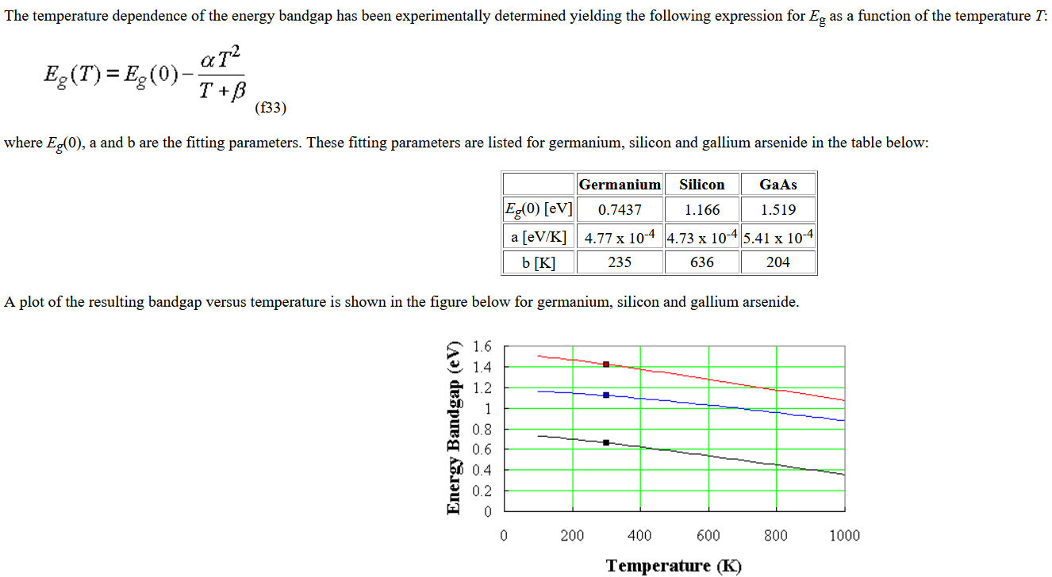
Optical Spectra in LN2
Can we predict the spectral adjustment needed?
InGaAsP?
?
?
?
Ref: https://ecee.colorado.edu/~bart/book/eband5.htm

Slide 17
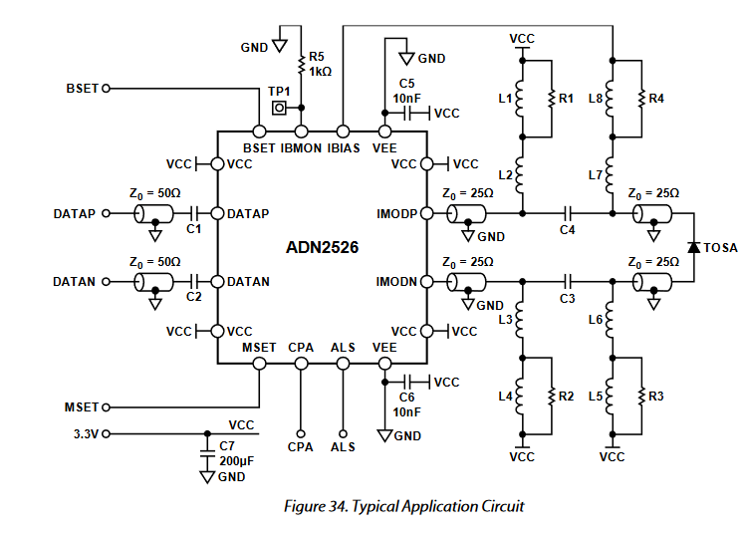
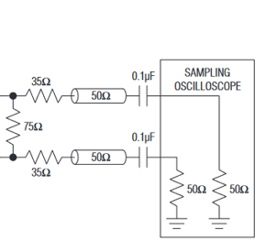
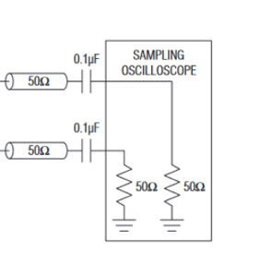
Simple Evaluation Board for Analog Devices ADN2526 Laser Diode Driver
Electrical Tests
All components will be
tested in LN2.
Power, configuration,
electrical excitation, and
electrical diagnostics
will be outside the dewar
Vibias_adj
SMA pair
SMA
pair
SMA pair
Coax
cable
DC
Block
Vimod_adj
Route Cross Point Adjust and Automatic Laser Shutdown to header.

Slide 18
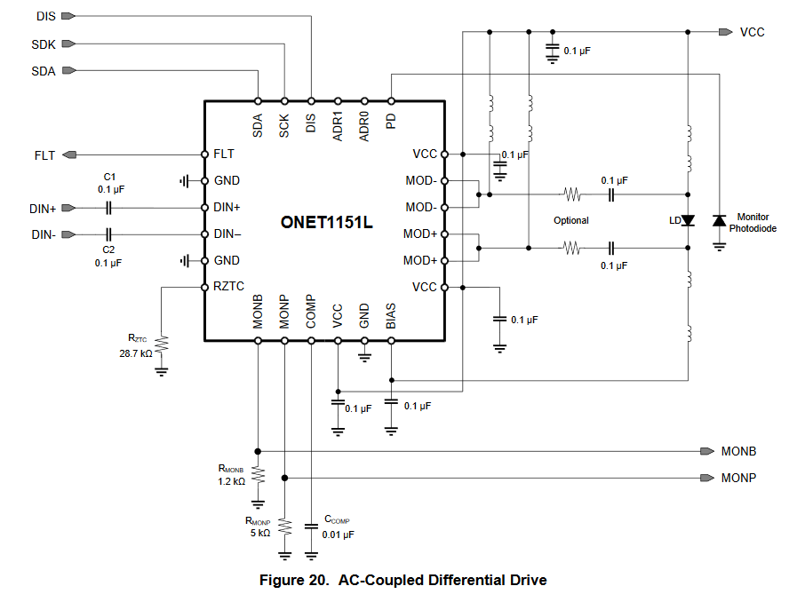
Texas Instruments ONET1151L PAB Test Circuit Proposal (Stage 1)
Interface
To
I2C Dongle
Outside
Dewar
SMA pair
SMA
SMA
Leave DIS unconnected (laser enabled)

Slide 19
Transmitter Only and Transceiver DC Power Consumption
Room Temperature
Conservatively estimate 900 mW @ 3.3V
for per channel power consumption
Source: LVDS Differential Signal @ 10 Gbps
PRBS7 Pattern
TRx Measurements Made in Optical Loopback

