Slide 1




US-LARP, US-AUP, status and process challenges
Giorgio Ambrosio
U.S. HL-LHC Accelerator Upgrade Project, Magnets L2
Workshop on State-of-the-Art in High Field Accelerator Magnets April 14-16, 2021

Slide 2
Outline
US LHC Accelerator Research Program (LARP)
  Program overview
  Achievements, Lessons Learned and areas for Improvements
US High-Luminosity LHC Accelerator Upgrade Project (AUP)
  Test results of first two deliverable magnets
  Achievements, Lessons Learned and possible Improvements for future projects

Slide 3
Acknowledgement
US HL-LHC Accelerator Upgrade Project (AUP)
  BNL: K. Amm, M. Anerella, A. Ben Yahia, H. Hocker, P. Joshi, J. Muratore, J. Schmalzle, H. Song, P. Wanderer
  FNAL: G. Ambrosio, G. Apollinari, M. Baldini, J. Blowers, R. Bossert, R. Carcagno, G. Chlachidze, J. DiMarco, S. Feher, S. Krave, V. Lombardo, C. Narug, A. Nobrega, V. Marinozzi, C. Orozco, T. Page M. Parker, S. Stoynev, T. Strauss, M. Turenne, D. Turrioni, A. Vouris, M. Yu
  LBNL: D. Cheng, P. Ferracin, E. Lee, M. Marchevsky, M. Naus, H. Pan, I. Pong, S. Prestemon, K. Ray, G. Sabbi, G. Vallone, X. Wang
  NHMFL: L. Cooley, J. Levitan, J. Lu, R. Walsh
CERN
  A. Ballarino, H. Bajas, M. Bajko, B. Bordini, N. Bourcey, J.C. Perez, S. Izquierdo Bermudez, S. Ferradas Troitino, L. Fiscarelli, J. Fleiter, M. Guinchard, O. Housiaux, F. Lackner, F. Mangiarotti, A. Milanese, P. Moyret, H. Prin, R. Principe, E. Ravaioli, T. Sahner, S. Sequeira Tavares, E. Takala, E. Todesco

Slide 4
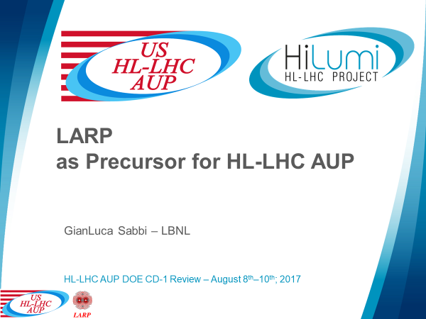
US LHC Accelerator Research Program (LARP)
Slides by G. Sabbi with small adjustments:

Slide 5
Introduction to the LARP Program
Organization:
Started in 2003 and ended in 2018
Progression from the US LHC Accelerator Research Project
Collaboration of four national Labs: BNL, FNAL, LBNL, SLAC
Funding level: $12-13M/year (from FY06)
Goals (as stated in the LARP proposal)
Extend and improve the performance of LHC
  Maximize scientific output in support of the experiments
Maintain and develop US Labs capabilities
  Prepare for a leadership role in future projects
Research and training for US accelerator physicists
Advance international collaboration on large accelerator projects
Magnet R&D

Slide 6
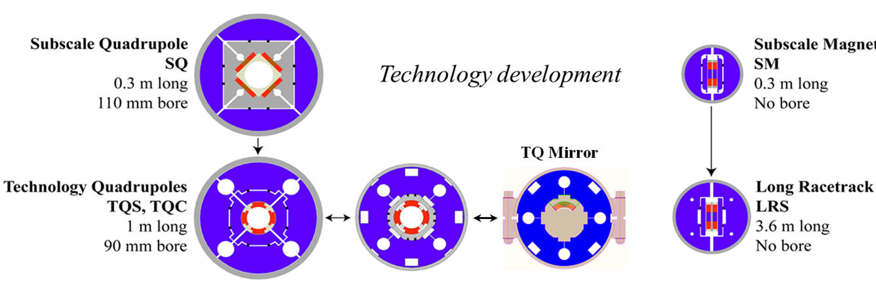
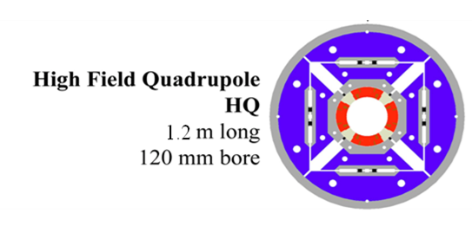
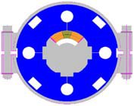
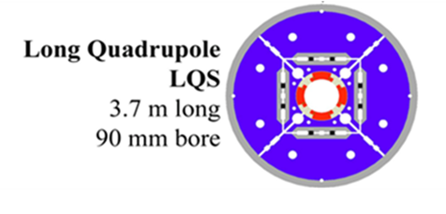
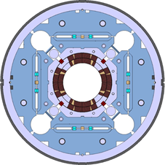
Model Magnet Development Chart
Started from simple configurations directed at basic technology studies and progressed to incorporate all requirements for operation in the accelerator
2003
Coil design selection
Structure selection
Lessons Learned
HQM
HQ and LQ Mirrors
Large aperture quadrupoles
Long quadrupoles
MQXF design in collaboration with CERN
2018

Slide 7
Fabrication and Test Database
Test facilities: LBNL (11 tests); BNL (2 tests); FNAL (26 tests); CERN (8 tests, funded by CERN)
(#): includes coil exchanges with previously used coils, full reassembly with same coils, or pre-load adjustments
(*): includes contributions from FNAL GARD program
(**): includes contributions from LBNL GARD program
Demonstrated viability of reusing and replacing coils in multiple assemblies
An important element of risk mitigation against defective coils in production

Slide 8
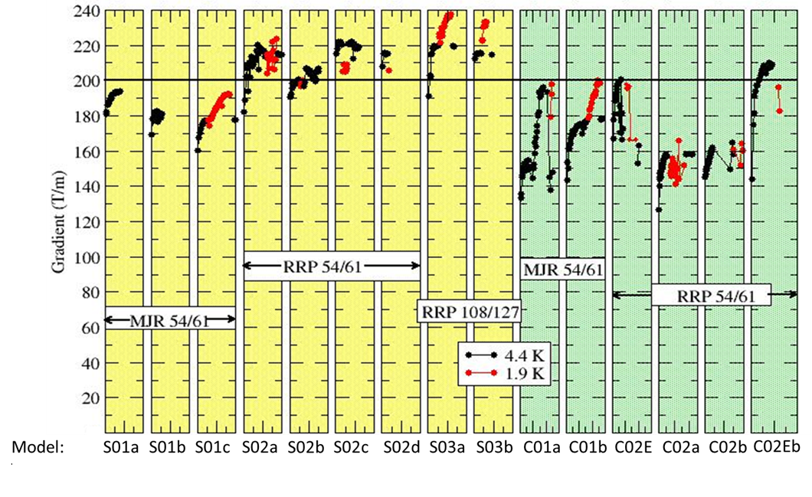
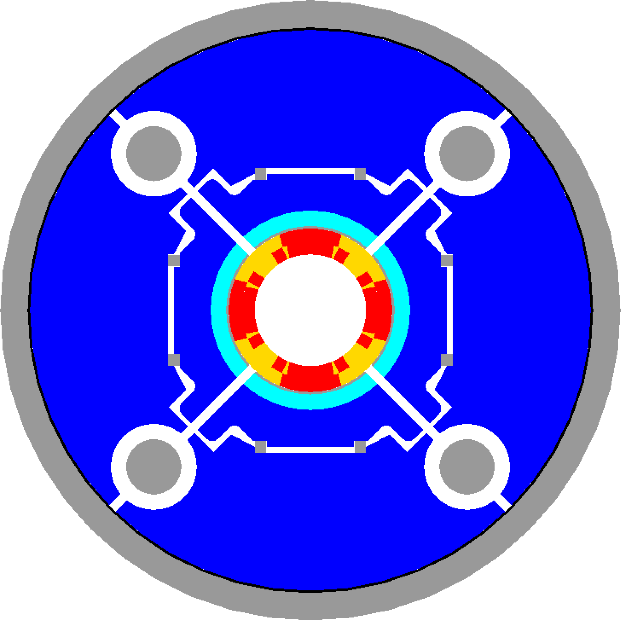
Mechanical design comparison and selection
Two mechanical structures were developed for the TQ coils and their performance was compared in a series of 15 tests
Both structures surpassed the target gradient of 200 T/m
The shell structure was selected and further developed in LQ and HQ
TQS (shell-based)
TQC (collar-based)
TQS (shell-based)
TQC (collar-based)

Slide 9
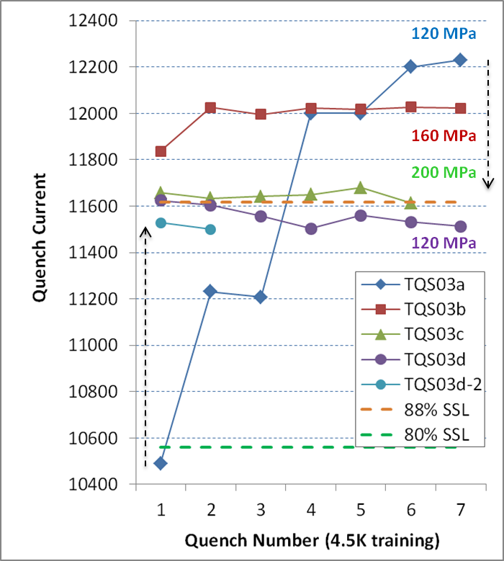
Pre-load optimization and stress limits
Balance speed of training and consistent plateau after thermal cycle vs. degradation
Four tests performed at CERN in TQS03 models with different pre-load
Increasing pre-load in a/b/c (pole ave.120/160/200 MPa) gives more stable but lower plateau (93/91/88%)
Degradation is permanent: TQS03d with lower pre-load does not recover initial level
Good performance in a broad range of coil stress with peak (calculated) up to 240 MPa
H. Bajas, M. Bajko, S. Caspi, H. Felice, P. Ferracin, R. Hafalia, R. Hannaford, J.C. Perez et. al

Slide 10
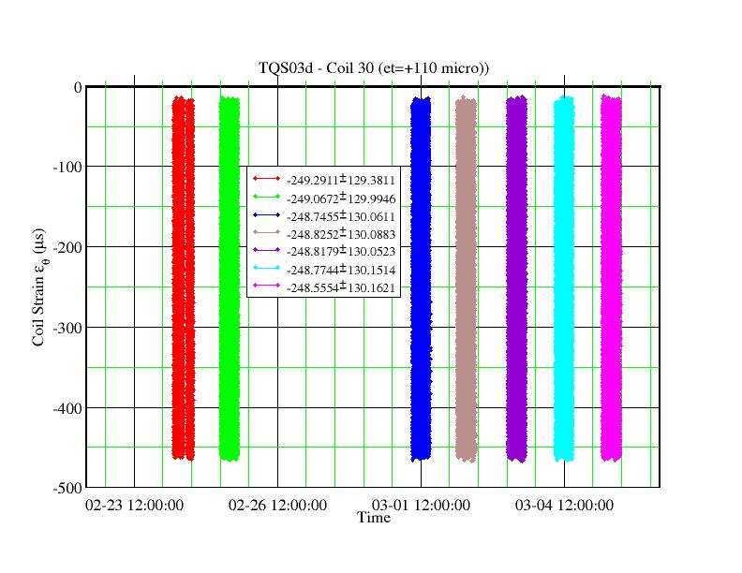
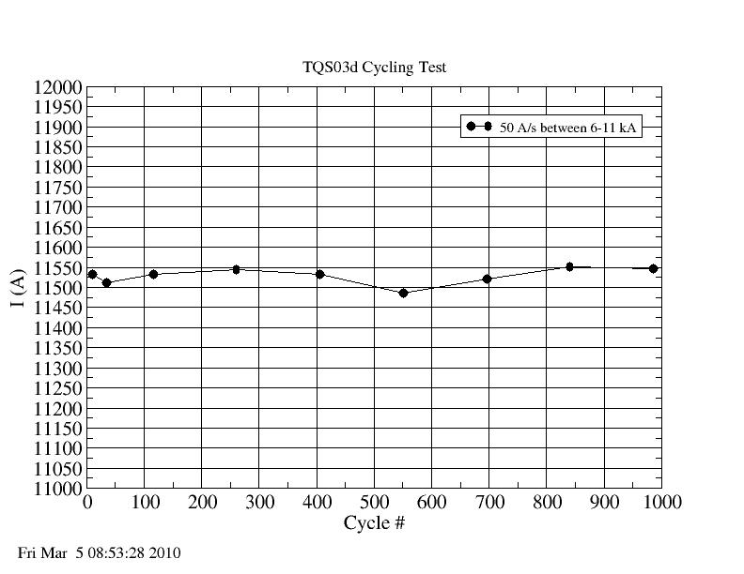
Cycling test to assess long-term degradation
Cycling test was carried out at CERN using magnet TQS03d
Performed 1000 cycles with control quenches every ~150 cycles
No change in mechanical parameters or quench levels
H. Bajas, M. Bajko, G. DeRijk, H. Felice, A. Milanese et. al

Slide 11
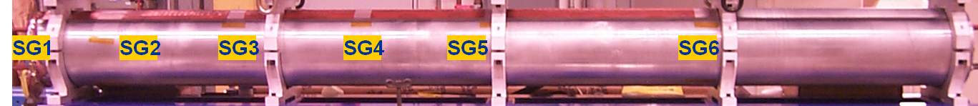
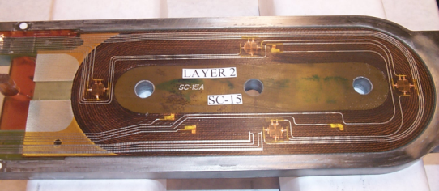
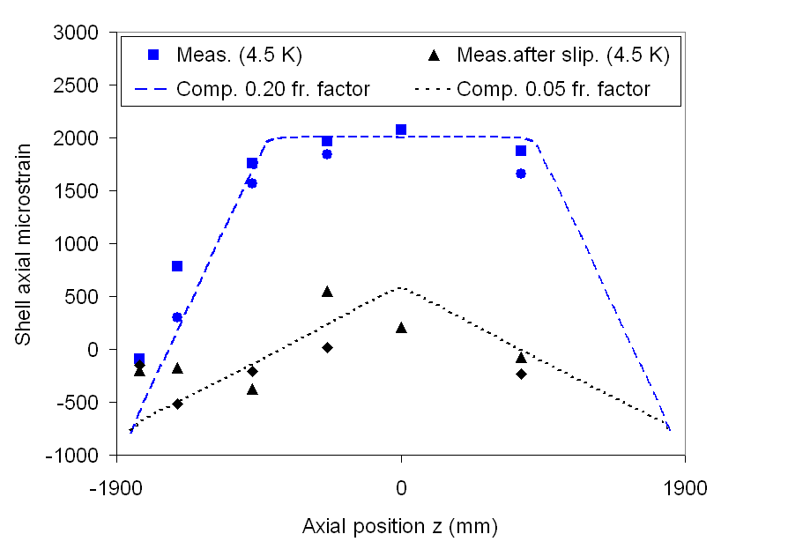
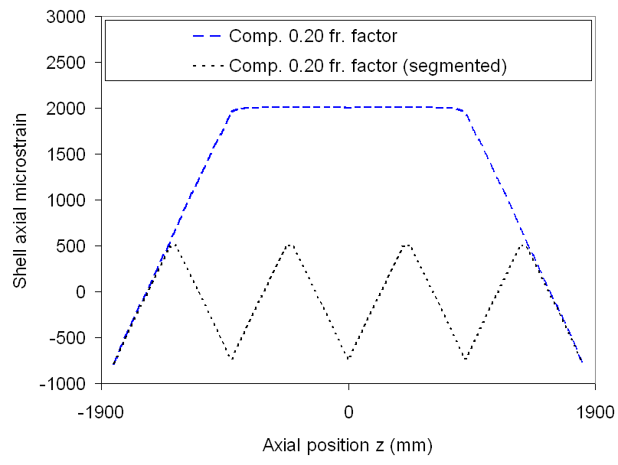
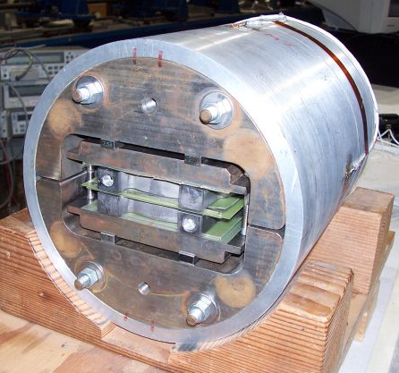
Scale-up to long coils and structures: LR
The magnet length scale-up was a defining goal of the first R&D phase
As a first step, the “subscale” coil and structure was extended from 0.3 to 4 m
The Long Racetrack (LR) magnet successfully achieved 98% SSL in 2006
Observation of shell-yoke slippage in LR01 led to shell segmentation in LR02
LR was also used to transfer the wind-and-react coil technology to BNL
LRS01
LRS01b
G. Ambrosio, M. Anerella, P. Ferracin, R. Hafalia, R. Hannaford, J. Muratore, J. Schmalzle, et al.

Slide 12
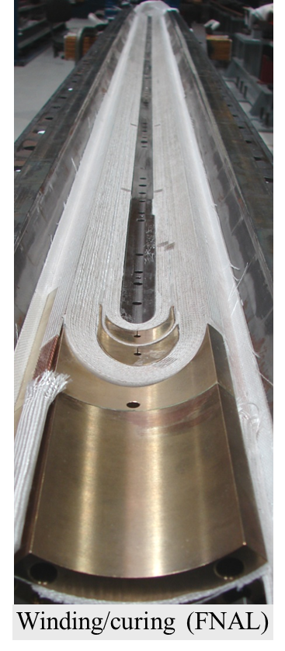
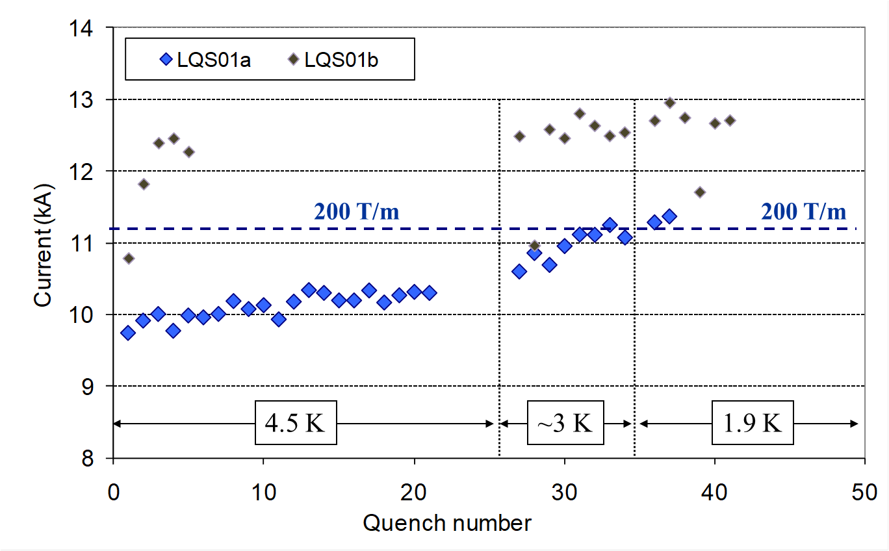
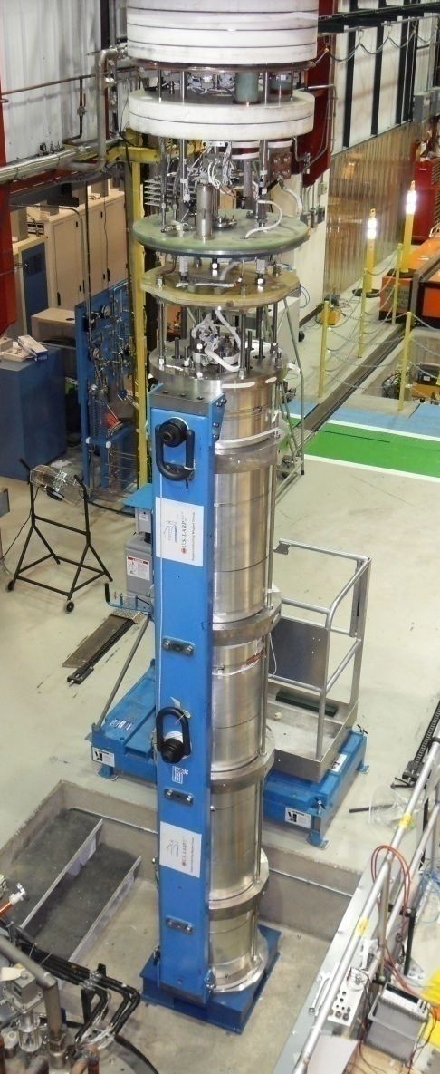
Scale-up to long coils and structures: LQ
LARP defining milestone: reach 200 T/m in 90 mm aperture and 4 m length
Based on TQ design, adding coil, tooling and structure features for scale up
Achieved goal in first test and further improved after radial shim optimization
Coil winding and curing
Quench performance of LQS01a and LQS01b
Cool-down test
G. Ambrosio, M. Anerella, R. Bossert, G. Chlachidze, D. Dietderich, H. Felice, P. Ferracin, A. Ghosh, R. Hafalia, R. Hannaford, A. Lietzke, F. Nobrega, J. Schmalzle, P. Wanderer et al.

Slide 13
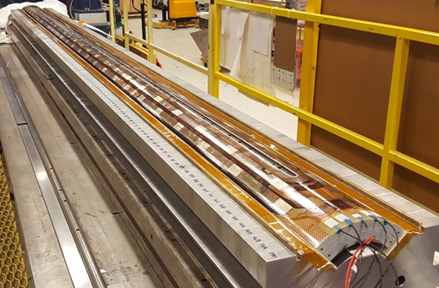
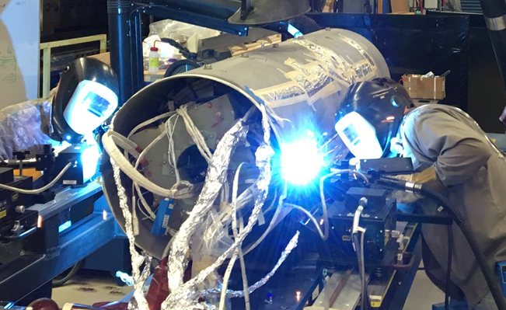
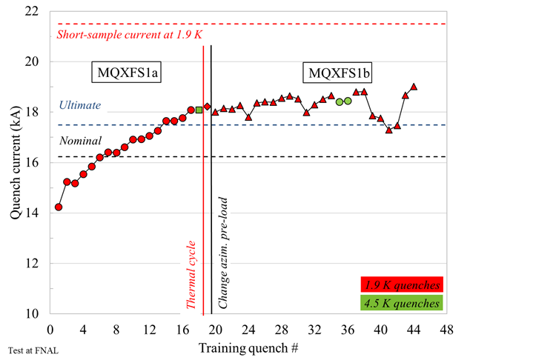
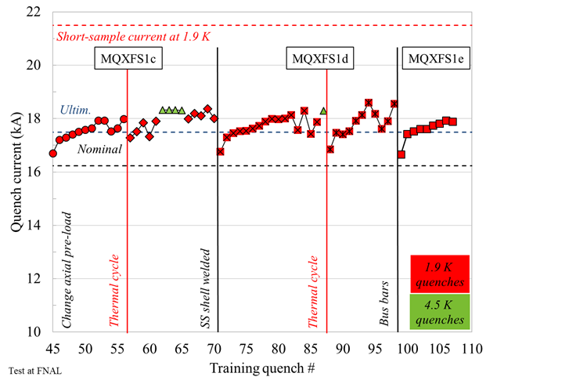
LARP contribution to
MQXF Design Validation
Single coil tests:
  Short and long coils
  I_max > 19 kA; 90% SSL
4m coil during assembly in mirror structure
Short model: MQXFS1a/b/c/d/e
  Two coils and structure by CERN
  MQXFS1d had SS shell welded
  I > I_ultimate (7 TC, 250 quenches)
MQXFS1d during welding of SS shell

Slide 14
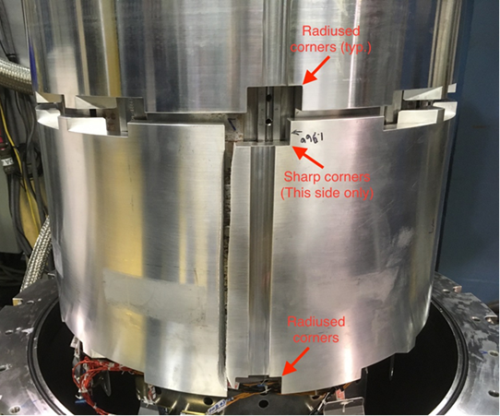
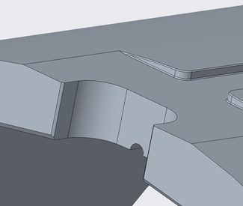
Prototypes: MQXFAP1 and MQXFAP2
Both prototypes had issues and we learned a lot from them:
  See: G. Ambrosio et al. “Lessons learned from the prototypes of the MQXFA Low-Beta Quadrupoles for HL-LHC and status of production in the US” IEEE TAS #4001105:
  During R&D phase, try to estimate peak voltages as early as possible
  Finalize Electrical and Structural Design Criteria in the early phase of magnet development
    In LARP Hipot at 1 kV before and after cold test; for MQXF: 3.7/0.5 kV (before/after)
    In AUP: Structural Design Criteria for brittle materials
  Equipment changes from short to long coils and the need to increase technician number may negatively affect coil yield in the early phase of Nb₃Sn coil production even after prototyping phase
  Before scaling up production by 1 or 2 orders of magnitude an intense effort should be spent to develop 2nd generation Nb₃Sn coil fabrication technology for accelerator magnets, aiming at significant reduction of touch labor
Sharp corners in MQXFAP2
10-15 mm radius in MQXF final design
Failure Assessment Analysis

Slide 15
LARP Achievements
Technology demonstration for HL-LHC IT Quadrupoles:
Conductor: RRP 108/127 (4.8 tonnes); Cables with SS-core
Coil fabrication technology used for MQXF
  G. Sabbi, et al., “Design Criteria for MQXFA Superconducting Elements” US-HiLumi-doc-885
Bladder-&-Key technology with accelerator quality features
Scale-up of Nb₃Sn coils up to 3.6 m
Scale-up bladder-&-key Nb₃Sn magnet structure up to ~4 m
Development of MQXF design in collaboration with CERN
Limits/Areas to be improved (addressed by AUP):
Electrical QC tests limited to 1 kV
No formal Structural Design Criteria
QA/QC plan different at each laboratory

Slide 16
Outline
US LHC Accelerator Research Program (LARP)
  Program overview
  Achievements, Lessons Learned and areas for Improvements
US High-Luminosity LHC Accelerator Upgrade Project (AUP)
  Test results of first two deliverable magnets
  Achievements, Lessons Learned and possible Improvements for future projects

Slide 17
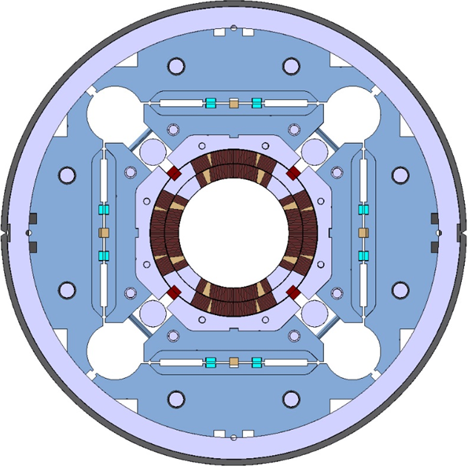
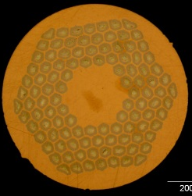
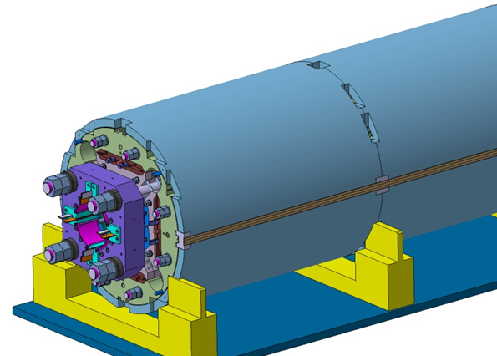
MQXFA/B Design
Parameter | Unit | MQXFA/B
Coil aperture | mm | 150
Magnetic length | m | 4.2/7.15
N. of layers |  | 2
N. of turns Inner-Outer layer |  | 22-28
Operation temperature | K | 1.9
Nominal gradient | T/m | 132.2
Nominal current | kA | 16.23
Peak field at nom. current | T | 11.3
Stored energy at nom. curr. | MJ/m | 1.15
Diff. inductance | mH/m | 8.26
Strand diameter | mm | 0.85
Strand number |  | 40
Cable width | mm | 18.15
Cable mid thickness | mm | 1.525
Keystone angle |  | 0.4
Nb₃Sn Conductor
RRP 108/127
P. Ferracin et al., “Development of MQXF, the Nb₃Sn Low-β Quadrupole for the HiLumi LHC ” IEEE Trans App. Supercond. Vol. 26, no. 4, 4000207
G. Ambrosio et al., “First Test Results of the 150 mm Aperture IR Quadrupole Models for the High Luminosity LHC” NAPAC16, FERMILAB-CONF-16-440-TD

Slide 18
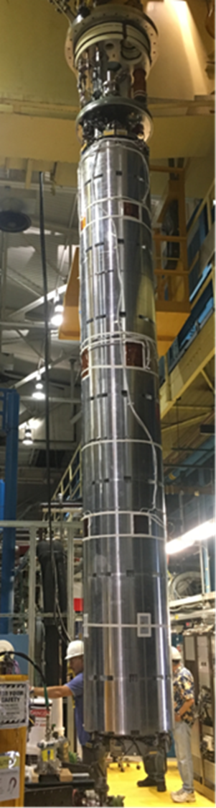
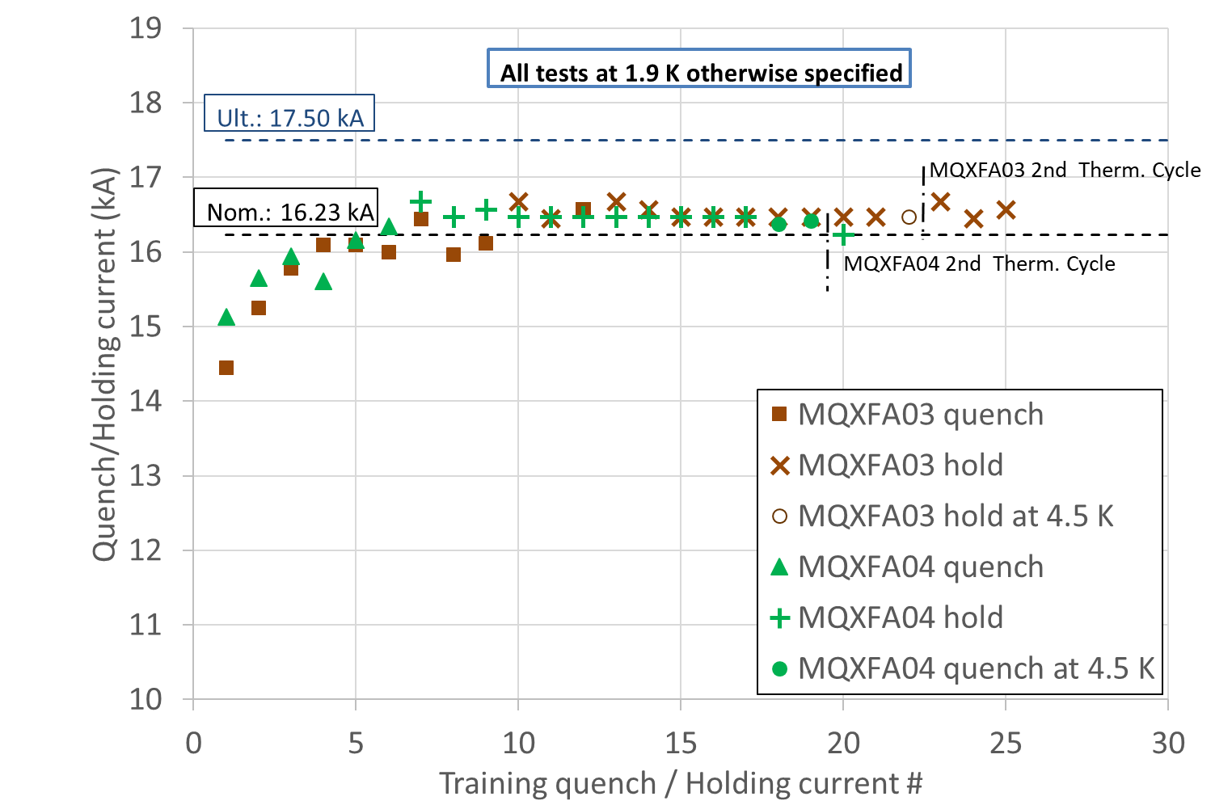
MQXFA03 and MQXFA04
Quench & Holding-Current History
J. Muratore et al., “Test Results of the First Pre-Series Quadrupole Magnets for the LHC Hi-Lumi Upgrade”, IEEE Trans. Appl. Superc. 2021, #4001804

Slide 19

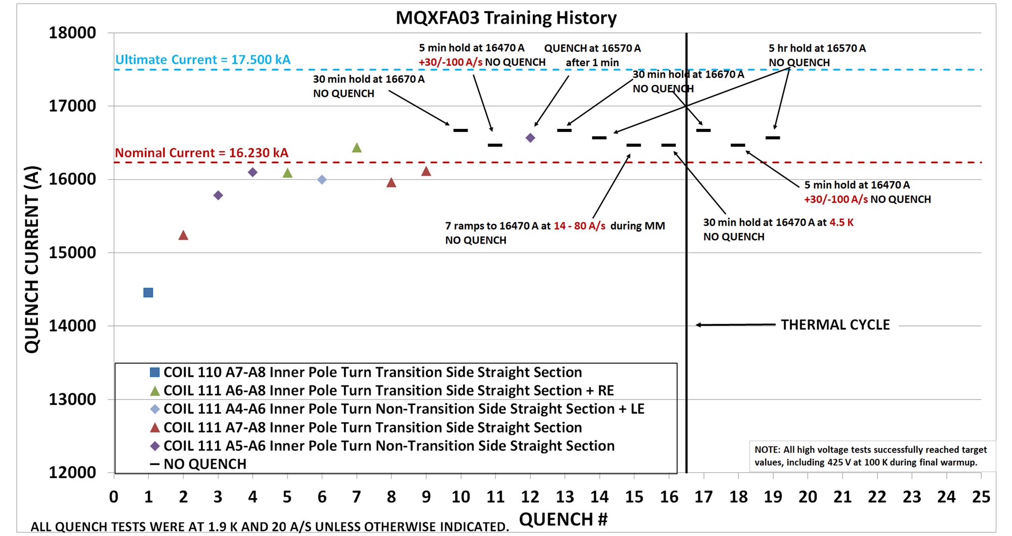
MQXFA03 Quench History @ BNL
Requirement MQXFA-R-T-03: The MQXFA magnet must be capable of operating at steady state providing an integrated gradient of 556.9 T in superfluid helium (HeII) bath at 1.3 bar and at a temperature of 1.9 K. ➔ 16230 A + 300 A (margin) = 16530 A for 300 minutes
Requirement MQXFA-R-T-17: After a thermal cycle to room temperature, MQXFA magnets shall attain the nominal operating current with no more than 3 quenches.

Slide 20
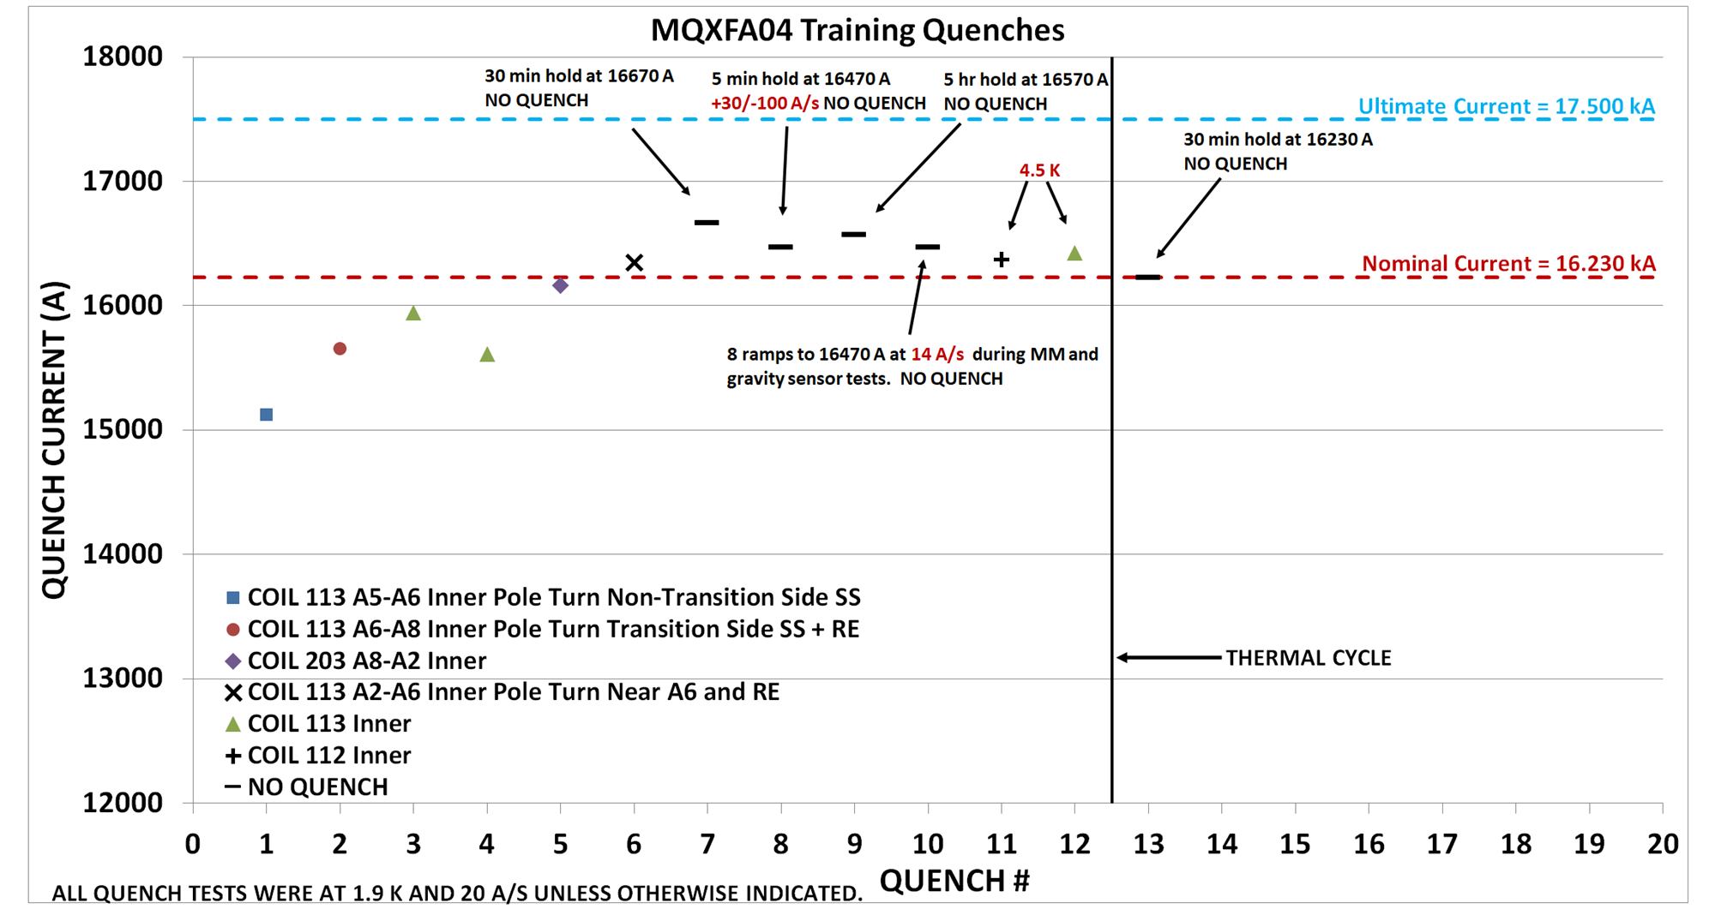
MQXFA04 Quench History @ BNL
Requirement MQXFA-R-T-03: The MQXFA magnet must be capable of operating at steady state providing an integrated gradient of 556.9 T in superfluid helium (HeII) bath at 1.3 bar and at a temperature of 1.9 K. ➔ 16230 A + 300 A (margin) = 16530 A for 300 minutes
Requirement MQXFA-R-T-17: After a thermal cycle to room temperature, MQXFA magnets shall attain the nominal operating current with no more than 3 quenches.

Slide 21
MQXFA03 & A04 Quench Locations
MQXFA03: ~all quenches in one coil (111), with one exception
  Location moved from one coil side to the other side, and along coil length
MQXFA04: ~all quenches in one coil (113), with two exceptions
  Quench location moved along coil length
Quench locations in MQXFA03 (# = quench number; T = transition side) by M. Marchevsky
J. Dimarco et al., “A Full-length Quench Antenna Array for MQXFA Production Series Quadrupole Magnet Testing”, IEEE Trans. Appl. Superc. TASC.2021.3068933

Slide 22
Warm Bore
Warm bore used for MQXFA vertical test at BNL is slightly magnetic (µ_{r}=1.01)
  Unstable equilibrium in quadrupole field
Warm bore came in contact with a coil(s) during test of MQXFA03 and MQXFA04
Training may have been affected by this unplanned load on the coils
Could also explain degradation in MQXFAP1b
We are also measuring coil mechanical properties, which may be contributing factor

Slide 23
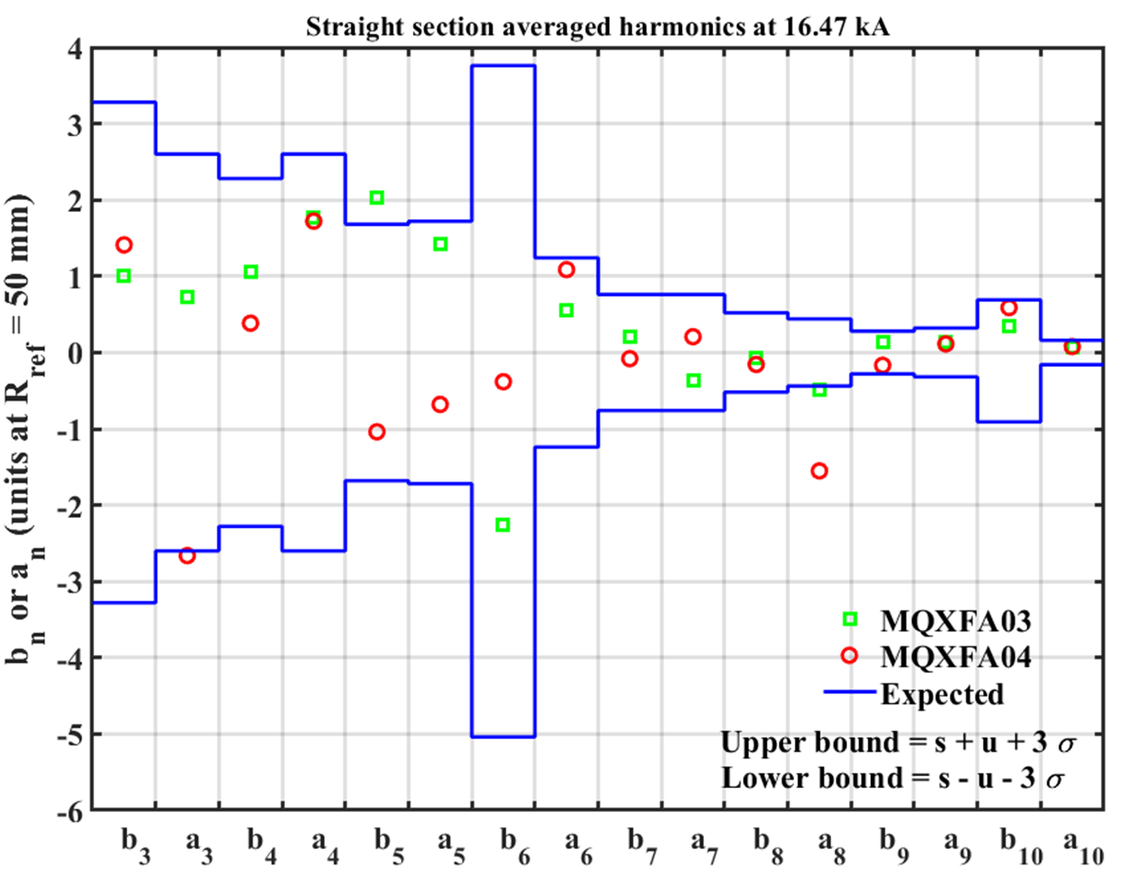
Magnetic Measurements: Field Quality
Field Quality is ~on target
B6 correction in coils is effective
MQXFA03 has 4 coils w/o b6 correction
MQXFA04 has 1 coil with b6 correction: 125 um shift toward midplane
Integral harmonics to be measured in Coldmass
H. Song, et al., “Magnetic Field Measurements of First Pre-series Full-Length 4.2 m Quadrupole MQXFA03 Using PCB Rotating Coils for the Hi-Lumi LHC Project”, IEEE Trans. Appl. Superc. 2021, # 4000207

Slide 24

MQXFA03 & A04 Test Summary
A03
A04
Requirements & Test Goals:
  Hold current at nominal current + 300 A (T-3)
  Ramp to/from I_nom at ±30 A/s (T-11)
  150 A/s ramp down w/o quench (T-18)
  Temperature margin
  Magnetic measurement (O-2)
  Splice resistance < 1 nΩ (T-29) – noisy system
  Training memory (T-17)
  All other requirements
MQXFA03 and MQXFA04 accepted for use in 1st LMQXFA Cold Mass

Slide 25
MQXFA Production Status
Conductor procurement: 72% complete
Cable fabrication: > 50% complete
Coil fabrication: close to 50% milestone
Structure procurement: close to 50%
Magnet Assembly: MQXFA03/4/5/6 done, A07 by end of April
Vertical magnet test: MQXFA03/4 done, A05 in progress
Coldmass assembly: LMQXFA01 in progress

Slide 26
Strand & Cable
Achievements:
small scale production of high-Jc Nb₃Sn w/o significant issues
  AUP: ~9.5 tonnes
High cable yield
Braded insulation by vendor

Slide 27
Coil part procurement
Achievements:
No major issue procuring parts for small scale production
Possible improvements for future projects:
Plasma coating: only one good vendor, fragile
Quench heaters: complicated fabrication; design can be improved

Slide 28
Coil fabrication - I
Achievements:
Nb₃Sn coil fabrication technology for MQXF magnets:
  11-12 T peak field – 4.2 m length
Developed techniques to fix coils
Fabrication of identical coils at two different sites (BNL and FNAL)
  Specifications, drawings and travelers for identical coils
  Coils from different sites can be used together
Successful shipment of 4.2 m coils across USA

Slide 29
Coil fabrication - II
Possible improvements for future projects:
Coil-pole insulation is marginal; ceramic binder must be controlled carefully
Coils with higher turn-turn voltages will require different cable insulation scheme
Longer coils will benefit from splice btw layers
  1/2 loss in case of issue
Coil azimuthal dimension variations
  Acceptable, but cause/mechanism is not very clear
Quench heaters: avoid bubbles (IL) and polyimide thickness reduction (OL)

Slide 30
Magnet Structure & Assembly
Achievements:
Developed Structural Design Criteria for brittle materials
  MQXFA Structural Design Criteria, US-HiLumi-doc-909
Tolerances under control for small scale production of bladder-and-key structures
Mapping pre-load space and assessment of “safe territory” (next slide)
Developed assembly procedure based on “safe territory” and actual coil dimensional variations
  MQXFA Series Magnet Production Specification, US-HiLumi-doc-4009
Magnet shipments across US w/o issues

Slide 31
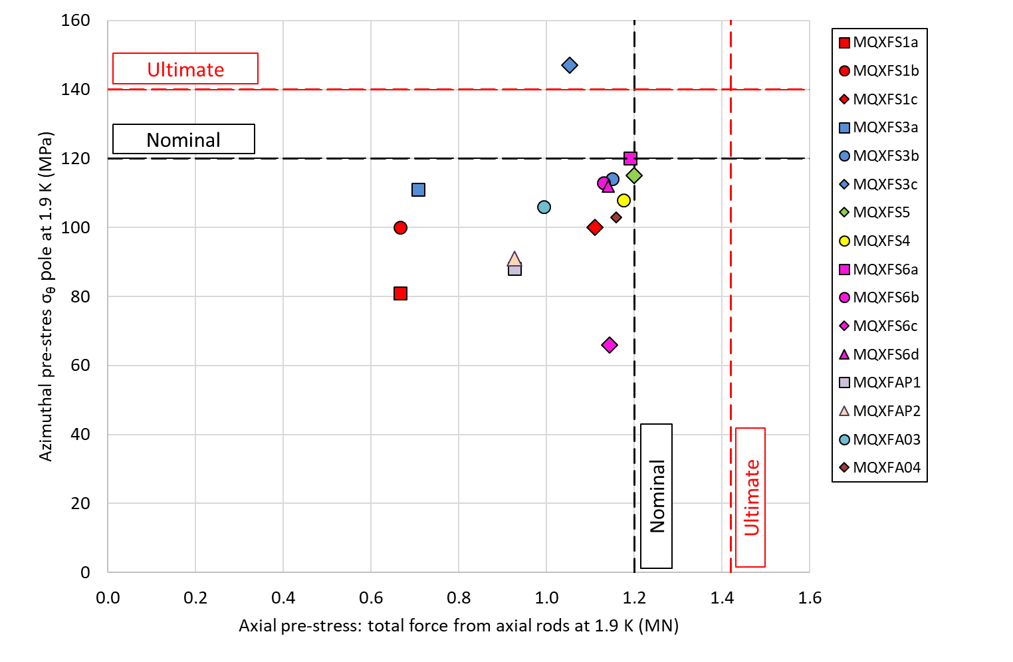
Safe Pre-load Space
Identified large area with acceptable pre-load
  Critical to accommodate coil & structure tolerances
Large number of short model assemblies & tests by CERN team instrumental for this achievement
Coil azimuthal pre-load vs. the axial pre-load force, both after cool-down, applied in different MQXF magnets. The dashed lines indicate computed reference levels to guarantee full coil-pole pre-load (no unloading) in the straight section and in the ends respectively at Nominal and Ultimate field.

Slide 32
Test performance
Achievements:
Training to nominal current of first 2 MQXFA deliverables
Demonstrated excellent memory
Demonstrated temperature margin
CLIQ + OL QH ➔ complete redundancy for quench protection (demonstrated in short models)
Field Quality in target range
All key requirements were met

Slide 33
Conclusions
Over 15 years and ~50 magnets the LARP program in collaboration with CERN developed Nb₃Sn coil fabrication technology and bladder-&-key structure for HL-LHC IT quadrupoles
The AUP project successfully tested the first two MQXFA deliverable magnets confirming readiness for production
  AUP is at ~50% coil production
Suggestions for future projects have been provided based on this feedback

Slide 34
Back-up Slides

Slide 35
Magnet Program Technical Highlights
The following slides present selected highlights which are representative of the progress made by the LARP magnet program in key technical areas:
Technology Fundamentals:
Selection of a uniform design and fabrication process for LARP coils
Mechanical Design Comparison and Selection
Pre-load optimization and stress limits
Demonstration of magnet performance over a large number of cycles
Scale-up to long coils and structures
Magnet production and operation in the accelerator:
Optimization of coil and structure design, and fabrication process
Introduction of cored cables to control eddy current effects
Field quality measurements, analysis and correction
Assessment of quench protection limits and CLIQ performance verification

Slide 36
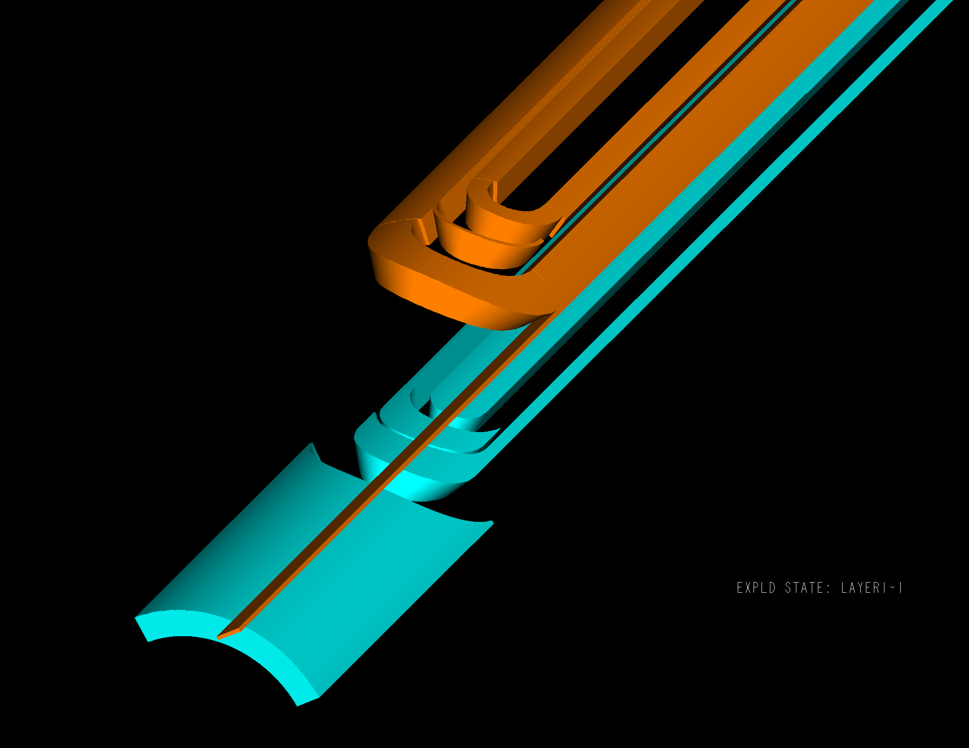
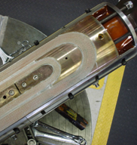
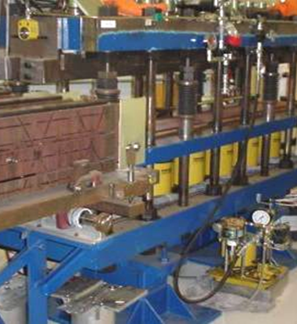
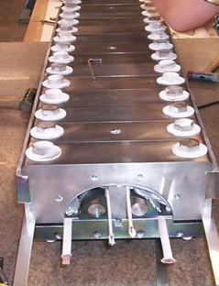
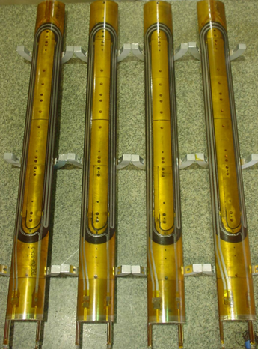
Uniformity of coil fabrication process
Detailed analysis and selection among coil fabrication processes developed at different Labs started during the TQ program and continued in LQ and HQ
Cable and insulation
Design of end parts
Coil curing process
Reaction tooling
Instrumentation/heater traces
Strain gauge installation
Winding & curing (FNAL - all coils)
Reaction & potting (LBNL - all coils)
R. Bossert, S. Caspi, D. Dietderich, P. Ferracin, R. Hafalia, R. Hannaford, V. Kashikhin, A. Lietzke, I. Novitski, A. Zlobin et al.

Slide 37
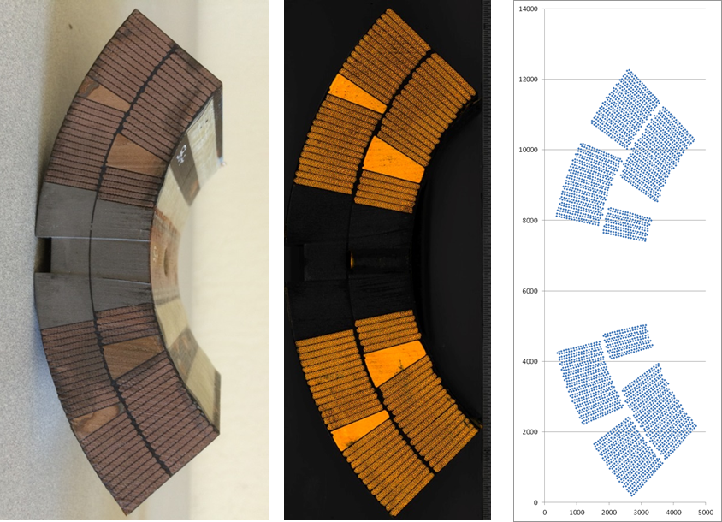
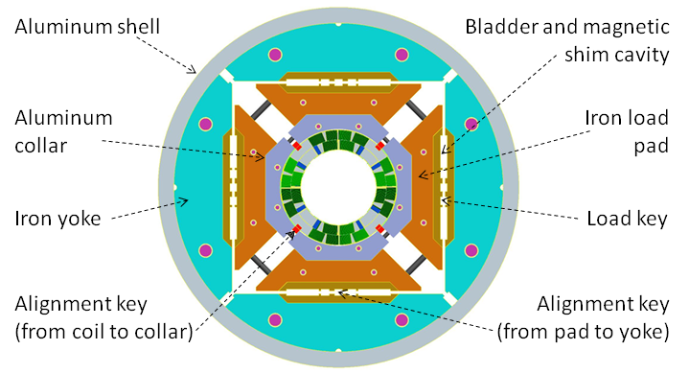
Design and process optimization in HQ and LHQ
Optimized coil and structure: peak stress at TQ/LQ level despite larger aperture and field
Introduced features to preserve alignment from coil fabrication to assembly and powering
Coil design
Mechanical structure
Second wedge for lower harmonics
Alignment key at pole
Strand coordinate scanning
Strand coordinate analysis
More outer layer turns to balance peak stress
Improved coil design and fabrication process for reliability and efficiency in production:
  Added axial/transverse space for cable expansion in reaction tooling based on HQ01 experience
  Electrical integrity: Aluminum oxide coating of coil parts, thicker insulation on cable and heaters
  New systems and more stringent criteria for electrical QA at all steps of fabrication and test
  Braided insulation for long unit lengths; new tooling/processes for winding with cored cable
G. Ambrosio, M. Anerella, F. Borgnolutti, R. Bossert, D. Cheng, G. Chlachidze, H. Felice, P. Ferracin, A. Ghosh, M. Marchevsky, F. Nobrega, P. Roy, J. Schmalzle, X. Wang, M. Yu

Slide 38
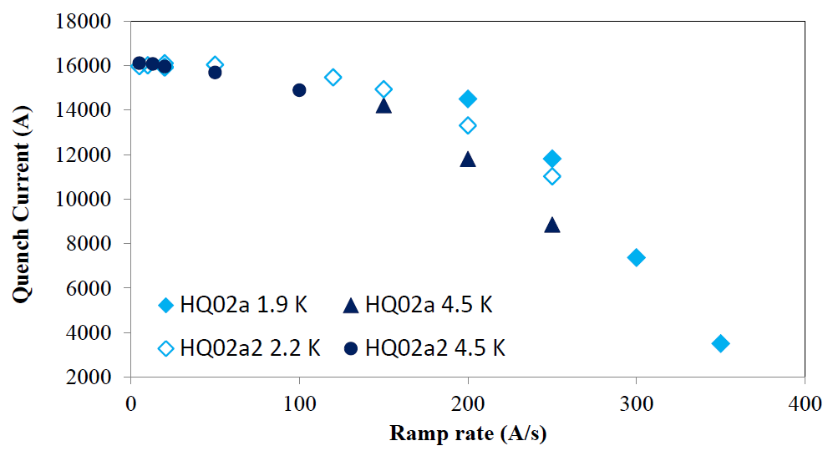
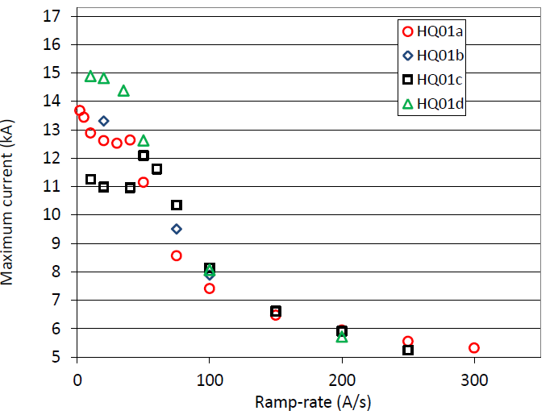
Cable with core for control of dynamic effects
New cable with stainless steel core in HQ02
  Partial coverage (80%) to control eddy currents while maintaining current sharing
  Biased to the thick edge for mechanical stability
Significant improvement in ramp rate effects:
  14.6 kA (80% SSL) up to 150 A/s (1.9K)
  Safe discharge up to 300 A/s
One-pass cabling process developed for cored cable cuts cabling effort by more than 50%
But: decreased mechanical stability for winding, requiring more refined tools and procedures
HQ02: 15kA @ 150 A/s
150 A/s
HQ01: 6.5 kA @150 A/s
150 A/s
Stainless steel core biased to the thick edge
Effective R_{c} change x10: from 0.1-0.4 μΩ to 2-4 μΩ
G. Chlachidze, D. Dietderich, J. DiMarco, A. Ghosh, H. Higley, A. Lietzke, N. Liggins, X. Wang et al.

Slide 39
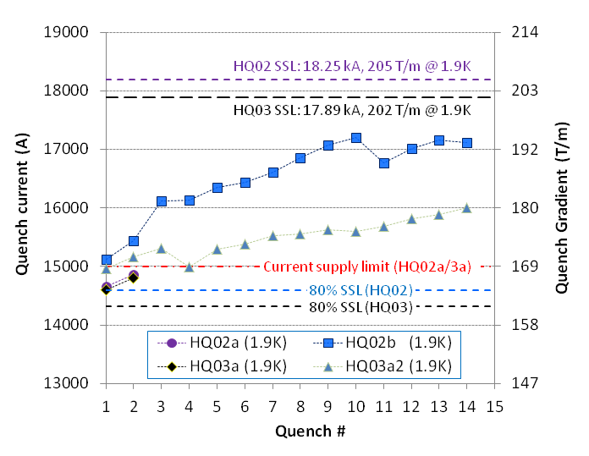
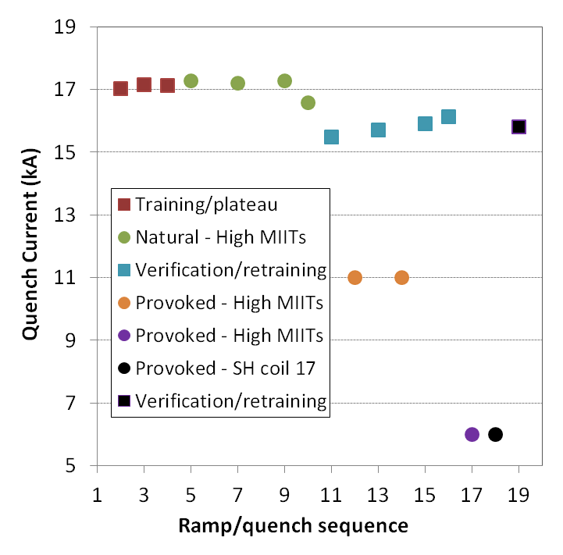

HQ Summary: Quench Performance
Highlights from HQ02 and HQ03 models with improved design based on HQ01 feedback:
HQ02a/a2: first quench at 80% SSL with all new coils; reached 98% SSL at 4.5K
HQ02b: 95% SSL with high (200 MPa) pre-load, 89% SSL after high MIITs study
HQ03a/a2: first quench at 81% SSL; reached 90% SSL (lower pre-load than HQ02b)
HQ02/03 quench training at 1.9K
HQ02b high MIITs study
13.5 MIITs
95% SSL
89%
95% SSL
90% SSL
14
19 MIITs
21
25
G. Ambrosio, M. Anerella, F. Borgnolutti, H. Bajas, R. Bossert, D. Cheng, G. Chlachidze, H. Felice, P. Ferracin, A. Ghosh, M. Marchevsky, F. Nobrega, H. Pan, E. Ravaioli, J. Schmalzle, X. Wang

Slide 40
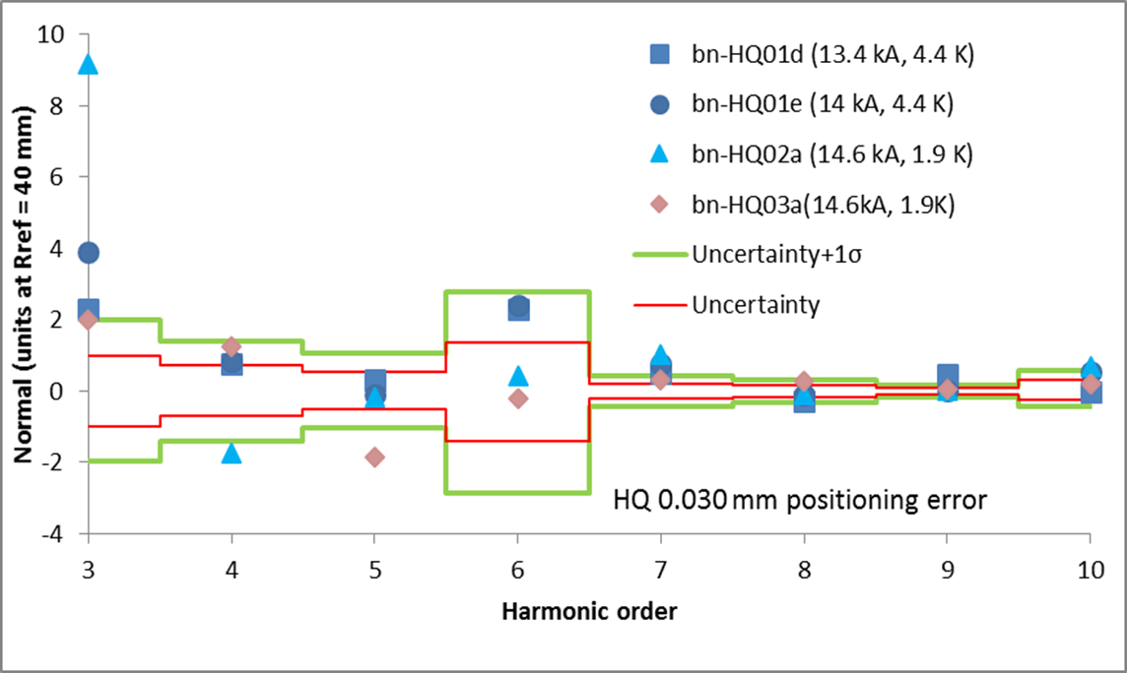
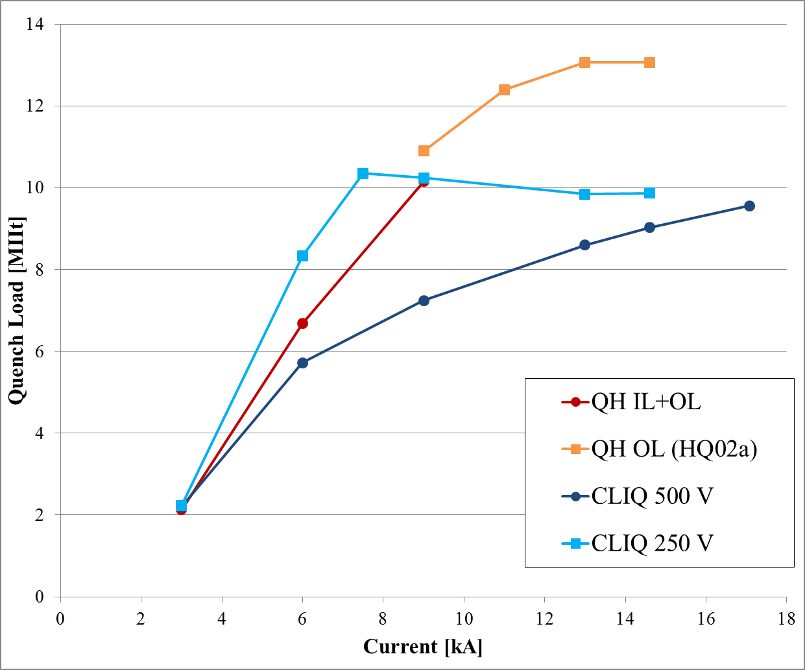
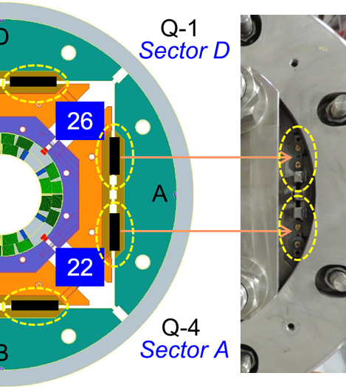
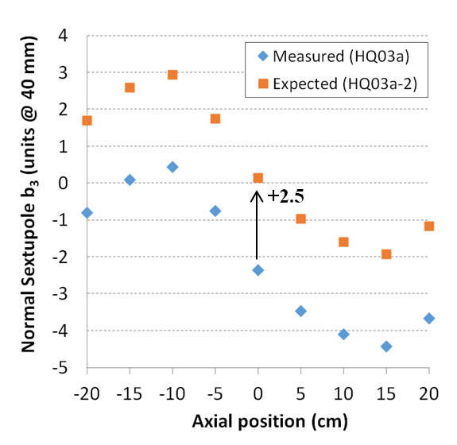
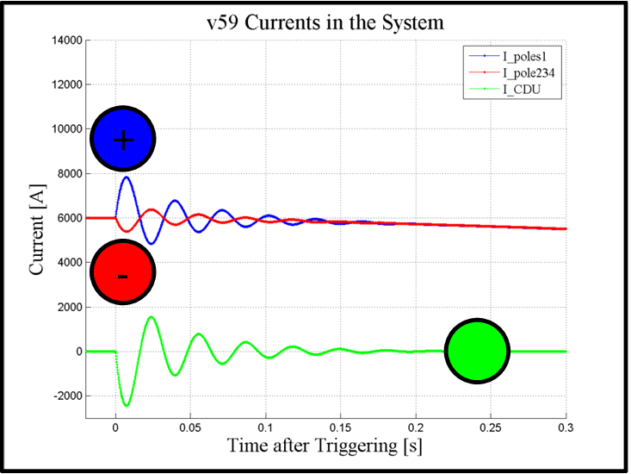

HQ Summary: Field Quality and Protection
Field quality: comparison of measurements with as-built calculations and targets
Tested magnetic shim correction scheme
HQ02b: first test of the CLIQ (Coupling-Loss Induced Quench) system on a Nb₃Sn magnet
Critical element of MQXF protection strategy
H. Bajas, D. Cheng, G. Chlachidze, V. I. Datskov, V. Desbiolles, J. DiMarco, J. Feuvrier, G. Kirby, M. Marchevsky, E. Ravaioli, X. Wang

Slide 41


Single Coils in Mirror Magnets
Charge 1
Short (1.2 m) & Long (4 m) coils
Large current & temperature margins
    “R-T-03: The MQXFA magnet must be capable of reaching a gradient of 143.2 T/m in superfluid helium at 1.9 K (…)”
Very good memory
    “R-T-17: After a thermal cycle to room temperature, MQXFA magnets should attain the nominal operating current with no more than 3 quenches.”
Coil Design & Fabrication can meet requirement

Slide 42


MQXFS1a/b/c/d/e
Charge 1
MQXFS1a
  1.2 m coils; 1st gen. design; 2 by US & 2 by CERN
  Demo: Ultimate current, Temp. Margin & Memory
  Quench protection with CLIQ & heaters
MQXFS1b/c/d/e
  Study of pre-load; SS shell welding; bus-bars
  Demo: Ultimate current after 100+ quenches
    Above nominal current after many th. Cycles
  Confirmed by MQXFS4 and MQXFS5 @ CERN
Magnet Design
meets requirement

