Slide 1
Vertical Drift Photon Detector Tile Design
David Warner for the Photon Detector Consortium
April 12, 2021

Slide 2
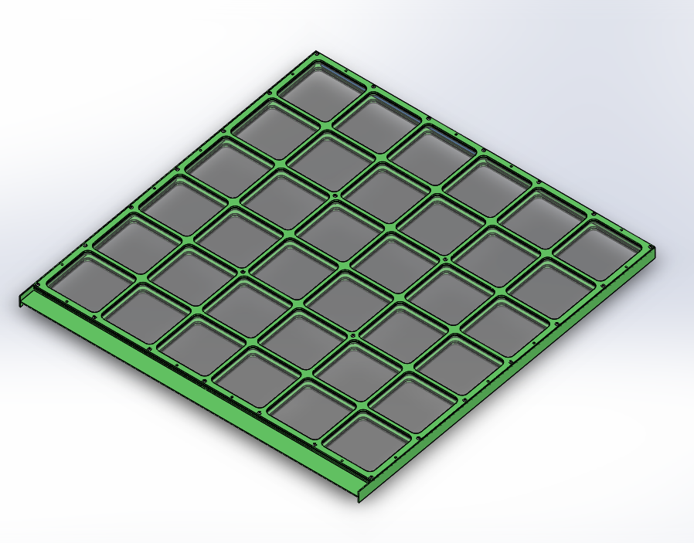
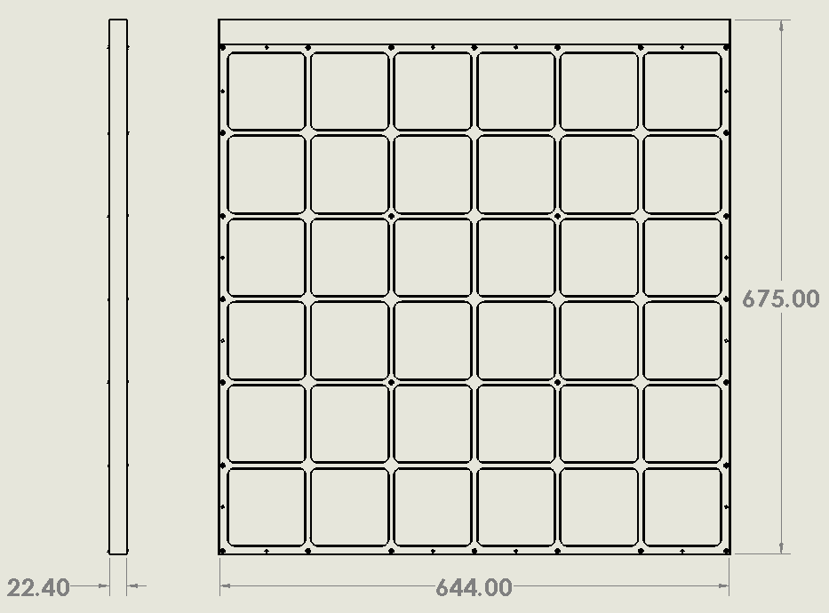
Mechanical Frame (Concept)
Side SiPM
Routing PCBs (X2)
Total active area ~3600mm^2 (X2 sides)
Estimated mass ~5.5kg per tile
160 SiPMs (40 per side)
FR-4 G-10 Frame components
End readout PCB

Slide 3
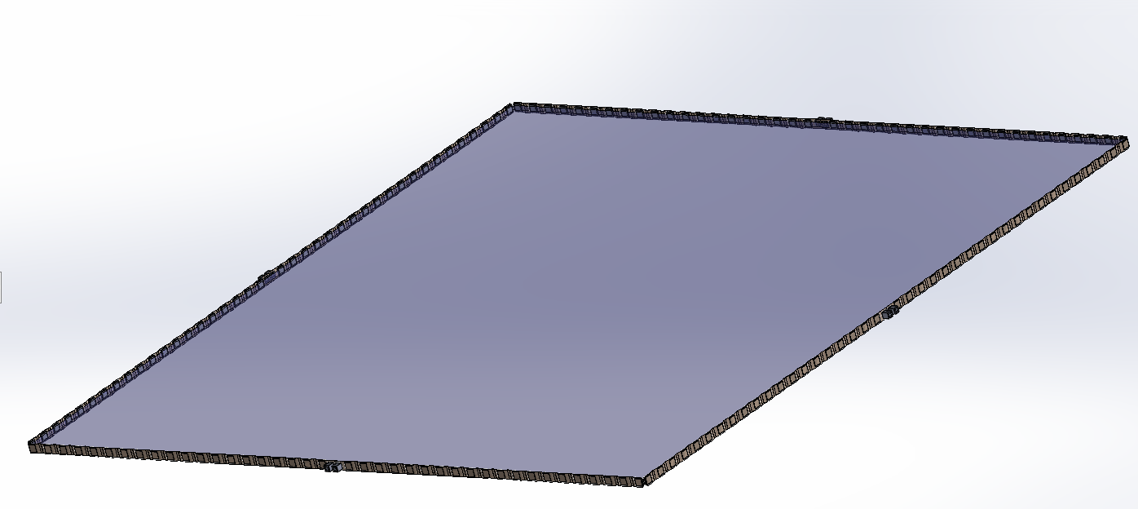
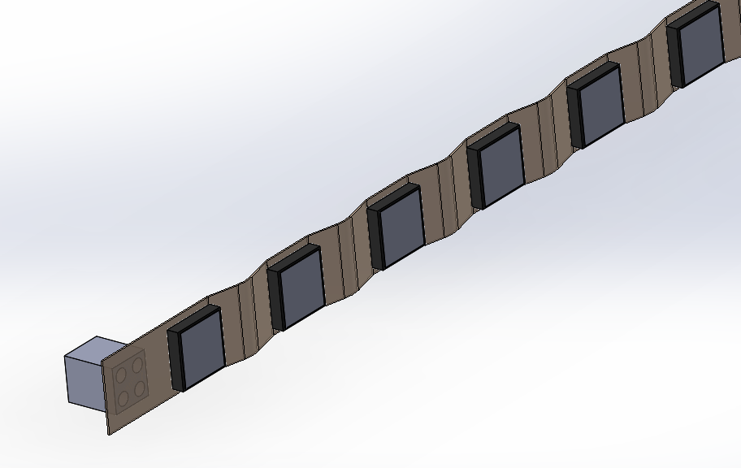
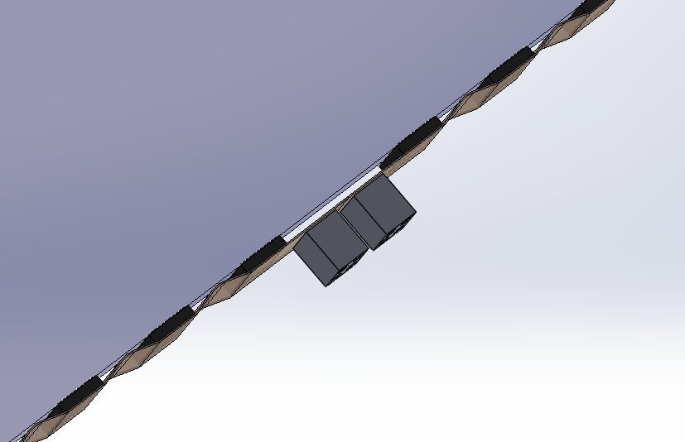
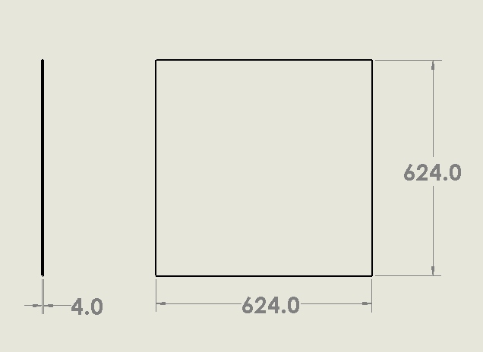
WLS Plate Assembly
160 SiPMs (40 per side)
  Glued to WLS Bar for improved performance
SiPMs mounted on Kapton flexi-PCB
  Addresses relative thermal contraction of WLS plate/frame.
Power-to-Glass FB-118 WLS plate (Milano)
Concept new to VD PD-- under development

Slide 4
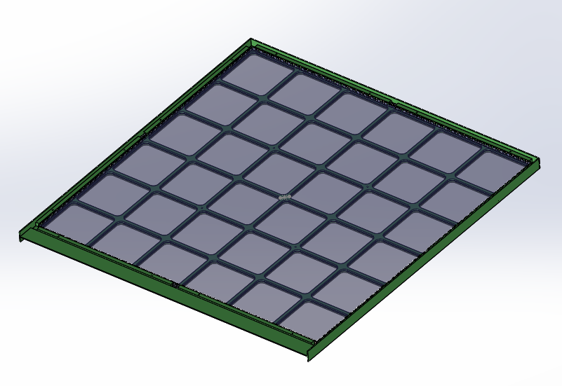
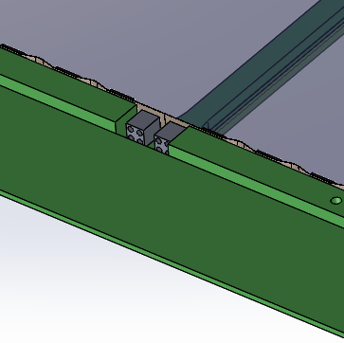
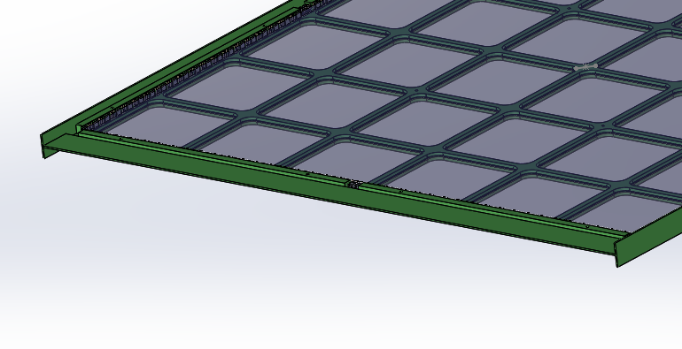
Module Assembly
2 kapton flexi-boards per side
20 SiPMs per kapton board.
Propose to mount ganging resistors/capacitors onto FR-4 signal routing PCBs
Connection points
(electrical and
Mechanical)
Electrical connectors
Tile readout PCB

Slide 5
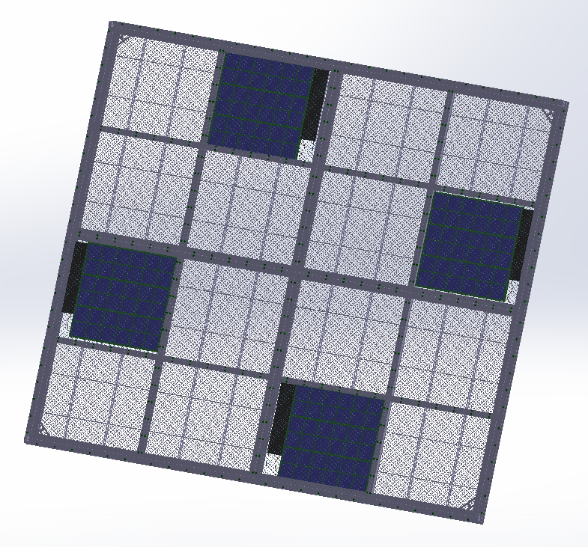
Frame mounting
Analog Signals
4 modules per cathode module
One readout electronics assembly per module
  ~200mm^
  Two PCBs in vertical stack: One analog board with amplifiers, (4 ADCs?) one digital board with signal readout, power, slow control
Power in
Signal out
Electronics
Control
module

Slide 6
Upcoming (CY-21) Module R&D
Complete preliminary cathode tile frame design (End of April 21)
  Procure dummy filter plates/WLS bars for initial test
  Assemble frame prototype and test in LN2 (Late May)
  Revise mechanical design (July)
  Fabricate 2 modules for cold box test (End of August)
  Cold test (CSU? FNAL?) (End of September)
  Cold box test CERN (October 21?)
Procure optical filters
  ~70 filters (July 21)
  Coat filters & Assemble into modules (August 21)
  Continue development of Xenon-optimized filter plates (Throughout 21, but not concluded in 21)
Procure 3 WLS plates (Power to Glass) (July 21)
Test Kapton flexi-PCBs for SiPM mounting (Summer 21)

Slide 7
BACKUP

Slide 8
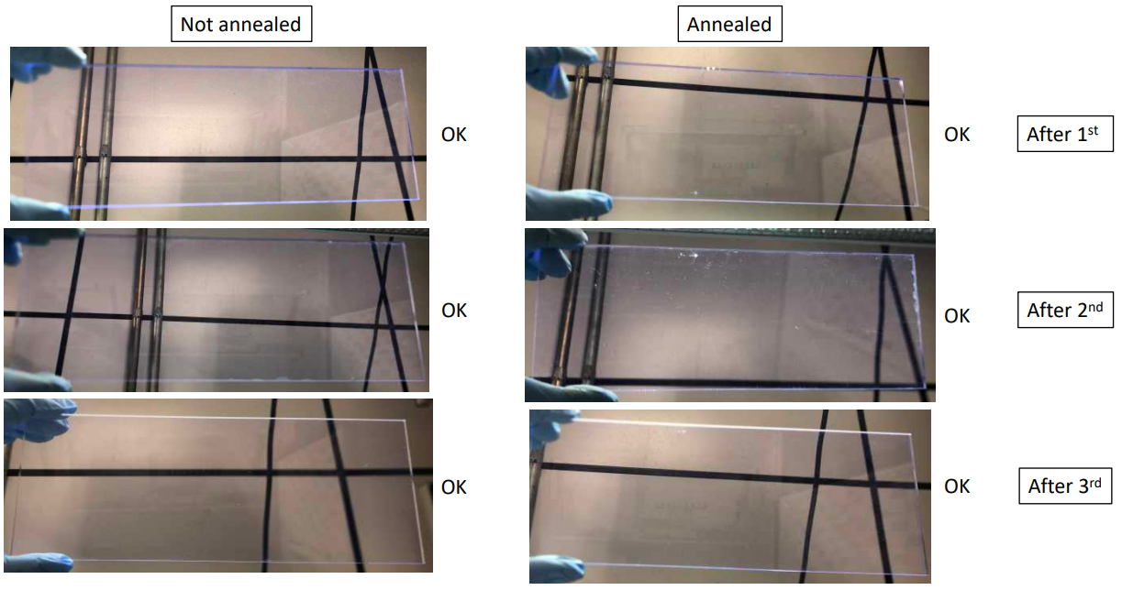
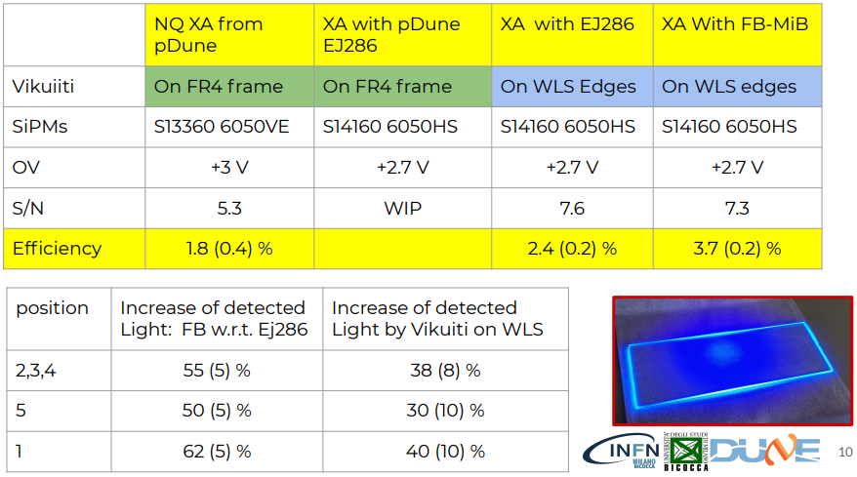
WLS Plates (EljenEJ286, FB118)
Initially observed thermal stress cracking of Eljen wavelength shifting plates traced to rate of cooling and improved by annealing
  Samples of both PVT (EJ286) and Polystyrene (EJ286-PS) were tested through multiple cooling cycles at UNICAMP
  No stress cracking observed with slow immersion in LN2.
  Well within DUNE, ProtoDUNE fill rates
Samples of both 1X (standard) and 4X WLS doping level WLS plates procured, will be tested in monochrometer (UNICAMP) and supercells (MIB, CIEMAT)
New custom-fabricated WLS plates fabricated by Glass to Power with MIB (Cattadori) (Acryllic)
  Early test results show significant improvement over standard-dopant concentration Eljen EJ286 bars
Eljen 286 (PVT Matrix)
FB118 (Milano Bicocca)

Slide 9
Photosensors
Collected in dark
Cross Talk
Initial SiPM tests performed for 6 candidate photosensors
  4X Hamamatsu
  2X FBK
PDE, afterpulsing and crosstalk measurements performed before and after 20 cryogenic cycles
Tests performed with redundancy (each type tested by at least 2 labs): Bologna, CIEMAT, Ferrara, Milano Bicocca, NIU, Prague, Valencia
No major issues observed
Afterpulse
Hamamatsu LQR 50mm Prague 77K
Gain, S/N of 1 sensor
FBK, Triple trench Bologna 77K
Dark and correlated noise
Model | #SiPM | PDE(%) | LN2 - First cycle |  | LN2 - Last cycle(20) |  | DIFF %
 |  |  | After pulses (%) |  | After pulses (%)
NUV-HD-Cryo | 23 | 40 | 0.23 | 1.82 | 2.16 | 2.29 | -25.93
 |  | 45 | 0.38 | 2.31 | 0.95 | 1.96 | 15.02
Triple Trench | 29 | 40 | 0.68 | 1.77 | 0.08 | 1.24 | 30.08
 |  | 45 | 0.04 | 1.75 | 0.45 | 1.50 | 14.42
Model | #SiPM | PDE(%) | LN2 - First cycle |  | LN2 - Last cycle(20) |  | DIFF %
 |  |  | Xtalk (%) |  | Xtalk (%)
NUV-HD-Cryo | 23 | 40 | 5.37 | 20.82 | 7.49 | 23.20 | -11.42
 |  | 45 | 5.45 | 25.64 | 4.50 | 23.67 | 7.67
 |  | 50 |  |  | 2.69 | 26.72
Triple Trench | 29 | 40 | 0.03 | 10.65 | 2.27 | 10.65 | 0.03
 |  | 45 | 0.65 | 14.19 | 2.31 | 12.93 | 8.91

Slide 10
Active Ganging (i)
Groups of 48 Hamamatsu and FBK SiPMs have been operated cryogenically at Bicocca
S/N ratio >5 observed (exceeding PD system requirements)
  Even better performance with optimized filtering
Ganging achieved (S/N>5) in November in a table-top design (Hamamatsu) and in January (FBK)
All measurements at 77 K.

Slide 11
Active Ganging (ii)
End-to-end readout of 48 SiPMs demonstrated at Milano Statale with Hamamatsu SiPMs
S/N ratio >5 observed (exceeding PD system requirements)

Slide 12
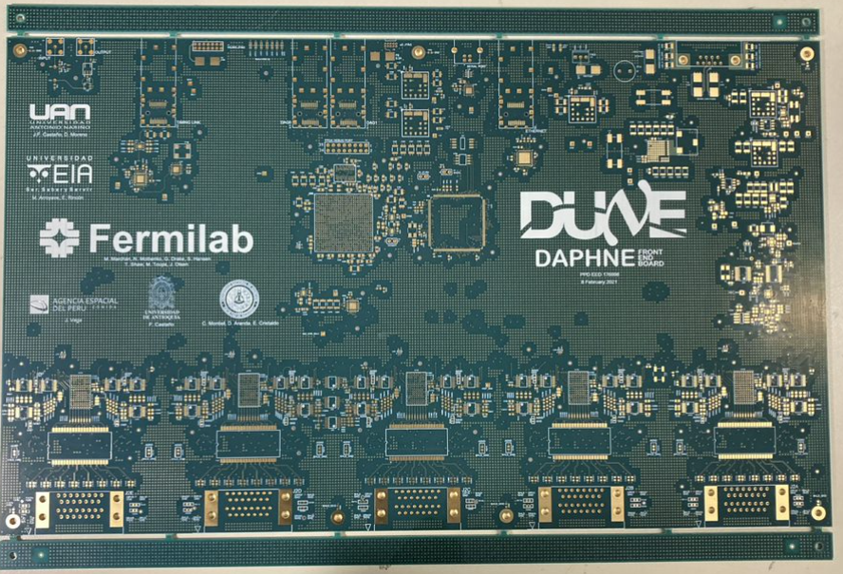
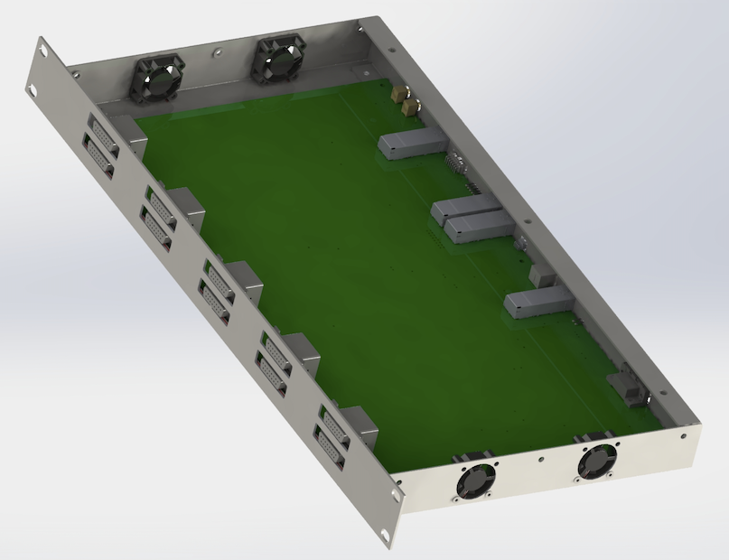
Warm Electronics (DAPHNE)
Bare PCBs arrived March 3
Visual inspection & review of testing documentation satisfactory March 4
Boards sent out for assembly March 4
  Expected back ~March 15
Chassis design complete and order in place
  Delivery expected ~March 15
Prototype testing plan, software, firmware & docs being finalized.
DAPHNE prototypes will be distributed approximately April 3.
  FNAL, 2
  Colombia, 2
  Italy 2
  Spain 1
  CERN 1
  CSU 1
  UNICAMP/FIUNA 1

Slide 13
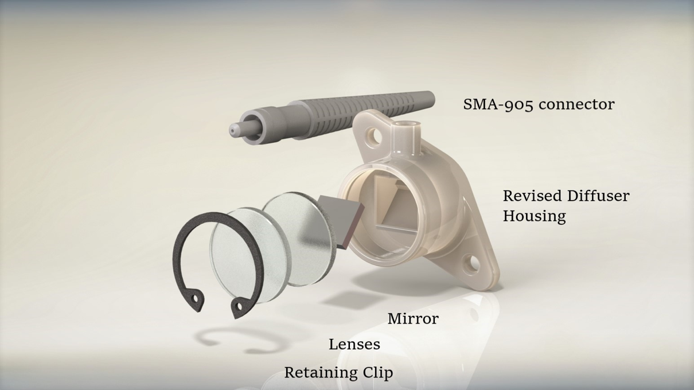
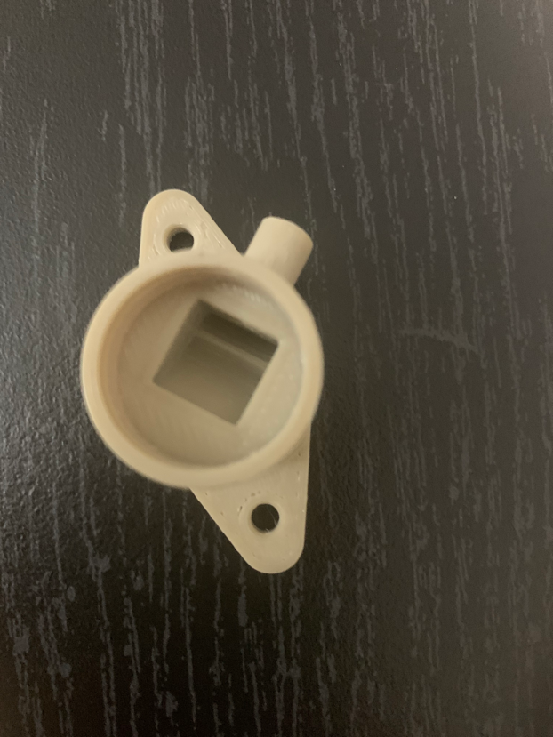
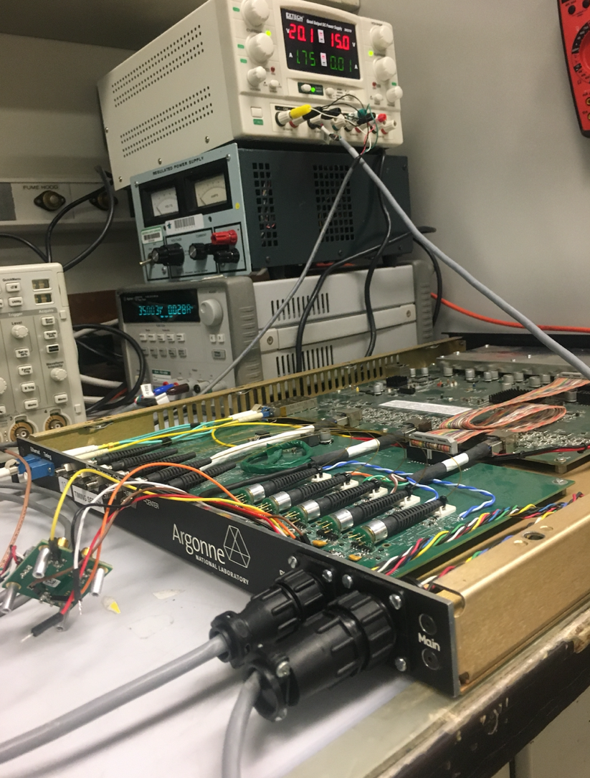
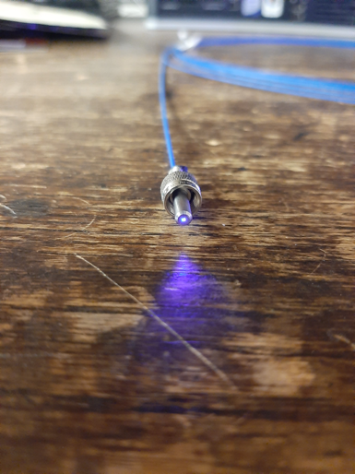
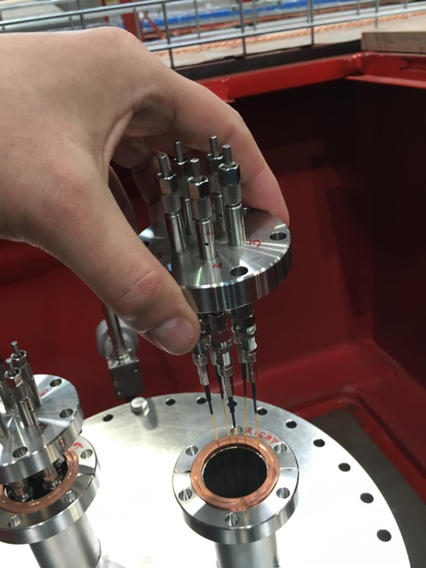
Monitoring System
Molded plastic diffuser design complete
3D printed diffusers fabricated (PEEK)
Value engineering of fiber candidate underway
Custom 5-fiber vacuum feedthrough fabricated & under test.
Modifications of SSPs into monitoring system drivers underway
Value engineering of monitoring system LEDs and on-board calibration underway.

Slide 14
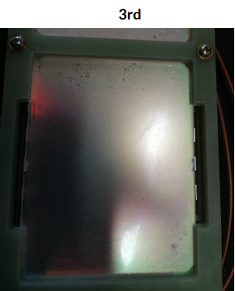
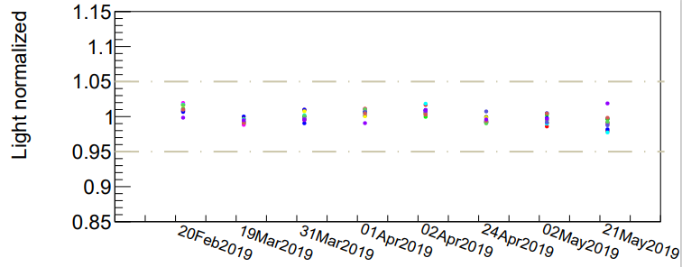
Optical Coating Stability Studies
Coating after 3 cycles (MIB)
ARAPUCA performance during run
Stability Studies of optical coatings were hampered by COVID-19 in both Syracuse and UNICAMP
Syracuse testing is re-opening now, and additional filter plates are being sent to allow additional testing
ProtoDUNE 1 data will be used to study stability as well
  Monitoring system data
  Mean PE per channel during running
  Examination of PD modules following removal from cryostat
Optical Coating Test Status & Plans
Completed first test of two filter plates 11/2020
.
Improve test stand procedures,
specifically slower cool-down.
Investigate adding a filter on
sampling port for pTP solubility study.
  See 10.1088/1748-0221/14/02/P02021
Begin series of one-week runs with
new filters from Campinas.
Extended run beginning ~March 2021
with latest filter lot from Campinas.
Monitoring system stability

