Slide 1
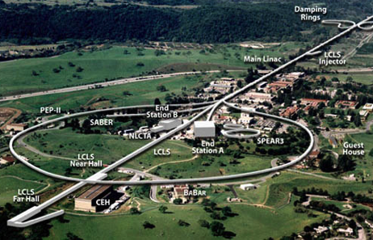
SLAC Accelerator Material Clearance Program and Experience
James Liu*, Jim Allan, Ryan Ford, Ludo Nicolas, Olga Ligeti, Sayed Rokni, and Henry Tran
Radiation Protection Department,
SLAC National Accelerator Laboratory, Menlo Park, CA
DOE Accelerator Safety Workshop, October 4-7, 2021

Slide 2
Outline
  Overview of DOE Order 458.1, ANSI N13.12 and DOE-STD-6004
  Personal property clearance program at SLAC
        Technical basis for activation and measurements
        Tier 1: IFB release for metals with proxies
        Tier 1: IFB release for lead (no proxies)
        SLAC process for Tier 2 clearance
        Disposal of SLAC accelerator materials via Authorized Limits (Tier 3 clearance for restricted release)
  Summary
Focus on Volumetric Radioactivity

Slide 3
DOE Order 458.1 (2020):
Release and Clearance of Personal Property
4.k.(3) Residual Radioactive Material. Property potentially containing residual radioactive material must not be cleared from DOE control unless either:
(a) The property is demonstrated not to contain residual radioactive
material based on process and historical knowledge, radiological
monitoring or surveys, or a combination of these; or
DOE-STD-6004 Tier 1: IFB
(b) The property is evaluated and appropriately monitored or surveyed
to determine:
    1. The types and quantities of residual radioactive material within the property;
    2. The quantities of removable and total residual radioactive material on property surfaces ….;
    4. That any residual radioactive material within or on the property is in compliance with applicable specific or pre-approved DOE Authorized Limits.
DOE-STD-6004 Tier 2: ANSI N13.12 SLs
Notes:
Clearance: Removal of personal property that contains or may contain residual radioactive material from DOE radiological control.
Release: Process that material has gone through the clearance process and is released off-site or on-site from radiological control
Detection Limit (DL): The smallest amount of radioactivity (in pCi/g for volumetric radioactivity measurements, or dpm / 100 cm² for surface contamination) that can be detected and quantified by a measurement method.
Detection Threshold (DT): The instrument signal level (in cpm, μR/h, etc.) associated with a determination that a measurement is different than background
Indistinguishable from Background (IFB): The absence of detectable radioactivity, as determined by measurement methods.
Process Knowledge: A collective, objective description of the physical, operational, administrative, and radiological conditions associated with material being considered for clearance such that a reasonable and defendable decision can be made regarding whether the material could or could not have become activated or contaminated.

Slide 4
ANSI N13.12 (2013) Screening Levels (SLs)
Radionuclide Group | Surface SL (dpm / 100 cm²) | Volume SL (pCi/g)
Group 1: High-energy gamma, radium, thorium, transuranics, and mobile beta-gamma emitters (e.g., ²²Na, ⁴⁶Sc, ⁵⁴Mn, ⁵⁶Co, ⁶⁰Co, ⁶⁵Zn, ¹²⁵Sb, ¹³⁷Cs, ¹⁵²Eu, ¹⁵⁴Eu, ²⁰⁷Bi) | 600 | 3
Group 2: uranium and selected beta-gamma emitters (e.g., ⁵⁷Co, ⁵⁸Co, ⁹⁰Sr, ²⁰⁴Tl, ²⁰⁶Bi) | 6,000 | 30
Group 3: General beta-gamma emitters (e.g., ⁷Be, ¹⁸¹W) | 60,000 | 300
Group 4: Low-energy beta-gamma Emitters (e.g., ³H, ⁴⁵Ca, ⁶³Ni) | 600,000 | 3,000
Group 5: Low-energy beta emitters (e.g., ⁵⁵Fe) | 600,000 | 30,000

Slide 5
Working Group for Technical Standard DOE-STD-6004
Contractor Writing Team
DOE Review Team
SLAC National
Accelerator Laboratory:
Sayed Rokni (Chair)
Ryan Ford
James Liu
Thomas Jefferson
National Accelerator Facility:
Keith Welch
Sandia National Laboratory:
Elaine Marshall
Oak Ridge National Laboratory:
Scott Schwahn
Office of Science:
Scott Davis (Lead and POC)
John Blaikie
National Nuclear
Security Administration:
Tim Cooper
Steve Wallace
Office of the Environment, Health and Security (AU):
Colleen Ostrowski
Gus Vazquez
Stevel Zobel

Slide 6
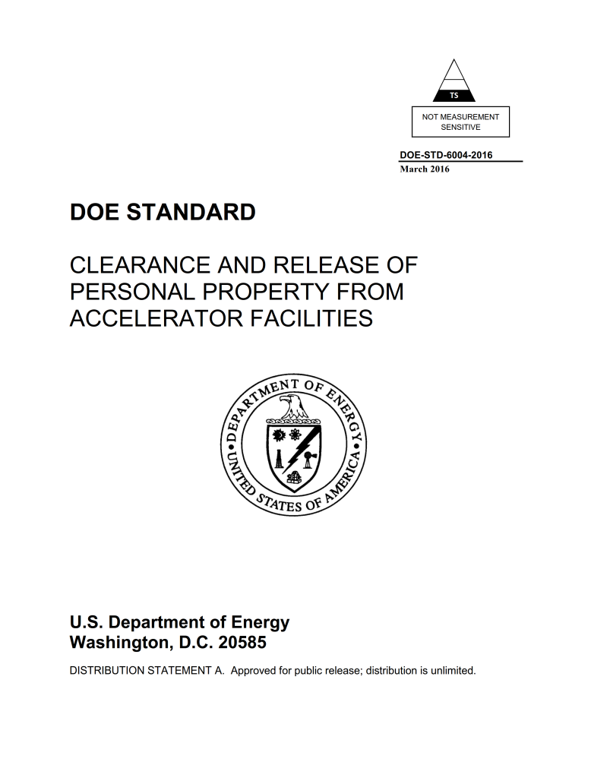
DOE-STD-6004 (2016):
7 Chapters and 5 Appendices
OE-3 (2016) concluded the DOE-STD-6004 standard established personal property disposition clearance processes that are compliant with DOE O458.1 requirements.
OE-3 (2021) approved the ANSI N13.12-2013 volumetric SLs as the pre-approved Authorized Limits (OE-3 attachment 1).
Notes:
RevCom in May 2015
70 pages coveer to cover ; 64 pages

Slide 7
3-Tiered Clearance Criteria in DOE-STD-6004 (2016)
  Criteria related to ANSI N13.12 Volume Screening Levels (SLs in pCi/g):
    Indistinguishable from Background (IFB)
        Material has no detectable radioactivity other than background
        Measurements’ Detection Thresholds (DTs) < SLs
        Preferred clearance criterion
    ANSI N13.12-2013 SLs
      Equal to O458.1 dose criterion of 1 mrem in a year
      Measurements’ Detection Limits (DLs) < SLs
    Higher than ANSI N13.12-2013 SLs
        Follows O458.1 Authorized Limit process (1 mrem/y)
        Mainly for restricted release

Slide 8
Highlights of SLAC Material Clearance Program
Purpose: Unrestricted release of solid metals and concrete
Release Criterion: Measurements are IFB (DOE-STD-6004 Tier 1)
Technical Basis (from FLUKA calculations and benchmark measurements):
      Induced radioactivity characteristics (levels and volumetric distribution)
      Proxy versus hard-to-measure radionuclides, and their relationship
Measurement Protocols:
  Use field survey instruments (with sufficient sensitivities) in an environment with acceptable low background
  Supplemented by confirmatory measurements in a graded approach
  The detection thresholds have been evaluated, and are lower than the ANSI SLs
8

Slide 9
Induced Radionuclides at Electron Accelerators
Material | Radionuclide | Half-life
Carbon steel (Fe, C) and Cast iron (Fe, C, Si, Mn) | ²²Na (proxy) | 2.6 y
 | ⁵⁴Mn (proxy) | 312 d
 | ⁵⁵Fe (5.9 keV x-ray) | 2.73 y
 | ⁵⁷Co | 272 d
Aluminum | ²²Na | 2.6 y
Copper | ⁵⁵Fe (5.9 keV x-ray) | 2.73 y
 | ⁵⁷Co | 272 d
 | ⁶⁰Co (proxy) | 2.6 y
Concrete | ³H (pure beta) | 12.3 y
 | ²²Na (proxy) | 2.6 y
 | ⁵⁴Mn (proxy) | 312 d
 | ⁵⁵Fe (5.9 keV x-ray) | 2.73 y
 | ⁵⁷Co | 272 d
 | ⁶⁰Co | 5.26 y
 | ¹⁵²Eu, ¹⁵⁴Eu | 13.5 y, 8.59 y
Hard-to-measure radionuclides (⁵⁵Fe) emit only beta or low-energy X-rays
Radionuclides (²²Na, ⁵⁴Mn, ⁶⁰Co) that emit high-energy and high-intensity gamma rays can be used as proxies

Slide 10
Technical Basis for Clearance Measurements
Radionuclides that are difficult to detect are generally accompanied by “proxy” radionuclides that can easily be measured.
    This supports measurements for proxy radionuclides only.
Induced activity in an object is volumetric and presents its maximum at/near the surface that faces beam loss points.
    This supports measurements over the object’s surfaces.
Generally, alpha emitters are not produced.
    This justifies the measurements of beta-gamma radionuclides.
“SLAC Material Release Program Manual” SLAC RPD-010 is consistent with the DOE-STD-6004-2016.

Slide 11
IFB Clearance Measurements at SLAC
Type | Method | Detectors & Measurements to Detect Proxy Radionuclides | DT for Proxies
Basic Measurements | 100% Surface Survey | Surface survey for gross beta-gamma counting rate using Ludlum 1”x1” NaI meter in scan or fixed-point measurements | < 3 pCi/g
Confirmatory Measurements (graded approach) | Field Gamma Spectrometry | Surface measurements using a portable gamma spectrometer for gamma radionuclide in fixed-point measurements | < 1 pCi/g
 | Portal Gate Monitor (for large batch) | Thermal Fisher Scientific Radiation Portal Monitor TFS SGS-II | < 1 pCi/g
 | Laboratory HPGe Measurements (as warranted) | Representative samples collected and counted using HPGe system with the environmental counting protocol | < 0.1 pCi/g
Detection Thresholds are quantified to be lower than the ANSI N13.12 SLs (3 pCi/g for proxy radionuclides).

Slide 12
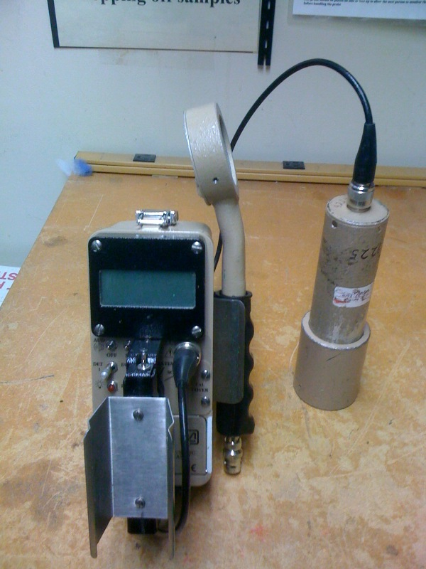
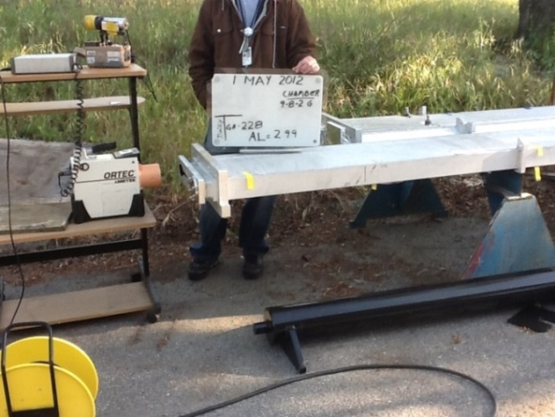
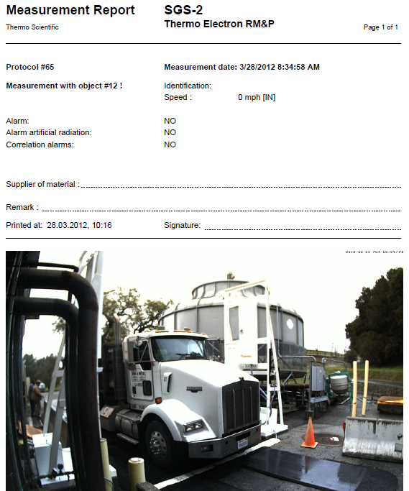
SLAC Instruments for Clearance Measurements
Field
Gamma Spectrometer
Portal
Gate
Monitor
Ludlum Model 2241 meter with 1”x1” NaI probe (DT < 3 pCi/g)
Small-area GM pancake probe

Slide 13
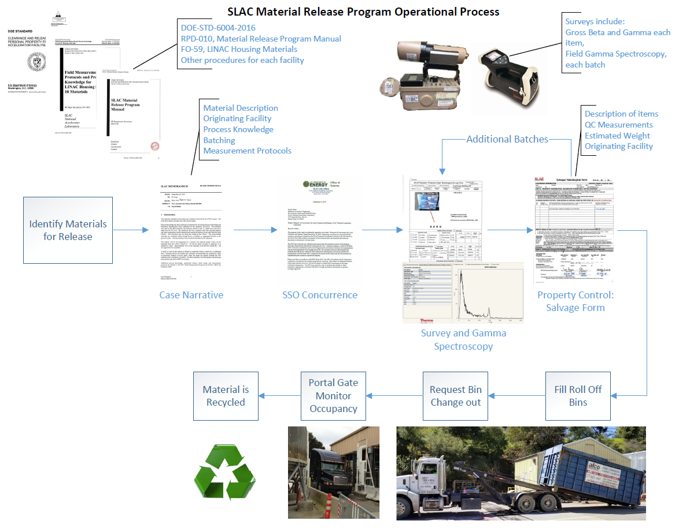
SLAC Material Clearance Program and Process
Notes:
Clearance: Removal of personal property that contains or may contain residual radioactive material from DOE radiological control.
Release: Process that material has gone through the clearance process and is released off-site or on-site from radiological control
Detection Limit (DL): The smallest amount of radioactivity (in pCi/g for volumetric radioactivity measurements, or dpm / 100 cm² for surface contamination) that can be detected and quantified by a measurement method.
Detection Threshold (DT): The instrument signal level (in cpm, μR/h, etc.) associated with a determination that a measurement is different than background
Indistinguishable from Background (IFB): The absence of detectable radioactivity, as determined by measurement methods.
Process Knowledge: A collective, objective description of the physical, operational, administrative, and radiological conditions associated with material being considered for clearance such that a reasonable and defendable decision can be made regarding whether the material could or could not have become activated or contaminated.

Slide 14
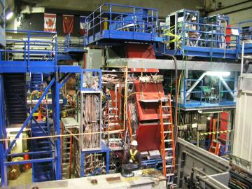
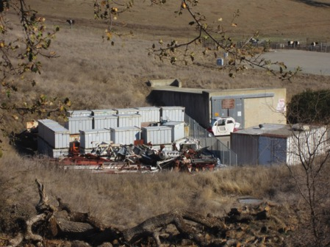
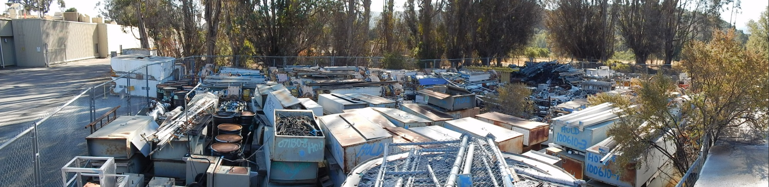
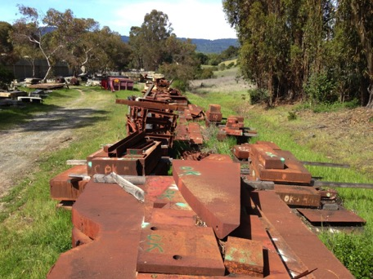
Excess Metal Accumulated at SLAC (before clearance)
Old IR2 with 3-story-high BaBar
Notes:
Steel/iron , concrete (with attached metal), aluminum, copper , wire, electronics
Covered-storage capacity for larger objects is exhausted. The excess items are being stored outdoors

Slide 15
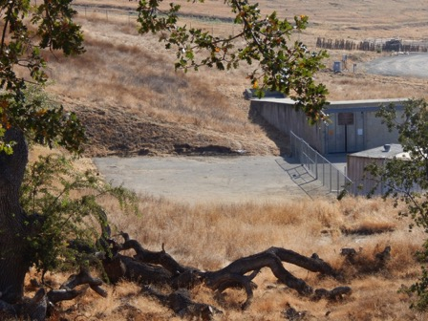
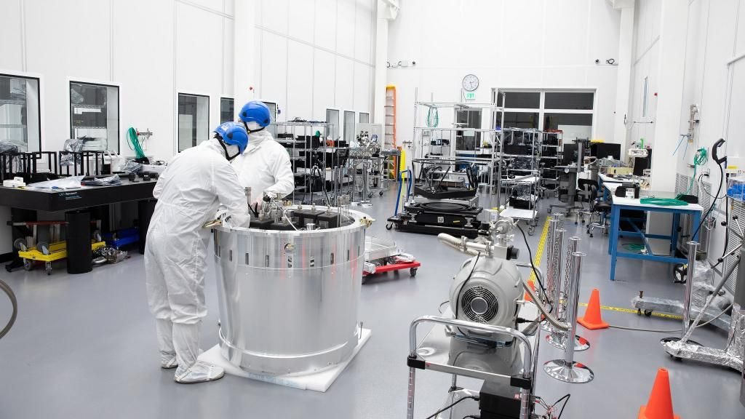
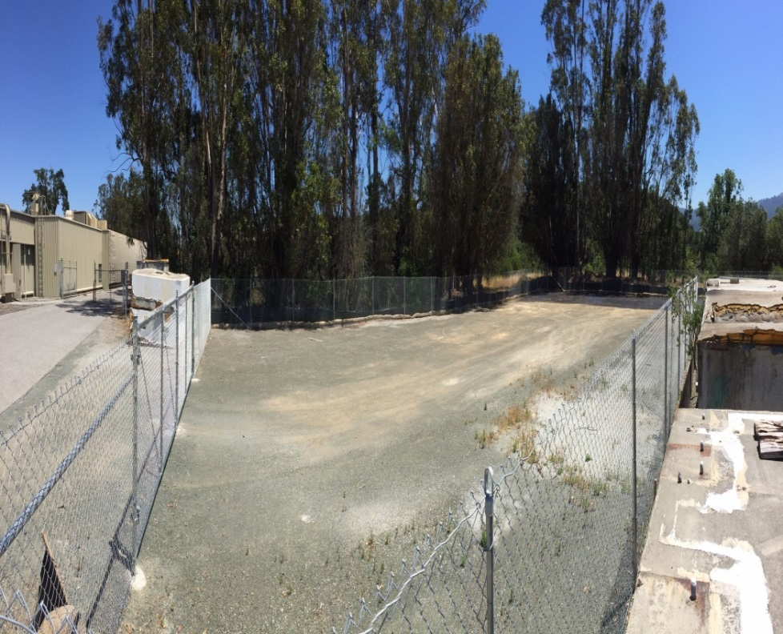
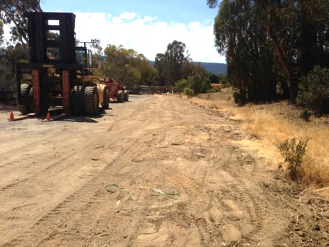
Excess Metal at SLAC (after clearance since 2011)
New IR2 space for LSST
Notes:
Steel/iron , concrete (with attached metal), aluminum, copper , wire, electronics
Covered-storage capacity for larger objects is exhausted. The excess items are being stored outdoors
3528 tons , $1,479,318 loads

Slide 16
SLAC Metal Recycle by Weight and Revenue

Slide 17
SLAC Metal Recycle by Commodity Type

Slide 18
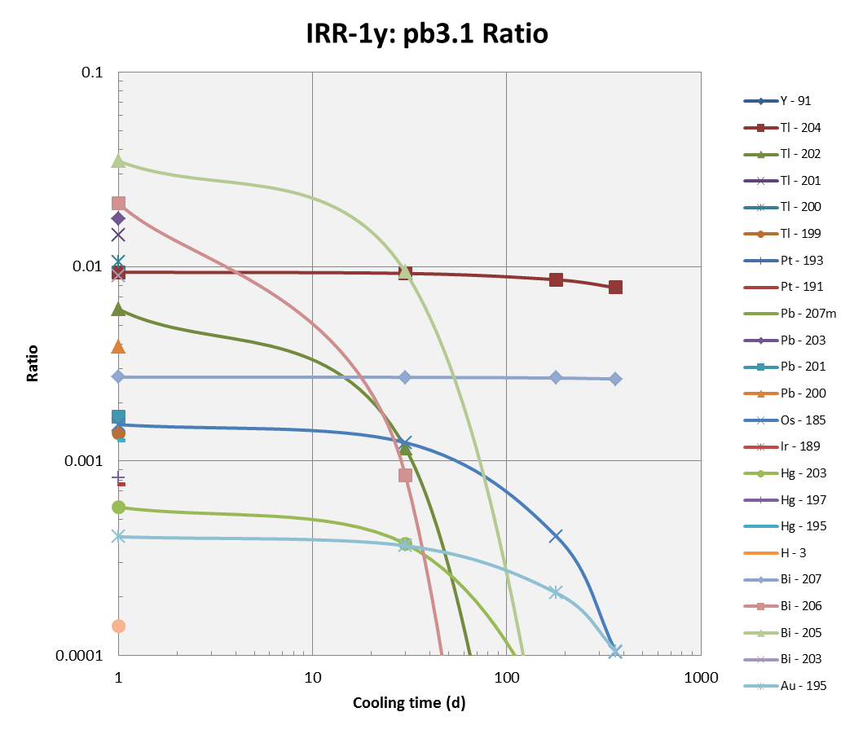
Clearance for Lead
Lead is a common shielding material
Can be a mixed waste (radioactive and hazardous)
As expected, FLUKA evaluation shows that Tl-204 (pure beta emitter; 3.8-yr) may dominate the induced radioactivity in lead.
Tl-202
Tl-204
A/SL
Bi-205
Bi-206
Bi-207
Clearance measurements for lead need to consider Tl-204.

Slide 19
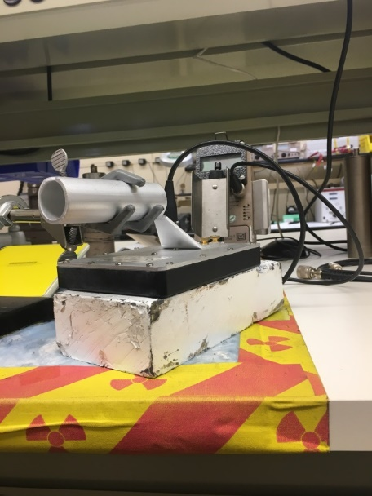
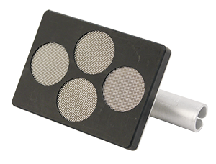
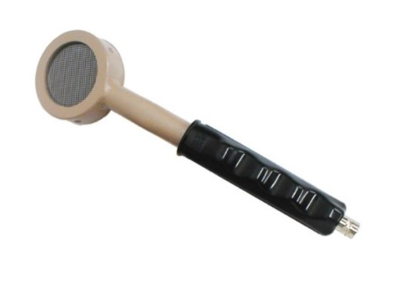
Lead Clearance Measurements at SLAC
The small GM probe is insufficient to measure Tl-204 betas
IFB measurements using a large-area GM (1-min static on contact)
DT for Tl-204 was quantified to be < ANSI SL of 30 pCi/g for Group 2 (based on FLUKA calculations and Tc-99 beta source calibration)
Ludlum 44-9 GM Probe
15.5 cm² active area
Ludlum Model 44-94 with 4 small GM probes
Also scan-survey using Ludlum 44-2 NaI meter for gamma radionuclides
RP Note 17-11: “Technical Basis and Measurement Methods for Radiological Clearance and Release of Lead at SLAC”
19

Slide 20
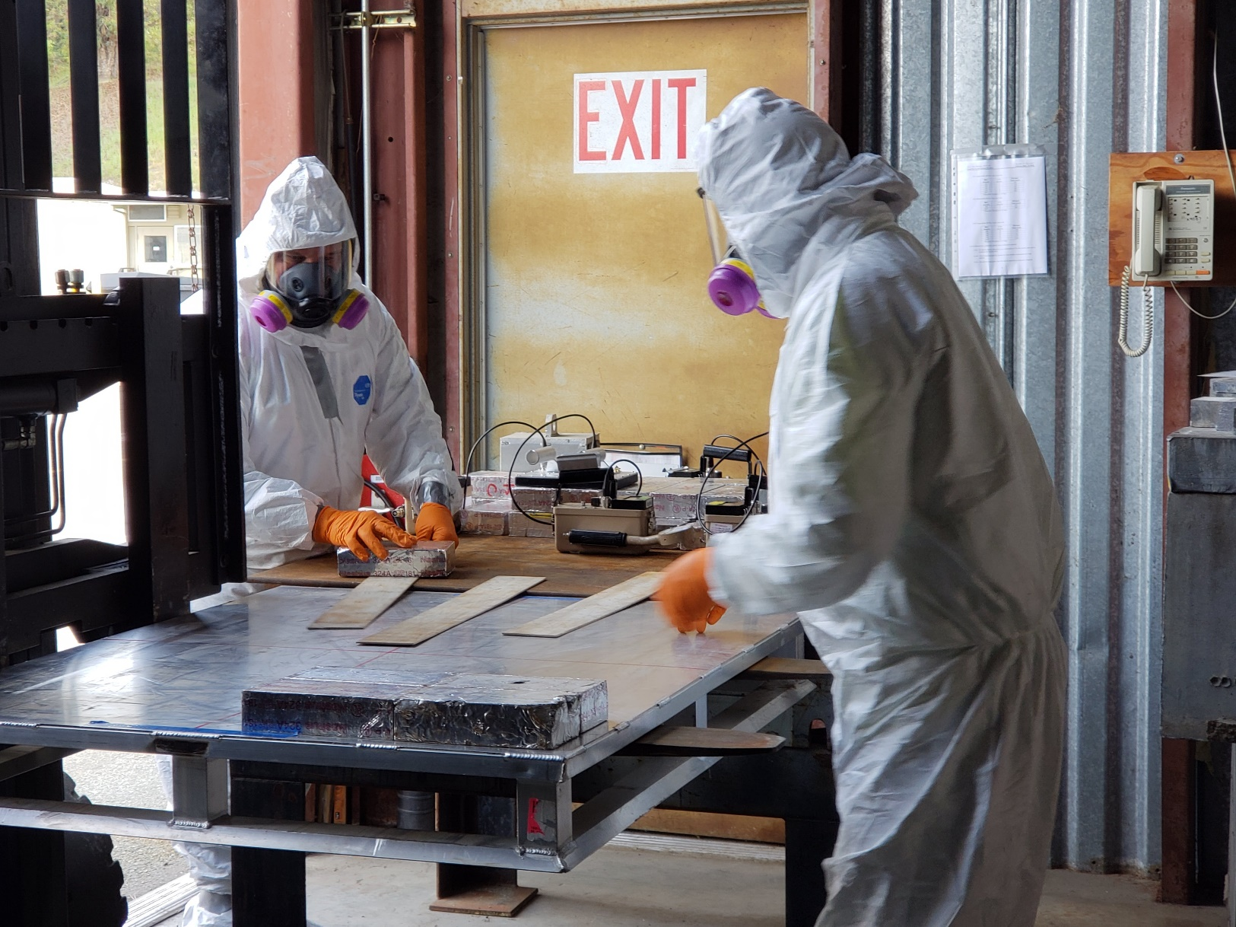
Radiological Survey of Lead (WPC and PPE)
20

Slide 21
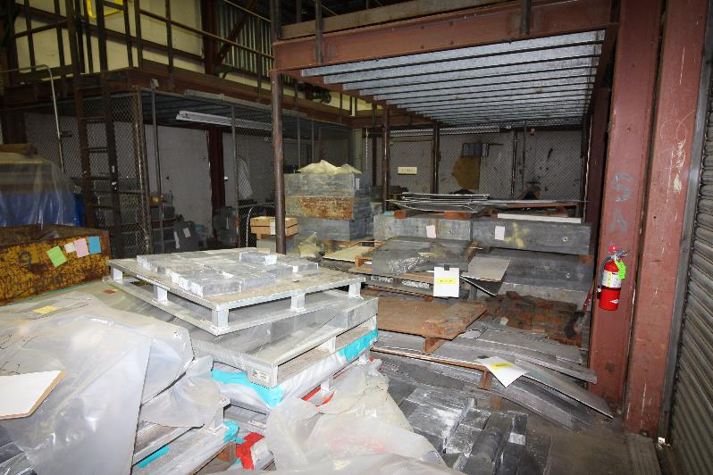
Lead Storage Area (before cleanup; ~300 tons)

Slide 22
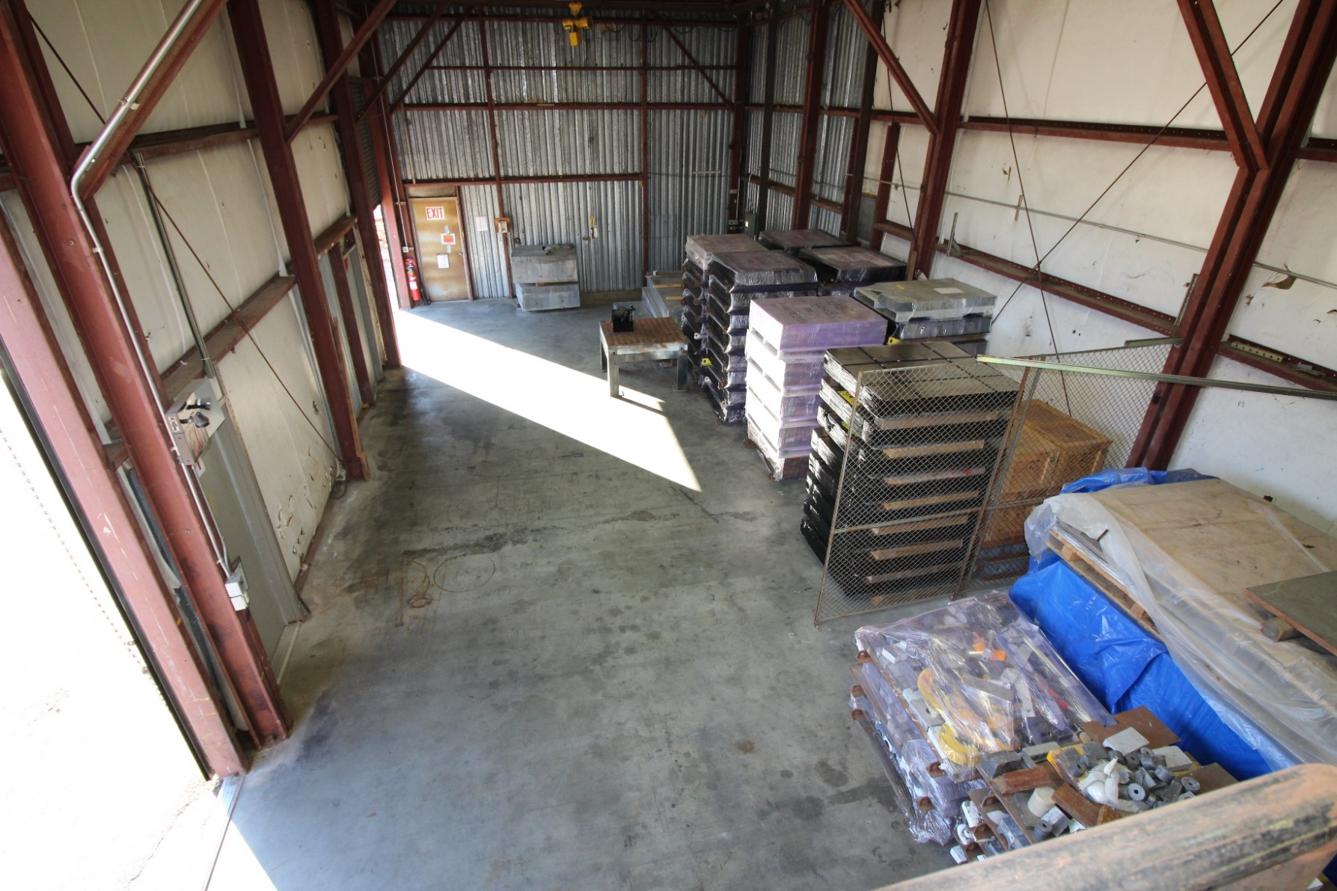
Lead Storage Area (~90 tons recycled up to 2021)

Slide 23
Tier 2 Release (ANSI N13.12 Volumetric SLs)
ANSI volumetric SLs for proxy radionuclides are detectable by commercially available survey meters
        Tier 2 criterion is releasing radioactive materials
DOE O458.1 requires characterization of proxy radionuclides within materials
        Gamma spectrometry to identify radionuclide types and estimates radioactivity concentration
Need to estimate the hard-to-measure radionuclides
Requirements: ∑_{i} (Ai / SLi) ≤ 1
The site program needs to include processes for Tier 1 and Tier 2 releases
Stakeholder communication (ASER, state, recycler, local community, etc.)
Tier 2 clearance is more challenging compared to IFB releases
Important that accelerator community has a consistent approach

Slide 24
SLAC Clearance via DOE O458.1 Authorized Limits
(DOE-STD-6004 Tier 3 Criterion)
SLAC developed a Technical Package in 2019:
    SLAC low level radioactive material profile (Ai > SLi)
    Evaluation of doses to workers and public from all exposure pathways (satisfying DOE annual dose constraint of 1 mrem)
    SLAC radioactive material management program summary
Obtained approvals from DOE and IDEQ in 2019-2020
Provides an alternative for safe and secure disposal.
The shipments started in Q4, FY2020.

Slide 25
Summary
SLAC material clearance program is consistent with the DOE Technical Standard DOE-STD-6004 (2016) and satisfies the DOE Order 458.1 clearance requirements
      SLAC implemented DOE-STD-6004 Tier 1 (IFB) clearance
      Surface survey supplemented by confirmatory measurements (gamma spectrometer and portal gate monitor)
SLAC has recycled large amounts of metals (e.g., steel, aluminum, copper and lead) and concrete blocks, and made valuable space available for use
SLAC has DOE approval to dispose radioactive materials at an approved site via DOE O458.1 Authorized Limits (DOE-STD-6004 Tier 3)

Slide 26
Thank You
26

Slide 27
Back-up Slides
27

Slide 28
DOE-STD-6004 (2016): 5 Appendices
Rationale for Endorsement of ANSI N13.12-2013 SLs as DOE Pre-Approved Authorized Limits
Process Knowledge for Volumetric Activation in Accelerator Facilities
Technical Basis for Volumetric Activation at Electron Accelerator Facilities
Technical Basis for Volumetric Activation at Proton Accelerator Facilities
Technical Basis for Measurement Methods of Volumetric Radioactivity and Determination of Detection Capabilities
Appendices C and D: “proxy” radionuclides in materials are identified for effective measurements in the field

Slide 29
SLAC Metal Recycle by Facility/Project

Slide 30
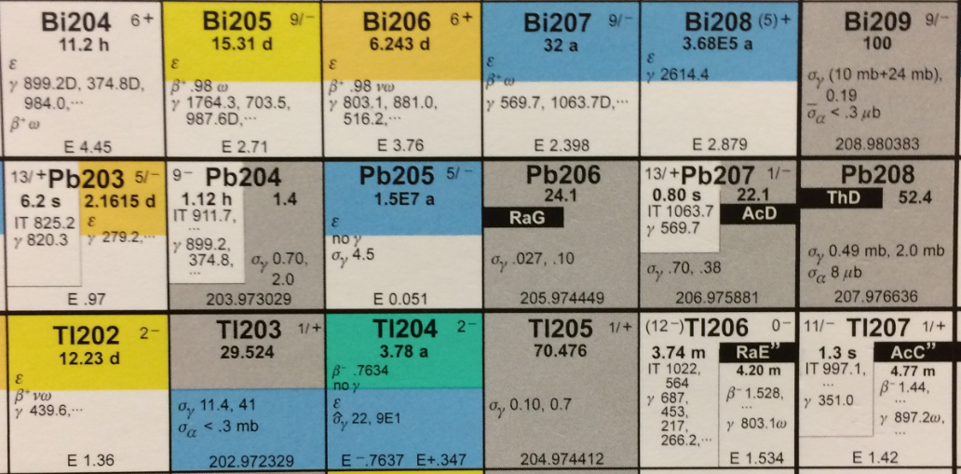
Key Radionuclides from Activated Lead
30
Radionuclide | Half-life | Emission | Yield | Energy (keV) | ANSI N13.12 Group | SL (Bq/g)
Os-185 | 96.6 d | gamma | 78% | 646 | 2 | 1
Pt-193 | 50 y | beta | 100% | 56.6 | 3 | 10
Tl-202 | 12.2 d | gamma | 91% | 440 | 3 | 10
Tl-204 | 3.78 y | beta | 97% | 763 | 2 | 1
Bi-205 | 15.3 d | gamma | 31% | 703 | 2 | 1
Bi-206 | 6.24 d | gamma | 99% | 803 | 2 | 1
Bi-207 | 31.6 y | gamma | 98% | 570 | 1 | 0.1
(p,n)
Reactions leading to induced radionuclides
(γ,n)
(γ,np)
(γ,p)
(γ,np)
30
Notes:
g,n and g,p and g,np and g,spallation

Slide 31
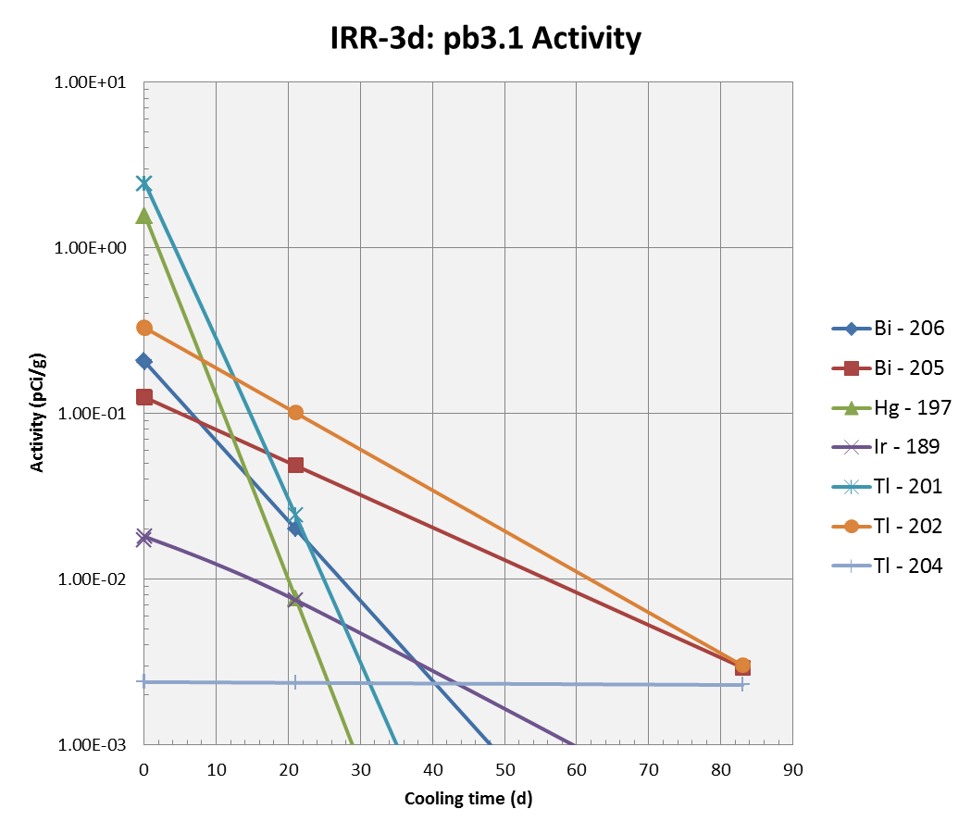
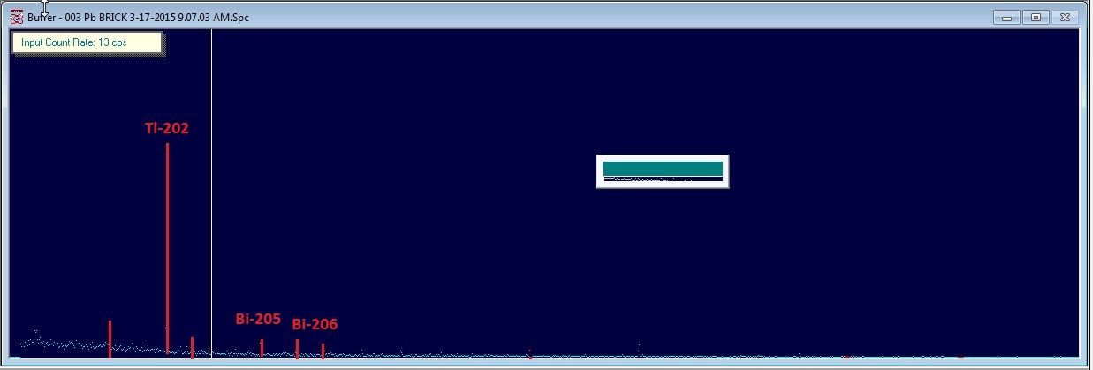
Clearance for Lead: SLAC 3-day Activation Experiment
Tl-202
Bi-205
Bi-206
Tl-204
FLUKA results of gamma radionuclides agreed with measurements
In addition, FLUKA shows that Tl-204 (pure beta emitter; 3.8-yr) exists (as expected).

Slide 32
SLAC Material Profile for Disposal via Authorized Limits
Radionuclide | Concentrations (pCi/g) | Total Activity (Ci/y)
Ag-108m | 1.40E-02 | 3.20E-05
Be-7 | 1.53E+01 | 3.50E-02
Co-56 | 3.45E-02 | 7.90E-05
Co-57 | 1.45E+02 | 3.31E-01
Co-58 | 2.13E+02 | 4.88E-01
Co-60 | 1.53E+02 | 3.50E-01
Cr-51 | 1.40E-01 | 3.20E-04
Eu-152 | 1.40E+01 | 3.20E-02
Eu-154 | 1.40E+01 | 3.20E-02
Fe-55 | 4.13E+04 | 9.45E+01
H-3 | 4.19E-02 | 9.59E-05
Mn-54 | 4.13E+02 | 9.45E-01
Na-22 | 1.14E+02 | 2.61E-01
Ni-63 | 2.06E+03 | 4.72E+00
Sc-46 | 6.99E-01 | 1.60E-03
V-49 | 8.27E+01 | 1.89E-01
Zn-65 | 3.23E+02 | 7.39E-01
Ti-44 | 1.49E+01 | 3.40E-02
Sum | 1.50E+03 | NA

Slide 33
Summary of MEI Dose Evaluation for Tier 3 Disposal
Facility Condition | MEI | Exposure | Method | Dose (mrem/y)
Operation | Workers | External Dose | MicroShield | 0.995 (landfill operator)
Operation | Workers | Internal Dose from Airborne Radionuclides | FGR-11 | 0.00035
Operation | Administrative Workers 600 m | External + Internal Doses | MicroShield & CAP-88 | 1.6E-3 & 1.8E-6
Operation | Public | Total Dose from Airborne Radionuclides | CAP-88 | 1E-6
Post-closure | Public Intrusion | External + Internal | RESRAD | 1E-9

Slide 34
Lessons Learned
An activated steel threaded rod was found by Radiation Protection (RP) staff during survey of a metal recycle bin
Two pieces of activated concrete were found in the construction debris bin next to the recycle bin
Radiological survey of bins by RP, and screening through Portal Gate Monitor are part of the requirements under SLAC Clearance program
Defense-in-depth approach is necessary
Need to manage containers in a manner to prevent the addition of radioactive materials
Portal gate monitor as the last barrier of defense provides additional assurance

