Slide 1
Meeting 10CFR835 Appendix D contamination control standard for Be-7
Scott O. Schwahn, Ph.D., CHP, FHPS

Slide 2
Problem
Ring injection area is the area of highest radiation and contamination in the tunnel
At times, rates exceed 1 rad/h (10 mGy/h) near the beamline components
Always a high radiation area (> 1 mGy/h) in the nearby area
Contamination is dominated by Be-7

Slide 3
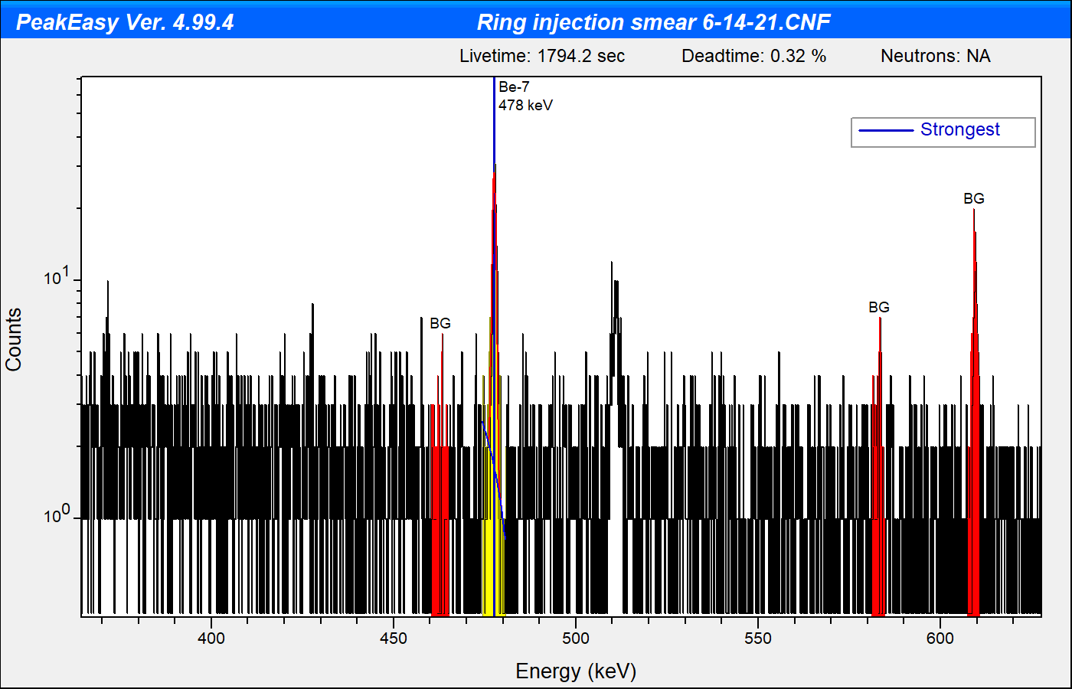
Problem
Be-7 produced from high-E spallation reactions in air
Half-life 53.2 d
Decays by electron capture with 10.44% gamma emission, 477.6 keV
Target nuclide | % by volume | Cross-section
N-14 | 78.1% | 10 mb
O-16 | 21.2% | 5 mb
Ar-40 | 0.46% | 0.6 mb
*From IAEA Technical Reports Series No. 283, Radiological Safety Aspects of the Operation of Proton Accelerators
Notes:
Don’t get caught up with the cross sections – for comparison purposes only
Also Be-7 is produced in the atmosphere by cosmic radiation and has been found in relatively high quantities in HVAC air filters where no man-made source is found

Slide 4
Problem
Shielded detector used in contamination smear surveys
Typical background in low-background area: 2,000 cpm (33 cps)
Critical Level (L_{c}) is count rate above background with 95% confidence that the source is present
$$L_{c}= \frac{1.645\sqrt{R_{b}t_{s}(1+\frac{t_{s}}{t_{b}})}}{t_{s}}$$
For 1-min background and 1-min count, L_{c} ≈ 100 cpm (1.7 cps)
Notes:
Most activation products in the accelerator are gamma emitters, so the NaI has a very good efficiency compared to a GM probe

Slide 5
Problem
ε_{477 keV} ≈ 11%, including geometry
$$\frac{100 cpm}{0.11c/γ × 0.1044 γ/d }$$
= 8,700 dpm (3.9×10⁻³ µCi, 140 Bq)
10CFR835 Appendix D specifies 1,000 dpm (17 Bq) per 100 cm² beta-gamma removable surface contamination value
Subpart L (§ 835.1101-1102) imposes many controls
But it can’t be detected in the field with standard equipment in reasonable times

Slide 6
Problem

Slide 7
Some Solutions
To detect at 1,000 dpm:
Specialized equipment
Plenty of time
$$L_{c}= \frac{1.645\sqrt{R_{b}t_{s}(1+\frac{t_{s}}{t_{b}})}}{t_{s}}$$
For R_{b} = 2,000 cpm
and desired L_{c} = 100 cpm/8.7 = 11.5 cpm
$$t_{b}=t_{s}=82 minutes$$
Notes:
Even to solve for 60-minute sample counts, the background count would have to be 129 minutes.
To quantify 1,000 dpm above background at the 95% confidence level, 5.5 hours needed.

Slide 8
Radiation Protection?
Inhalation Dose Coefficients from ICRP-68
Notes:
DAC values in 10CFR835 are based on ICRP-68. Perspective: about 2X that of tritium in water.
Nearly 2 orders of magnitude lower than other beta-gamma emitters.
Cr-51: 320 keV, 9.9%

Slide 9
Radiation Protection?
Equivalent Hazard
1,000 dpm/100 cm² Co-60 = 125,000 dpm/100 cm² Be-7
Consensus standard ANSI/HPS N13.12-2013 Surface and Volume Radioactivity Standards for Clearance recommended levels
600 dpm/100 cm² for Mn-54, Co-60, Zn-65, and Cs-137
60,000 dpm/100 cm² for Be-7
600,000 dpm/100 cm² for Cr-51
NOT recommending risk-based values overall – too difficult to manage

Slide 10
Recommendation
Exemption request for Be-7 (and perhaps Cr-51) in 10CFR835 Appendix D
30,000 dpm/100 cm² removable
Dosimetrically conservative compared to other β/γ fission products
Conservative with respect to ANSI/HPS N13.12-2013
150,000 dpm/100 cm² fixed+removable
Does not apply to areas that experience activation in depth (can’t be distinguished)
Consistent with the factor of 5 in Appendix D
ORNL intends to pursue, but would benefit many other laboratories
Notes:
NOTE: 100 cpm → 1,000 dpm for other γ emitters (conservative)
100 cpm → 8,700 dpm for Be-7 (not quantifiable at this level)
Background and sample count times of 1 minute are achievable

