Slide 1
New experimental station at ATLAS
October 5, 2021
Matt Hendricks
ATLAS Operations Manager

Slide 2
outline
ATLAS orientation
New experimental station at ATLAS
Hazards
Hazard mitigation
Questions

Slide 3
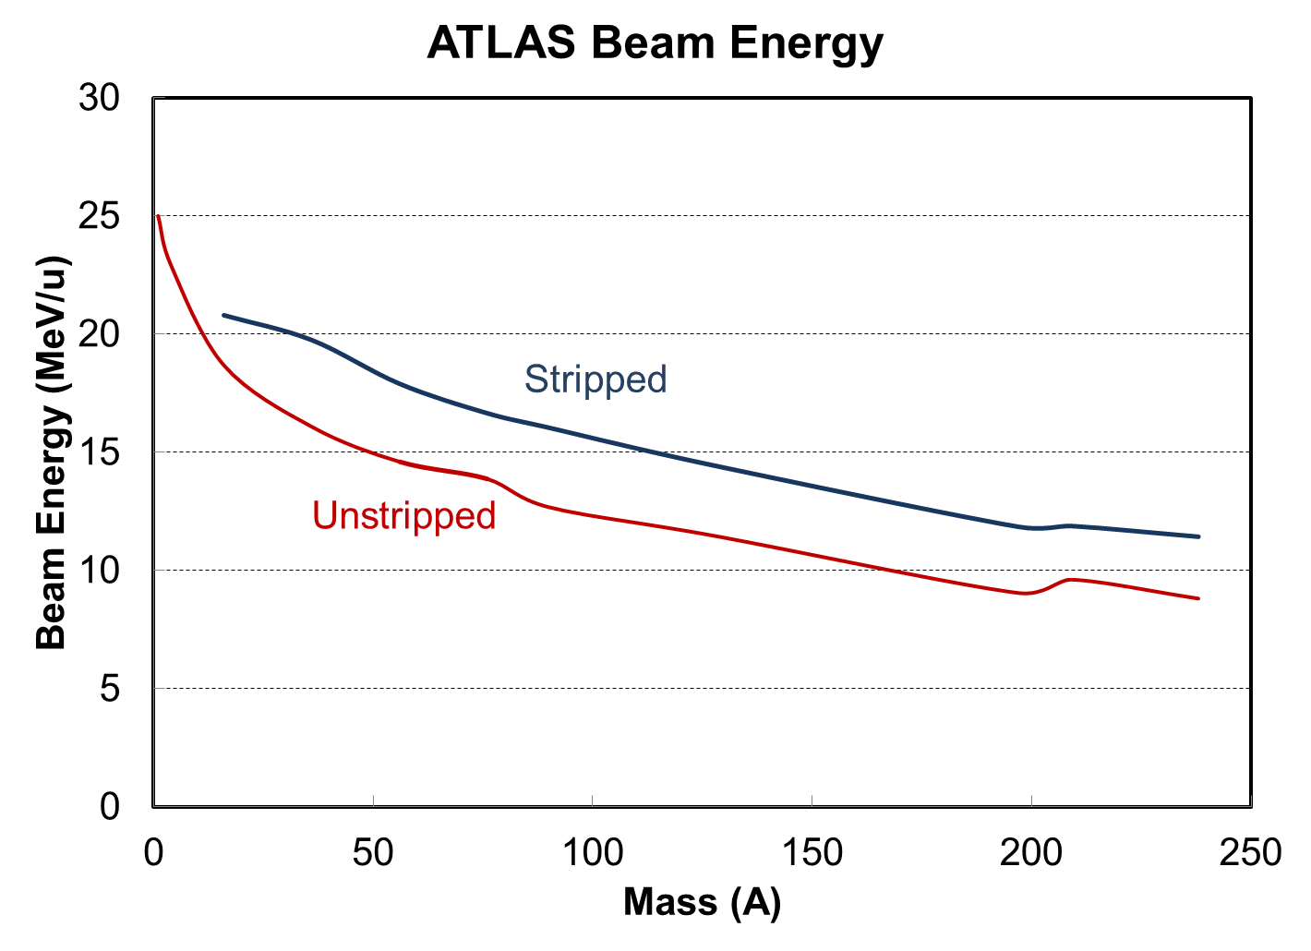
Overview
Quick stats:
DOE National User Facility for low energy nuclear physics research
3 distinct accelerator sections
50 superconducting resonators, total voltage of 52MV
Typical 1 to 500 pnA range currents, higher possible for some species
H through U stable isotopes available, some radioactive species too
CARIBU – radioactive isotopes via ²⁵²Cf source to either:
ATLAS
1 of 4 stopped target stations; 1 in assembly stage
6 accelerated target stations
1 new target stations in assembly stage
New experiment every week on average;
24/7 operation ~40 weeks/year
26 FTEs operations side

Slide 4
Credited controls
Shielding
Beam Current Monitor
Redundant passive pickups, stops beam when above threshold
ARIS (ATLAS Radiation Interlock System)
Permits personnel access to areas with accelerated beam only if:
Dose rate < 5mrem/hr
Accumulated dose < 20 mrem/8 hr (rolling)
Talk on this system by J. Clark - tomorrow
NARIS (New ATLAS Radiation Interlock System)
CARIBU’s interlock system
Cannot stop radiation, only warn that levels are above threshold

Slide 5
Source to target maximum length: ~130m

Slide 6
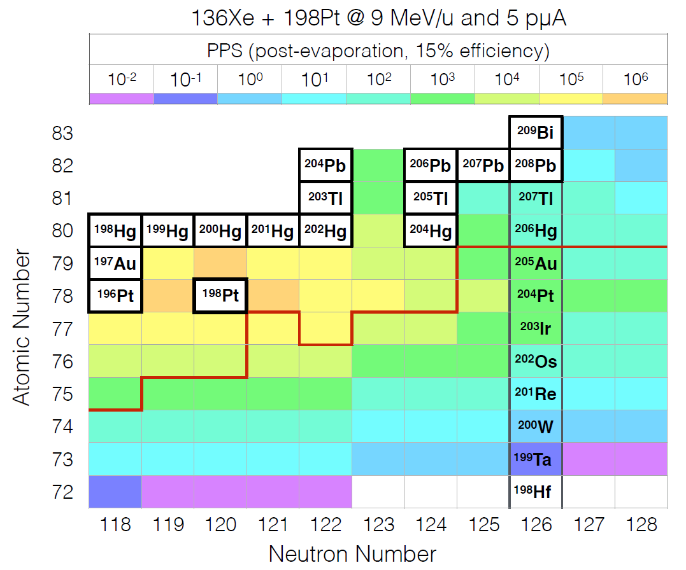
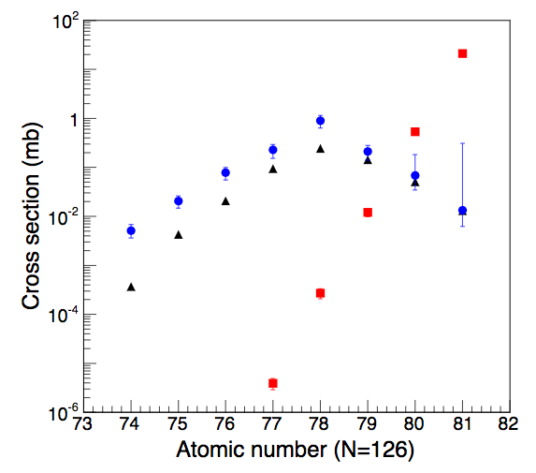
New target area motivation
AREA126
Nuclear astrophysics question
Improved understanding of the r-process
Occurs in neutron rich nuclei
²⁰⁸Pb + ⁹Be at 1 GeV/u
(fragmentation reaction with best cross-sections for N = 126)
¹³⁶Xe + ¹⁹⁸Pt at 10 MeV/u
(best multi-nucleon transfer (MNT) reaction)

Slide 7
Multi-nucleon transfer
¹⁹⁸Pt (target)
¹³⁶Xe (projectile)

Slide 8
Multi-nucleon transfer
Neutron donation
neutron
²⁰⁴Pt (target)
proton
+6 neutrons
-6 neutrons
¹³⁰Xe (projectile)

Slide 9
Multi-nucleon transfer
²⁰⁴Pt (target-like)
¹³⁰Xe (projectile-like)

Slide 10
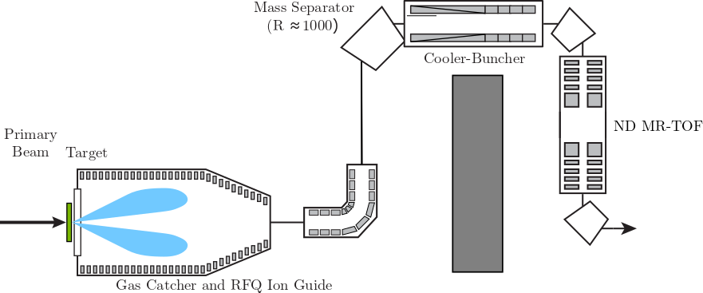
Separation
Gas Catcher
Takes a continuous, isotopically mixed, low energy beam
Bunched, isotopically pure, low-emittance beam
Cooler-Buncher
Separated cooling and bunching sections, simplified electrode construction, optimized injection optics
beam dump
Multi-Reflection – Time Of Flight
Mass Resolution in excess of 10⁵
Deliver isotopically pure beams to experiments

Slide 11
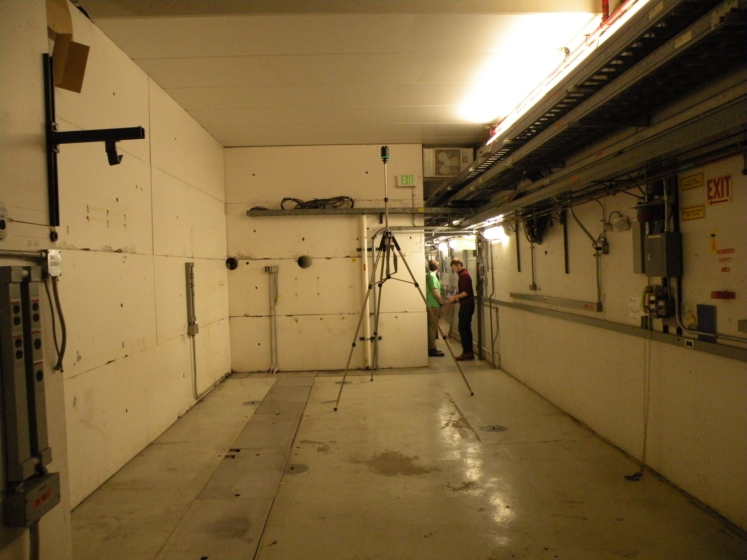
Tight fit
Very cramped space for 2-dimensional installation
Concrete ceiling from past experimental setup
Adjacent to beam transport
Exterior wall
Beam axis

Slide 12
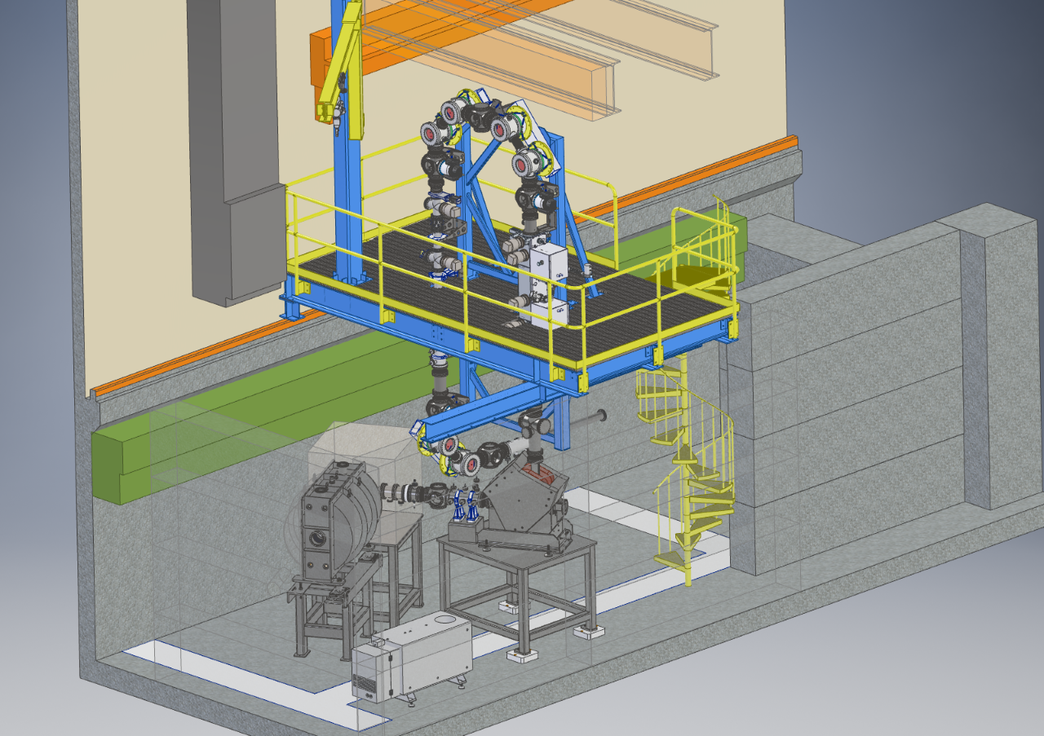
Innovative solution (at least for us)
Use 3rd dimension
Platform instead of “ceiling”
Beam to other targets
Beam axis
(Target just inside port)
Notes:
Over the past 4 years the average BRP has been 733 mrem/hr

Slide 13
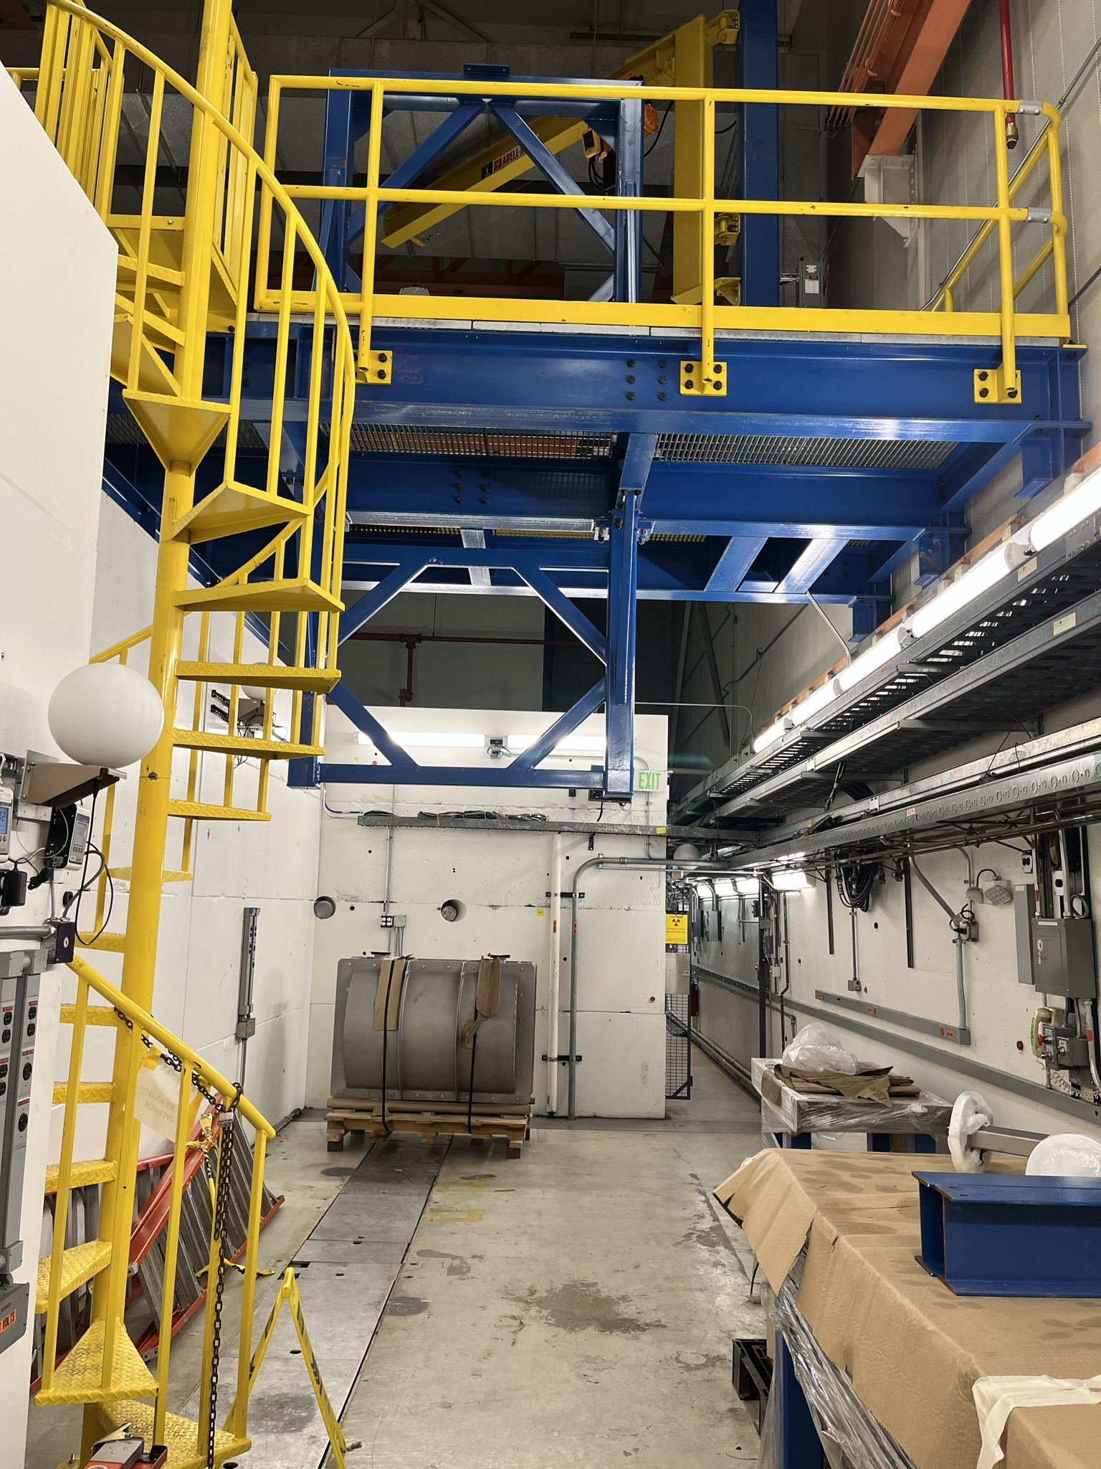
Current status
Beam axis

Slide 14
Hazard matrix
 | Current |  | Future
 | Radiation | Other | Radiation | Other
Ground Floor | Adjacent beams | SIH | Adjacent beams In room beams Activation | SIH
Elevated Platform | Adjacent beams | SIH | Adjacent beams | SIH
SIH = Standard Industrial Hazards
Typical beam for experimental area: ¹³⁶Xe @ 10MeV/u, 1pμA
- Estimated radiation: 72 rem/hr @ 0⁰ and 13.1 rem/hr @ 90⁰ (at 1m)

Slide 15
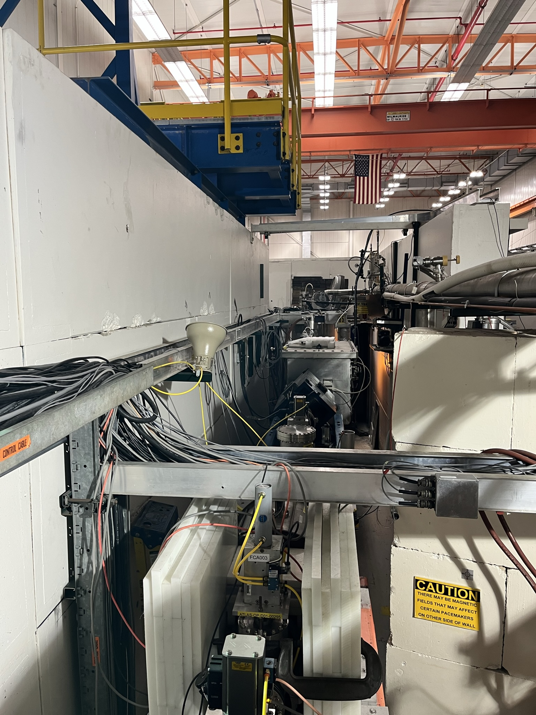
loss points close to platform
AREA126 platform
Notes:
Illustrates worker proximity to unshielded beam and loss points, due to being above shield wall.

Slide 16
Beam Radiation potential since 2017
Beam Radiation Potential (BRP): Predicted maximum radiation for that experiment, scaled from explicit measurement (90⁰ @ 1m)
85% of beams had BRP<1 rem/hr
Facility limit: 100 rem/hr @ 1m (any direction)

Slide 17
hazard mitigation – through 2021
Prompt Radiation Mitigation
Ground floor – interlocked by ARIS (ATLAS Radiation Interlock System)
Stairs to platform
Locked and posted
Access only granted without beam or with health physics review
Remaining Hazard Mitigation
Standard industrial hazards captured by ATLAS/PHY/ANL policies or procedures

Slide 18
hazard mitigation – 2022 and beyond
Prompt Radiation Mitigation
Add platform area into ARIS; separate area
Permits access only when:
Instantaneous radiation is < 5 mrem/hr
Integrated radiation is < 20 mrem/8 hr
Above 100 mrem/hr area is physically locked
Integration Jan. 2022
Remaining Hazard Mitigation
Standard industrial hazards captured by ATLAS/PHY/ANL policies or procedures

Slide 19
Thank you. Questions?

