Slide 1
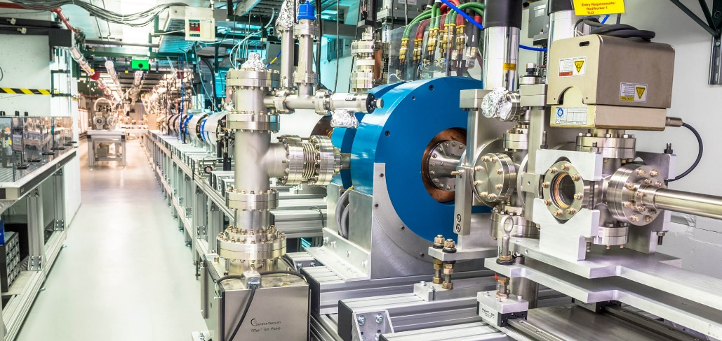
Argonne wakefield accelerator (AWA)
October 05, 2021
Accelerator safety workshop
Rik Yoshida
John power
Eric Wisniewski
High Energy Physics
Division Director
AWA Group Leader
AWA Facility Manager
www.anl.gov/awa

Slide 2
Accelerator safety workshop
Outline
Introduction to AWA
  Staff
  Location
  Building/Bunker
  Linac
  Laser
  Operation
  Experimental Thrusts
Facility Safety Highlights
  Personnel Safety (safety chains)
  Personnel Training
  Compliance Documentation
  Reviews and Support
Challenges
This work is supported by the U.S. Department of Energy, Office of High Energy Physics, under Contract No. DE-AC02-06CH11357.

Slide 3
Introduction to awa

Slide 4
Accelerator safety workshop
AWA Staff
AWA Staff (7)
AWA associates (8)
  John Power
    Group Leader
    Laser operations
  Eric Wisniewski
    Facility Manager
    Operations/Vacuum/Cathodes
  Wanming Liu
    Electrical Engineering/RF
    Control system/DAQ/programming
  Scott Doran
    Mechanical Engineering/Operations
  Charles Whiteford
    Technician/Operations
  New staff (starting this month)
  Xiaowei Wu -Researcher/AAC: structures
  Seong-Yul Kim – Post-doc ABP
  Emmanuel Aneke (intern)
Euclid Techlabs Personnel
Chunguang Jing
Ben Freemire
Ao Liu
NIU-AWA Joint appointments
Philippe Piot
Xueying Lu
Post-docs
Gwanghui Ha
Administrative Support
JoAnn Furman
Safety
+ 2-6 Graduate students

Slide 5
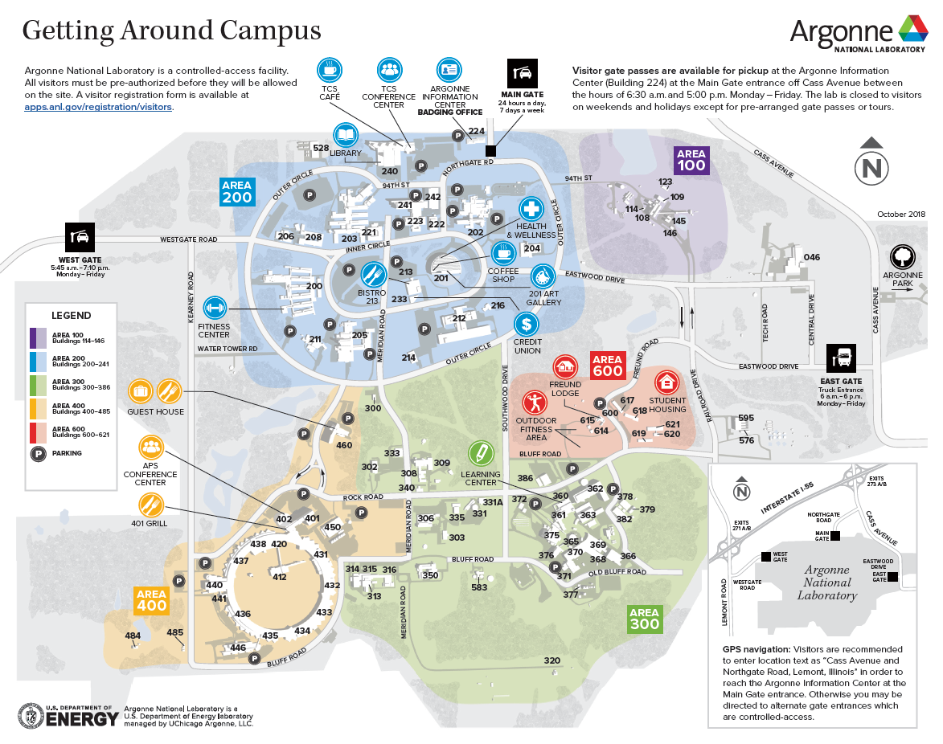
Accelerator safety workshop
AWA Location: Argonne National Laboratory - Building 366
Building 366

Slide 6
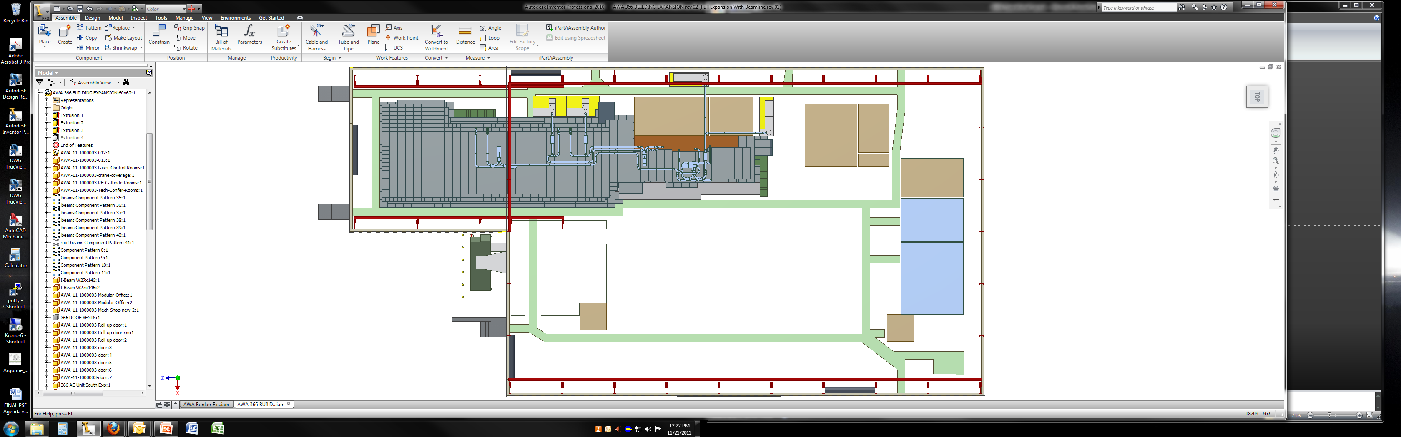
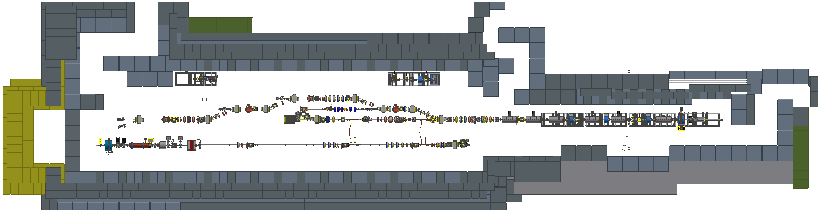
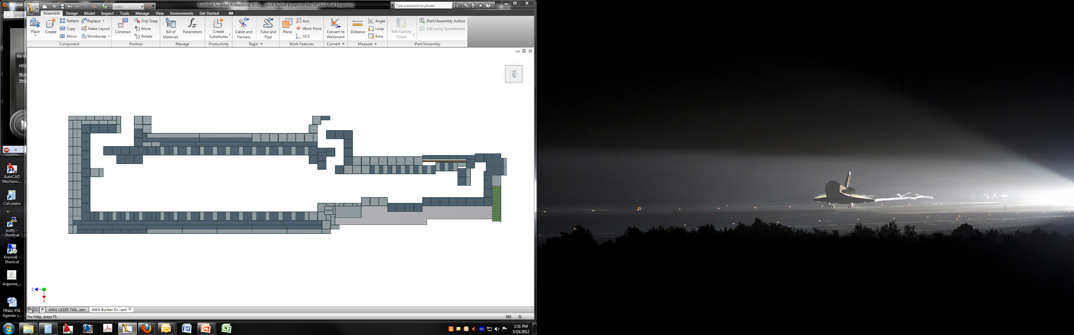
Accelerator safety workshop
AWA Spaces Inside 366
Laser Room
RF Room
Cathode Room 1
Vacuum Room
Building 366 is HEP’s multi-role card-key secured building that houses many different HEP experiments. Shown here are AWA specific spaces.
It is an open hi-bay style building with a 35-ton main crane. AWA also has its own 15-ton crane over the expanded area.
Bunker
Storage Annex
D.I. Water System
Control Room
Cathode Room 2
W
KLY1
KLY5
KLY4
KLY3
KLY2
S
N
Storage Shelves
Bldg
North
Building 366 Addition
Shielded Room
Building 366
E
Storage Containers
AWA Areas of Building 366

Slide 7
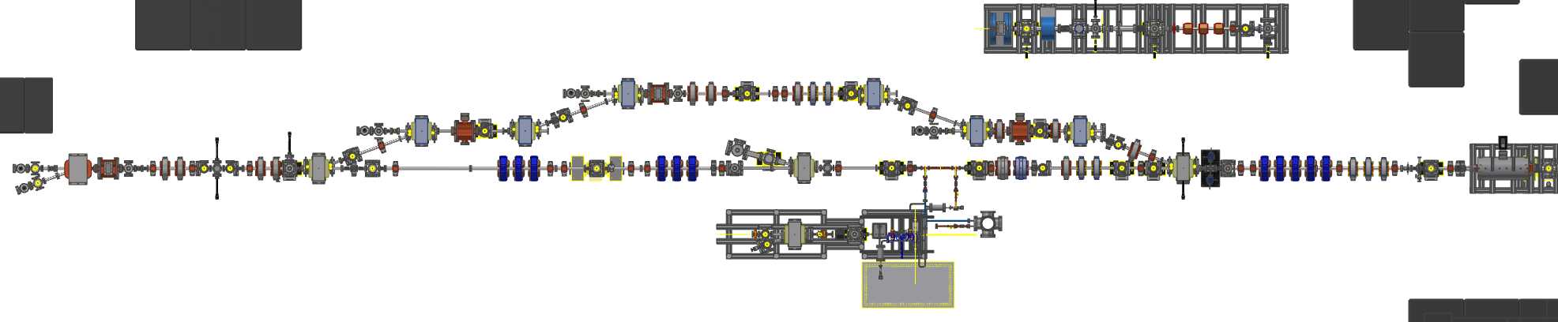
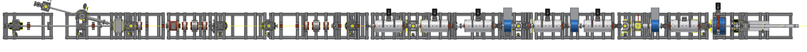
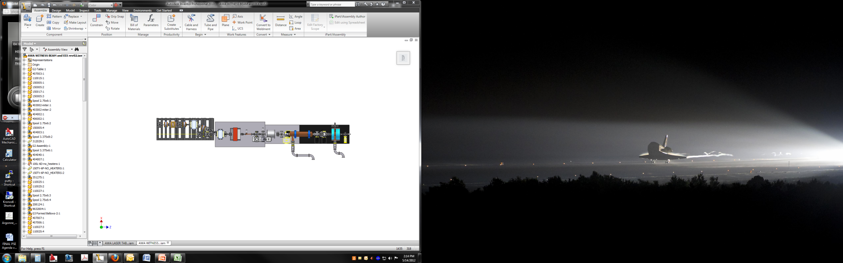
Accelerator safety workshop
AWA Beamlines and Bunker
The AWA Bunker is ~130’ long inside. The bunker walls (in most places) are 7’ thick (3’ of HD concrete and 4.5’ of standard concrete) and 7.5’ high inside.
The AWA has three beamlines: 65 MeV Drive Beam, 15 MeV Witness Beam, and the 2 MeV Argonne Cathode Test-stand (ACT).
HD Concrete
AWA Experimental Area
Standard Concrete
AWA Drive Beamline
Linac
Door 3
ACT
Door 2
Steel Plates
Door 1
KEY
AWA Witness Beamline
AWA RF Shielded Room
Door/Key Tree
Roof Access
Facility Rated for 80 MeV
Roof Control
Safety Chain
AWA Beamlines and Bunker Schematic

Slide 8
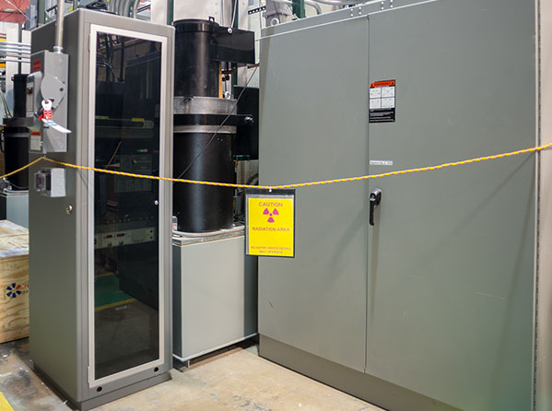
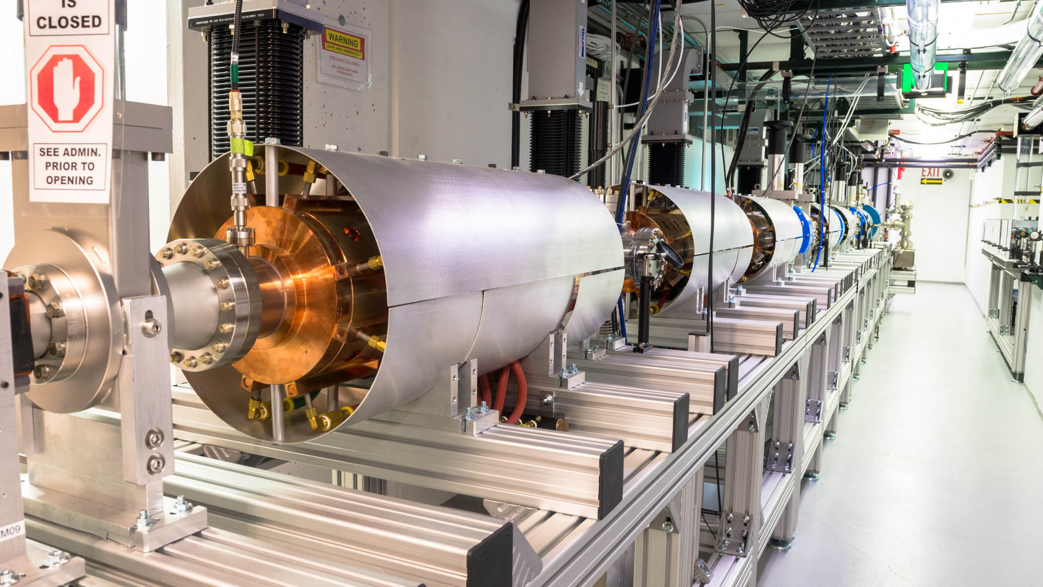
Accelerator safety workshop
AWA Linac
The AWA Linac(s) uses 4 - 25 MW klystrons to generate RF power at 1.3 GHz that drives the 65 MeV Drive Beam (a 1.5 cell Photoelectric Gun and 6 standing wave Accelerating Cavities) while simultaneously driving the 15 MeV Witness Beam (a 1.5 cell Photoelectric Gun and 1 standing wave Accelerating Cavity). To run the ACT, AWA uses RF switches to divert power from a Drive Beam accelerating cavity to the ACT. The ACT always operates on its own.
AWA has a 5th - 25 MW klystron that powers 4 deflecting cavities for its Double Emittance Exchange program and for longitudinal phase space measurements.
The remaining space in the bunker is dedicated to the AWA experimental programs. AWA is unique in the manner that the accelerator is the experiment.
AWA Klystron
AWA Drive Beam

Slide 9
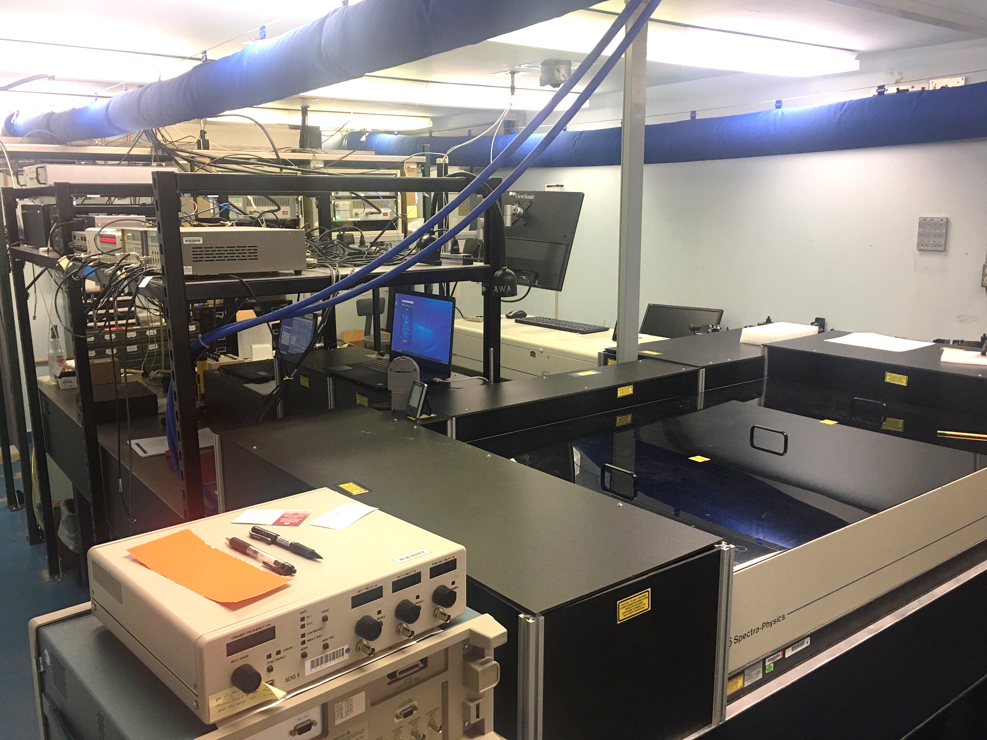
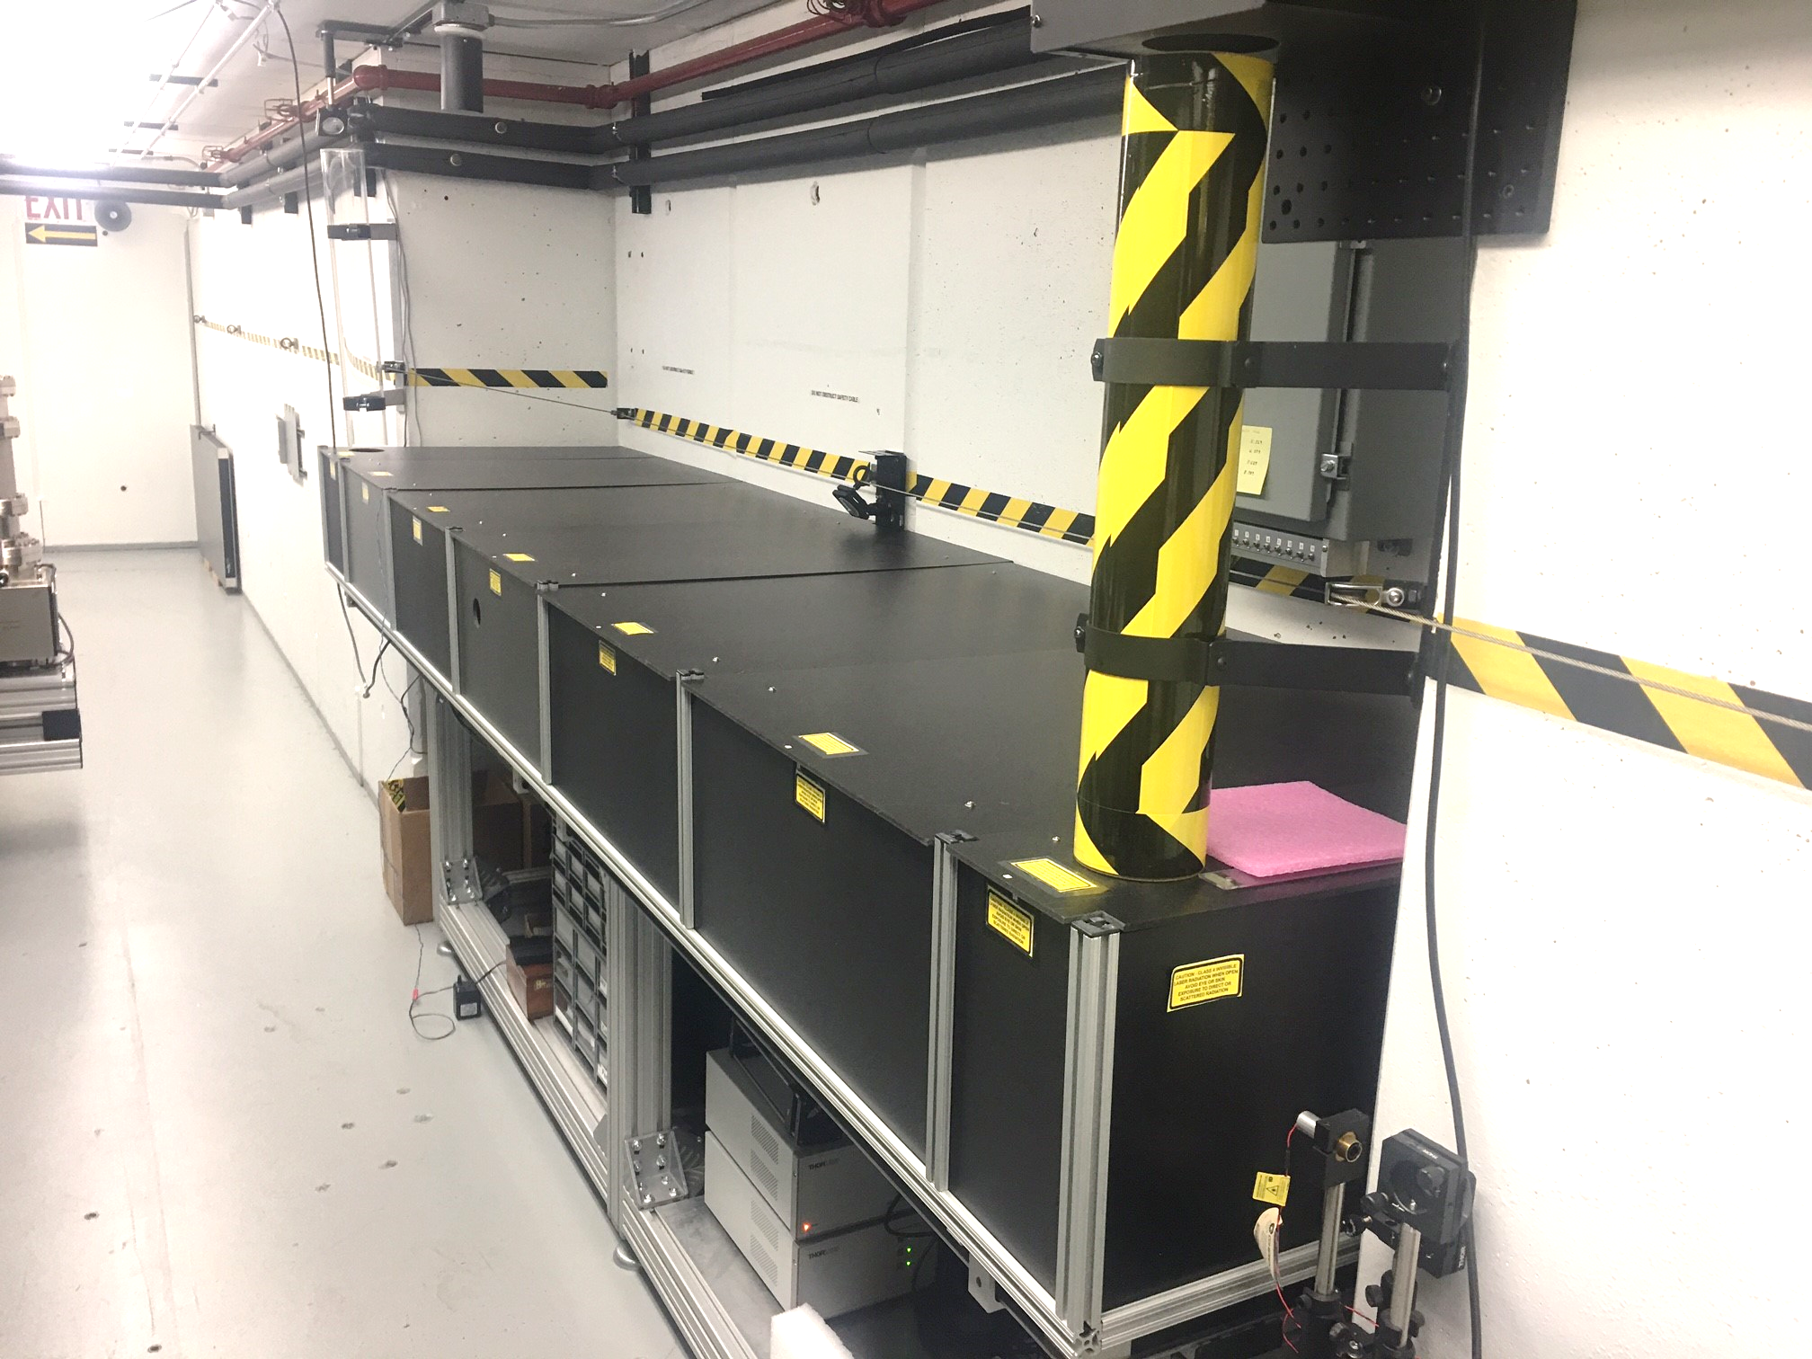
Accelerator safety workshop
AWA Laser
The AWA Laser is a two-part Class 4 laser system.
Inside the AWA Laser Room IR (<100 mJ of 785 nm) is generated. It then goes through a hole in the bunker wall that can be blocked by a shutter. (The shutter can only be opened when the bunker is surveyed in either “Beam” or “Laser” mode.)
Inside the AWA Bunker the IR is transported through a pipe to a covered laser table (see figure) where it is converted to UV (<10 mJ of 262nm) and the UV laser is delivered to a Cs2Te coated cathode in the Gun where the electrons are made.
Inside Laser Room
Inside Bunker

Slide 10
Accelerator safety workshop
AWA Operations: Major Operational Modes
Bunker Open
Bunker Closed
Experiment Support
  Installation and configuration of standard and custom elements for a run.
Facility Support
  Maintenance, safety, upgrades, and continuous improvements.
Running Accelerator
    Bunker is closed with no personnel access.
    Roof is closed with no personnel access.
  Experiments, about 15-20 per year.
  Machine Studies.
  Operator Training.
RF Mode
    Bunker is closed with no personnel access
    Roof is open.
  For diagnosing Klystron issues.
Laser Mode
    Bunker is closed with personnel access.
    Roof is open.
  For setting up laser elements inside the bunker and/or laser room.

Slide 11

Accelerator safety workshop
AWA Operations: Vacuum and Experimental Zones
AWA has separated the main beamline vacuum into seven different zones and operates six different experimental zones (2, 3a, 3b, 4, 5) + the ACT. We built in this efficiency to make installation and run scheduling more flexible and protect internal components from unnecessary exposure to air.
This scheme allows us the ability to install in one zone, for instance, 3a or 3b, and while that vacuum is pumping down, maintain the ability to run an experiment in another zone (2, 4, 5, or ACT).
ZONE 4
ACT
Beam
ZONE 5
B
ZONE 3
A
ZONE 2
ZONE 1

Slide 12
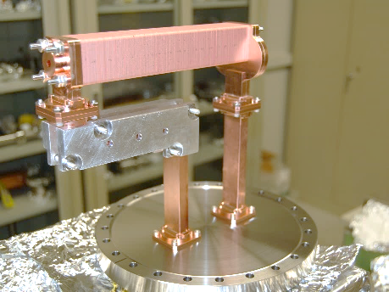
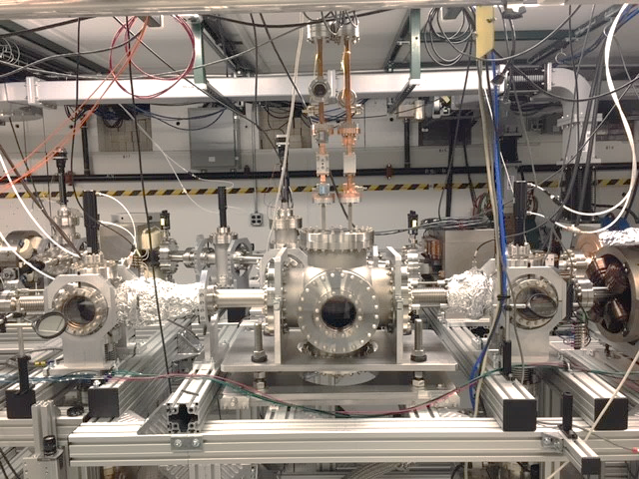
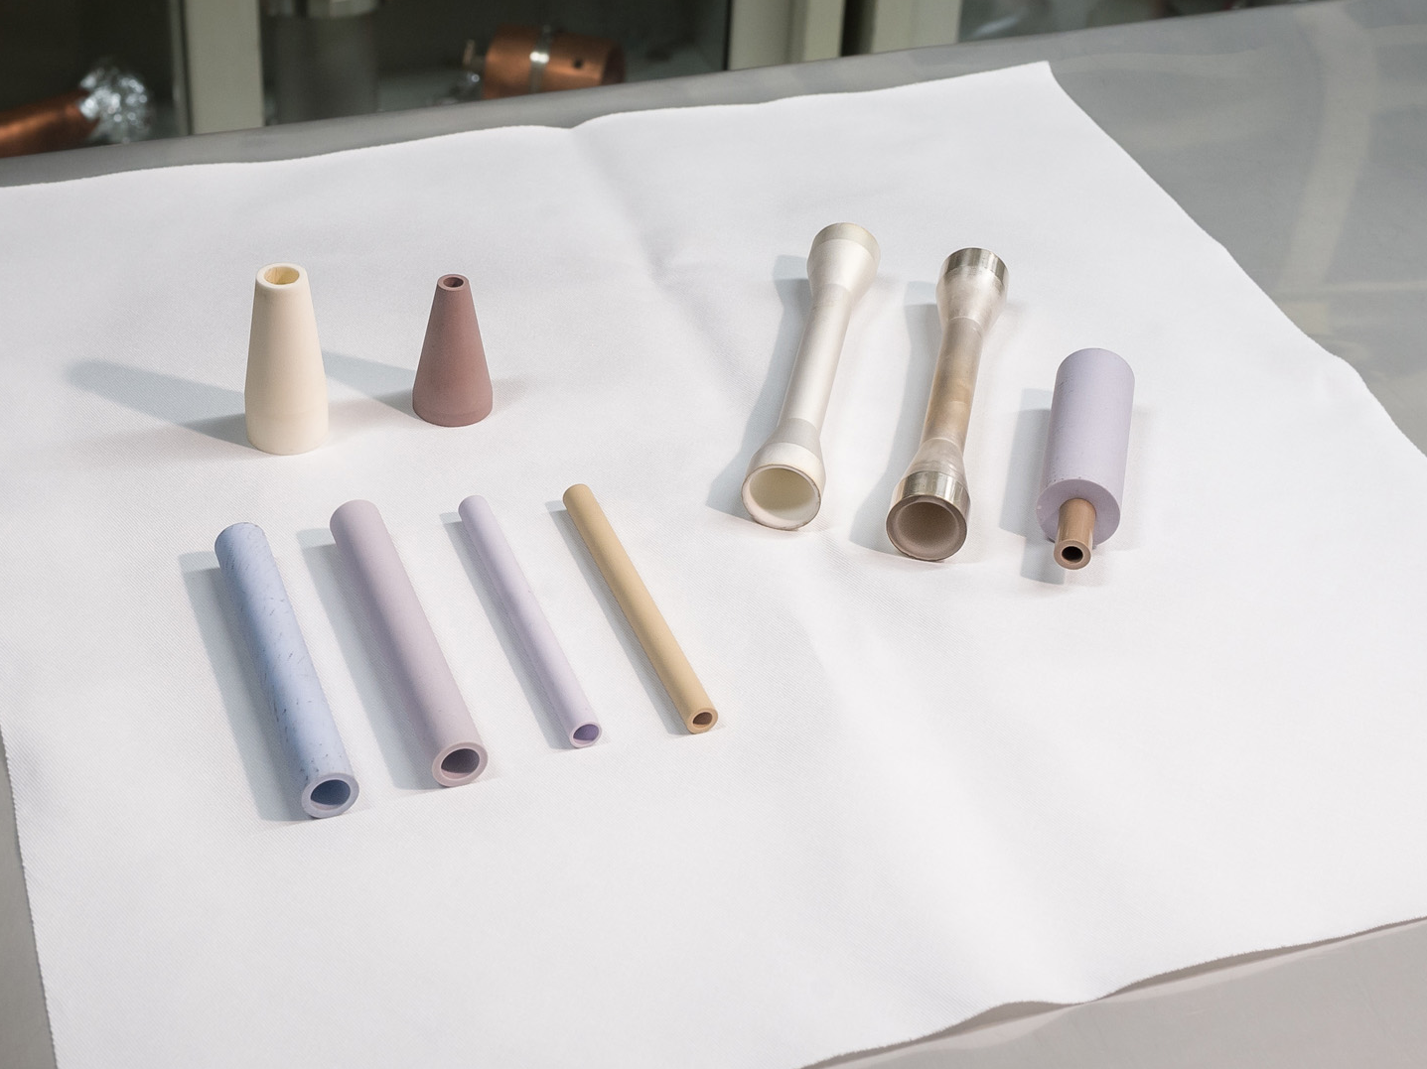
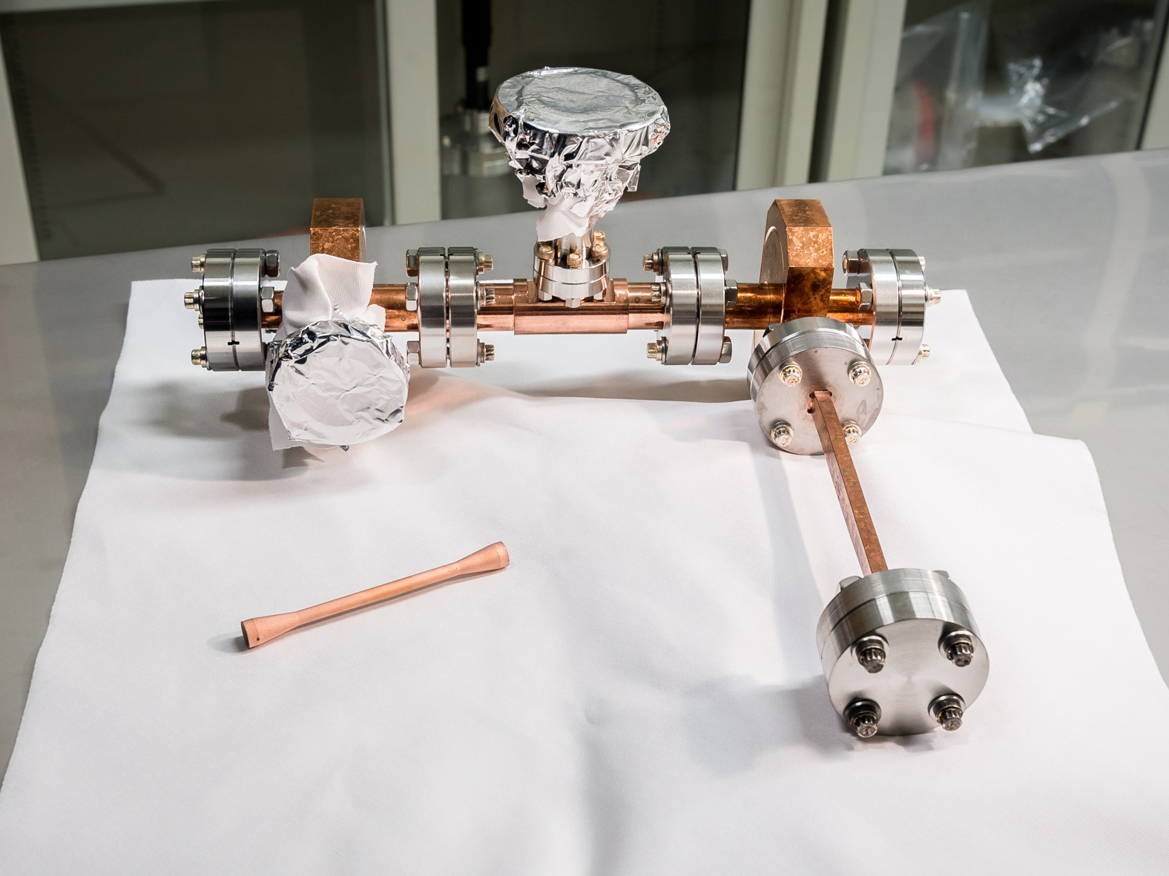
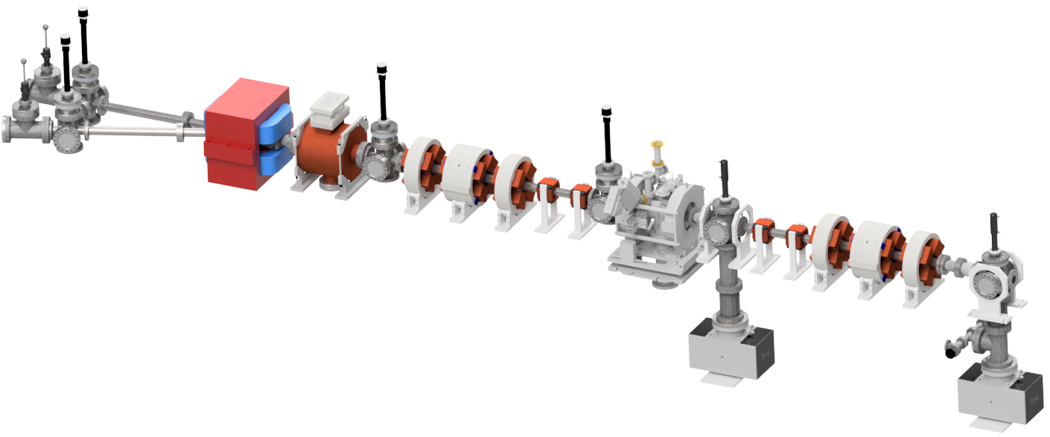
Accelerator safety workshop
Metallic structures like this
AWA Experimental Thrusts
The AWA uses three different techniques to experiment with different ways to manipulate electrons to generate “Wakefield Acceleration” in order to make future accelerators more powerful, efficient, and cost effective.
Metallic structures and Dielectric structures get assembled into various types of vacuum chambers and assembled into an Experimental Zone. Plasma experiments may have their own beamline section.
Metallic
Get assembled into vacuum chambers
Dielectric structures like these
Dielectric
Get assembled into structure chambers
Plasma
Plasma Generating Unit

Slide 13
Awa safety highlights

Slide 14
Accelerator safety workshop
AWA Personnel Safety
Inside Bunker
Outside bunker
Audible tone during survey(s) and start-up
Physical bunker survey before start-up
Radiation monitors
Interlocked safety pull-chord along walls
Covered laser transport tubing and laser table
Signage
Audible tone during survey(s) and start-up
Physical roof survey before start-up
Radiation monitors
During beam operation
  Locked doors (interlocked)
  Rotating lights
  Lighted signs
  Emergency stop button in Control Room
Access to bunker during pause
  Operator key (turns accelerator on and off as well as locks and unlocks doors)
  Key trees

Slide 15
Accelerator safety workshop
AWA Personnel Training
AWA has several different categories for personnel. Most personnel are assigned tasks in AWA’s Work Control Document (WCD). These personnel must complete and maintain a training profile through their Job Hazard Questionnaire (JHQ). Others must meet a minimum threshold in order to participate in AWA work or operations.
Staff
Staff, students, and some associates usually need all the same training as any regular full-time employee. This includes a task-based JHQ and OJT. The JHQ generates required Environment Safety and Health (ESH) courses as well AWA specific training. AWA-101 is for all personnel and AWA-102 is specifically for accelerator operators.
Assign Tasks in WCD
Individual Completes JHQ
Student
Review Training
AWA Assesses Scope
Associates
Contractor
External contractors are technicians that work on very specific parts of the accelerator like the laser system. They have contractor and laser training.
Collaborator
Collaborators and some associates are most often defined as visitors and usually just observe and advise during specific experiments.

Slide 16
Accelerator safety workshop
AWA Compliance Documentation
Major documents
WCD Task List
Work Control Document (WCD)
  The vast majority of AWA work performed under one WCD.
  Associates personnel with tasks from the list.
  Task list associations may generate additional, and in some cases, extensive, ESH training.
Safety Assessment Document (SAD)/ Accelerator Safety Envelope (ASE)
  Defines operations and operating parameters of accelerator.
Configuration Management (CM)
  Currently efforting final version for release.
Interlock Testing Procedure
  Full test of all interlocks yearly.
Operation of the RF systems
Participation in experiments in AWA bunker
Mechanical installation of equipment (waveguide etc)
Prep & assembly: vacuum components
Assembly/low power RF test of components (cold test)
Electrical work other than on klystrons and modulators
Electrical work on klystrons and their modulators
Mechanical fabrication of components
Laser operation and UV beam
Laser operation, including UV and IR beams
Tasks require on the job training (OJT) and mentoring to assess the “skill of the worker” before an individual can preform the task alone.

Slide 17
Accelerator safety workshop
AWA External Reviews and Support
External Reviews
External Support
Bi-annual HEP Division Director safety walkthrough
Annual ESH safety walkthrough
Annual Laser Safety Review
Annual radiation monitor calibration
Close relationship with Health Physics (HP)
  Regular surveys of potentially activated equipment.
  Scheduled surveys.
  Annual calibrations.
  Signage.
Close relationship with Laboratory ESH and other personnel
  Erika Glombicki, Kevin Rader, many more!
  Assist with accelerator reviews, documentation, and compliance.

Slide 18
Accelerator safety workshop
AWA Internal Reviews and Organization
Internal Reviews
Internal Organization
Annual Interlock Testing
Regular maintenance schedules
Vigilant and dedicated staff
Comprehensive systems overview
Start-up/shut-down check lists
ELOG
Box
Teams
Check lists for all major systems to assist maintenance and upkeep
Near Future

Slide 19
Accelerator safety workshop
Challenges
Student Safety
  Training/Oversight/Onboarding/OJT
Facility Complexity
  Heavy Industry has many minor hazards and a few large ones
Compliance Documentation
  Recent group leader (Manoel Conde) retirement not replaced so safety was added to the workloads of two people, Eric and Scott
Coordinating Internal Tasks
  Large upgrades, complicated installations
Collaborator Deadlines
  Universities, SBIR

Slide 20
Thank you

