Slide 1
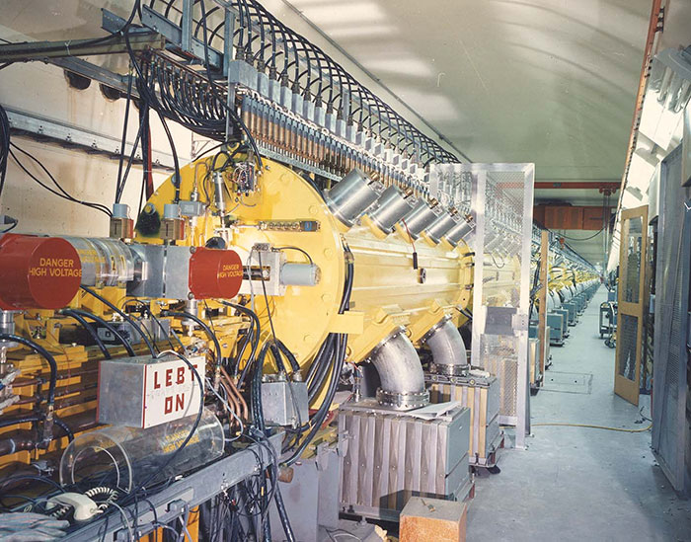
ASW 2021, Plenary Session, Conducting Effective Remote Reviews and Assessments, JLab Perspective
Considerations for the MIRP ARR for Full Operations
R May
Deputy Director, ES&H
This material is based upon work supported by the U.S. Department of Energy, Office of Science, Office of Nuclear Physics under contract DE-AC05-06OR23177
Brookhaven’s linear accelerator is 144.8 m long and feeds a beam either to the BLIP or the Booster accelerator. Image credit: BNL
Accelerator Safety Workshop, Fermi National Accelerator Lab, October 2021

Slide 2
FNAL 2021 ASW
What we hope to address in this session:
  What was the nature of the remote or hybrid review (video meetings, inspections, readiness reviews. etc.)?
  What were the challenges setting up and running the review
  What would you have done differently (if anything) in retrospect or what are a few key lessons learned you would like to share?

Slide 3
FNAL 2021 ASW
Background
  BNL scheduled an ARR for the Medical Isotope Research and Production (MIRP) Program
  ARR scope addressed target irradiation, on-site transportation, and target processing to extract radionuclides for medical use
  ARR was conducted at the height of COVID-19 pandemic conditions June 15 – 26, 2020
    Large number of reviewers - 11 external and 1 internal (DOE Site Office) reviewer
    Entirely virtual review via teleconference – no travel due to pandemic
    Two business weeks of meetings via teleconference (no travel allowed)
    Significant front end work for this review - detailed LOI, extensive documentation on share-point, pre-recorded video tours and video recordings of the status of equipment, and recordings of personnel conducting critical work
    Dedicated Agenda times intended for teleconferences requested by the ARR Team and follow up sessions

Slide 4
FNAL 2021 ASW
Background, cont’d.
  Key finding from this review:
    Post-Commissioning: Conduct an in-person, boots on the ground ARR tailored to verify implementation of new and improved procedures and processes and to validate the virtual ARR process prior to transitioning into “Routine Operations.”
  This does not address the considerable effort by the ARR Chair and the ARR Team to “get their heads” around the mechanics of a remote review
Considerations from this ARR:
  Key addition to the ARR Plan - COVID-19 Health and Safety Plan
  Considerable IT support need and front-end verification for ARR Team remote connectivity and functionality with chosen teleconferencing tools and access to documentation and recorded video
  Considerably more Admin support needed - including Admin staff with technical competence in video teleconferencing tools
  Significant number of teleconference sessions requested by ARR Team and as follow-up to scheduled presentation

Slide 5
FNAL 2021 ASW
Considerations from this ARR, cont’d.:
  Technology challenges
    Establish a common video conferencing platform accessible by all reviewers and capable of handling a large number of participants
      Most labs were still working though the selection and common use of remote conferencing tools
    Use pre-recorded video accessible in advance to reviewers
    Schedule videoconferencing events with a large number of schedule variables – BNL staff and ARR Team at work both in offices or in the field, some at home
    Determine how to use live video interactively to address questions from reviewers
    Overcome some connectivity and bandwidth issues
    Quickly setup follow-up videoconferencing sessions for Q and A subsequent to scheduled sessions
    Overcome technical issues like trying to record someone speaking through a “mask” in a high noise environment…

Slide 6
FNAL 2021 ASW
Based on the Post-Commissioning finding
  An in-person, “boots on the ground” follow-up ARR for MIRP Program Routine Operations was scheduled May 18 – 26, 2021
  Smaller number of reviewers (6 external, 2 internal)
  Goal was to determine effectiveness for BNL actions to meet Findings (but skipped NO key LOI for a complete ARR), focus on
    Physical verification of presence and functionality of Credited Controls
    BNL implementation of new and improved procedures and processes from June 2020 ARR,
    Integration of lessons-learned during commissioning to operations plans and procedures before transitioning to “Routine Operations.”
ARR for Routine Operations
  BNL ARR Lead and ARR Team determined that a hybrid review seemed to be the best approach
  All hands participated in teleconference sessions and subset travelled to BNL
    Limitations in vaccine availability
    Not all team members were approved for travel by their home institutions

Slide 7
FNAL 2021 ASW
ARR for Routine Operations, cont’d.
  ARR Plan developed with LOIs (standard process)
  First week May 18 - 21 consisted of (4 days) afternoon videoconference presentations on ARR focus areas, all team members participating
  Followed by May 24-26 (2.5 days) two days of boots-on-the ground walk-down of equipment, installations, one-on-one discussions with operators and technicians plus half-day close out
    Off-site ARR reviewers participated in on-site team discussions regarding in-the-field observations
    Close out was a teleconference, covered all the activities for ARR for Routine Operations, and included off-site ARR reviewers who presented during the closeout
Considerations from the ARR for Full Operations
  Timing: while planning for the Routine Operations ARR began in October 2020 for an “end of the year” ARR but pandemic conditions and travel restrictions prevented travel
  The schedule shifted at least twice over a half a year before it landed on May 2021

Slide 8
FNAL 2021 ASW
Considerations from the ARR for Full Operations, cont’d.
  In addition to the considerations identified from the June 15 ARR there were additional considerations for the boots-on-the-ground staff to meet BNL COVID-19 Plan requirements
    Not all ARR Team could be scheduled on-site during the boots-on-the-ground phase
    Not all reviewers gathered at BNL could occupy certain rooms or spaces at the same time during a discussion or demonstrations – sometimes events had to be repeated and this took additional time in the field
    Large conference room with setup for physical distancing to allow for follow-up interviews
    Follow-up interviews were a combination of in-person and teleconferenced events, so admin support was needed-on-the-fly to set up meetings
    Admin support had to be technically competent with teleconferencing tools for setup and troubleshooting
    Admin support and recordkeeping during ARR Team discussions reduced paper handling to a manageable “pandemic” levels

Slide 9
FNAL 2021 ASW
Summary
  ARR is a structured review based on ARR Plan, including LOI, that incorporates a performance based approach
  The standard preparation activities for an ARR are all still essential and in-play; there are no steps you can skip
  The logistics for a virtual (or a hybrid review) are no less complicated; in many case more complicated and resource intensive
  The ARR Team at BNL had substantial resources from intensive BNL preparation
  This seasoned ARR Team from the June 15 review determined that boots-on-the-ground verification review was a essential element for a performance-based ARR
    Some people you have to talk with face-to-face,
    Some things you have to physically observe to fully understand in context
    some hardware you have to touch

Slide 10
FNAL 2021 ASW
Please hold questions for
the Panel Discussion

