Slide 1
Managing System Readiness
Ken Baggett
Department Head
Electrical Engineering Systems

Slide 2
Outline
Hot Checkout / System Readiness
Process overview
Process Execution
Evolution
Summary

Slide 3
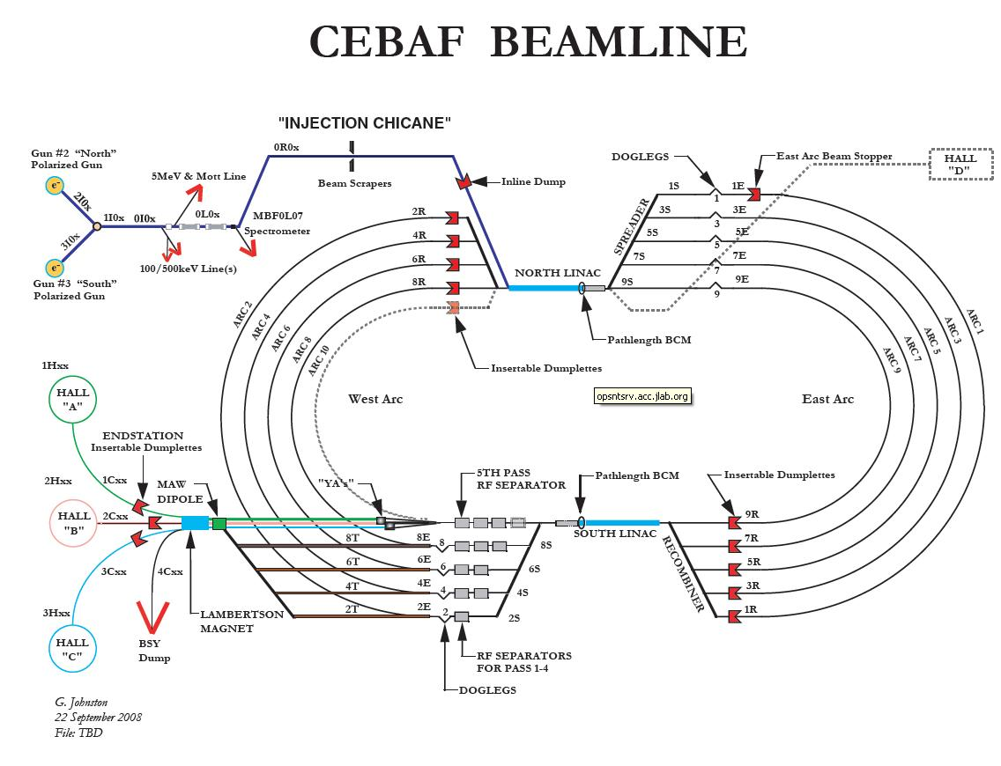
Regions
North East Spreader

Slide 4
Motivation
On 10/14/12 two Septa magnets (YR) in the Northeast Spreader region caught on fire and sustained heavy damage.
Two direct causes:
LCW valves for the dipoles were closed.
A jumper in the box supply prevented the thermal switches from tripping the box supply on an over temperature fault.
Root causes were determined to be:
Lack of adequate Work Control practices
No systematic method of checking system readiness
Indirect Cause:
Poor communication between System Owners and Operability

Slide 5
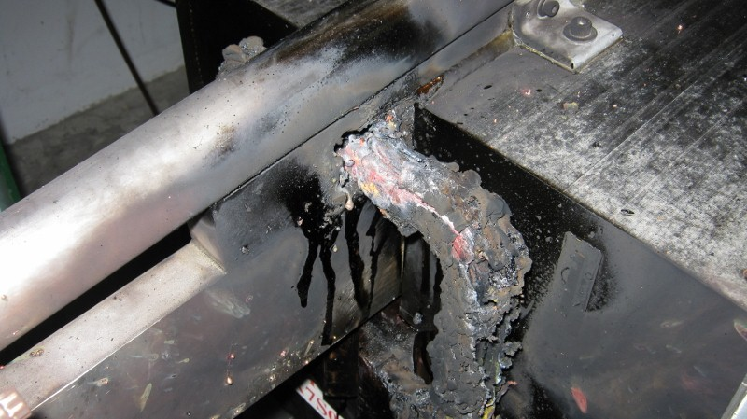
YR Incident - Damaged Coils

Slide 6
YR Fire - What went wrong? (cont.)
Contributing Causes:
Poor communication between System Owners and Operability
Very light attendance at RECO meetings by System Owners.
Tools for System Owners/RECO inefficient or inadequate for information management.
Important to recognize the recommendation that tool requires two way input (system owners ↔ operations)

Slide 7
Approach for Hot Checkout and System Readiness
Involve everyone
Engage both technicians and management.
Involve them in the system design
Be specific
HCO software captures checkout of each component.
Ensure work plans are developed for component HCO
Be efficient
HCO software is web-based
Include documentation/links in the tool.
Displays multiple, dynamic reports.
Change the culture
Ensure management transparently supports the program
In our case, Accelerator Readiness Reviews (ARR) helped.

Slide 8
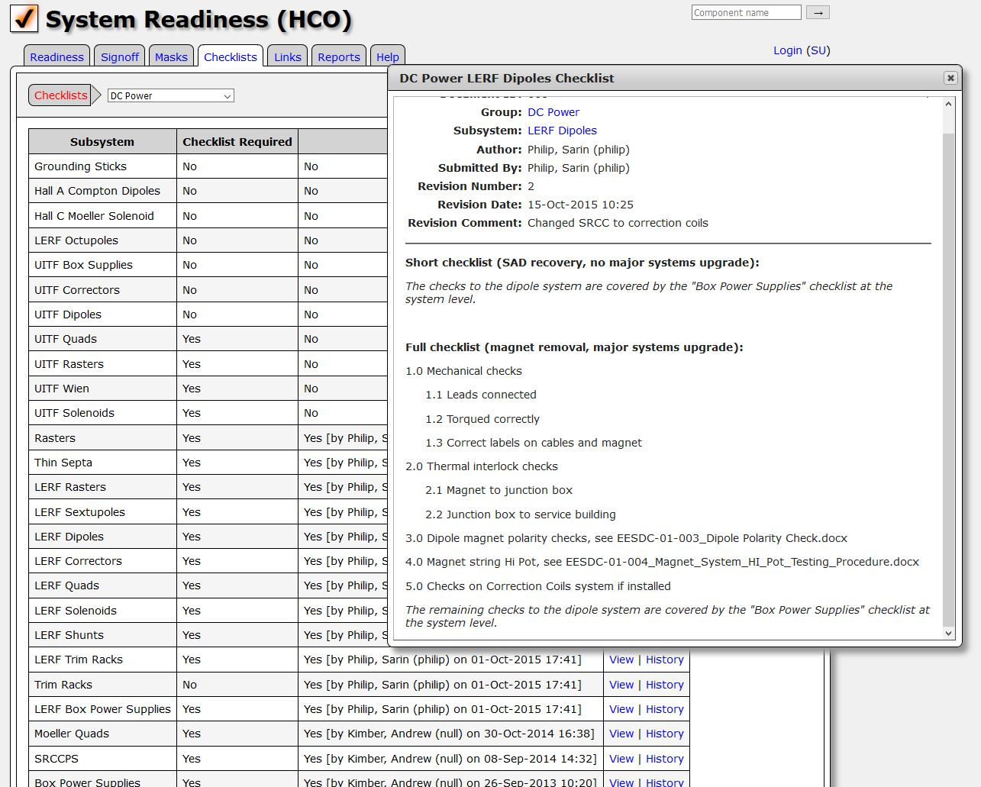
Checklists
Checklists are used (and required) for each group performing work that could cause damage to personnel or the machine during beam operations.
HCO Checklists are:
Maintained by work groups.
Stored in the HCO database
Documented using a configuration management process in software.

Slide 9
Users
Technicians – Work to checkout components based on HCO requirements.
Group Leaders & Experts – System Experts, Group Leaders, Engineering Liaison work together to determine system readiness.
Management – Program Deputy (PD), Engineering Deputy, and Operability managers monitor/drive HCO progress based on beam destinations.
Operations – Verifies component status based on beam destinations prior to establishing beam for the PD’s accelerator program.

Slide 10
Sign-off Process
New process utilizes a three-stage sign-off process
Components are initially “Not Ready”.
Technicians upgrade them to “Checked” once work is completed
Group leaders upgrade them to “Ready” once work is reviewed.
Staff can add comments without having to change status.
Anyone can downgrade a component to “Not Ready”.
Once all groups have signed off on a component, the component name will be turned GREEN on the interface.

Slide 11
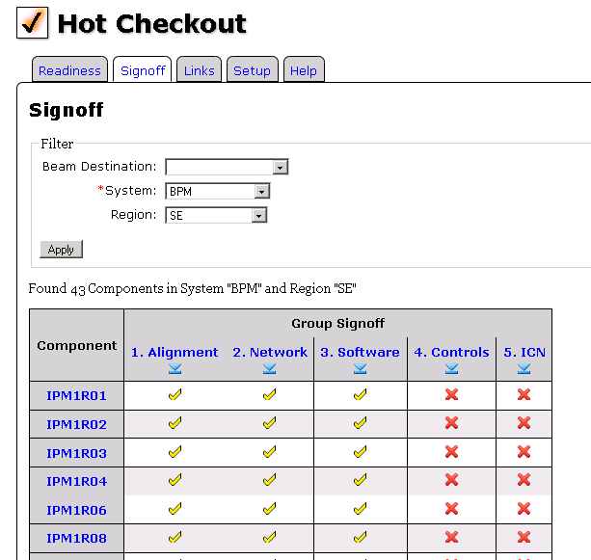
Group Signoff
Group leader or technician can verify that all components in the region have been Checked/Ready.
The software interface:
Is web-browser accessible.
Shows all associated groups in work order.
Provides for simple bulk signoff of components.
Facilitates making, tracking, and reviewing comments.

Slide 12
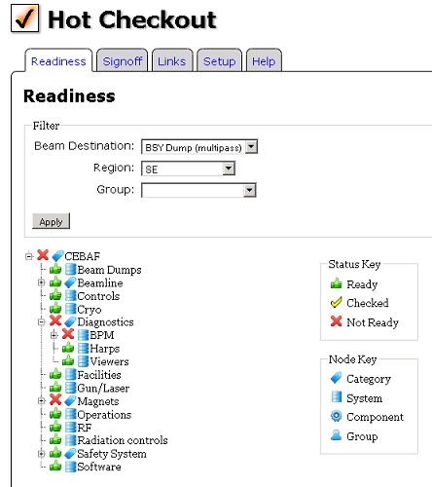
Readiness Status
Accelerator status:
Can be filtered and displayed based on beam destination
Incomplete HCO components
RED
Completed HCO components
GREEN
Checked HCO components
YELLOW

Slide 13
HCO Process Execution
HCO Program
HCO team lead initially served as Program Deputy (PD)
Now mature: no specific PD needed
Electrical Engineering Systems Deputy for Accelerator Reliability manages the process
Coordination and Sign-off
Daily 0800 meetings to
Refine the plan for the day.
Communicate system status.
Resolve any group and/or schedule conflicts.

Slide 14
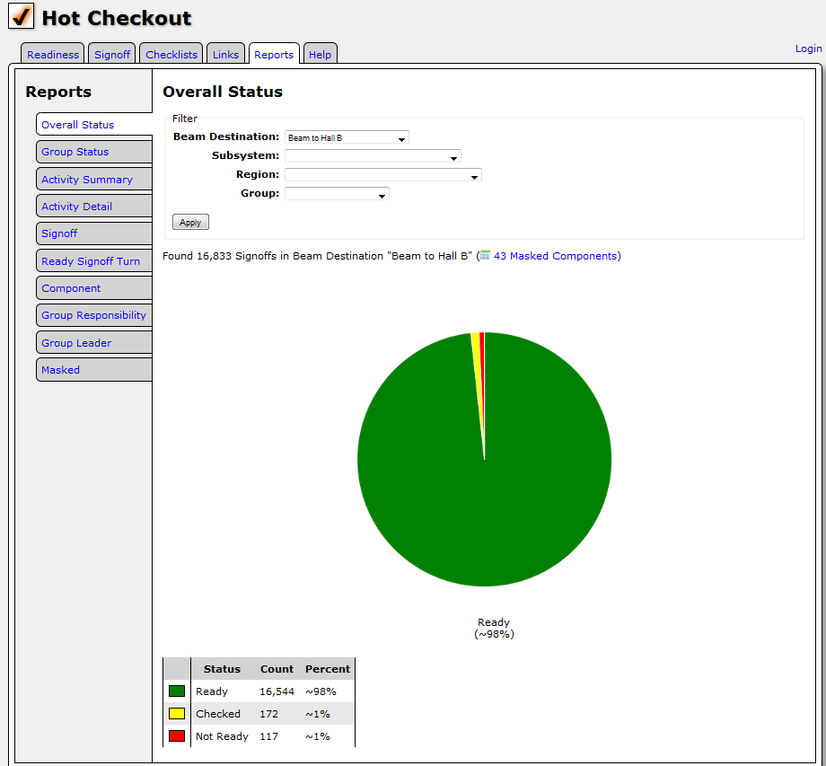
Overall Status

Slide 15
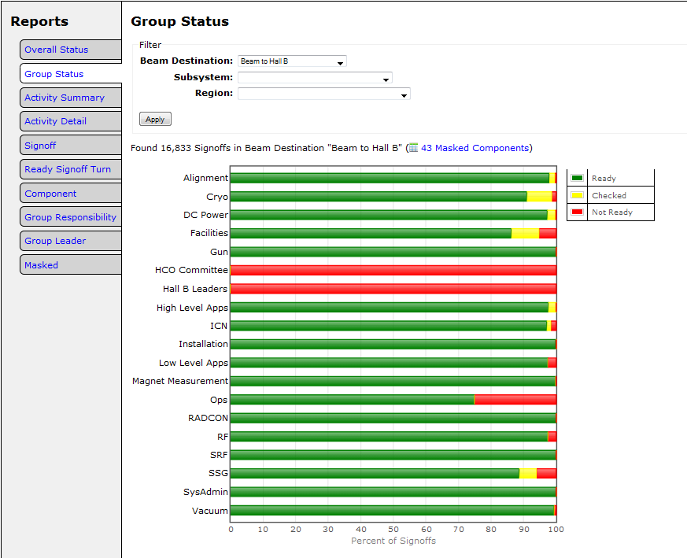
Group-by-Group Progress

Slide 16
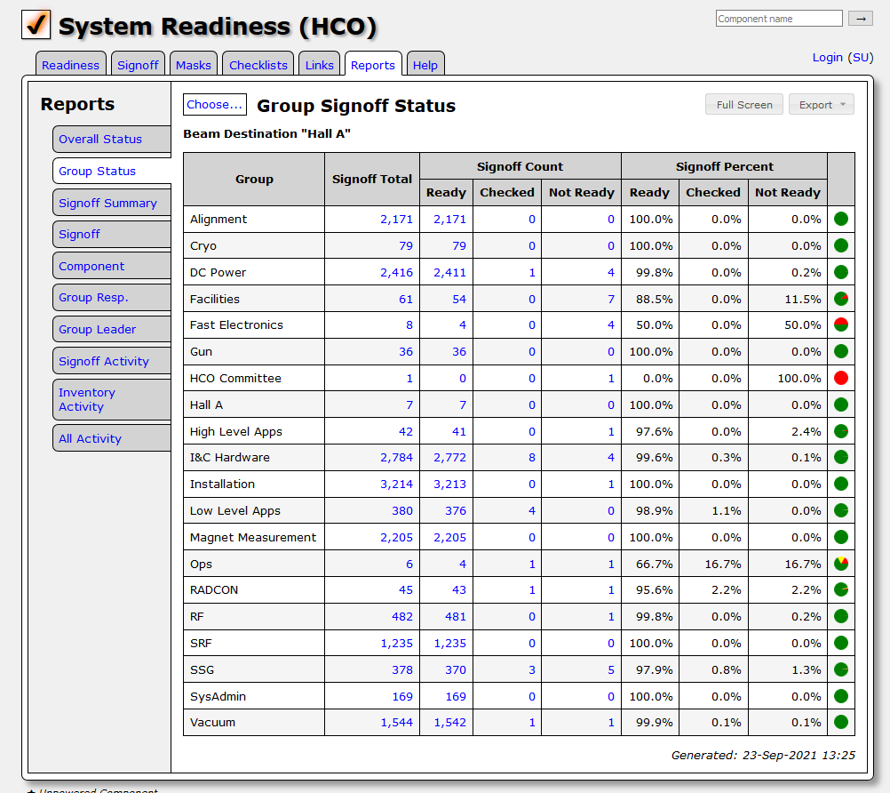
Group-by-Group Status Breakdown

Slide 17
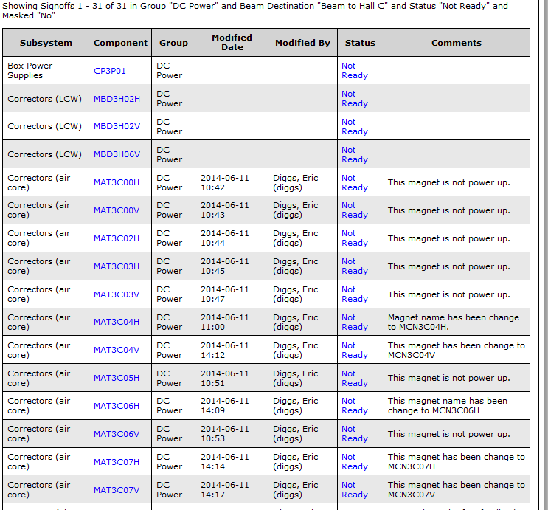
Drill Down

Slide 18
Updates / Additions

Slide 19
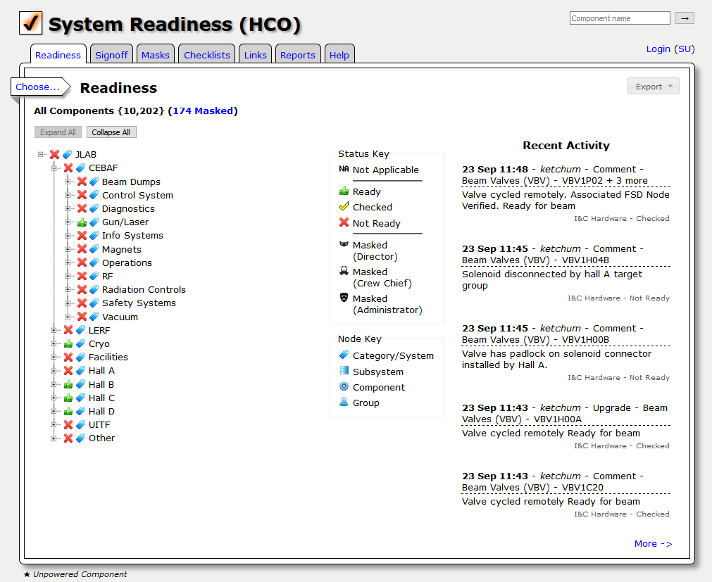
Recent Activity Notices

Slide 20
Masking Components

Slide 21
Auto-generating Beamline Diagrams

Slide 22
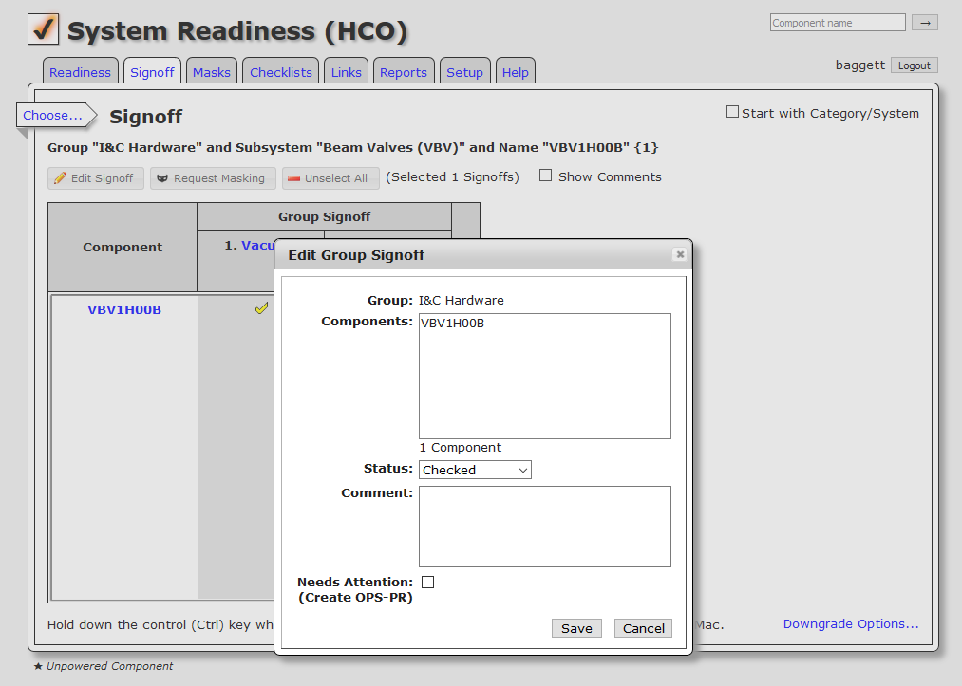
Problem Reporting

Slide 23
Limitations
“Ops Centric” – Beam destination vs PSS segmentation
Beam Authorization tool built to fill this gap
Auto downgrades don’t capture specialized work
Workers focus on work vs downgrades
Requires dedicated oversight
Readiness change / cascade notifications can get lost when too many emails
Adding new components or changing to unpowered can cause confusion
Done when physicists require a change
Halls work autonomously
Resolution of checkout differs hall->accelerator and hall->hall
A HCO team is necessary to manage the restoration process

Slide 24
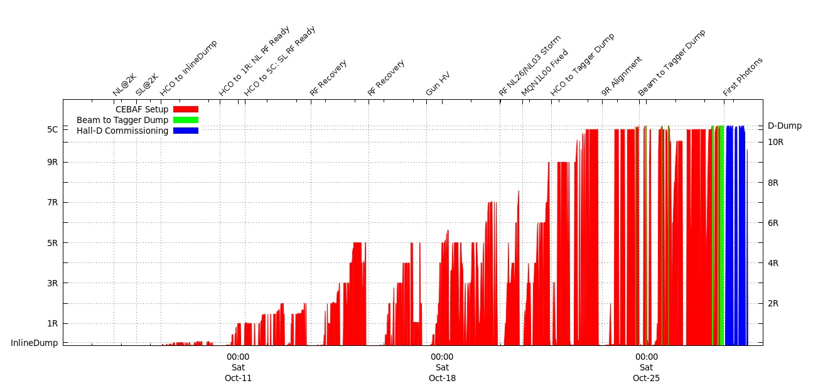
Has it worked?
Significant schedule and readiness issues associated with first run after long down.

Slide 25
Summary
The System Readiness tool allows us to complete our HCO safely and efficiently
It also allows us to monitor component and system readiness during operations.
System ties together people, process, resources, and environment.
Process focuses on system owners involvement.
System requires groups to have a written checklist for components that may not have a safe failure mode.
Technicians “Check” components.
Group leaders responsible for saying components are “Ready”
Operations can use tool to communicate readiness of components across shifts during runtime.

