Slide 1
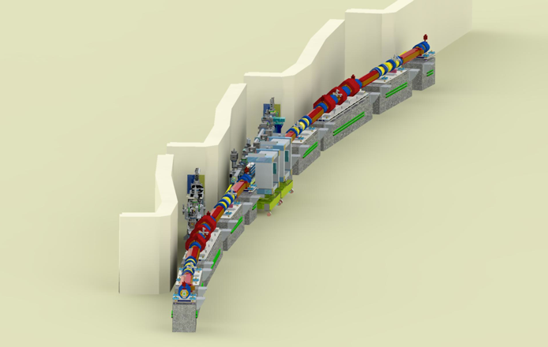
Component Database (CDB)
- Machine Elements -
A Framework for Configuration Control/Management
John Quintana
Manager, Beamline and Accelerator Engineering
Photon Sciences Directorate
Argonne National Laboratory
jpq@anl.gov
Notes:
Univ of Chicago Review, Aug. 30, 2010
1

Slide 2
Outline
APS Upgrade Project
Component Database and Etravelers
Current Uses

Slide 3
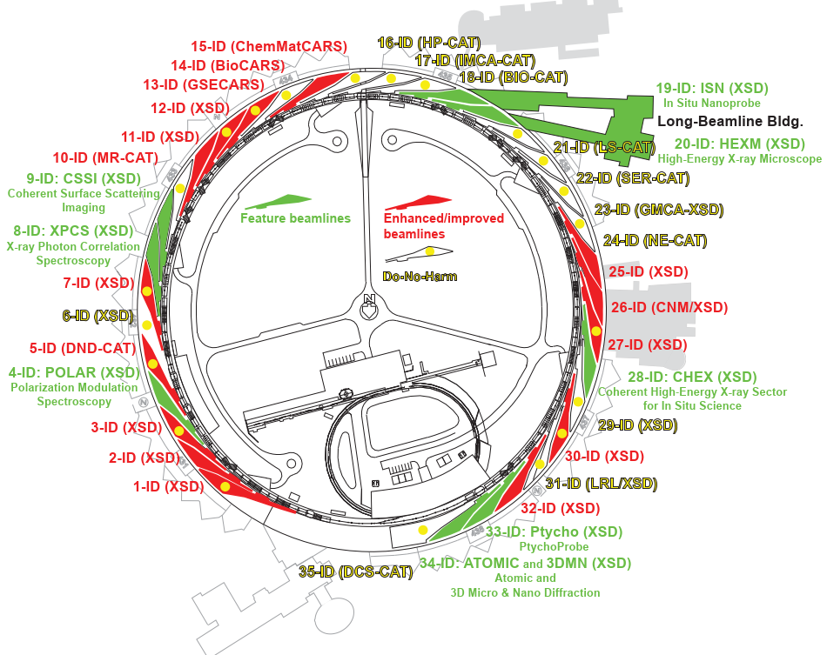

APS-U Project Scope
New storage ring:
42-pm emittance
@ 6 GeV, 200 mA
New and updated insertion devices, including superconducting undulators (SCUs)
Combined result in brightness increases of up to 500x
9 new feature beamlines + Long Beamline Bldg
15 enhanced and improved beamlines
“Do no harm” beamlines; realign 17 bend magnet lines
Exploit high-performance computing, AI
815M$ project to update and renew the facility
Re-uses 1.5B$ in existing infrastructure
APS-U Director’s Review Sept. 28 – Oct.1, 2021
3

Slide 4
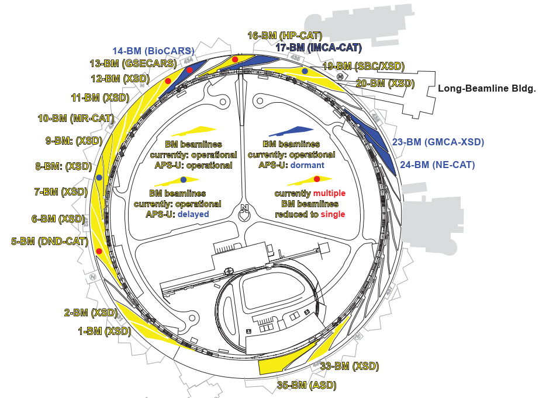
Scope – Bend Magnet Beamlines (“do no harm”)
APS-U Director’s Review Sept. 28 – Oct.1, 2021
4

Slide 5
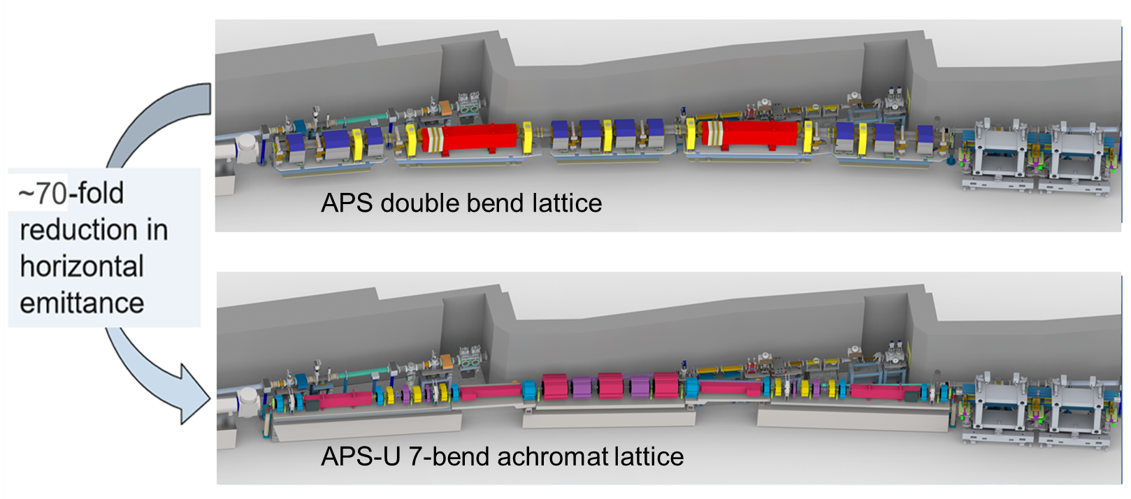
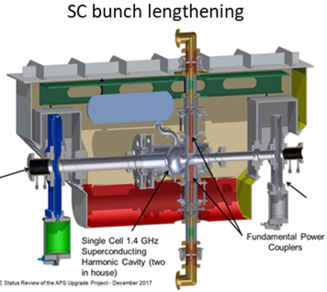
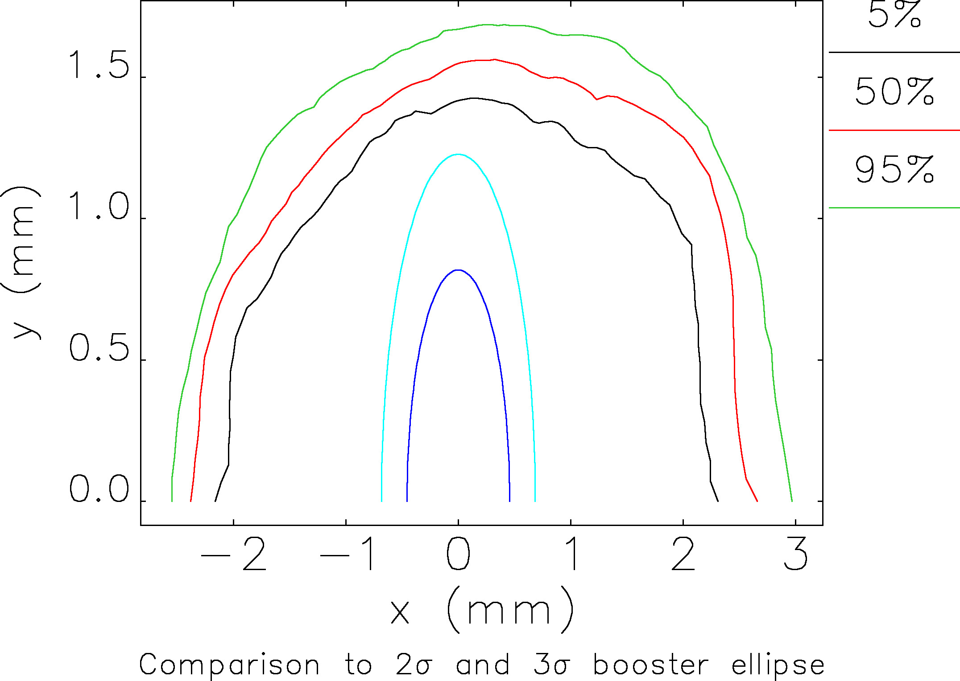
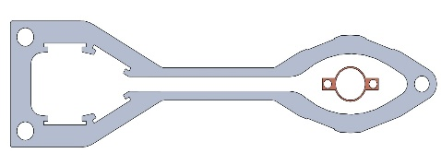
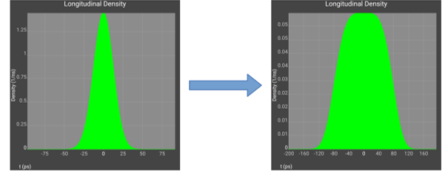
APS-U – High Ring Lattice with Swap-out Injection
7 GeV → 6 GeV
3000 pm → 42 pm
100 → 200 mA
1104.05m → 1103.61m
mm-dynamic aperture necessitates on-axis, “swap-out” injection every few 10s of seconds
Bunch lengthening for few-hour lifetime
APS and APS-U chambers
APS-U Director’s Review Sept. 28 – Oct.1, 2021
5

Slide 6
Component Database (CDB)
Assists staff in managing & tracking components
  Provides a mechanism to associate drawings, documents, specifications, requisitions, pictures, … to a component
  Define properties that a set of components have in common
  Allows for identifying and tracking inventory items (where installed, repair record, periodic maintenance, …)
  Documents installed components (type / instance / location)
Allows for “Project-wide” processes to be applied
  Common naming conventions
  QA Properties and work flow
  Organizing of eTravelers – Electronic Travelers -> Process Checklist/Data Forms
Facilitates Configuration Management
  Provides a description of a machine with “placeholders” where like-for-like items an be slotted in.
  Maintains separate attributes (relationships, operational info) separate from the physical item.

Slide 7
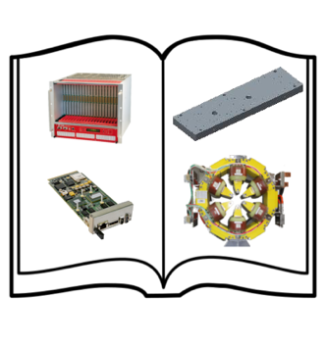

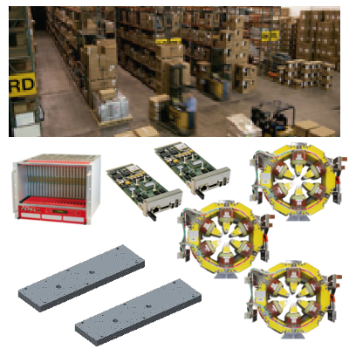
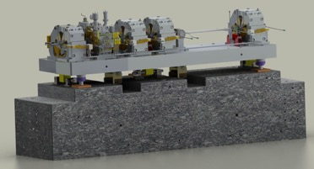
Component Database (CDB) - Vocabulary
The term “component” is used in many different ways … sometimes referring to a particular model # (e.g. Arista 7150S-24 Network Switch), a specific part (e.g. serial #10ADW1101), or the function it fulfills in a machine (e.g. S01A:Q2).
Careful vocabulary is imperative when referring to a “component” so as not to lose the proper context.
Catalog
(each unique type of component or component design or COTS item + properties/drawings/specification/..)
Inventory
(each unique instance of component procured or fabricated) + properties/serial #/QR code/travelers/pictures/…)
Machine Elements
(A group of catalog components to perform a particular function + inventory items to build it +
Properties/pictures/locations/…)

Slide 8
Catalog Entry
Optional Properties
Common Properties

Slide 9
Inventory Entry
Optional Properties
Common Properties

Slide 10
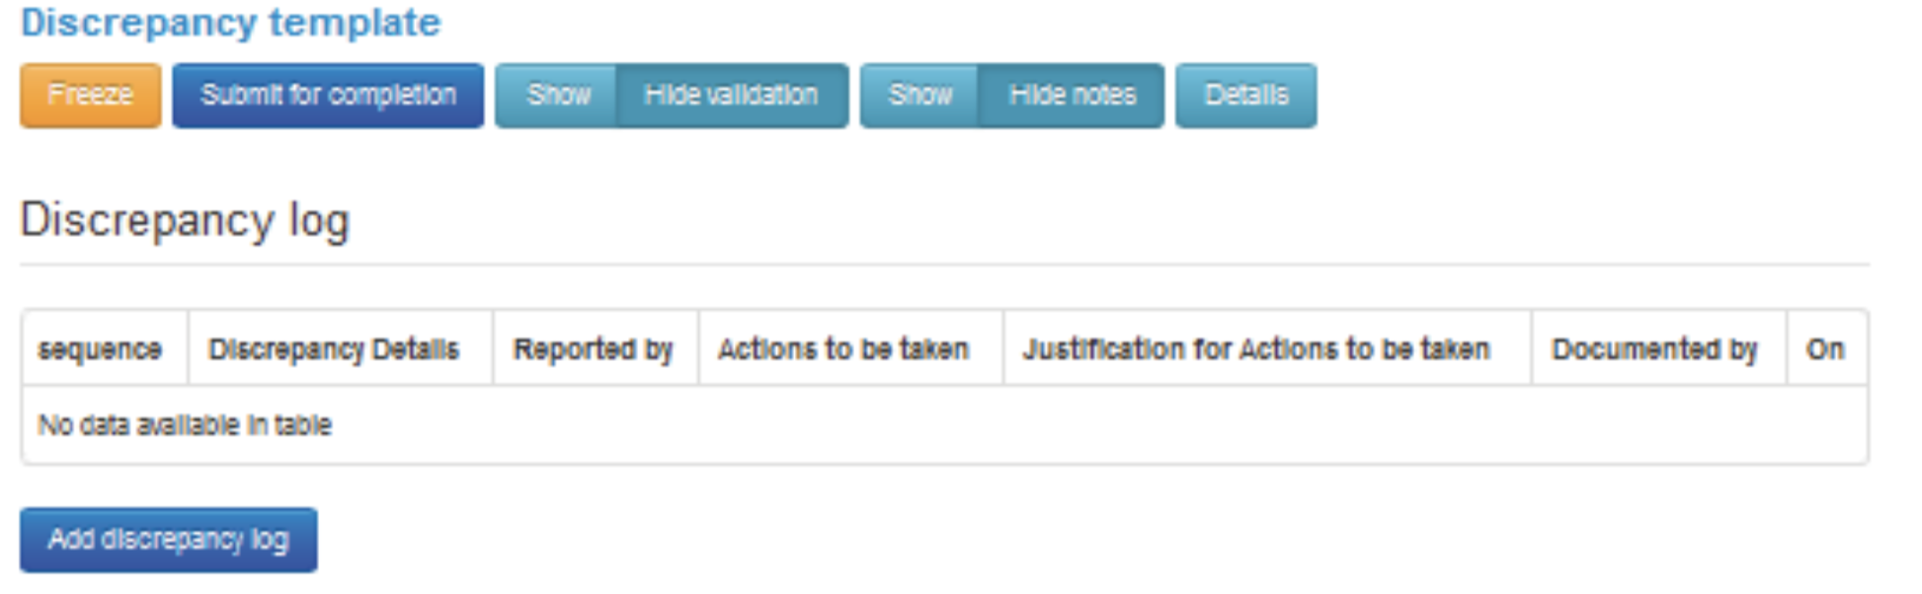
Integration with QA Processes
Each eTraveler has a built-in Discrepancy Log

Slide 11
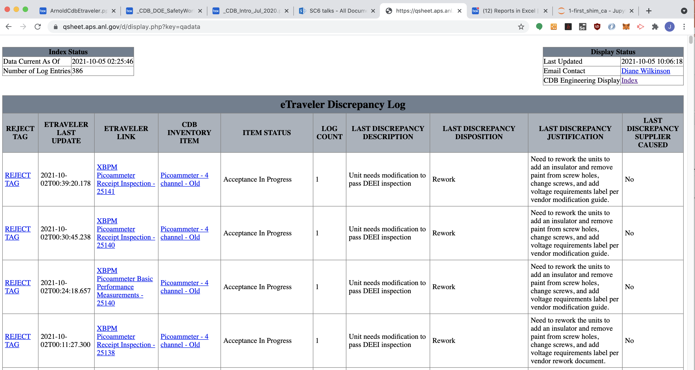
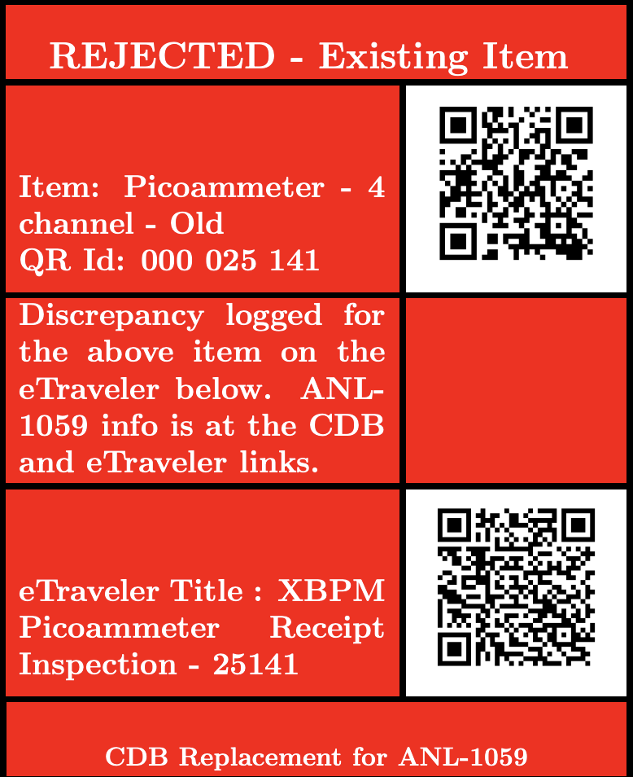
Consistency in QA Discrepancues Facilitates Reporting

Slide 12
Machine Elements
A simple hierarchical model of machine elements
• Assign a catalog item
• Assign an inventory item

Slide 13
CDB Features in Configuration Management
Assignment of a catalog item and inventory item to any machine element
  Keeps the documentation associated with the correct entity, minimizes redundant data
  Machine Element attributes define relationships that define a working machine.

Slide 14
CDB Features in Configuration Management
Associate eTravelers, photos, critical parameters, drawings to Machine Elements

Slide 15
CDB Features in Configuration Management – Assignment of Attributes
Create and apply specialized properties to critical machine elements
Catalog Items | Inventory Items | Machine Items
Name | Name | Name
Model Number | Tag | Machine Tag
Alternate Name | Catalog Item (automatic)
Description | Description | Description
Project(s) | Project(s) | Project(s)
Technical System | QR # | QR #
Function | Serial Number
Sources (Vendors) | Location | Location
 | Location Details | Location Details
<< Optional Properties >> Links to Drawings & Documents Images Web Links Uploaded Documents Form Factor eTraveler Templates QA Level/Requirements Link to Software Support Modules | << Optional Properties >> Purchasing Info Images Uploaded Documents Revision # eTraveler Instances Inspection Results Test/Measurement Results | << Optional Properties >> IP # Host Name GPIB Address VME/VXI Configuration Location in Rack Radiation Safety Component Link to Source Code Survey Data

Slide 16
CDB Progress by the Numbers*
Registered Users
274
Catalog Items
2,102 1223 at 2020 Status Review
Inventory Items
27, 031
11209 at 2020 Status Review
Machine Elements
10,681
Measurement and Analysis Archive (MAARC)
81,070
* Approximate - numbers change daily as work is being done.
Notes:
These number are an approrximation. Number change daily

Slide 17
CDB Features in Configuration Management
Mini-logbook for each item
An API allows for integration with external processes and/or GUIs
  eTraveler (Developed at FRIB)
  APS Document Management System
  Windchill (mechanical drawing repository)
  Trello
  Tableau (commercial report generator)
  Python scripts to export data to Excel
  Python scripts to export data for web viewing

Slide 18
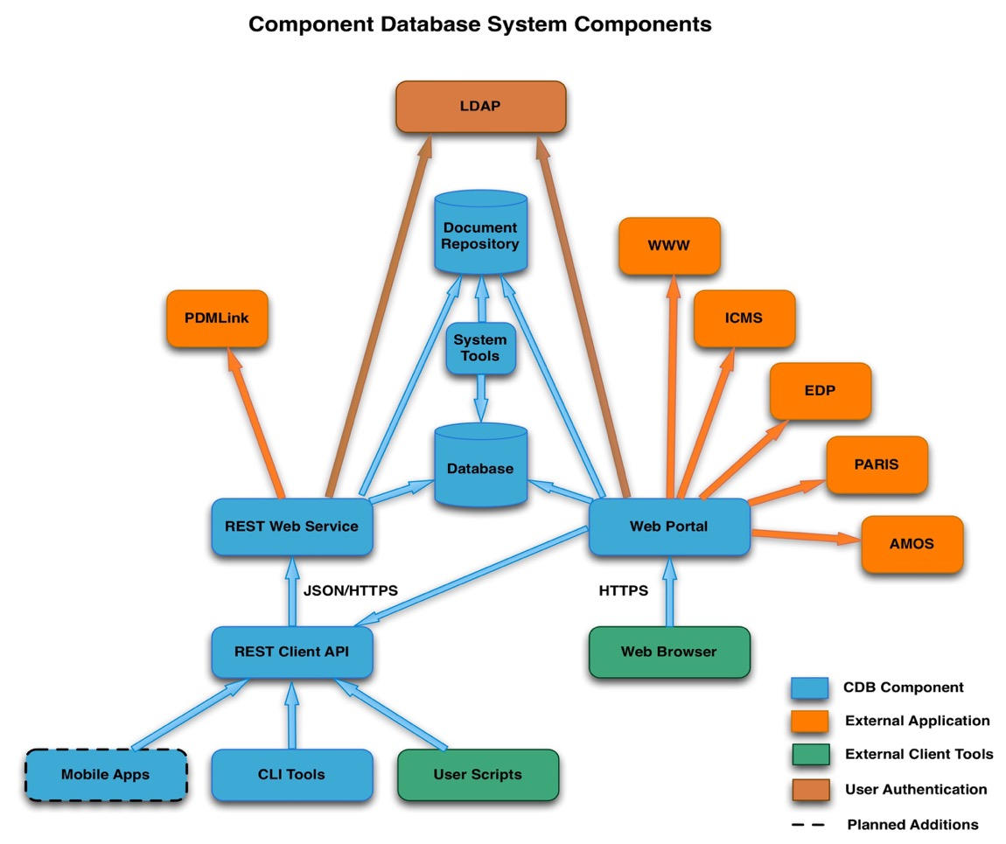
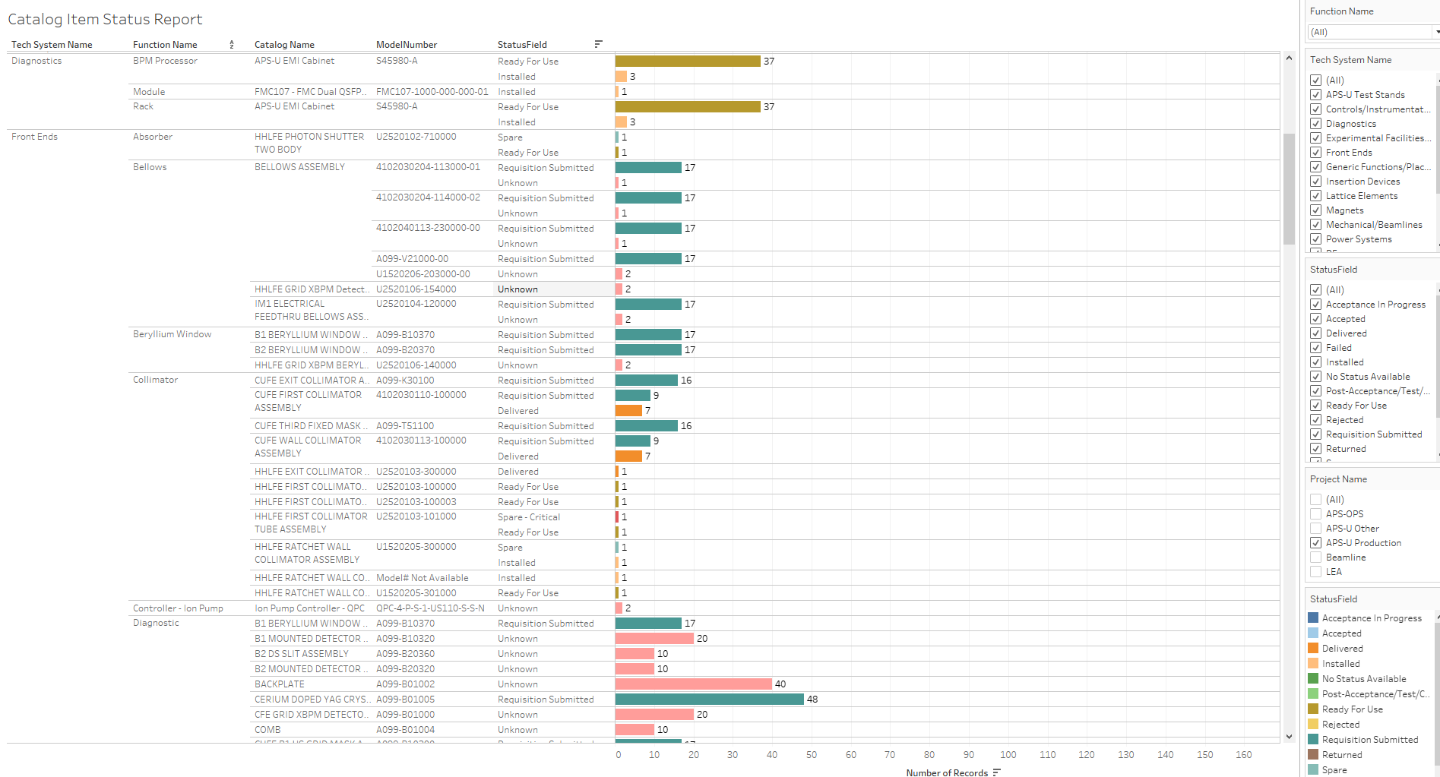
CDB Components/Interfaces
lists.anl.gov
Tableau
Process Sheets
Document Management System
FRIB eTraveler

Slide 19
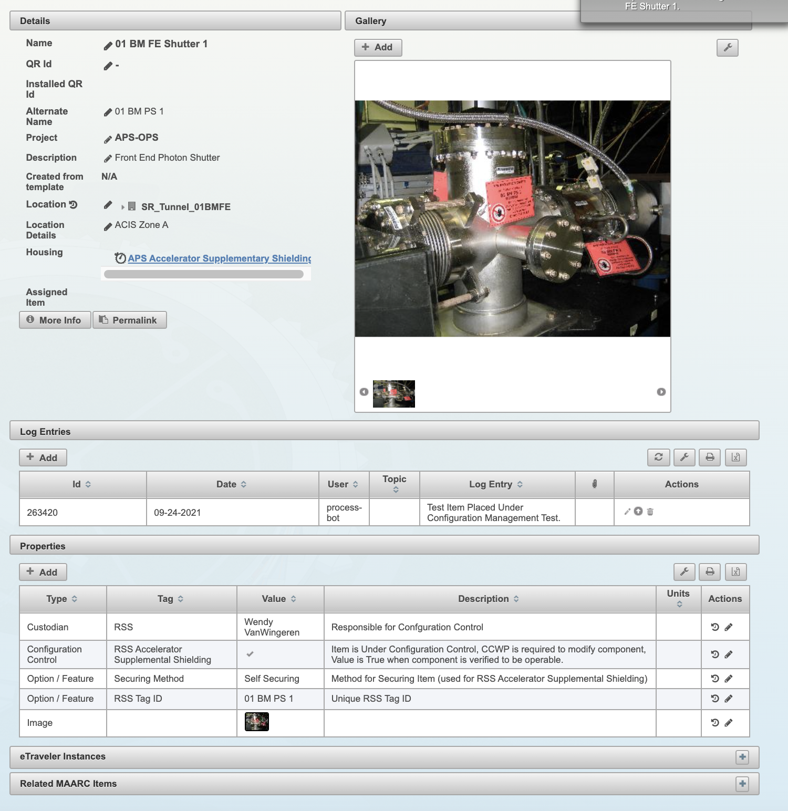
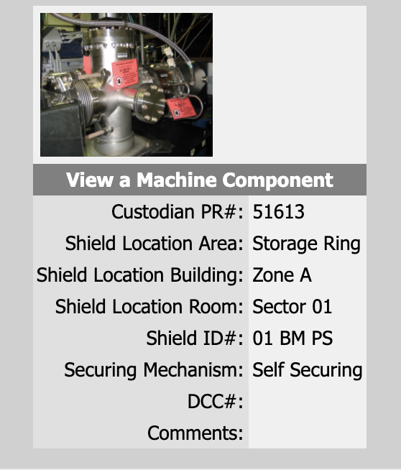
Improving Operational Processes
A successful ARR will require close integration between APS-U and Operations.
APS (OPS+U) is beginning to develop requirements for migrating legacy Configuration Management Databases for management consideration.
Designed Circa 2002
Designed Circa “2022”

Slide 20

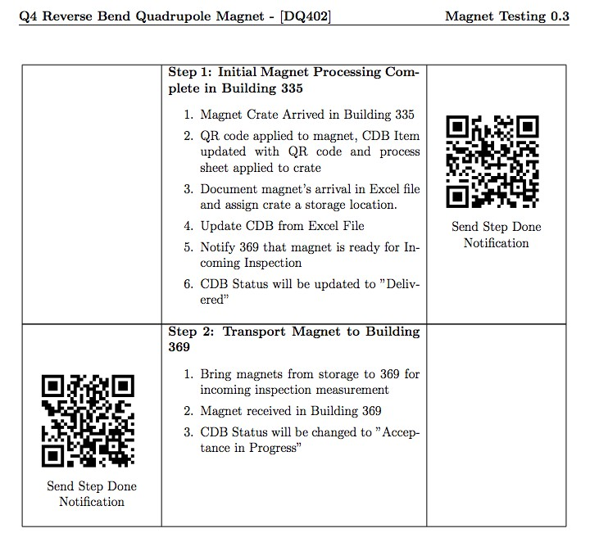

Use of Cue Sheets to Manage Process Flow – Work Control
When needed, Cue Sheets guide the workflow
Sheets contain ‘clickable’ QR Codes
Groups define and own their process and Done Rules – some tied to completions of eTravelers; e.g., component may require several eTravelers by different work groups before it is “Accepted”
Provide consistent communications between people with predefined roles through email, including notification to QA when when a discrepancy is noted
Simple “bots” read the listserv messages update the “status” fields in CDB to help maintain data
All actions are logged in the CDB

Slide 21
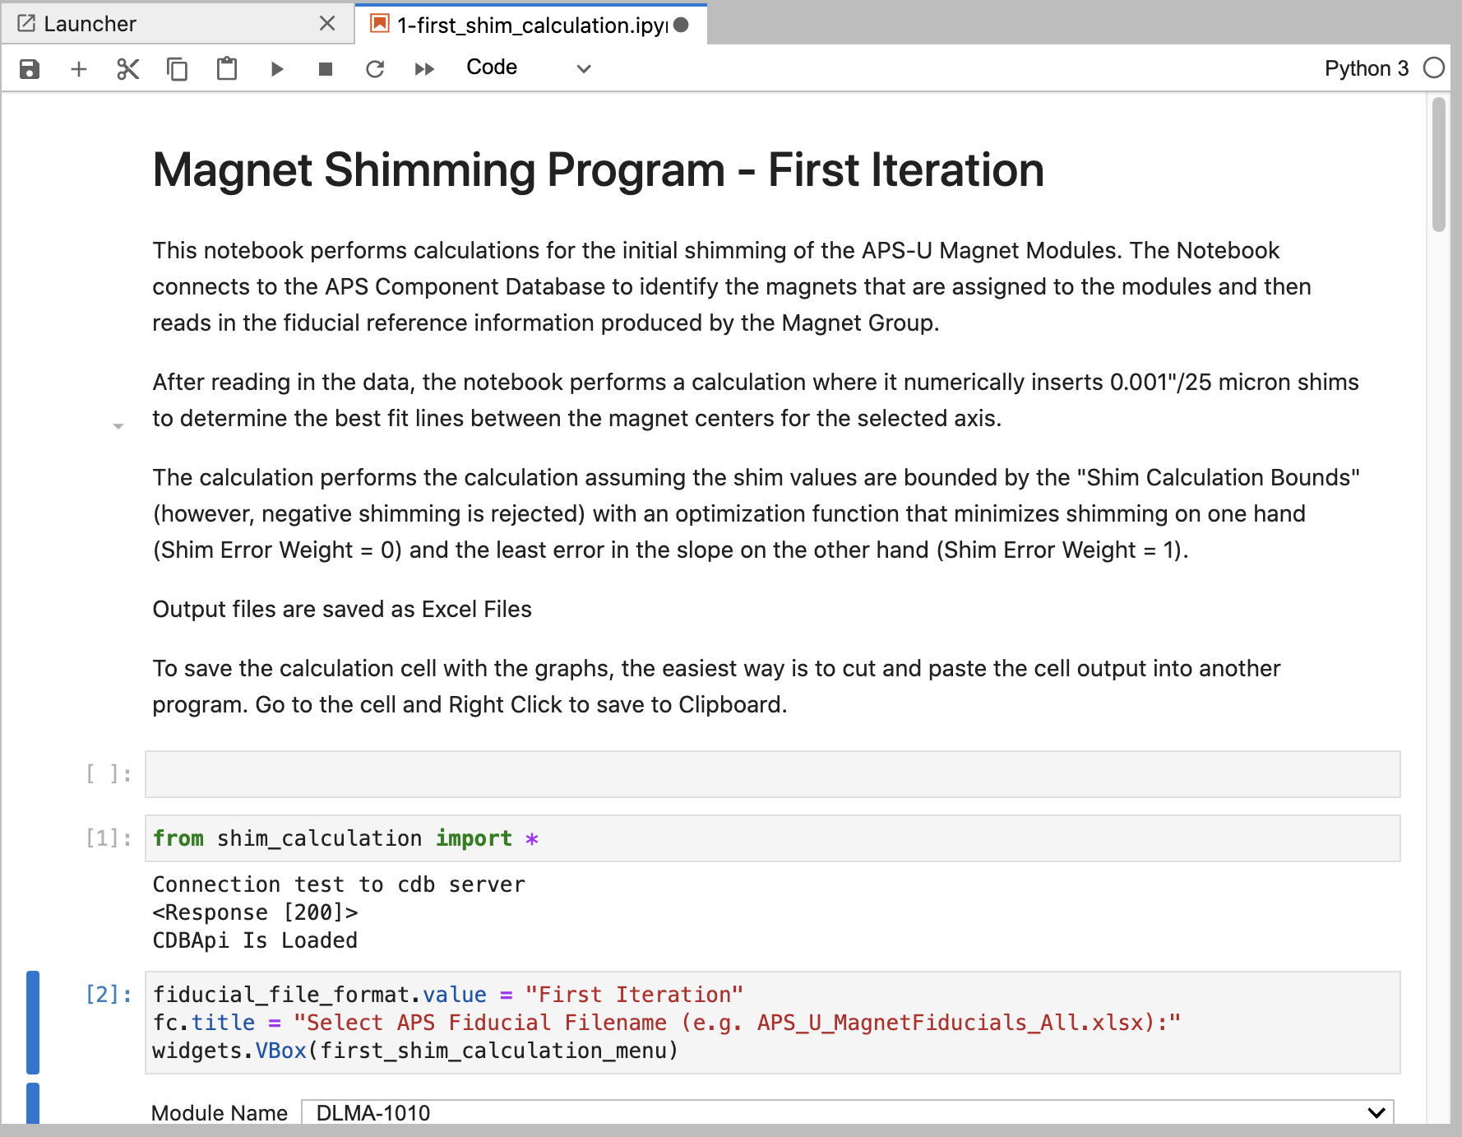
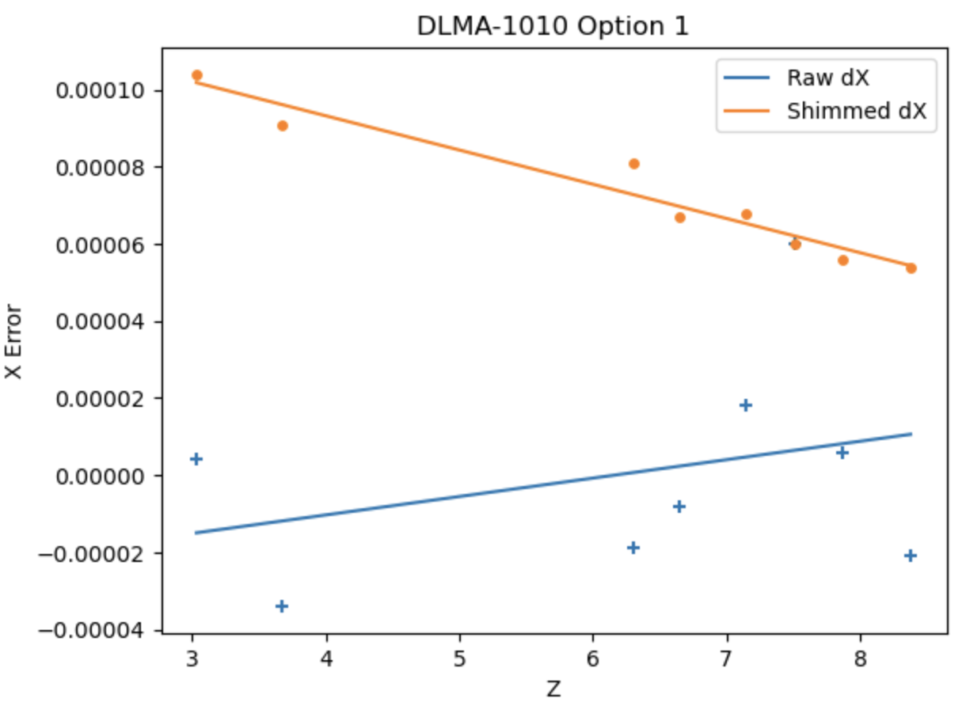
Magnet Center Shimming Calculations
Magnets are shimmed on their mounts to form the best fit line through magnetic centers.
CDB interfaces allow for high end optimization tools to be developed for field staff that retrieve configuration data from the database.

Slide 22
Summary
The combination of a flexible database to store unique parameters and an API which allows diverse tools & views of the data provides a rich framework for Configuration Management for APS

Slide 23
More Info
Acknowledgements
  Bob Hettel
  Diane Wilkinson
  Ned Arnold
  Darius Jarosz
Much like the EPICS collaboration, the CDB effort is open to collaborations
https://github.com/AdvancedPhotonSource/ComponentDB
This work used resources of the Advanced Photon Source, a U.S. Department of Energy (DOE) Office of Science User Facility at Argonne National Laboratory and the APS Upgrade project and and is supported by the U.S. DOE Office of Science-Basic Energy Sciences, under Contract No. DE-AC02-06CH11357.

