Slide 1
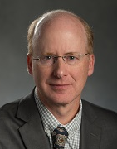
US Particle Accelerator School
(USPAS)
Overview
USPAS Web Site
http://uspas.fnal.gov/
Prof. Steven M. Lund
Director, US Particle Accelerator School / Fermilab
Michigan State University / Physics & Astronomy / Facility for Rare Isotope Beams
2021 DOE Accelerator Safety Workshop
Wednesday, October 6, 2021

Slide 2
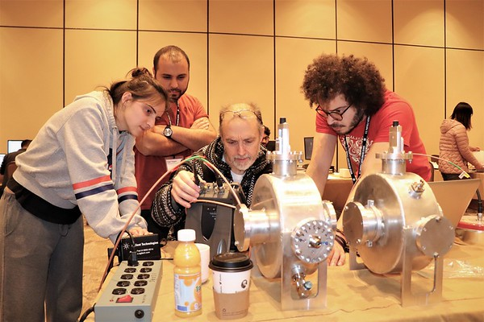
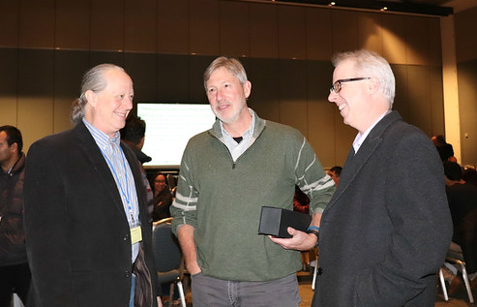
Outline
USPAS Overview
Sessions in 2022
Conclusions
USPAS Web Site
http://uspas.fnal.gov/

Slide 3
Background
Particle Accelerators are tools of discovery science and industry with wide ranging and profound impact
High Energy Physics Materials Science Medical
Nuclear Physics Industrial Military ….
Accelerator Science & Technology is very broad
Physics Engineering Technology Materials Science
Physics to Design Engineering, Conceptual to Precise, Experiment to Modeling to Theory
and many recognized career opportunities exist
Government Labs Universities Medical Industry ….
that are central to our modern technological society
  ~15 k/year Researchers use accelerator facilities
  > 40 of 150 Nobel Prizes in Physics since 1939 linked
  Health: 10s Million Cancer Treatments /year Medical Isotopes
  Protein Crystallography / Drug Discoveries
  Industrial: ~$500 B/year value products of accelerator technology

Slide 4
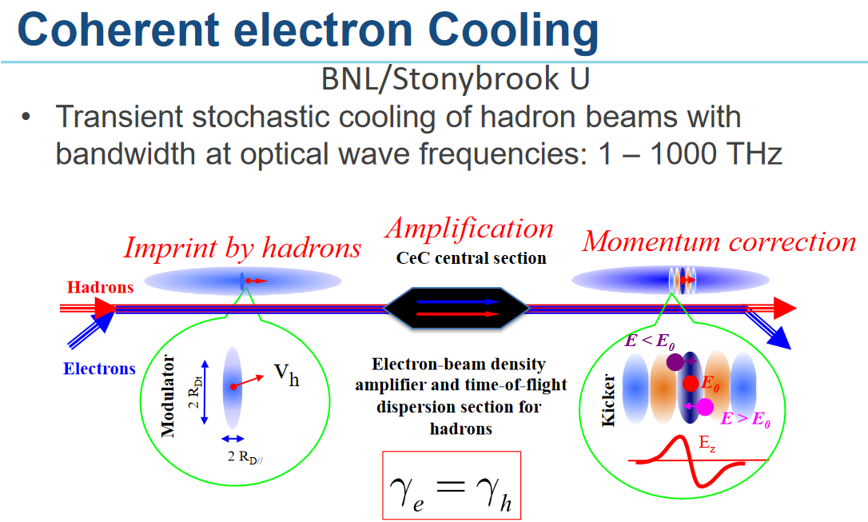
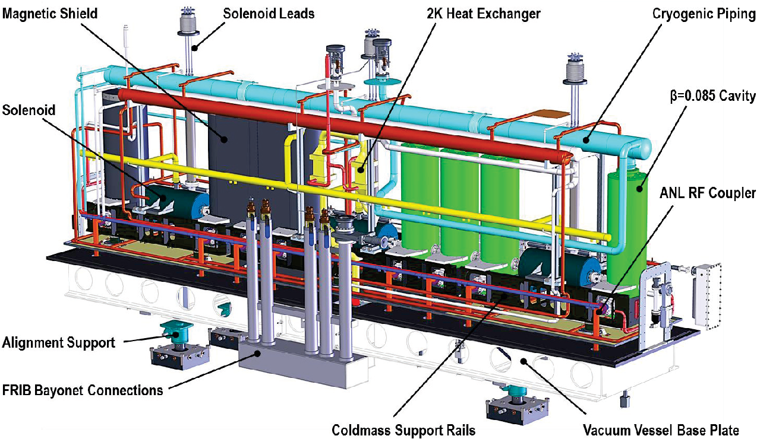
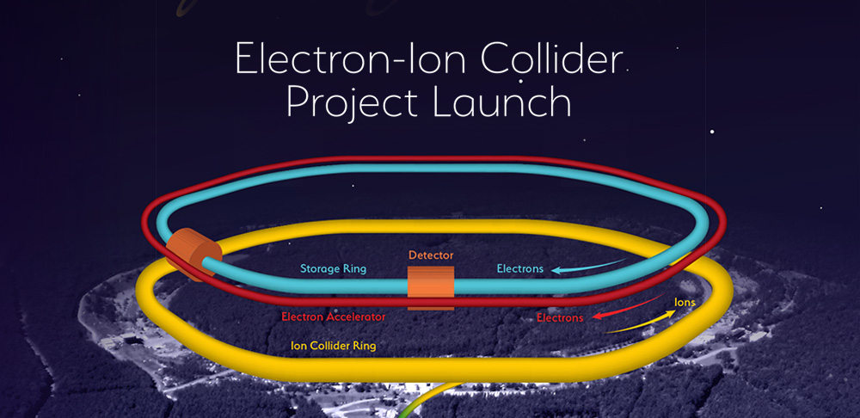
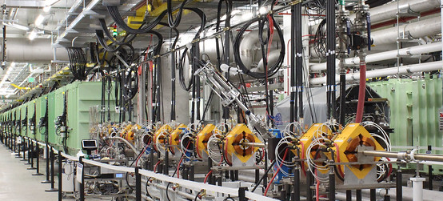
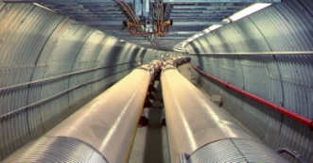
Training the accelerator workforce is critical to USA technical leadership
Accelerator Workforce ~ 2,500 +
  DOE Labs have older workforce demographics
  Train ~ 5-10% workforce/year just to maintain level
FRIB @ MSU
EIC @ BNL
Accelerators challenging to Design, Build & Operate
  Efficient, and cost-effective operation and extension key
  Need workforce of world leading scientists & engineers with specialized training
The USA must have an outstanding
accelerator workforce development program

Slide 5
Workforce Data, 2019 Cal Year shows strong hiring desire in USPAS collaboration labs
DOE Need Area Topic | ANL | BNL | Cornell/ CBB | Fermi | FRIB/ NSCL | JLAB | LANL | LBNL | ORNL | SLAC
Accel Phys 1 | 0 | 10 | 2 | 4 | 5 | 6 | 6 | 15 | 1 | 8 | 57
Operations 1 | 2 | 5 | 0 | 7 | 1 | 2 | 5 | 12 | 1 | 12 | 47
Diagnostics 1 | 1 | 2 | 0 | 1 | 0 | 0 | 2 | 2 | 1 | 2 | 11
Software 1 Controls | 1 | 1 | 0 | 2 | 2 | 1 | 9 | 4 | 2 | 2 | 24
RF 3 Eng/Phys | 0 | 1 | 0 | 3 | 1 | 1 | 4 | 4 | 4 | 1 | 19
SRF 2 Eng/Phys | 0 | 1 | 1 | 7 | 0 | 2 | 0 | 0 | 0 | 5 | 16
Cryo Eng 4 | 2 | 1 | 0 | 1 | 1 | 2 | 1 | 1 | 0 | 0 | 9
Manage 1 | 0 | 0 | 1 | 0 | 0 | 1 | 2 | 0 | 1 | 5 | 10
Other Part 1 | 2 | 10 | 1 | 3 | 2 | 0 | 0 | 0 | 6 | 7 | 31
 | 8 | 31 | 5 | 28 | 12 | 15 | 29 | 38 | 16 | 42 | 224

Slide 6
Core skills for the Accelerator Workforce
Physicists
  Electromagnetism, Relativity, Hamiltonian Mechanics, Applied Math, Numerical Methods
Electrical Engineers
  Waveguides, Transmission Lines & Antennas, Electronics, Signal Processing, Power Electrons, Pulse Power
Mechanical Engineers
  Structures, Alignment/Tolerances, Heat & Mass Transfer Thermodynamics, Fluids, Vacuum Technology
Safety & Management
  Radiation, Personnel & Machine Protection, Regulations, Project Management
Operators
  Undergrad & grad-level Intro to Physics, Technology, Design, Accelerator Operations
Technicians
  Basic Engineering & Physics Concepts, Hands-on Training
  + All need specialized courses for effective training

Slide 7
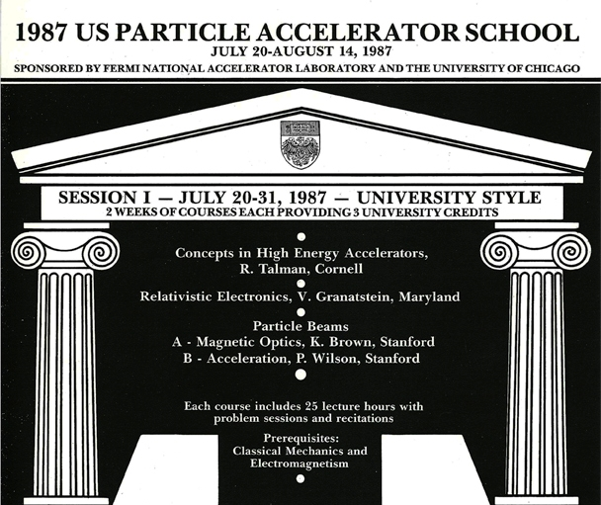
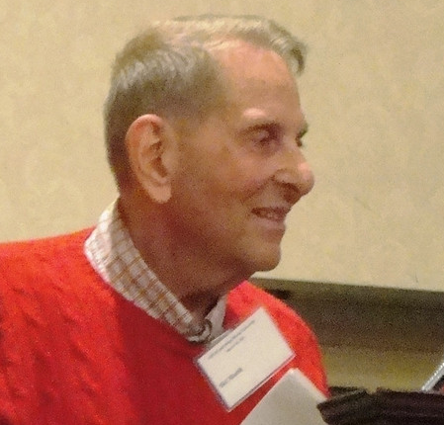
University programs are insufficient to train accelerator workforce in specialized needs
Only small number of university basic accelerator courses
  Typically only limited students every few years even in larger centers and core topics like Accelerator Physics etc.
  Situation worse for key specialty classes:
  Examples: Photocathode Physics, Space-Charge Effects,
  RF Power Engineering, Cryogenic Engineering, …
Training in field can be provided by:
Self-Study Apprenticeship/On-Job
Regional / International Accelerator Schools
Mel Month,
Founding Director
The USPAS was developed to provide
high-quality training for the community

Slide 8
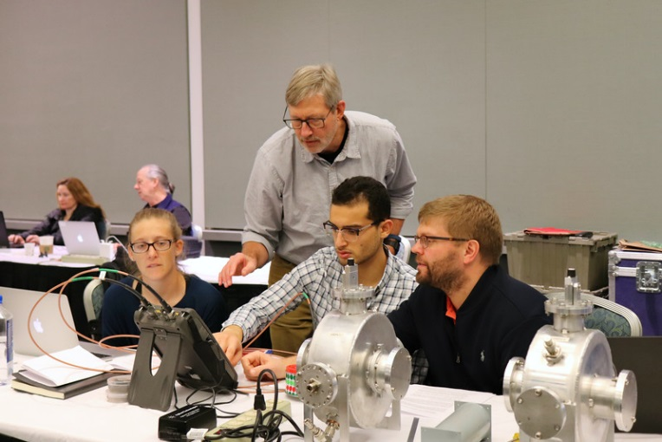
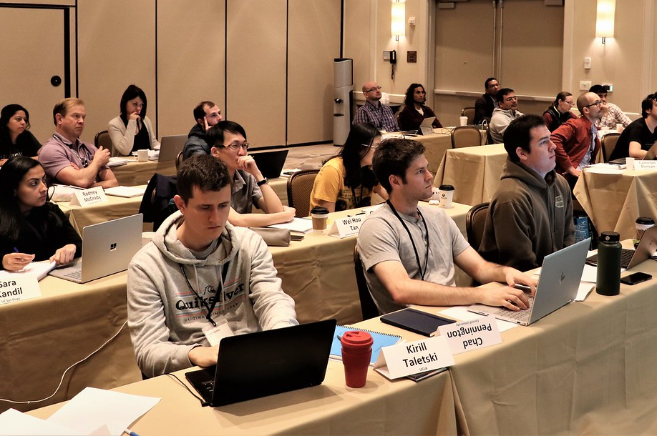
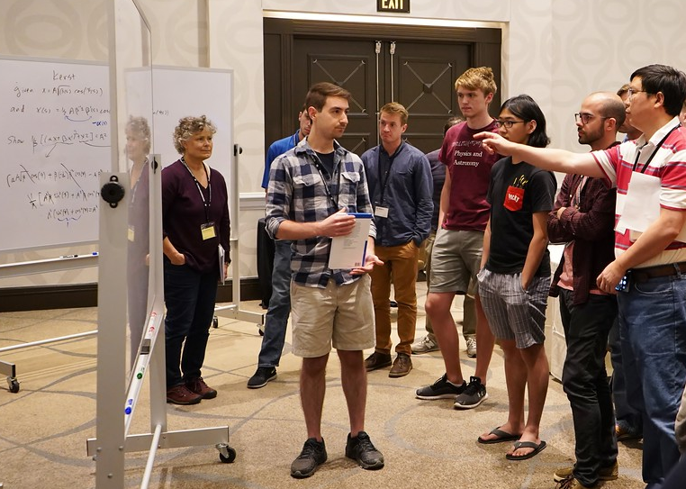
The US Particle Accelerator School (USPAS) trains specialists in Accelerator Science & Technology
USPAS is recognized as world leading
Formed out of necessity
Present format since 1987 (63 Sessions, 642 Courses)
Holds two, two-week intensive sessions per year: Winter (January) Summer (June)
Sessions move around country near Accel facilities
Linked to host universities providing graduate credit

Slide 9
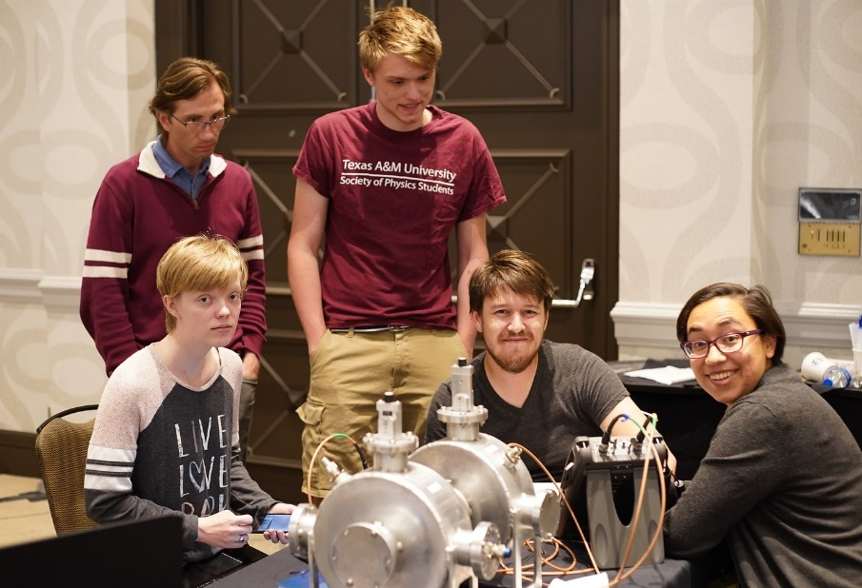
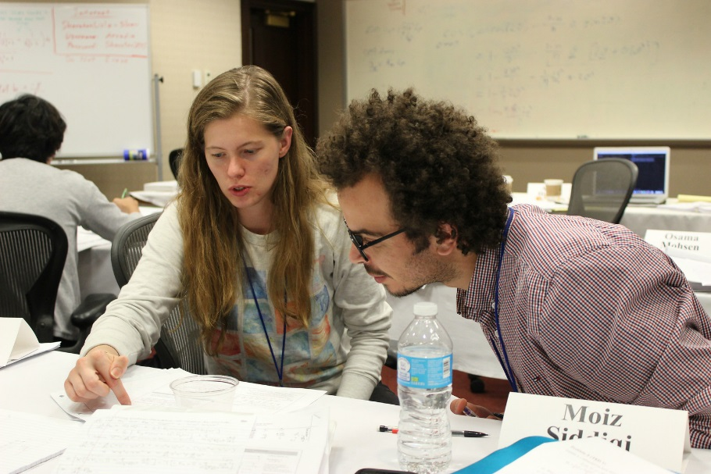
Most USA specialists in Accelerator Science and Engineering pass through USPAS several times
Topics covered from basic to advanced specialized courses that cannot be regularly taught at Universities
Microwave Measurements Wakefield & Plasma Acceleration
RF Cavities and Components High Brightness e- Injectors
Photocathode Physics Engineering for SRF Linacs
Space-Charge Physics Magnetic Systems
A “critical mass” of highly motivated students from all over gather to learn in academically rigorous classes

Slide 10
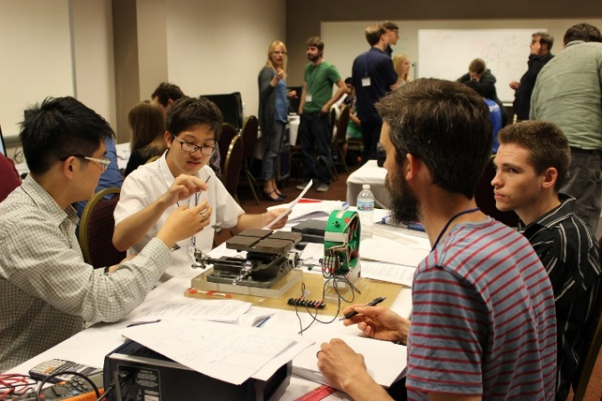
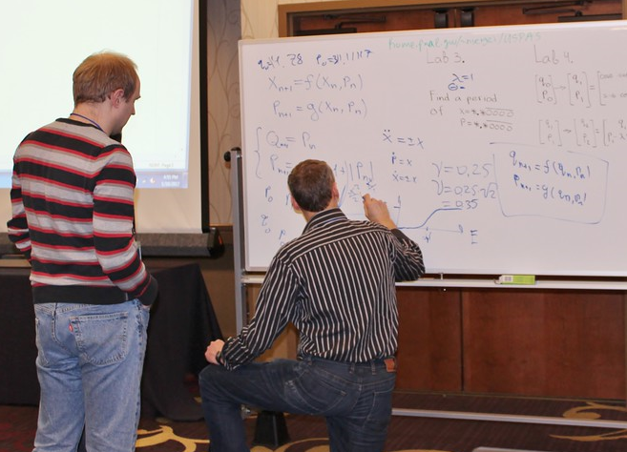
USPAS students study long hours in our 2-week intensive sessions – typically beyond hours in Universities
~45 hours instruction for 3 semester hours in Universities
  USPAS often ~ 65+ engagement hours
Intensive format does have issues:
  Rapid pace (2 weeks) relative to semester (~15 weeks) leaves little time for concepts to “sink in”
  But abbreviated period enables Lab instructors to participate

Slide 11
USPAS distinguished from a plethora of international AS&E schools by academic rigor
Many international accelerator schools (primarily Europe)
  CERN Accelerator School (CAS)
  Joint Universities Accelerator School (JUAS)
  International Accelerator School (IAS) … USPAS linked
  Nordic Particle Accelerator Project (NPAP)
  + Massively Open Online Course (MOOC)
  Korea Particle Accelerator School (KoPAC)
  Accel Innovation and Research for European Society (AIRES)
  … + More and Growing …
  Most closer to seminar series (JUAS exception)
  Contrast: USPAS hours, homework & exams ~ University Format
USPAS is a rigorous academic school
  Grades motivate students for max effort compressed into 2-week session with minimal time away from institute / university activities
  Major research universities “host” session to convey credit
    3 semester hour credit for full session is transferrable

Slide 12
Percentage of students taking for grade
(last 10 years of pre-pandemic sessions)
Average = 59%
2010
2020
Students generally learn more when enrolled for credit

Slide 13
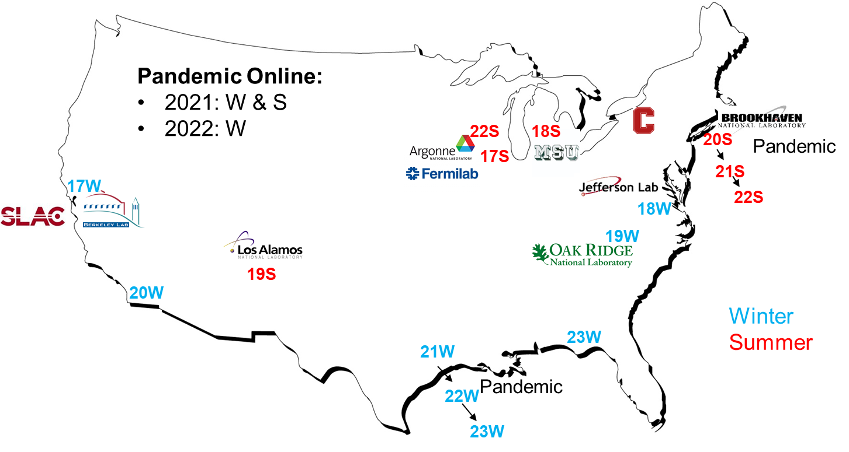
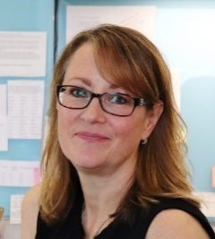
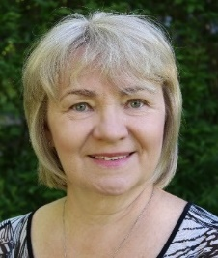
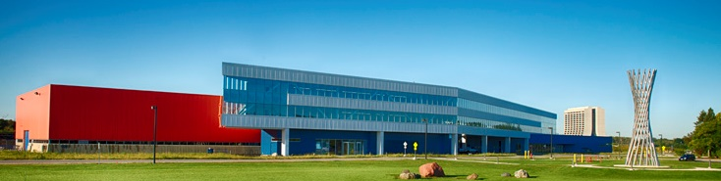
The USPAS is funded by the DOE Office of High Energy Physics and administered by Fermilab
DOE High Energy Physics is steward of accelerator R&D
  USPAS funded to support Accelerator Science & Engineering
USPAS office at Fermilab, sessions near accelerator labs
  Typically at Hotel/Conf Centers
  Director (3/4-time) Steve Lund
  & Two (full time) Office Staff
Susan Winchester
Irina Novitski
USPAS Office in IARC Facility
DOE lab instructors benefit from teaching experience
High fraction DOE workforce passes through our sessions

Slide 14
The USPAS is governed by a collaboration of labs/Universities via a signed MOA
Collaboration members (10):
Governing bodies ensure broad AS&T representation
  Advisory Council (10): Advise director + collaboration interface
  Curriculum Committee (11): Input on school curriculum
  Institutional Board (5): Grade school performance
Free to join collaboration (post FY16 DOE reorganization), BUT:
  Expected to support staff (time + travel) who teach / study
    USPAS budget insufficient to pay for teaching
    Augments USPAS student support
  Take part in school governing bodies
    Helps ensure representation of collaboration member needs
ANL
BNL
Cornell
Fermilab
LBNL
LANL
MSU
ORNL
SLAC
JLab
DOE Lab
University
(NSF / DOE fund)
NNSA Lab
0

Slide 15
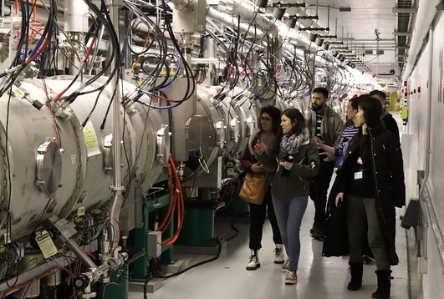
Example: Winter 2019 Session: Knoxville, TN
NIU+UT-Battelle Sponsor, Jan 21-Feb 1, 2019
Link to Session Page (USPAS Website)
Link to Opening Session Talk (Lund Dropbox pdf)
  13 Courses:
      Two-week: 3
      One-week: 10
  45 instructors, TA’s, Graders
      Web site credit (mostly Instructors): 36
      Non-credited (mostly Graders, some TA’s): 9
  161 students: 6th Largest Session Ever:
      78 (48%) Universities
      62 (39%) National Labs
      21 (13%) Industry (13), Foreign Labs (5), Military (2), Gov (1)
      21 (13%) International [Europe (10), Americas (8), Asia (1), Aus. (1), Middle East (1)]
      38 (24%) Women
SNS Tour
Typical larger pre-pandemic
size

Slide 16
Winter 2019, Knoxville
Typical recent larger session
Two-Week Courses
Expanded Team: Fundamentals (undergraduate level) [Students = 19]
  Cousineau ^{W}, Holmes, Evans, Ruisard ^{W} (ORNL)
Accelerator Physics [23]
  Peggs (BNL); Satogata (Jlab)
Expanded Team: Magnet & RF Cavity Design [27]
  Holzbauer, Badgley ^{W}, Berrutti (Fermilab)
One-Week Half-Courses
NEW: High-Power Targets [19]
  Riemer; Winder; Iverson; Gallmeier (ORNL); Hurh, Ammigan (Fermilab)
NEW: Precision Storage Rings -- Muon g-2 [8]
  Syphers (NIU/Fermilab); Stratakis (Fermilab); Rubin (Cornell)
NEW: Undulators for Storage Ring & FEL Light Sources
  Gluskin, Sajaev (ANL)
Beam-Based Diagnostics [20]
  Steier (LBNL); Safranek, Huang (SLAC)
NEW: Wakefields & Collective Beam Instabilities [13]
  Stupakov, Baxevanis (SLAC)
NEW: Neutrino Beams [13]
  Zwaska, Fields ^{W} (Fermilab)
Integrable Particle Dynamics [11]
  Nagaitsev, Zolkin (Fermilab)
Principles of Superconducting Linear Accelerators [11]
  Kim, Doleans (ORNL)
NEW: Engineering of Beam Diagnostics [14]
  Wendt (CERN); Zorzetti ^{W}, Thurman-Keup (Fermilab)
Expanded Team: EPICS Control Systems [20]
  Kasemir, Sinclair, Vodopivec (ORNL)
6 NEW Classes
3 Expanded Team
4 Red: ORNL led classes
13 Red: ORNL Instructors
13 ORNL-linked students
2 Industry Student Scholarships
RadiaBeam Technologies
Radiasoft
5 woman Instructors
(^{W} superscripts)
Tour to SNS
80+ Students
[11]

Slide 17
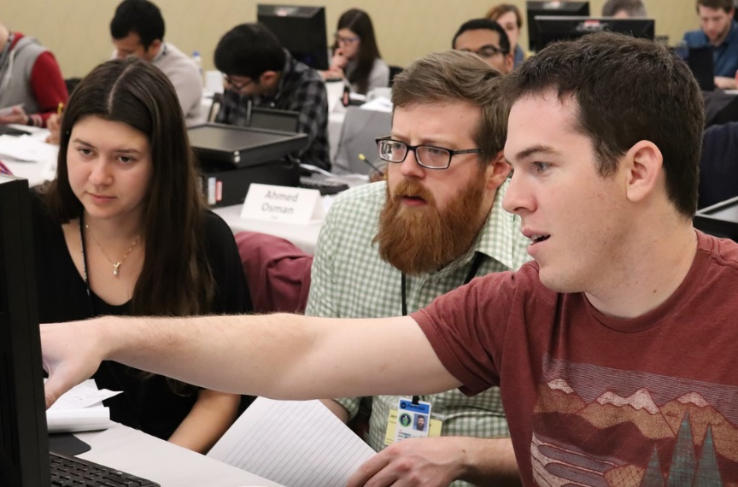
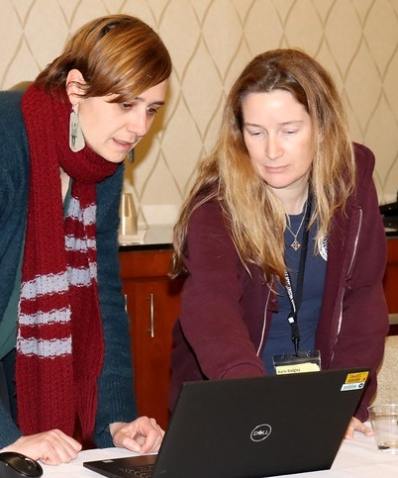
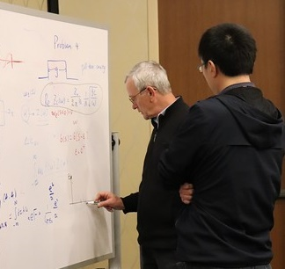
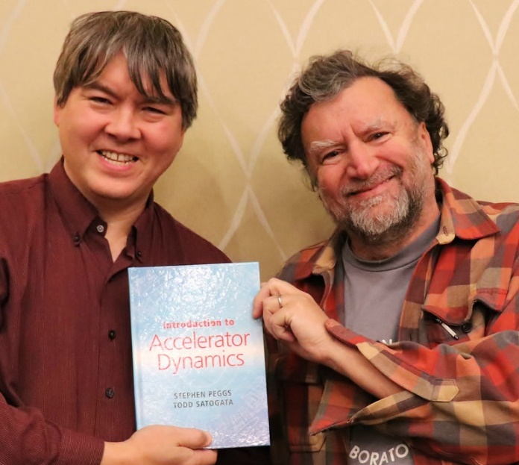
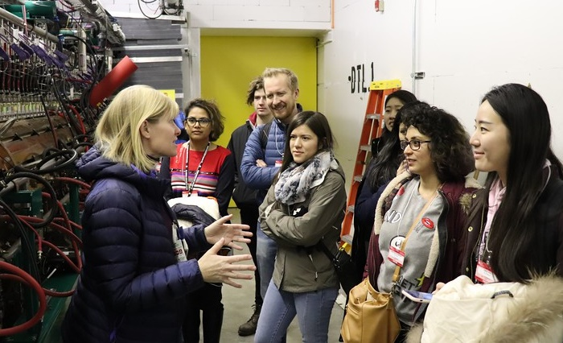
Highlights of 2019W Knoxville Session
Stupakov in Wakefields:
Domestic team in need area
Cavity & Electromagnet Design:
large (25) engaged class
Peggs & Satogata, Accel Physics
use new book: ultra-high rated class
ORNL SNS Tour well attended & Cousineau
Later announces APS DPB Scholarships

Slide 18
Number of USPAS students per year over duration of University style format (from 1987)
USPAS Enrolled Students by Year
Average = 281
1987
2020

Slide 19
Pre-Pandemic USPAS Sessions Large which serves DOE workforce training needs
New Record
New
Director
184
2015
USPAS Review
USPAS Reorg
Cannot usually go over ~175 students with our usual low-cost location hotel/conf center venues
2010
2020
High demand for AS&E training + USPAS driven by
  Lab Accel Projects + Lab Workforce Demographics
  4 DOE Traineeships (MSU / NIU-IIT / SBU-Cornell, ODU)
  IU-USPAS MS program + Center Bright Beams

Slide 20
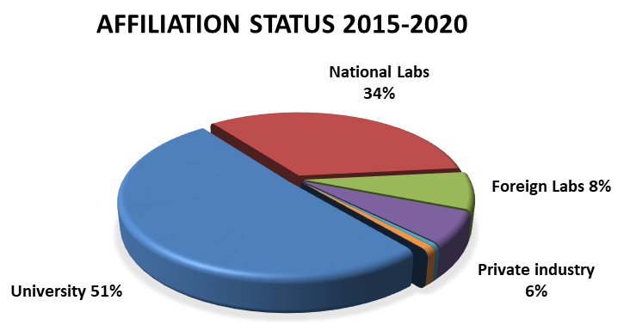
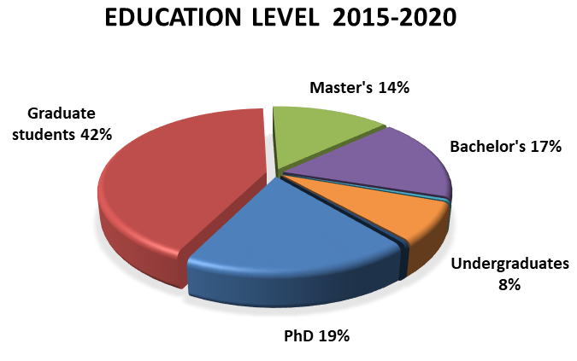
Students are primarily drawn from universities and national labs with a range of preparation
2010
2020
2015
2020
High School < 1%
Associates < 1%

Slide 21
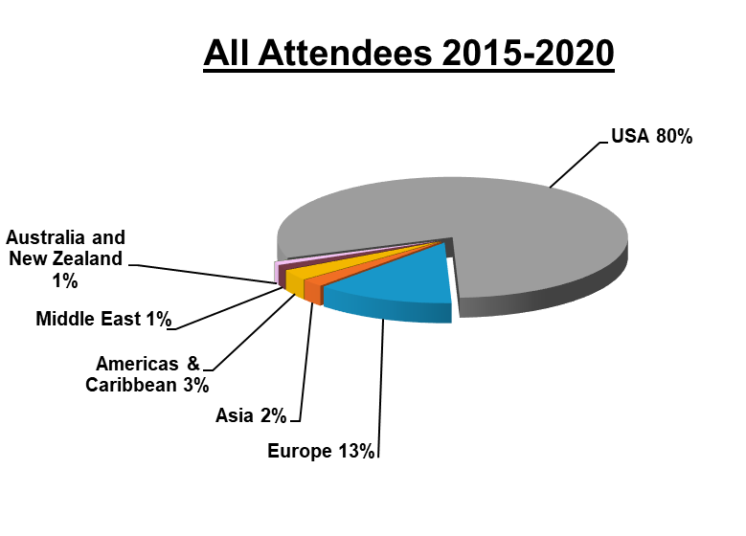
USPAS students are primarily domestic or domestic-University enrolled
Average = 63%
USA 80% includes international students enrolled in USA Universities
2007
2020
Most USPAS students are interested in employment in USA National Labs & Universities

Slide 22
Distribution of course topics evolves
Fundamentals (undergrad level)
Distribution of topics slowly evolves as our field changes
Emphasis within courses also evolves

Slide 23
with corresponding attendance …
Fundamentals

Slide 24
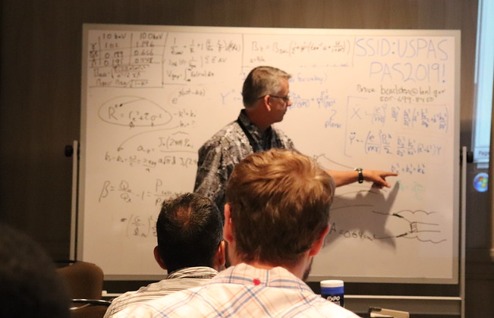
Instructors are primarily drawn from the USPAS collaboration institutes
DOE
University
NNSA
Non-Collab =
Univ, Industry,
Gov, etc.
USPAS Collaboration Labs
2010
2020
Bruce Carlsten, Summer 2019
Lab employees benefit from teaching
  Enhances understanding
  Makes valuable contacts
  Recruiting & Prestige
USPAS cannot pay our Lab instructors
  Academic field, instructors still want to teach
  Prestige, community service, etc

Slide 25
The USPAS sessions are economical and students are supported
In-Person session cost ~$2800 economical
$1500 Registration: Course Fee, Food (breakfast & dinner), Credit, Book
$ 700 Hotel (shared room)
$ 600 Travel + Per-diem (lunch)
  Universities 40-60% higher without hotel, food, book
  Professional training in Tech, Medicine Business typically much more costly
The USPAS is economical while setting the standard for quality
Financial aid available for students enrolled for credit
  USPAS Scholarships covering Registration Fee + Hotel + Food
    Travel NOT included
    High rate of award for qualified students with proper status
  APS Division of Physics of Beams Travel Awards
    Cover travel to and from session
    ~12 expected per session post pandemic
  New Sekazi Mtingwa Underrepresented Minority Scholarships
    USPAS Scholarship + Travel for full coverage to attend
    Low cost covered for most students

Slide 26
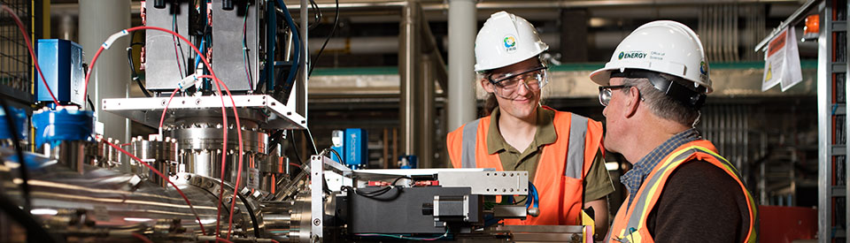
Four DOE Funded Traineeships are now bringing in new talent to field
Format: DOE pays up to 2 years @ university then students placed in National Labs to complete training/thesis research
  1st year typically TA-centered + University core courses
  3 of 4 programs focus on MS with select students progressing to PhD
  Programs rely on USPAS for specialized training
Programs
MSU ASET (2017 start)
  PhD centered, any DOE lab,
  21 students (~ steady limit)
IIT/NIU CAST (2020)
  MS centered, Fermilab and ANL linked
SBU/Cornell Courant (2020)
  MS centered, BNL linked
ODU (2021)
  MS centered, Underrep Minority recruitment emphasis

Slide 27

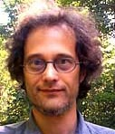
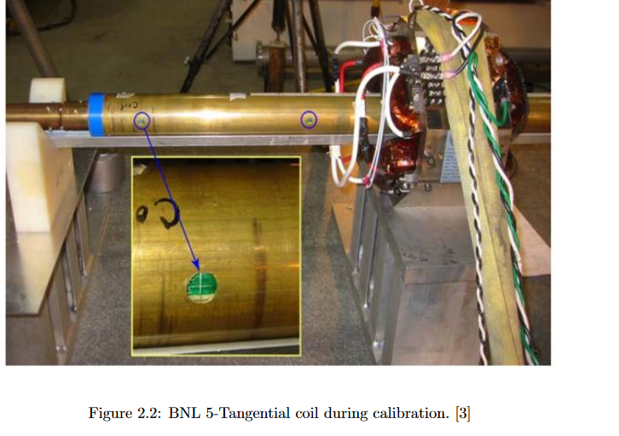
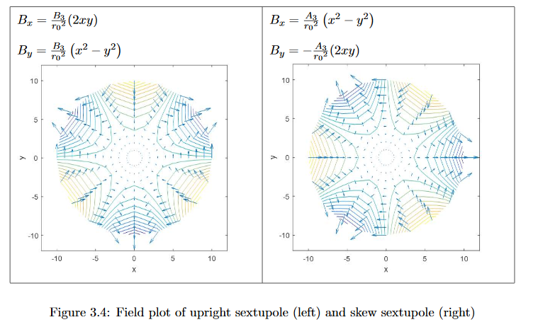
Indiana Univ / USPAS MS Program growing and improves DOE operator training
Program healthy: Prof. Mike Snow took over from SY Lee
  11 students at present: 2-3 historic average
Program based on USPAS courses + Thesis
  Unique & low-cost (~$150/credit-hr + USPAS fees; most theses at work)
  Improved descriptions on USPAS web site
IU wants more students & USPAS recruiting
  Handouts at: Sessions & Accel Conferences Overviews at Sessions
Mike Snow
Graduates of Program
2021 | 2021 | 2019 | 2018 | 2017 | 2016 | 2015 | 2014 | 2013 | 2012 | 2011 | 2010
1 | 0 | 1 | 2 | 1 | 0 | 2 | 1 | 1 | 1 | 1 | 0
Expect increase near future
Yung-Chuan Chen, Conceptual Design of Rotating Wire System with Bucking Using Multichannel Lock-In Amplifier, 2018

Slide 28
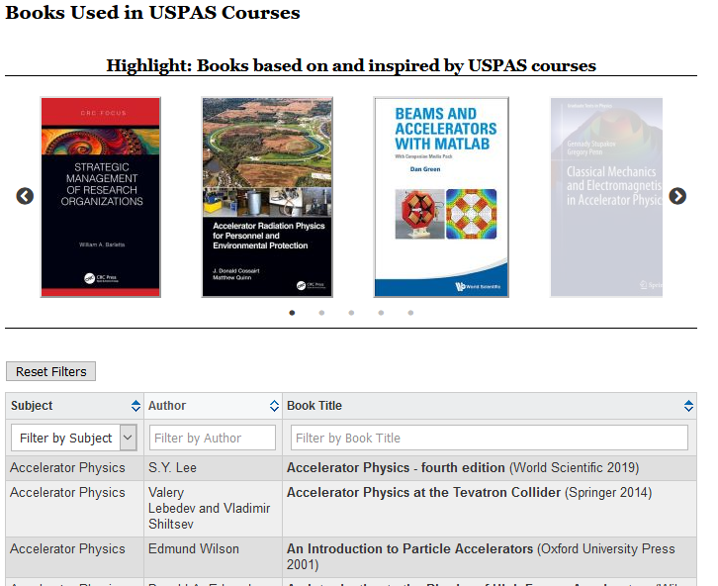
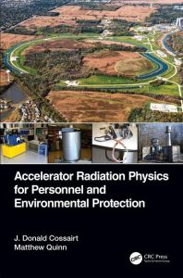
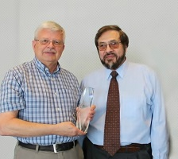
USPAS web site: https://uspas.fnal.gov/ has been refined as a key portal of resources in our field
Integrated & searchable course/session/instructor information
Books (18) linked to USPAS courses Tutorials/Augmentations
Educational and Career Opportunities in process
IU / USPAS MS Program Info
USPAS Committees and Roles
….
USPAS Web Site Link: Books
Don Cossairt: 2016 USPAS
Teaching Award: 14 classes!

Slide 29
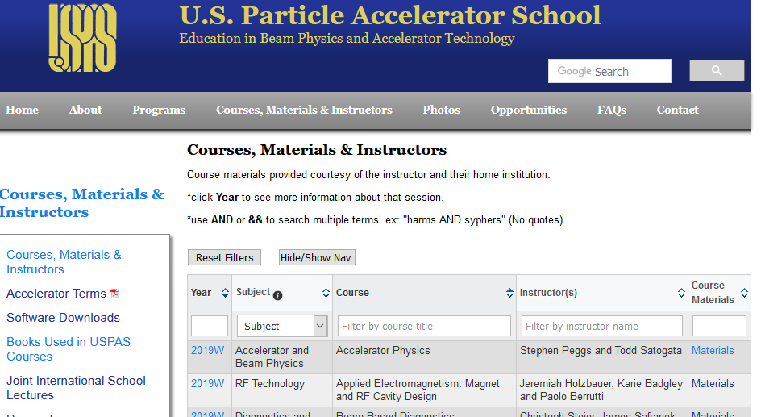
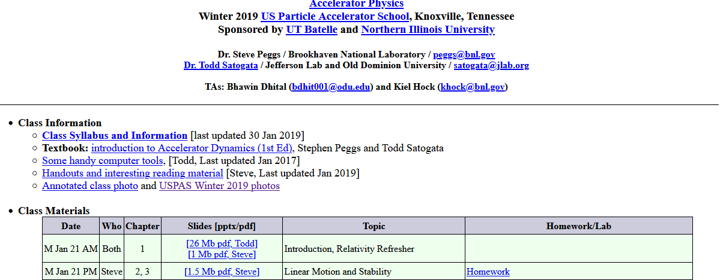
Cloud Storage coming online to enhance course augmentations for community
Fermilab MS SharePoint based cloud storage
  Almost unlimited long-term storage
    Avoids web server limits and allows archiving video records of lecture streams
Tools promise increased efficiency
  Backed up and accessible any time by teaching teams w/o Fermilab accounts
  Well suited to class web-sites under control of instructors
    Updateable even outside of teaching cycles
Avoids valuable course materials disappearing for community
Present Course Materials Postings (USPAS Link)
Links to:
private server (can disappear)
USPAS domain pdf (limited store)
New: large cloud storage archive in teaching team control to update etc.

Slide 30
Pandemic Disrupts USPAS starting Summer 2020: Summer & Winter 2021 Online
Winter 2020 Session in San Diego ended Jan 24
  School Successful: all-time record (184) student enrollment
Pandemic rapidly escalates culminating in the Summer 2020 session (Melville, Long Island) being canceled
  Insufficient time to transition online
  Limited fill in (only no credit Fundamentals without labs)
Online Strategy
  Zoom: double duration (2 weeks -> 4 weeks) & half daily intensity
    Necessary for online tolerance
  Extra teaching team help
    Challenge to reach students with online homework help
  Keep format close to in person as possible
    Retain fostering of professional contacts USPAS is well known for
  Exploit technology
    Cloud computing, Slack channels, Software Tools, …
    Derive long-term benefits when we return to in-person sessions
  Stress: Credit Classes that transition online Domestic Students
    Retain usual community composition and avoid online apathy

Slide 31
Qualified Online Success: Smaller but viable online sessions keep USPAS training going
Online 2021 Sessions
  Winter: 6 classes 81 students
  Summer: 9 classes 109 students
  Both had core Fundamentals and grad Accelerator Physics
  Mix of specialty classes that transition online
    Lab classes outside of Fundamentals deferred
  Student reviews strong: in-line with usual high school performance
    USPAS reputation & identity for academic seriousness maintained
Qualifiers
  Very hard to line up teaching teams for online
    ¾ opt out of teaching online longer duration problematic with lab jobs
    Needed lab classes do not transition well online
  Student hesitancy to enroll
    Pandemic online burn-out inhibits desire for online electives
  Despite Effort: Stress expands Large class performance spread
    Top students do well online, but bottom ~1/3 performance drops strongly
    Hard to juggle longer intense online format with other tasks
  Winter 2022 now online as pandemic persists
    Can pull off Summer 2022 online but likely not sustainable beyond

Slide 32
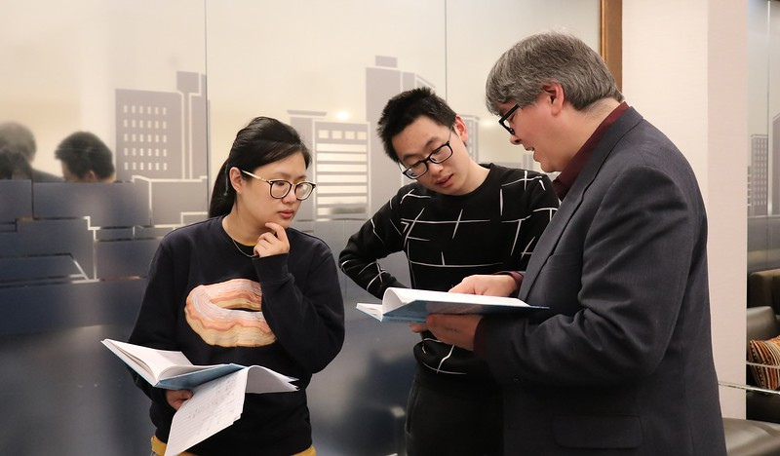
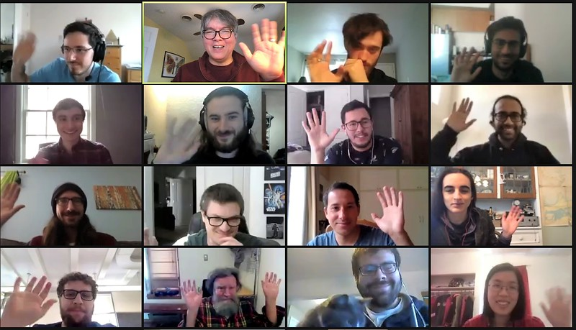
Online opens additional challenges
USPAS well known for fostering technical relationships in in-person sessions: continue online
  Meet online with fellow students, instructors, TAs to discuss lectures, homeworks, etc
  Teaching teams enhanced and adapted for online
  Full-term in 4 weeks is still intensive! Simultaneous involvement in other activities problematic

Slide 33
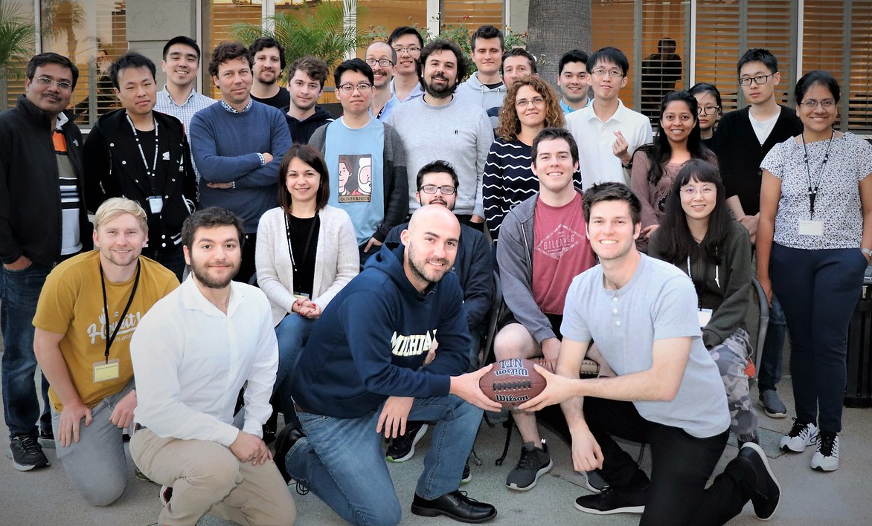
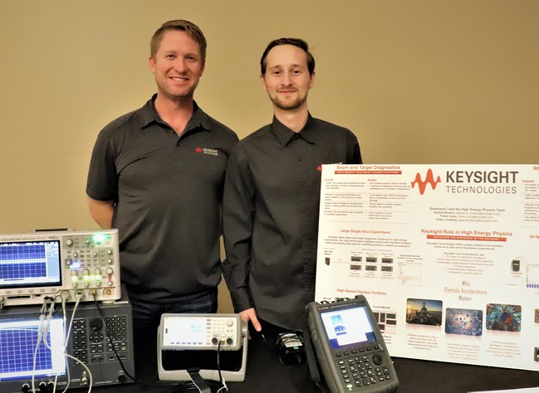
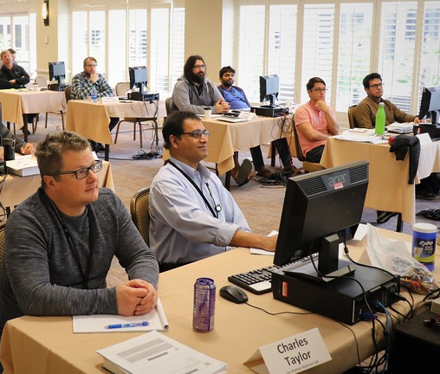
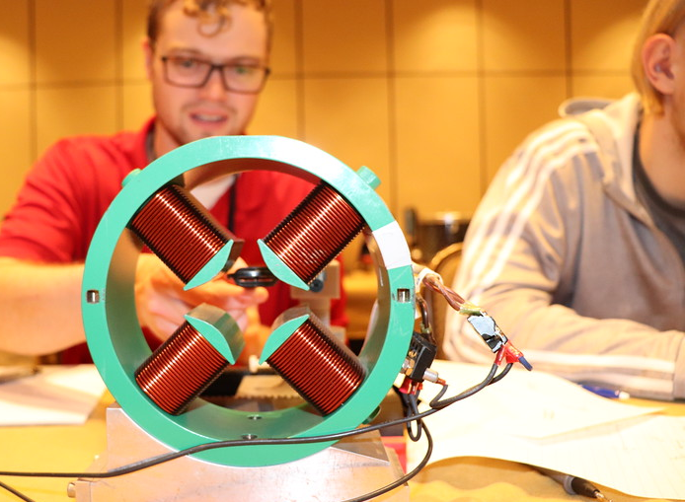
Outline
USPAS Overview
2022 Sessions
Conclusions

Slide 34
Online Winter 2022 Courses
Jan 24 – Feb 18: Reg open till Oct 20, 2021
Full Courses (4-Weeks: Jan 24 – Feb 18)
Fundamentals (undergraduate level)
  Prebys (UC Davis) + Lab Team (ORNL, FNAL, UMD, MSU)
Accelerator Physics
  Bogacz & Krafft (Jlab/ODU)
Half-Courses (1st 2 Weeks: Jan 24 – Feb 4)
EPICS Control Systems
  Kasmir (ORNL) + Team
Colliders for HEP and NP
  Shiltsev, Lebedev, Mokhov (FNAL)
Accel Power Electronics
  Sebek (SLAC), Belomo (Ret. SLAC)
Optimization and Machine Learning for Accel
  Lehe (LBNL) + Team of 5 (SLAC, U Chicago)
Half-Course (2nd 2 Weeks: Feb 7 – Feb 18)
Beam Measurements & Diagnostics
  Wu & Yan (Duke U), Hao (ORNL)
Colliders Interaction Regions for HEP and NP
  Mokhov (FNAL), Sullivan (SLAC), Furletova (JLab)
Pulse Power Engineering
  Burkhardt & Beukers (SLAC), Anderson & Poppas (ORNL), Waldron (LBNL)
Smaller, viable session
  Expect ~110 Enroll
  High Credit Fraction
  Core: Fundamentals & Accelerator Physics
MATLAB & Python for Accel and Beam Physics
  Greene (FNAL Emeritus), Eldred & Watts (Fermilab)

Slide 35
Summer 2022 scheduled in-person Jun 13–24 Near BNL/SBU: pending DOE travel approvals
Full Courses (2-Weeks: June 13 – 24)
Fundamentals (undergraduate level)
  IIT + NIU Team
Accelerator Physics
  MSU + LBNL + BNL Team
RF Superconductivity
  FNAL Team
Microwave Measurements
  LBNL Team Team
Synchrotron Radiation & FELs
  ANL + SLAC Team
Half-Courses (1Week: June 13 – 17)
Laser Physics & Applications for Accel
  JLab + SLAC + BNL Team
Mechanical Alignment
  SLAC Team
TBA Slot
Vaccinations required for for all students & instructors to participate
Lab courses restart
Some format changes for pandemic persist
  Cloud Computing
  Some instructors may record lecture streams by choice and post for online resource
Half-Courses (1Week: June 20 – 24)
Laser-Plasma Accel
  UCLA + U Michigan + SBU Team
Mechanical Vibrations
  FNAL Team
TBA Slot

Slide 36
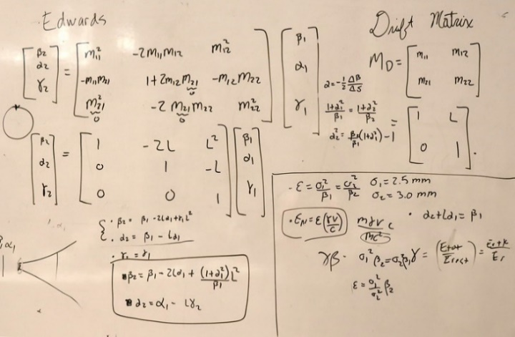
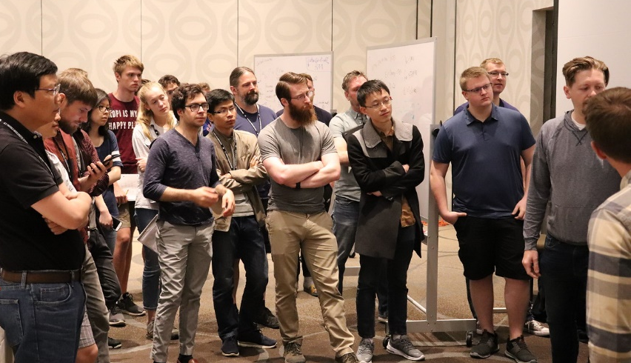
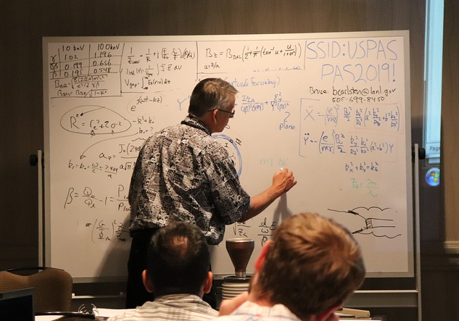
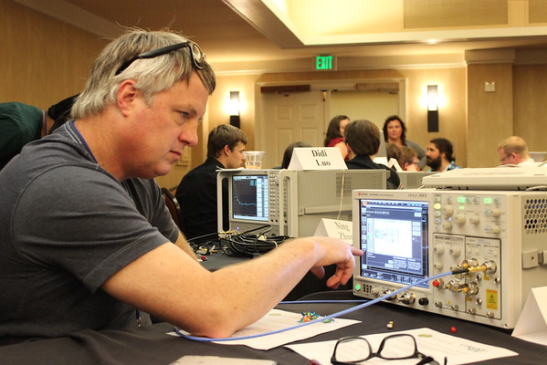
Outline
USPAS Overview
Sessions in 2022
Conclusions

Slide 37
USPAS offerings for the Safety Community must return post pandemic
Active
Fundamentals
    Every session, various teams
Radiation Physics, Regulation, & Management
    Cossairt & Qinn (Fermilab)
    11 times, last 2018S and overdue
Beam Loss and Machine Protection
    Schmidt & Wenninger (CERN), Curry (ORNL) + 3 Team
    2017W, pandemic delayed, likely 2023
Effect of Radiation on Electronics & Materials
    Koeth (UMD) & Qinn (LANL) + Team
    219W last, should resume post-pandemic
Strategic Management & Project Management
    Barletta (MIT) & Robinson (Berkeley) + Team
    2021W during pandemic, roughly 2-3 year cycle continuing
Post pandemic (2023+) Needs: 2019 start discussions delayed due to pandemic
Personnel Safety
    Mahoney & Prior (ORNL) 6x System Safety & Safety Systems, last 2014
    Barat (LBNL) & Bong (ORNL) 1x Controlling Risks, Safety Systems, 2012
    Need community input on directions and teaching talent targeting post-pandemic (2023+) restart to meet community needs

Slide 38



USPAS provides accelerator training relevant to the accelerator community
Expect high demand for USPAS classes post pandemic
Pandemic Adjusts ongoing, but response being managed to bring long-term benefits to school: Online session(s) till summer 2022
Safety Community Relevant: both in core accelerator topics & focus topics
  Community input needed on new courses and teaching talent targeting post pandemic (2023+)

Slide 39

Thank You!
Help us make USPAS better
Students become the future leaders of our field

