Slide 1
Remote Materials Handling: Expanded Use of Robotics To Perform Sample Changes and Detector Positioning
erhtjhtyhy
Mike Fries
ESH Coordinator – X Ray Science Division
Argonne National Laboratory
October 4-7, 2021
DOE Accelerator Safety Workshop

Slide 2
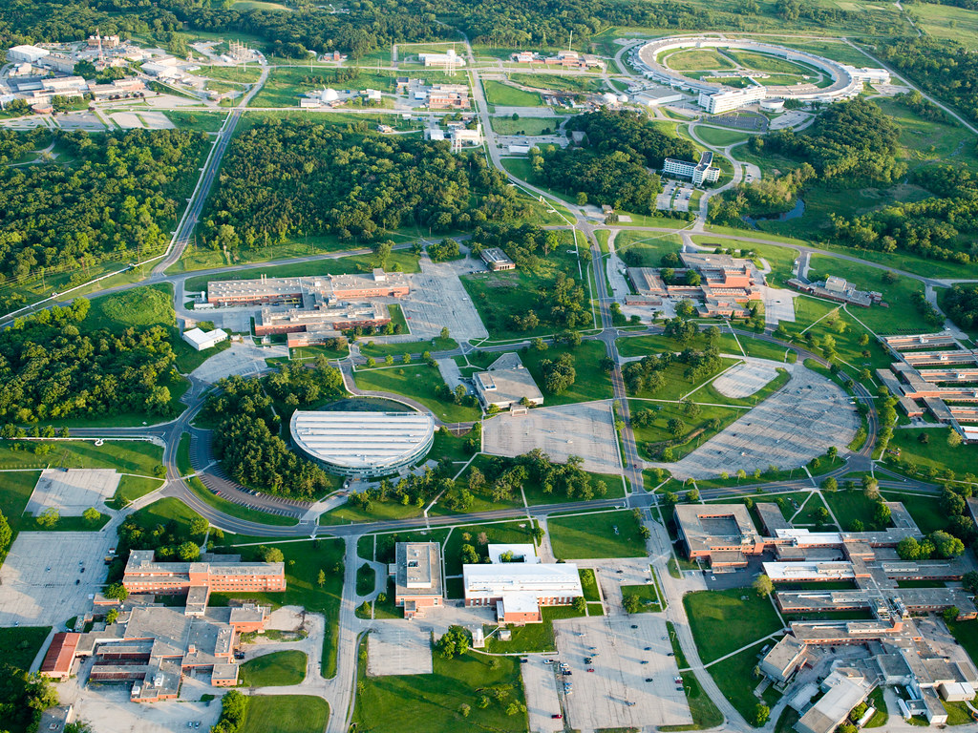
Outline
The Advanced Photon Source (APS) Overview
Robotic Applications at the APS
Potential Hazards (Analysis)
Encountered Obstacles
Lessons Learned

Slide 3
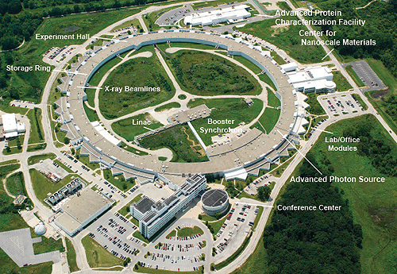
APS Overview
The APS provides high energy x-ray beams for research in the structure and function of materials.
This x-ray research is providing the evolution of combustion, aiding in the development of new pharmaceuticals, and pioneering nanotechnologies, to name just a few examples.
There are six main components that make up the APS technical facility.
Linear accelerator (linac), particle accumulator ring, booster synchrotron, electron storage ring, insertion devices, and experimental hall.

Slide 4
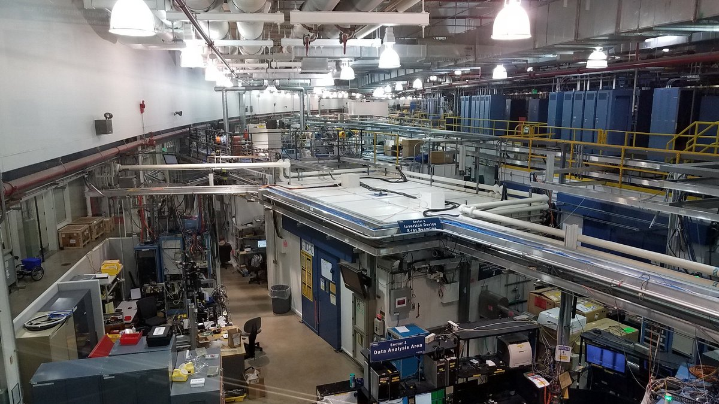
APS Overview (Experimental Hall and LOMs)
The APS is comprised of over 30 sectors that have x-ray beams.
The circular experimental hall as shown, is where scientists assemble their experimental devices to conduct research.
The beam is passed to a radiation proof experiment station that contains the sample under investigation.

Slide 5
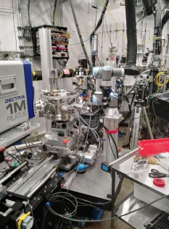
Robotic Applications at the APS
So far, robots have been introduced at the APS for two functions.
Grip detectors and manipulate them to different positions during experiments.
Automated sample handling.
Both functions take place inside our hutches at the beamline.
All robots have only one functioning arm.

Slide 6
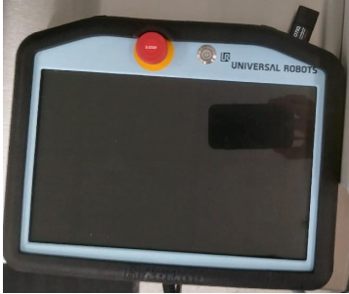
Robotic Functions
The APS robots are set up to operate via teach and repeat.
A trained operator uses a teach pendant to manually instruct a robot its positionings and tasks.
The “teach” programming task should be conducted at slow speeds.
ANSI currently recommends that this speed should not exceed 10 in/sec.

Slide 7
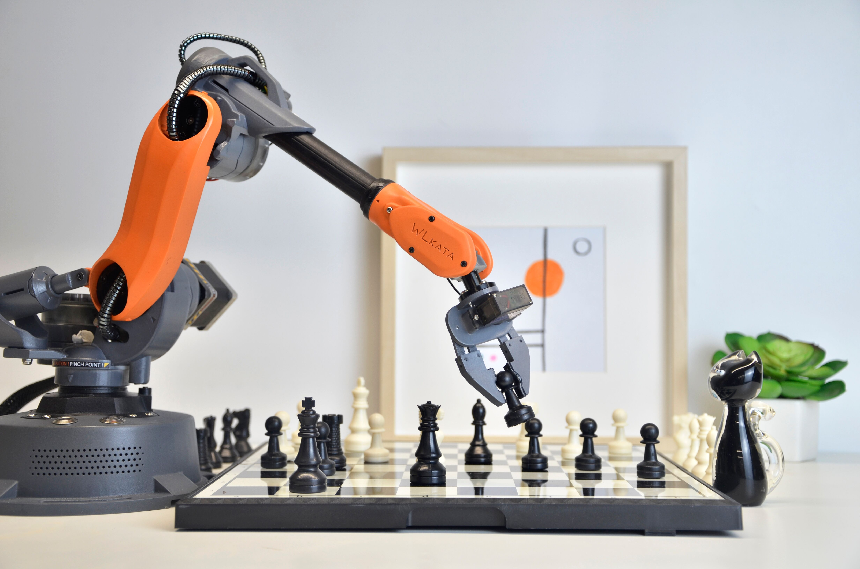
Robotic Safety System/Hazard Analysis
In order to have an effective safety system in place, a hazard analysis must be conducted.
Things to consider during this analysis are:
Function of the robot (What specific task will it be performing?)
Program features (How does it start up? Shut off? Etc.)
Workplace conditions (Where will this robot be placed?)
Maintenance (Who can perform these tasks? How will they be conducted?)
Possible malfunctions
This Photo by Unknown Author is licensed under CC BY-SA

Slide 8
Potential Robot Hazards
Human Errors
Control Errors
Unauthorized Access
Mechanical Errors
Environmental Hazards
Electric, hydraulic, and pneumatic power sources

Slide 9
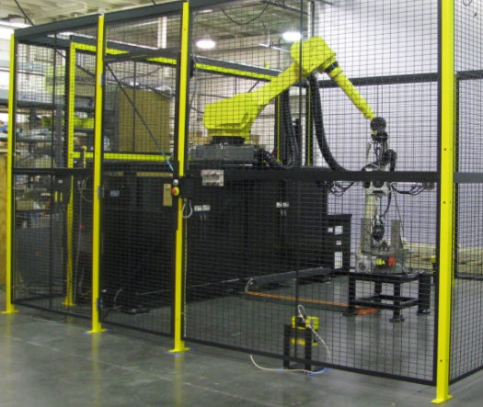
Hazard Mitigations
MACHINE GUARDING
Interlocked Barrier Guard (Essential Guarding Method at APS)
Physical barrier around robot that will shut off operations of the robot when opened. Must prevent access from all points (Over, under, around, and through)
Fixed Barrier
A barrier that requires tool for removal and also prevents access.
Presence Sensing Devices
Most commonly used are pressure mats and light curtains.
Detects an individual stepping into a hazardous area near a robot.

Slide 10
Other Safety Features
Audible and visible warning signs.
Having the control panel outside of the robot working area.
Accessible E-Stops in easily located positions.
Installing the robot in accordance with manufacturer’s recommendation.
The robot is secure so that it will not tip over or fall off of its surface.

Slide 11
Training
Effective training is imperative for accident prevention.
Personnel should have a standard operating procedure (SOP) with authorized users listed.
All personnel working with the robot need to be trained.
Programming and maintenance should be limited only to those who have received training in those specific tasks and are familiar with the control of the robot.
Should also contact manufacturer prior to any maintenance activities.

Slide 12
APS Safety System: Robotics
A robotics working group was created to evaluate the future usage of robots at the APS.
This included bi-weekly discussions involving meetings and demonstrations with the manufacturers, a hazard analysis, and walkdown of areas.
Personnel who were identified with operating the robot were required to create an SOP (standard operating procedure) describing:
General Specifications
Operating Modes
Hazards and Mitigations
Maintenance Procedures
Authorized Personnel

Slide 13
Operating Modes: Manual
In Manual Mode, the robot only accepts input from the teaching pendant located inside the hutch.
The robot is usually switched to manual mode via a key that is kept by a specified individual.
The teaching pendant has an E-stop button, a touch screen, and a normally open push button that must be depressed by the operator to enable Freedrive.
A teaching function that disables the robot drive so the operator can guide the robot by hand to waypoints that can be saved and used to program a trajectory for the robot.
The operators are required to wear safety glasses and post caution tape across the hutch doors before enabling Manual Mode.

Slide 14
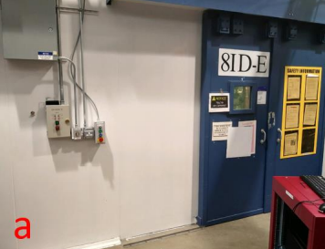
Operating Modes: Automatic
For Automatic Mode, the robot is interlocked with the hutch doors and will not operate unless the doors are closed, as sensed by magnetic proximity switches.
During automatic mode, the robot is able to accept input from a computer terminal.
The keyswitch is also located outside of the hutch.

Slide 15
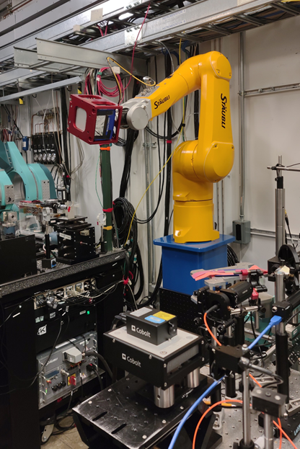
Encountered Obstacles
Restricted on-site access and scheduling for demonstrations and presentations.
What methods will work best for specific areas?
Time constraints
Minor hiccups in wiring robotic system to interlock doors.

Slide 16
Lessons Learned
Currently no specific OSHA standards for the robotics industry.
OSHA website does provide detailed guidelines for robotic operations.
ANSI/RIA R15.06-The industrial robot safety standard
Communication has been key.
Demonstrations from company, weekly updates, and subject matter expert (SME) reviews.
Create a lab working group to collaborate and receive input from various areas.
Especially helpful if devices are to be used in various parts of the lab.

Slide 17
QUESTIONS OR COMMENTS?

