Slide 1
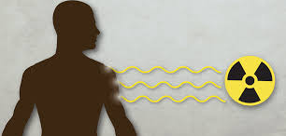
Atlas radiation interlock system (ARIS)
Jason clark
Scientist, Argonne Physics Division
Chair, Physics Division Radiation Safety Committee
October 6, 2021

Slide 2
outline
    Overview of the ATLAS facility at ANL
    Overview of ARIS
    Motivation to upgrade ARIS
    ARIS description and details
    Summary

Slide 3
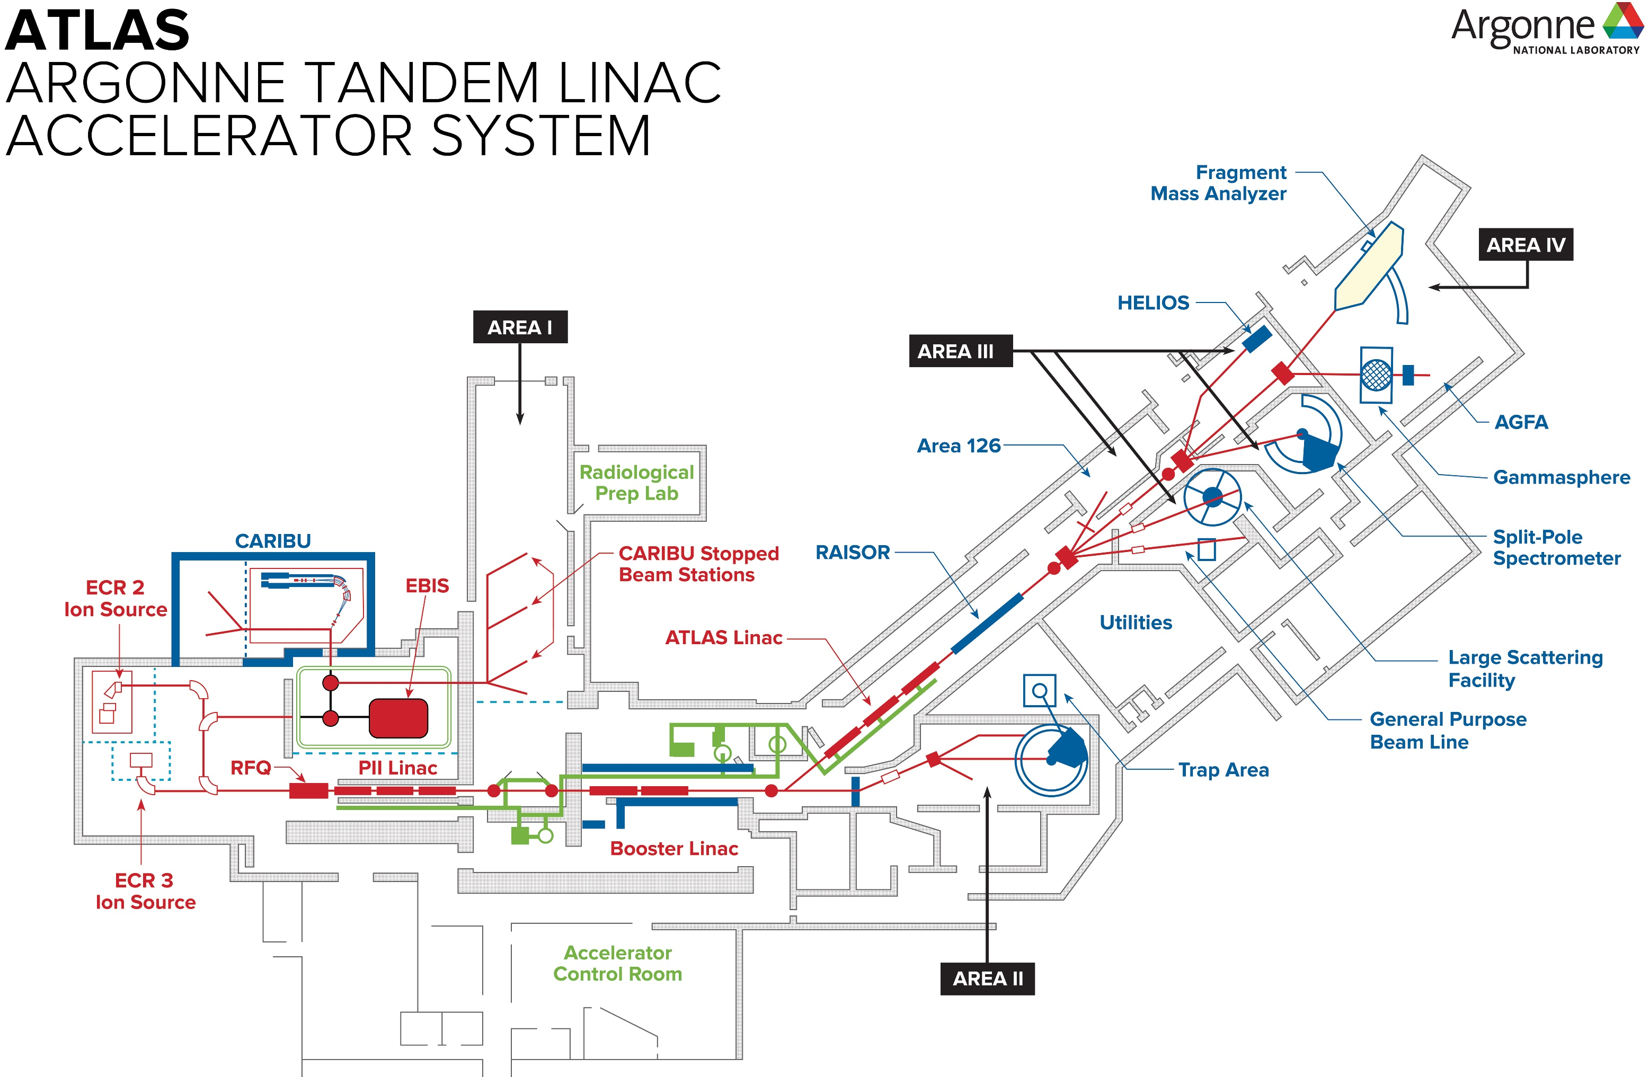
ATLAS at ANL
    ATLAS can provide stable beams ranging in mass from protons to uranium (up to ~ pµA)
    In-flight facility (RAISOR) can provide low-intensity radioactive beams (close to stability)
    CARIBU can provide radioactive beams using fission fragments from a ²⁵²Cf fission source
      intensity up to ~ 10⁴ pps
    Maximum beam energies ranging from ~ 24 MeV (protons) to 10 MeV/u (uranium)
    Accelerator Safety Envelope limits unmitigated radiation to 100 rem/h at 1 m

Slide 4
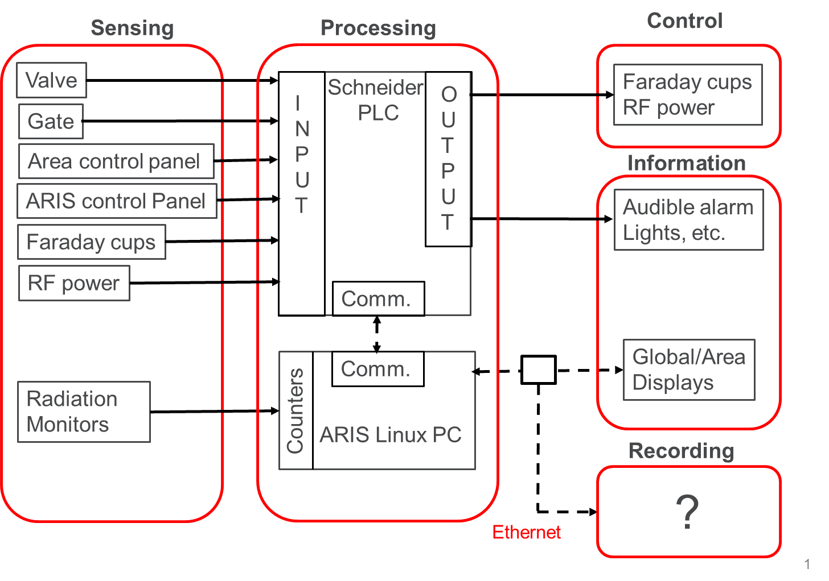
Aris IN a nutshell
    ARIS designed to protect against unnecessary radiation exposure, but access to low levels of radiation permissible (while beam is on)
    Radiation limits to prevent:
      Public from accessing areas with > 2 mrem/h
      Workers from accessing areas with > 5 mrem/h and accumulating > 20 mrem within an 8-hour period in any one area
    All ARIS-controlled areas monitored by appropriate radiation monitors accounting for prompt radiation generated in area:
      x-ray (primarily from ECR ion sources)
      gamma (generated from RF accelerating structures, and beam-induced)
      neutron (beam-induced)
    Radiation monitors provide TTL pulsed output read by counting cards in ARIS PC (couldn’t find practical frequency counter for safety PLC)
    PLC can stop/permit radiation generation via control of Faraday cups (beam) and relays (RF power) after considering radiation levels/doses and access
    Information about the status of each area shown on local area displays
    Information about the entire suite of areas shown on global displays and is logged

Slide 5

Motivation for aris upgrade
    Operationally:
      Access to areas for maintenance and upgrades
      Decrease administrative burden (locking adjacent areas until a survey is complete, for instance), thereby increasing beam on target
      Consistent set of rules for all areas
      More information available for diagnostics, reporting
      Additional monitoring for instant feedback on changing conditions of accelerator
    Technically:
      Replace aging system
      Allow for expansion, flexibility

Slide 6
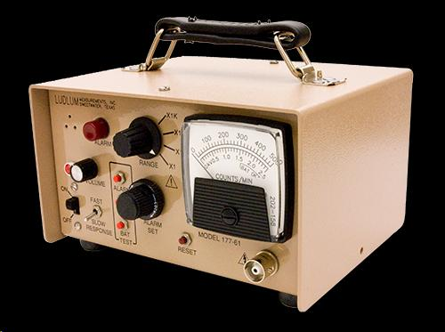
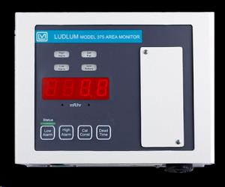
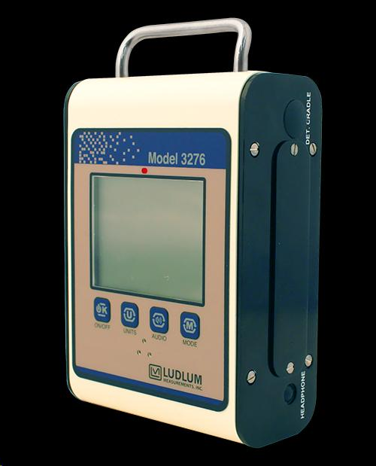
Radiation monitors
    Radiation monitor output/meter provides TTL pulsed output read by counting cards in ARIS PC
      Considered analog output, but required dynamic range is too large (need to measure both low and high levels of radiation)
      Require knowledge of radiation level, not just when alarm level is reached
    Radiation monitors constantly checked to make sure they are working:
      ARIS 2.0 requires a detection of 1 pulse per 5 minutes
      ‘Tickle’ sources (3 nCi ²⁴⁸Cm) installed in neutron monitors
      Sufficient background radiation for gamma/x-ray monitors
    Radiation detected by monitors is scaled by:
      Calibration factor (to account for detector efficiency)
      Distance factor to estimate radiation 1 m from source / expected loss point (Faraday cup, slit, aperture, target, wall at boundary of adjacent area, etc.)
    Radiation monitors calibrated once per year by ANL Instrument Group

Slide 7
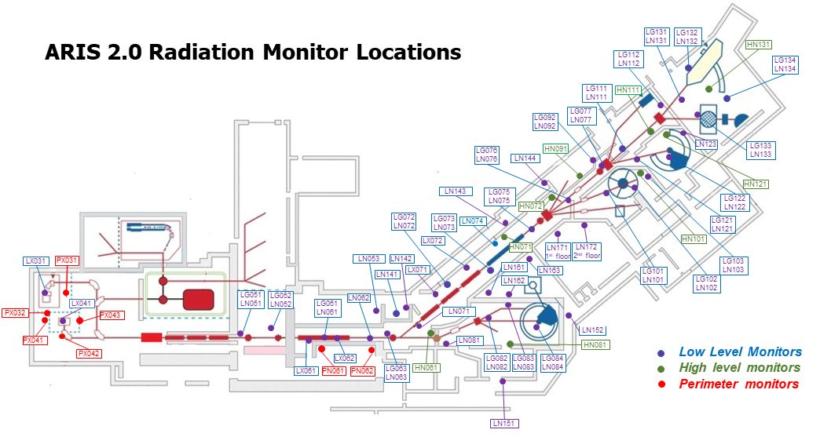
Radiation monitors

Slide 8
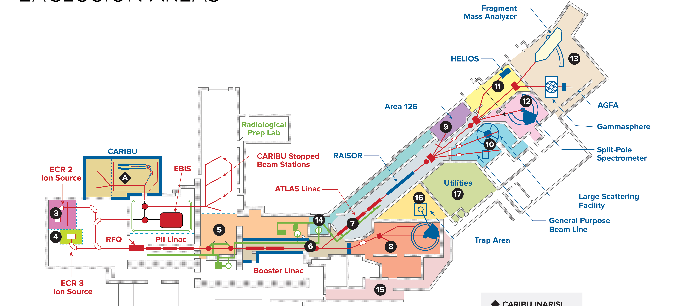
Aris-controlled areas
ECR 2 11. HELIOS
ECR 3 12. Spectrograph
Service area 13. FMA/AGFA
Booster 14. RF corridor
Tunnel 15. Hallway
Area 2 16. Triangle
Area 126 17. Utility
ATSCAT
    15 ARIS-controlled areas:
      Areas where we expect the possibility of radiation exposure

Slide 9
Aris-controlled areas:
    ARIS-controlled areas are either considered a ‘radiation generating area’ or an ‘adjacent area’
      ‘Radiation generating area’:
        ‘Beam area’: beam-induced radiation from interaction of beam with materials
        ‘RF area’: accelerator-induced radiation from RF power applied to the accelerator structures in the area
        Radiation monitors scale detected radiation to 1 m from expected loss point
      ‘Adjacent area’
        Any area not considered a ‘radiation generating area’
        Monitors in ‘adjacent area’ scaled differently (ex: to wall)

Slide 10
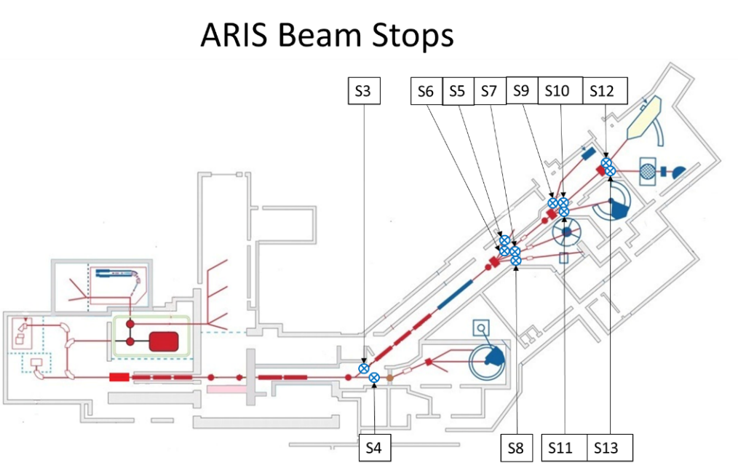
Establishing a radiation generating area
    When area first becomes a ‘radiation generating area’, area must first be evacuated of personnel and locked before radiation first introduced into area
      ‘Beam area’
        Beam can be delivered to only one experimental area at a time; i.e.: there is a well-defined beam path for each experiment run at ATLAS
        Will be defined by opening ‘beam stop’
        For every fork in beamline system, beam path defined by the single open ‘beam stop’ at the exit of the fork
        More than one ‘beam stop’ open at a fork results in a ‘beam path conflict’
      ‘RF area’
        Established when a request for RF is made by Operations via a touch screen control panel

Slide 11
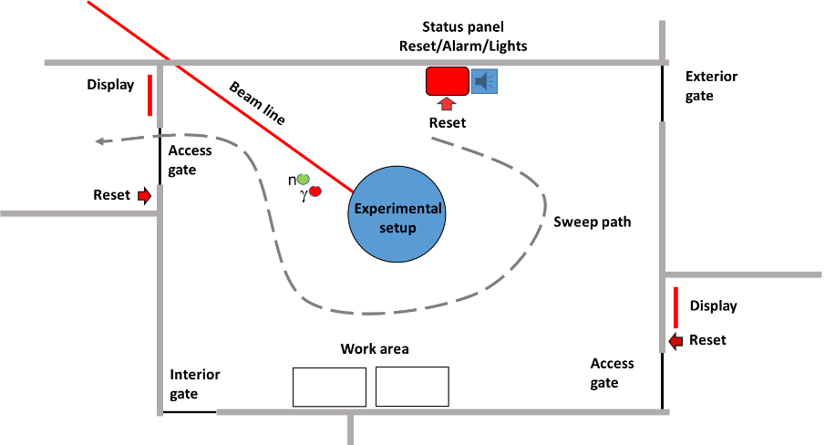
Access gates
    ‘Access gates’
      Have at least 1 ‘access gate’ per ARIS-controlled area
      Status displayed outside each ‘access gate’
    ‘Other gates’
      A gate not considered an ‘access gate’
        Could be a door to a different room or a door to the outside of the building
      Lights (red/green) indicate status (can enter or not)
Other gate
Other gate

Slide 12
Access gates

Slide 13
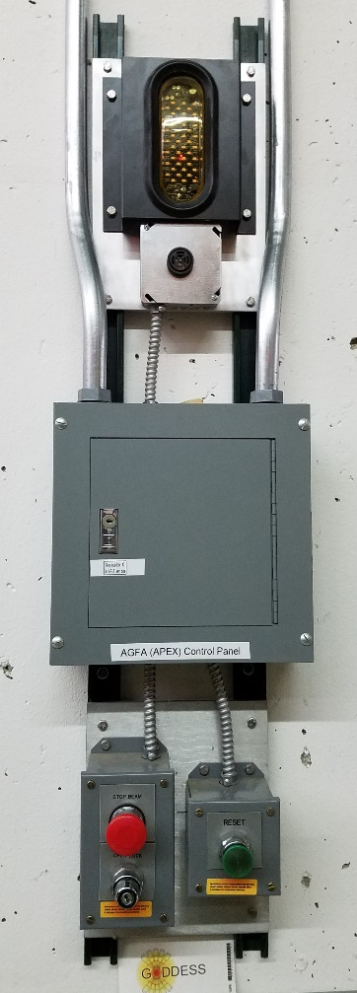
Sweep (search and secure) procedure
    With only one ‘access gate’ open (all other gates closed):
      Push ‘Interior Reset Button’ inside area
      Audible alarm activates
      Search the area
      Push any additional ‘Interior Reset Buttons’
      Close the original open ‘access gate’
      Push ‘Exterior Reset Button’ outside area
Other gate
Other gate
    If any gate is opened while sweep is in progress, sweep stops/fails.
    Two types of sweeps:
      ‘Sweep open’: Key switch in ‘open’ position; any trained personnel can execute
      ‘Sweep locked’: Key switch in ‘locked’ position; only ATLAS Operator can execute

Slide 14
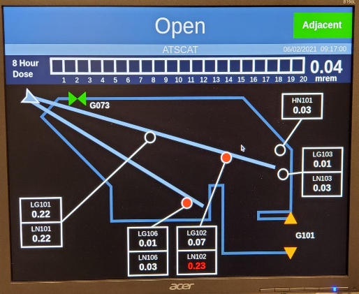
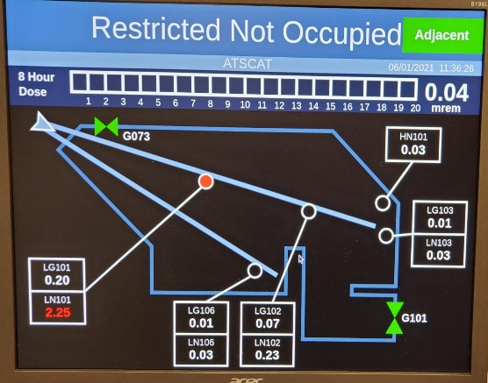
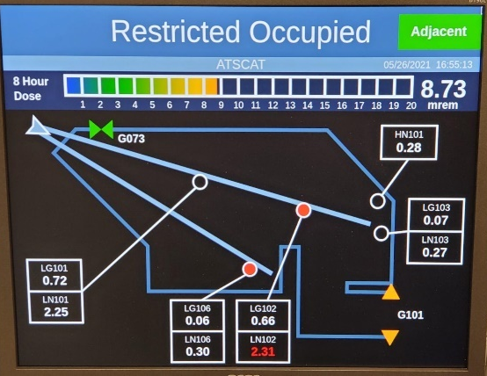
Access states
    Open
      Conditions:
        For ‘adjacent’ areas only
        < 2 mrem/h for previous 30 minutes
      If > 2 mrem/h at any point within previous 30 minutes, access state will change to ‘inhibit’
    Restricted Access (Not Occupied)
      Conditions:
        Area vacated by ‘sweep open’ procedure
        < 5 mrem/h
      If < 2 mrem/h for previous 30 minutes, operator can request area go to ‘Open’ state
      If > 5 mrem/h, PLC will change from ‘Restricted Access / Not Occupied’ to ‘No Access’
    Restricted Access (Occupied)
      Conditions:
        < 5 mrem/h
        < 20 mrem / 8 hours
      If < 2 mrem/h for previous 30 minutes, operator can request area go to ‘Open’ state

Slide 15
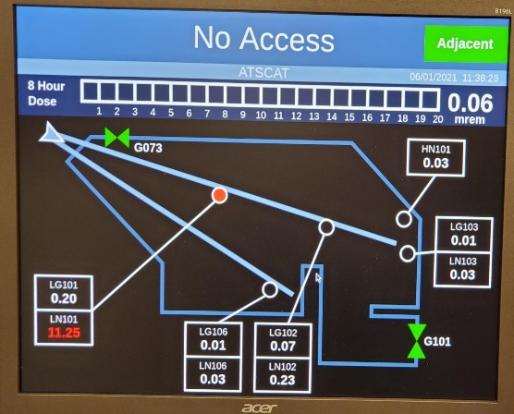
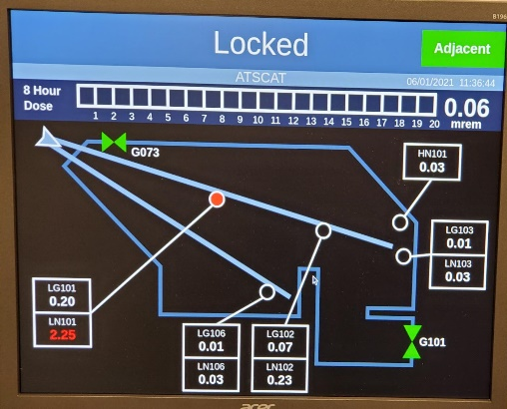
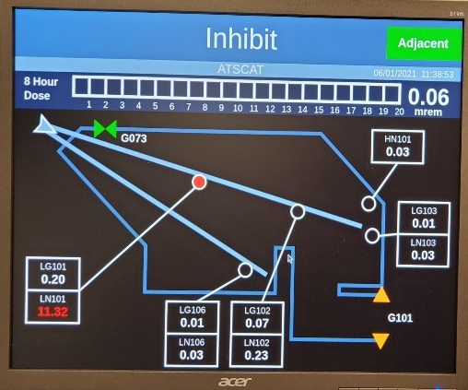
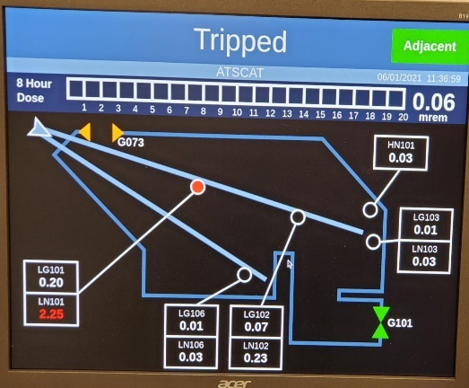
Access states
    No Access
      Conditions:
        5 mrem/h < radiation < 100 mrem/h
      If < 5 mrem/h, PLC will change from ‘No Access’ to ‘Restricted Access / Not Occupied’
    Locked
      Conditions:
        Area vacated by ‘sweep locked’
        < 20 rem/h
    Inhibit
      Radiation inhibited from area
      Result of normal operation of the interlock system
    Tripped
      Stops all radiation sources in area
      Considered the result of an unwarranted occurrence

Slide 16

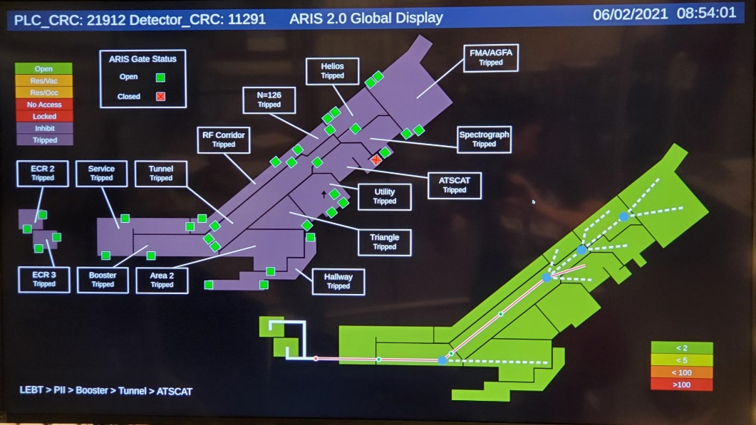
displays
    Area status displays
      At entrance to each ARIS-controlled area
      Provides enough information for personnel to make informed decision whether to enter area
        Access state, instantaneous radiation levels, integrated dose
    Global status displays
      In control room and data room
      Provides overview/status of areas within facility

Slide 17
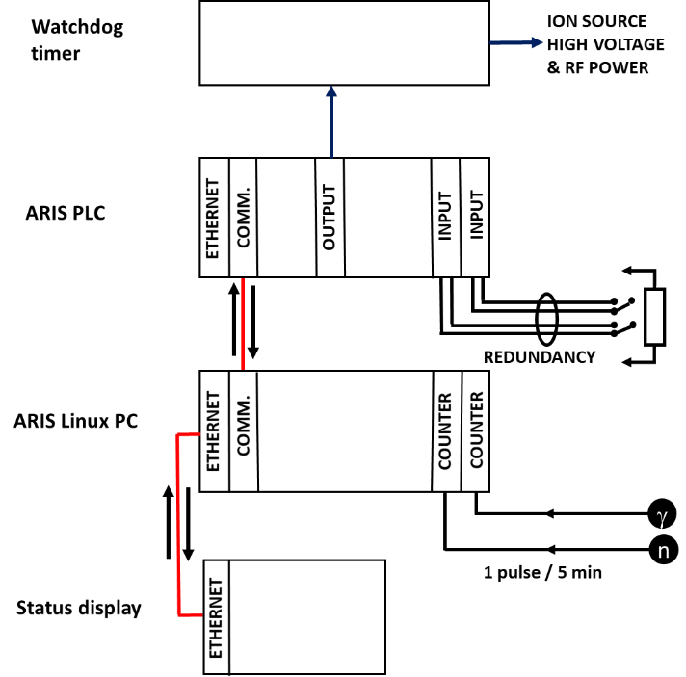
ARIS architecture fail-safe features
    Loss of handshake between PC/PLC and ‘Area Status Display’ for ‘radiation generating areas’ results in ‘Inhibit’
    Loss of handshake between PC and PLC results in ‘Tripped’ state
    No detection of pulses from radiation monitors results in ‘Tripped’ state (‘radiation generating area’) or ‘Inhibit’ (‘adjacent area’)
    No sense of Faraday cup in place when demanded results in other cups being inserted or ultimately deenergizing RF accelerating structures and high voltage on ion source platforms
    Absence of PLC signal to Watchdog results in deenergizing RF accelerating structures and high voltage on ion source platforms

Slide 18
Hazard analysis
    Followed industry standard SIL (Safety Integrity Level) analysis
    Defined 21 safety functions
    Analysis considered:
      Sensors: those required for safety (gates, Faraday cups) are designed with 1oo2 (1 out of 2) architecture
      Processing: generic PLC, combined with data handshake and Watchdog
      Controls: redundant controls (1oo2 architecture) for devices which can stop radiation hazard (Faraday cups, relays powering RF accelerating structures) combined with Watchdog
    Results of analysis:
      Require system with SIL = 1
      Implemented system with SIL = 2
ARIS Safety Functions
Safety Function | Safety Function Description | Required SIL | PFH_{sys} or PFD_{sys} | Implemented SIL
SF1 | Change from ‘not occupied’ to ‘occupied’ state when an ‘access gate’ is opened. | SIL <1 | PFH_{sys} 5.3x10⁻⁷ | SIL2
SF2 | Change from ‘not occupied’ to ‘no access’ state when the radiation level exceeds the ‘access limit’ of 5 mrem/hr. | SIL <1 | PFH_{sys} 7.3x10⁻⁷ | SIL2
SF3 | Change from ‘open’ to ‘inhibit’ state when an ‘ARIS beam stop’ is opened. | SIL <1 | PFH_{sys} 5.3x10⁻⁷ | SIL2
SF4 | Change from ‘res/not occ’, ‘res/occ’, ‘no access’, and ‘locked’ to ‘inhibit’ state when a 2nd ‘ARIS beam stop’ is opened. | SIL <1 | PFH_{sys} 5.3x10⁻⁷ | SIL2
SF5 | Change from ‘no access’ to ‘inhibit’ state when an ‘access gate’ is opened. | SIL <1 | PFH_{sys} 5.3x10⁻⁷ | SIL2
SF6 | Change from ‘no access’ to ‘inhibit’ state when the radiation level exceeds the ‘locked state limit’ of 100 mrem/hr. | SIL <1 | PFH_{sys} 7.3x10⁻⁷ | SIL2
SF7 | Change from ‘open’ to ‘inhibit’ state when the radiation level exceeds the ‘open limit’ of 2 mrem/hr. | SIL <1 | PFH_{sys} 7.3x10⁻⁷ | SIL2
SF8 | Change from ‘occupied’ to ‘inhibit’ state when the radiation level exceeds the ‘access limit’ of 5 mrem/hr. | SIL <1 | PFH_{sys} 7.3x10⁻⁷ | SIL2
SF9 | Change from ‘locked’ to ‘tripped’ state when an ‘access’ gate is opened. | SIL1 | PFD_{sys} 5.0x10⁻³ | SIL2
SF10 | Change from ‘not occupied’ to ‘tripped’ state when an ‘other gate’ is opened. | SIL <1 | PFH_{sys} 5.3x10⁻⁷ | SIL2
SF11 | Change from ‘occupied’ to ‘tripped’ state when an ‘other gate’ is opened. | SIL <1 | PFH_{sys} 5.3x10⁻⁷ | SIL2
SF12 | Change from ‘no access’ to ‘tripped’ state when an ‘other gate’ is opened. | SIL <1 | PFH_{sys} 5.3x10⁻⁷ | SIL2
SF13 | Change from ‘locked’ to ‘tripped’ state when an ‘other’ gate is opened. | SIL1 | PFD_{sys} 5.0x10⁻³ | SIL2
SF14 | Change from ‘inhibit’ to ‘tripped’ state when an ‘other’ gate is opened. | SIL <1 | PFH_{sys} 5.3x10⁻⁷ | SIL2
SF15 | Change from ‘occupied’ to ‘tripped’ state when the 8-hour accumulated dose exceeds the ‘dose limit’ of 20 mrem. | SIL <1 | PFH_{sys} 7.3x10⁻⁷ | SIL2
SF16 | Change from ‘open’ to ‘tripped’ state when the radiation level exceeds the ‘high limit’ of 100 rem/hr. | SIL1 | PFH_{sys} 7.3x10⁻⁷ | SIL2
SF17 | Change from ‘not occupied’ to ‘tripped’ state when the radiation level exceeds the ‘high limit’ of 100 rem/hr. | SIL<1 | PFH_{sys} 7.3x10⁻⁷ | SIL2
SF18 | Change from ‘occupied’ to ‘tripped’ state when the radiation level exceeds the ‘high limit’ of 100 rem/hr. | SIL1 | PFH_{sys} 7.3x10⁻⁷ | SIL2
SF19 | Change from ‘no access’ to ‘tripped’ state when the radiation level exceeds the ‘high limit’ of 100 rem/hr. | SIL <1 | PFH_{sys} 7.3x10⁻⁷ | SIL2
SF20 | Change from ‘locked’ to ‘tripped’ state when the radiation level exceeds the ‘high limit’ of 100 rem/hr. | SIL <1 | PFH_{sys} 7.3x10⁻⁷ | SIL2
SF21 | Change from ‘locked’ to ‘tripped’ state when area control panel ‘crash’ button is hit. | SIL1 | PFD_{sys} 7.0x10⁻³ | SIL2

Slide 19
summary
    Upgrade to ARIS designed with similar philosophy as ARIS predecessor, but with the benefit of hindsight and 30 years of operations
    ARIS is an effective, simple, consistent, and efficient safety system
      Keep radiation exposure ALARA
      Consistent set of rules throughout facility
      Maximize access to the extent possible while minimizing radiation surveys needed
      Lead to more beam delivered to experiments
    Upgrade project began ~ January, 2019 and was installed in May/June 2021
      Direct costs ~ $500k (mostly hardware; doesn’t include labor of existing staff)

