Slide 1
Credited Controls and Instrumentation SNS Beam Power Limit System
Patrick Bong
Senior Protection Systems Engineer
Spallation Neutron Source at ORNL

Slide 2
Beam Power Limit System
Credited control using FPGA
Instrumentation based on current transformers
Safety PLC calculates average beam power
Multiple shutoff paths through PPS and MPS
Standards guided engineering
Firmware verification
Requirements tracking using ReqTracer

Slide 3
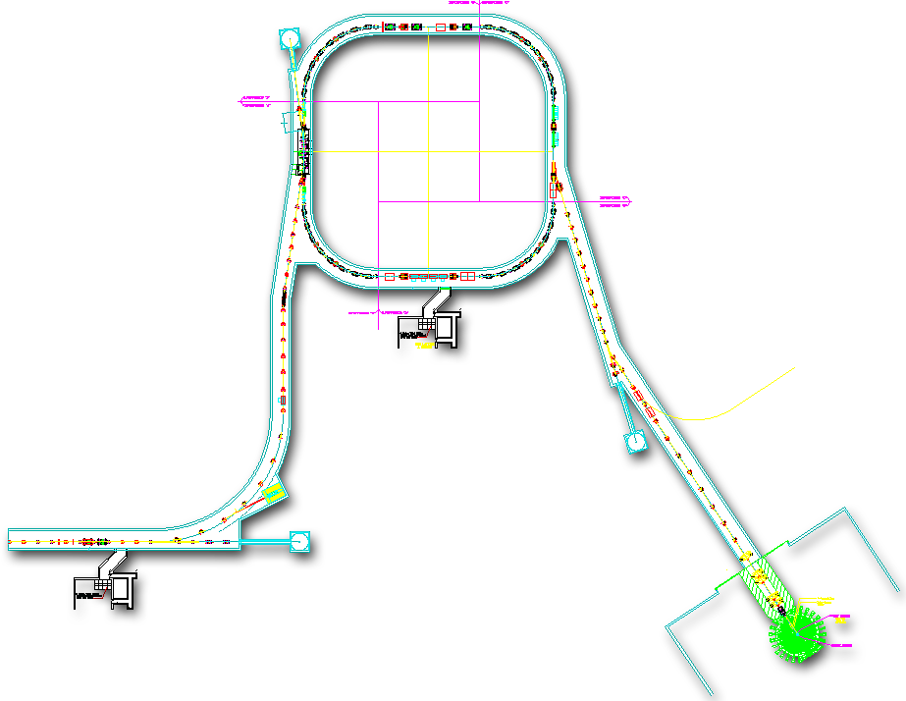
Using instrumentation to limit beam power to 2MW
RTBT:
Add BPLS – interlock on max beam power
Injection
Extraction
RF
0.7MW
RTBT
~1300 MeV
HEBT
2MW
STS
Warm Linac
Superconducting LINAC
Linac PPS Segment:
New Cryomodules
Second Target Station
First Target Station
Beam Power Limit System:
Upgrade to Safety PLC
FPGA added to credited controls

Slide 4
BPLS Calculates Power Based on Beam Energy and Current
Beam Energy calculated from critical device dipole DH13 current
Beam Current measured with Fast Current Transformer
Trips PPS if Beam Power > 2.145 MW for 60 seconds
Trips MPS if beam Power > 2 MW
Injection
Extraction
RF
0.7MW
RTBT
~1300 MeV
Measure Energy
HEBT
2MW
STS
Warm Linac
Superconducting LINAC
Measure Charge
Second Target Station
First Target Station

Slide 5
BPLS Design
MPS
AFE
MicroTCA
PSI Test
DPU
PSI
CPU
FTS FCT Channel A
ADC
Pulse Trig
ADC
(Ethernet)
DIO
Timing
(PCIe)
Cycle Start
Dipole DH13
DCCTs
6
/
PLC
PPS
Timing
Mode: Init, Op, Cal, Maint, Fault
Mailbox
PLC
(Ethernet)
EPICS
MicroTCA
AFE
DPU
Cycle Start
PSI
CPU
FST FCT Channel B
DIO
Timing
(PCIe)
ADC
Pulse Trig
ADC
(Ethernet)
PSI Test
Credited Engineering Control (CEC) Boundary
MPS

Slide 6
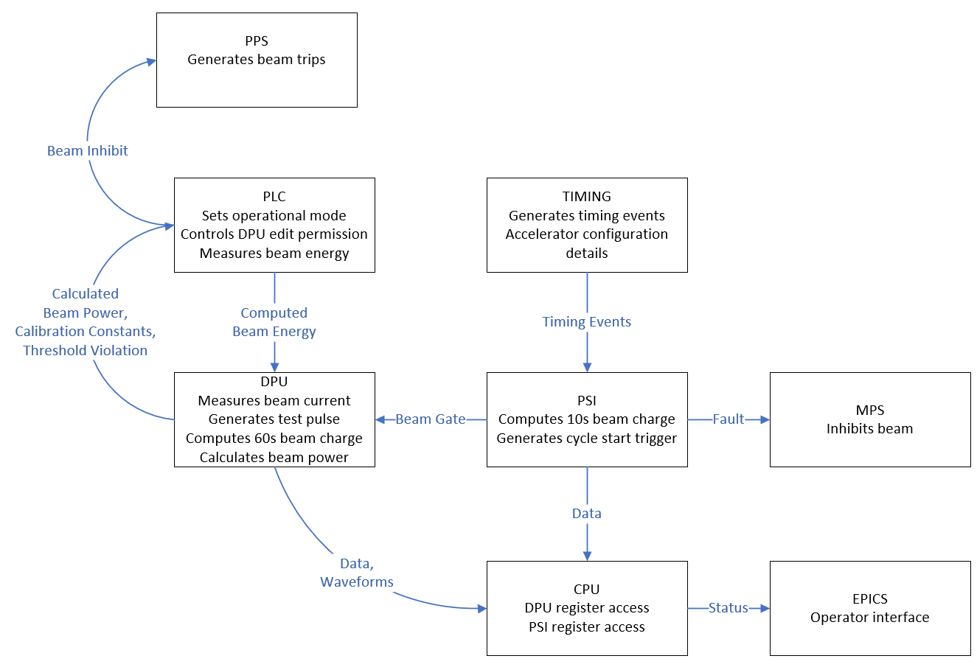
BPLS Functional View
Safety Critical Functions

Slide 7
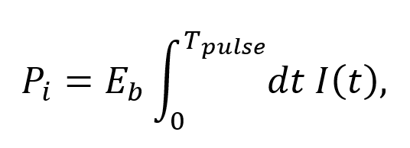
Calculating Beam Power
FCT
Fast Current Transformer
Measures beam current pulse-to-pulse
Calculated by DPU (FPGA)
DCCT
Direct Current, Current Transformer
Measures beam Energy
Calculated by PLC
Calculation
E_{b} = energy
I(t) = current
T_{pulse} = pulse length of the current
AFE
DPU
FTS FCT Channel A
ADC
DIO
Dipole DH13
DCCT
6
/
PLC
PPS
Mode: Init, Op, Cal, Maint, Fault
Mailbox
PLC

Slide 8
DPU Interfaces
DPU Blocks
Main Safety Function
System Health
System Test
PSI
Cycle Start
I/O
RS485
Charge Threshold,
Config, Status, Diag
Test Pulse Trig
Fault Reset
Main Coil
ADC
FPGA
Major Fault
Calibration Coil
Minor Fault
PLC
I/O
Watchdog Req
AFE
Watchdog Reset
Test Pulse Trig
I/O
Test Pulse Req
Test Pulse Ok
Test Voltage Req
PSI
Cycle Start: locks internal machine cycle timer
Test Pulse Trig: Capturing Test Pulse data
PLC
RS485 Read/Write: Beam Charge data
RS485 Read Only: Status & diagnostics
Reset & Faults: Major Fault indicates over Beam Charge Threshold & Minor Fault indicates a system error/failure
Watchdog: Interface verification
Test Pulse: Request and ok handshake
PLC/AFE: Test Voltage for Major Fault/ADC check
AFE
Main Coil: Low Gain FCT for Beam Charge measurement
Calibration Coil: Test Pulse for system verification to test cable, AFE, and DPU

Slide 9
DPU Firmware Block Diagram
PLC Fault Reset
PLC RS485
PLC Major Fault
UART RX
PLC Minor Fault
PLC I/O Interface
Modbus Registers
Modbus Interface
PLC
RS485
PLC Watchdog Req
UART TX
PLC Watchdog Reset
Single Event Upset
PLC Test Pulse Req
Modbus CRC
PLC Test Pulse Ok
PSI Cycle Start
Machine Cycle Timing
Test Pulse
Test Pulse Gen Window
Test Gen
Fault
ADC
ADC/Clock SPI
ADC/Clock Initialization
Test Pulse Meas Window
Test Meas
Fault
AFE Cal Coil
ADC Interface
Test Pulse Generate
AFE/PSI Test Pulse Trigger
AFE Main Coil
Sliding Pulse Charge
Pulse Charge
Beam Charge
Pulse Charge Integrator
Peak Pulse Charge A
Beam Charge Integrator
Baseline Integrator
Peak Pulse Charge B
Beam Charge Comparator
Major Fault

Slide 10
Calculating Charge Without Cycle Start
Use 2, 16.67 msec windows offset by 5 µsec
When one 16.67 msec window lands on a pulse, the other is still valid
Taking the larger value results in a valid measurement
Internal Timer 1
Baseline
Internal Timer 1
Max
Baseline
Internal Timer 1
Baseline
Max
Max
Internal Timer 2
Internal Timer 2
Internal Timer 2
Max
Baseline
Max
Baseline
Max
Baseline

Slide 11
DO-254, Design Assurance Guidance for Airborne Electronic Hardware Standard
DO-254 is a requirements-driven process-oriented safety standard used for commercial electronics that go into aircraft
Applies to the quality assurance of custom micro-coded components such as field programmable gate arrays (FPGA), programmable logic devices (PLD), and application-specific integrated circuits (ASIC)
A walkthrough of the standard applied the design assurance levels to the SNS FSAD-PF to develop a risk matrix
The FPGA parts of the BPLS are engineered using applicable parts of the standard and is used as a best engineering practice

Slide 12
DO-254 Design Assurance Levels (DALs)
The SNS FSAD definitions of consequence are similar to the DO-254 descriptions
The FSAD consequences were mapped to the DO-254 matrix to determine Design Assurance Levels
DO-254 DAL C (Major) was determined to be the appropriate classification for the BPLS
The acceptable level of risk is equivalent to SIL 2
The analysis is documented in a cross walk (PPUP-406-TD0001-R00)

Slide 13
IEC 61511 and ANSI/ISA S84.01
Functional Safety of Electrical/Electronic/Programmable Electronic Safety-Related Systems for the Process Industries Sector
Captures best practice for complex systems
Performance based requirements
Used as guidance for the development of PLC based PPS systems

Slide 14
Safety reliability requires diagnostics and self-test
IEC 61511¹/61508 Safety reliability is reached by:
Robust design
Redundancy
Verification and Validation (V&V)
Includes modeling and simulation – extensive capability in digital
Diagnostics and Self-test
Digital affords greater coverage AND efficient use of resources
Table 3
 | Hardware Fault Tolerance (Redundancy) N+1 required for safe operation
Detectable Faults | 0 | 1 | 3
< 60% | Not Allowed | SIL 1 | SIL 2
60% - < 90% | SIL 1 | SIL 2 | SIL 3
90% - < 99% | SIL 2 | SIL 3 | SIL 4
>= 99% | SIL 3 | SIL 4 | SIL 4
Target for BPLS
1. SNS uses IEC 61511, formerly ISA S84, in the design of safety systems
IEC 61508-2 “Functional safety of electrical/electronic/programmable electronic safety related systems”

Slide 15
Federal and DOE Requirements
10 CFR 835, Occupational Radiation Protection
This section of the Code of Federal Regulations contains requirements for radiation protection that the laboratory must meet to comply with Federal law
DOE O 420.2C, Safety of Accelerator Facilities
This directive establishes accelerator specific safety requirements to promote the safe operation and ensure the protection of workers
DOE G 420.2-1A Accelerator Facility Safety Implementation Guide
This guide provides supplemental information to help accelerator facilities implement the requirements of the order
DOE O 414.1D, Quality Assurance
This order establishes the requirement for a Quality Assurance Program (QAP) and defines the necessary steps to implement the program

Slide 16
IEC 62443 Standard
IEC 62443, Cyber Security for Industrial Automation and Control Systems
Provides guidelines for establishing a cyber security program for industrial automation and control systems
In practice, the safety system network is connected to the controls network through a firewall
Programming laptops are not allowed to be connected to the internet
The safety system is engineered using parts of the standard and is used as a best engineering practice

Slide 17
Firmware Verification Methodology & Tools
Each firmware module is individually tested (‘linted’) using BluePearl RTL analysis
Standard syntax checking
Common mistakes not caught by simulation
Constant false / true statements
Missing process sensitivity signals
Range mismatch
Ambiguous coding styles
Limited timing analysis
Enforces IEC62566 section 8 (except 8.3.4(f))

Slide 18
Firmware Simulation Methodology & Tools
Each firmware module is individually simulated using Xilinx Vivado simultion using Xilinx XSI interface & Python 3
Multiple unit tests per module (typically at least 2)
Easily extended to corner cases as needed
Some modules are fully coverage-tested for all inputs & outputs
Others are too complex - impossible to validate fully without making assumptions about the code under test - use ‘Monte Carlo’ method
Overall firmware is simulated using a combination of simulated & measured input data

Slide 19
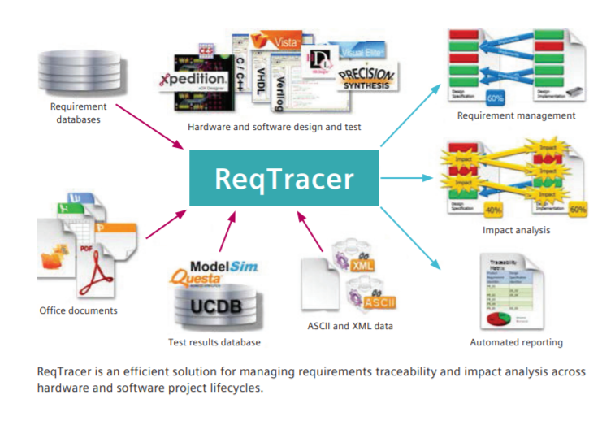
ReqTracer Tool to Manage Requirements
ReqTracer is a requirements traceability solution
Links development & verification documents with formal requirements.
Ability to trace and manage design requirements from specification to implementation and verification.

Slide 20
ReqTracer tool will ensure requirements are covered & tested in the BPLS project
ReqTracer is a requirements traceability solution. It links development & verification documents to formal requirements.
ReqTracer has ability to trace and manage design requirements from specification through implementation and verification.
Key Features:
Connect requirements from many source files, databases
Supports standards like DO-254, ISO 26262, IEC 61508 and IEC 60601
Links relationships and dependencies
Immediate notification of requirement changes, additions and deletions
Confirms that all design requirements have been implemented and fully tested

Slide 21
Summary
The BPLS is the first credited control at SNS to use a firmware programmed device for safety
A standard used for airborne safety will be used as guidance
The DO-254 standard has close alignment with the IEC standard and Safety Integrity Levels
ReqTracer has been instrumental with connecting component requirements to the System Requirements Document (SRD)

