Slide 1
STS Personnel Protection Systems
Tommy Michaelides Lead Personnel Protections Systems Engineer
ASW - October 2021

Slide 2
Outline
SNS Overview
STS PPS Overview
Requirements
Scope
Work Breakdown Structure (WBS)
PPS Challenges
Looking ahead
Questions

Slide 3
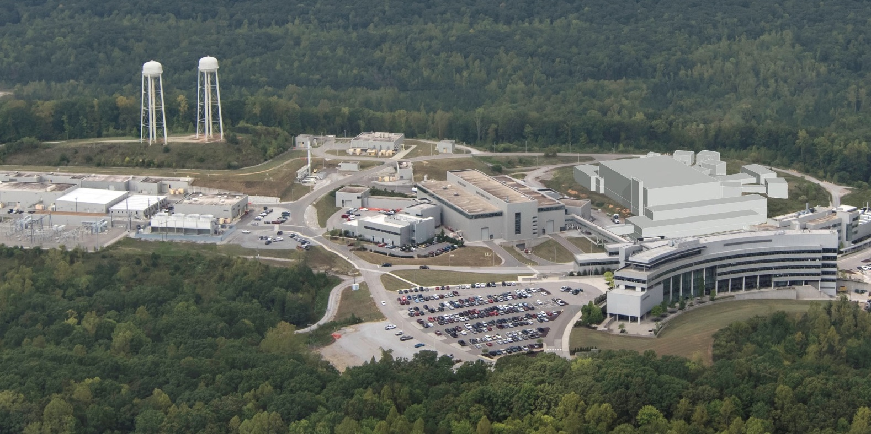
SNS Overview
Accumulator Ring
Future
Second Target Station (STS)
First Target Station (FTS)
Linac
HEBT
RTBT

Slide 4
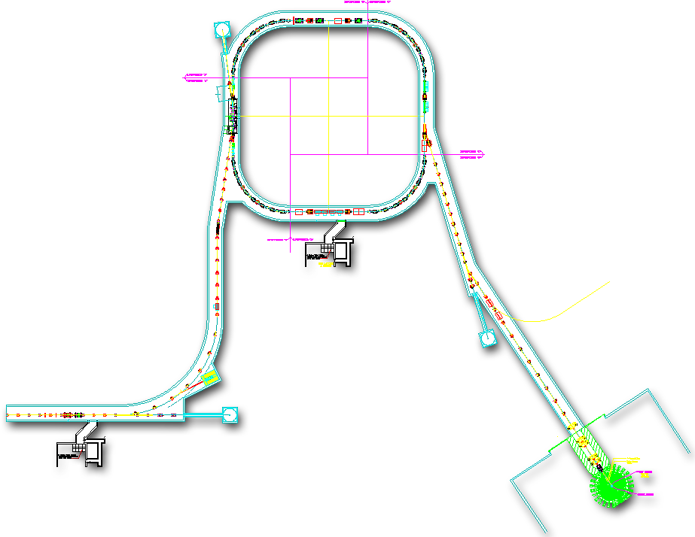
SNS/STS PPS Overview
Existing Personnel Protection System (PPS) tunnel segments
New PPS tunnel segments
Linac
HEBT
RING
RTBT
FTS
RTST
STS
Injection
Extraction
RF
STS
HEBT
IS
RFQ
MEBT
DTL
CCL
SRF
SRF
RTBT
Liquid Hg FTS
7 new superconducting linac cryomodules (PPU)

Slide 5
PPS Requirements are being developed
Requirements build on existing SNS PPS requirements
Personnel Protection System (PPS) provides protection against prompt radiation exposure and provides a permissive to allow beam
The credited engineering solutions are identified through documented Hazard Analyses (HA) and the Accelerator Safety Envelope (ASE)
The PPS shall integrate the Ring To Second Target (RTST), Second Target PPS (STPPS), maintenance shutters and instruments with the existing SNS PPS
The PPS shall enforce the proton beam destination and ensure a safe concurrent or independent operation for the first and second target stations

Slide 6
PPS Requirements
The PPS shall trip the accelerator systems on prompt ionizing radiation in accessible Ring to Second Target (RTST) or target building areas
Implement PPS exclusion areas in RTST, target, and instruments
Trip the accelerator on RTST access violations
Trip the accelerator on target access violations
Close operations shutter for instrument access violations and propagate a trip to the accelerator systems if needed
PPS shall limit the beam power to STS as defined in the Accelerator Safety Envelop (ASE) and terminate beam if it’s not within limits
The PPS shall be managed through the Central Control Room (CCR), and provide remote statuses to target operations control room, and instrument hall coordinators office through the integrated control systems (ICS - EPICS)

Slide 7
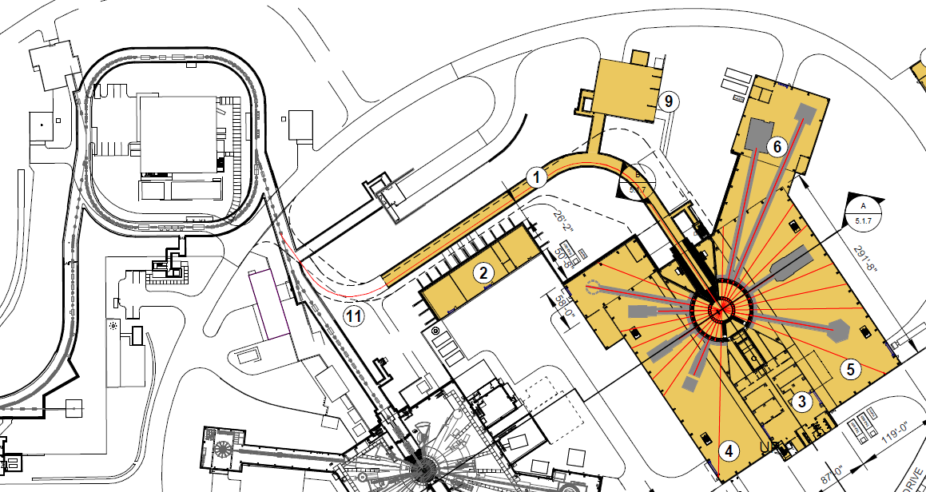
PPS Scope is being refined based on PHA findings
Ring Service building
RTST PPS kicker interface
Dipole PPS interface
RTST PPS segment
Personnel entry station access
Search and evict stations
Interlocked area radiation monitors
Second Transport dipole PPS interface
Beam power limiting system

Slide 8
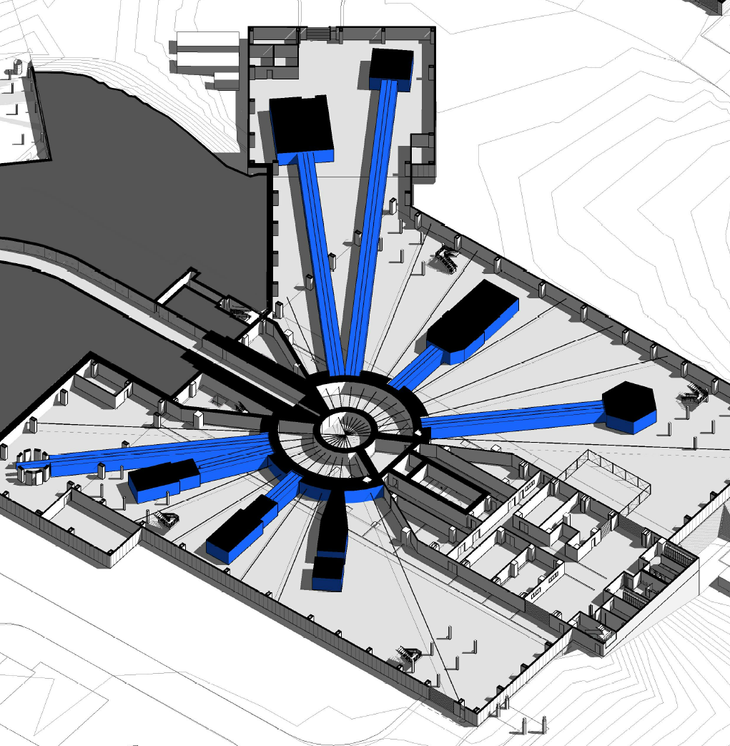
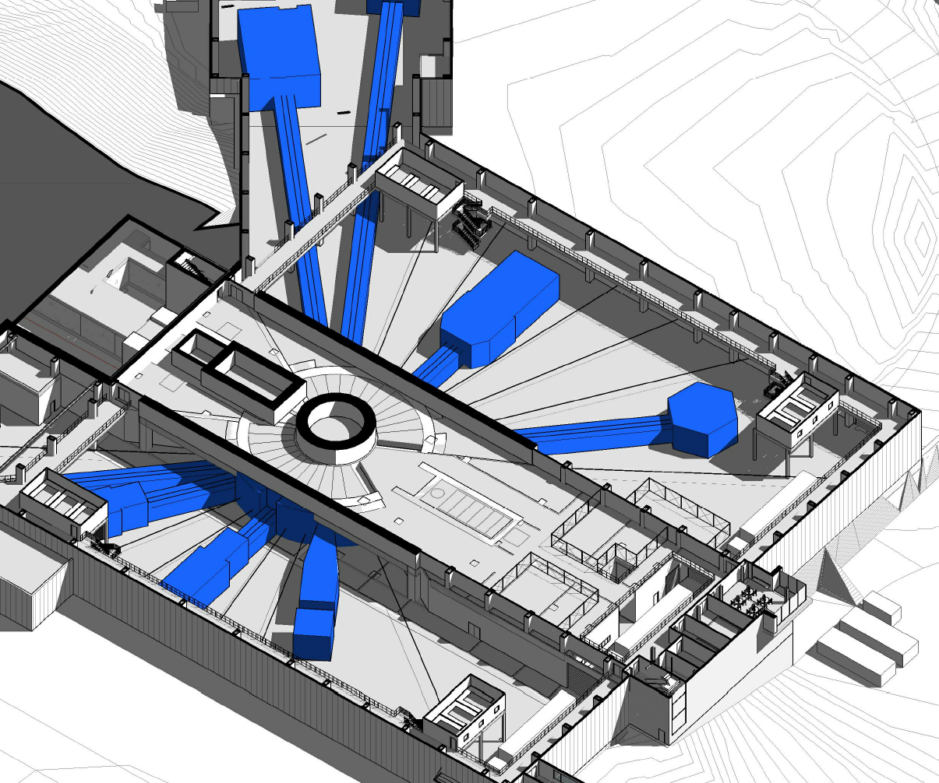
PPS Scope is being refined based on PHA findings
Prompt ionization radiation detection:
Target basement, 1st and 2nd floors
Instrument cave areas
Oxygen Deficiency Monitors
Cryogenic Moderator Systems
Instrument cave areas
Environmental Protection
Flow monitoring of the stack exhaust
Radiation monitoring of the exhaust air flow
1st Floor
2nd Floor

Slide 9
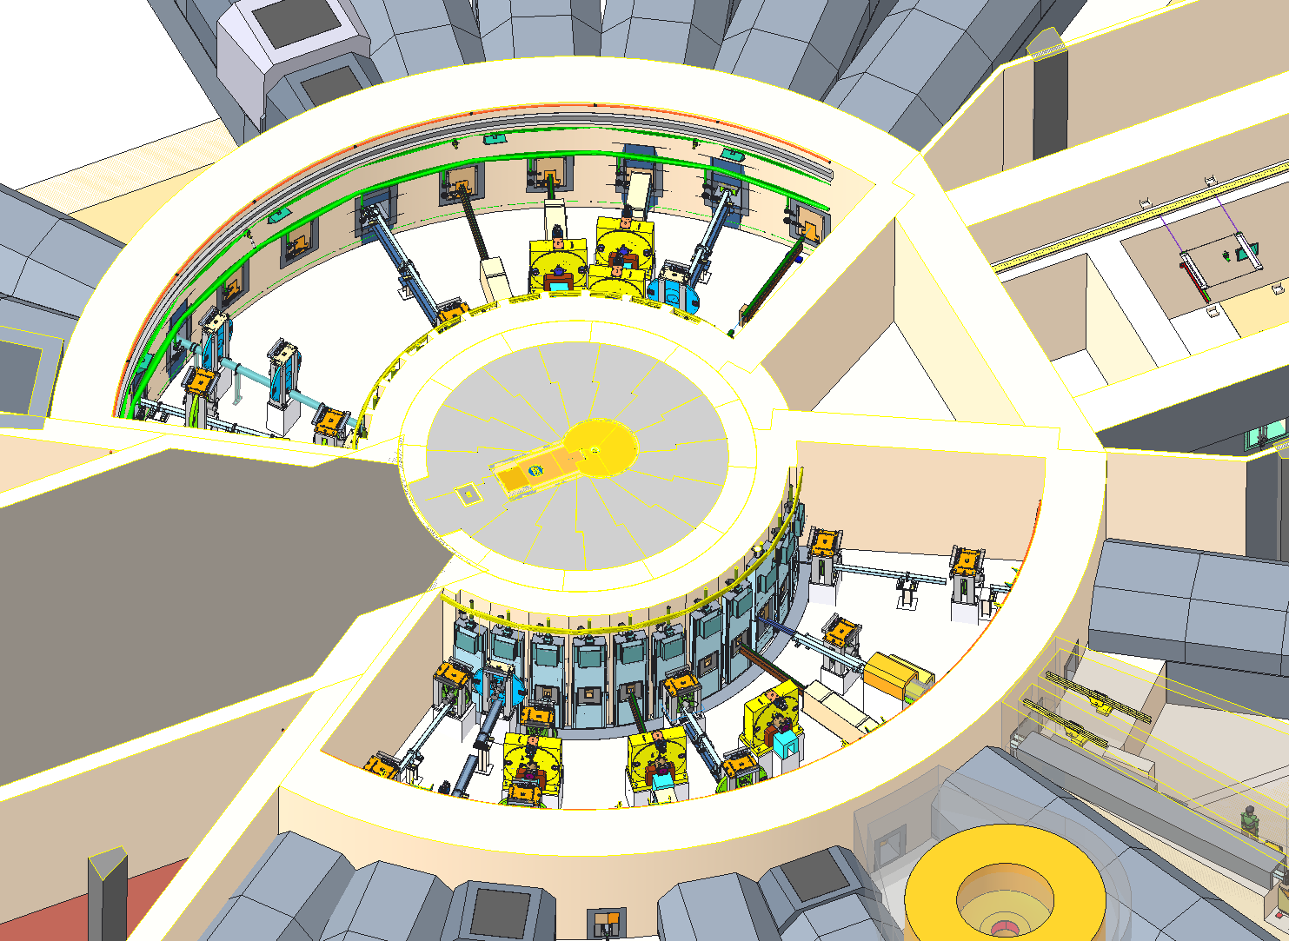
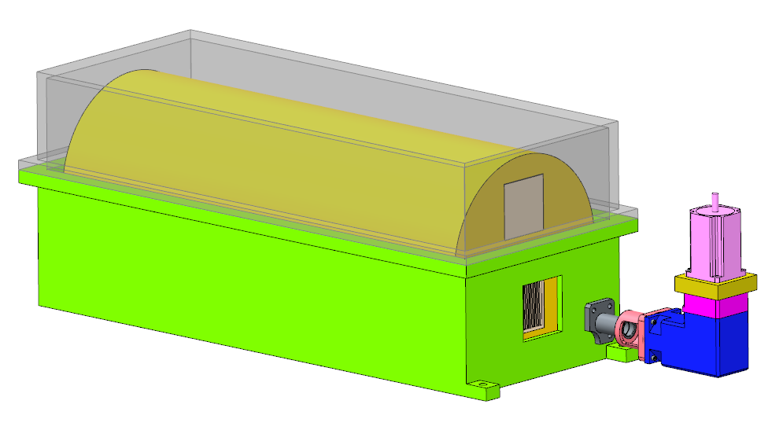
PPS Scope
Maintenance Shutters
PPS ensures the shutters are in the gamma blocker position to allow access to the bunkers
PPS allows beam to the target only in the open or neutron absorber positions
PPS shall allow engineering controls for bypassing each shutter during outage
IPPS – 8 instruments
Access Controls
Operations shutter permits and statuses
Oxygen deficiency monitoring
Local area radiation monitoring
PPS Switches
Open Position (Guide)
Neutron Absorber
Gamma
Blocker
Maintenance Shutter
Operations Shutter

Slide 10
Work Breakdown Structure (WBS)
S.06.06 Personnel Protection Systems
Michaelides
S.06.06.01
Personal Protection Systems Management
S.06.06.02
Accelerator PPS
S.06.06.03
Target PPS
S.06.06.04
Instrument PPS
S.06.06.05
Target Protection Systems
S.06 Integrated Control Systems
Hartman

Slide 11
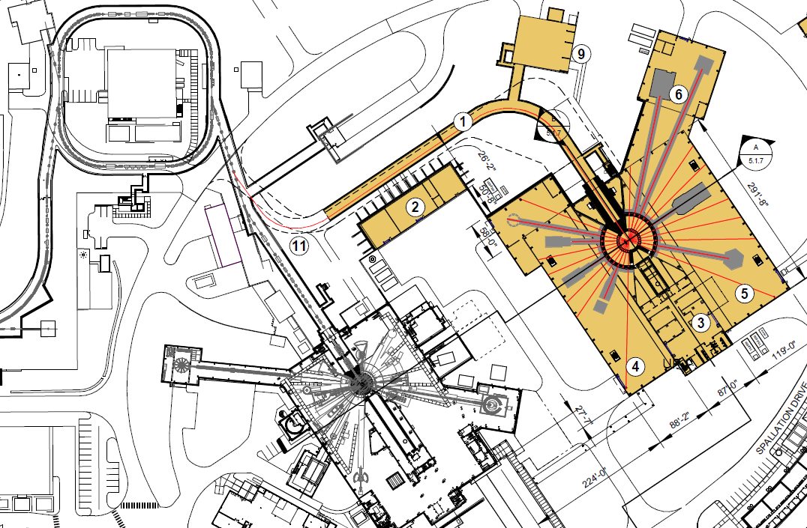
STS PPS Challenges
SNS Final Safety Assessment Document (FSAD-PF) requires two critical devices during FTS target change out (~3 times a year)
Existing PPS will not allow beam to the RTBT if the FTS target cart is not in position by disabling the ring extraction septum magnet & RTBT DH-13
Beam cannot be extracted from the ring for the STS
A solution will be pursued to allow beam to STS during FTS target change outs
Ring Extraction
Septum Magnet
RTBT Dipole Magnet DH-13
Notes:
Part of reviewing the scope for STS

Slide 12
Looking Ahead
Advance the hazard analysis for critical areas with supporting analysis documentation
Define a roadmap for providing beam to STS during FTS target change out
Define the interfaces & requirements for each PPS segment
Update & document the new beam destinations and incorporate them with the existing SNS PPS modes
Define the STS-PPS architecture
A single safety PLC vs. two safety PLCs
Two independent programmers vs. one programmer

Slide 13
Questions?
The preliminary design for CEC systems is advancing; the update of the PHA was a major step
The scope for CEC systems is being refined and updated per PHA
Interfaces between safety systems and other technical systems are understood and being communicated

