Slide 1
Update of the ESS project DOE - Accelerator Safety Workshop, October 2021
PRESENTED BY Peter Jacobsson
Slides provided by ESS staff

Slide 2
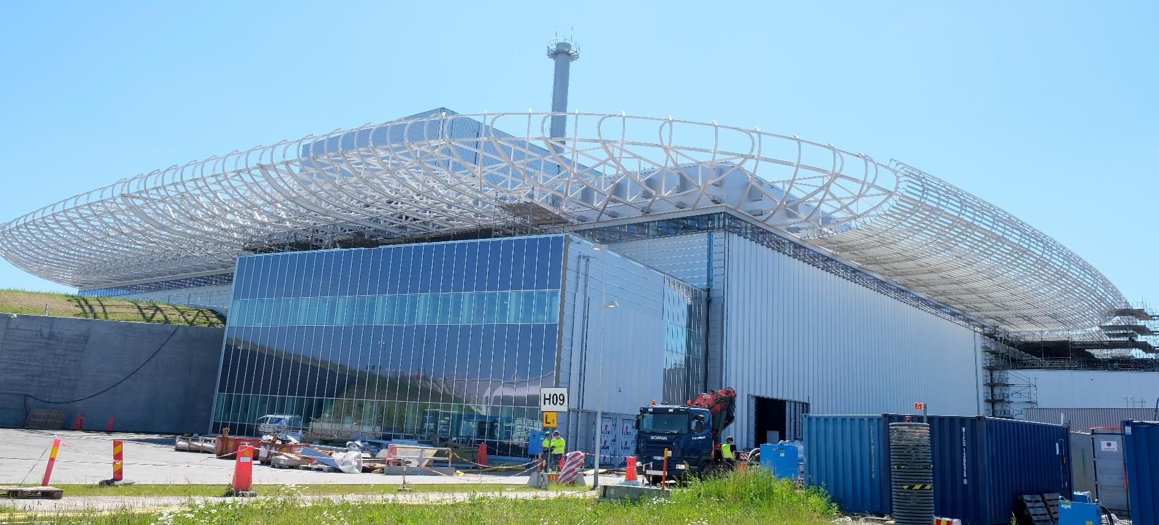
D-buildings
D01, D02, D04, D03

Slide 3
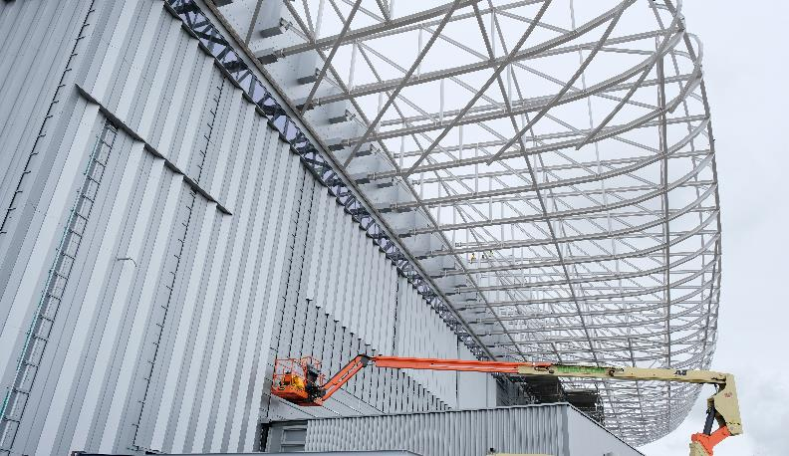
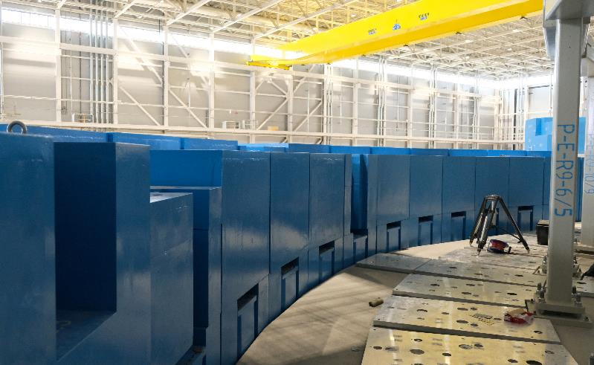
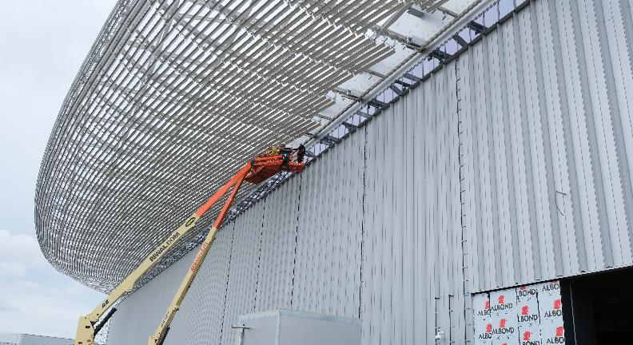
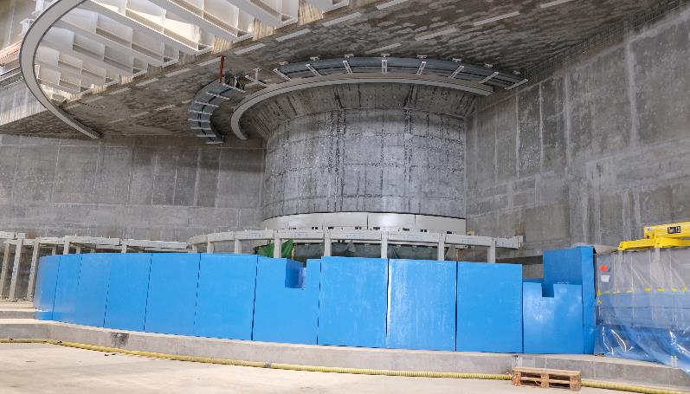
D01 Experimental Hall 1
Facades, cantilever roof, NSS bunker & ESTIA Selene guide.

Slide 4
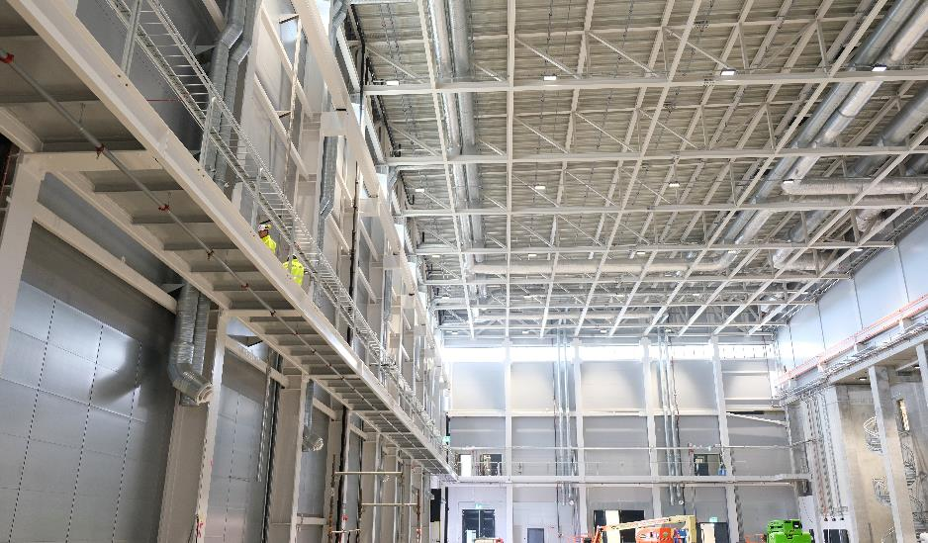
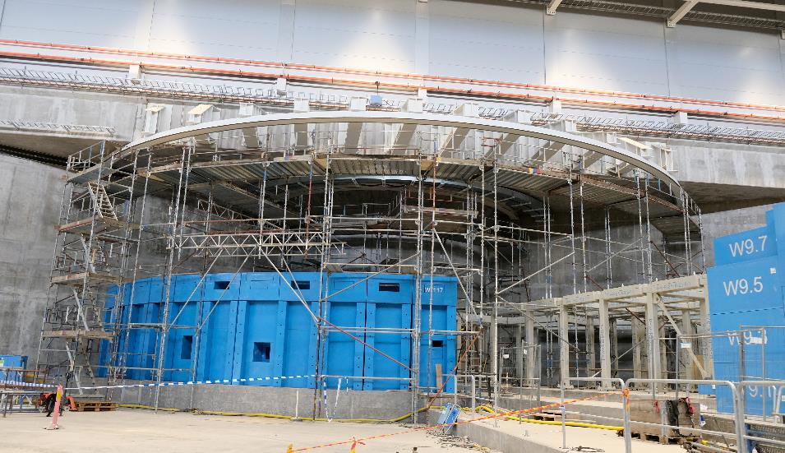
D03 Experimental Hall 1
Walkways, NSS bunker

Slide 5
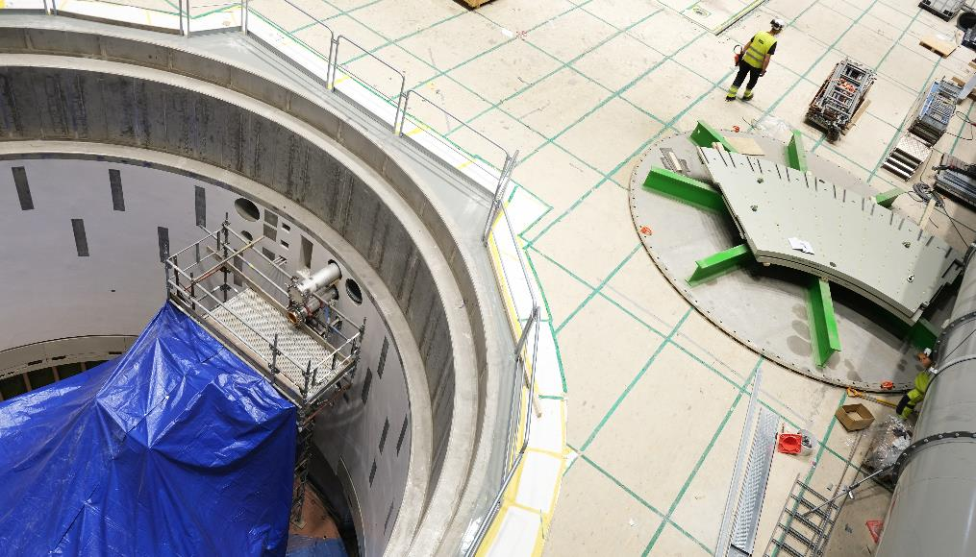
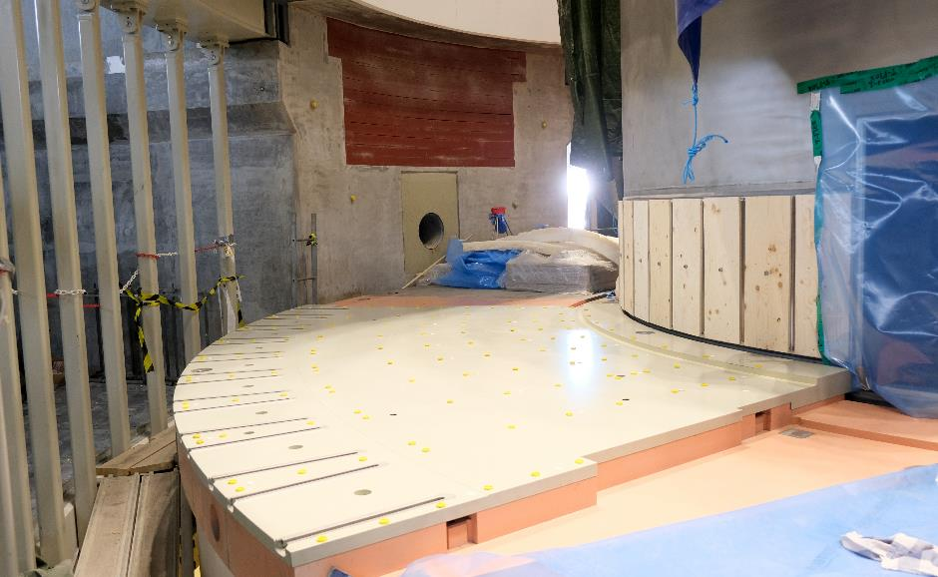
D02 Target Building
Monolith bottom plate for port tubes

Slide 6
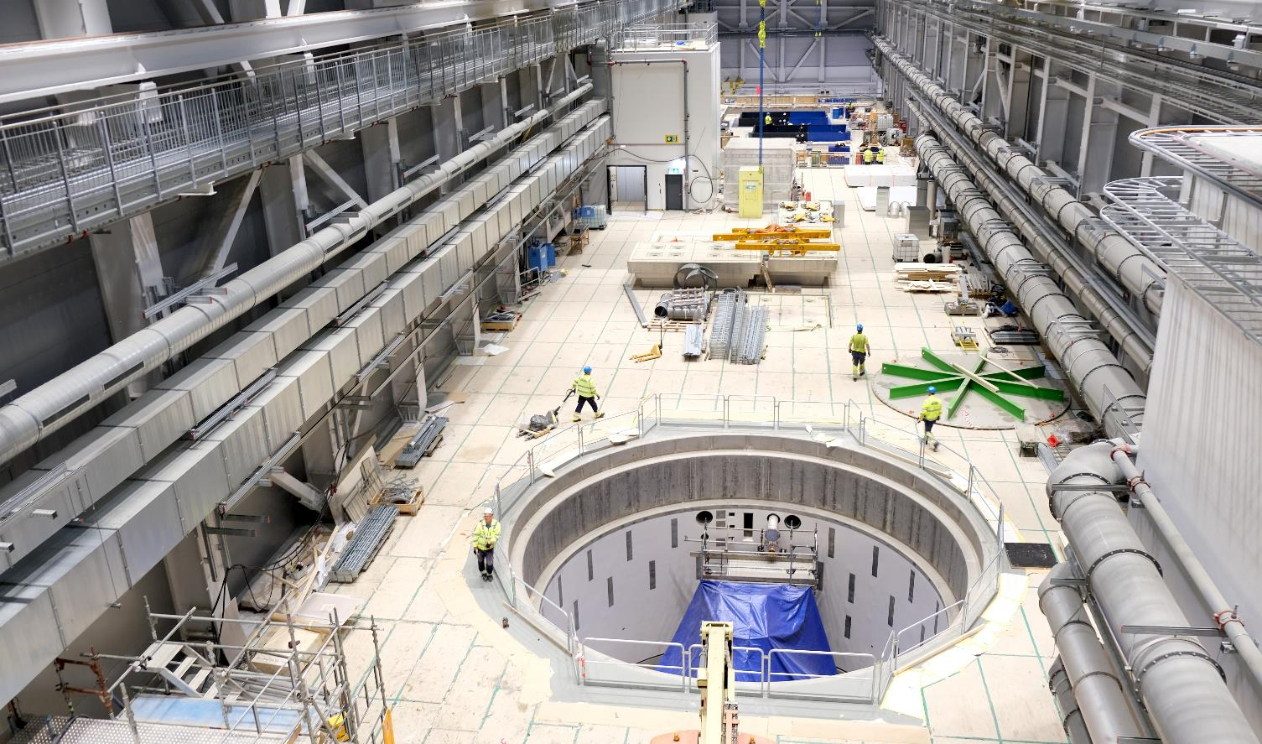
D02 Target Building – high bay

Slide 7
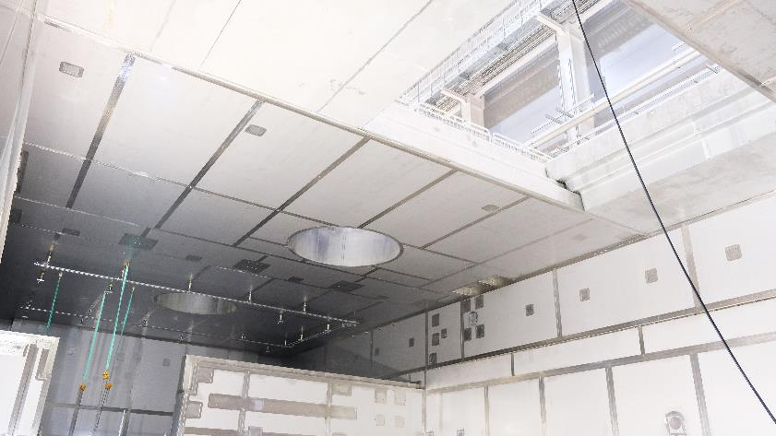
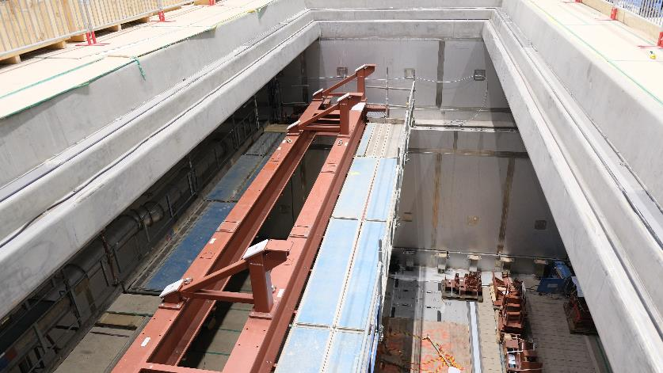
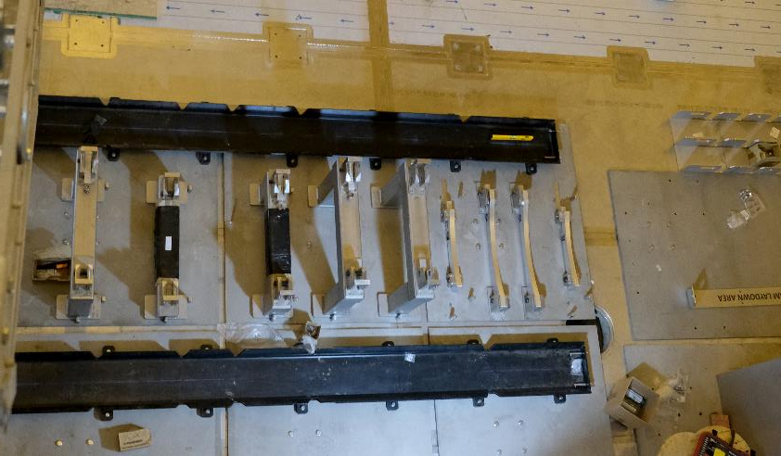
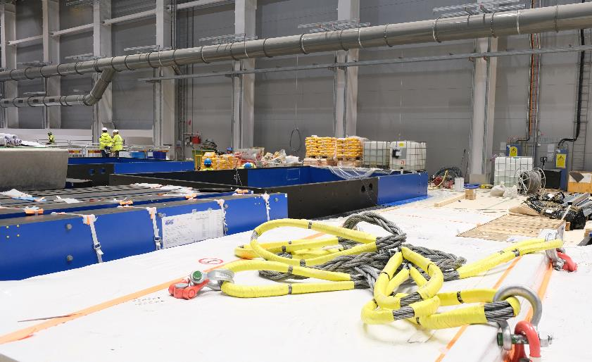
D02 Active Cell
Shaft cutting station, intrabay doors & floor valves

Slide 8
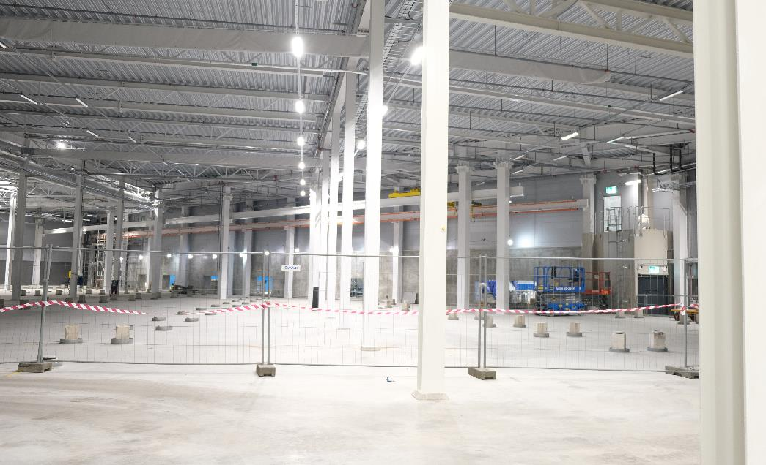
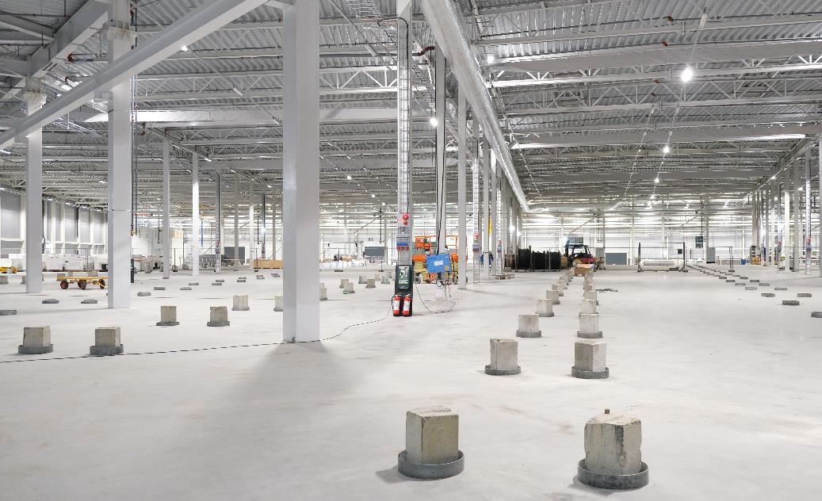
E02 part 2, Beamline Gallery
Handover to ESS: 13 September 2021

Slide 9
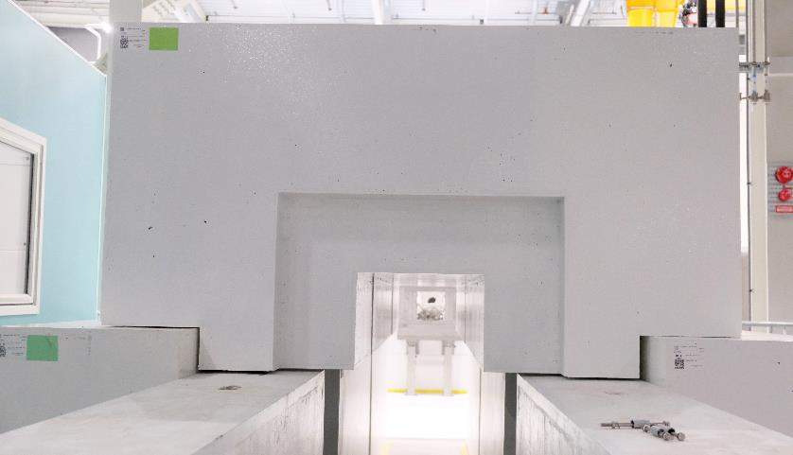
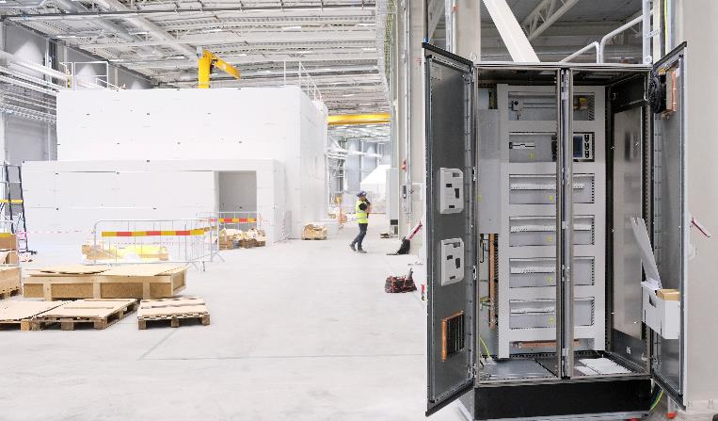
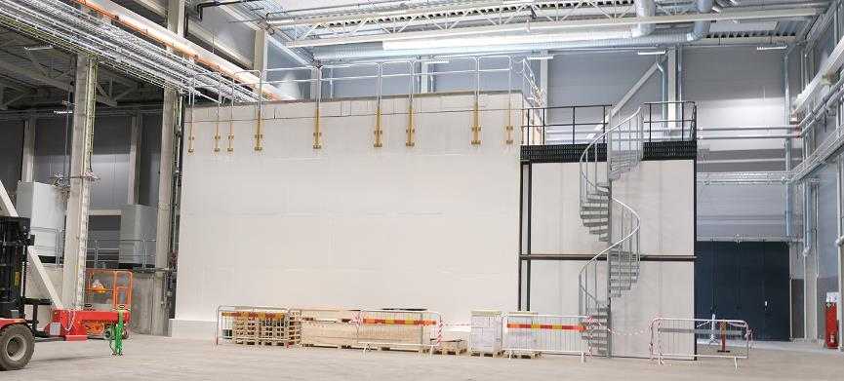
Experimental Hall 3
BIFROST & NMX caves

Slide 10
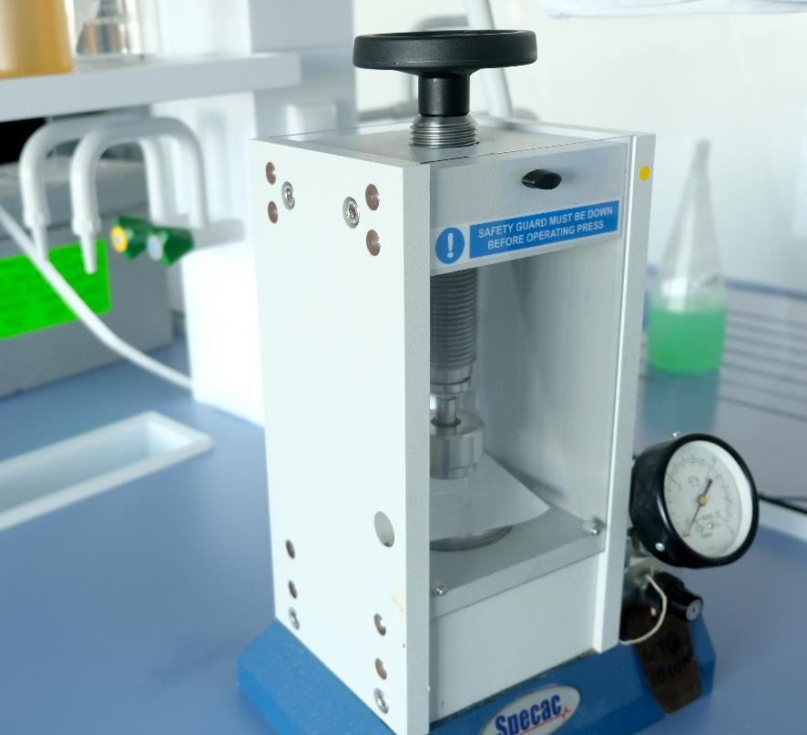
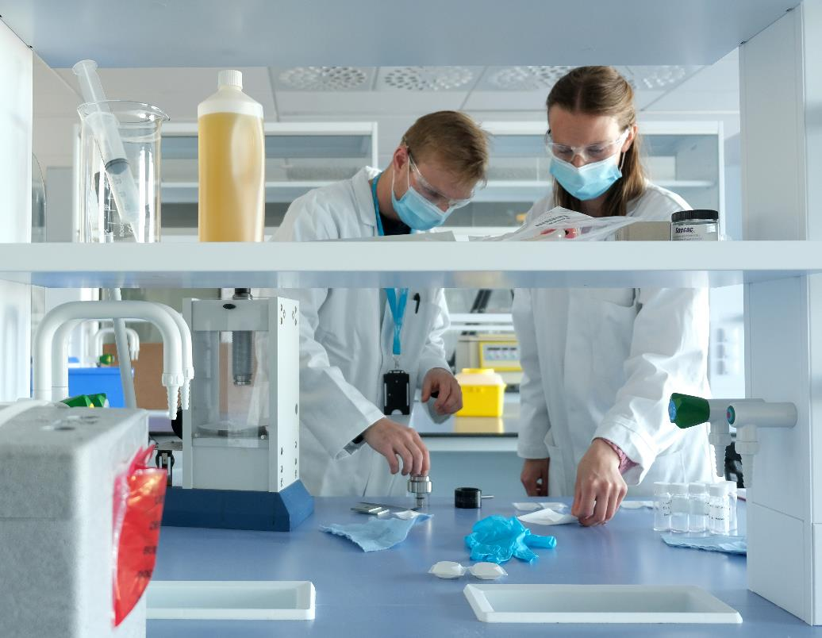
E03 & E04 labs
Operational since early 2021

Slide 11
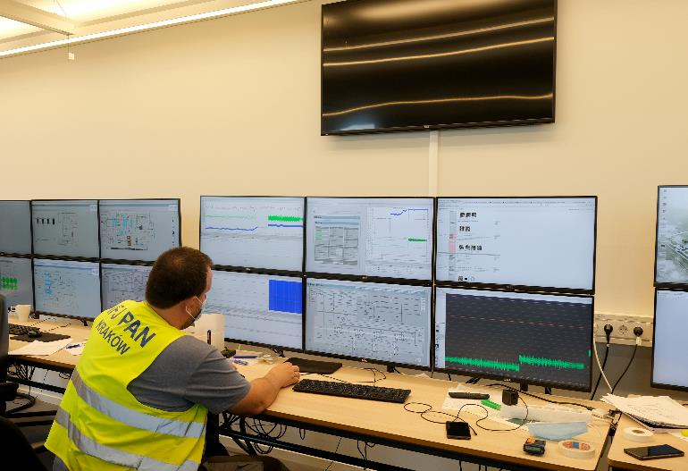
Accelerator buildings
Test Stands 2 cryomodule testing

Slide 12
Accelerator buildings
Klystron Gallery

Slide 13
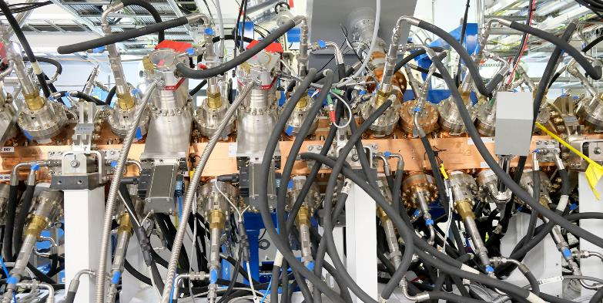
Accelerator buildings
RFQ conditioning completed

Slide 14
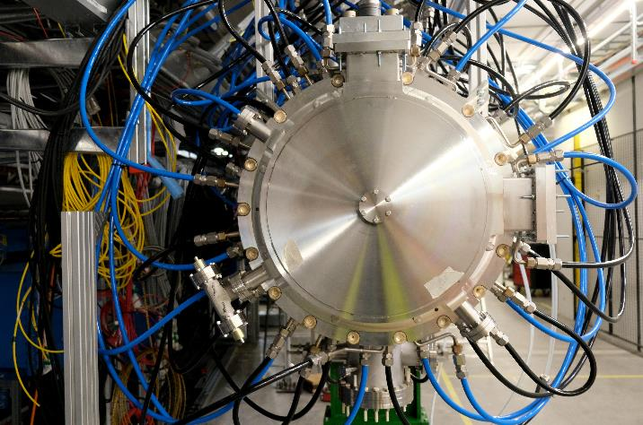
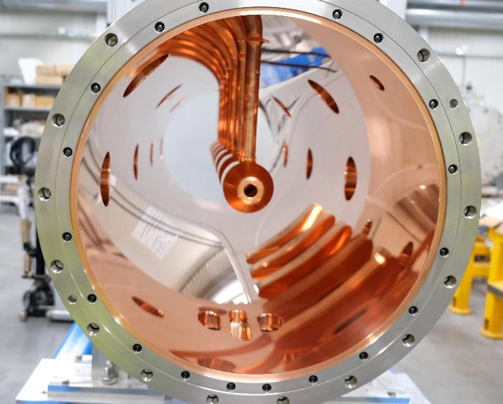
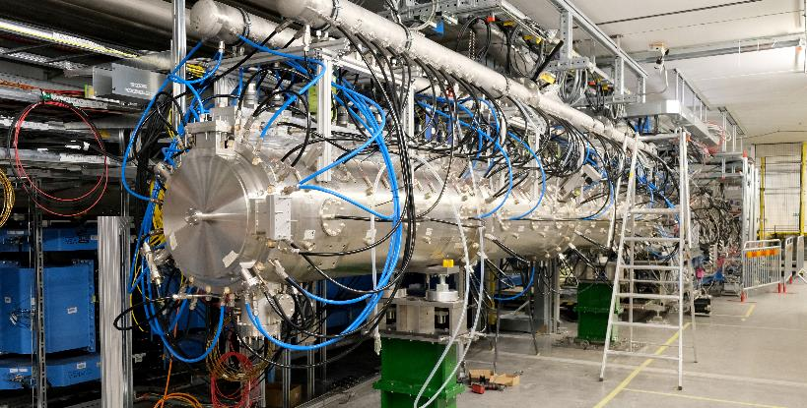
Accelerator buildings
DTL tank 1 installation

Slide 15
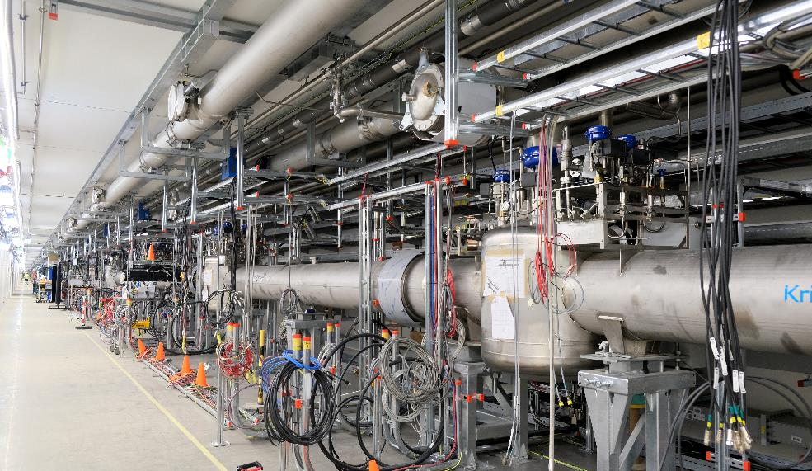
Accelerator buildings
Accelerator tunnel, Cryo Distribution System

Slide 16
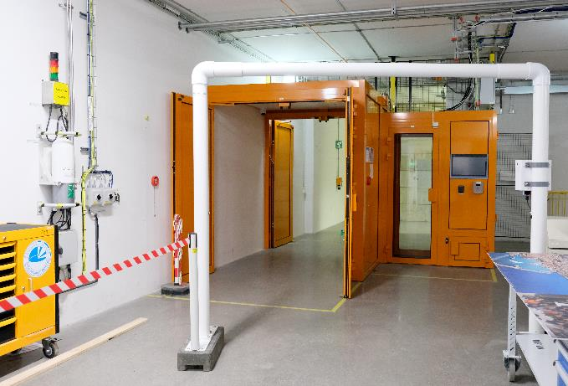
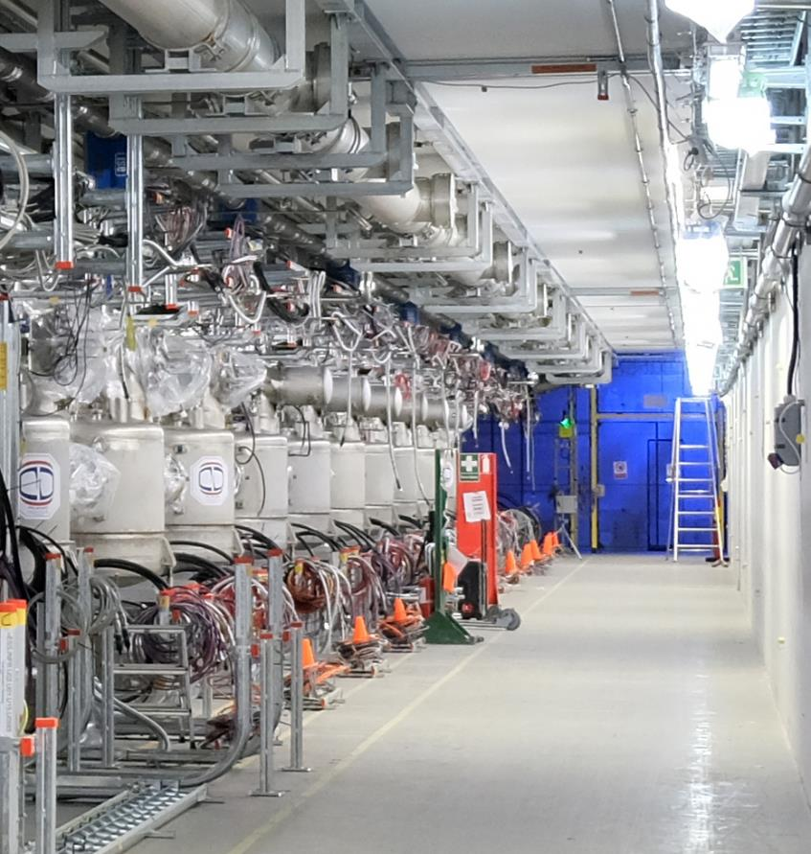
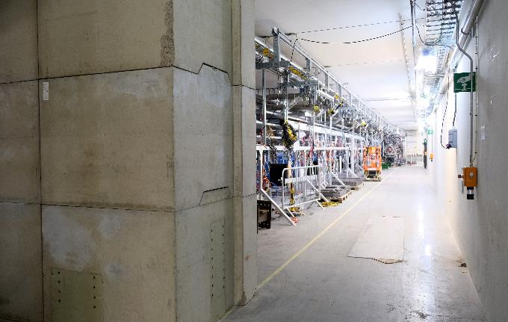
Accelerator buildings
Personnel Protective Systems

Slide 17
Safety Readiness Review (SRR), 2a
First part of the Normal Conduction Linac (NCL), Ion Source & MEBT
ESS has a permit from SSM to commission and operate the whole NCL. As one condition undertaking by ESS, we will perform and independent SRR
Additional permits, e.g. flammable material & explosives (the local fire brigade) are in place
SRR2a conducted first week of September 2021 as a “in-person” meeting during two days.
Main topics
System description, documentation, configuration control
PSS, REMS, Shielding, operational RP
Pressurised equipment
Fire safety, explosives and emergency preparedness
Electrical safety
On-site inspection conducted

Slide 18
SRR2a Committee members and Observers
Name | Company
John E Anderson (Chair) | Former Fermilab
Stefan Choroba | MHF-p Group at DESY
Michael Dressel | Group MPS at DESY
Yves Loertscher | CERN
Stefan Roesler | CERN
Mattias Skafar | European Spallation Source ERIC
Friedrich Szoncso | Former CERN
Observers:
Peter Frisk | SSM Sweden
Tomas Andersson | SSM Sweden
Pia Eriksson | SSM Sweden

Slide 19
SRR 2a
Conclusions
9 pre-start recommendations
4 clarifications related to PSS
2 for validation & testing of equipment to be installed/put back in place
2 related to “clean-up” of documentation
1 related to configuration control
6 post-start recommendations
2 related to maintenance instructions
2 related to future (operational) resources for RP and PSS
1 related to definition of “Safe state” (extension of non-radiation hazards)
1 related to assessing the need for an interlock system for RF monitoring
Planned commissioning date: 13th of October is OK!

Slide 20
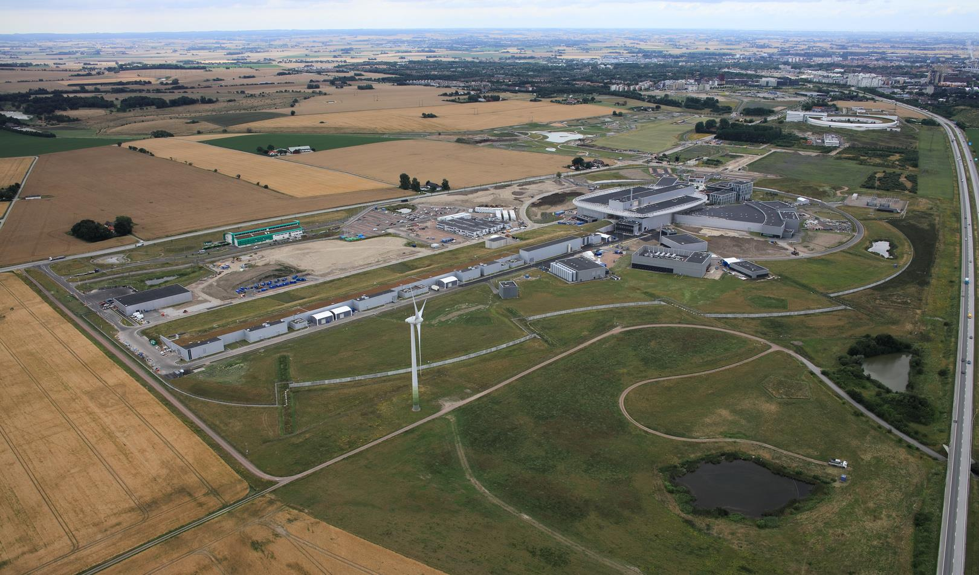
Thank You

