Slide 1
Safely Upgrading The Advanced Photon Source (APS) Current challenges
erhtjhtyhy
Tiffany CR Freedman
ESH Coordinator – APSU
Argonne National Laboratory
October 4-7, 2021
DOE Accelerator Safety Workshop

Slide 2
Outline
The Advanced Photon Source (APS) - NOW
The Advanced Photon Source (APS) – SOON
Safe Accelerator Operations
COVID
Argonne COVID Response
Proximity Devices
Work Planning and Control, including Work Authorization
Summary

Slide 3
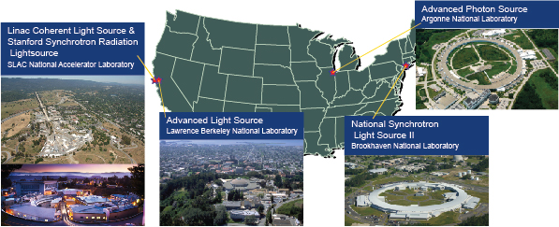
U.S. Department of Energy X-ray Light Sources
The U.S. DOE Office of Science supports the operation of many major research facilities across our nation.
They provide open, peer-reviewed access to sophisticated research tools for scientists (users) from academia, national laboratories, and industry carrying out research in all major scientific disciplines

Slide 4
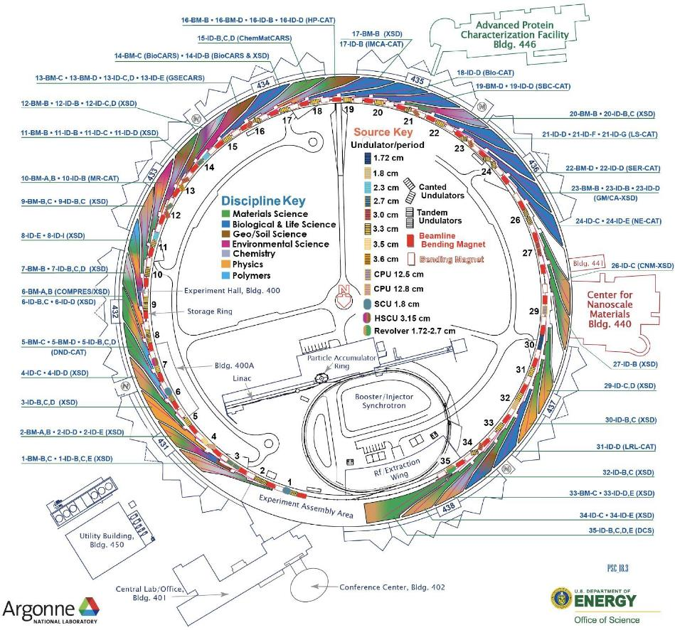
The Advanced Photon Source Overview
Commissioned in 1995, first top-up operation in 1999
7 GeV electron storage operating at 102 mA
In FY18, >5,700 unique onsite/offsite users
from >700 institutions
68 simultaneously operating endstations
46 undulator beamlines
22 bending magnet beamlines
35 APS-operated with BES funding
33 partner beamlines, principally CATs
1 jointly operated between APS & CNM (26ID)
2 (SBC) operated by APS with BER funding
3 (GM/CA) operated by APS with NIH funding
4 (HP-CAT) operated by APS with NNSA funding
Two sectors (25,28) being developed by APS-U
Notes:
Funding (construction and operations): U.S. Department of Energy Office of Science
Location: Argonne National Laboratory, Argonne, Illinois
APS construction cost: $467 million (excluding cost of beamlines)
Annual operating budget: ~$130 million per year
Construction start: spring 1990; Research start: fall 1995
Number of APS operations staff: ~450
Outer diameter of the APS experiment hall: 390 meters (1,225 ft)
Height of the Willis Tower in Chicago: 436 m (1,454 ft)
Concrete used in construction of the APS experiment hall: 54,600 cu yds (1,600 cu yds of heavy-weight concrete for shielding), equivalent to a football-field-sized block 30 ft high
Structural steel used in construction of the APS experiment hall: 5800 tons, equivalent to 3,500 mid-size autos
Wire used in construction of the APS experiment hall: 600,000 m (2,000,000 linear ft)
Total gross floor space of all APS buildings: 86,310 m² (959,000 square ft)
The APS accelerator comprises:
More than 2,000 conventional electromagnets & 16 pulsed electromagnets
More than 700 electron beam-position monitors, 600 magnets, & 80 computer systems to monitor & correct beam orbit and steer x-ray beams onto experiment samples to micron-size tolerances
X-ray beam-position monitors to provide beam stability that is equivalent to firing a stream of bullets through the bull's-eye of a target from several miles away
More than 120 computers, monitoring more than 25,000 signals, for personnel protection systems
APS beam diagnostics that control 43 x-ray beams simultaneously
Nearly 100 remote computers to collect data from the 500 monitors & re-steer the x-ray beams 1,500 times per sec
A control system of 80 workstations, more than 200 distributed input/output computers (IOC), more than 7,000 replaceable hardware components, & over 100,000 IOC points monitoring or controlling more than 450,000 technical parameters

Slide 5
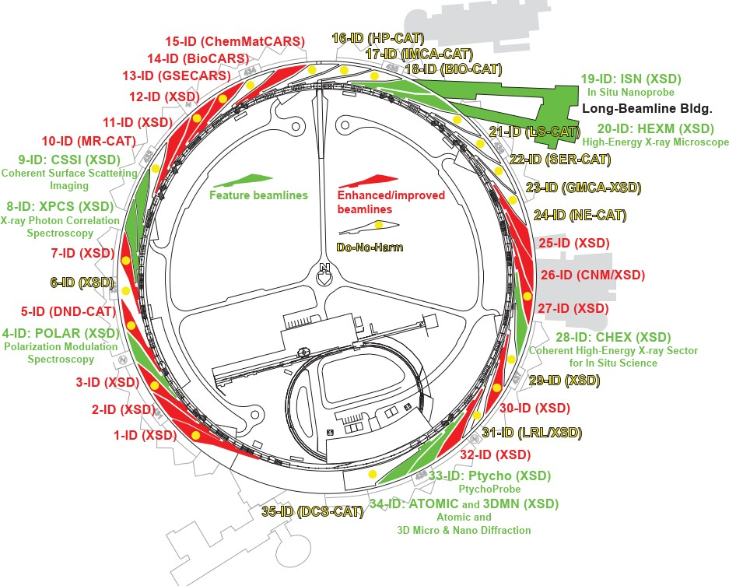
APS-U Project Scope
New storage ring: 42-pm emittance @ 6 GeV, 200 mA
New and updated insertion devices, including superconducting undulators (SCUs)
Combined result in brightness increases of up to 500x
9 new feature beamlines
+ Long Beamline Bldg
15 enhanced and improved beamlines
Exploit high-performance computing, AI
815M$ project to update and renew the facility
Re-uses 1.5B$ in existing infrastructure

Slide 6
APS-U by the Numbers (partial)
Storage Ring | Insertion Devices | Front Ends | Beamlines
1,321 Magnets | 11 Phase Shifters/Supports | 470 Tables/Supports | 36 Enclosures
4,640 Vacuum Components | 48 Canted Magnets/Supports | 162 Shutters | 61 Mirrors
120 Modules | 33 Corrector Magnets | 108 BPMs | 28 Instruments
80 Support Plates | 800 Vacuum Components | 162 Masks | 23 Monochromators
2,245 Power Supplies | 68 Power Supplies | 116 Collimators | 9 Transports
400 Power Supply Controllers | 4 Superconducting Undulators* | 19 High Heat Load Front Ends | 22 Compound Refractive Lens
560 RF BPM Electronics | 43 Planar Insertion Devices** | 16 Canted Front Ends | 13 Enhanced Beamlines
200 Module Assemblies | 12 Revolver Devices*** | 20 Bending Magnets | 9 Feature Beamlines
* 2 different periods, 3 different core lengths
** 2 different periods

Slide 7
Safe Accelerator Operations
Risks/Hazards of Particle Accelerator Technologies | Beam Hazards and Ionizing Radiation | Industrial Safety
Magnets Normal Conducting, Superconducting | Beam Loss | Electrical
Cryogenics Cryogenic Fluids, Oxygen Deficiency Hazards (ODH) from Cryogenic Fluids | Beam-Matter Interactions | Machines Machines, Transport and handling
Radiofrequency Technologies | Ionizing Radiation Sources, Dosimetry, Shielding, Control of Radioactive Material | Pressure Vessels
Lasers |  | Fire Safety
Beam intercepting devices Collimators, targets, beam dumps |  | Occupational Noise
 |  | Environmental Impact
Organization: Process, Organization and Management, Beam Safety, Functional Safety
Notes:
Normal safety considerations for running an accelerator. Many are the same for the upgrade…Additional considerations

Slide 8
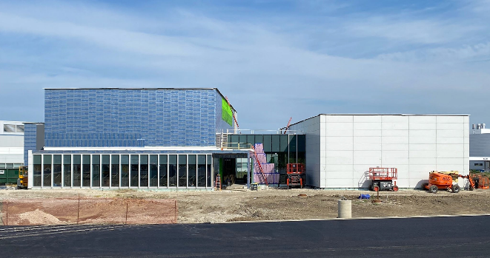
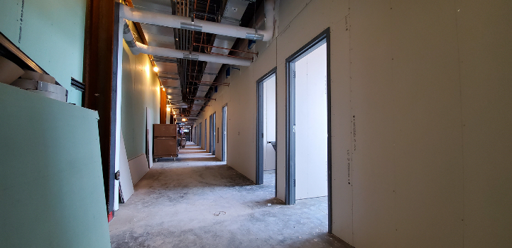
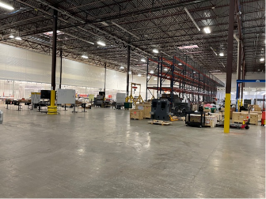
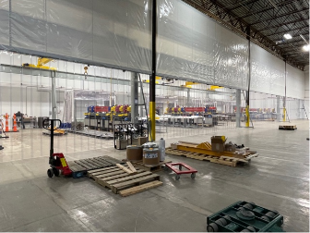
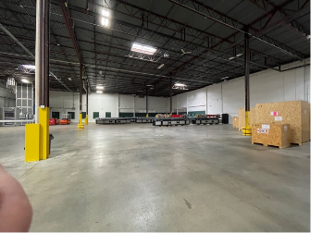
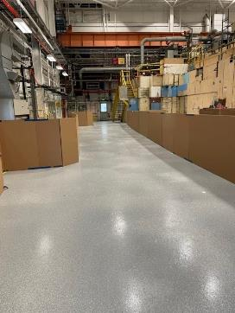
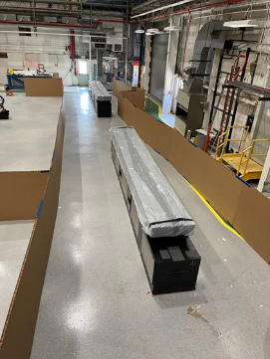
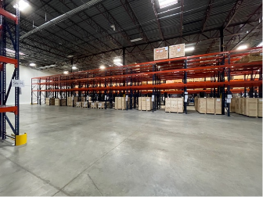
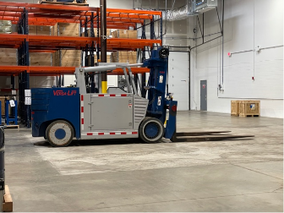
General Construction and Industry Safety
Long Beamline Building (LBB)
West Elevation
20-ID Corridor (looking West)
Building 375 – Full Sector Mockup
Building 981 – Offsite Warehouse
Notes:
But even this couldn’t have prepared us for our biggest safety challenge.

Slide 10
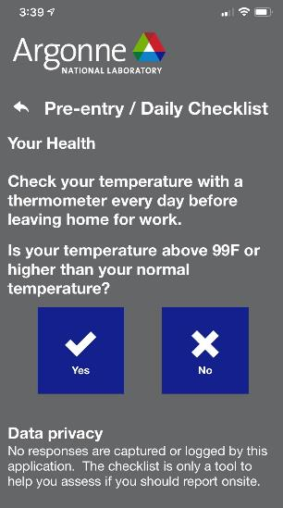
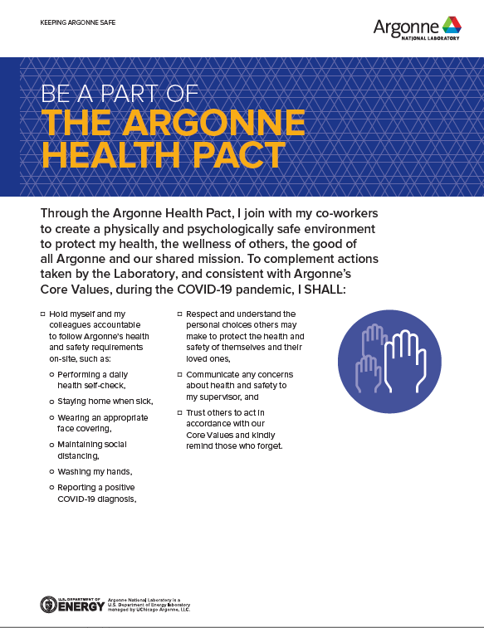
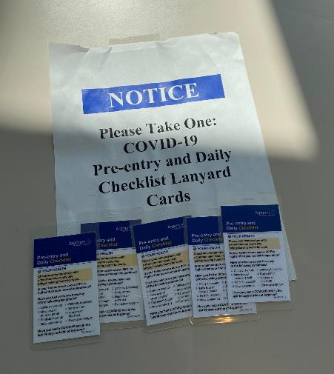
Argonne COVID response
Staff asked to sign an Argonne Health Pact in Workday.
On-site staff perform a self check each day prior to arrival – Argonne app can be used without PII recorded.
COVID100 course is required for site access.
PPE inventory and associated usage rates are actively managed.
Onsite testing is offered and available to all employees.
Argonne made a limited quantity of vaccines available for eligible on-site staff.

Slide 11
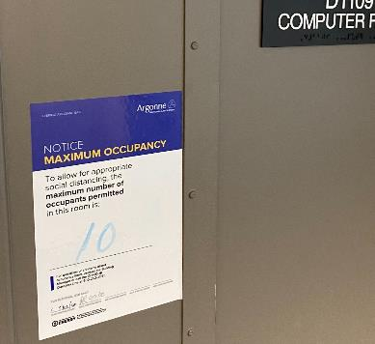
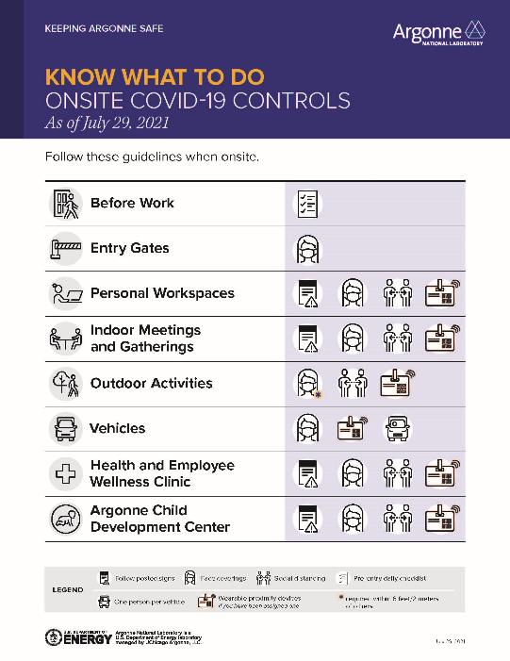
Argonne COVID response
Lab continues to map, track, and limit density.
Occupancy limits and distancing reminders are posted.
Facilities have regular “COVID Walk downs”
Active contact tracing program
Proximity monitors to aid in contact tracing and encourage continued social distancing
Work planning and control process includes COVID controls
Staff asked to attest to vaccination status in compliance with White House Executive Orders

Slide 12
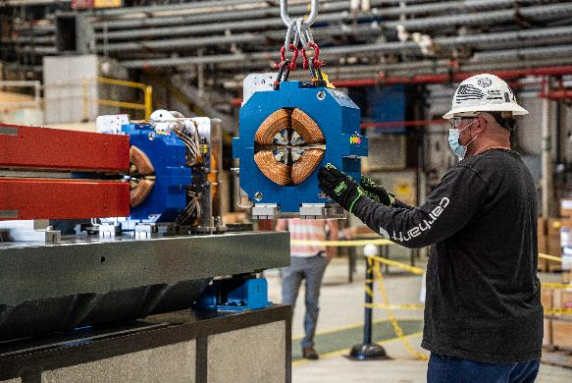
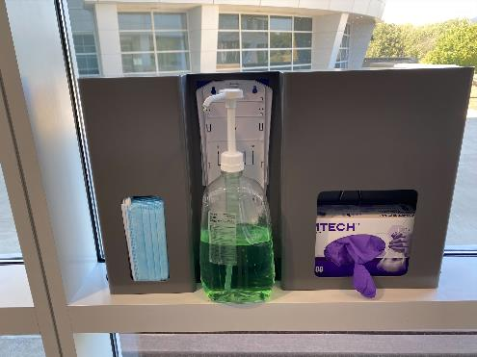
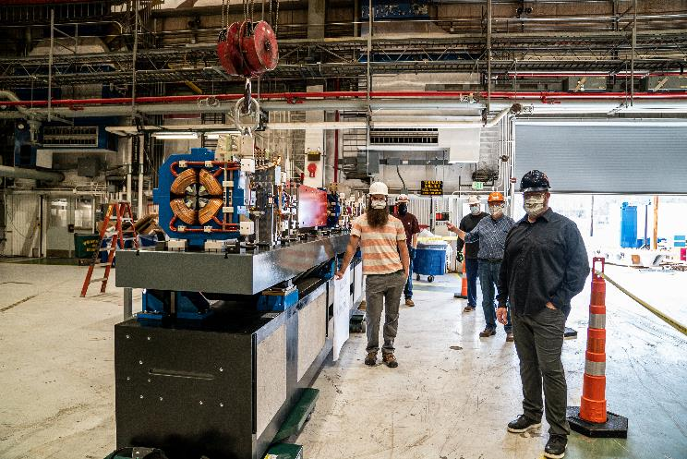
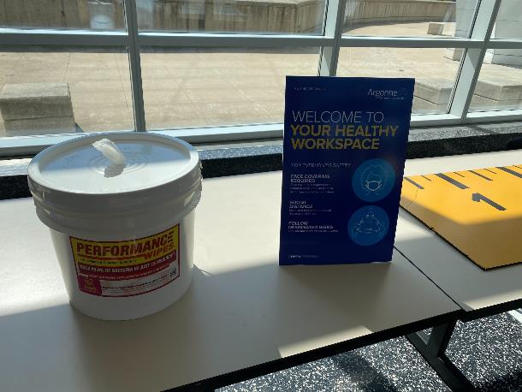
Argonne COVID Response
Buildings continue to provide COVID resources.
Face covering requirements reflect local key indicators
Notes:
Building provide COVID resources and are regularly walked down to ensure continuity of supply- frequency based on population density. Facility Readiness Working Team: Amenities, Common spaces and Offices
Surrounding counties dictate mask requirements. Changes are communicated lab wide

Slide 13
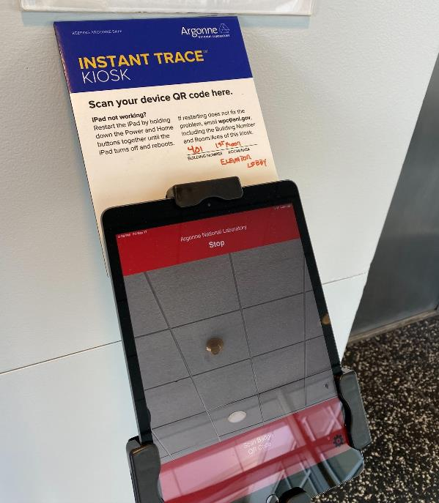
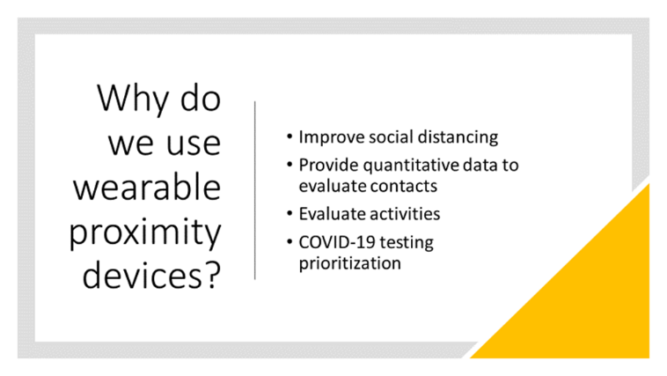
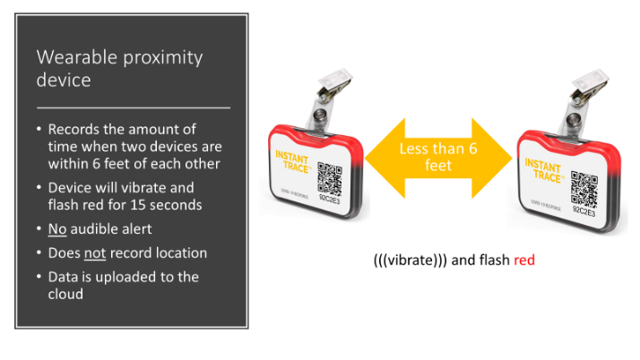
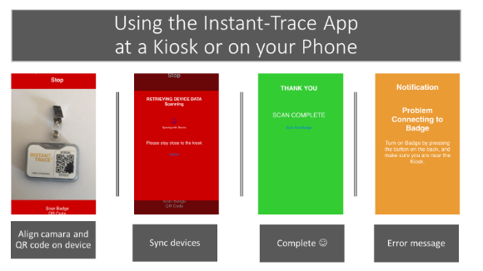
Argonne COVID Response
Proximity Devices

Slide 14
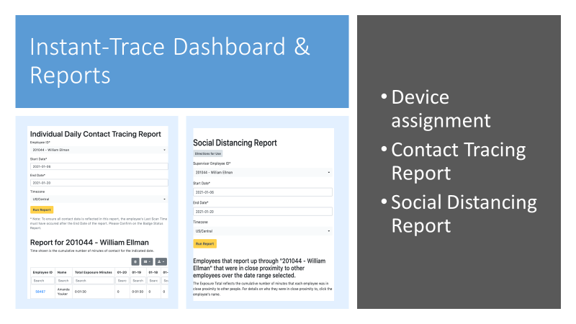
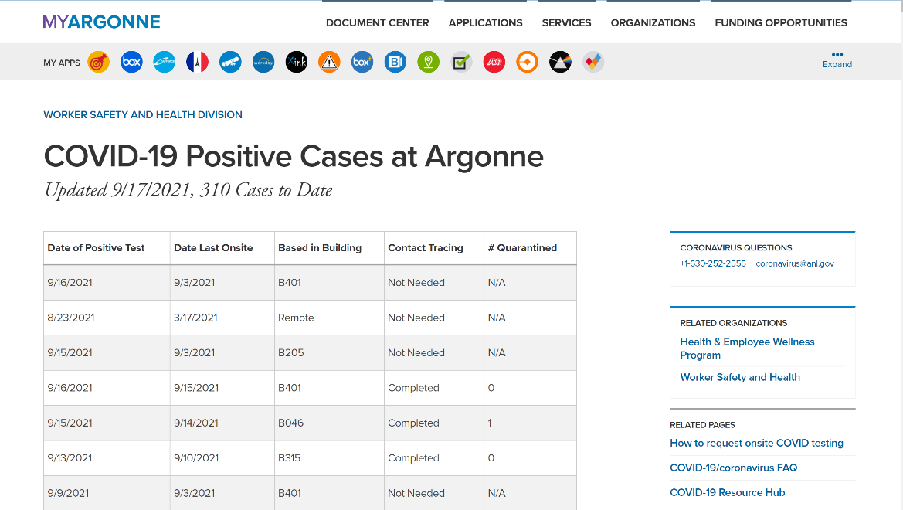
Argonne COVID Response
Contact Tracing
Notes:
Contact tracing experience
How did prox badges change the experience?

Slide 15
Work Planning and Control, including Work Authorization
Argonne COVID Response
Work under limited operations is evaluated for appropriateness and authorized to address COVID controls
WPC Process documents updated to include COVID controls
Video teleconference is used to support WPC development, reviews and safety reviews
WPC & ESH Leads meet with work team to talk through work evolutions, leading to better procedures, Work Control Documents, and eTravelers
COVID communications improved work planning!

Slide 16
Summary
Argonne COVID Response –
Limited Operations
Ongoing work continues to require social distancing, enhanced cleaning and disinfection
Face coverings requirements reflect local key indicators
Workspaces are reconfigured to promote distance
Additional equipment needs are identified in planning process
All work is evaluated for COVID exposure and control, and then formally authorized and briefed
ESH support shifted to maintain coverage for work with back up available
Safety topics are written including relevant current COVID guidance.
Impact on future work
Work activities are authorized for a limited duration of time, considering risk; work authorized during Limited Operations or later transitional stages is reviewed, to ensure appropriate COVID controls are integrated and adopted, thus evolving as the Lab transitions to new operational statuses
APS-U/PSC/ANL ESH staff will continue to support APS-U operations in accordance with evolving guidelines

Slide 17
QUESTIONS

Slide 18
Additional slides

Slide 19
Argonne COVID Response

Slide 20
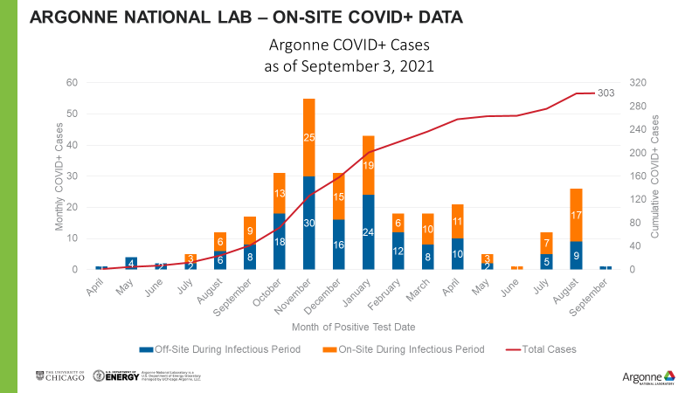
Argonne COVID Response
COVID response based on key health and operational indicators communicated to lab leadership on daily and weekly basis

Slide 21
Argonne COVID Response
Notes:
PSC COVID response dashboard, updated/rebriefed regularly.

Slide 22
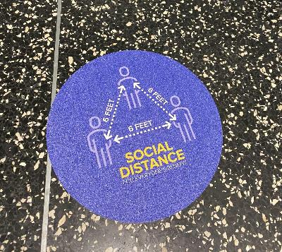
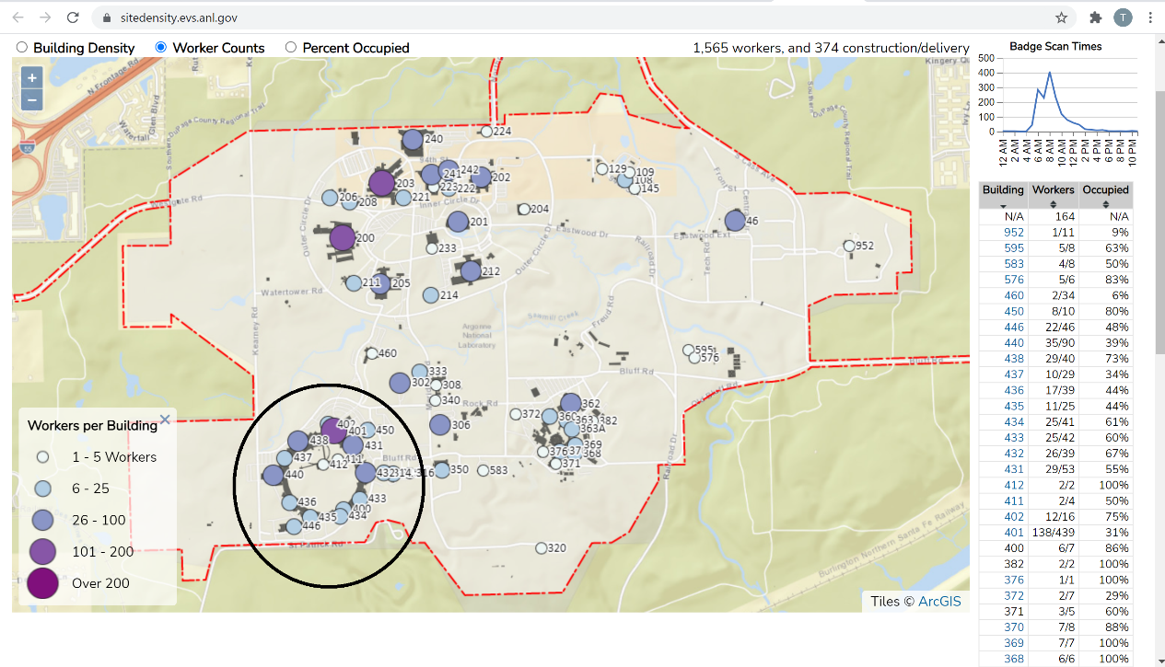
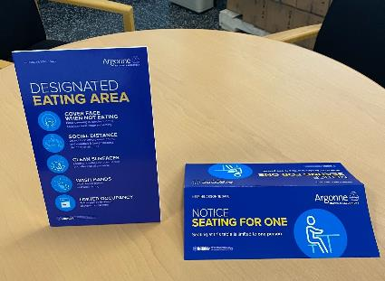
Argonne COVID Response
Lab continues to map, track, and limit density.
Occupancy limits and distancing reminders are posted.
Notes:
Information from WorkDay and badge scans, not proximity devices

Slide 23
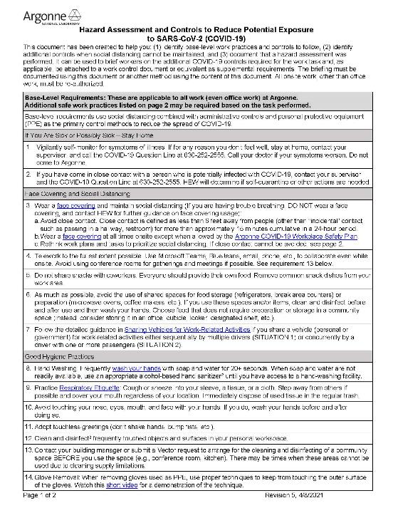
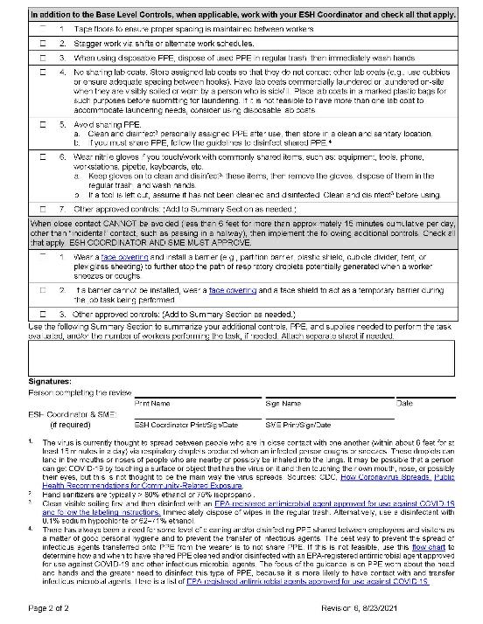
Work Planning and Control, including Work Authorization- HAC
Argonne COVID Response
Hazard and control strategy worksheet designed as a supplement to existing WCDs
identifies base-level work practices and controls to follow
Identifies additional controls when social distancing cannot be maintained
documents that a hazard assessment was performed.
can be used to brief workers on the additional COVID-19 controls required for the work task and, as applicable, be attached to a work control document or equivalent as supplemental requirements.
Working < 6 ft from others requires an SME industrial hygiene review, in addition to ESH coordinator
All onsite work, other than office work, must be re-authorized and requires new pre-job briefing
Notes:
Existing WCDs

Slide 24
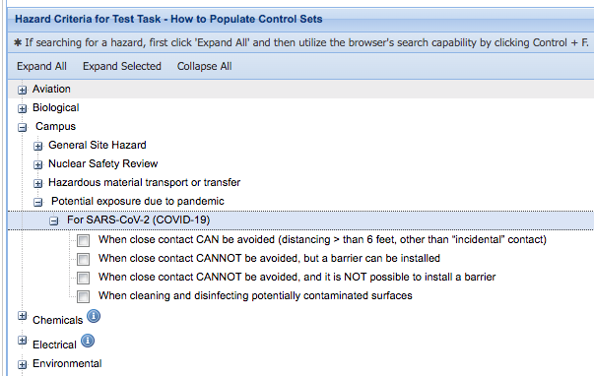
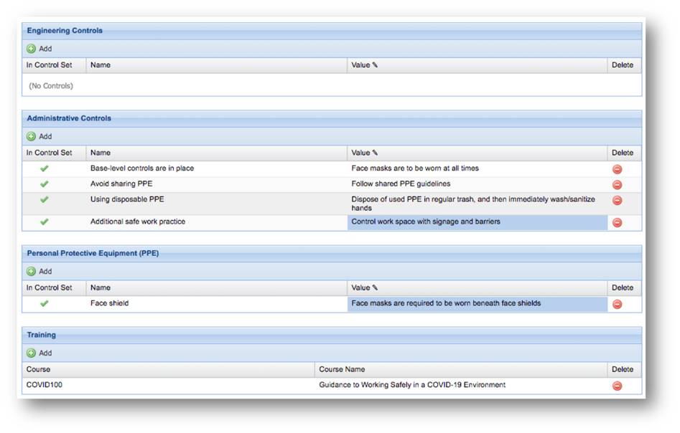
Argonne COVID Response
Work Planning and Control, including Work Authorization-COVID-19 Control Strategy added to Aware
Hazard tree in the Aware WPC application includes COVID-19
Selecting “when close contact CANNOT be avoided…” requires industrial hygiene SME approval
SME-developed control sets are available in the system – “values” allow the work planner to elaborate on control strategy
Aware also checks that workers have completed the COVID100 training

Slide 25
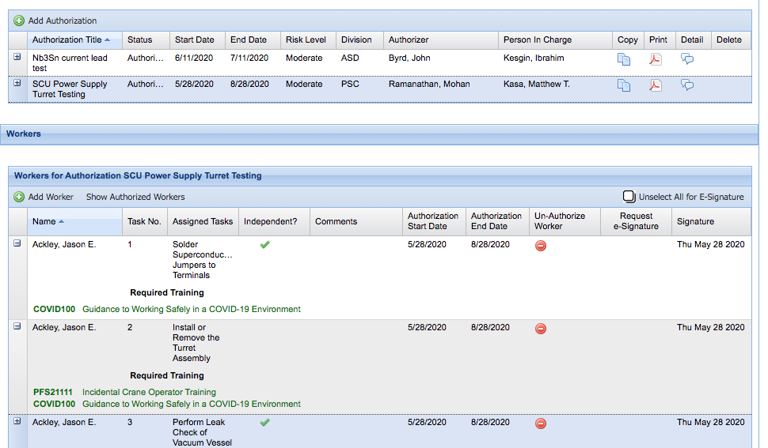
Argonne COVID Response
Work Planning and Control, including Work Authorization-WPC authorization
Authorization tool:
Integrates with Training Management System to validate completion of worker training required by task
Designates a Person in Charge
COVID100 course is required for all tasks

Slide 26
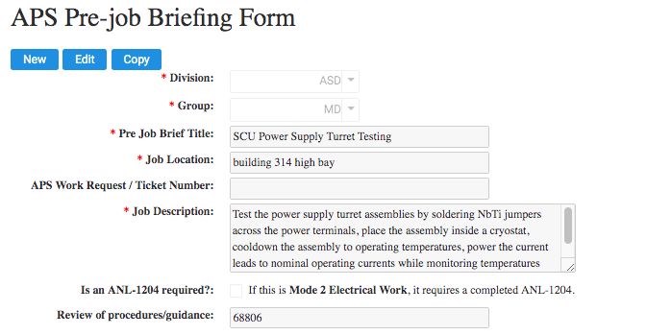
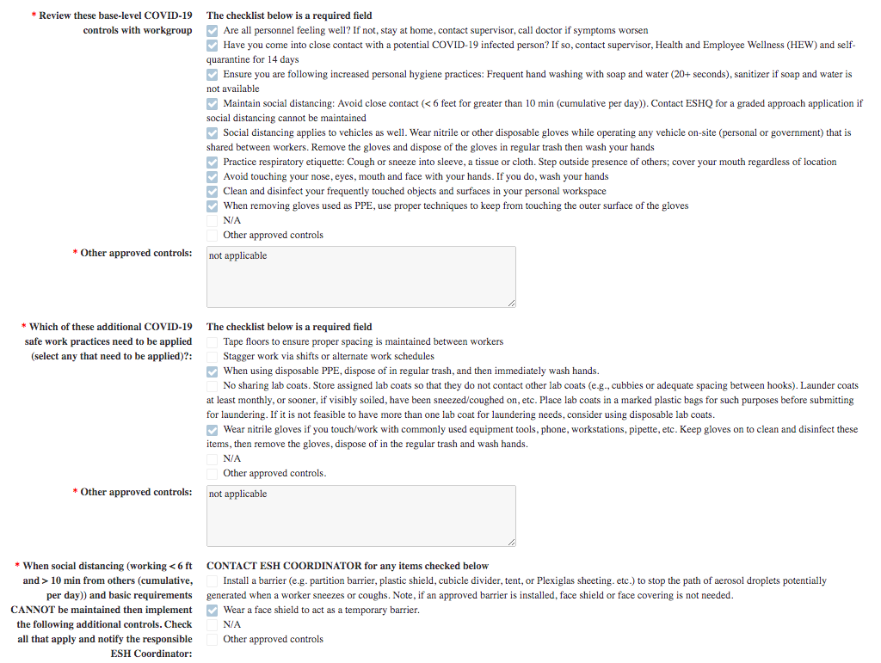
Argonne COVID Response
Work Planning and Control, including Work Authorization-APS PreJob Brief
Pre-job briefings include a checklist on COVID-19 safe work practices

