Slide 1
Construction Status of Personnel Protection System for FRIB
Masanori Ikegami Facility of Rare Isotope Beams, Michigan State University

Slide 2
Outline
Background
Facility layout
Major design parameters
Phased Accelerator Readiness Reviews (ARR’s)
Personnel Protection System (PPS) for Linac
Radiation Safety System (RSS)
Oxygen Deficiency Hazard Control System (ODHCS)
Extension of PPS to experimental area
Summary

Slide 3
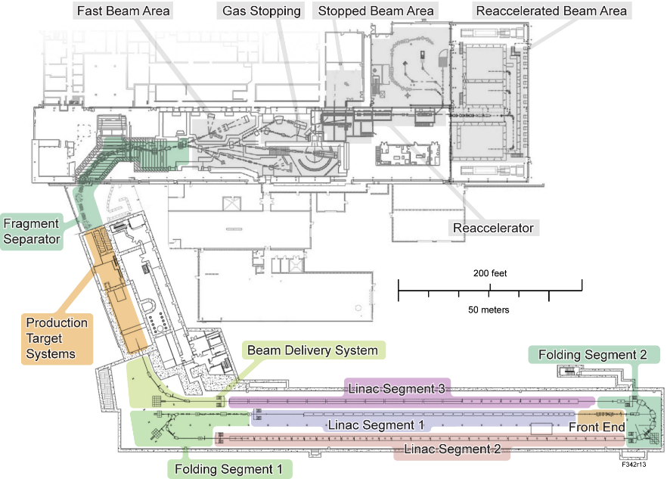
Layout and Major Parameters for FRIB
Delivers primary beams to production target to support physics experiment utilizing various secondary particles
Accelerate ion species up to ²³⁸U with energies of higer than 200 MeV/u
Provide beam power up to 400 kW
Continuous Wave (CW) operation
Constructed beside the existing NSCL (National Superconducting Cyclotron Laboratory) building
Utilize experimental beam lines for NSCL

Slide 4
FRIB Technical Construction 2014 – 2021
FRIB driver linac in accelerator tunnel
Superconducting Radio Frequency (SRF) technology extensively adopted
324 SRF cavities in 46 cryomodules in total to accelerate heavy ion beams from 0.5 MeV/u to ≥ 200 MeV/u
Folded layout with 3 Linac Segments (LSs) connected with 2 Folding Segments (FSs)

Slide 5
Phased Commissioning and Accelerator Readiness Reviews
Commissioning of FRIB accelerator is conducted in phases
Phase | Area with beam | ARR
ARR01 | Ion source, Low Energy Beam Transport (LEBT), Radio Frequency Quadrupole (RFQ), Medium Energy Beam Transport (MEBT) | 07/2017 | ✔
ARR02 | Linac Segment (LS) 1 (β=0.041 cryomodules) | 05/2018 | ✔
ARR03 | Rest of LS1 and first dipole of Folding Segment (FS) 1 | 02/2019 | ✔
ARR04 | Rest of FS1, LS2, and part of FS2 to straight dump | 03/2020 | ✔
ARR05 | FS2, LS3, part of Beam Delivery System (BDS) to straight dump | 04/2021 | ✔
ARR06 | BDS, target hall pre-separator | 10/2021
ARR07 | Fragment separator, FRIB project completion | 01/2022
6
BDS
5
LS3
FS2
3
LS1
2
1
FS1
4
LS2

Slide 6
Hazards Introduced in Phase
Beam parameter for commissioning are limited to introduced hazard in phase
Phase | Max. Beam Energy | Max. Primary Beam Power/Current | Max. Secondary Beam Power | Ion Species | Newly Introduced Hazards
ARR01 | 1 MeV/u | N/A | N/A | All stable ions except hydrogen | X ray from ion source | ✔
ARR02 | 2.4 MeV/u | 100 euA | N/A | ⁴⁰Ar, ⁴⁸Ca, ⁵⁸Ni, ⁶⁴Ni, ⁷⁸Kr, ⁸⁶Kr, ⁸²Se, ⁹²Mo, ¹²⁴Xe, and ²³⁸U | Oxygen Deficiency Hazard, X-ray from Superconducting RF cavities | ✔
ARR03 | 27.5 MeV/u | 500 W | N/A | O to Xe | Neutron from beam-material interaction, long-lived isotope from beam-material interaction | ✔
ARR04 | 257 MeV/u | 135 W | N/A | O to Bi (extended up to U later) | No new hazards, higher energy but lower power than ARR03, area of hazard extended | ✔
ARR05 | 257 MeV/u | 135 W | N/A | ⁸⁶Kr, ¹²⁹Xe | No new hazards, area of hazard extended | ✔
ARR06 | 257 MeV/u | 135 W | 1 W | ⁸⁶Kr | No new hazards, area of hazard extended
ARR07 | 257 MeV/u | 135 W | 1 W | ⁸⁶Kr | No new hazards, area of hazard extended

Slide 7
Personnel Protection System Being Implemented in Phase with Commissioning
Personnel Protection System (PPS) is designed to address
Radiological hazards for workers and the public from prompt exposure where significant exposure is possible without action
Oxygen Deficiency Hazard (ODH) conditions from a major release of cryogen
PPS for FRIB has been implemented in phase to mitigate hazards warranted for the phase of commissioning
Personnel Protection System (PPS)
Radiation Safety System (RSS)
Oxygen Deficiency Hazard Control System (ODHCS)
Radiation Control System (RCS)
Access Control System (ACS)

Slide 8
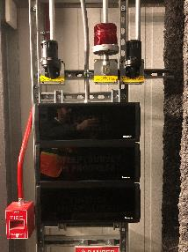
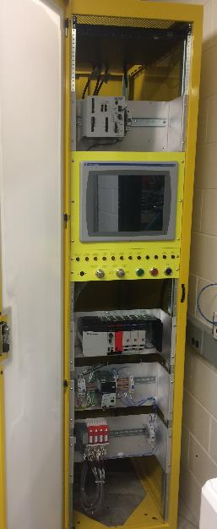
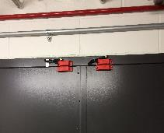
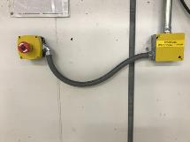
Access Control System for Linac Radiation Safety System (RSS) in Operation
Linac Access Control System (ACS) supports sweep of linac tunnel
Sweep buttons
Gate/door switches
Lights and sounders
Tunnel access state indicators
Linac ACS shuts off beam with beam inhibit devices (on the next slide) at detection of activation of e-stop buttons or opening of doors with tunnel secured state
Entrance signs
Door switches
E-stop button
PPS rack
Sweep path for linac tunnel

Slide 9
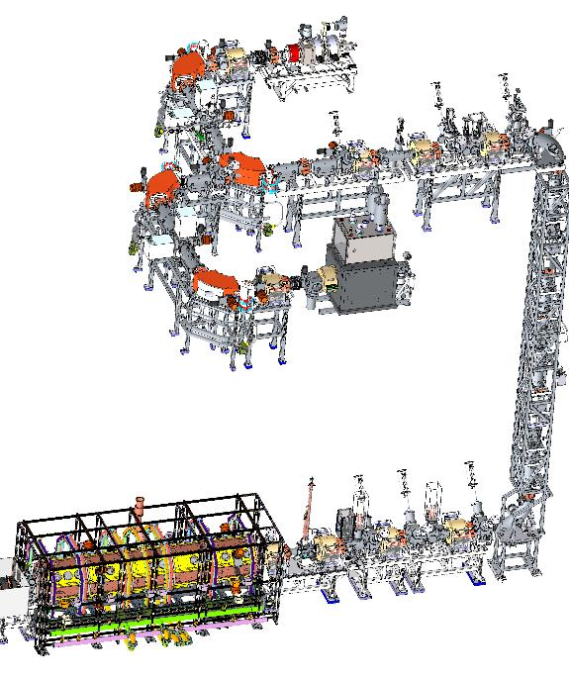
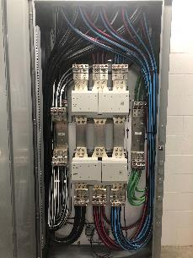
Beam Inhibit Devices for Linac RSS
3 Beam Inhibit Devices (BIDs)
Beam plug in Low Energy Beam Transport (LEBT)
AC and DC contactors for electrostatic bends high voltage
Beam inhibit with AC contactor for Artemis ion source high voltage as defense in depth
9 AC contactors for RF amplifiers for SRF cavities in cryomodules
AC contactor for Artemis high voltage (defense in depth)
Beam plug
AC and DC contactors for electrostatic bends high voltage
AC contactor

Slide 10
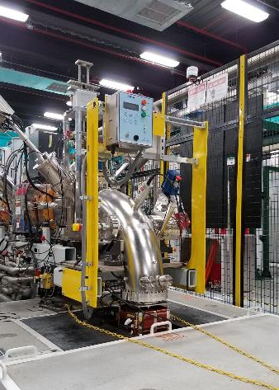
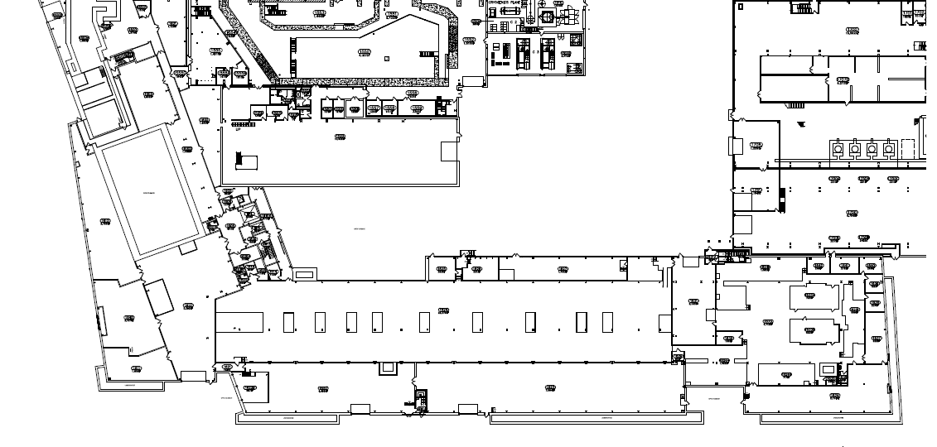
Radiation Monitors for Linac RSS in Operation
Interlocked neutron monitors in accessible area to shut off beam at detection of ≥ 2 mrem/h
Neutron monitor installed at front-end drop
Inside target hall (basement level)
Decontamination room (basement level)
East loading hatch
(ground level)
Front-end drop (ground level)
Conduits near FS2 dump (ground level)
HVAC OUT shaft (ground level)
West loading hatch (ground level)
Cryogenic distribution shaft (ground level)
Neutron monitor
HVAC IN shaft (ground level)

Slide 11
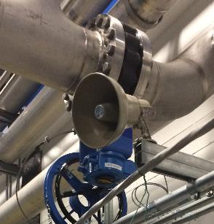
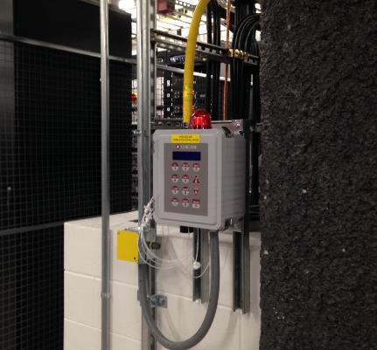
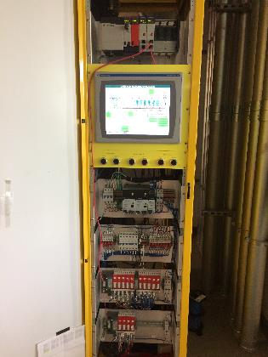
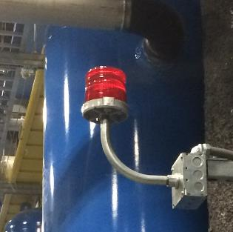
Oxygen Deficiency Hazard Controls Systems in Operation
Cryoplant Oxygen Deficiency Hazard Control System (ODHCS) in operation since August 2017
6 Oxygen Deficiency Hazard (ODH) monitors with 24 air sampling points covering cold box room, warm compressor room, and cryo control room
Linac tunnel ODHCS in operation since March 2018
3 ODH monitors with 12 air sampling points
Horn
ODH monitor
Warning light
PPS rack

Slide 12
Network for Personnel Protection System Isolated from General Controls
Personnel Protection System (PPS)
Radiation monitor/ODH monitor
General Controls
Controls
network
Serial-Ether Converter
Contact
signal
Hardwires
Input / Output Controller
Remote IO
PLC
DO
Hardwires
Data Archiver
Safety PLC
DO
PLC
DI
Work Station
Boundary with no
network connection

Slide 13
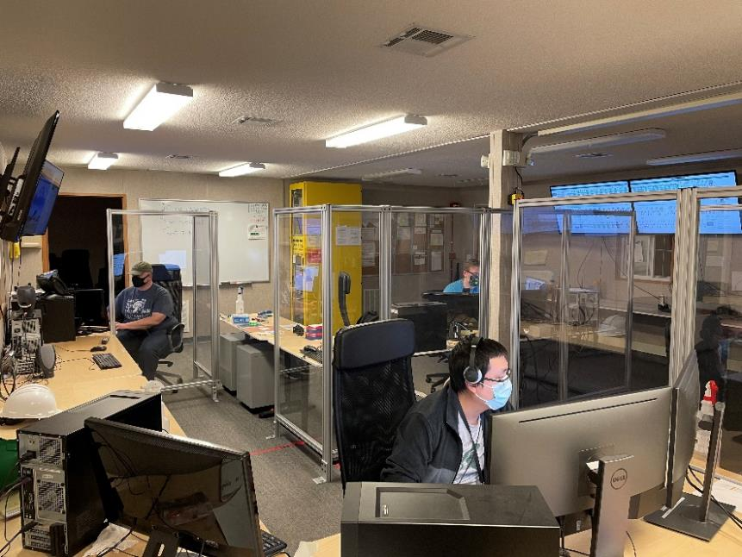
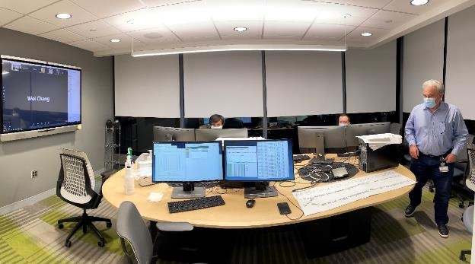
ARR05 Beam Commissioning Conducted with COVID-19 Safeguards
ARR05 beam commissioning conducted from main control room and 3 satellite control rooms to have social distance
Main control room and satellite control rooms are connected with a Zoom session
One of satellite control rooms (AP control room)
Main control room

Slide 14
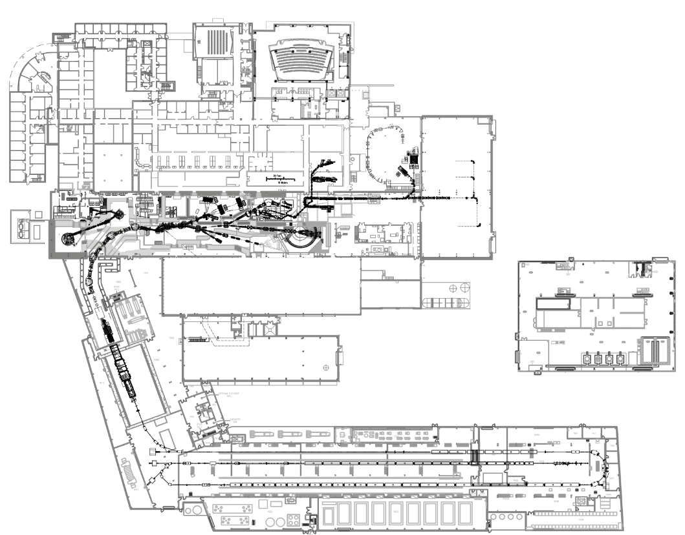
Radiation Safety System Being Extended to Experimental Area
FRIB will have 3 Programmable Logic Controller (PLC)-based Radiation Safety Systems (RSS) each of which has its own safety PLC
Linac RSS
Target Facility RSS
Experimental vault RSS
Interface of Experimental Vaults RSS will be changed when integrated with FRIB
Experimental Vaults RSS
(Formerly NSCL RSS)
Target Facility RSS (In construction)
Linac RSS (In operation)

Slide 15
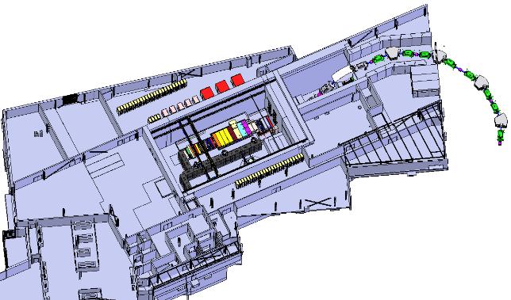
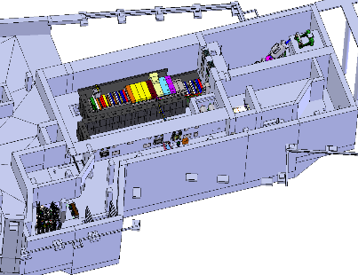
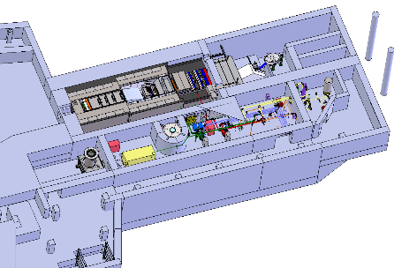
Five Access Control Areas for Target Facility RSS being Implemented
Ground Level
Five access control areas are administered by Target Facility RSS (PLC based)
Being implemented with the same standard with Linac RSS to benefit from its operational experience
Target hall
Basement Level
Vertical pre-separator room and transfer hall
Filter room
Sub-basement Level
Non-Conventional Utility (NCU) rooms
Waste handling room

Slide 16
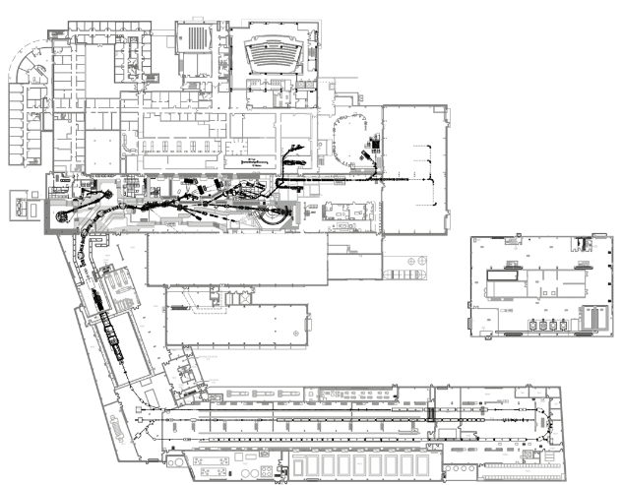
Fast Beam Containment System Being Developed for Future High Power Operation
Fast Beam Containment System (FBCS) being developed to shut off beam within ~ 1 ms at detection of elevated radiation dose rate to protect against unintentional delivery of high power beam to secondary beam line
Prototype being installed for testing in ARR06 beam commissioning (not as a safety system yet)
Ion chambers for FBCS
Sub-system | Function | Status
Ion chamber | Detect elevated radiation | Delivered and Acceptance Criteria Listing (ACL) test complete
Comparator | Implement trip threshold | Prototyped and tested with RF switch
Fiber transport | Transport trip signal to RF switch | Prototype test conducted with 100 ft.
RF Switch | Inhibit beam by shutting of RF for RFQ | Prototyped and tested with comparator
Safety PLC | Provide health monitoring and machine mode control | Interface being finalized
Comparator
Signal transport to comparator
Ion Chamber
RF Switch
Fiber transport to RF switch (~700 ft.)

Slide 17
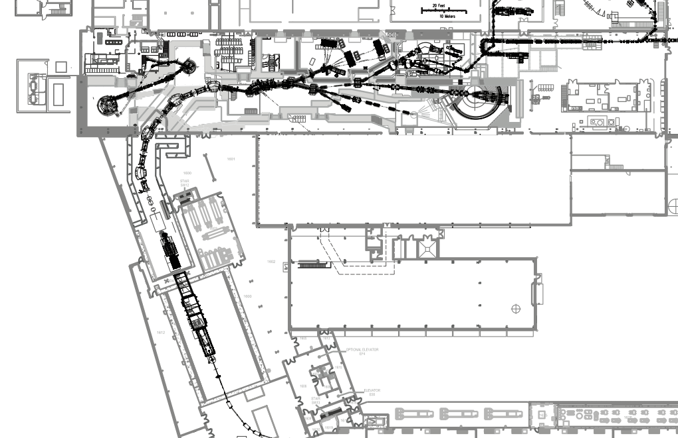
Planned Radiation Monitor Layout
Neutron monitor layout in Room 1500 and experimental vaults is the same with NSCL
Surrounding secured vault
Plan to add ion chamber pairs near wall plugs to experimental vaults
U
U
U
U
Interlocked neutron monitor
U: upper level
B: basement level
Others: ground level
Interlocked ion chamber pair
U
B
B
B

Slide 18
Interface between RSS’s
E
Linac RSS
A
Target Facility RSS
C
Exp. Vault RSS
B
D
FE BIDs, SRF RF
BDS BID
Beam stops and wall plugs
F
G
Fast Beam Containment System
RFQ RF BID
T10501-CM-000117
 | Hardwires
A | Target ready for beam (including radiation not high) BDS BID status (Linac RSS has own sensors)
B | Beam permit to target issued
C | Vault ready for beam (including radiation not high) Beam plug status (Target and Transfer Line RSS has own sensors)
 | Hardwires
D | Beam permit to beamline issued
E | Vault ready for beam (including radiation not high) Beam plug status (Target and Transfer Line RSS has own sensors)
F | Radiation high
G | Target ready for beam

Slide 19
Construction Status and Path Forward
Target Facility RSS for ARR06 constructed and being validated
ARR06 review in late October 2021
Target Facility RSS for ARR07 being constructed to be integrated with Experimental Vault RSS in December 2021
ARR07 review in January 2022
Commencement of user operation in early 2022

Slide 20
Summary
FRIB is being commissioned in phase with construction
Hazards are introduced in phase and PPS has been implemented to mitigate the hazards warranted for each phase
PPS for linac constructed and in operation
PPS for experimental area is being established to support final phases of commissioning
PPS construction is on track to support early completion of FRIB project in January 2022 and commencement of user operation in early 2022

Slide 21
Backup

Slide 22
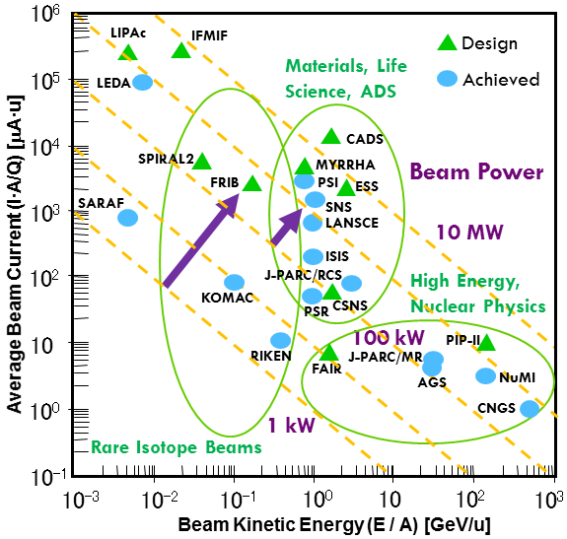
Power Ramp Up to the Frontier of Heavy Ion Facilities
Riken is holding current record of highest heavy ion beam power
Presently 14.5 kW of Zn-70 and 9.6 kW for uranium
Aiming at ~ 90 kW with improvements like charge stripper ring
FRIB aims at ramping up to 400 kW primary beam power in 6 years after commencement of user operations

