Slide 1
NOvA/AD MCenter Beam Meeting
04/14/2021
Buse Naz Temizel

Slide 2
MCenter Secondary Beam Line
MC6ABS
~3m tgt center to collimator end
MC6SC1
MC6SC2

Slide 3
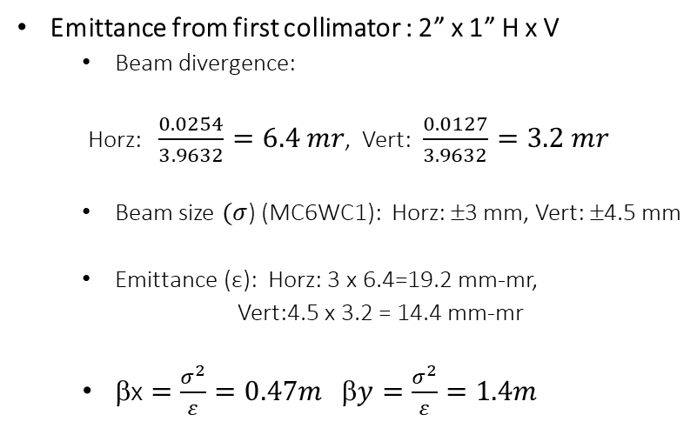
Calculating Initial Emittance
Emittance from first collimator : 2” x 1” H x V
  Beam divergence:
  Horz: $\frac{0.0254}{3.9632}=6.4 mr$, Vert: $\frac{0.0127}{3.9632}=3.2 mr$
  Beam size $(σ$) (MC6WC1): Horz: ±3 mm, Vert: ±4.5 mm
  Emittance (ε): Horz: 3 x 6.4=19.2 mm-mr,
  Vert:4.5 x 3.2 = 14.4 mm-mr
  $\text{}\text{x}=\frac{σ^{2}}{ε}=0.47m$ $\text{}y=\frac{σ^{2}}{ε}=1.4m$
MC6ABS
MC6TGT
5 x 5 mm
2” x 1” H x V
aperture
MC6TGT
MC6Q1-1
2.1342 m
0.946887 m
1.8288 m (72”)
This emittance does not make it through downstream apertures
This means downstream components define the beam emittance
We are adjusting the beta functions and the emittance we calculated from the apertures
4.9100 m

Slide 4
Initial Emittance
Angular cut with 1st collimator
x’
x’
Spot size
on target
x
x
Beam ellipse shears and becomes elongated in the drift after the target
Small spot size on target

Slide 5
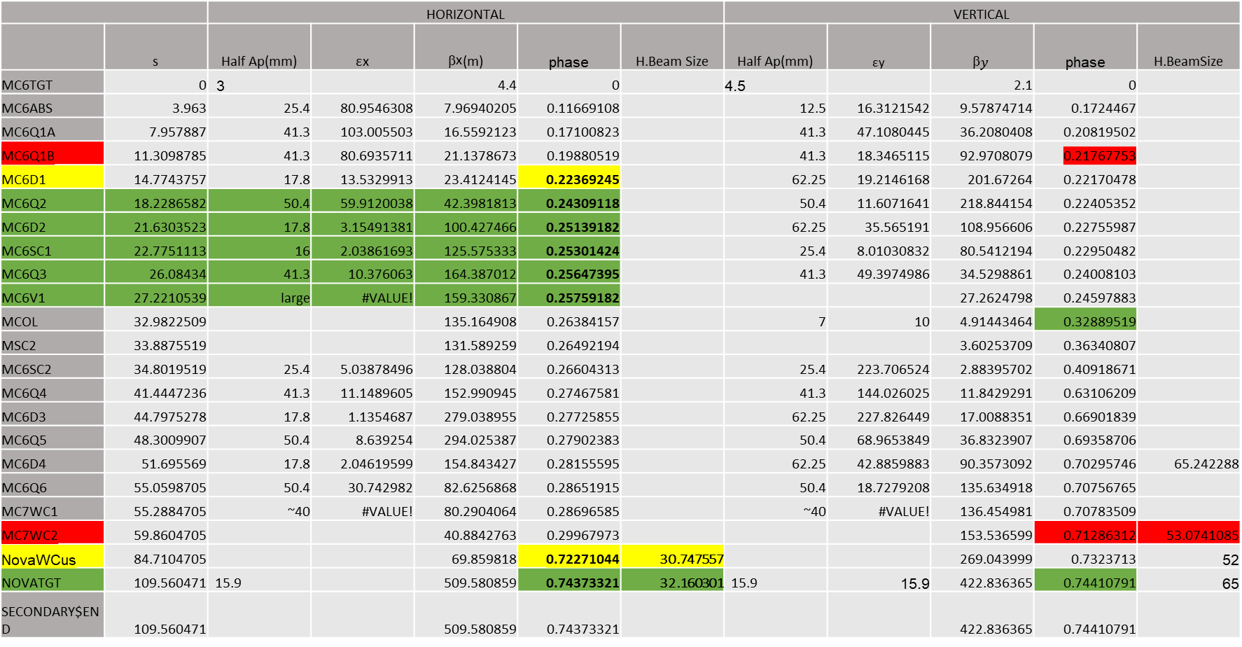
Operational Tune
 |  | HORIZONTAL |  |  |  |  | VERTICAL
 | s | Half Ap(mm) | εx | $\text{}\text{x}$(m) | phase | H.Beam Size | Half Ap(mm) | εy | $$\text{}y$$ | phase | H.BeamSize
MC6TGT | 0 | 3 |  | 4.4 | 0 |  | 4.5 |  | 2.1 | 0
MC6ABS | 3.963 | 25.4 | 80.9546308 | 7.96940205 | 0.11669108 |  | 12.5 | 16.3121542 | 9.57874714 | 0.1724467
MC6Q1A | 7.957887 | 41.3 | 103.005503 | 16.5592123 | 0.17100823 |  | 41.3 | 47.1080445 | 36.2080408 | 0.20819502
MC6Q1B | 11.3098785 | 41.3 | 80.6935711 | 21.1378673 | 0.19880519 |  | 41.3 | 18.3465115 | 92.9708079 | 0.21767753
MC6D1 | 14.7743757 | 17.8 | 13.5329913 | 23.4124145 | 0.22369245 |  | 62.25 | 19.2146168 | 201.67264 | 0.22170478
MC6Q2 | 18.2286582 | 50.4 | 59.9120038 | 42.3981813 | 0.24309118 |  | 50.4 | 11.6071641 | 218.844154 | 0.22405352
MC6D2 | 21.6303523 | 17.8 | 3.15491381 | 100.427466 | 0.25139182 |  | 62.25 | 35.565191 | 108.956606 | 0.22755987
MC6SC1 | 22.7751113 | 16 | 2.03861693 | 125.575333 | 0.25301424 |  | 25.4 | 8.01030832 | 80.5412194 | 0.22950482
MC6Q3 | 26.08434 | 41.3 | 10.376063 | 164.387012 | 0.25647395 |  | 41.3 | 49.3974986 | 34.5298861 | 0.24008103
MC6V1 | 27.2210539 | large | #VALUE! | 159.330867 | 0.25759182 |  |  |  | 27.2624798 | 0.24597883
MCOL | 32.9822509 |  |  | 135.164908 | 0.26384157 |  | 7 | 10 | 4.91443464 | 0.32889519
MSC2 | 33.8875519 |  |  | 131.589259 | 0.26492194 |  |  |  | 3.60253709 | 0.36340807
MC6SC2 | 34.8019519 | 25.4 | 5.03878496 | 128.038804 | 0.26604313 |  | 25.4 | 223.706524 | 2.88395702 | 0.40918671
MC6Q4 | 41.4447236 | 41.3 | 11.1489605 | 152.990945 | 0.27467581 |  | 41.3 | 144.026025 | 11.8429291 | 0.63106209
MC6D3 | 44.7975278 | 17.8 | 1.1354687 | 279.038955 | 0.27725855 |  | 62.25 | 227.826449 | 17.0088351 | 0.66901839
MC6Q5 | 48.3009907 | 50.4 | 8.639254 | 294.025387 | 0.27902383 |  | 50.4 | 68.9653849 | 36.8323907 | 0.69358706
MC6D4 | 51.695569 | 17.8 | 2.04619599 | 154.843427 | 0.28155595 |  | 62.25 | 42.8859883 | 90.3573092 | 0.70295746 | 65.242288
MC6Q6 | 55.0598705 | 50.4 | 30.742982 | 82.6256868 | 0.28651915 |  | 50.4 | 18.7279208 | 135.634918 | 0.70756765
MC7WC1 | 55.2884705 | ~40 | #VALUE! | 80.2904064 | 0.28696585 |  | ~40 | #VALUE! | 136.454981 | 0.70783509
MC7WC2 | 59.8604705 |  |  | 40.8842763 | 0.29967973 |  |  |  | 153.536599 | 0.71286312 | 53.0741085
NovaWCus | 84.7104705 |  |  | 69.859818 | 0.72271044 | 30.747557 |  |  | 269.043999 | 0.7323713 | 52
NOVATGT | 109.560471 | 15.9 |  | 509.580859 | 0.74373321 | 32.160301 | 15.9 | 15.9 | 422.836365 | 0.74410791 | 65
SECONDARY$END | 109.560471 |  |  | 509.580859 | 0.74373321 |  |  |  | 422.836365 | 0.74410791

Slide 6
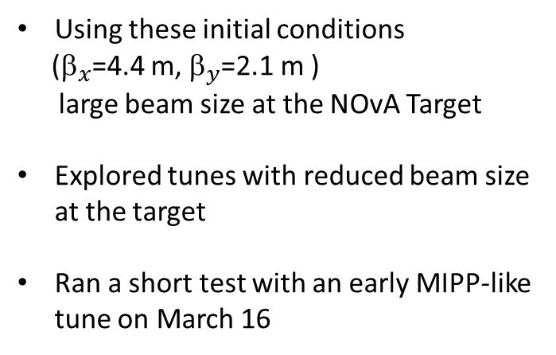
Operational Tune
Using these initial conditions
(${\text{}}_{x}$=4.4 m, ${\text{}}_{y}$=2.1 m )
large beam size at the NOvA Target
Explored tunes with reduced beam size at the target
Ran a short test with an early MIPP-like tune on March 16

Slide 7
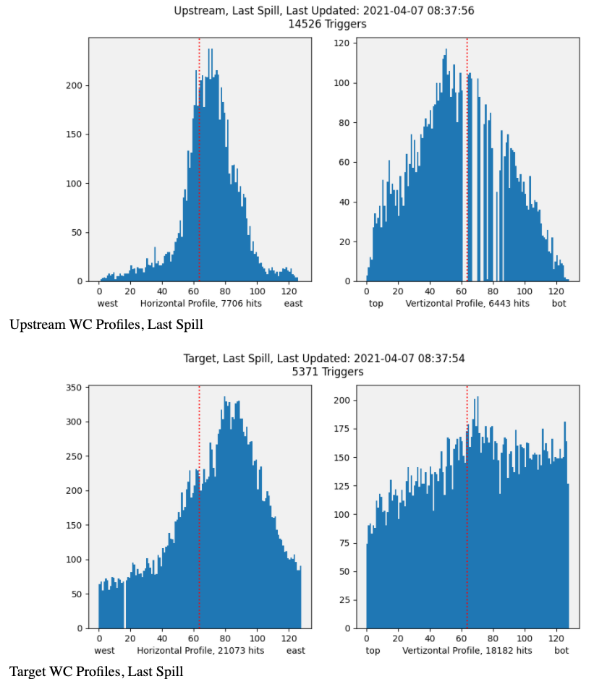
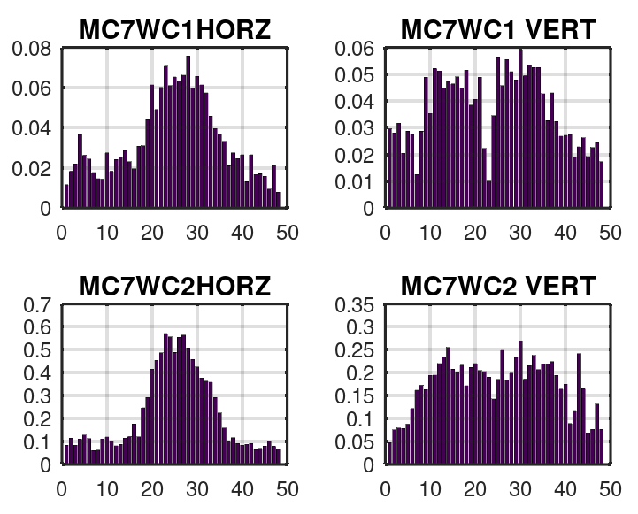
Operational Tune

Slide 8
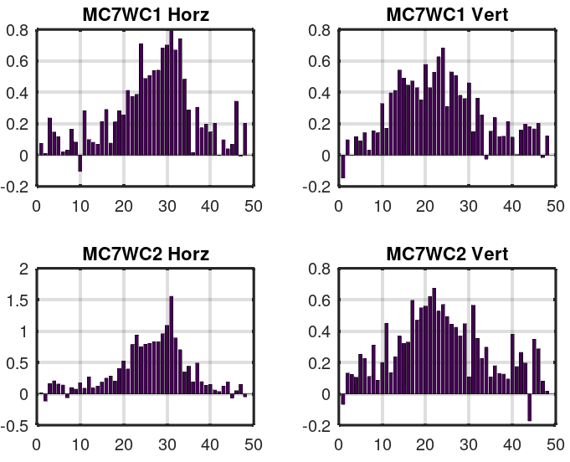
Operational vs (MIPP-like) Test Tune March 16

Slide 9
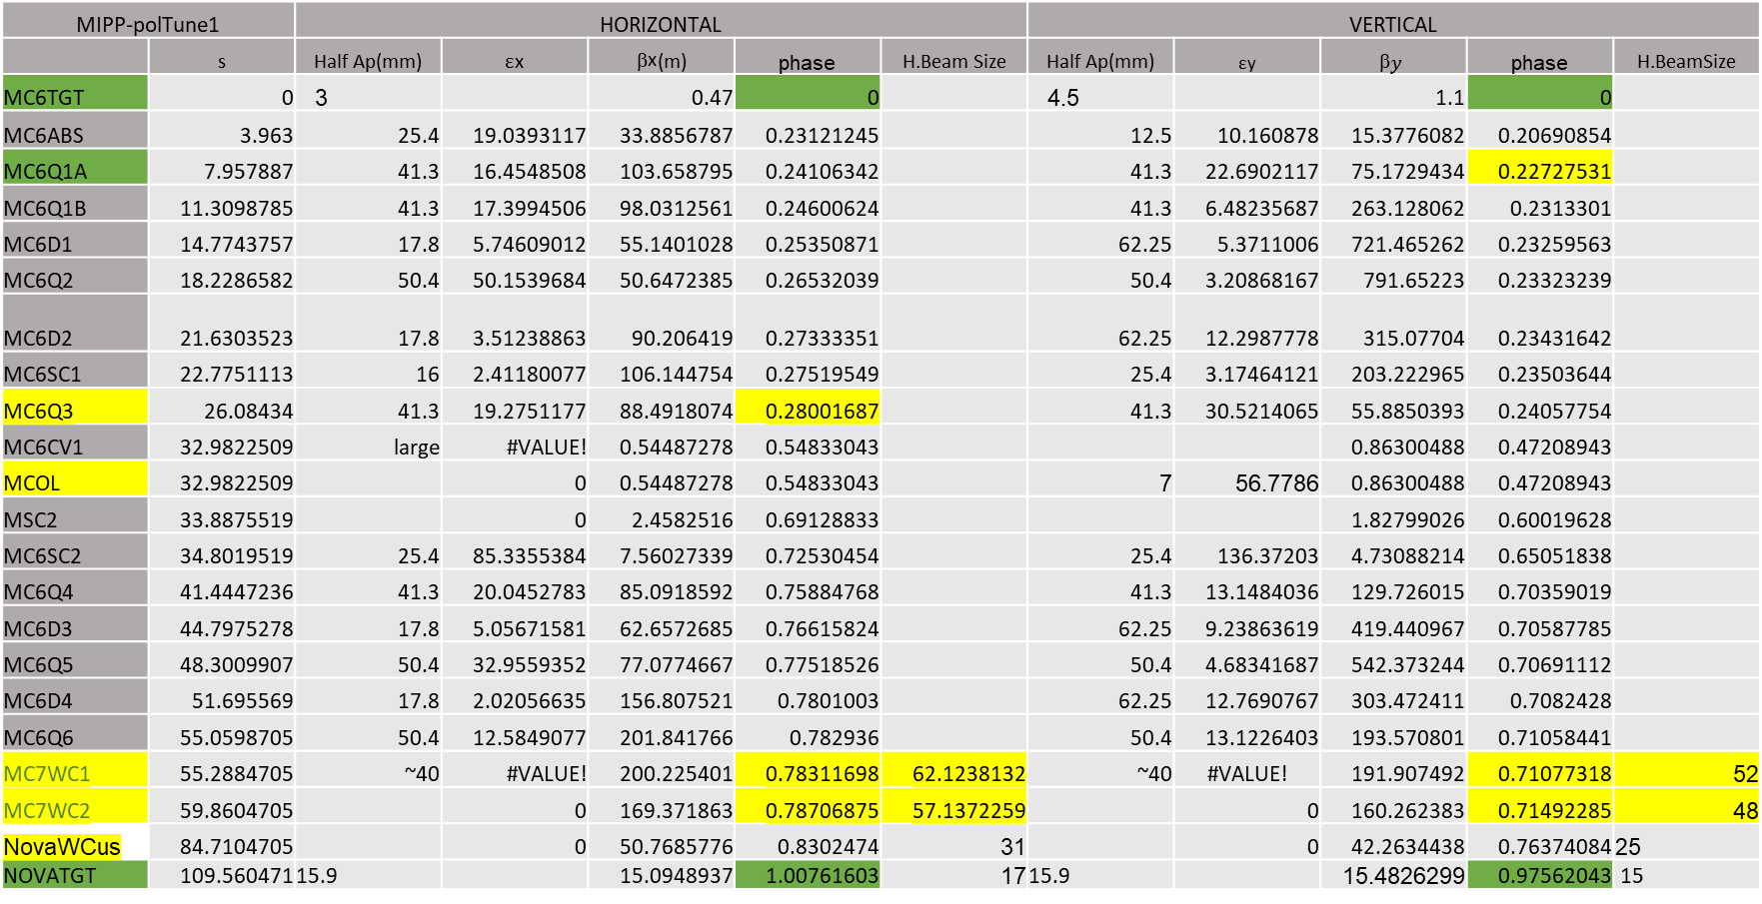
MIPP-like Tune
MIPP-polTune1 |  | HORIZONTAL |  |  |  |  | VERTICAL
 | s | Half Ap(mm) | εx | $\text{}\text{x}$(m) | phase | H.Beam Size | Half Ap(mm) | εy | $$\text{}y$$ | phase | H.BeamSize
MC6TGT | 0 | 3 |  | 0.47 | 0 |  | 4.5 |  | 1.1 | 0
MC6ABS | 3.963 | 25.4 | 19.0393117 | 33.8856787 | 0.23121245 |  | 12.5 | 10.160878 | 15.3776082 | 0.20690854
MC6Q1A | 7.957887 | 41.3 | 16.4548508 | 103.658795 | 0.24106342 |  | 41.3 | 22.6902117 | 75.1729434 | 0.22727531
MC6Q1B | 11.3098785 | 41.3 | 17.3994506 | 98.0312561 | 0.24600624 |  | 41.3 | 6.48235687 | 263.128062 | 0.2313301
MC6D1 | 14.7743757 | 17.8 | 5.74609012 | 55.1401028 | 0.25350871 |  | 62.25 | 5.3711006 | 721.465262 | 0.23259563
MC6Q2 | 18.2286582 | 50.4 | 50.1539684 | 50.6472385 | 0.26532039 |  | 50.4 | 3.20868167 | 791.65223 | 0.23323239
MC6D2 | 21.6303523 | 17.8 | 3.51238863 | 90.206419 | 0.27333351 |  | 62.25 | 12.2987778 | 315.07704 | 0.23431642
MC6SC1 | 22.7751113 | 16 | 2.41180077 | 106.144754 | 0.27519549 |  | 25.4 | 3.17464121 | 203.222965 | 0.23503644
MC6Q3 | 26.08434 | 41.3 | 19.2751177 | 88.4918074 | 0.28001687 |  | 41.3 | 30.5214065 | 55.8850393 | 0.24057754
MC6CV1 | 32.9822509 | large | #VALUE! | 0.54487278 | 0.54833043 |  |  |  | 0.86300488 | 0.47208943
MCOL | 32.9822509 |  | 0 | 0.54487278 | 0.54833043 |  | 7 | 56.7786 | 0.86300488 | 0.47208943
MSC2 | 33.8875519 |  | 0 | 2.4582516 | 0.69128833 |  |  |  | 1.82799026 | 0.60019628
MC6SC2 | 34.8019519 | 25.4 | 85.3355384 | 7.56027339 | 0.72530454 |  | 25.4 | 136.37203 | 4.73088214 | 0.65051838
MC6Q4 | 41.4447236 | 41.3 | 20.0452783 | 85.0918592 | 0.75884768 |  | 41.3 | 13.1484036 | 129.726015 | 0.70359019
MC6D3 | 44.7975278 | 17.8 | 5.05671581 | 62.6572685 | 0.76615824 |  | 62.25 | 9.23863619 | 419.440967 | 0.70587785
MC6Q5 | 48.3009907 | 50.4 | 32.9559352 | 77.0774667 | 0.77518526 |  | 50.4 | 4.68341687 | 542.373244 | 0.70691112
MC6D4 | 51.695569 | 17.8 | 2.02056635 | 156.807521 | 0.7801003 |  | 62.25 | 12.7690767 | 303.472411 | 0.7082428
MC6Q6 | 55.0598705 | 50.4 | 12.5849077 | 201.841766 | 0.782936 |  | 50.4 | 13.1226403 | 193.570801 | 0.71058441
MC7WC1 | 55.2884705 | ~40 | #VALUE! | 200.225401 | 0.78311698 | 62.1238132 | ~40 | #VALUE! | 191.907492 | 0.71077318 | 52
MC7WC2 | 59.8604705 |  | 0 | 169.371863 | 0.78706875 | 57.1372259 |  | 0 | 160.262383 | 0.71492285 | 48
NovaWCus | 84.7104705 |  | 0 | 50.7685776 | 0.8302474 | 31 |  | 0 | 42.2634438 | 0.76374084 | 25
NOVATGT | 109.560471 | 15.9 |  | 15.0948937 | 1.00761603 | 17 | 15.9 |  | 15.4826299 | 0.97562043 | 15

Slide 10

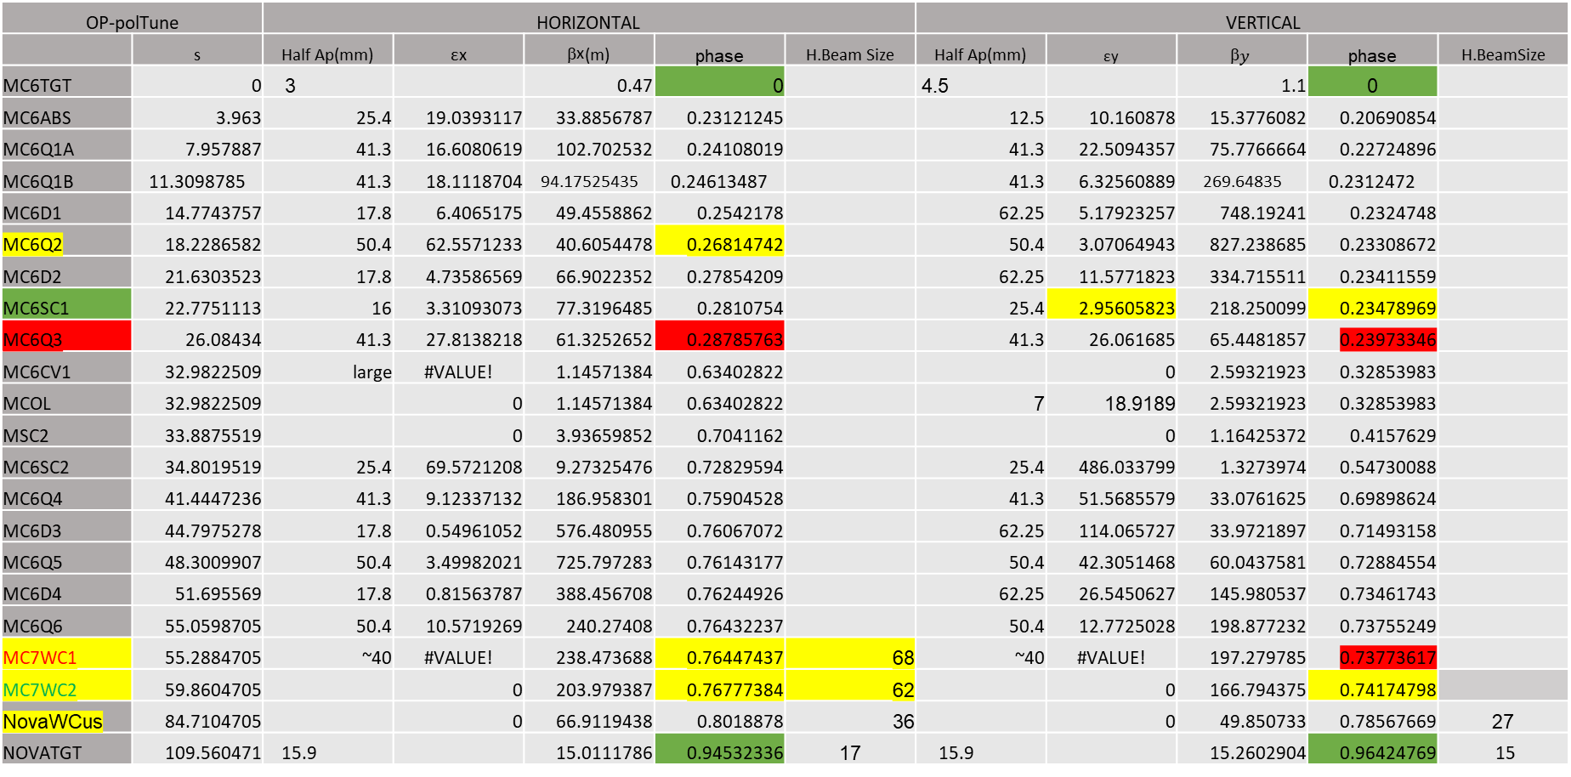
Operational Polarity Tune
OP-polTune |  | HORIZONTAL |  |  |  |  | VERTICAL
 | s | Half Ap(mm) | εx | $\text{}\text{x}$(m) | phase | H.Beam Size | Half Ap(mm) | εy | $$\text{}y$$ | phase | H.BeamSize
MC6TGT | 0 | 3 |  | 0.47 | 0 |  | 4.5 |  | 1.1 | 0
MC6ABS | 3.963 | 25.4 | 19.0393117 | 33.8856787 | 0.23121245 |  | 12.5 | 10.160878 | 15.3776082 | 0.20690854
MC6Q1A | 7.957887 | 41.3 | 16.6080619 | 102.702532 | 0.24108019 |  | 41.3 | 22.5094357 | 75.7766664 | 0.22724896
MC6Q1B | 11.3098785 | 41.3 | 18.1118704 | 94.17525435 | 0.24613487 |  | 41.3 | 6.32560889 | 269.64835 | 0.2312472
MC6D1 | 14.7743757 | 17.8 | 6.4065175 | 49.4558862 | 0.2542178 |  | 62.25 | 5.17923257 | 748.19241 | 0.2324748
MC6Q2 | 18.2286582 | 50.4 | 62.5571233 | 40.6054478 | 0.26814742 |  | 50.4 | 3.07064943 | 827.238685 | 0.23308672
MC6D2 | 21.6303523 | 17.8 | 4.73586569 | 66.9022352 | 0.27854209 |  | 62.25 | 11.5771823 | 334.715511 | 0.23411559
MC6SC1 | 22.7751113 | 16 | 3.31093073 | 77.3196485 | 0.2810754 |  | 25.4 | 2.95605823 | 218.250099 | 0.23478969
MC6Q3 | 26.08434 | 41.3 | 27.8138218 | 61.3252652 | 0.28785763 |  | 41.3 | 26.061685 | 65.4481857 | 0.23973346
MC6CV1 | 32.9822509 | large | #VALUE! | 1.14571384 | 0.63402822 |  |  | 0 | 2.59321923 | 0.32853983
MCOL | 32.9822509 |  | 0 | 1.14571384 | 0.63402822 |  | 7 | 18.9189 | 2.59321923 | 0.32853983
MSC2 | 33.8875519 |  | 0 | 3.93659852 | 0.7041162 |  |  | 0 | 1.16425372 | 0.4157629
MC6SC2 | 34.8019519 | 25.4 | 69.5721208 | 9.27325476 | 0.72829594 |  | 25.4 | 486.033799 | 1.3273974 | 0.54730088
MC6Q4 | 41.4447236 | 41.3 | 9.12337132 | 186.958301 | 0.75904528 |  | 41.3 | 51.5685579 | 33.0761625 | 0.69898624
MC6D3 | 44.7975278 | 17.8 | 0.54961052 | 576.480955 | 0.76067072 |  | 62.25 | 114.065727 | 33.9721897 | 0.71493158
MC6Q5 | 48.3009907 | 50.4 | 3.49982021 | 725.797283 | 0.76143177 |  | 50.4 | 42.3051468 | 60.0437581 | 0.72884554
MC6D4 | 51.695569 | 17.8 | 0.81563787 | 388.456708 | 0.76244926 |  | 62.25 | 26.5450627 | 145.980537 | 0.73461743
MC6Q6 | 55.0598705 | 50.4 | 10.5719269 | 240.27408 | 0.76432237 |  | 50.4 | 12.7725028 | 198.877232 | 0.73755249
MC7WC1 | 55.2884705 | ~40 | #VALUE! | 238.473688 | 0.76447437 | 68 | ~40 | #VALUE! | 197.279785 | 0.73773617
MC7WC2 | 59.8604705 |  | 0 | 203.979387 | 0.76777384 | 62 |  | 0 | 166.794375 | 0.74174798
NovaWCus | 84.7104705 |  | 0 | 66.9119438 | 0.8018878 | 36 |  | 0 | 49.850733 | 0.78567669 | 27
NOVATGT | 109.560471 | 15.9 |  | 15.0111786 | 0.94532336 | 17 | 15.9 |  | 15.2602904 | 0.96424769 | 15

Slide 11
Proposed Currents
 | OP_polTune | MIPP-like Tune | Optune
MC6Q1I | 44.4709678 | 43.0310731 | 19.38
MC6Q2I | -793.30275 | -795.37619 | -649.5
MC6Q3I | 76.4601737 | 76.0336493 | 37.23
MC6Q4I | -70.544146 | 76.2335174 | -49.93
MC6Q5I | 730.713185 | -724.41386 | 577.2
MC6Q6I | -42.716507 | 37.3246977 | -30.19

Slide 12
Proposed Beam Study
Operational tune has large beam size at the Nova target
We would like to perform a beam study using two new proposed tunes
  MIPP-like Tune with different polarities on the downstream triplet
  Operational polarity tune

