Slide 1


RFD Dressed Crab Cavities
Status, Issues and Delivery Dates
Leonardo Ristori – Fermilab
L2 Manager – RFD Dressed Crab Cavities Fabrication
PMG #34 – 20th April 2021

Slide 2
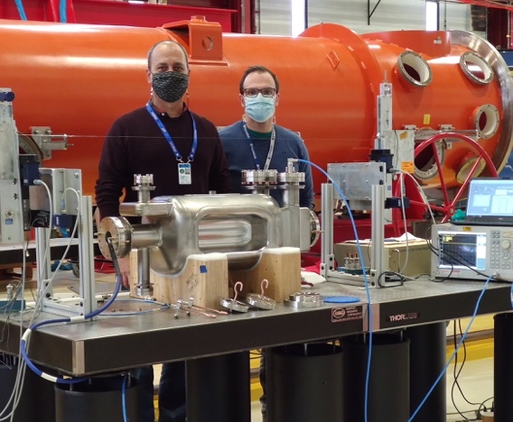
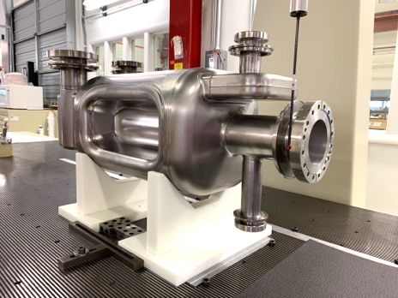
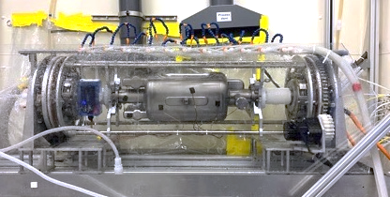
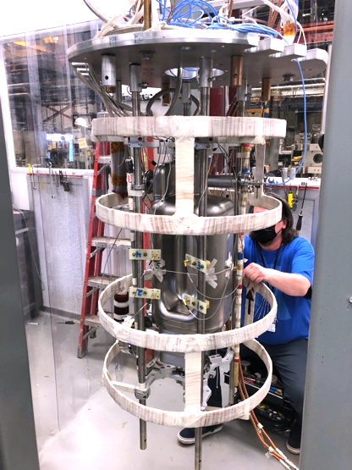
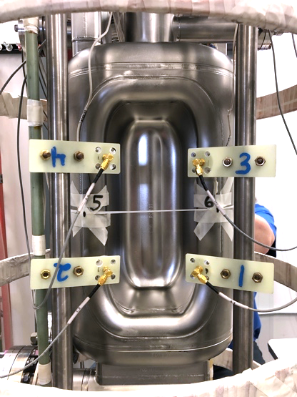

AUP Prototype #1
Incoming inspections completed.
Frequency off target, will be adjusted after cold test.
Pole symmetry on target.
Rotational chemistry (Bulk + Light) completed at ANL.
High temperature heat treatment completed at FNAL.
Final rinse + assembly at ANL completed last week (with issues, see next slide).
Cold Test at FNAL tomorrow. Pictures from today →→
RF Bead Pull at FNAL
CMM Measurements at FNAL
Rotational BCP at ANL
VTS Preparations
Second Sound Instrumentation

Slide 3
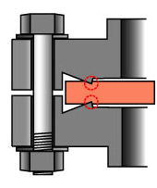
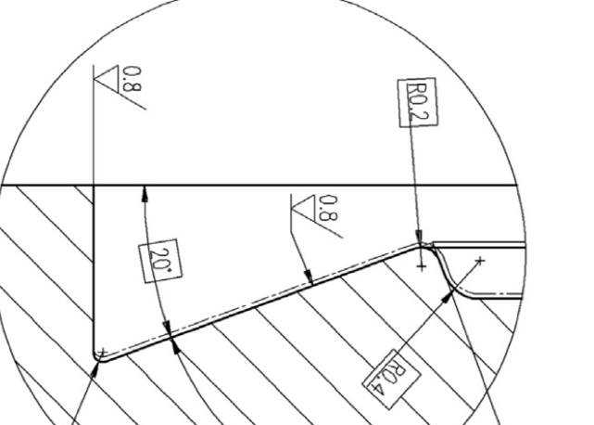
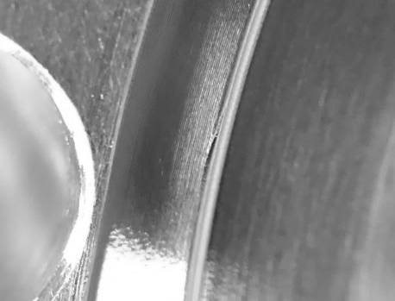
Issues with Prototype #1
Achieving a cold test for Prototype #1 is taking longer than expected due to leaks at cavity flanges.
We have only recently realized that CERN-designed conflat flanges need custom copper gaskets. Commercial gaskets “sort-of” fit and have resulted in the perfect storm generating several issues.
Stuck gaskets needed extra force to be removed causing damages to sealing surfaces.
Repair of knife-edges is non-trivial due to the limited amount of material that one can remove.
Before maintenance

Slide 4
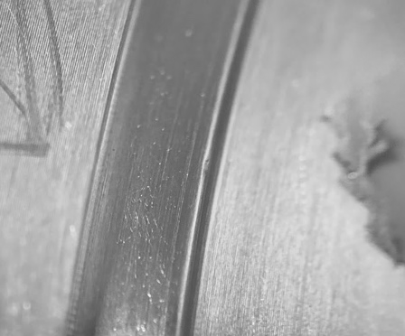
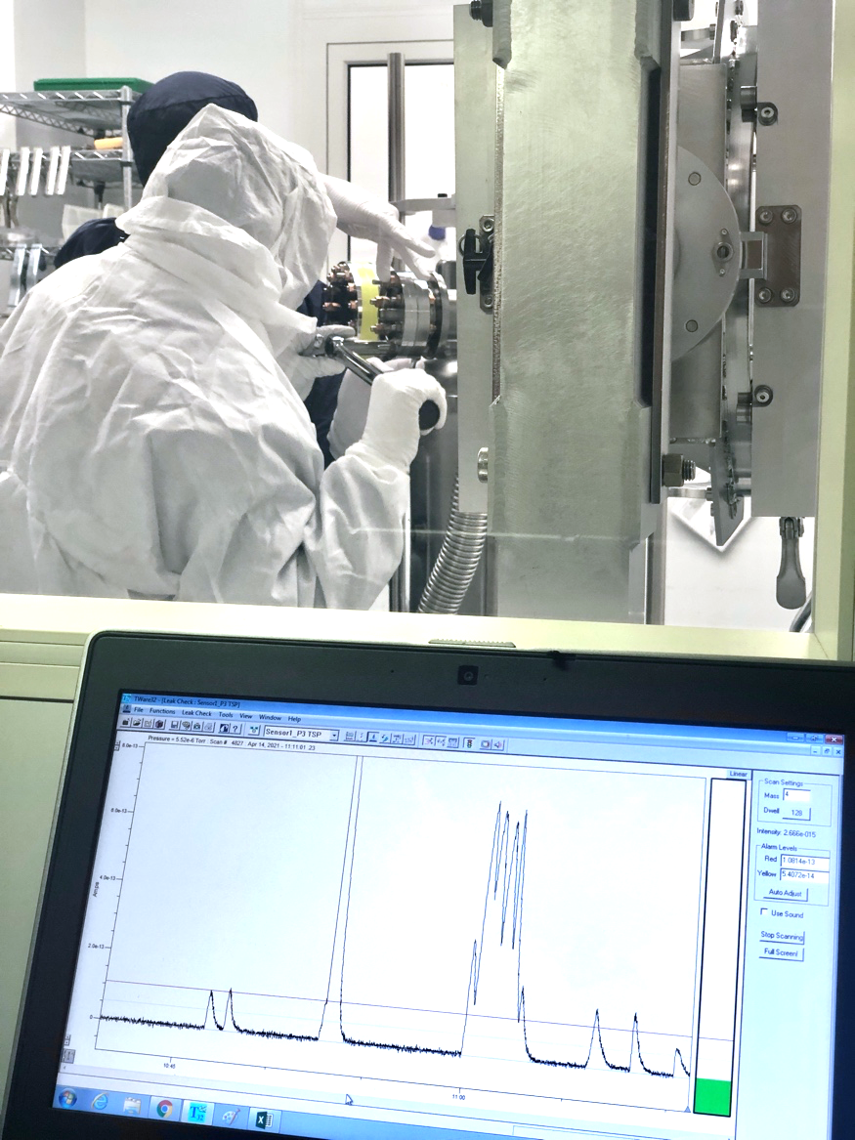
Repairs and Plan Forward
Successful maintenance allowed to achieve leak tight connections and maintain momentum towards VTS.
4 cycles of high-pressure rinsing, assembly, evacuation and leak checking were needed.
Requested input from CERN on details of gaskets, hardware and procedures employed.
Requested one complete hardware kit to be shipped from CERN.
Exploring possibility of acquiring CERN gaskets directly from CERN store.
After maintenance
Leaks in Clean Room

Slide 5
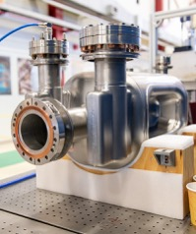
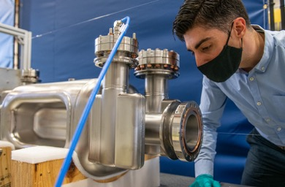
AUP Prototype #2
Completed RF Bead-pull (frequency and pole symmetry on target).
Completed Metrology. Improvement of metrology score from Proto #1 (54/100 → 64/100).
Internal optical inspection complete.
Enhanced flange inspections and technician oversight.
Processing and Heat treatments to start in May.
VTS test in June.
Proto #2
Proto #2 inspections

Slide 6
Zanon – 2 Pre-Series Bare Cavities
CERN specification drawing is adopted at Zanon for Pre-Series
Addressing PRR recommendations:
  Added scope to ZRI contract to expand fabrication drawings per CERN request
  3 pilot drawings completed (below), pre-approved by CERN.
  ZRI working on entire package (69 dwgs + 69 QA sheets) + MIP.
    ETA end of April (imminent). Aiming to share with CERN beginning of May.
Goal: start cutting metal in June (on schedule according to initial plan).
  Need urgent convergence with CERN on Welding Book, brazed joints, fabrication spec for pre-series, to allow start of fabrication in ~2 mo.

Slide 7
Transition Plan: Prototypes, Pre-Series, Series
LARP prototypes (2017-2019):
  Validation of cavity design in achieving key performance requirements (e.g. deflecting voltage, quality factor).
  Validation of FNAL/ANL facilities and processes for surface chemical processing, heat-treatments and cold test.
AUP prototypes (2020-2021):
  First development of fabrication process at Zanon.
  First development of QA documentation.
  Practice with CERN system for Manuf. Records & NCRs.
  Confirmation of FNAL/ANL facilities and processes.
  Validate Zanon facilities for processing.
AUP Pre-Series (2021-2022):
  Convergence with CERN on fabrication and QA documentation (DWGs, MIP, welding book, NCRs,..).
  Validate fabrication process, including processing, at Zanon.
AUP Series (2022-2023):
  Repeat process of pre-series, deliver cavities to FNAL ready for VTS.

Slide 8
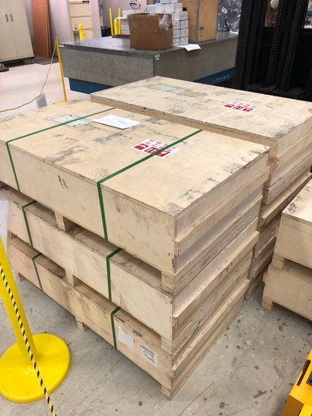
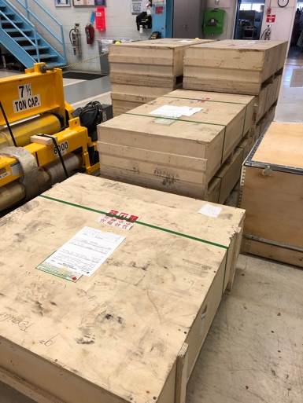
Niobium & Raw Materials Procurement
Majority of material for pre-series is already at Zanon. Balance will arrive at FNAL at the end of April (in transit from China as of today), and at Zanon in June, on time for production to start.
All (83) Niobium sheets for series have been received from China. Inspection at FNAL imminent. Shipments to Zanon will start towards the end of 2021.
Collaboration with WP4 is working well in providing prompt comments to supplier (e.g. to improve inspection reports).
Last two batches of material for series are already on contracts as options and should be a non-issue.
Additional resources being identified to tackle increased QA activities (for raw materials, and rest of scope as well).
Niobium Sheets for Series at FNAL

Slide 9
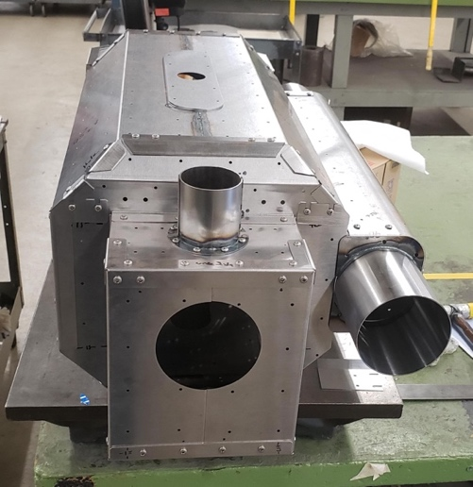
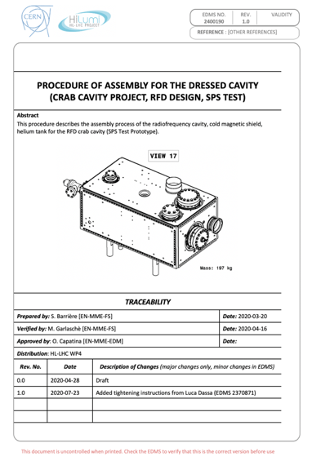
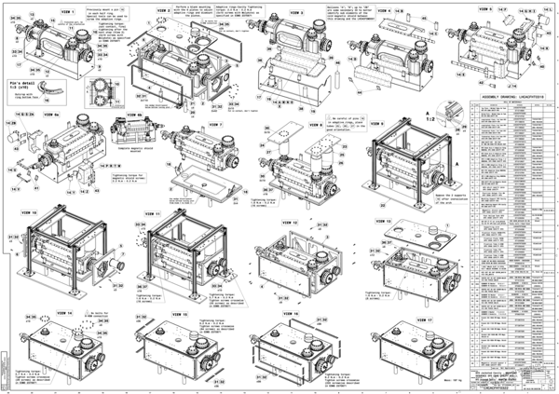
Helium Tanks
Prototype magnetic shields were procured from Ad-Vance (U.S.) and are at FNAL.
To launch jacketing of prototypes, we have collected available CERN drawings and documents.
We will seek CERN input/comments in the next weeks. Bids will be open to several U.S. suppliers.
Contract will only include prototypes at this moment, a change order will be issued to add quantities for series.
To allow a seamless transition to series in early 2022, a final release by CERN of all drawings and supporting documents is needed by end of 2021.
3 Shield Assemblies are at FNAL (Ad-Vance)

Slide 10
Delivery Dates – as of Feb 2021 Status
New delivery dates have been communicated on 23rd Feb 2021, and are consistent with AUP February 2021 Status.
The dates (in orange below) fall still within the agreed “window”, with 4-6 months of additional delays since the last communication in Sep 2020 (in yellow).
There is now a 4-6 month float to the agreed delivery dates (in blue).
Delays resulted from additional work to address recommendations received at the Nov ‘20 Production Readiness Review for Bare Cavities, and from COVID impacts and inefficiencies.

