Slide 1
Tracker Spatial Resolution Measurement
Adam Molnar

Slide 2
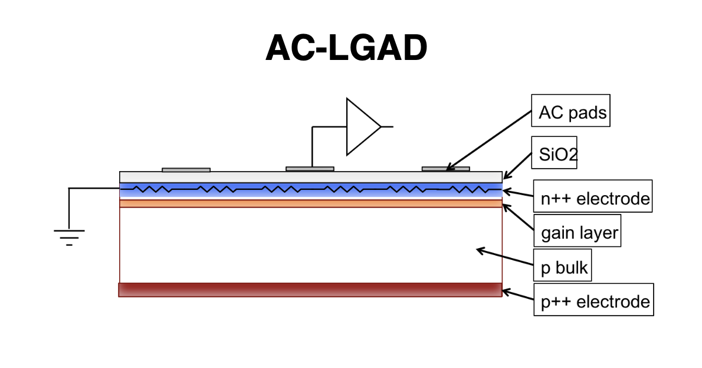
Background-LGADs
AC LGADs are the new generation of particle detectors
The hope is that they are able to produce better timing resolution than standard silicon detectors with less dead space than standard DC LGADs
Different geometries with several AC pads to better determine timing resolution

Slide 3
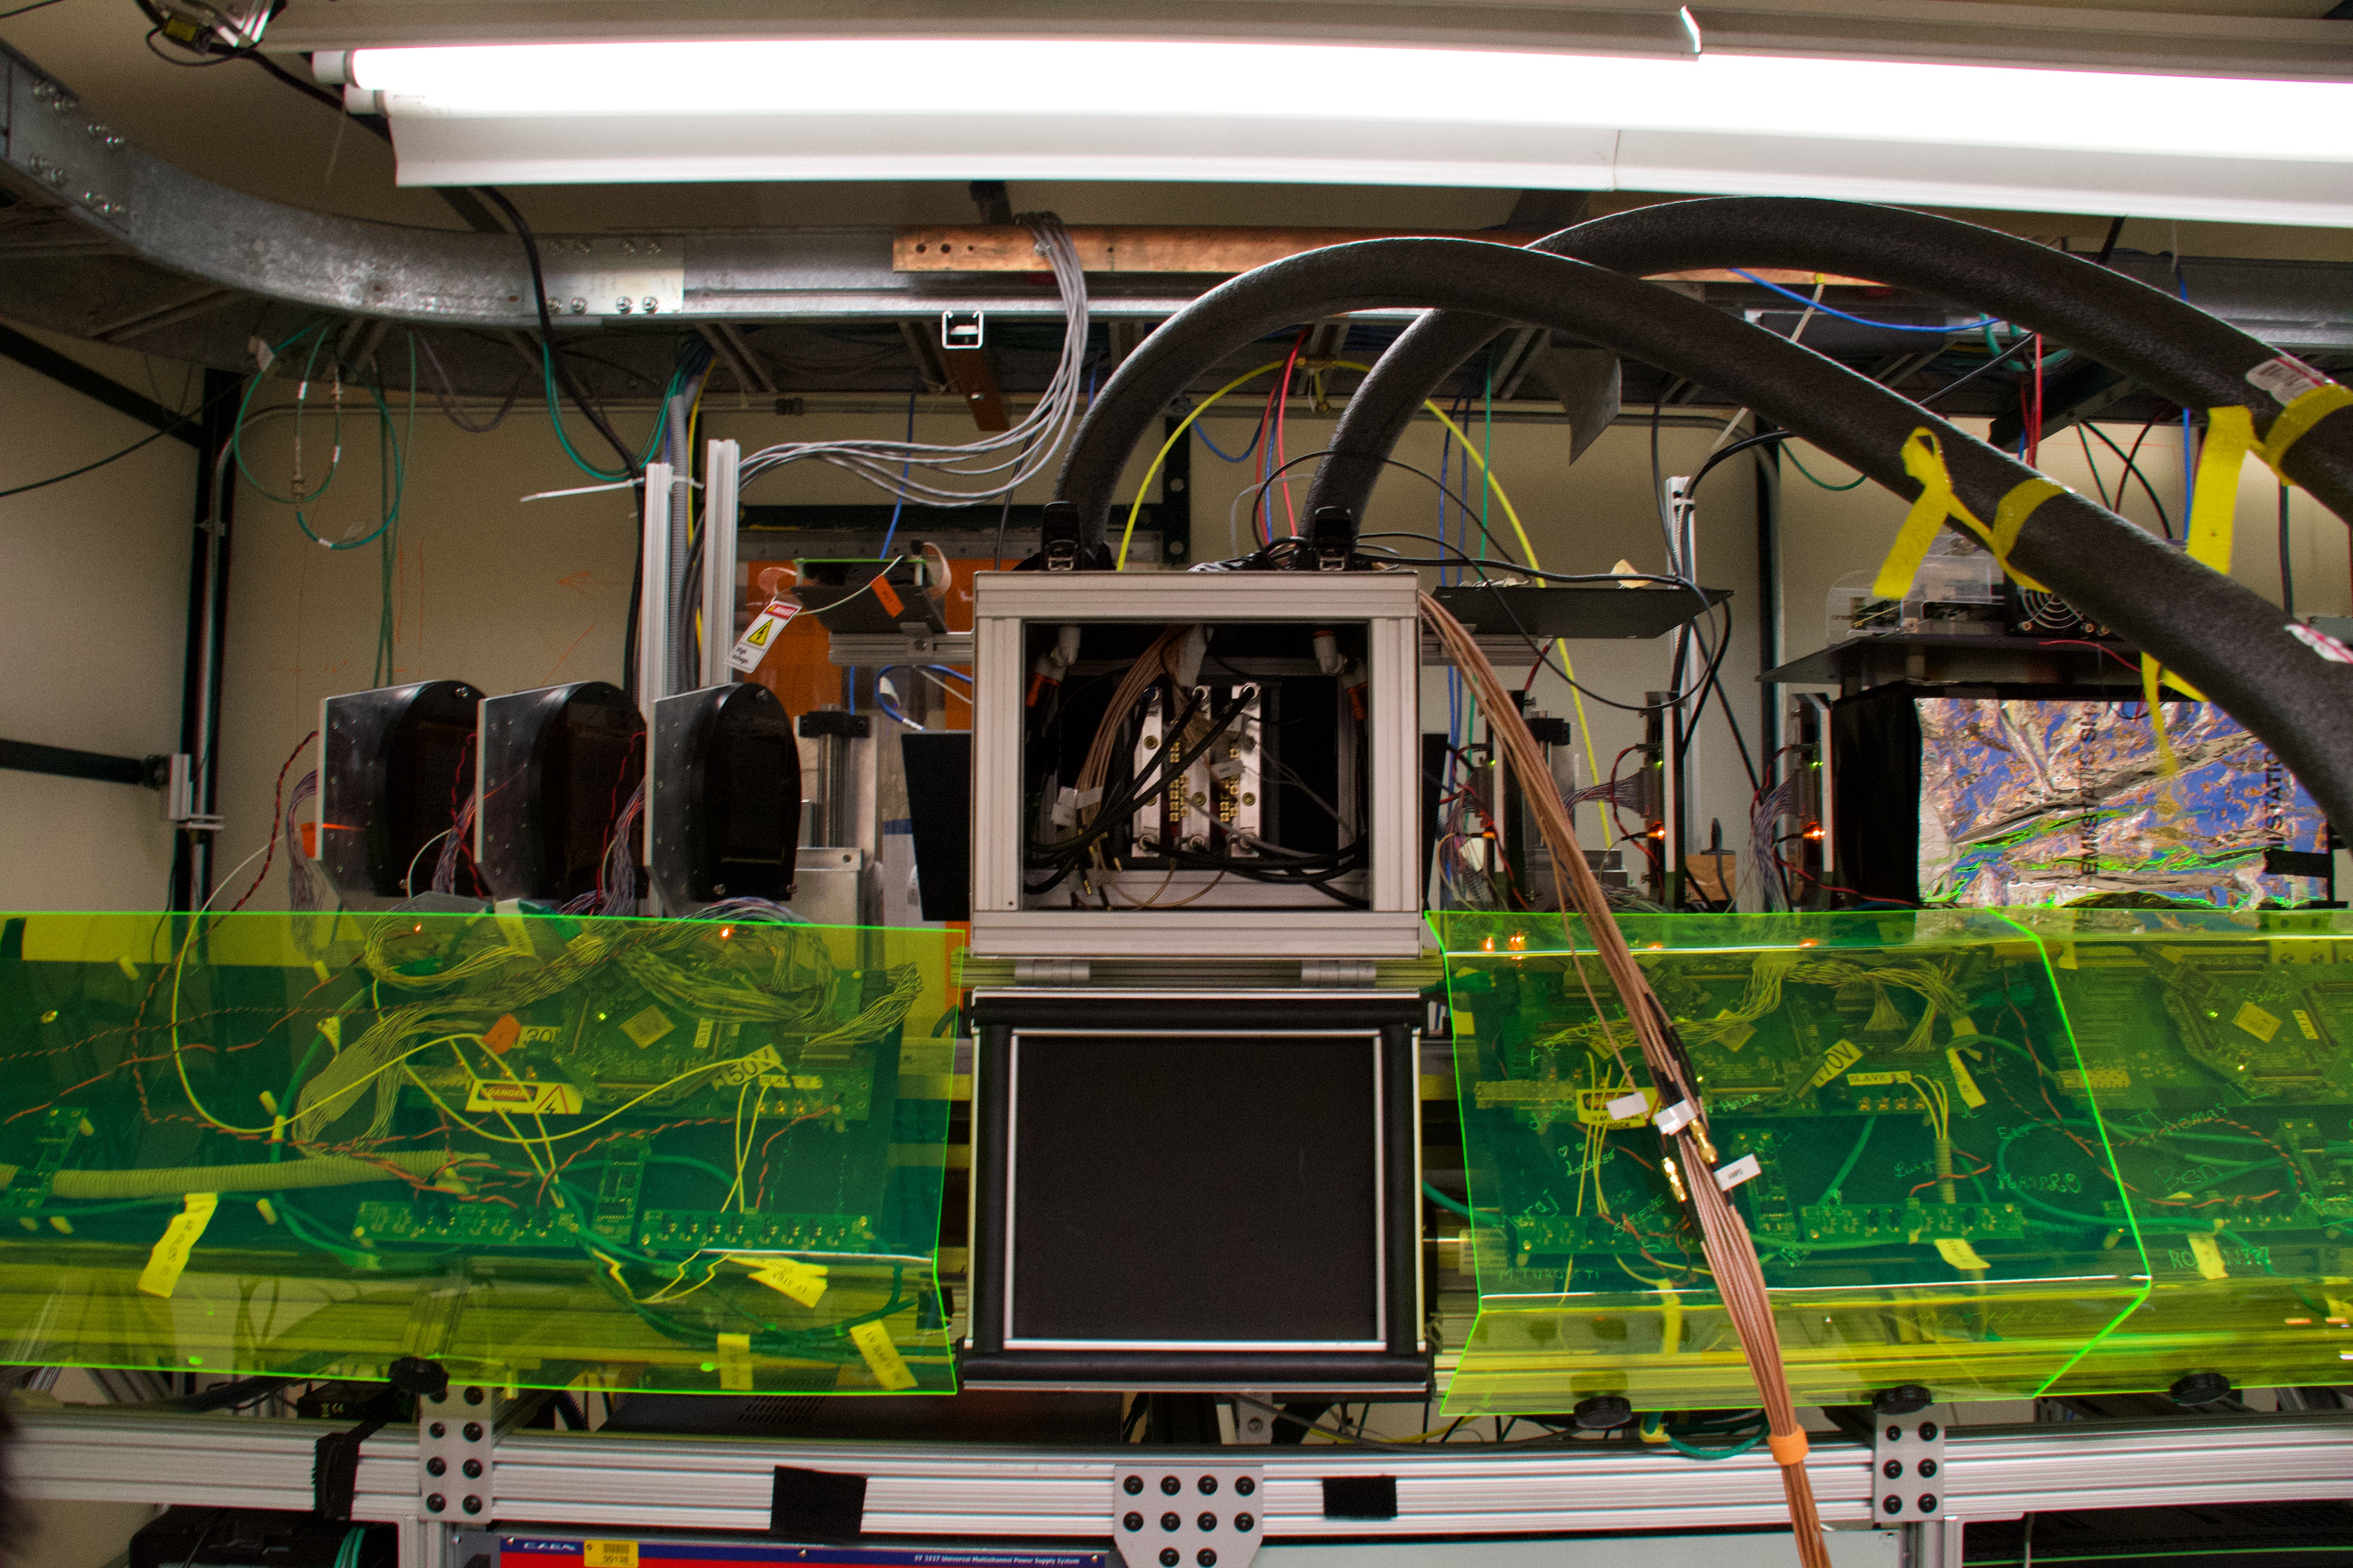
Background FTBF and Setup
Tracker
Fermilab Beam
AC LGADS

Slide 4
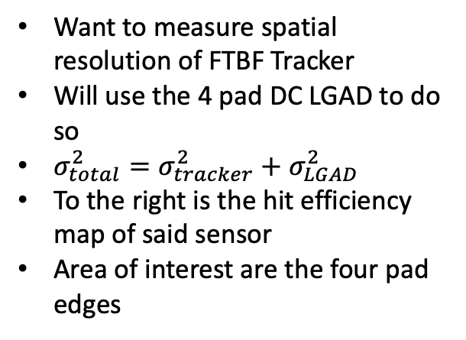
Background on measurement
Want to measure spatial resolution of FTBF Tracker
Will use the 4 pad DC LGAD to do so
$σ_{total}^{2}=σ_{tracker}^{2}+σ_{LGAD}^{2}$
To the right is the hit efficiency map of said sensor
Area of interest are the four pad edges

Slide 5
Binning
Efficiency graph is highly dependent on the binning chosen
Want to make the x bins as small as possible to give as many data points as possible
In order to then counterbalance these skinny x bins the y bins are chosen to be very long
Want to ensure that no bins on the pad locations are empty due to how tiny they are chosen
Final bins are 10 microns in width for the x and 266 micron width in the y

Slide 6
Slices
Note that the right hand side of the sensor did not have as many hits as the rest of the sensor. Thus, the right hand error function is not fit.
Two y bins chosen for the slices
Slice 3
Slice 2
Slice 1
Slice 0

Slide 7
Background
We assume the edges are actually step functions
However, due to tracker resolution it smears out
Can fit a error function to the curves and the sigma or width parameter will give the tracker resolution
Need to pick appropriate slices or vertical sections out of the entire efficiency plot
Curve 1
Curve 2
Curve 3
Curve 4

Slide 8

Example Fit
Fit Parameters
Note: we forced the fit to have a tail value of exactly 0 to better simulate the assumed condition. Did not force head to go to 1

Slide 9
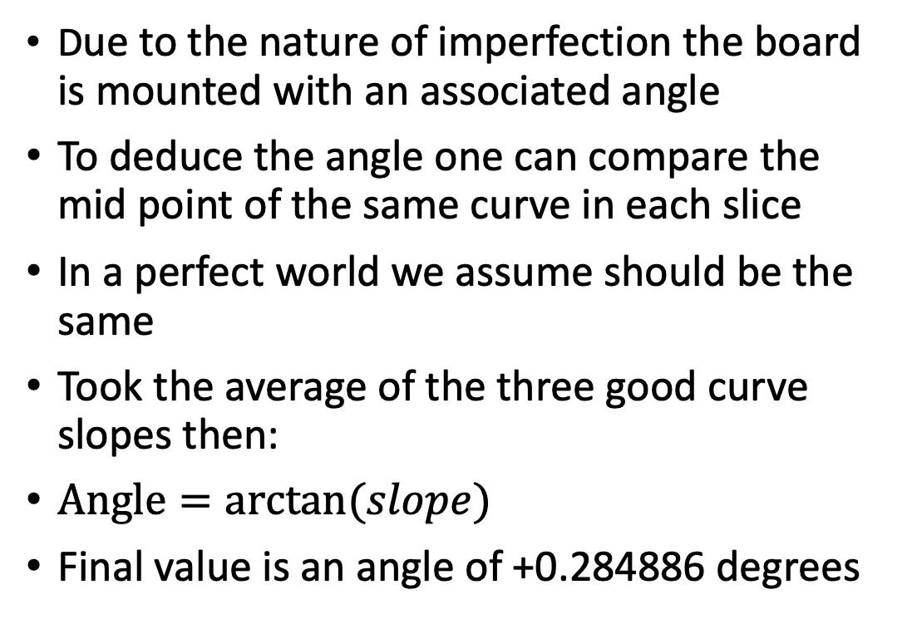
Angle Measuring
4 Curve Midpoints
Due to the nature of imperfection the board is mounted with an associated angle
To deduce the angle one can compare the mid point of the same curve in each slice
In a perfect world we assume should be the same
Took the average of the three good curve slopes then:
$Angle=arctan⁡(slope)$
Final value is an angle of +0.284886 degrees
4 Curve Midpoints

Slide 10
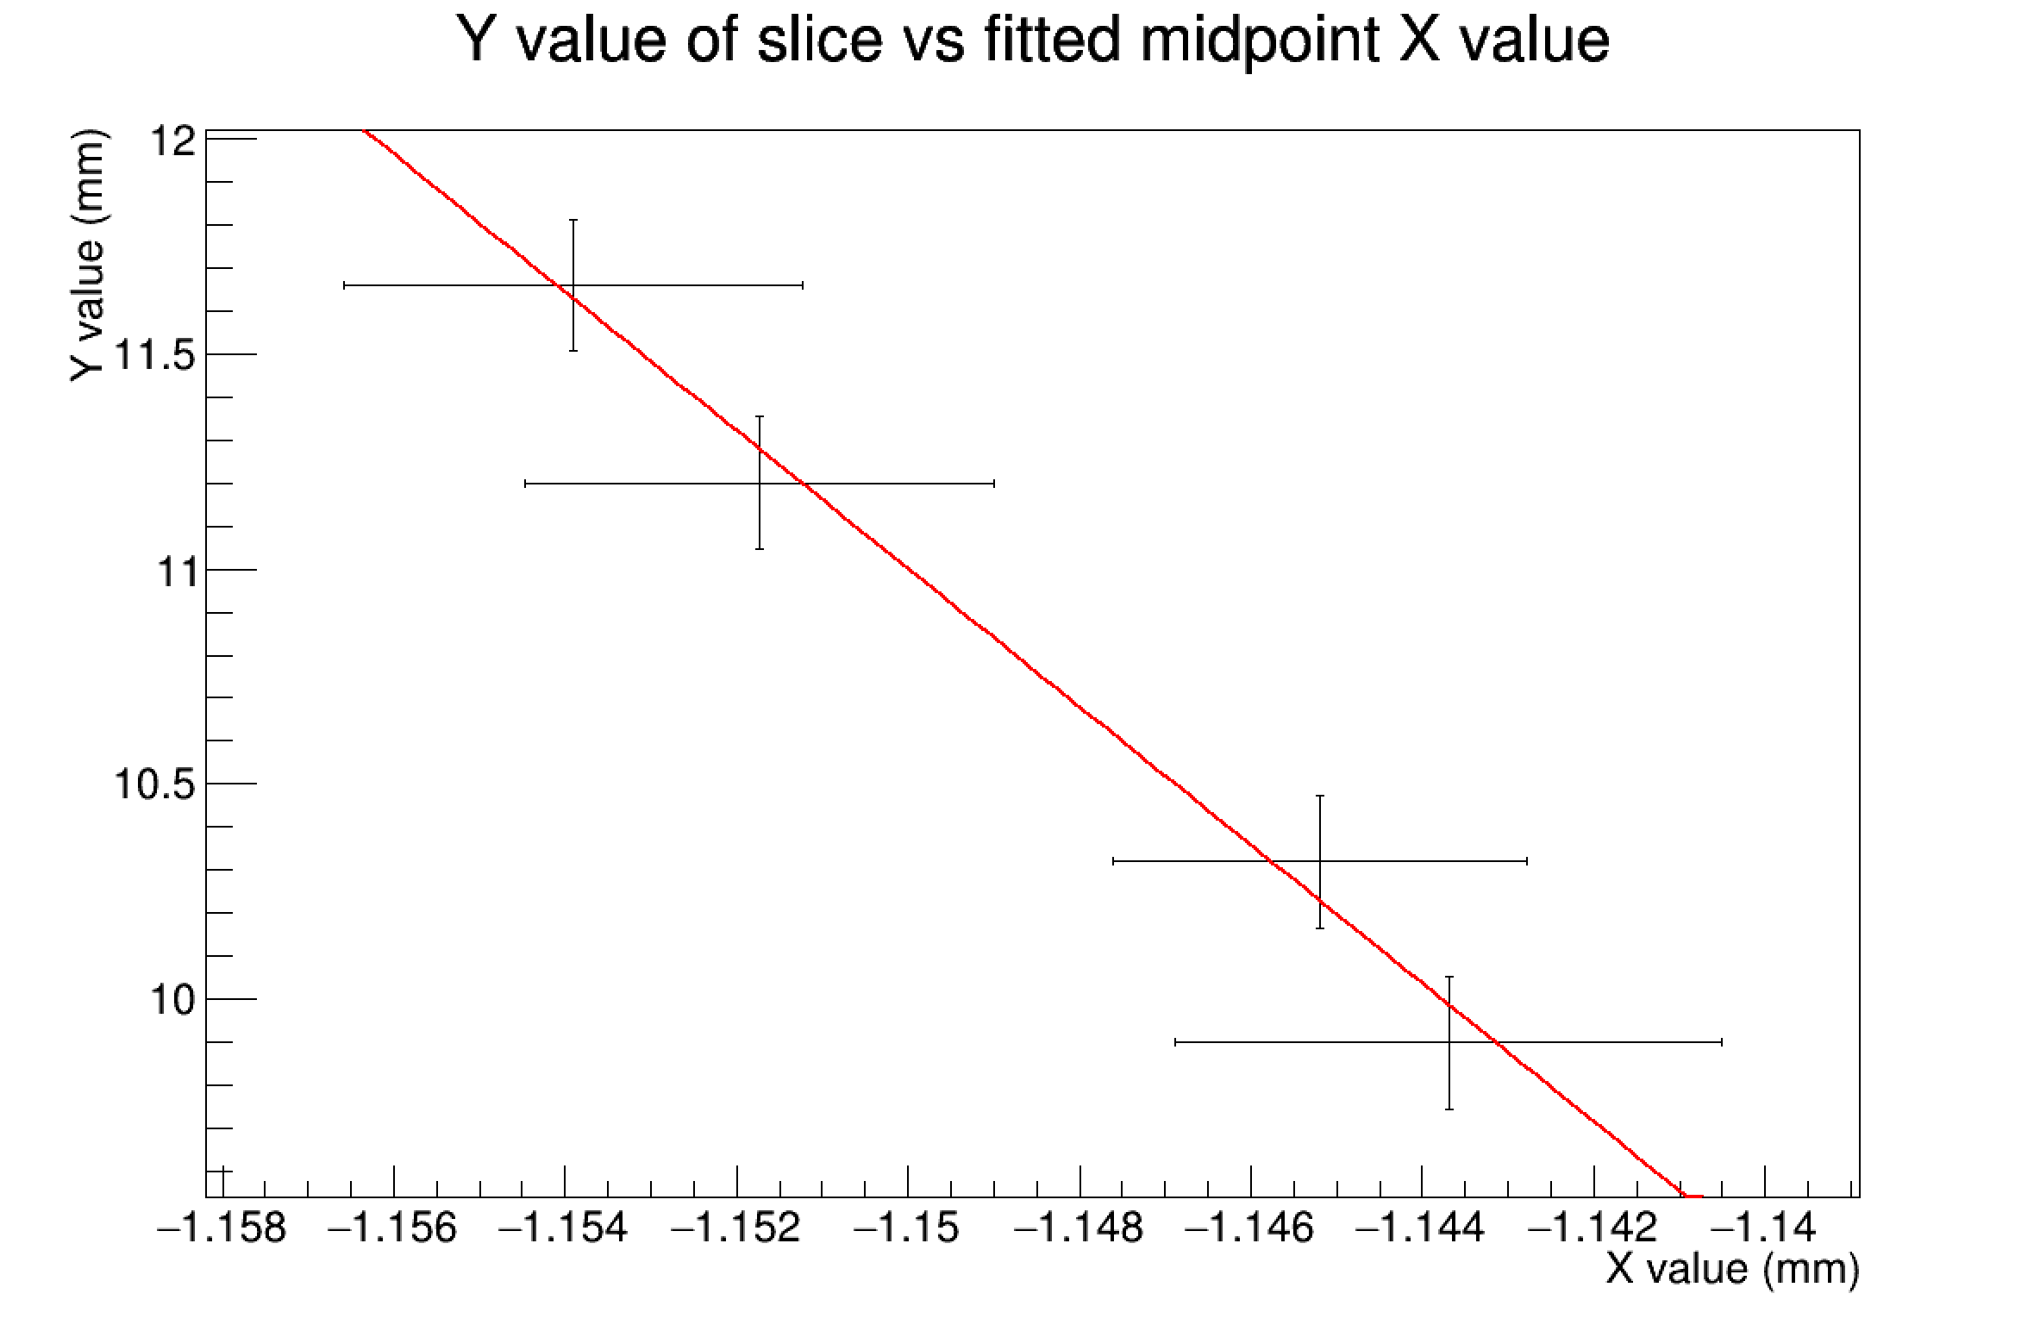
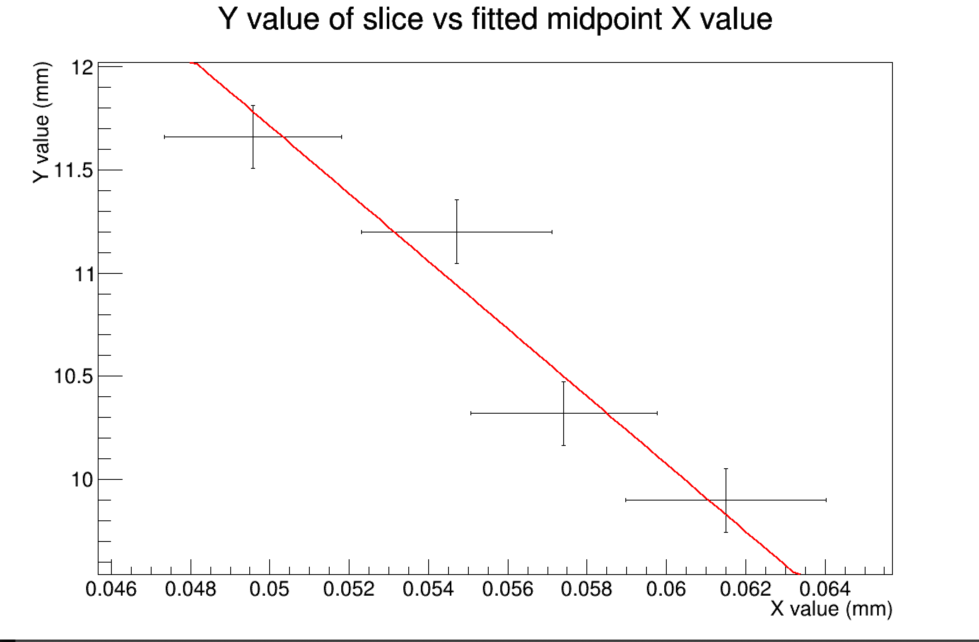
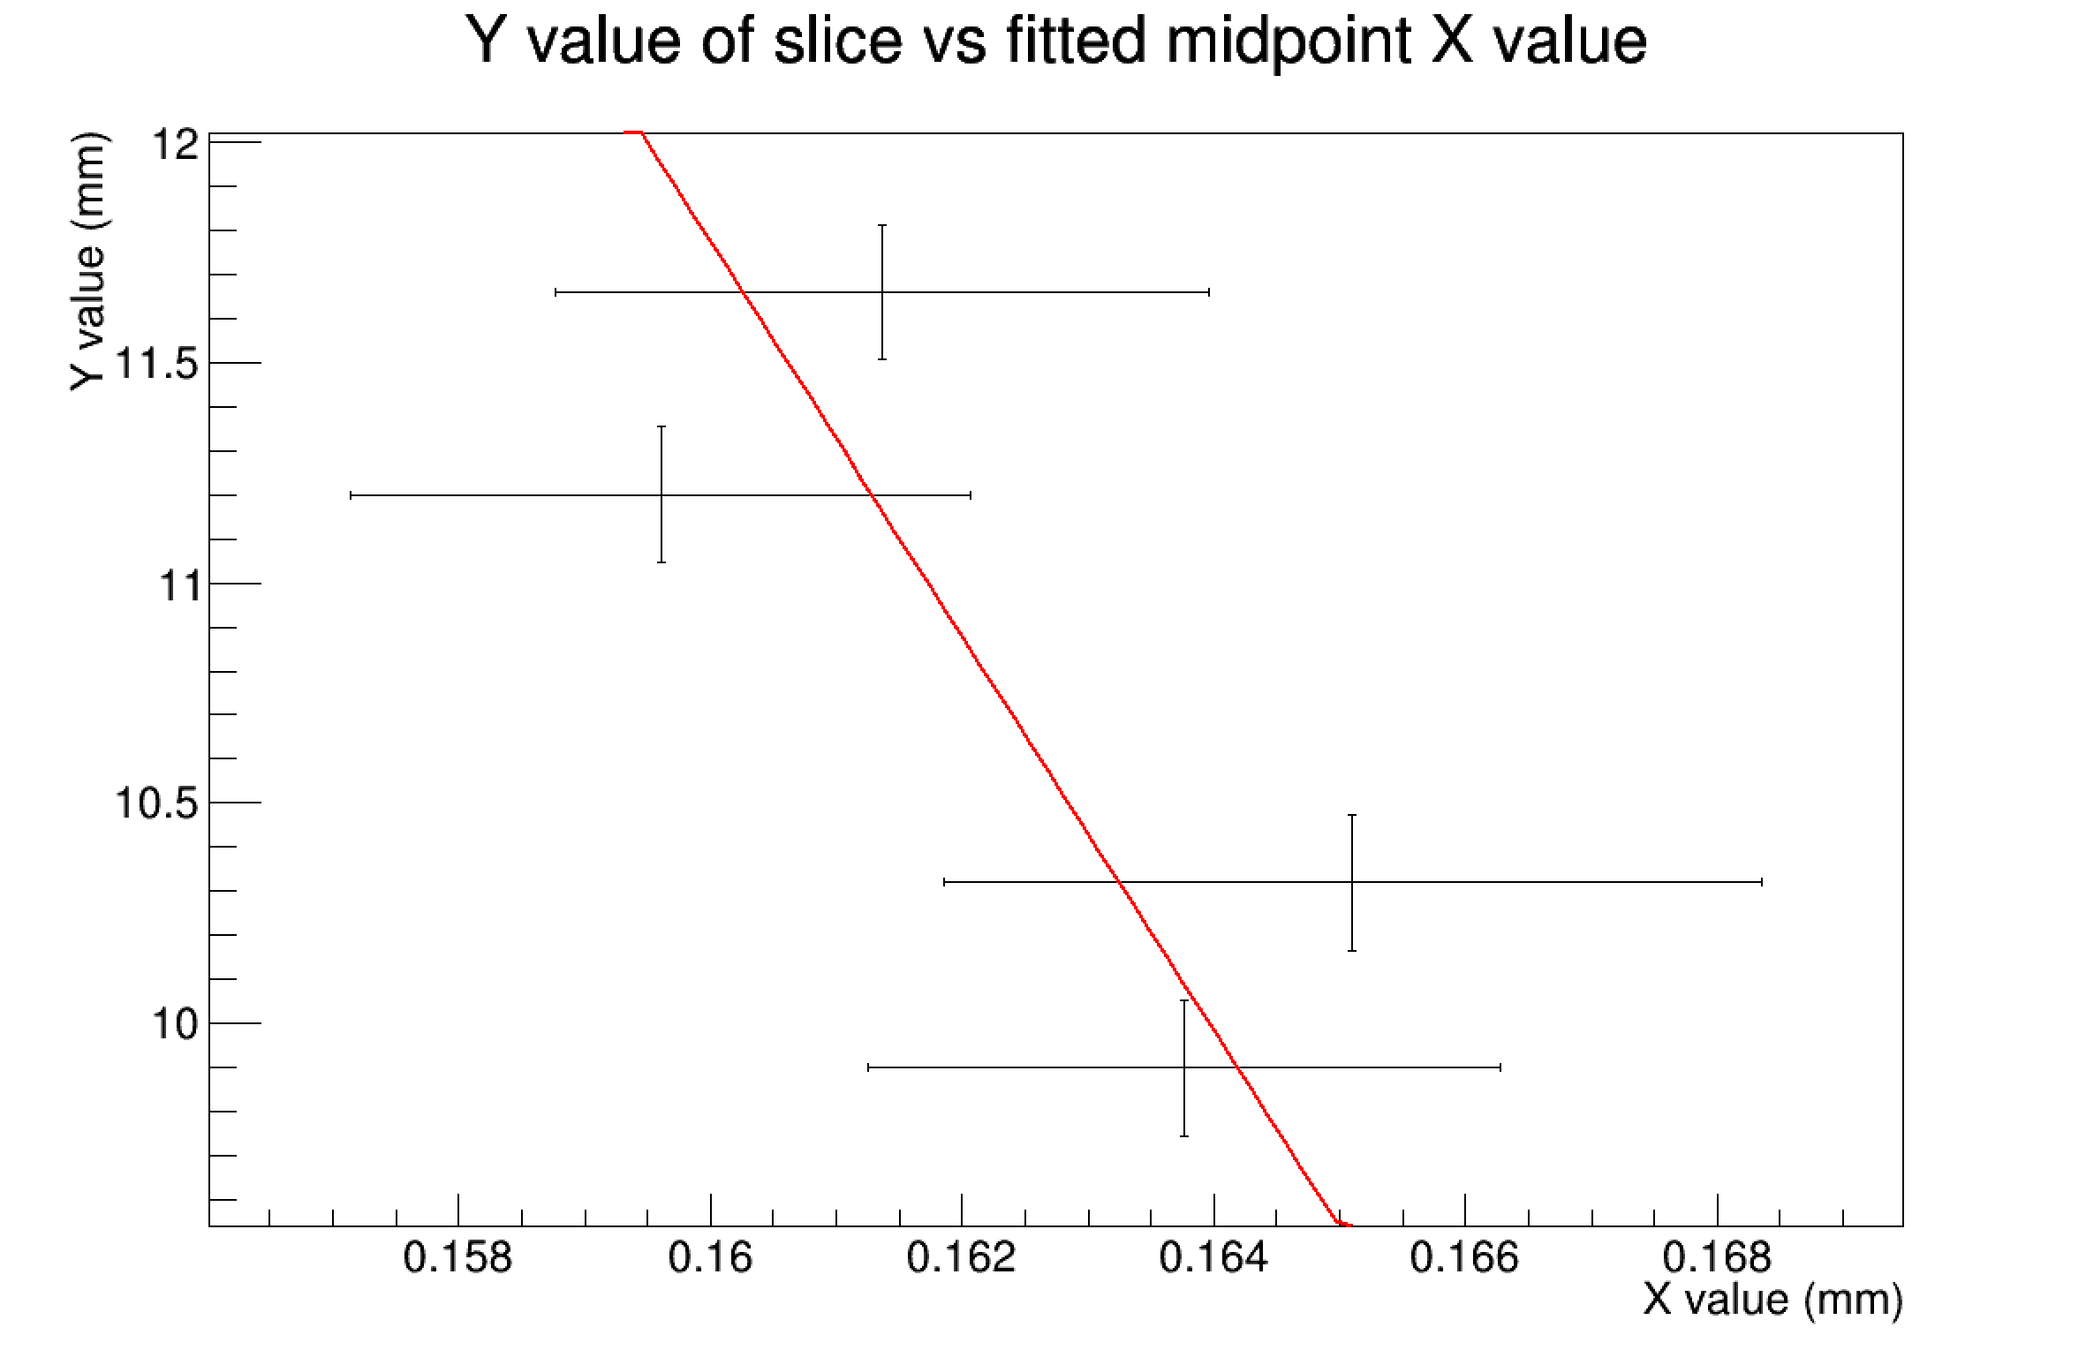
Determining Angle of Rotation at 0 Degrees
Curve 1
Curve 2
Curve 3
There is no consistent trend about which way a secondary correction angle should be.
And delta x is already less than the x bin width
Redid the fit last night got 0.2226

Slide 11
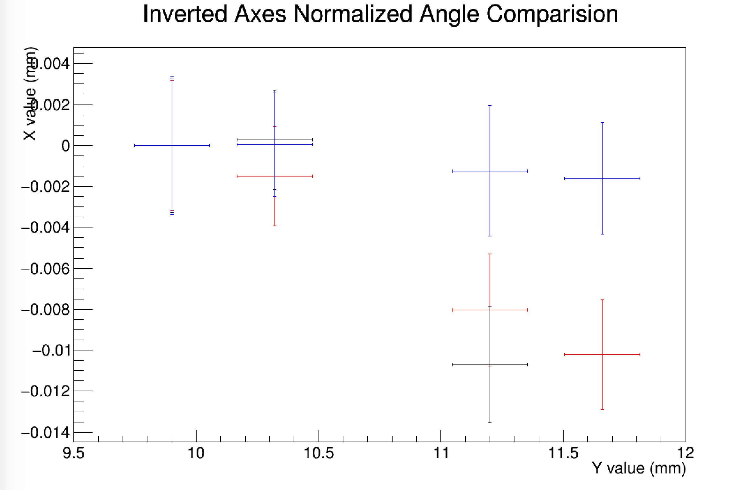
Want to Compare No angle vs +Angle vs -Angle
Positive Angle
No Angle
Negative Angle
Note this is only curve 1

Slide 12
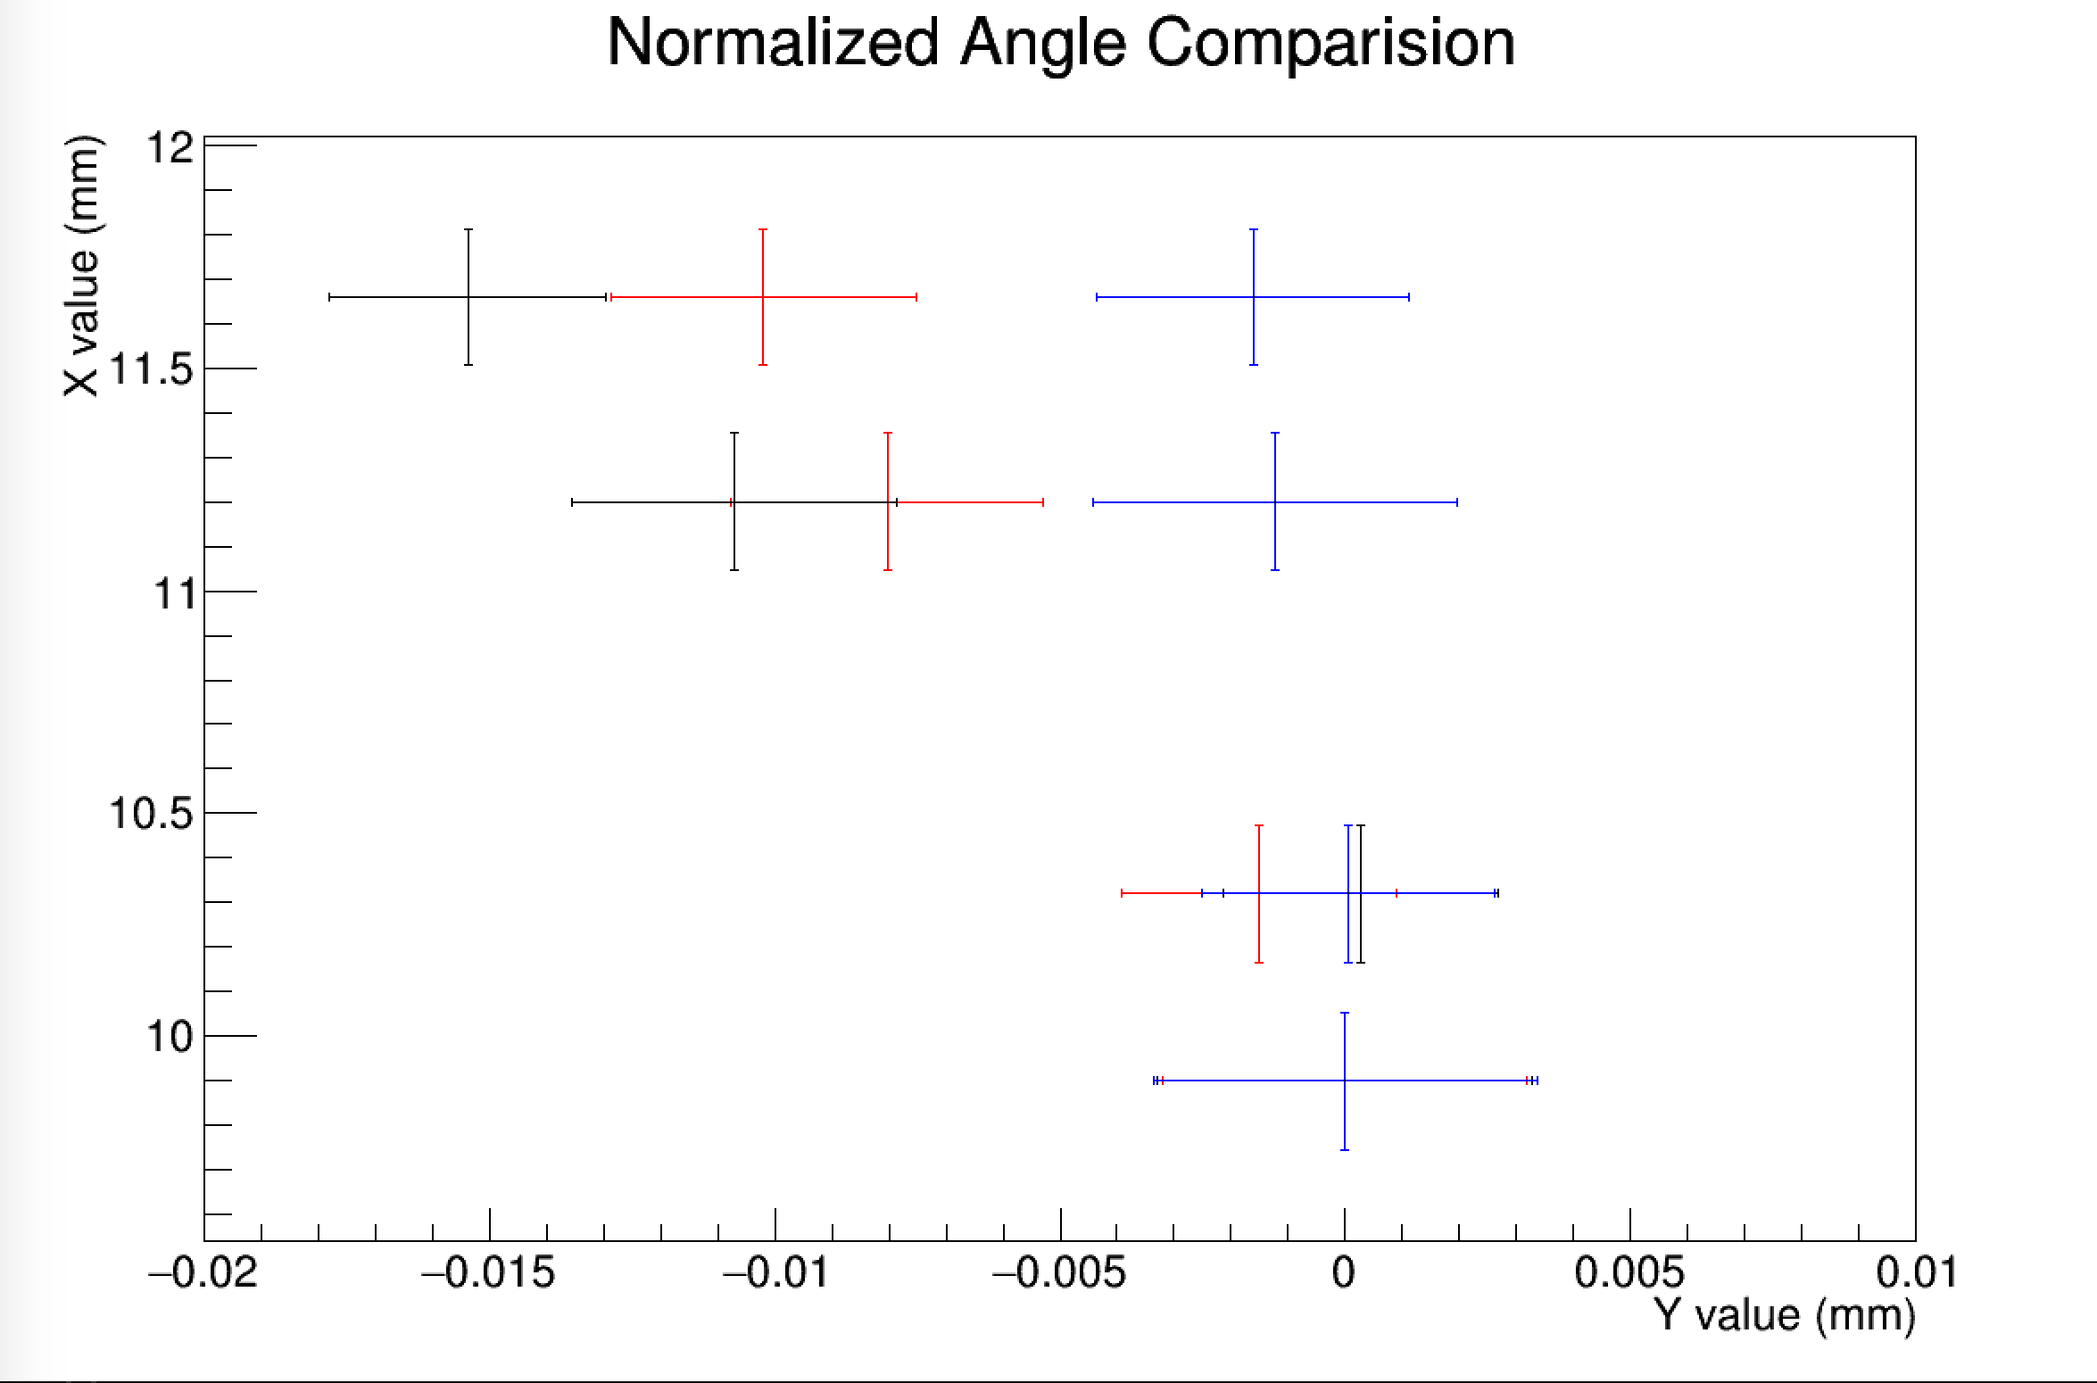
Positive Angle
No Angle
Negative Angle
Claim is that blue angle is the correct angle

Slide 13
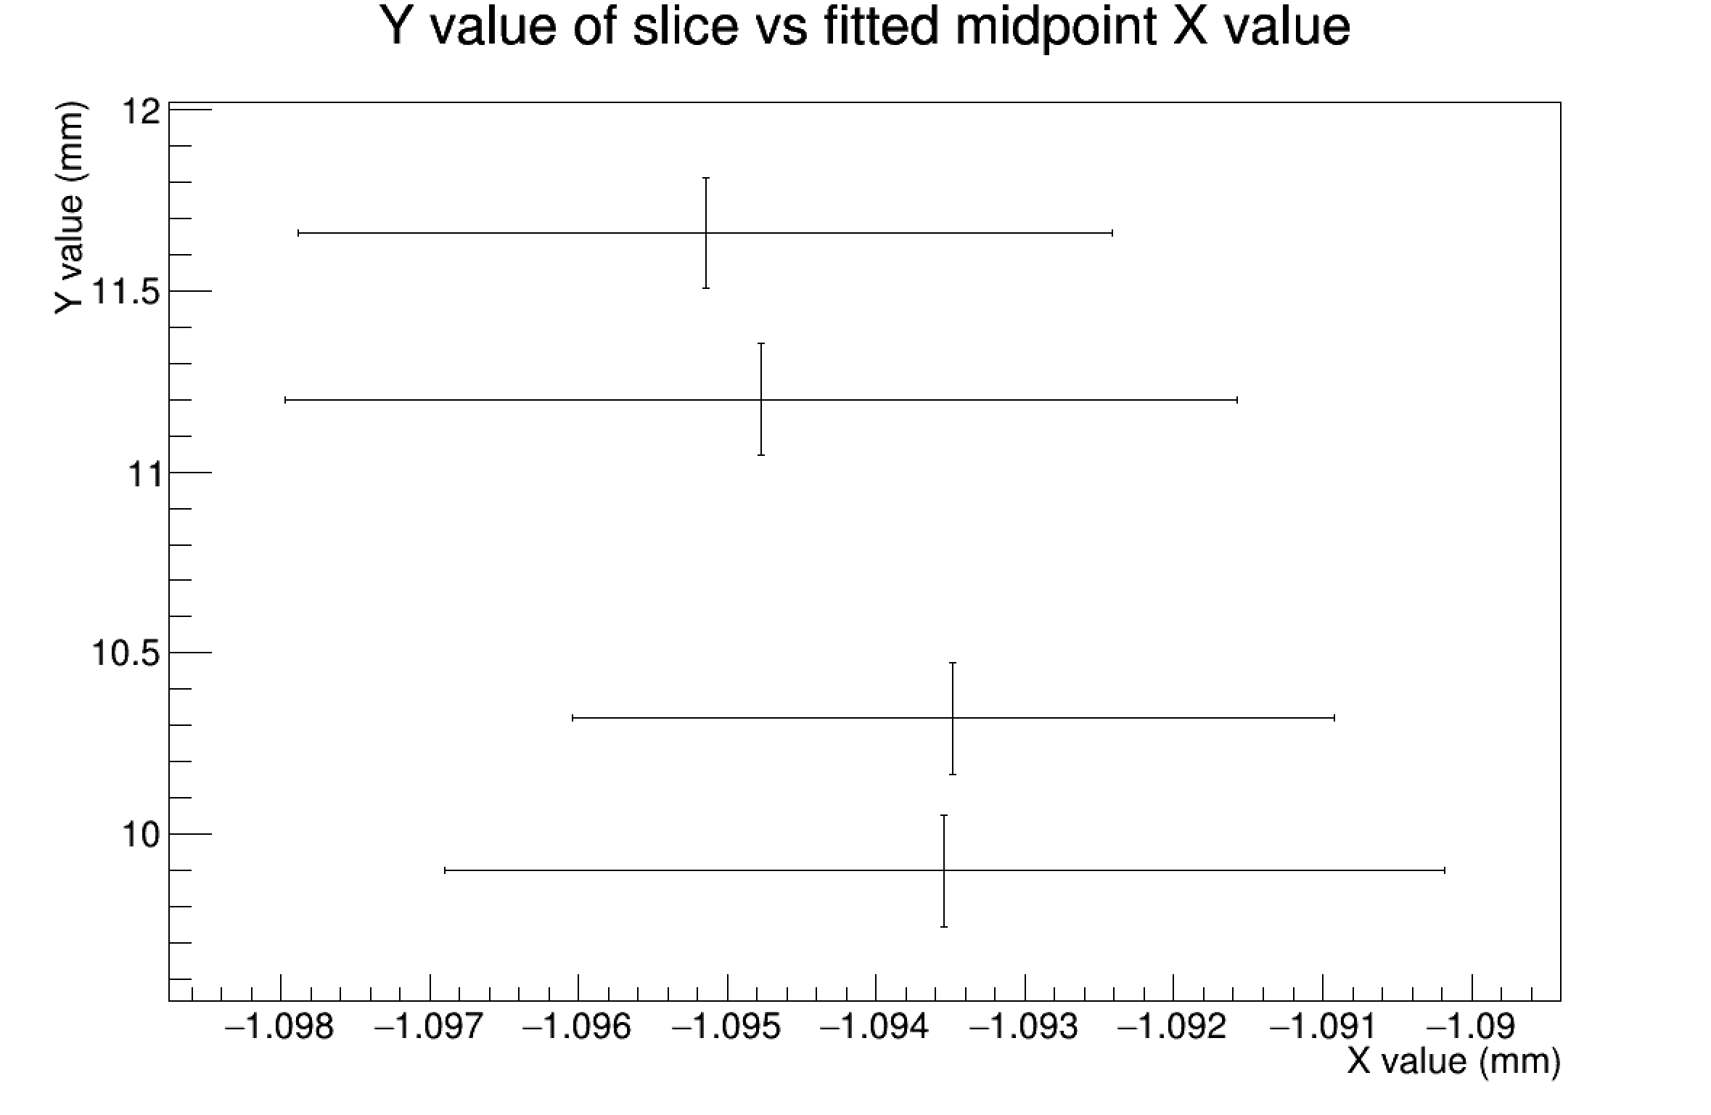
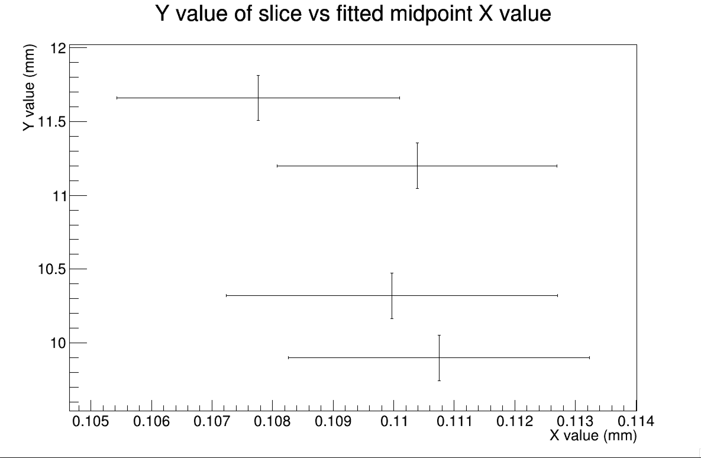
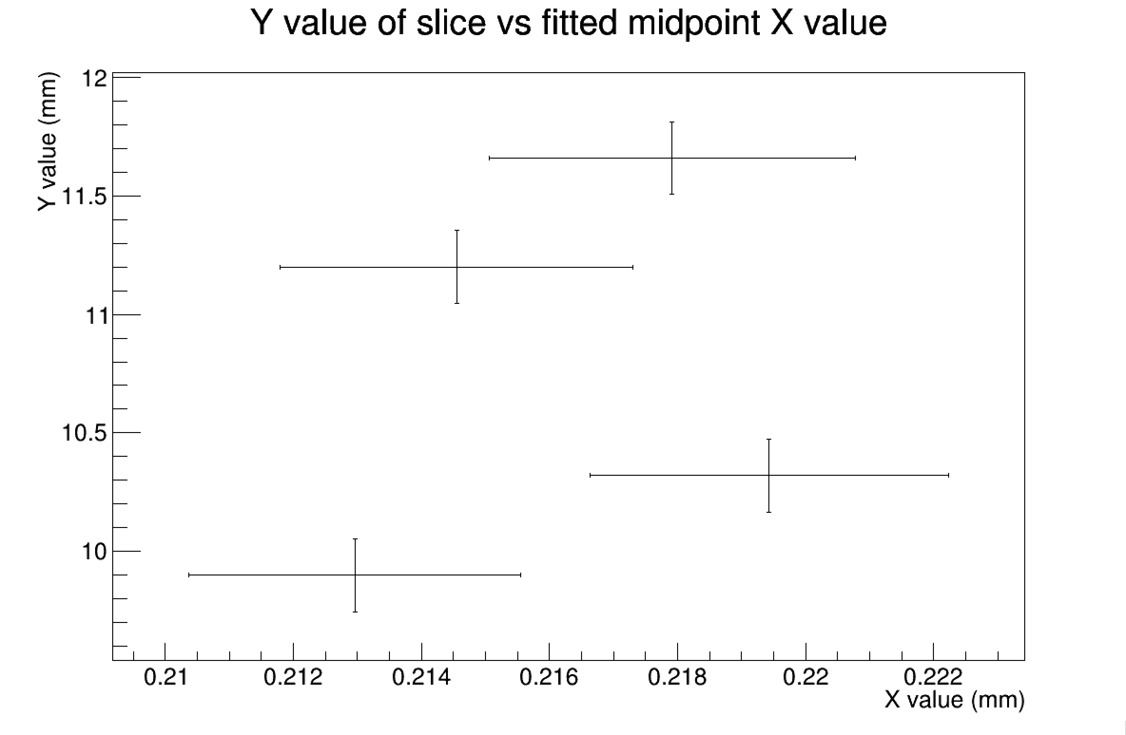
Evidence that Blue/Positive Angle is Correct
Curve 1
Curve 2
Curve 3
There is no consistent trend about which way a secondary correction angle should be.
And delta x is already less than the x bin width

Slide 14
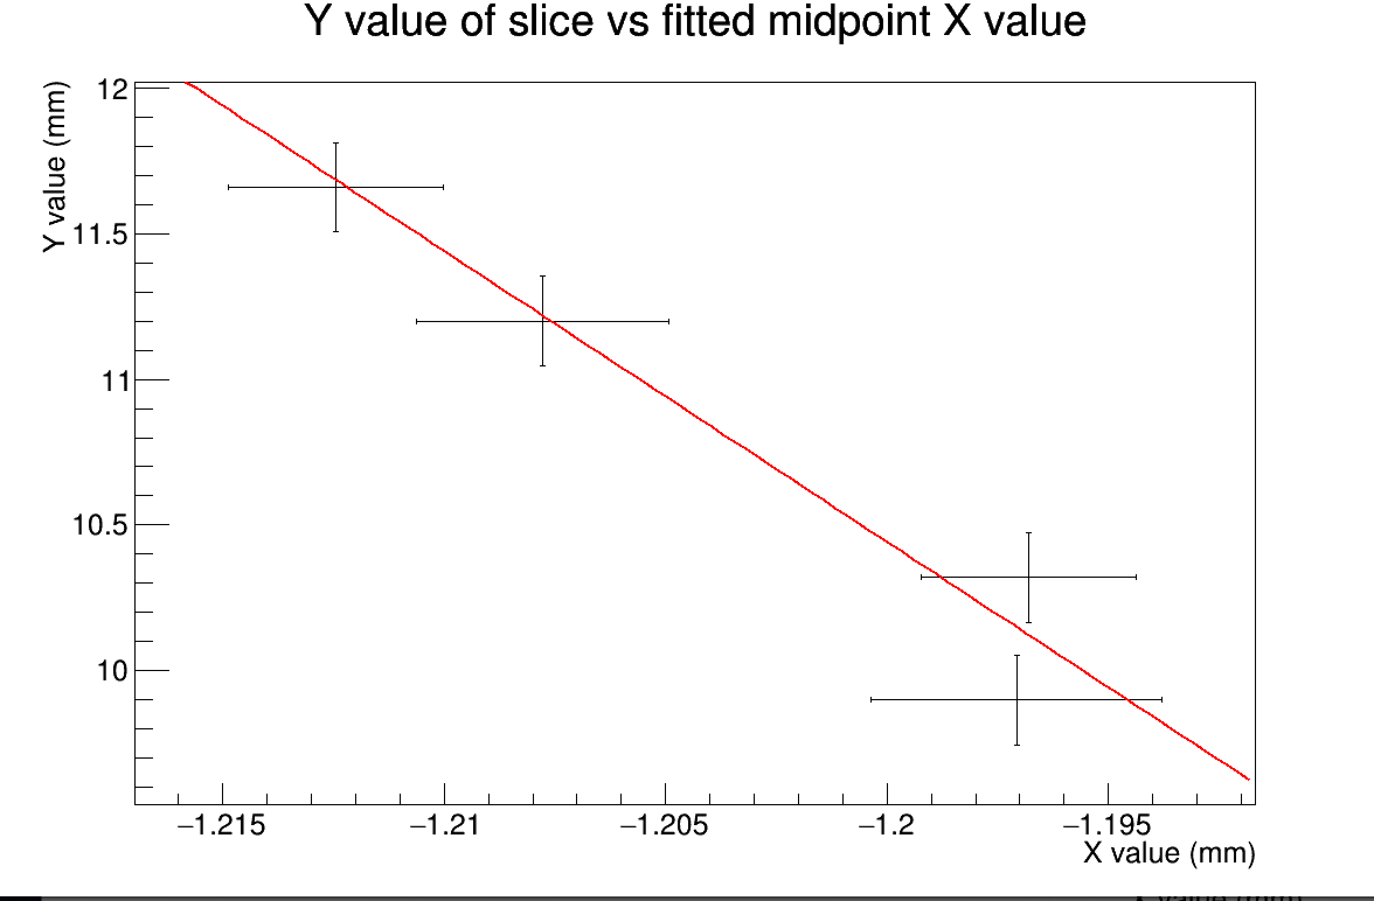
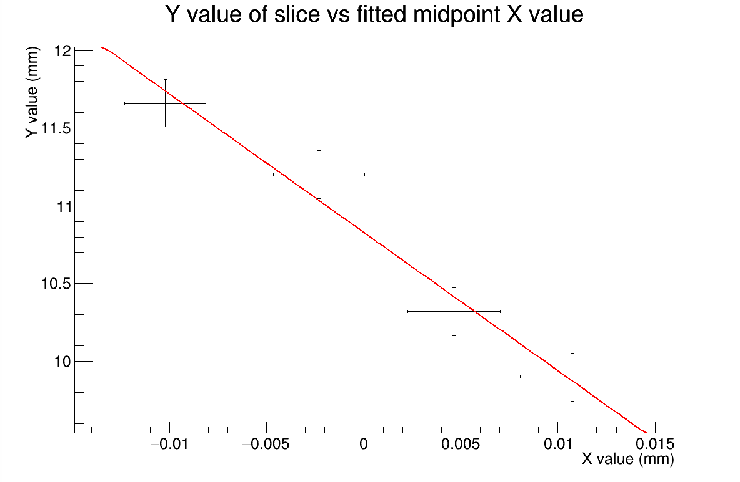
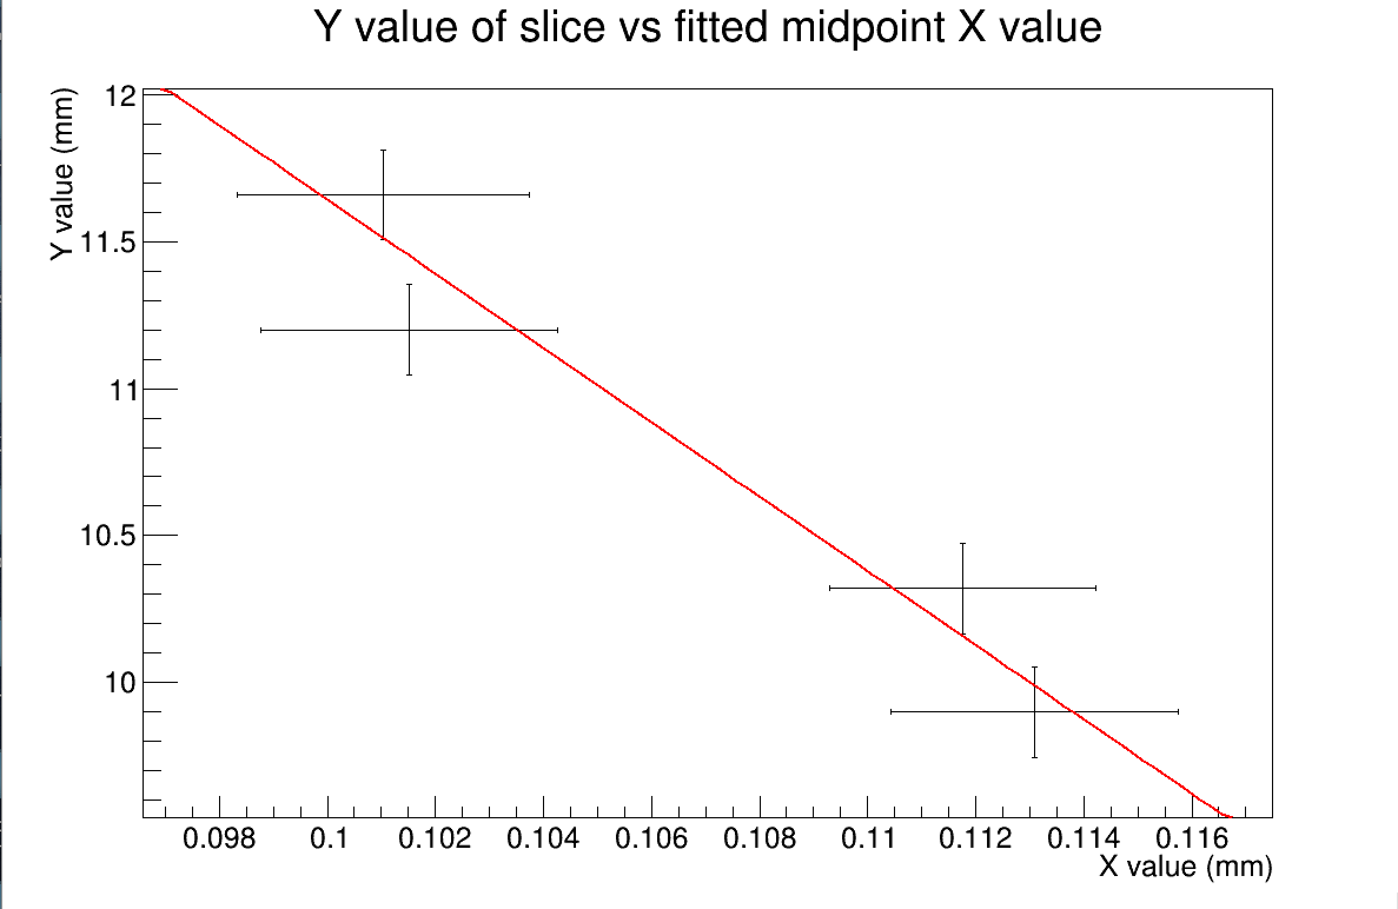
Evidence that Blue/Positive Angle is Correct
Curve 1
Curve 2
If we go the phase 1 angle (+0.284886 degrees) in the wrong direction get new angle measurement of 0.5452 degrees or 2*0.2726 degrees
Curve 3

Slide 15
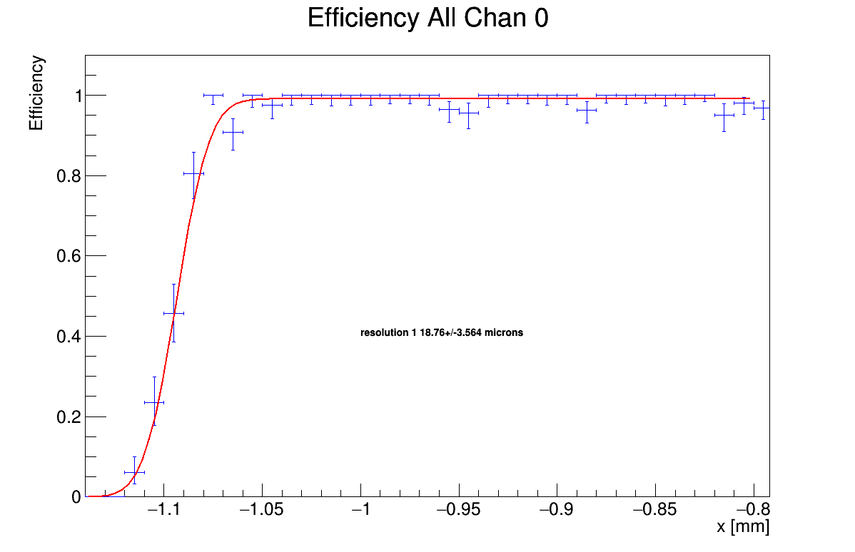
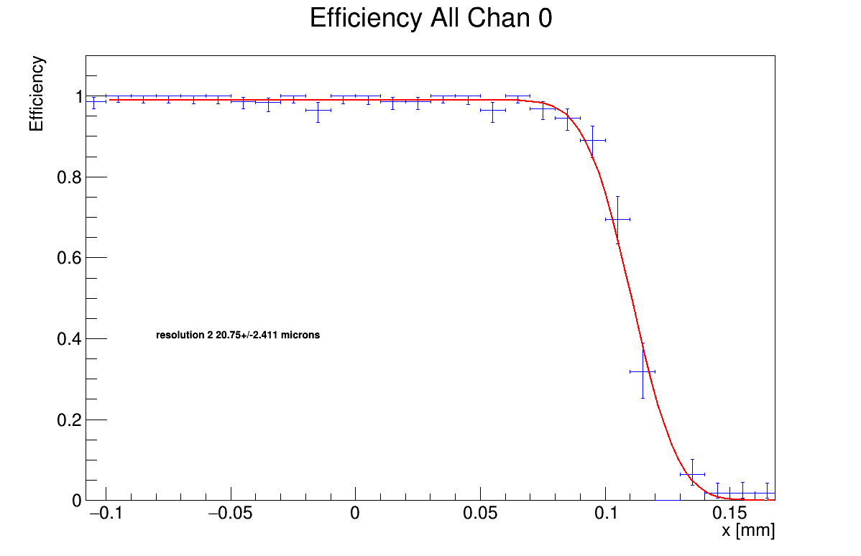
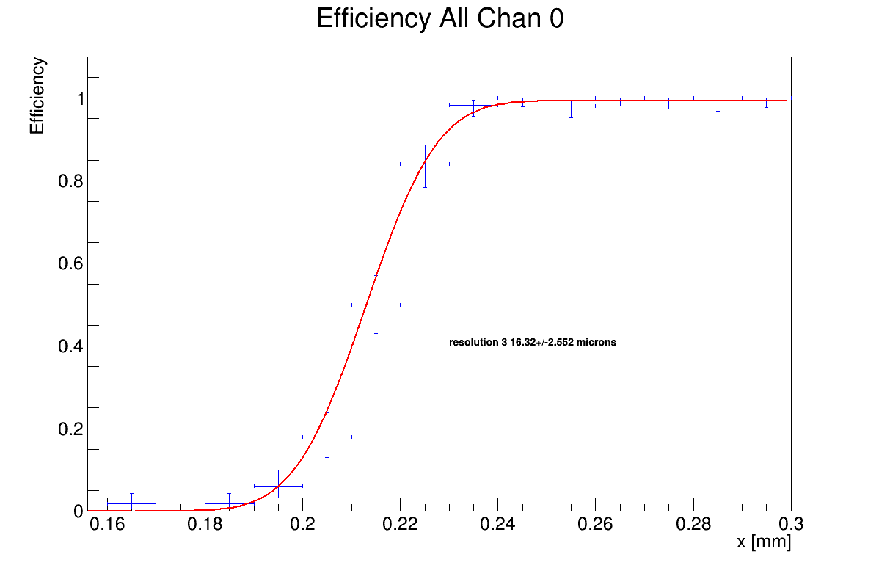
Fitting Error Functions Slice 0 At +2.8 Degrees

Slide 16
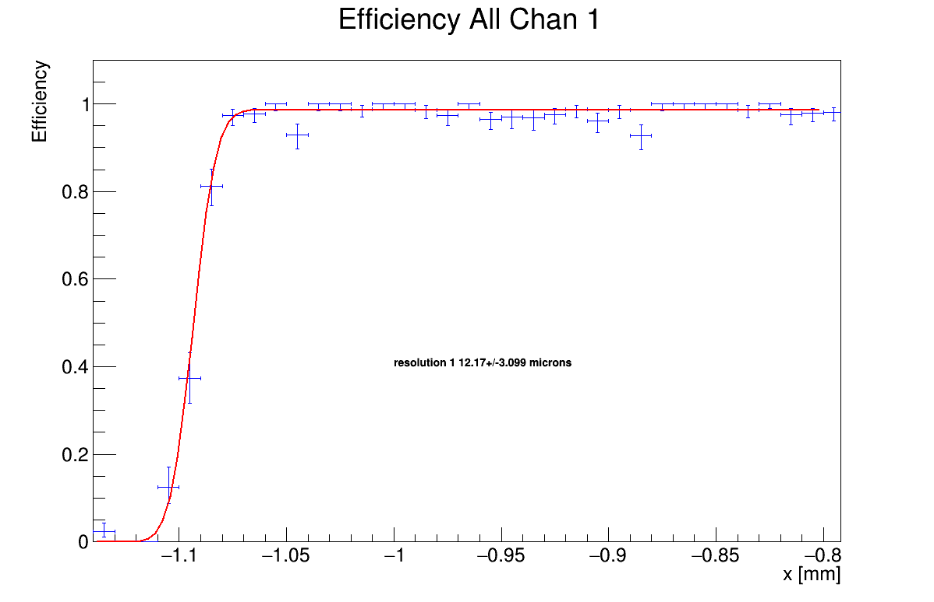
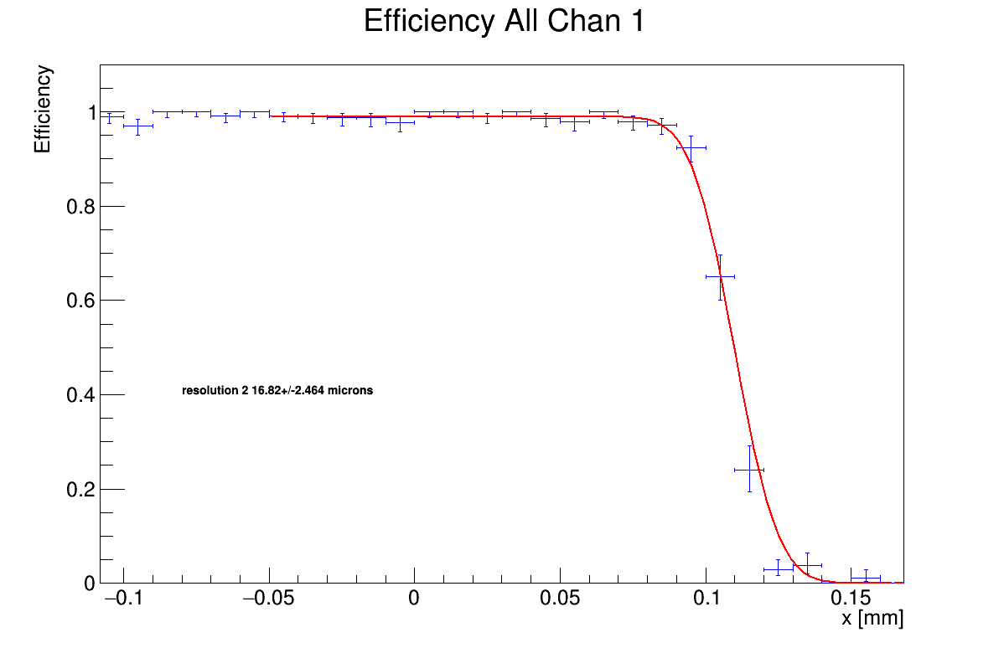
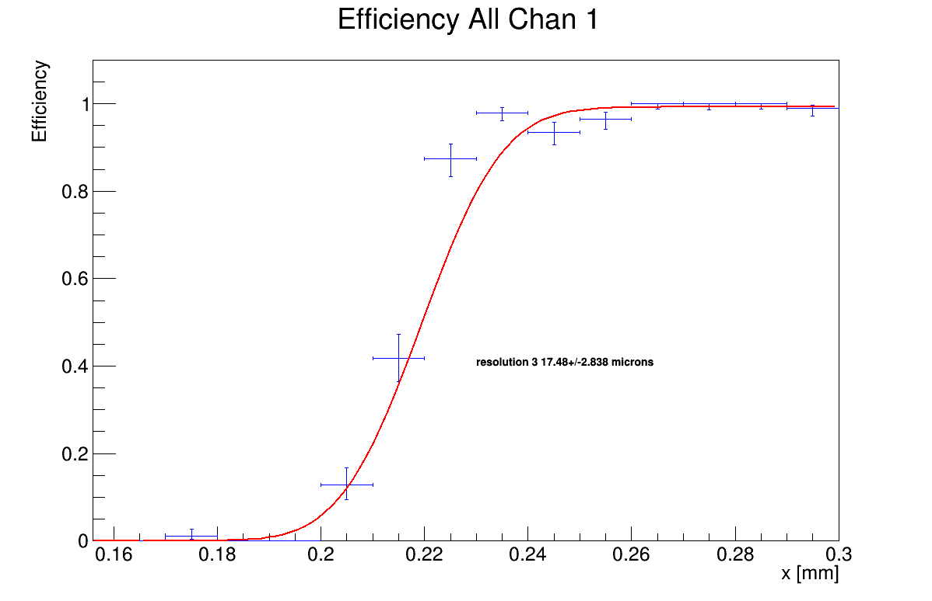
Fitting Error Functions Slice 1 At +2.8 Degrees

Slide 17
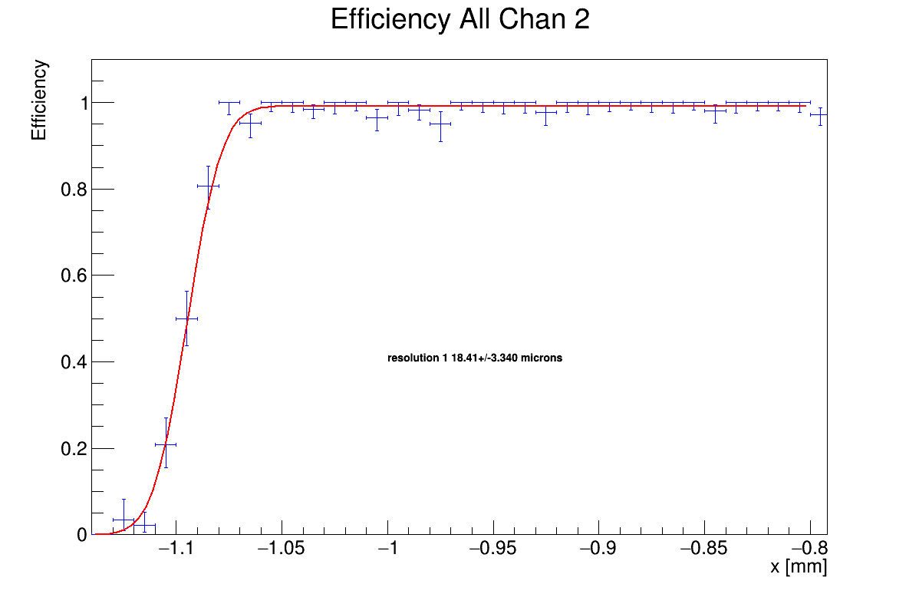
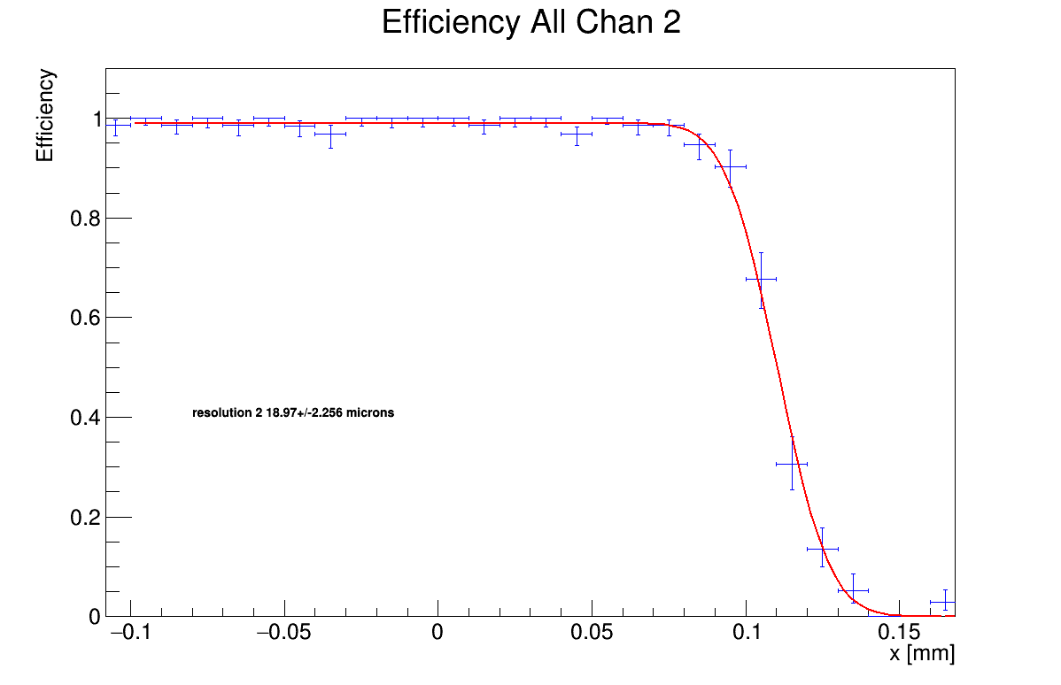
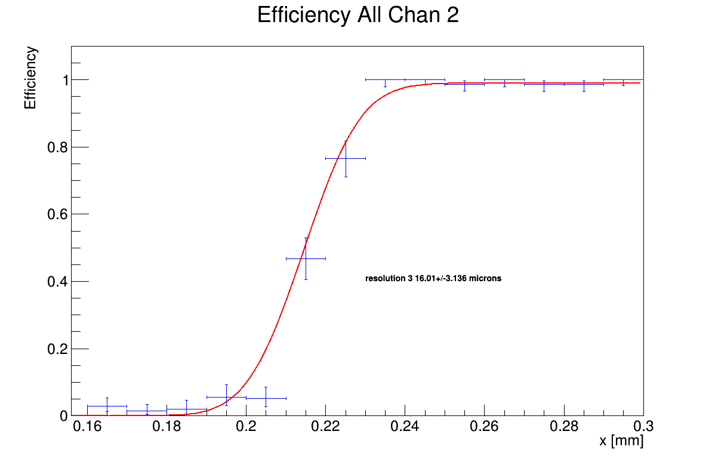
Fitting Error Functions Slice 2 At +2.8 Degrees

Slide 18
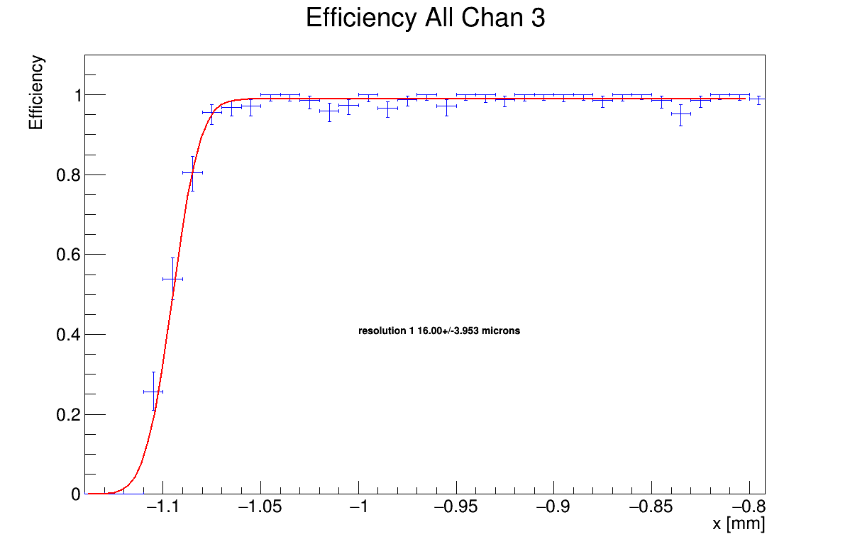
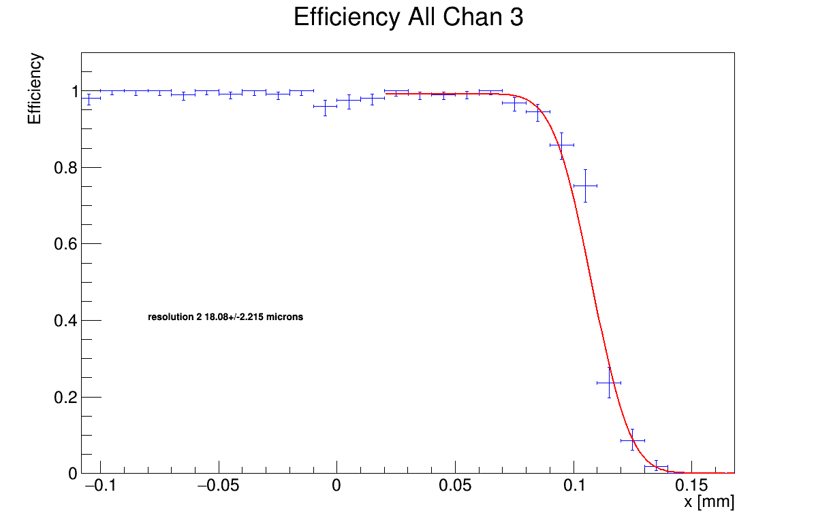
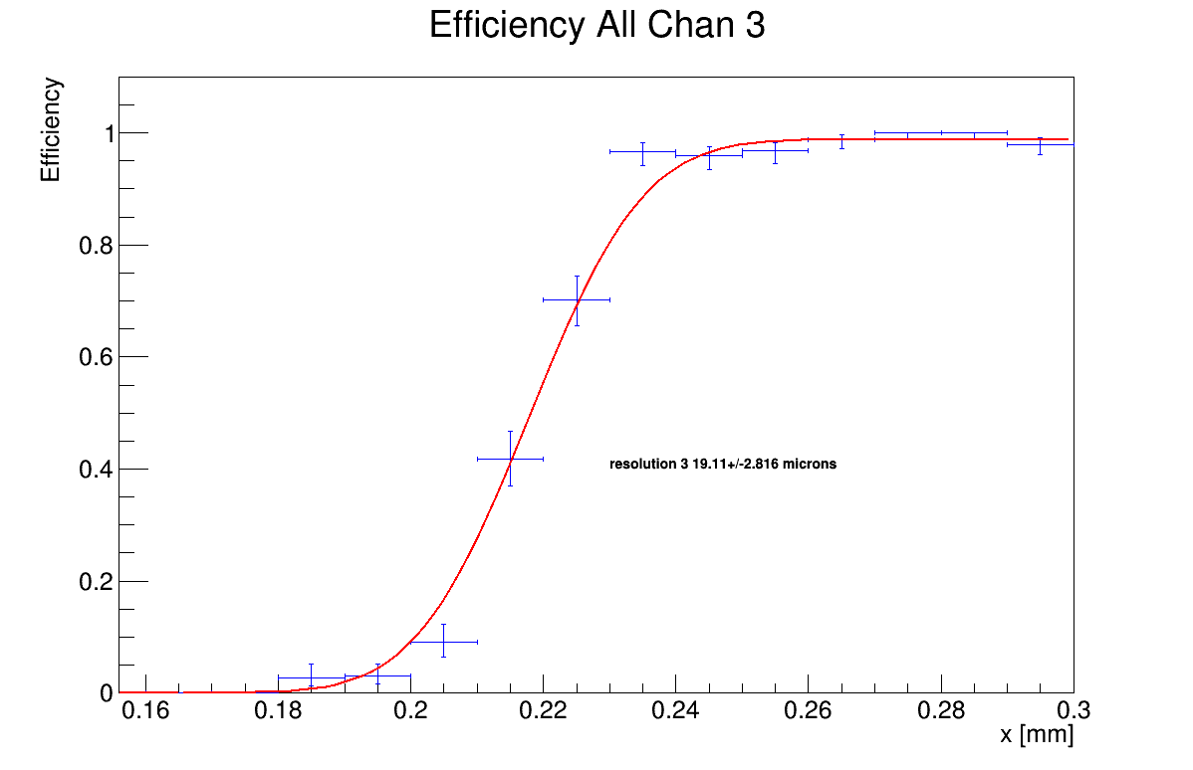
Fitting Error Functions Slice 3 At +2.8 Degrees

Slide 19
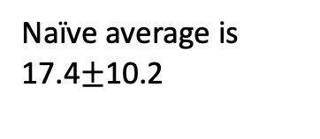
Final Table/Conclusion
No Angle
+2.8 Degrees
Slice | Resolution [μm} | Error [μm] | Midpoint [mm] | Error [mm] | Chi Square
0 | 19.6 | 3.51 | -1.1437 | 0.0032 | 25.3
0 | 20.14 | 2.55 | 0.0615 | 0.0025 | 8.6
0 | 17.25 | 2.46 | 0.1638 | 0.0025 | 3.0
1 | 11.2 | 2.89 | -1.1452 | 0.0024 | 30.9
1 | 12.57 | 2.39 | 0.0574 | 0.0024 | 9.2
1 | 18.54 | 4.27 | 0.1651 | 0.0032 | 10.1
2 | 18.21 | 3.03 | -1.1517 | 0.0027 | 14.2
2 | 18.58 | 2.56 | 0.0547 | 0.0024 | 4.0
2 | 14.89 | 2.31 | 0.1596 | 0.0025 | 10.2
3 | 16.39 | 2.99 | -1.1539 | 0.0027 | 23.6
3 | 15.8 | 2.47 | 0.0496 | 0.0022 | 9.9
3 | 18.99 | 2.64 | 0.1614 | 0.0026 | 9.4
Slice | Resolution [μm} | Error [μm] | Midpoint [mm] | Error [mm] | Chi Square
0 | 18.76 | 3.57 | -1.0935 | 0.0034 | 19.9
0 | 20.75 | 2.41 | 0.1107 | 0.0025 | 14.1
0 | 16.32 | 2.55 | 0.2130 | 0.0026 | 5.8
1 | 12.17 | 3.10 | -1.0935 | 0.0026 | 33.9
1 | 16.82 | 2.46 | 0.1100 | 0.0027 | 9.9
1 | 17.48 | 2.84 | 0.2194 | 0.0028 | 16.9
2 | 18.41 | 3.34 | -1.0948 | 0.0032 | 14.4
2 | 18.97 | 2.26 | 0.1104 | 0.0023 | 10.4
2 | 16.01 | 3.14 | 0.2145 | 0.0028 | 14.4
3 | 16 | 3.95 | -1.0952 | 0.0027 | 21.7
3 | 18.08 | 2.22 | 0.1078 | 0.0023 | 5.0
3 | 19.11 | 2.82 | 0.2179 | 0.0029 | 13.3
Naïve average is 17.4$±$10.2
Spatial Resolution of tracker seems to be between 15—20 microns!

