Slide 1
IOTA Proton Injector Update
Dean (Chip) Edstrom
04/16/2021

Slide 2
Safety
Documentation
SAD amendment, including a USID (which was not enforced previously)
Enclosure model needed – Steve Wesseln will work on this next week
CDC justification form
Likely GV301 & Ion Source high voltage (N:PS)
Additional radiation monitors for the RSS likely unnecessary
based on the energy of the proton beam (max = 2.5MeV)
To be verified with SAD addendum
The ESS will provide a closed contact for the 325 MHz LLRF
Necessary for the RFQ
LLRF expects a TTL signal to be sourced from the 325 MHz RF area (e.g. RF PLC)
RF Switch Mode Controller
Dummy Load / RFQ
Will likely live in the 325 MHz RF area
Beam Switch
Universal beamswitch for FAST?

Slide 3
325 MHz RF
Build-out
Design approved by all major parties
RF (John & Ding) / LCW (Yurick) / Electrical (Kermit)
Steve Wesseln will provide top-down drawing and a few 3D views of the full layout early next week
As of 4/15 Steve still needed the RF Switch dimensions
Fast Interlocks in progress
Details on the next slide
Slow Interlocks PLC components in hand
LLRF
Being built by Euclid Techlabs
EPICS 7 interface – No real forward progress yet
Mode controller
À la Electron Gun & CM

Slide 4
325 MHz RF Fast Interlocks – Peter / Ding / John
RFQ/Klystron (waveforms):
PMT#1 -> Klystron window
PMT#2 -> Transmission line (Kermit wanted)
RF #1 from Klysrton's reflected port
RF #2 Forward signal from Klystron forward port or from directional coupler #1 (before circulator) forward port or both.
RF #3 Reflected signal from directional coupler #1. (before circulator)
RF #4 Reflected signal from directional coupler #2 (after circulator)
RF #5 Reflected signal from directional coupler #3. (after adjustable coupler)
RF #6 Reflected signal from 3 1/8" directional coupler #4 before RFQ
RF #7 Reflected signal from 3 1/8" directional coupler #5 before RFQ
Buncher (waveforms):
RF #8 forward signal
RF #9 reflected signal
RF Cavity Probes (waveforms):
A selection of RFQ/Buncher cavity probes
There are 24 total for the RFQ alone, but we probably want/need to monitor waveforms for a few of these
Levels:
Klystron Solenoid
Pressure (I think we are planning on pressurizing at least part of the 6" line... how many channels?)
RF leak detection
Cavity vacuum
Modulator status
An auxiliary sum (klystron vacuum, LCW, etc)

Slide 5
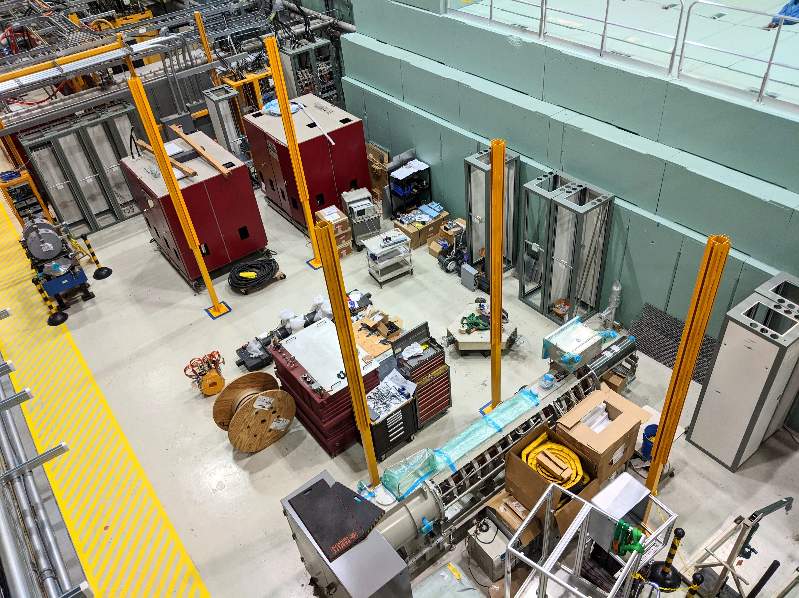
The 325 MHz HLRF Buildout
Location of Klystron, Circulator, Variable Tap, RF Switch.
Final alignment of WR Klystron output.
Install the Pb shield on the Klystron.
Electrical fixed-price contract.
80-20 stands for the circulator and variable tap.
Alignment of the circulator and variable tap.
Anchor the circulator and variable tap stands.
Water fixed-price contract.

Slide 6
IOTA Proton Injector Beamline - Fabrication
IS LEBT RFQ MEBT D604
1
2/3
7
5
7
4
8
6
4
9
Split flange to scraper adapter
In progress
Electrically Isolated Diaphragm (EID)
Initial 10 mm aperture
In progress
RFQ upstream flange rework
Diamond long. profile detector (X332)
RFQ/T310 ceramic rework
KF to Conflat
Dogleg bend chambers (D330 / D340)
T301 ceramic spool
T344 ceramic spool

Slide 7
Engineering & Instrumentation
Vacuum analysis underway
Will inform us of need for additional pumpout ports / gauging
RGA? – Just proposed.
-150V 4-Channel LEBT Bias Current monitor
Final Source Electrode
LEBT Scraper (2 Channels)
EID
Toroids (3x) & Wall Current Monitor
In hand
Scanning Wires
Borrow / Adopt from PIP-II IT
Vacuum chambers will be our own
LEBT Allison Scanner
Borrow from PIP-II IT (NML Gallery Commissioning Only)
MEBT Allison Scanner
Borrow from PIP-II IT (Electronics in ESB)
Diamond longitudinal profile detector
Borrow / Adopt from PIP-II IT
Vacuum chamber will be our own

Slide 8
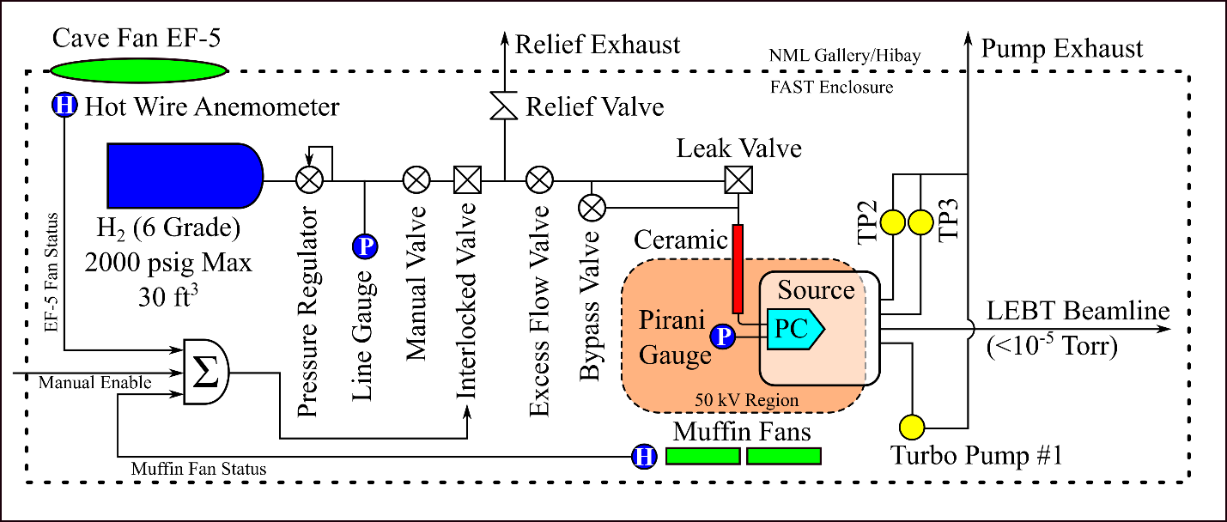
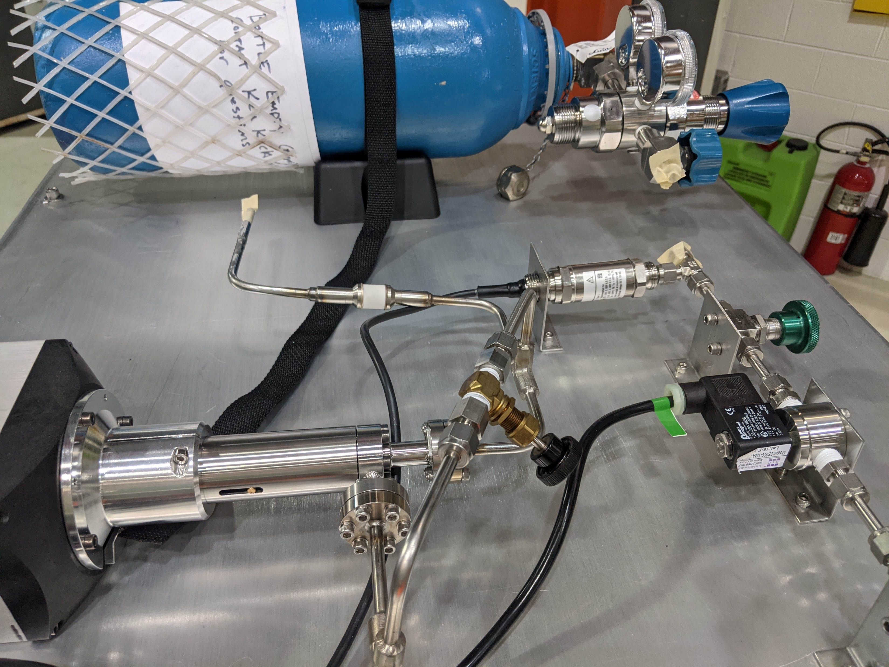
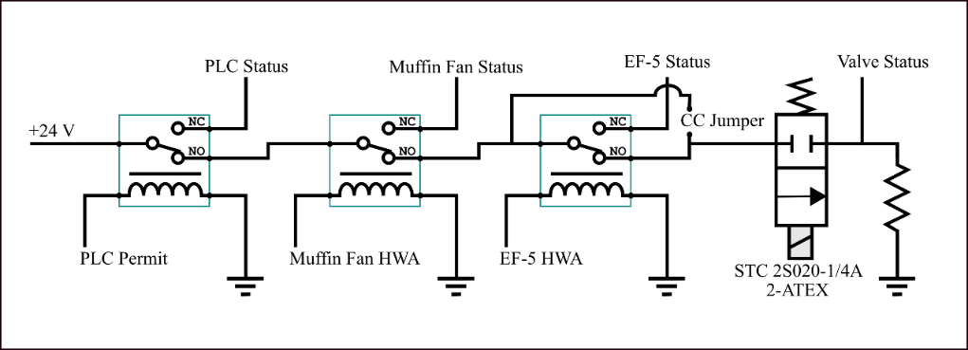
Source Assembly
Hydrogen Distribution is coming together
Need to start working on the interlocks box…

Slide 9
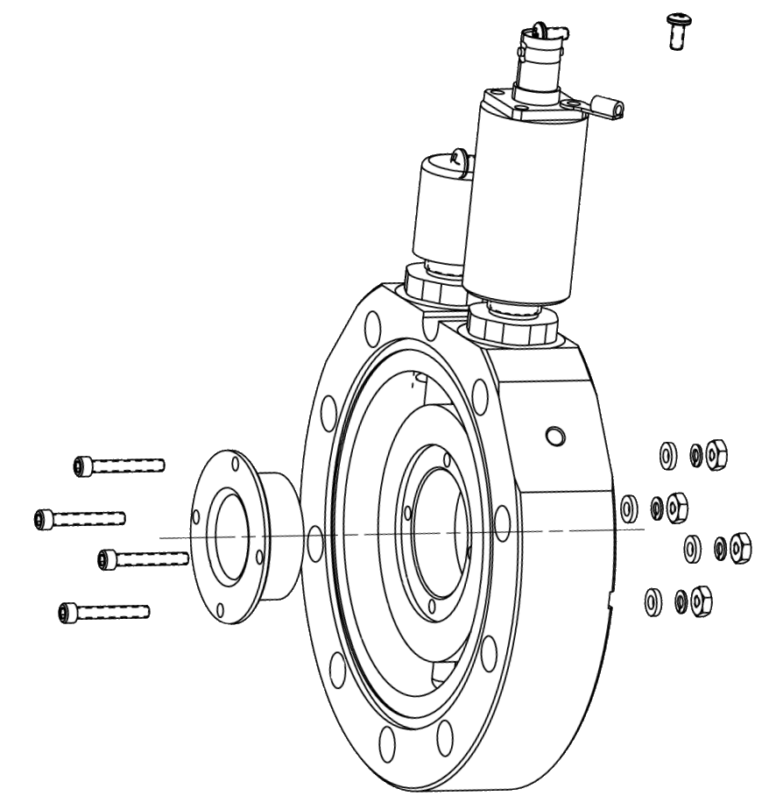
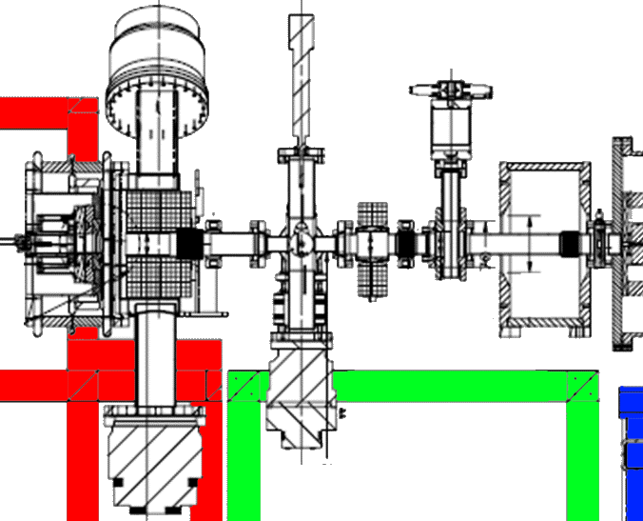
Source / LEBT
The Source Stand (red) may be removed from the cave
Stand-alone 50 keV studies
Includes Upstream LEBT Solenoid
The LEBT includes the following components:
Solenoids
Scraper Assembly
Toroid
Gate Valve
Electrically Isolated Dipragm (EID)

Slide 10
Timeline
Electrical Fixed Price Contract
Late-April to Mid-May: Begin everything that can be done before power outage
Late June: IOTA Shutdown
Power outage for RF Gallery Tie-in
Begin assembly of Beamline
Assemble and recommission the 50 keV source / LEBT in NML Gallery
Cable Pulls

