Slide 1


High Intensity Frontier Initiative (HIFI) νSTORM and Neutrino Factory based on the ESSνSB facility
J.P Delahaye / CERN
M.Dracos / IN2P3, T.Ekelof / UU
for the ESSνSB/HIFI collaboration
https://essnusb.eu/
Notes:
Thanks providing the opportunity to present the High Intensity Frontier Initiative of studying major muon based facilities, like nuSTORM and Neutrino Factory extended from the ESSνSB facility, on the site of the European Spallation Source (ESS) in Sweden

Slide 2
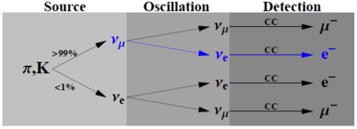
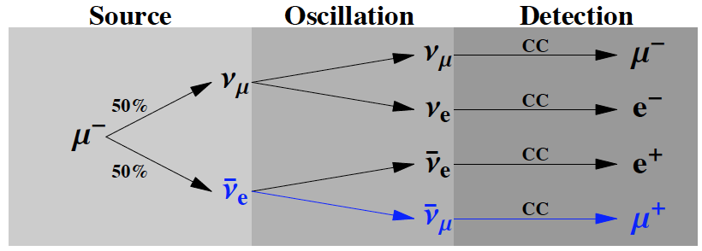
Accelerator based neutrino production
(http://euronu.org)
Pions decay: The Long Base Line or ESSνSB approach
Muons decay: Attractive ESSνSB evolution
π ⁺ → μ ⁺ + ν_{μ}
π ⁻ → μ ⁻ +‾ν_{μ}
Neutrinos as
secondary particles
Mainly:ν_{μ} and‾ν_{μ}
Superbeams
The only method in existing accelerator based facilities
Contamination: < 1% of ν_{e} &‾ν_{e}
μ ⁺ → e⁺ +‾ν_{μ} + ν_{e}
μ ⁻ → e⁻ + ν_{μ} + ‾ν_{e}
Neutrinos as tertiary particles
Equal quantities of:
ν_{μ} , ν_{e} ,‾ν_{μ} and‾ν_{e}
Multitude channels available
Neutrino beam known < % level
Clean muon detection
More challenging (expensive)
Notes:
There are two major processes of neutrino production. The first one is the most commonly used. It relies on pion decays which is the Long Base Line approach chosen by LBNF, T2K or ESSνSB. © The second one relies on muon decays and is the subject of this presentation. Muon decays are specially attractive since they generate all species of neutrinos in equal quantities. But it is more challenging since based on tertiary instead of secondary particles. The two methods provide pure neutrino beams with well defined flux & flavor composition and are very synergetics since the second one takes advantage of the muons created by the first method instead of dumping them.

Slide 3
Muon beams
Beauty of muon beams
π ⁺ → μ ⁺ → e⁺ +‾ν_{μ} + ν_{e}
Neutrinos as tertiary particles
Equal quantities of:
ν_{μ} , ν_{e} ,‾ν_{μ} and ‾ν_{e}
π ⁻ → μ ⁻ → e⁻ + ν_{μ} + ‾ν_{e}
Enable facilities at both:
High precision frontier (Neutrinos from muons decay)
  Short Base Line (without acceleration and no cooling)
    In a channel (Moment approach)
    In a storage ring (nuSTORM approach)
  Long Base Line (after acceleration and cooling)
    Neutrino Factory (decay in storage ring)
High energy frontier (Muon collisions before muon decay)
  TeV class Lepton Collider
    in muon collider ring after acceleration & cooling
Notes:
Because of their specific properties, muon beams enable a range of attractive facilities both at the High Precision frontier by using neutrinos from muon decays, in short base line which is the nuSTORM approach or in long base line which is the Neutrino Factory approach and are the subjects of this talk. They also enable facilities © at the High Energy frontier through collisions of muons in multi-TeV class Lepton Colliders. However, such facilities lie beyond the scope of this presentation.

Slide 4
European Strategy for Particle Physics Update
High-priority future initiatives
Innovative accelerator technology underpins the physics reach of high-energy and high-intensity colliders. It is also a powerful driver for many accelerator-based fields of science and industry. The technologies under consideration include high-field magnets, high-temperature superconductors, plasma wakefield acceleration and other high-gradient accelerating structures, bright muon beams, energy recovery linacs. The European particle physics community must intensify accelerator R&D and sustain it with adequate resources.
Major developments from the 2013 strategy
To extract the most physics from DUNE and Hyper-Kamiokande, a complementary programme of experimentation to determine neutrino cross-sections and fluxes is required. Several experiments aimed at determining neutrino fluxes exist worldwide. The possible implementation and impact of a facility to measure neutrino cross-sections at the percent level should continue to be studied.
The design studies for next-generation long-baseline neutrino facilities should continue
Notes:
The recent European Strategy for Particle Physics Update fully recognizes the interest of neutrinos and muons applications by strongly supporting their developement. As one of the high priority future initiatives, to intensify the R&D on bright muons beams. © As major developments, to study the possible implementation and impact of a facility to precisely measure neutrino cross sections to improve the physics output of long baseline neutrinos facilities and finally © to continue the design studies for next generation of these facilities.

Slide 5

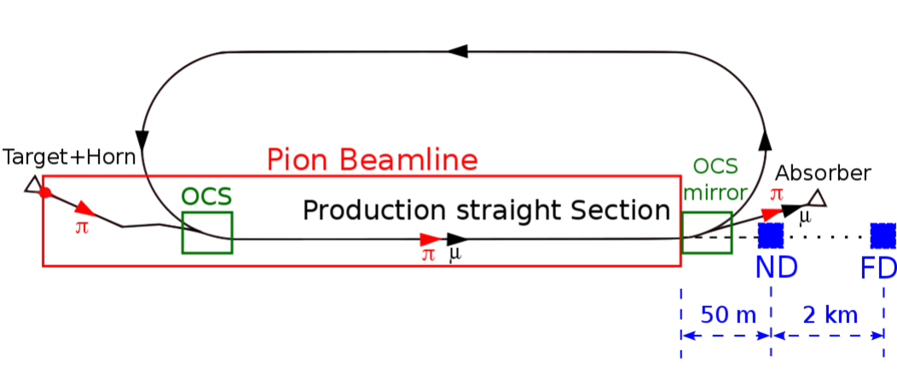
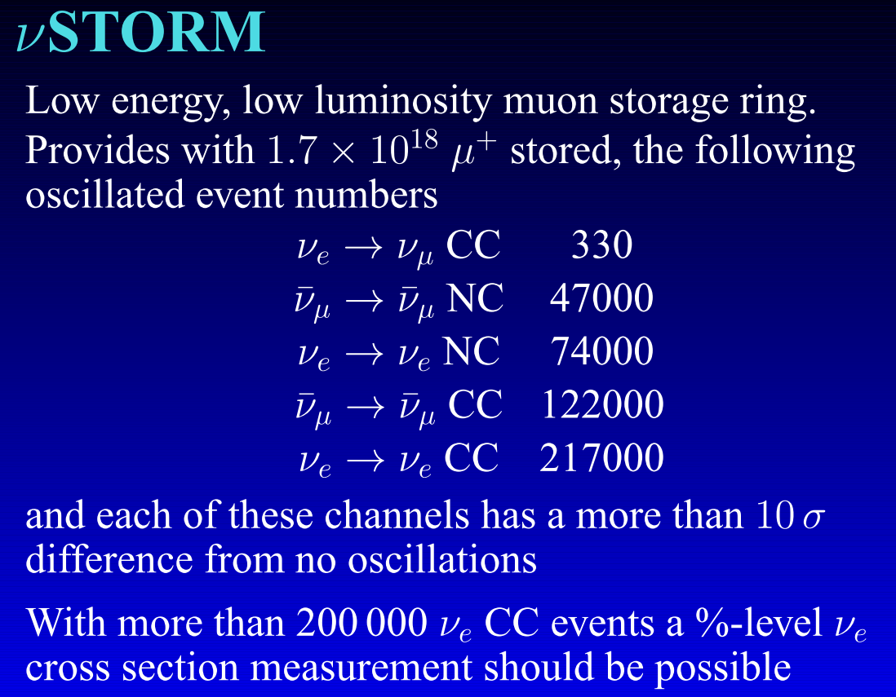
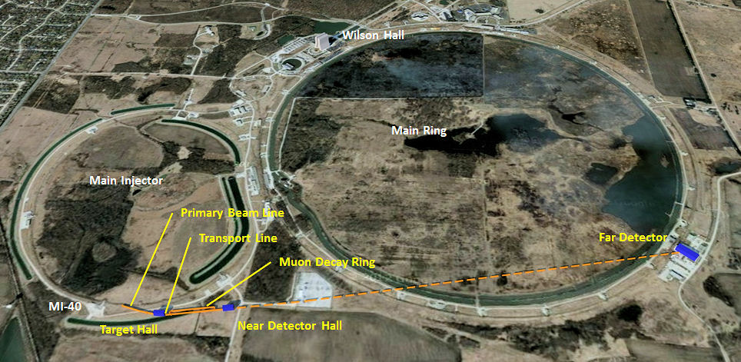
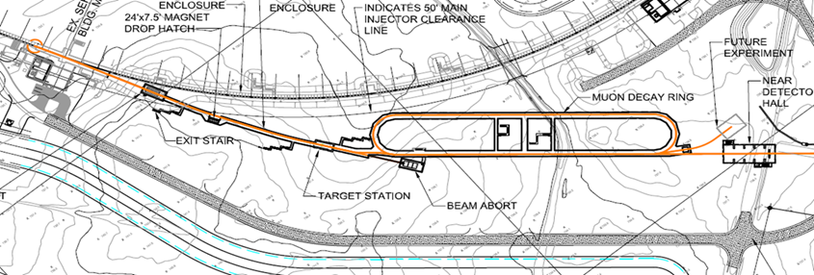
nuSTORM
neutrinos from STOred Muons
A.Bross/FNAL
C.Rogers/RAL
μ
Entry-level NF?
DOES NOT
Require Development of
ANY New Technology
Large Acceptances
Ideal Facility for
Sterile Neutrino search
Neutrino cross sections measurements with unprecedented precision
LBL performance improvement by systematic error mitigation
ν
P.Huber
Virginia Tech
FNAL
3.8 GeV/c stored μ
120GeV
200kW
226m
Notes:
nuSTORM, standing…, is well suited for precise neutrino cross section measurements. Pions produced by a proton beam hitting a target, are injected into a Pion Beam Line where they decay in muons which are accumulated in a racetrack ring. Muons then decay in neutrinos which are analyzed in near and far detectors. © A design study of NuSTORM @ Fermilab shows that by using the Main Injector as a proton driver, about 10¹⁸ muons per year would produce more than 450000 neutrinos oscillations of all kinds analysed by specific detectors on the Fermilab site. © NuSTORM is therefore an ideal facility at a reasonable cost for sterile neutrino search and for neutrino cross section measurements with unprecedented precision which would improve the performance of Long Baseline Neutrino Facilities like LBNF or T2K by mitigation of their systematic errors.

Slide 6
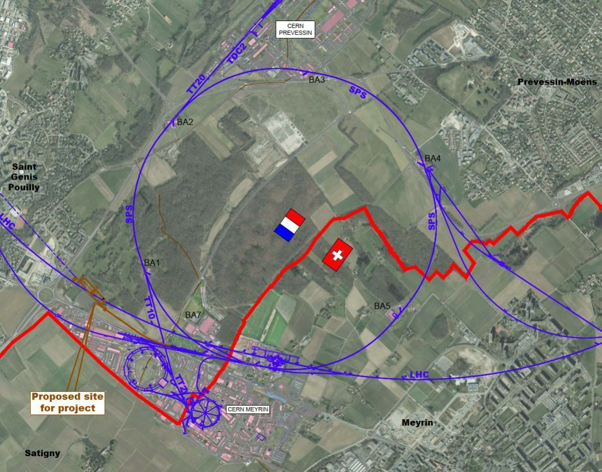
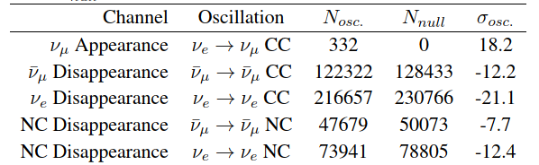
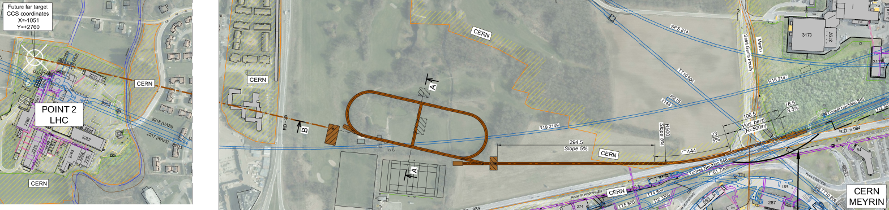
nuSTORM @ CERN
Feasibility study: CERN-PBC-2019-003
S.Tygier
I.Efthymopioulos
Investigated as part of Physics Beyond Colliders
100 GeV/250kW H⁺ from SPS
Muons up to 6.5 GeV/c
Far detector at LHC point 2 (1.75 km) + near detector
Feasibility studies done for integration, civil engineering and radiation protection
Notes:
Another feasibility study of nuSTORM has also been made on the CERN site in the frame of the Physics Beyond Collider study. It uses the SPS beam as a proton driver with a decay muon ring to be built in a new beam line at SPS extraction and a far detector at the LHC point 2, producing per year a similar number of neutrino oscillations of all species.

Slide 7
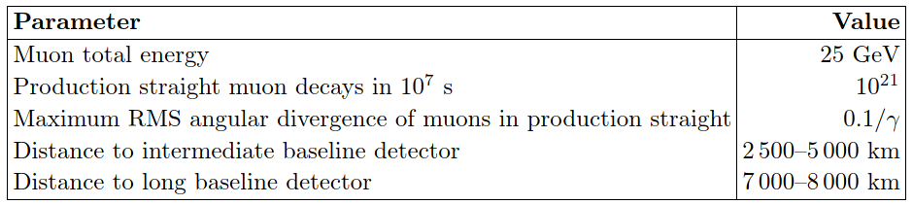
Long Base Line Neutrinos from Stored Muons decay
The Neutrino Factory approach
5 GeV?, 4 MW
Muons decay in high energy neutrinos after μ acceleration and circulation in rings
Requires bunching and (some) ionization cooling to match the muon beam emittances to the accelerator acceptances
Fast acceleration by linacs (straight and/or recirculating)
proton driver
Accumulator
ring + bunch
compressor
Magnetic
capture
Ionization
cooling
Target
Recirculating Linacs
Drift
Phase rotation
Linac
Ideal Facility for
High precision measurements of
Neutrino oscillations PMNS matrix parameters
Decay ring – 50 GeV
≈2000 m circumference
ν beam to far detector
ν beam to near detector
magnetized detector needed
10²¹ ν_{e} or ν_{μ} to detectors per year
International Design Study (IDS-NF): “Generic” design (not site-specific)
10 GeV muon storage ring optimized for 1500-2500km baselines
https://www.ids-nf.org/wiki/FrontPage
Notes:
A similar but more ambitious muon based facility consists in a Neutrino from which the layout is derived from a non site specific international design study. It is based on a proton driver and target at low energy but high power in the MW range creating a large number of low energy muons which are accelerated rapidly up to tens of GeV and accumulated in a storage ring where they decay in neutrinos providing up 10²¹ neutrinos per year which are characterized in a near detector and their oscillations analysed in a far detector several thousands of kms away, © thus making a Neutrino Factory the ideal tool for high precision measurements of the Neutrino oscillation PMNS matrix parameters.

Slide 8
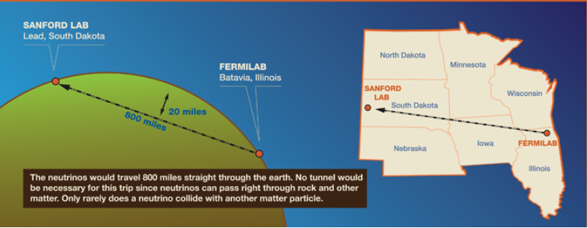
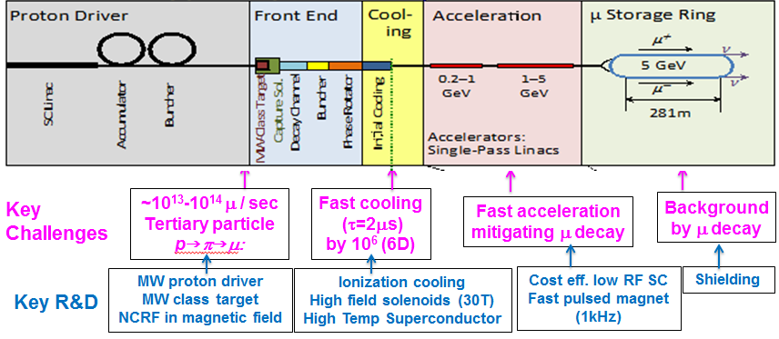
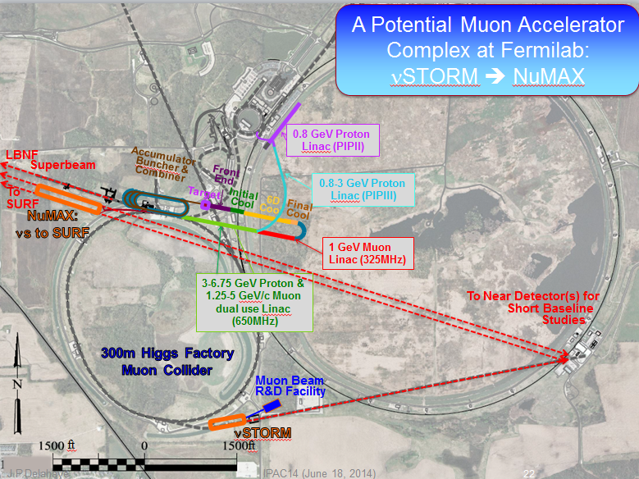

A site specific study: FNAL to SURF
NuMAX (Neutrinos from Muon Accelerator CompleX)
Muon Accel. Prog. (MAP)
M.Palmer/BNL
5GeV staged Neutrino Factory optimized for a far detector at SURF 1300kms from FNAL
(arXiv:1803.07431)
NuMAX Staging:
Commissioning
  1MW Target
  No Cooling
  10kT Detector
Notes:
A site specific design study of a Neutrino Factory at Fermilab, so called NuMAX standing for… has been made in the frame of the Muon Accelerator Program addressing all feasiblity issues by specific R&D. It is optimised for a far detector at Sanford, the same location as the LBNF Dune detector, 1300kms away from FNAL. © The necessary muon energy is therefore limited to 5GeV thus a reduced cost further mitigated by adopting a dual linac accelerating both protons and muons. © It is based on a realistic staged scenario with progressive increase of the technical challenges (beam power, target, cooling, detector) with corrresponding performance improvements.

Slide 9

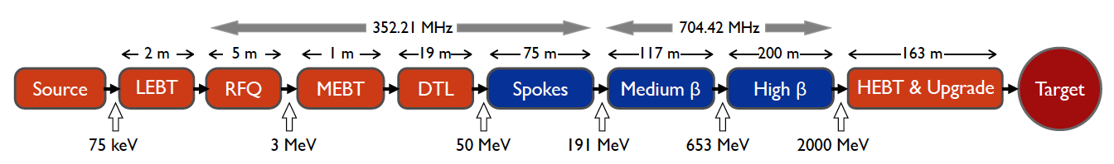
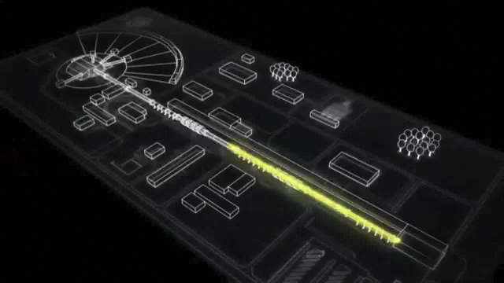
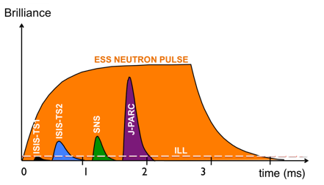
Driven by the world most powerful proton linac
European Spallation Source
under construction in Sweden
empty space for energy upgrades
The ESS will be a copious source of spallation neutrons.
5 MW average beam power.
125 MW peak power.
14 Hz repetition rate (2.86 ms pulse duration, 10¹⁵ protons).
Duty cycle 4%.
2.0 GeV protons (upgradable to 3.5 GeV)
>2.7x10²³ p.o.t/year.
Linac ready by 2023
providing attractive opportunities
Notes:
Any of these facilities requires powerful proton driver in the MW range in order to produce the necessary muons and neutrinos. The European Spallation Source (ESS) of a Neutron facility, presently under construction in Sweden will be driven by the world most powerful linac of 2GeV/5MW. © The construction of this linac is already well advanced. It will be available by 2023 thus providing attractive opportunities.

Slide 10
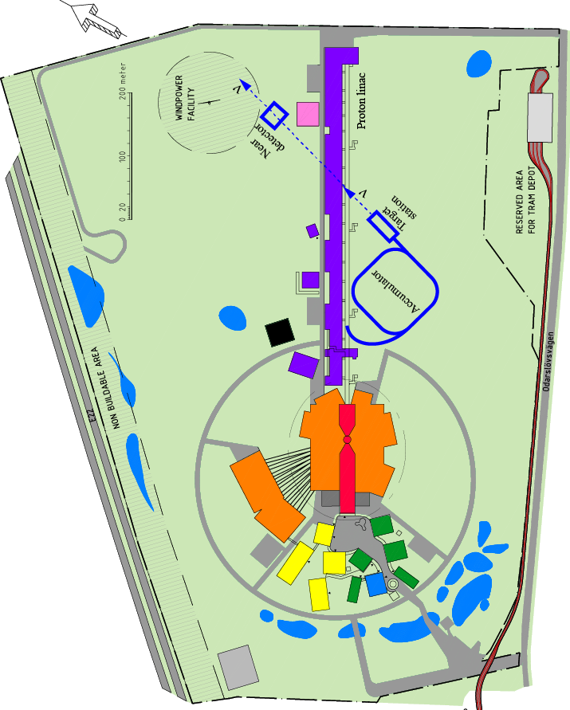
Extending ESS to a neutrino facility
M.Dracos
T.Ekelof
The neutron program must not be affected and if possible synergetic modifications.
Linac modifications: 5MW → 10 MW
(14→28 Hz rep rate, 4→8% duty cycle)
Accumulator (C~400 m) to compress to few μs the 2.86 ms proton pulses
  H⁻ source (instead of protons)
Short pulses (~μs) will also allow DAR experiments (as those proposed for SNS) using the neutron target
~400 MeV neutrinos.
Target station (studied in EUROν).
Underground detector (studied in LAGUNA).
Great synergies providing
considerable cost savings
Notes:
The most attractive opportunity consists in a series of performing and complementary Neutrino Facilities by sharing the proton driver without interfering with the Neutron source. By mainly doubling the linac repetition rate, an additional 5MW proton beam would serve as an exceptional driver of a Long Base Line Neutrino facility from which you see the additional systems © appearing on the ESS site mainly an accumulator, a dedicated target and a near detector. © Overall, Neutron and Neutrino facilities could profit from great synergies providing considerable cost savings.

Slide 11


ESSνSB design study
(2018-2021)
A H2020 EU Design Study (Call INFRADEV-01-2017 http://essnusb.eu/
Title: Discovery and measurement of leptonic CP violation using an intensive neutrino Super Beam generated with the exceptionally powerful ESS linear accelerator
Design of a second generation long base line neutrino for CP violation observation with high sensitivity at 2nd oscillation maximum
Total cost: 4.7 M€, EU budget: 3 M€, over 4 years
15 participating institutes from 11 European countries including CERN and ESS
6 Work Packages
Approved end of August 2017
Conceptual Design Report (CDR) by end 2021
ESSνSB
BENE (2004-2008)
ISS (2005-2007)
EUROν (2008-2012)
LAGUNA (2008-2010)
LAGUNA-LBNO (2010-2014)
COST Action CA15139 (2015-2019)
Notes:
This is why a second generation of Long Baseline Neutrino facility is considered on the ESS site for CP violation observation with high sensitivity at 2nd maximum made possible by the exceptionally large proton beam power available. A design study of such a facility, ESSnuSB, has been launched in 2018 by a specific collaboration strong of 15 Institutes from 11 countries with EU support, aiming at a Conceptual Design Report by the end of this year.

Slide 12
ESSνSB future upgrade
High Intensity Frontier Initiative
(HIFI @ ESS)
HIFI @ ESS design study of the possible future implementation in a staged approach of ESSνSB, nuSTORM and Neutrino Factory on the ESS campus
Taking advantage of the, thus existing, ESS 2 GeV/5 MW world most powerful linac
Including parameters, performances, R&D to address major feasibility and cost issues
Building up on the excellent work and progress already achieved in the frame of the IDS-NF, Muon Accelerator Program (MAP) and CERN Beyond Collider Physics.
Applying for EU support as Research Infrastructure Concept Development
3M€ over 4 years (2022-2025)
Launch of an ESSνSB-HIFI collaboration (presently participating 70 physicists from 24 institutes) extended from existing ESSnuSB collaboration aiming by 2025 at:
ESSνSB Technical Design Report (TDR)
ESS-NuSTORM and ESS-Neutrino Factory Preliminary Conceptual Designs
A unique opportunity not to be missed
Notes:
A High Intensity Frontier Initiative (HIFI @ ESS) is now proposed to explore further upgrades of ESSnuSB with muon based neutrino facilities, namely NuSTORM and Neutrino Factory, taking advantage of the powerful ESS linac and of great synergies with ESSnuSB. It would be done by an ESSνSB-HIFI collaboration extended from the present ESSnuSB collaboration, asking support from EU and aiming by 2025 at a ESSnuSB Technical Design and Preliminary Designs of nuSTORM and Neutrino Factory on the ESS campus. © A unique opportunity not to be missed.

Slide 13
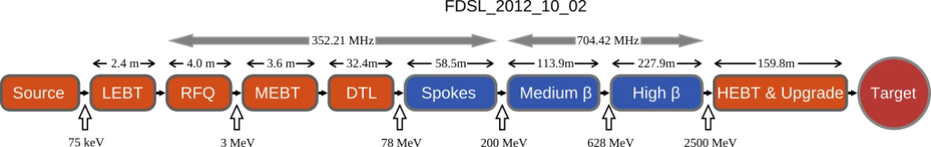
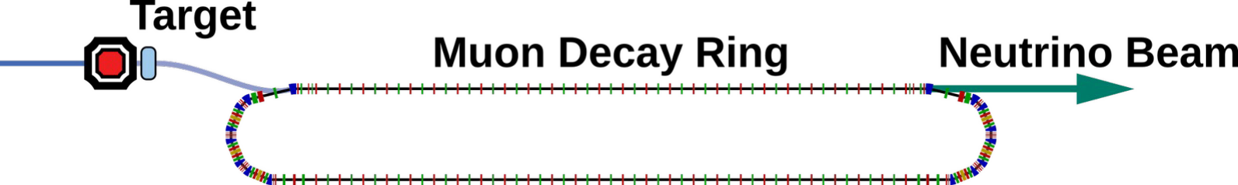
νSTORM @ ESS
ESSνSB Accumulator
V cross sections
Sterile V search
ESS Linac
H⁻
H⁺
π
ND
FD
π ⁺ → μ ⁺ → e⁺ +‾ν_{μ} + ν_{e}
π
μ
Test Line
μ beam R&D
μ
nuSTORM preliminary designs already available
  Driven by FNAL-MI at 120GeV/0.2MW or CERN-SPS at 100GeV/0.25MW
Adaptation to the ESS 2 GeV / 5 MW proton beam
  Inspired from IDS & MAP Neutrino Factory driven by 8GeV/4 MW proton beam
  Adaptation of the pions production target
  Optimisation and characteristics of the muon and neutrino beams
  With shorter μ lifetime and lower ν energy (300 MeV)
Lower energy & smaller size (and cost) of the Accumulator & Muon Decay Ring
Physics and Detector optimisation
for precise ν cross section measurements and Sterile ν search
No critical feasibility issues but large acceptances
Performance optimisation & cost mitigation R&D
Ideal Test Bed for Muon Science Development, Test & Demonstration
Notes:
nuSTORM @ ESS would benefit from the studies already made at FNAL in the frame of MAP and at CERN in the frame of PBC. They are based on conventional technologies without major feasibility issues but require large acceptance in order to collect as many μ as possible. The nuSTORM @ ESS study would first address the adaptation to the ESS linac specificity with a lower energy of 2 GeV and beam power up to 5MW. © In parallel with physics measurements, this facility could provide an attractivel μ beam to a dedicated test bed to develop , test & demonstrate the novel muon technology required for further upgrades in the future.

Slide 14
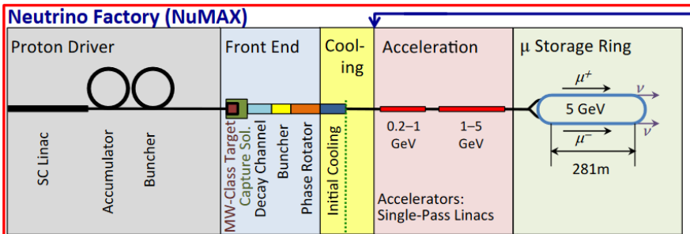
Neutrino Factory @ ESS
Key issues and R&D to address feasibility
Strong synergies between
νSTORM & Neutrino Factory
νSTORM
μ
Test Line
μ beam R&D
Near & Far
Detectors
Key
AdditionalChallenges
ν_{μ} & ν_{e}
anti ν
charact
Fast cooling (τ=2μs) by 50 (6D)
Fast acceleration
mitigating μ decay
Background
by μ decay
Ionization cooling
High field solenoids (30T)
High Temp Superconductor
Cost eff. low RF SC Recirculating Linac
FFAG synchrotrons
5 GeV
High Intensity
Large accept
Magnetized
Liquid Argon
Key R&D
Taking advantage of the excellent work & progress in the frame of IDS-NF & MAP
νSTORM ideal for R&D & test of muon beam science & technology
Notes:
Hopefully, Neutrino Factory @ ESS from which the standard MAP layout is displayed here © showing great synergies with the one of nuSTORM reminded on top especially © the Muon Production System and the Muon Decay Ring although at different energies. © But it suffers additional key issues and challenges, especially a moderate but fast cooling which requires developpement of novel method of Ionization Cooling, followed by a 5GeV acceleration, which has to be fast because of the limited muon lifetime of 2 μs, and finally magnetized detectors for identification of all species of neutrinos. © All these R&D would profit from progress already made and could be addressed in a Test beam line at nuSTORM extraction in parallel with the Physics program

Slide 15
HIFI @ ESS, Staged Approach
ESS ESSνSB νSTORM Neutrino Fact
ESS Linac 2GeV/5MW H⁻
ESS upgraded Linac 2GeV / (5MW H⁺ & 5MW H⁻)
Neutrons
ESS
Accumulator
ν_{μ} or ‾ν_{μ}
ESSνSB
Long
Baseline
Detector
π decay
Near
P to π target
ν+
μ+
μ⁺ or μ⁻
ν_{μ} +‾ν_{e}
Front end
νSTORM
On site Detectors
μ Decay ring
ν_{e} + ν_{μ}
ν-
μ-
Cooling
ν+
μ+
Neutrino
Factory
Far
Detector
RLA or FFAG
acceleration
Near
μ Storage ring
ν-
μ-
Notes:
A realistic implementation on the ESS site of these facilities (or a selection of them) would be based on a staged approach, starting with the ESS neutron source as presently being built then © the implementation of the additional systems of the long base line neutrino ESSnuSB, mainly the ESS linac upgrade, an accumulator, a dedicated target followed by a pions decay line to neutrinos and the near and far detectors. Note that the accumulator could also be beneficial to the ESS neutron community by providing short neutron pulses opening attractive experimental conditions © The ESSnuSB systems would then serve as injector of the nuSTORM facility adding a muon decay ring and corresponding detectors on site and finally © of the neutrino Factory requiring a front end for μ capture & bunching followed by cooling, acceleration, storage ring and detectors.

Slide 16
Conclusion
The ESS facility provides a unique opportunity for a range (or a selection) of top level muon-based facilities in a staged approach with great synergies, complementing the Neutron Source presently being built.
A novel ESSνSB / HIFI collaboration is being launched, hopefully with EU support aiming, by 2025, at:
  Technical Design of the world most intense, second generation long base line neutrino facility, ESSνSB, for CP violation observation with high sensitivity at 2nd oscillation maximum.
  Preliminary designs of νSTORM as short baseline facility for neutrino cross section measurements with unprecedented precision and of a NEUTRINO FACTORY for measurements of PMNS matrix parameters
These facilities would leverage and take advantage of the ESS world most powerful proton driver thus providing substantial cost savings.
2Their designs would benefit from the excellent progress already made in the frame of IDS-NF, MAP and PBC
Performing μ beams would be available to test beds of Muon Beam Science & Technology for even more ambitious μ based facilities in the future.
All Interested Welcome
Notes:
As a conclusion, ….
© Finally, you are all welcome to join this HIFI collaboration and participate to these passionating studies, enjoying the view of Matterhorn the nices peak montain in Switzerland just just behind me

Slide 17
Back-up slides

Slide 18
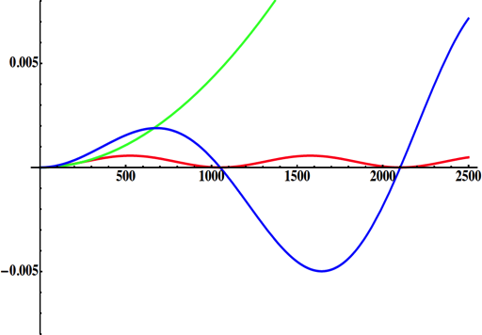
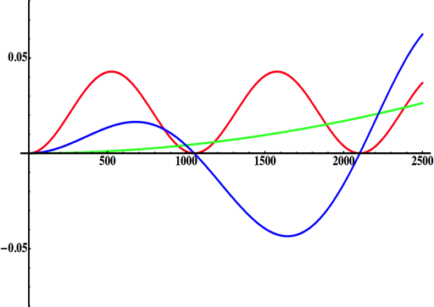
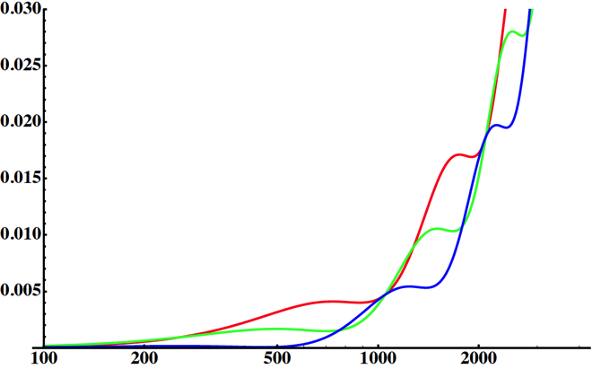
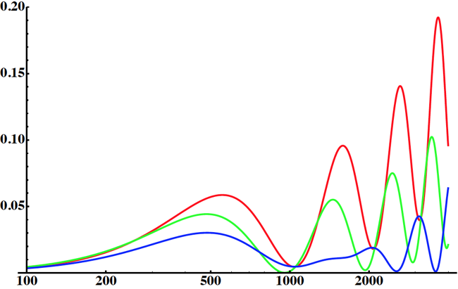
Neutrino Oscillations with "large" θ₁₃
solar
atmospheric
for "large" θ₁₃ 1st oscillation maximum is dominated by atmospheric term
for small θ₁₃ 1st oscillation maximum is better
atmospheric
solar
L/E
L/E
CP interference
(arXiv:1110.4583)
θ₁₃=1º
CP interference
θ₁₃=8.8º
solar
2nd oscillation maximum
P(ν_{μ}→ν_{e})
1st oscillation maximum
θ₁₃=1º
("small" θ₁₃)
δ_{CP}=-90
δ_{CP}=0
δ_{CP}=+90
θ₁₃=8.8º
("large" θ₁₃)
L/E
L/E
1st oscillation max.: A=0.3sinδ_{CP}
2nd oscillation max.: A=0.75sinδ_{CP}
more sensitivity at 2nd oscillation max.
(see arXiv:1310.5992 and arXiv:0710.0554)

Slide 19
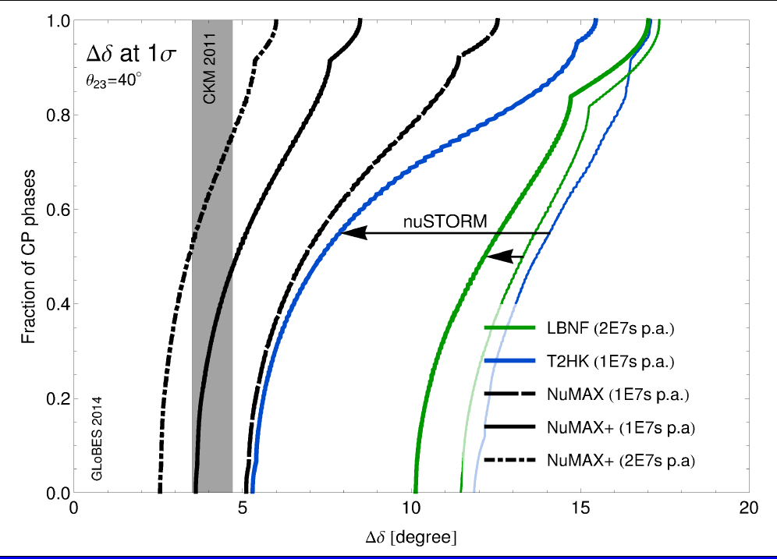
Leverage potential by nuSTORM for Long Baseline ν Experiments
Super-Beams
with nuSTORM
Super-Beams
alone
nuSTORM + LBL offers significantly improved sensitivity vs LBL alone
By higher precision of ν cross sections and corresponding reduction of systematic errors
GLoBES comparison of potential performance of the various Advanced Concepts
P. Coloma
P.Huber
Notes:
As shown on this graph which compares the performance of CP violating phase measurements in Long Base Line facilities like LBNF or T2K , the precise determination by nuSTORM of neutrinos cross sections could be extremely useful to greatly improve their sensitivity by mitigating their systematic errors.

Slide 20
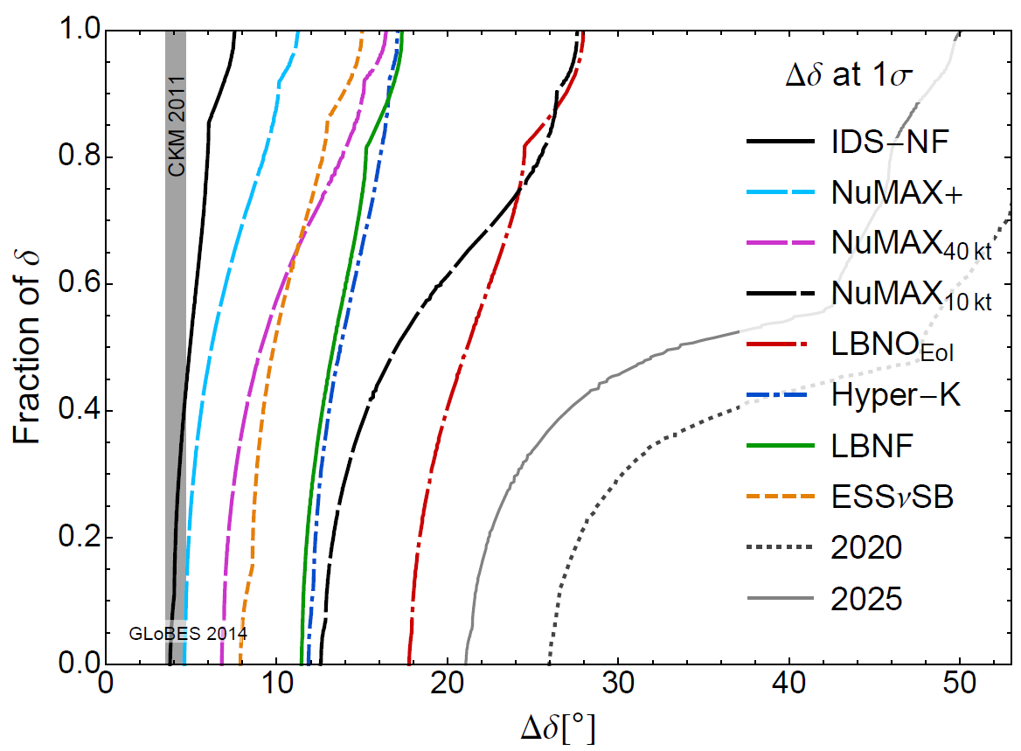
Physics reach of various technologies A large improvement potential
Neutrino Factories
Super-Beams
Present facilities
Pilar
Coloma
δ = CP violating phase
Notes:
With such performance, a Neutrino factory would further increase the one envisaged in Super Beams facility presently being built as shown on this slide.

Slide 21
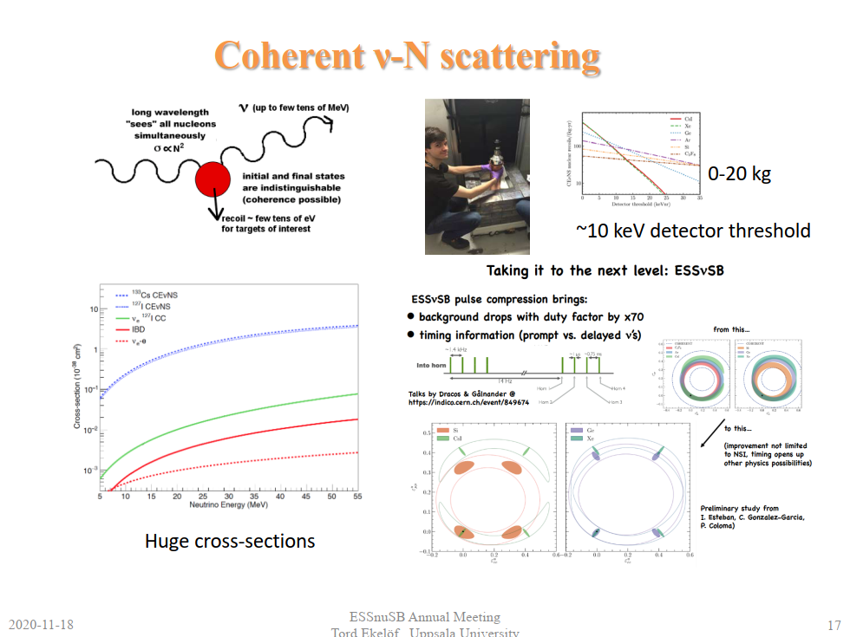

Slide 22
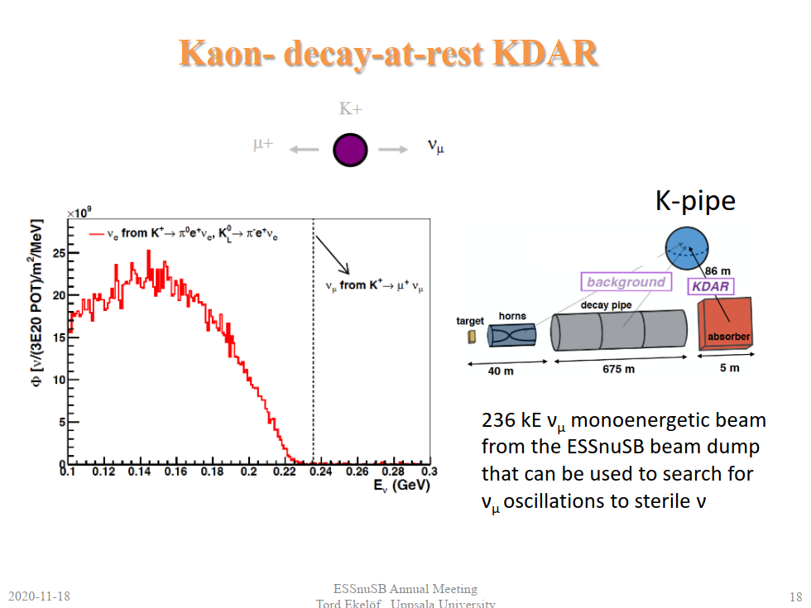

Slide 23
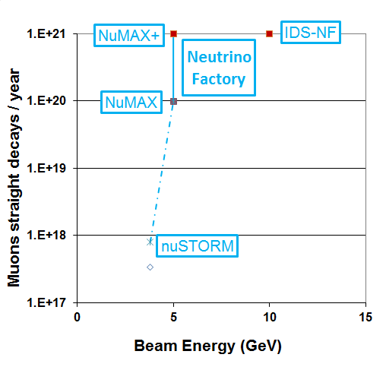
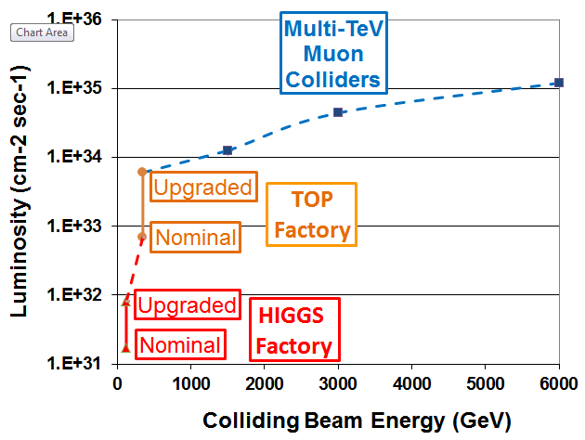
An attractive staging scenario of facilities with physics interest at each stage
Intensity Frontier
Energy Frontier
Beyond Standard Model
Precision ν physics
CP violation
New ν physics exploration
Top properties
Sterile ν
ν cross sections
Higgs properties
Direct mass&width

Slide 24
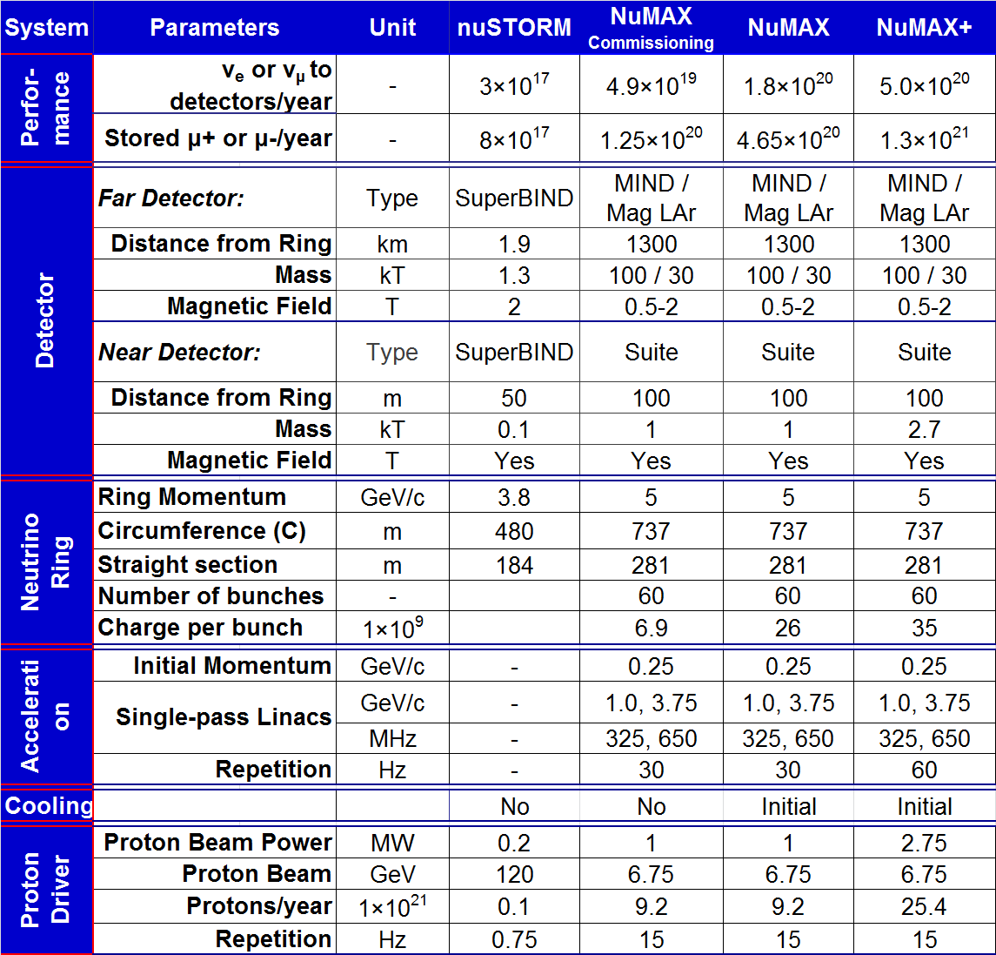
Staged Neutrino Factory main parameters
Increasing complexity and challenges
M.Palmer
Muon Accelerator Program (MAP)
Notes:
The major parameters of the staging process are summarized on this slide starting with nuSTORM and evolving in stages to a high performance Neutrino Factory. I have no time going through all of them but are available here for your info. I just like to point out the progressive increase of the performance from one stage to another especially the number of neutrinos © with facilities of modest energies and dimension in the hundred meters range starting © with limited beam power of a few hundred KW, no cooling and no acceleration and progressively increasing technical challenges of beam power, cooling and acceleration.

