Slide 1
Summary of the Sterile Neutrinos at the Crossroads Workshop
Jonathan Link
Virginia Tech
Pre-High Intensity Workshop, Fermilab
10/24/2011

Slide 2
Workshop Objective
The goal of this workshop was to bring together experts in the various sub-disciplines − such as nuclear and particle theory and experiment, cosmology, and neutrino phenomenology − in order to critically review the evidence for and against sterile neutrinos and to discuss the need or otherwise to pursue dedicated new experiments and possibly new strategies.
Notes:
Nuclear theory (reactor fluxes, nucleosynthesis)
Nuclear experiment (reactor experiments, flux measurements, LSND/Karmen, MiniBooNE),
Cosmology (WMAP/Planck),
Neutrino phenomenology (global fits, alternative models),

Slide 3
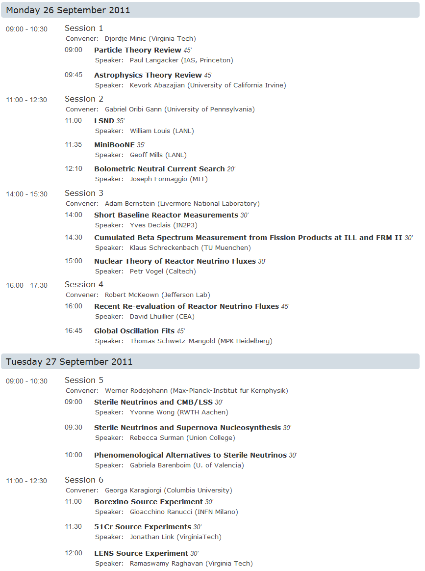
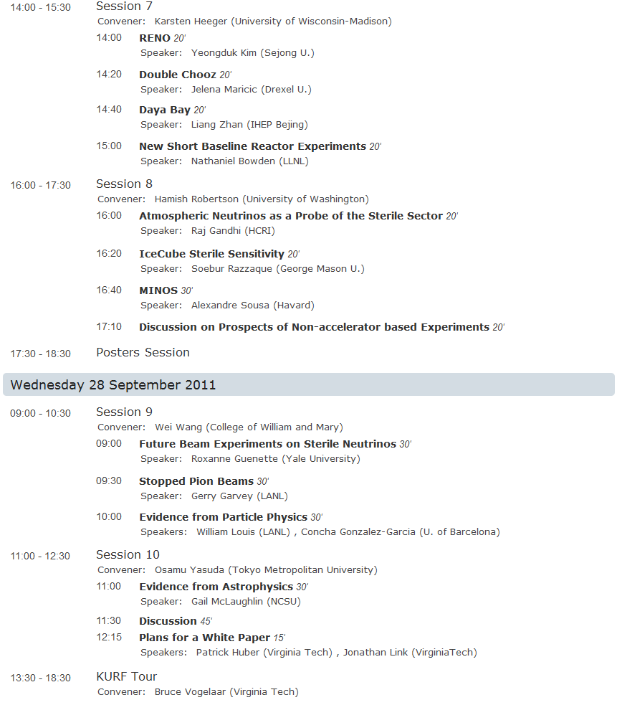
Workshop Program
All talk slides can be viewed at:
http://www.cpe.vt.edu/snac/
Notes:
28 oral presentations and 9 posters

Slide 4
Theory and Phenomenology
All talk slides can be viewed at:
http://www.cpe.vt.edu/snac/

Slide 5
Theory and Phenomenology

Slide 6
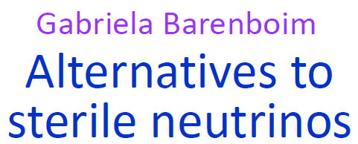
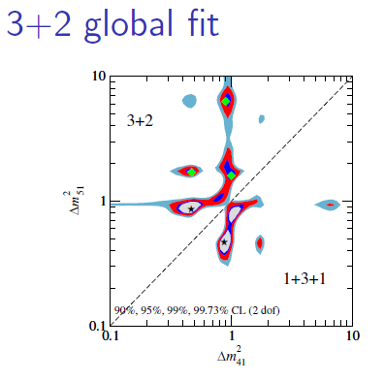
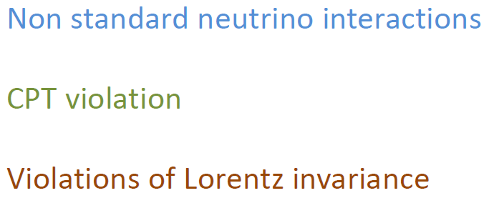
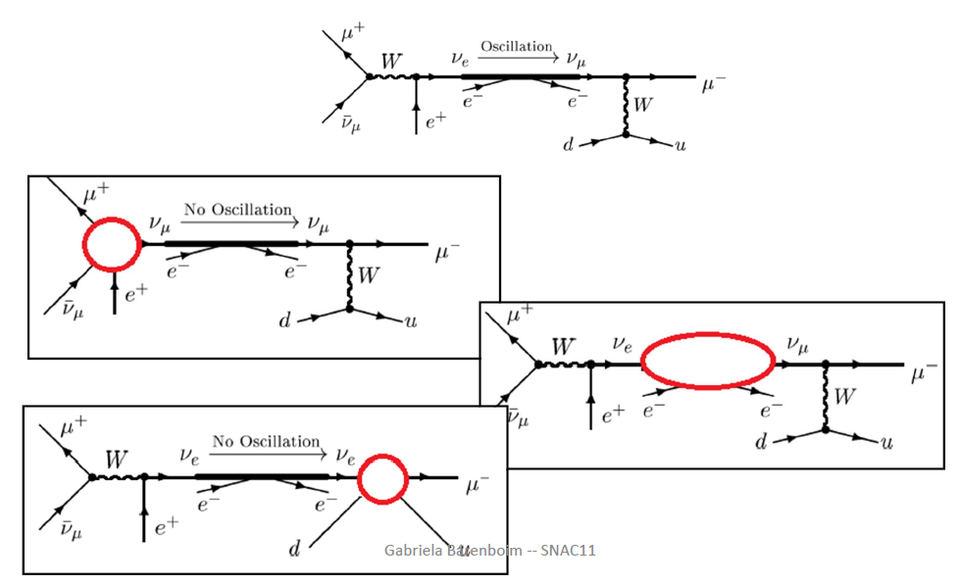
Theory and Phenomenology

Slide 7
Evidence from Particle Physics
All talk slides can be viewed at:
http://www.cpe.vt.edu/snac/

Slide 8
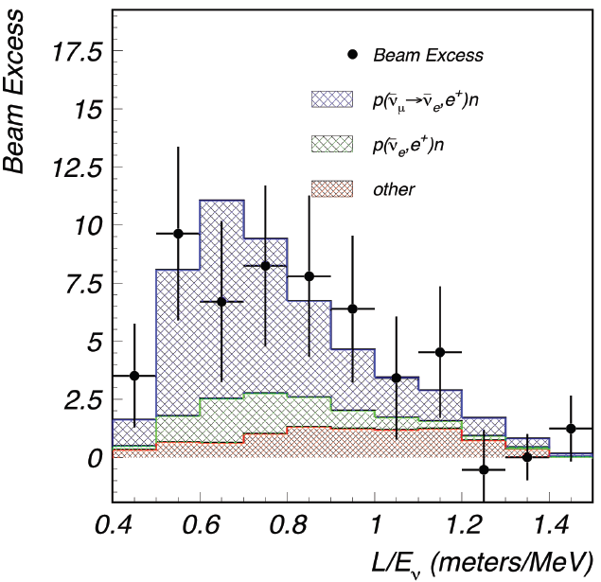
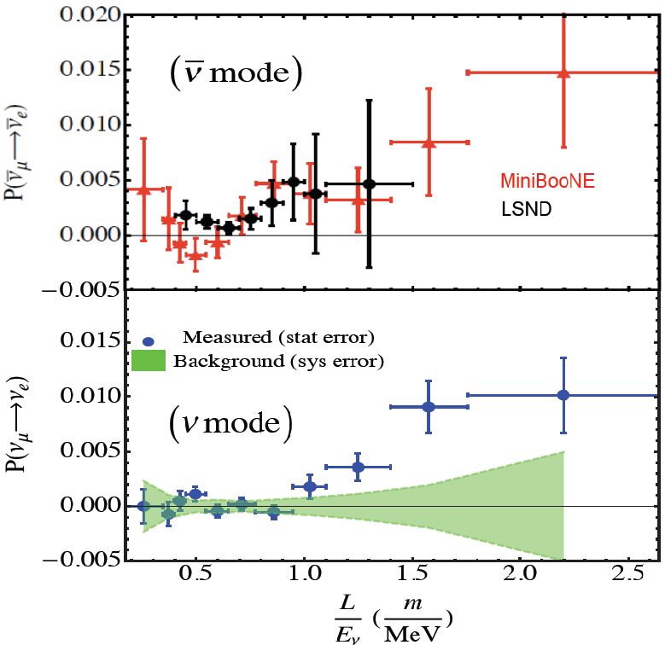
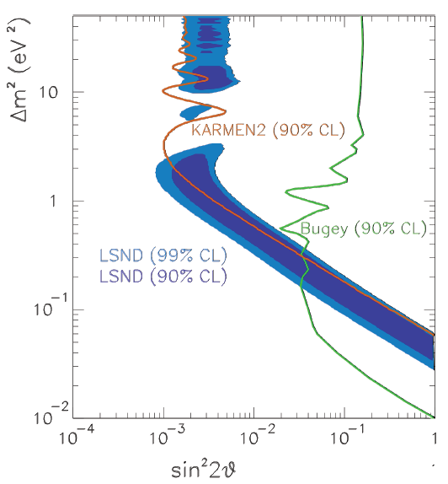
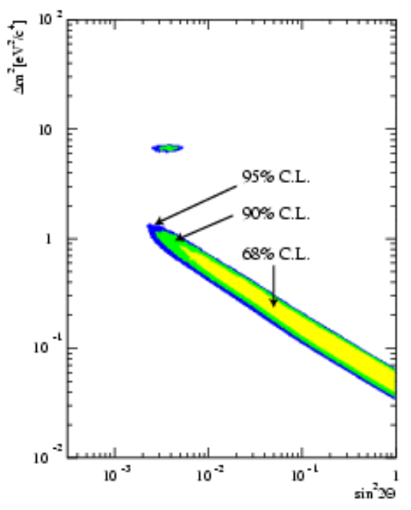
Evidence from Particle Physics
Bill Louis
LSND

Slide 9
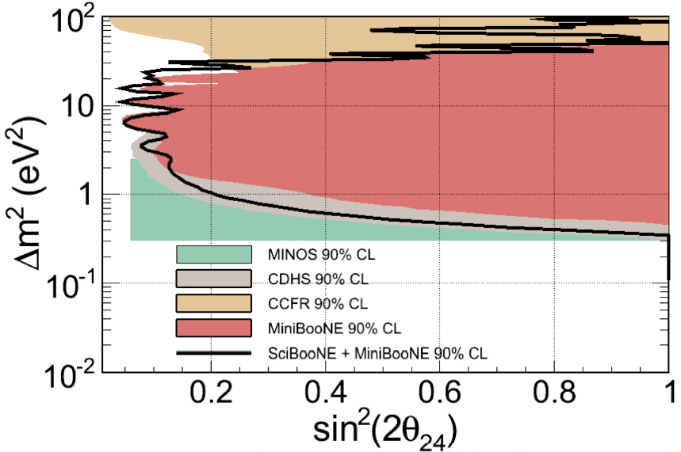
Evidence from Particle Physics

Slide 10
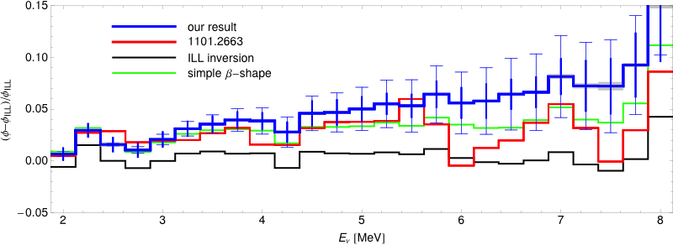
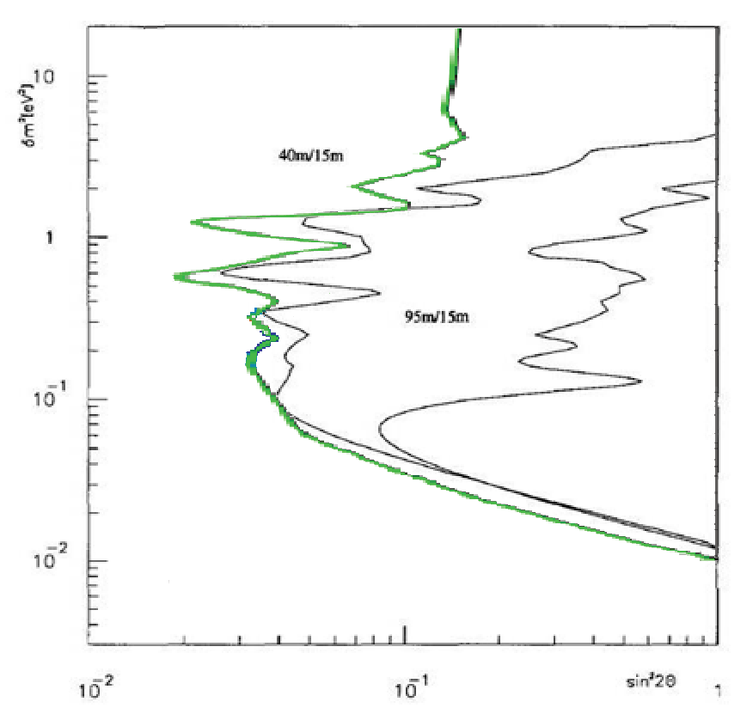
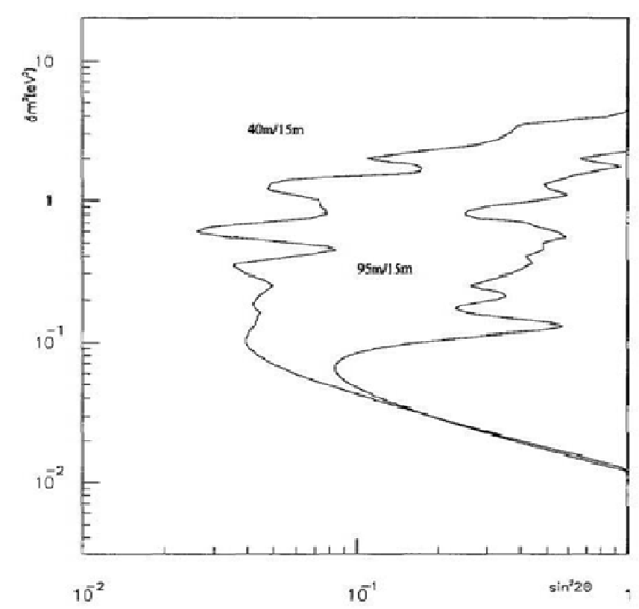
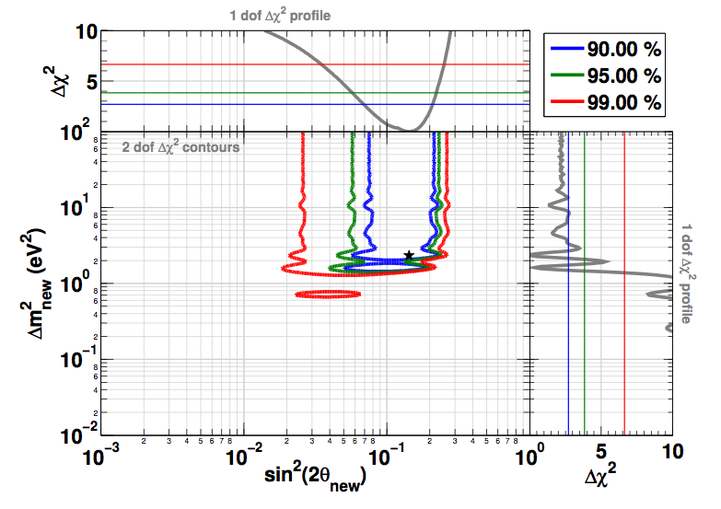
Evidence from Particle Physics
Yves Déclais
Short Baseline
Reactor Experiments
New conversion
New conv. with simple β-shape
Mixed-approach
ILL inversion
Bugey III

Slide 11
The Reactor Neutrino Flux Anomaly
All talk slides can be viewed at:
http://www.cpe.vt.edu/snac/

Slide 12
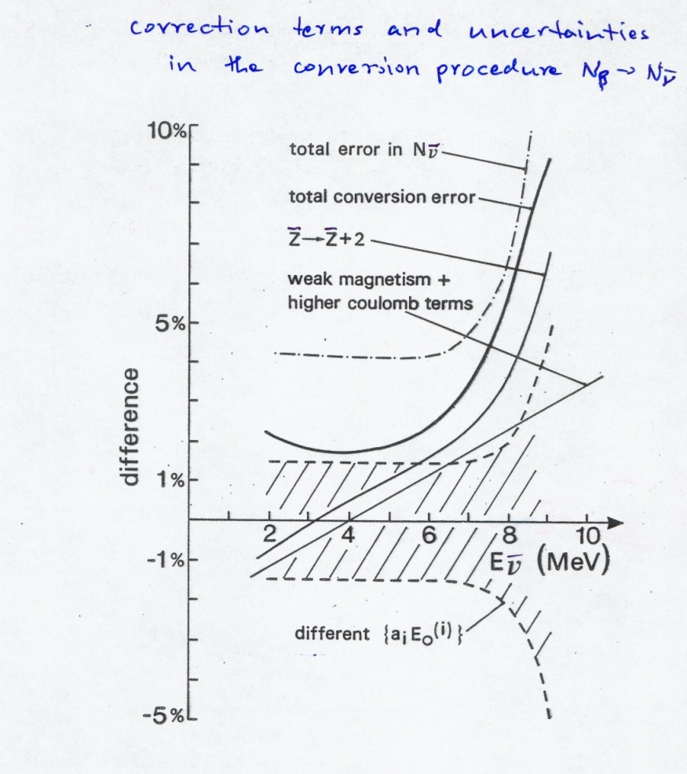
The Reactor Neutrino Flux Anomaly

Slide 13
The Reactor Neutrino Flux Anomaly

Slide 14
The Reactor Neutrino Flux Anomaly

Slide 15
Evidence from Astrophysics & Cosmology
All talk slides can be viewed at:
http://www.cpe.vt.edu/snac/

Slide 16
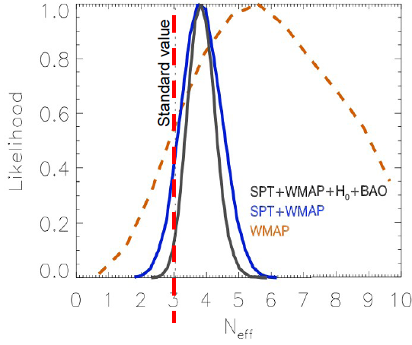
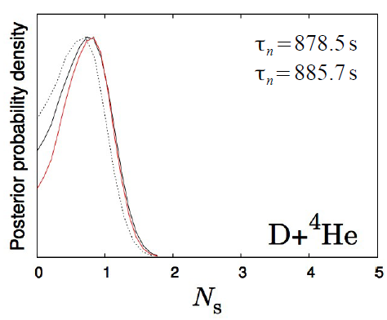
Evidence from Astrophysics & Cosmology
Notes:
Cosmology prefers lighter sterile neutrinos than LSND/MiniBooNE/Reactor anomaly (m_{s} <0.48 for 3+1 and m_{s1}+m_{s2} <0.9 for 3+2) This can be fixed by suppressing sterile neutrino thermalization or playing with parameter degeneracies.

Slide 17
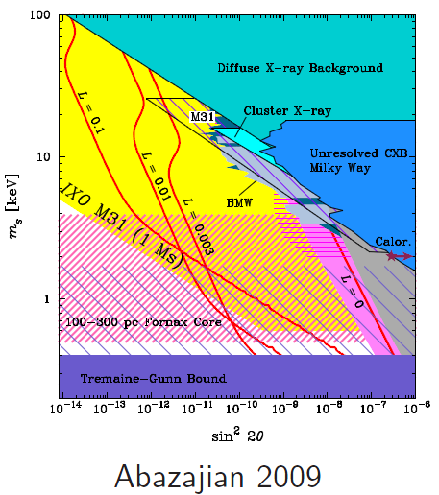
Evidence from Astrophysics & Cosmology
Other hints from the cosmos…
r-process nucleosynthesis (talk by Rebecca Surman)
KeV Steriles (talks by Kev Abazajian and Gail McLaughlin)
Pulsar kicks
Dark matter
Lyman α forrest

Slide 18
Measurements at Atmospheric Experiments
All talk slides can be viewed at:
http://www.cpe.vt.edu/snac/

Slide 19
Proposals for Source Experiments
All talk slides can be viewed at:
http://www.cpe.vt.edu/snac/

Slide 20
Proposals for Source Experiments
These experiment involve a new type of measurement know as precision Oscillometry.
Joe Formaggio – NC detectors and a ⁵¹Cr source.
Gioacchino Ranucci – inverse β-decay (⁹⁰Sr, ¹⁴⁴Ce) or elastic scattering (⁵¹Cr)sources with Borexino.
Raju Raghavan – LENS with on site production of short lived source (⁶He).
Brice Littlejohn (poster) – inverse β-decay source (¹⁴⁴Ce) with the Daya Bay far detectors.
Jon Link – ⁵¹Cr source inside the SNO+ detector.

Slide 21
Proposals for Accelerator Experiments
All talk slides can be viewed at:
http://www.cpe.vt.edu/snac/

Slide 22
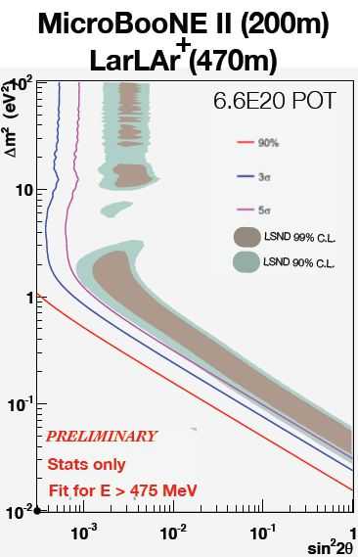
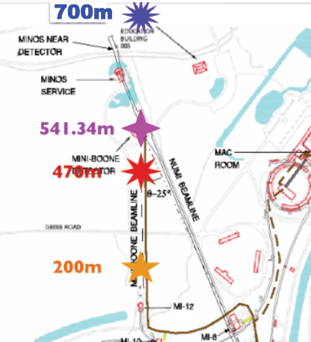
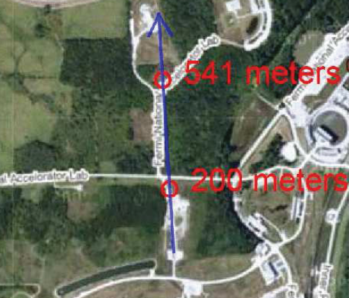
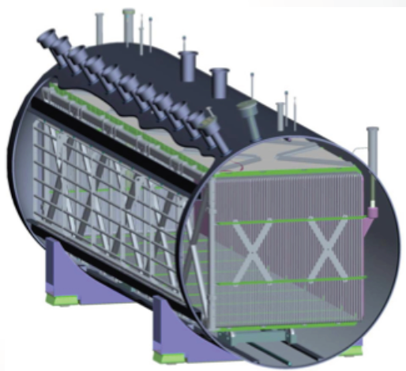
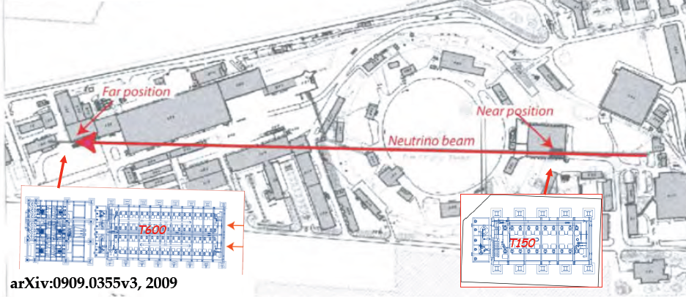
Proposals for Accelerator Experiments

Slide 23
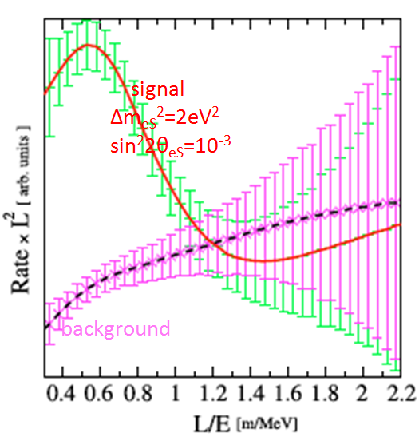
Proposals for Accelerator Experiments
Large scintillating detectors like LENA and Noνa can also be paired with cyclotrons

Slide 24
Sterile Neutrino White Paper
All talk slides can be viewed at:
http://www.cpe.vt.edu/snac/

Slide 25
Sterile Neutrino White Paper
Outline and Section Editors
(Editors: Patrick Huber, Virginia Tech and Jon Link, Virginia Tech)
Theory and Motivation (Section Editors: Gabriela Barenboim, Valencia and Werner Rodejohann, MPI Heidelberg)
Astrophysical Evidence (Section Editors: Kev Abazajian, UC Irvine and Yvonne Wong, Aachen)
Evidence from Oscillation Experiments (Section Editors: Joachim Kopp, FNAL and Bill Louis, LANL)
Global Picture (Section Editors: Thierry Lasserre, CEA Saclay and Thomas Schwetz, MPI Heidelberg)
Requirements for Future Measurements (Section Editors: Bonnie Fleming, Yale and Joe Formaggio, MIT)
Appendix: Possible Future Experiments (Section Editors: Patrick Huber, Virginia Tech and Jon Link, Virginia Tech)
Visit http://cnp.phys.vt.edu/white_paper to participate

