Slide 1
A New Experiment to Verify/Refute the OPERA Result
Michael Schmitt
Mayda Velasco
Northwestern University
October 24, 2011
Fermilab Neutrino Workshop

Slide 2
Motivation
arXiv:1109.4897 (23-Sep-2011)
OPERA observed neutrinos arriving ΔT = 60.7 ± 6.9(stat) ± 7.4(syst) ns
too early.
Given their baseline, this corresponds to a velocity faster than the speed of light by
(v-c)/c = ( 2.48 ± 0.28(stat) ± 0.38(syst) )× 10⁻⁵
This result needs to be verified (confirmed or refuted) by an independent experiment, preferably with different methods.
There have been three points of criticism of the OPERA analysis:
synchronization of CERN and LNGS clocks using GPS
possible time-dependent primary beam & horn effects
reliance on p waveforms to represent ν waveforms

Slide 3
Concept
decay tube
detector
target
ν
π
p
μ
laser
Design Goals:
use direct-sight laser for synchronization
build in comparisons to relativistic non-ν particles
eliminate or minimize the statistical cost of long spills
allow for changes of ν beam parameters (especially energy)
Method:
10km decay tunnel – laser propagates from target to detector
π ➔ μν_{μ} mainly in first 1-2 km; ν_{μ} travels most of the distance
allow μ to reach the detector - compare TOF of μ and ν_{μ}
take advantage of the time structure of the Main Injector / NuMI beam
(see also Kalbfleisch, PRL 43 (1979) 1361)

Slide 4
(some) Details
primary beam
120 GeV Main Injector beam – very similar to current NuMI beam
about 500 p batches, each batch is 8 ns long, 18.8 ns between batches
assume 10¹⁹ to 10²⁰ protons on target
laser is synched to p batches via electrostatic pick-up, and detected/read-out through same device/channels as neutrino events
decay tube
10 km long, on surface (not underground) filled with He at low pressure
a small fraction of muons and some undecayed pions reach the detector
detector
collects four kinds of signals:
laser pulses
neutrinos from pion decays
muons from (other) pion decays
“dual events” in which both the muon and the neutrino from a single pion decay interact in the detector
make a direct comparison

Slide 5
Detector Concept
basic parameters
transverse position resolution to 1 cm
longitudinal position resolution to 3 cm
time resolution to 10 ps
design
sampling calorimeter with transverse segmentation
dense material such as brass induces the showers
quartz fibers provide fast narrow signal
Cherenkov light from shower e±
very good time characteristics
showers appear narrow and compact
energy resolution not great
if necessary for position resolution, some layers of wire chambers, GEMs?
inter-channel synchronization via laser pulse system and incoming muons

Slide 6
Feasibility Study (1)
simulation
simple PYTHIA at particle level
incoming 120 GeV p beam on fixed p target
define fiducial region for detector
simple Gaussian smearing of position and time coordinates
physics assumption
focus on TOF measurement
take OPERA result as pertaining to ν velocity
for 10 km flight distance, TOF anomaly would be 0.8 ns (out of 33 μs)
yields
about 4 × 10⁻⁵ neutrinos per proton: 4 × 10¹⁴ νs for 10¹⁹ pot
σ ≈ 4 × 10⁻³⁸ cm² 1x1x3 m³ brass or iron: 24 tons
2 × 10⁴ charged-current events (twice OPERA sample)
(MINOS near detector, 1kton, 1km away, > 10⁶ events for 10²⁰ pot)
(units for all forthcoming plots are meters and nanoseconds)

Slide 7
Feasibility Study
TOF smeared by
position and time resolution
ν TOF in ideal case
normal
TOF
if OPERA result
is correct

Slide 8
Feasibility Study (2)

Slide 9
Feasibility Study (3)
Observed time with respect to laser pulse.
Black histograms indicate reference distribution coming from muons and hadrons.
if OPERA result
is correct
normal case

Slide 10
Feasibility Study (4)
toy fit
assume only 1000 events
perform an unbinned likelihood fit
approximate the total resolution on TOF by a Gaussian σ = 27 ps
analytical function (convolution of a top-hat distribution and a Gaussian)
huge difference in –NLL comparing the normal SM neutrino and the case in which the OPERA result is correct
normal case
if OPERA
result
is correct

Slide 11
Feasibility Study (5)
dual events
a pion decays and both the muon and the neutrino interact
which one reaches the detector first?
many resolution effects cancel
event is “self-synchronized”
events are biased toward
higher energy
decays closer to the detector
still extremely powerful
can expect hundreds of events
normal case
if OPERA result
is correct
(smeared)

Slide 12
Summary
We have presented a concept for an experiment to verify or refute the OPERA results.
It bypasses all of the criticisms of the OPERA analysis.
It can be done with the NuMI beam line.
It requires a several-km decay tunnel.
It requires a detector carefully designed for time & position resolution
assumed parameters are very challenging but not insanely so
detector design is notional
If 10 ps is achieved, the tunnel can be shortened; if we have a 10 km tunnel, then 50 ps is good enough.
We can avoid using a horn
If the anomaly is confirmed, would vary neutrino parameters.

Slide 13
extras

Slide 14
Yields
simulate 4M pp collisions (120 GeV on fixed target)
for 4m x 4m
3200 nu produced: yield is 8 x 10⁻⁴
38% anti-ν_{μ} and 62% ν_{μ}
15000 non-nu particles hit the detector: about 50 per nu
4000 of these are muons (should be about the same as nu)
about 100 dual events (3% of nu events)
for 1m x 1m, scale by 1/16
5 x 10⁻⁵ nu per p
6 x 10⁻⁵ muons per p
1 x 10⁻⁶ “dual events” per p

Slide 16
dual events
ν
μ

Slide 17
dual events
mean neutrino decay distance (m)

Slide 18
RHIC ZDC
quartz fibers
NIM A470 (2001) 488

Slide 19
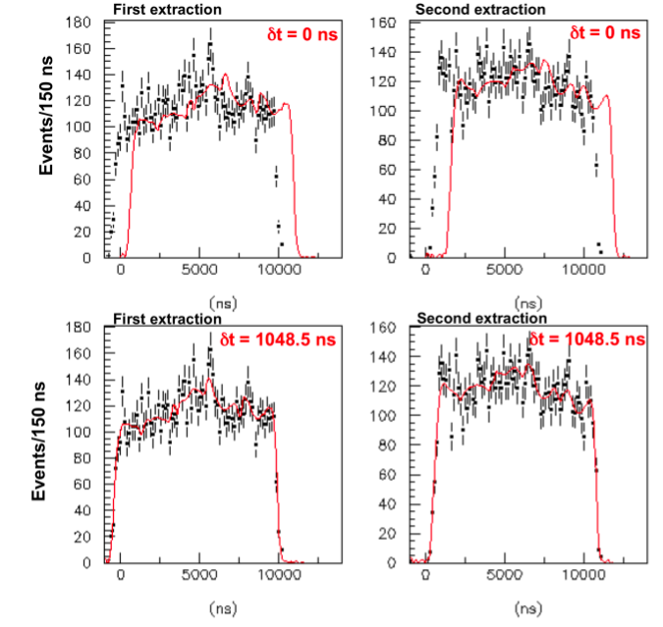
The inference of δt was done “blindly” – i.e., with an unknown offset.
The offset was corrected after the fits were completed and finalized.
OPERA

Slide 20
OPERA

Slide 21
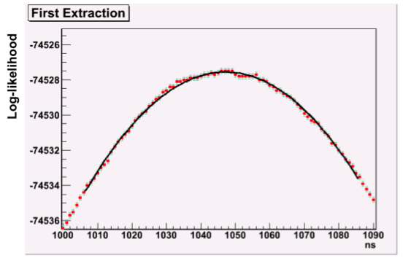
also checked:
day vs. night
summer vs. fall+spring (no data during winter)
“closure test” of fitting
toy MC shows that intentional shift measured at better than ns level with expected statistical uncertainty
for the actual fit to data,
χ² / ndf = 1.06 for extraction 1, 1.12 for extraction 2
OPERA
60 ns

Slide 22
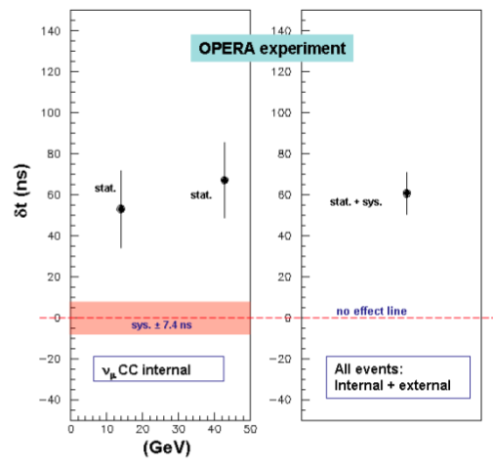
right: the final result. left: divide in two energy bins.
OPERA

