Slide 1
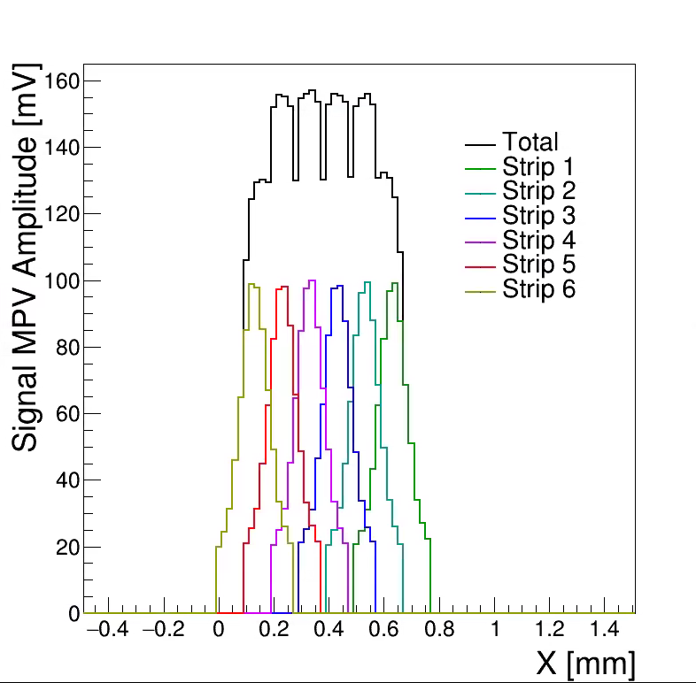
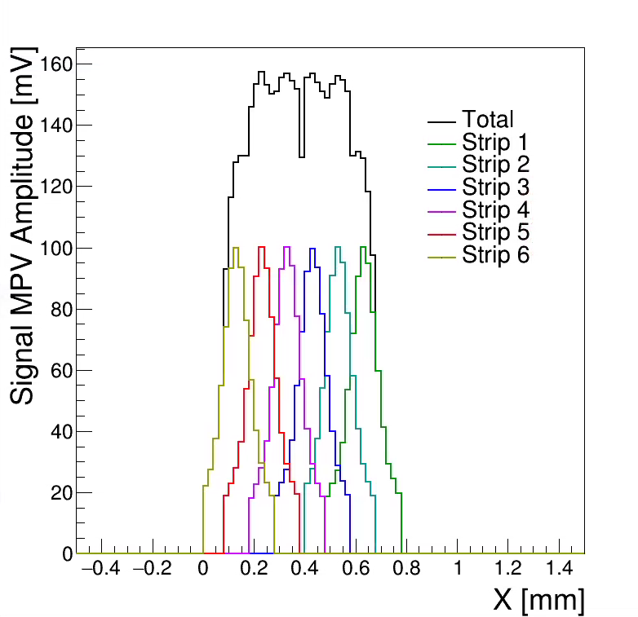
Shifted axis by 0.01mm
Equalized the amplitudes per strip to account for amplifier response non-uniformity on the readout board
Clearly still observe the wiggles in between the strips.

