Slide 1
Argonaut - LDRD
Dec 2020
WP, NC, FC

Slide 2
Argonaut
Will:
Enhance the Laboratory's ability to carry out the mission of DOE and the Laboratory in areas that are outside current programmatic activities but are well-aligned with the strategic goals of the Laboratory.
Contain:
Novel, cutting edge, and explore forefront areas of science and technology.

Slide 3
Goals
Demonstrate technologies that are needed for:
  Motion in a cryogenic environment
    Directional control of a visual aid
      In both x and y plane (2 plane)
      If possible – in z direction (3 plane)
    Basic arm pincher
      Similar to optics control but with additional complexity of exposed joints and strength
  Power delivery to cryogenic environment suitable for motion & diagnostics
  Power Over Fiber – likely delivery choice: Power needs, regulation requirements, heat load
    Less power – slower motion
    Higher power – boiling issues leading to bubbles
    Distributed heat load – modeling and testing
  Diagnostics electronics and readback
    Investigate recent success in micropower communication devices at cryo temps
    Investigate low power high resolution cameras with tunable focal
    Investigate additional sensors – such as acoustic, voltage

Slide 4
Diagnostic Example - Camera Need
DUNE CALCI Scope Review Meeting 2020-05-05
Monitor “High Voltage Systems” – “HVS” = field cage, cathode planes, feedthroughs, grounds – “verify the stability, straightness, and alignment of the hanging TPC structures during cooldown and filling” and “ensure that no bubbling occurs near the GPs (SP) or CRPs (DP)” [from TDR]
Inspect detector components – “inspect the state of movable parts in the detector module (calibration devices, dynamic thermometers)” and “closely inspect parts of the TPC after any seismic activity or other unanticipated event” [from TDR]

Slide 5
Some of the CERN workshop conclusion highlights
There are a limited number of ports available on top of the cryostat which must be shared between CISC and calibration.
During the cool down [of the ProtoDUNEs] the cameras were extremely useful to verify what was going on.
The focus of the cameras needs to be remotely adjustable.
As further developments: remote optical zoom and the possibility of remotely rotate the camera should be explored.
Fixed cameras “in the cold” (HV)
Movable cameras inserted from “warm”

Slide 6
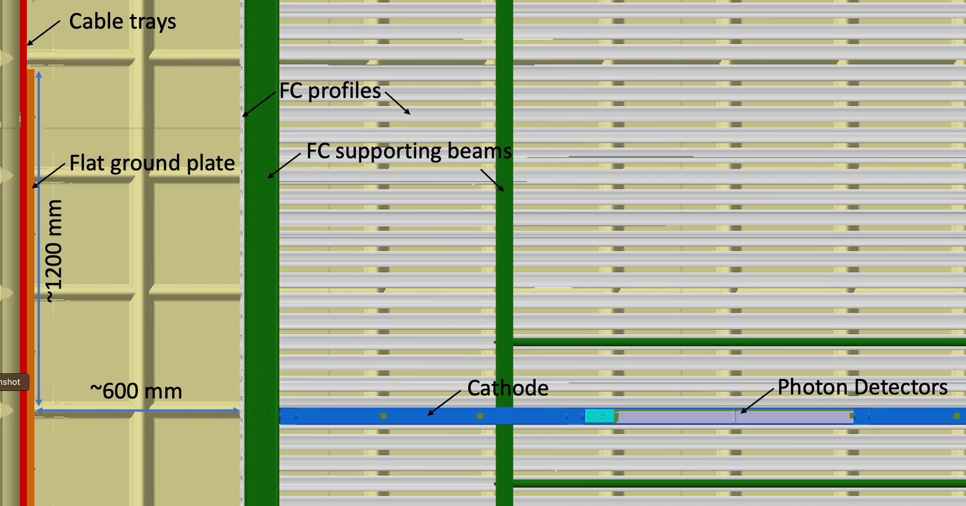
A DUNE detector – Offers a glimpse of final Argonaut

Slide 7
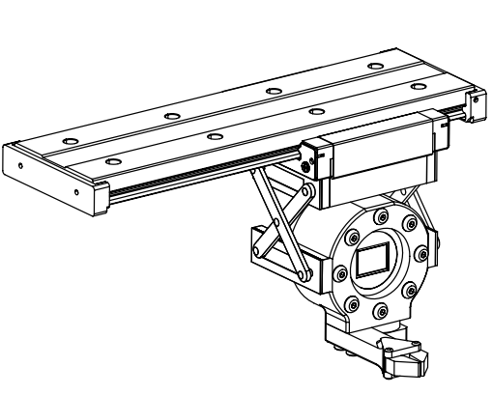
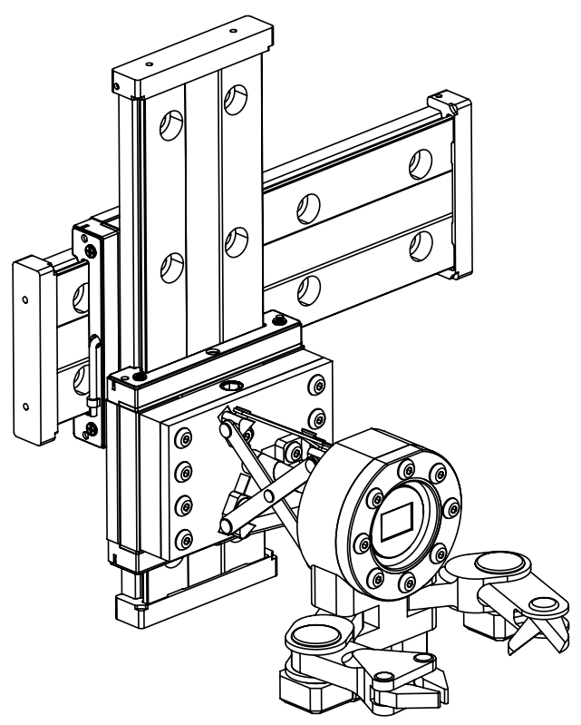
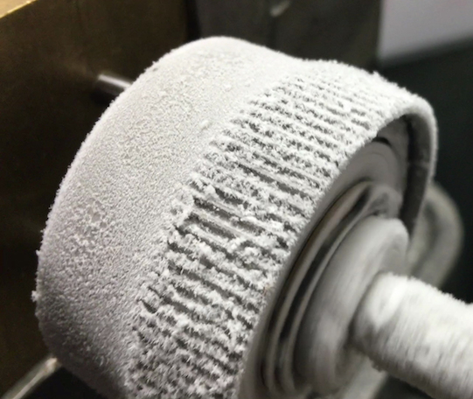
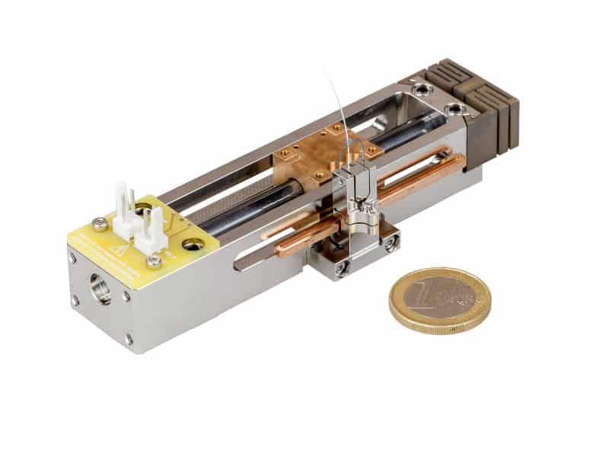
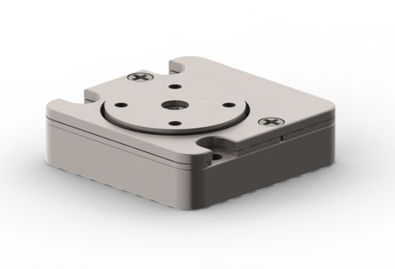
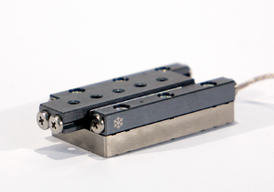
Argonaut Prototype Mechanical Design
Possible Prototype Concept
Swappable, fixed tool arm
2-axis motion
Light-weight
Power efficient
Compact and simple to test
Future Development Concepts
Multi-axis tool arms
3-axis motion
Advanced extension mechanisms
Detector repair capabilities
Increased weight and power draw
5 Relevant key technologies:
Cold gears (JPL)
Cryo Linear Drive (CLD)
Non-conductive linear guides
Micro piezo stages
Cryo compatible composites

Slide 8
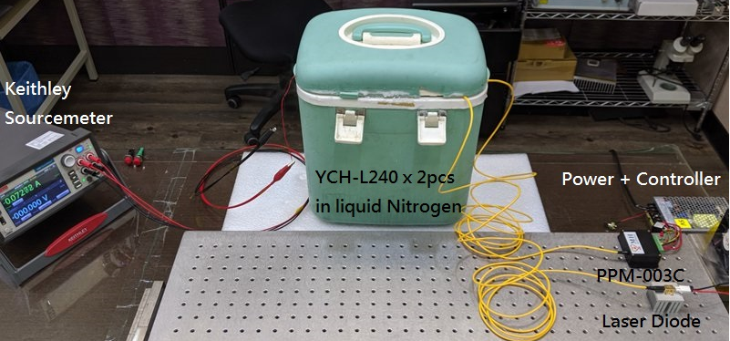
Power & Electronics perspective
PoF systems are becoming more available – with increasing options
Working with several vendors
  MH-GoPower (Very interested – have started their own cryogenic testing to assist us)
  RLH Industries (Slightly different component topology – may be slightly more efficient)
    US vendor interested in developing products for new markets (DOE/DOD)
Testing of their systems for cryogenic operations:
Several power converter/fiber options need to be fully vetted
Have some ideas on data transmission over fiber
This technology would be beneficial to FNAL on several projects/problems

Slide 9
Diagnostics
First order of business –
  Tunable camera with the capability of < 1mm
    Ideally both visual and IR systems
    Options have been explored with two promising high D optiom
    Position/angle control
  Communication via wireless link
    The recent trend in extreme low power links are presenting us options
    The IoT world is driving the low power low profile technology
    Options: Wifi 6, Blue Tooth and cellular
      Once we get a robotic module – we can populate it with option
    Antennas located at the surface would be off the shelf dipoles
    Recent PoF test shows that Blue Tooth and WiFi are capable of operation at cold air temp.
      Sealed box made of PEEK submerged in nitrogen bath – temperature recoded with test embedded.
  Communication via fiber link
    Being pushed as an option by one vendor – low noise, robust link
  Once we have a Robotic unit – opens up additional simple electronic testing
    Temperature probes on exterior and voltage taps connected to internal electronics

Slide 10
Partners and Future Options
Partnering with NASA is highly encouraged these days by DOE Office of Science. Joe Lykken
NASA/JPL (Many options – very well received by multiple teams)
The R&D team is interested in exploring a joint effort and collaboration between DOE and NASA. They would like for us to set up a virtual meeting to get a better feel and idea of what you would like to do. We would like to tie in the instrumentation and cryogenic teams.
CERN (Effort on several fronts: The CERN project is funded by the European Union)
Stephen Pordes: (Participating with CERN Effort) …’Fermilab and CERN are considering ways to interact with a detector from inside the cryostat is mutually beneficial.’
Giovanna Lehmann, Francesco Pietropaolo (DUNE Diagnostics) – Initial Robotic DUNE applicible effort exploration
Mario Di Castro – Member of the CERN accelerator Robotic team. Worked with FNAL on a UC robotic proposal last year.
Universities – We have had significant interest and student participation – building up an ‘Robotic Initiative’ with university involvement (Mayling Squires)
Reggie Martin, P.E.
Electrical Engineer, NASA
Engineering Development Lab
Dr. Linda Del Castillo
Senior Materials Scientist/Component Engineer
Jet Propulsion Laboratory
Brett Kennedy
Chief Engineer, Mobility and Robotic Systems Section
Supervisor, Robotic Vehicles and Manipulators Group

Slide 11
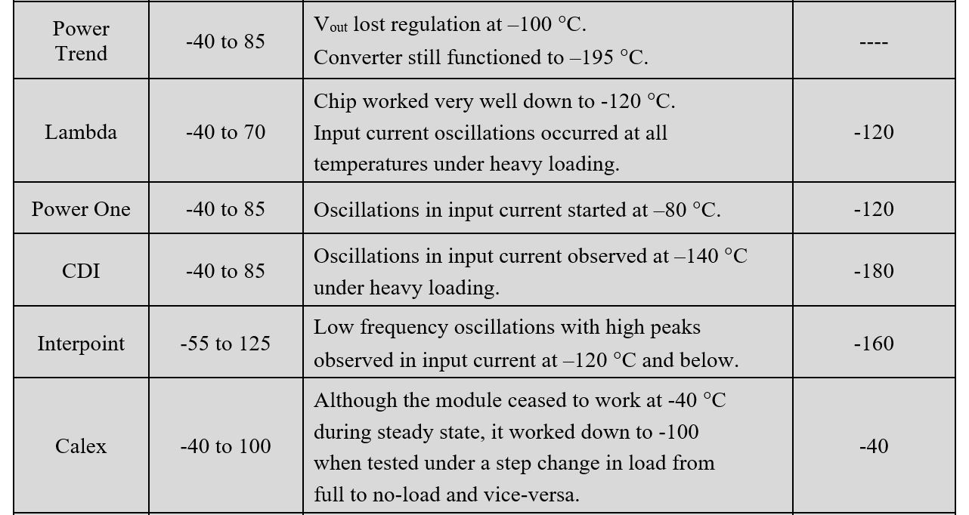
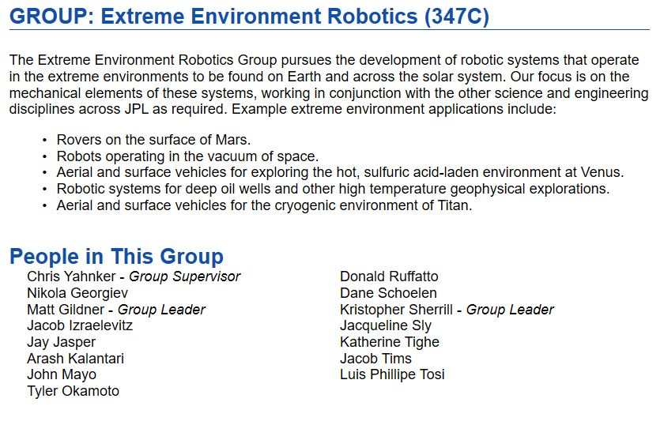
NASA Needs Match HEP
Electronics Testing
Diagnostics
Specialized equipment for vision research includes a variety of cameras in visible and thermal-infrared wavelengths, an optical bench with translation stages for acquiring image sequences with precise ground truth on camera or object motion, and a camera "gantry" test bed, which is a five-degree-of-freedom camera-motion device that enables image acquisition for small-scale emulation of orbiting and landing trajectories.

Slide 12
Options
Demonstrate rotation of camera in X and or Y.
Demonstrate Robotic device can move up and down Y plane.
Demonstrate Robotic device can move in X plane.
Demonstrate arm motion
Demonstrate arm extension
Demonstrate 3D unit with adequate I/O
Demonstrate wireless video
Demonstrate power conversion efficiency
Demonstrate thermal stability

