Slide 1

Weekly Summary
Tevatron Department Meeting
Tevatron Coordinator
Jerry Annala
September 23, 2011- September 30, 2011
Tevatron Coordinator - FNAL
9/30/2011
1

Slide 2
Store Summary
Store | Avg Init. Lumi (E30) | Avg Deliv’d Lumi (nb⁻¹) | Time (hr) | How did it end? | Comments
9147 | 344.9 | 8030 | 16.8 | Normal
9148 | 330.9 | 6452 | 12.1 | Normal
9151 | 312.2 | 6827 | 14.8 | Normal
9152 | 346.0 | 7696 | 15.6 | Normal
9153 | 335.1 | 8155 | 16.8 | Normal
9154 | 326.7 | 7925 | 17.4 | Normal
9155 | 363.6 | 8007 | 15.3 | Normal
9156 | 347.4 | 7498 | 15.4 | Normal | Proton tune was pushed way too high in middle of store
9157 | 360.0 | 8449 | 17.2 | Normal
9158 | 360.1 | 8000* | 17 | Helen will push the button

Slide 3
Problems
None

Slide 4
Studies Completed
Bunch Shaking

Slide 5
Initial Luminosity
5

Slide 6
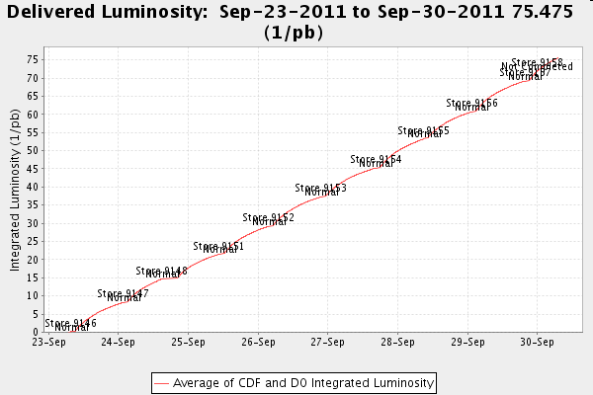
For the Week (2nd best week)

Slide 7
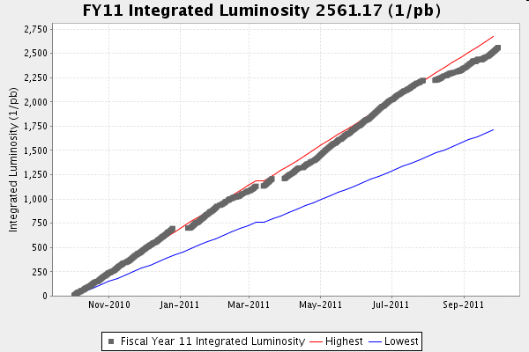
For the Year

Slide 8
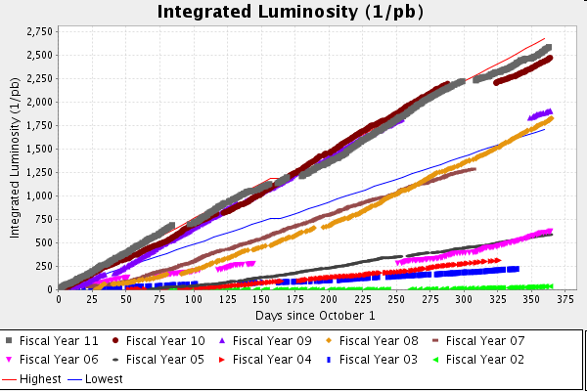
Lum for the years

Slide 9
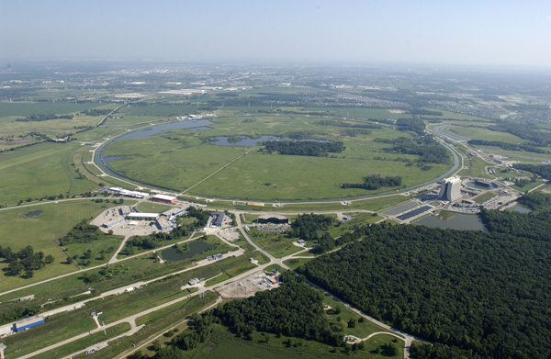
It has been a fun ride, but now we turn off the lights, the party is over

