Slide 1
Anode Adapter Board Updates
May 5, 2021

Slide 2
Upper Readout Adapter Board
List of changes:
Adding RC circuits to the 2nd induction plane strips to maintain bias
Still no info on the intended bias range expected on this plane
Currently assuming the same 2kV rated capacitors => +$3k per CRP in cost
Adding anode bias wire connections
Adding inter-board locking/guiding features

Slide 3
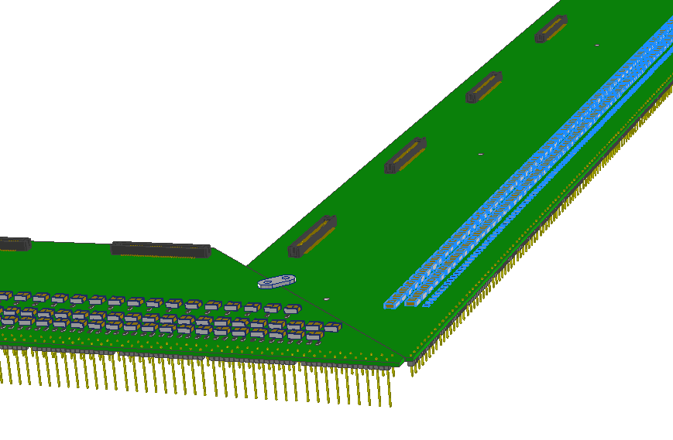
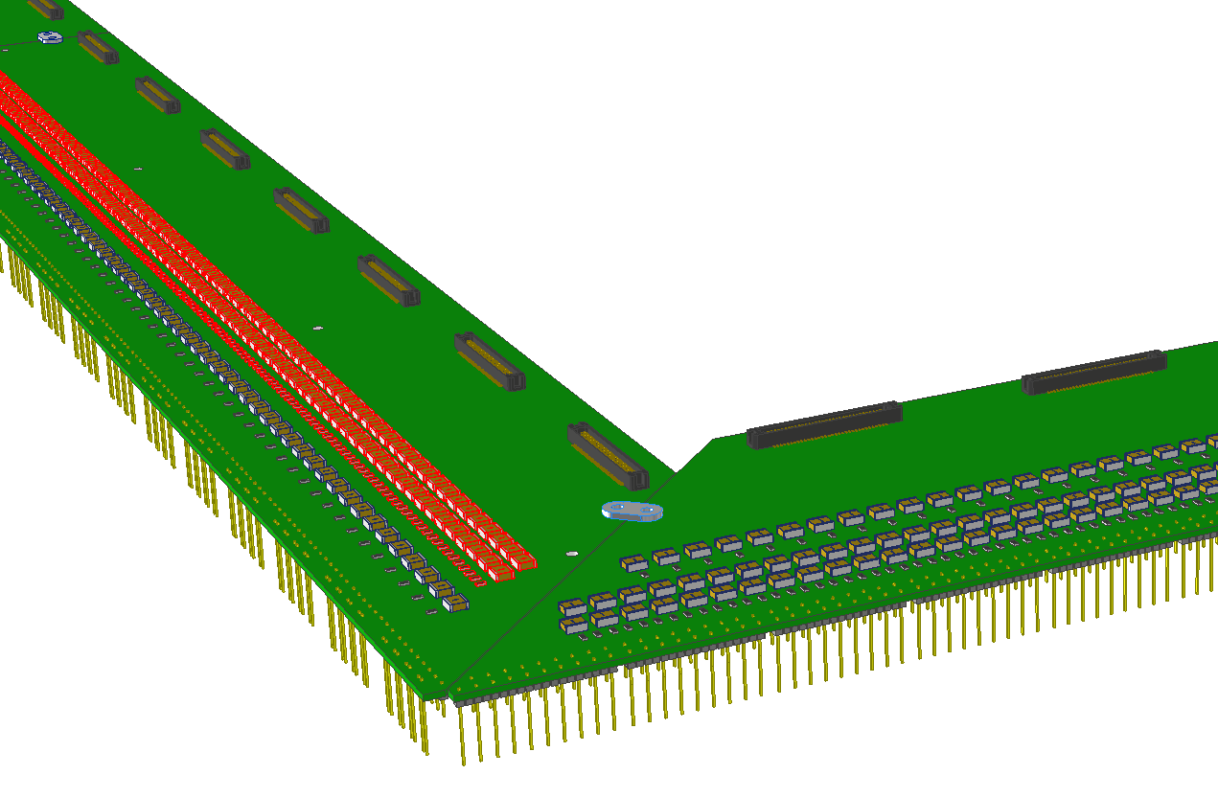
Upper Readout Adapter Board

Slide 4
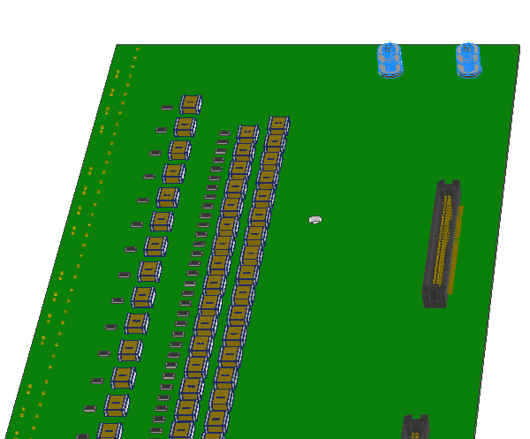
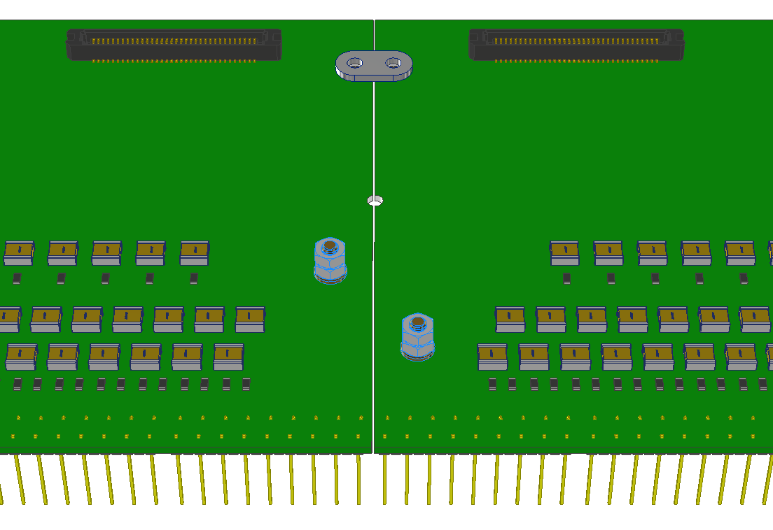
Upper Readout Adapter Board

Slide 5
Lower Readout Adapter Board
List of changes:
Extended the “CE box mounting platforms” on the short sides by 10mm to allow support from the composite frame, and added screw holes for such connections.
Added mounting holes for the monolithic FEMB CE boxes.
Adding anode bias wire connections

Slide 6
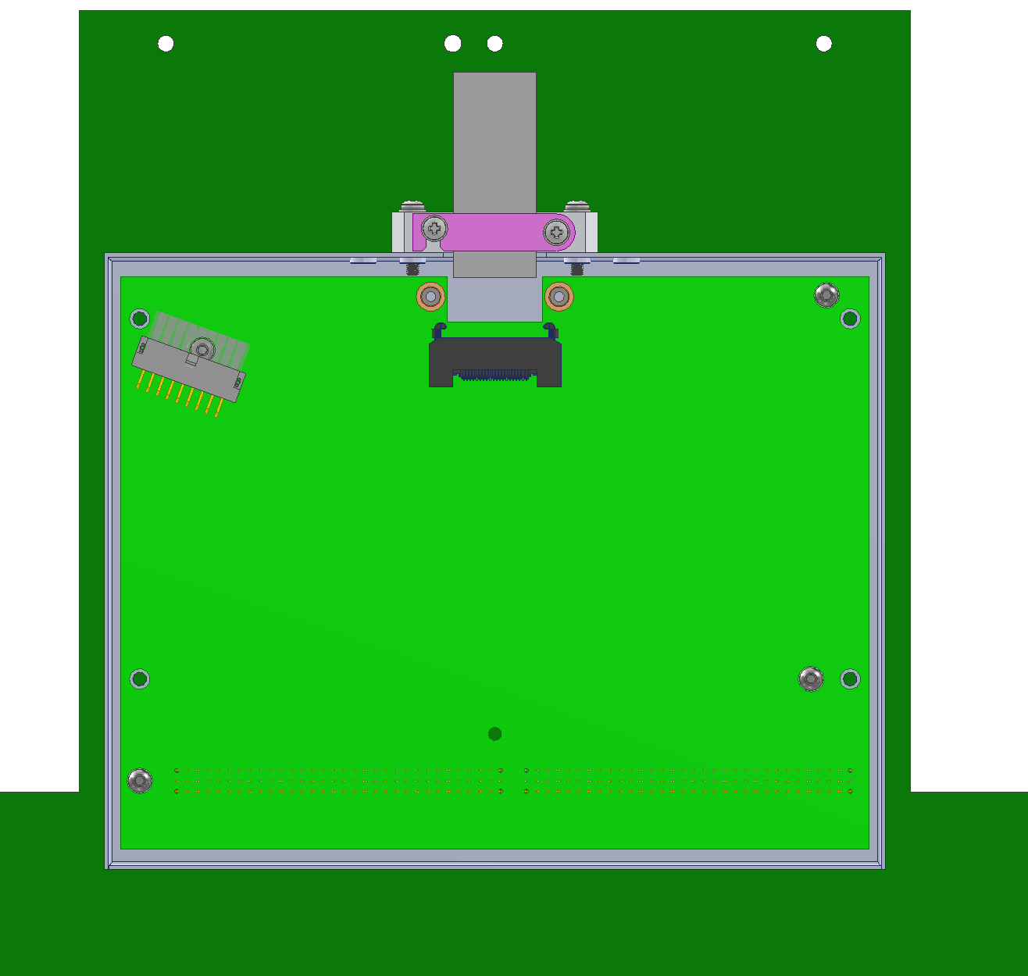
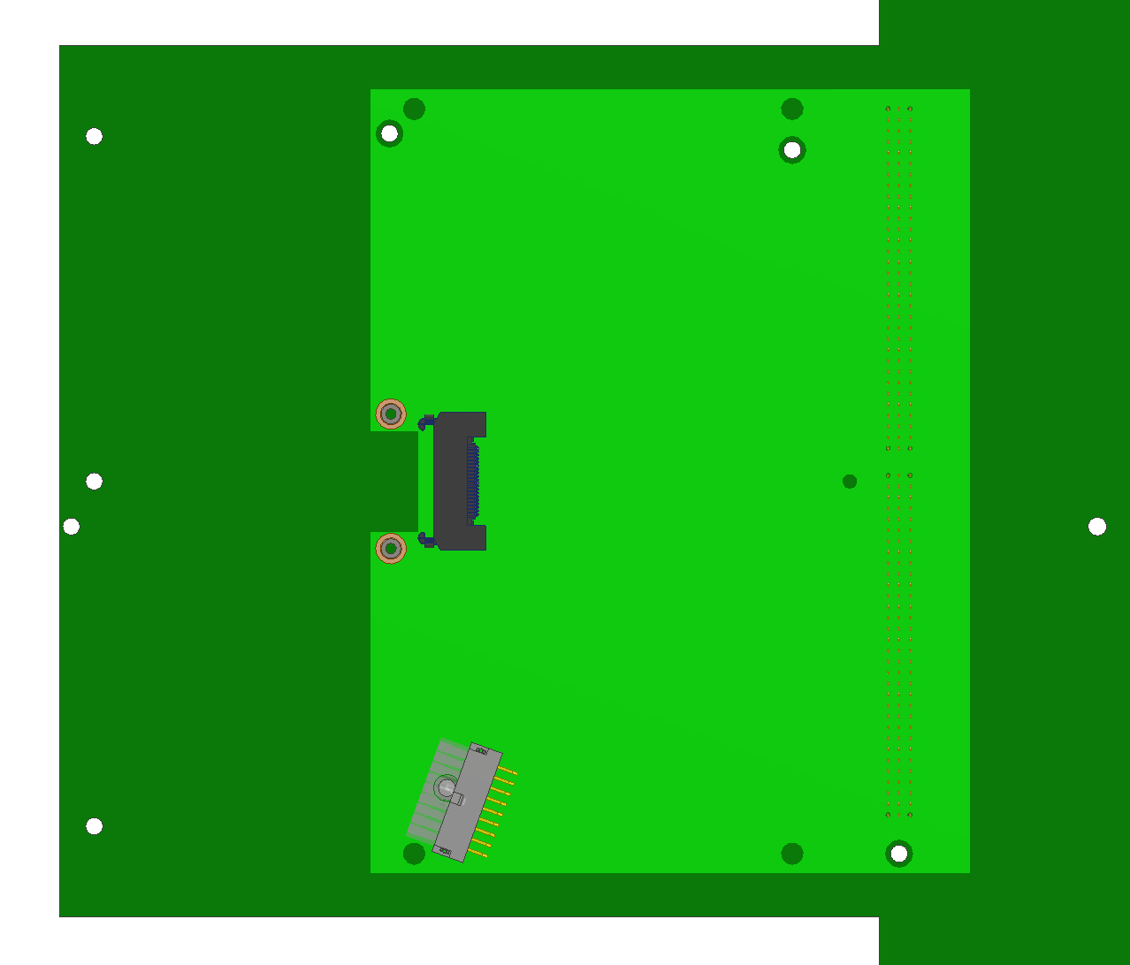
Lower Readout Adapter Board
To anode plane

Slide 7
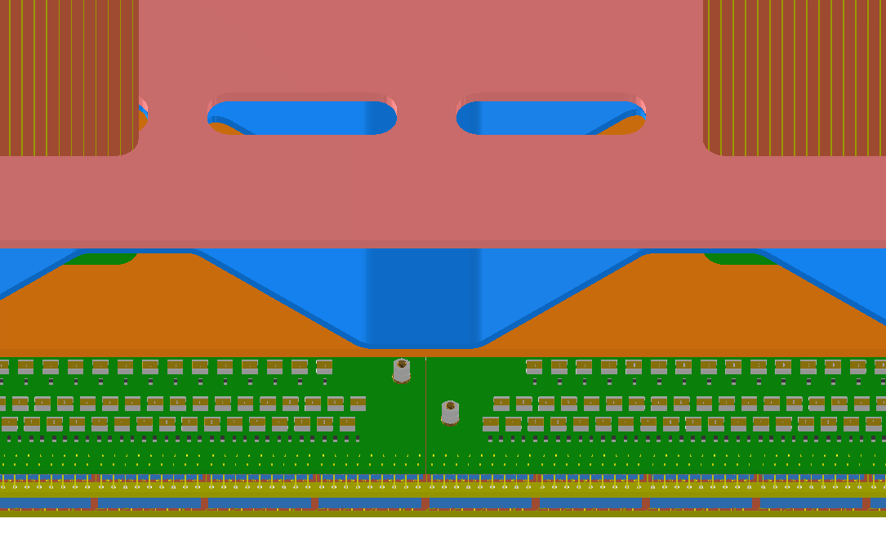
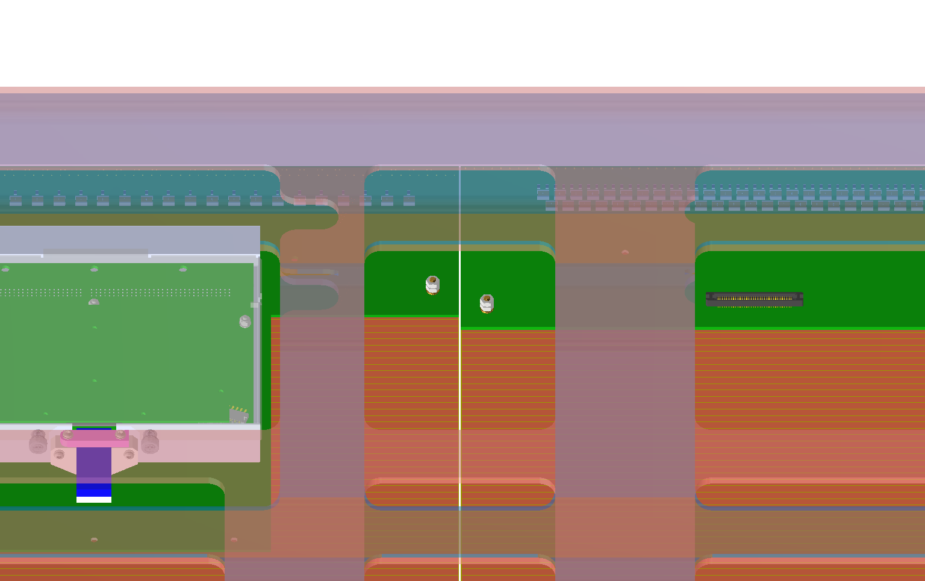
Lower Readout Adapter Board

