Slide 1
PIP-II Low Level RF Performance
Brian Chase
PIP-II Machine Advisory Committee Meeting
1-3 June 2021

Slide 2
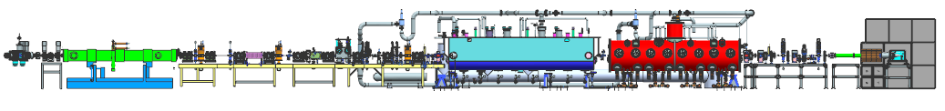
LLRF Requirements
Requirements for LLRF with CW RF and pulsed beam
  Vector sum of beam energy jitter components at exit of Linac: 1E-4 r.m.s.
  Cavity Amplitude and Phase variation: 6E-4
  Cavity Resonance Control for SRF cavities; +- 20 Hz peak detuning
Requirements for Beam Pattern Generator
  Provide any arbitrary pattern of passed and kicked beam (DC to 81.25 MHz)
  Provide timing control of all edges with 38 psec resolution and low dispersion
( 2mA x 0.5mms x 20Hz)
SSR1
(<15mA)
Ion source & LEBT
30 keV
(<10mA) RFQ
(10mA x 0.55ms x 20Hz)
MEBT
2.1 MeV
HWR
10 MeV
HEBT
Dump
22 MeV
Bunching cavities

Slide 3
Design Status and Plans – PIP2IT Results
Successfully operated Fermilab designed LLRF controllers on all cavity types meeting field regulation requirements with in-loop measurements ( RFQ, Bunching Cavities, HWR, SSR1)
Successfully operated Berkeley/LCLS-II style LLRF controllers on two SSR1 cavities meeting field regulation requirements with in-loop measurements
  Only a few shifts of running
Successfully operated Fermilab and LCLS-II resonance controllers on all cavity types in PIP2IT meeting peak detuning requirements ( RFQ, Bunching Cavities, HWR, SSR1)
  Bunching cavities were under operator control to limit tuner movement. Operations requests automated control

Slide 4
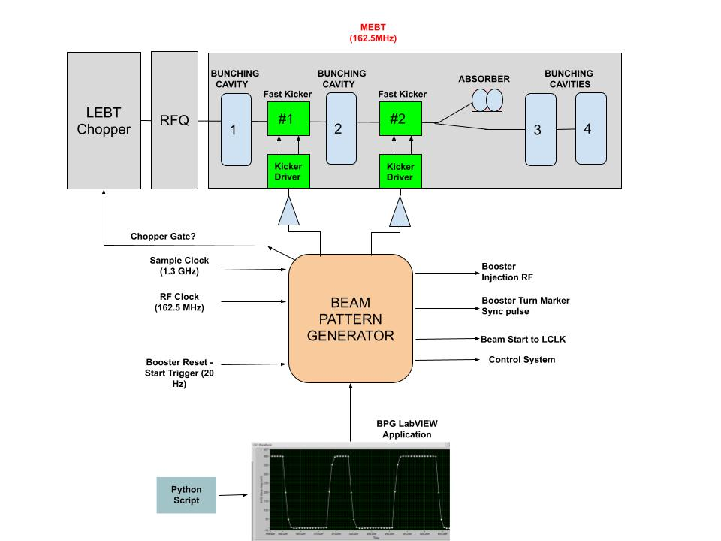
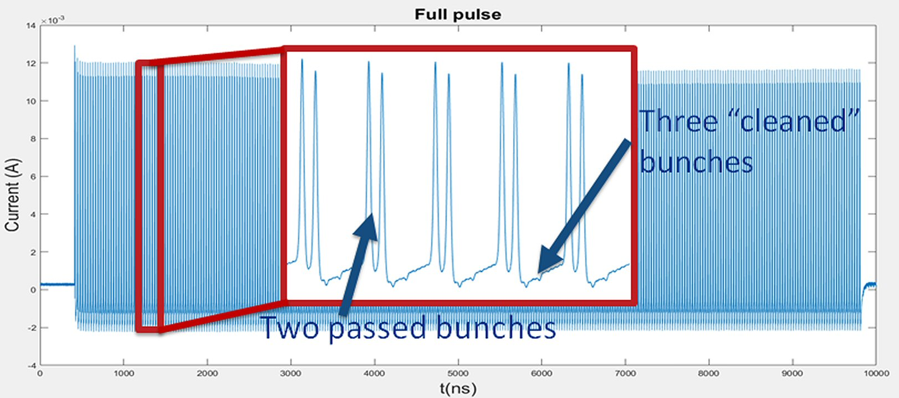
Design Status and Plans – PIP2IT Results
Beam Pattern Generator successfully drove the MEBT Kickers providing many beam patterns including a prototype 550 usec Booster injection pattern
The design shows agility as it was quickly modified to accommodate design change requests during the run
Booster injection locking was not implemented
Note that the wall current monitor is a high-pass circuit

Slide 5
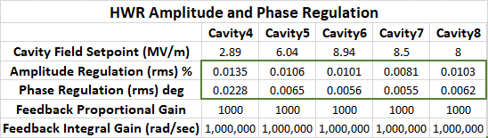
HWR Amplitude and Phase Regulation
Short Term( 5 min) In Loop Measurements (No Beam)
PIP-II Specifications
Amplitude Regulation (individual cavity) < 0.06%
Energy Stability (Linac) < 0.01%
Phase Regulation < 0.06 deg

Slide 6
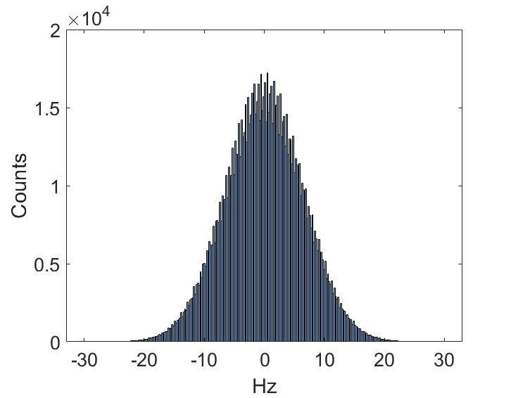
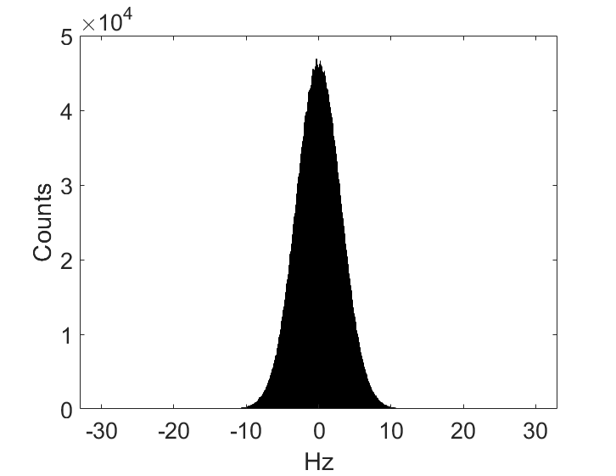
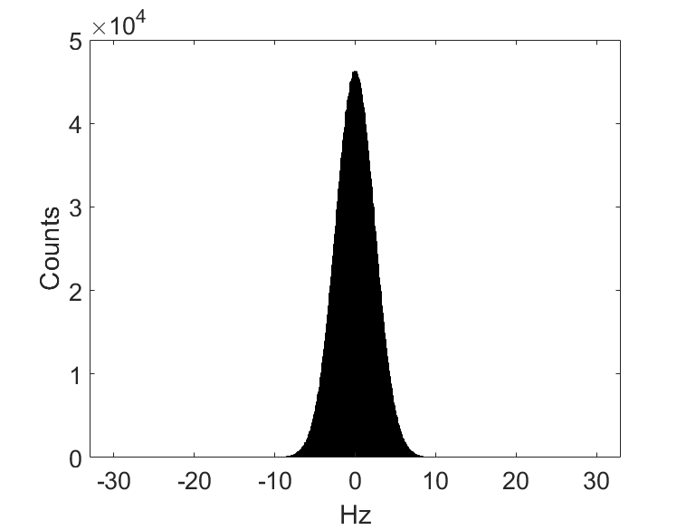
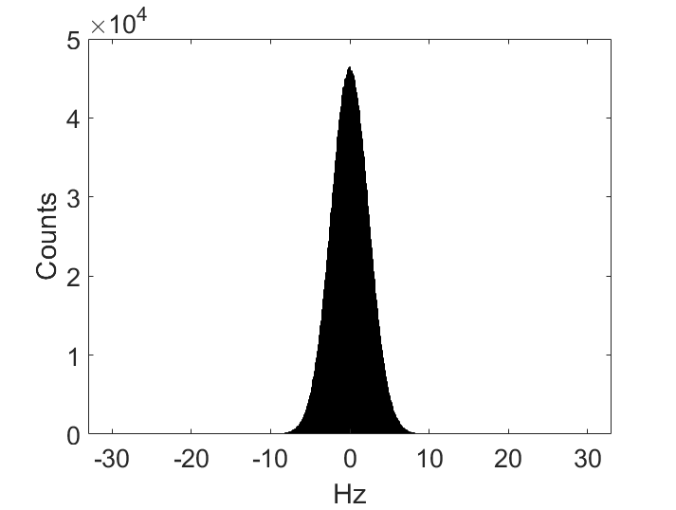

HWR Cavity Detuning Histograms
+- 20 Hz detune limits
Cavity 4
Cavity 5
Cavity 6
Cavity 7
Cavity 8

Slide 7
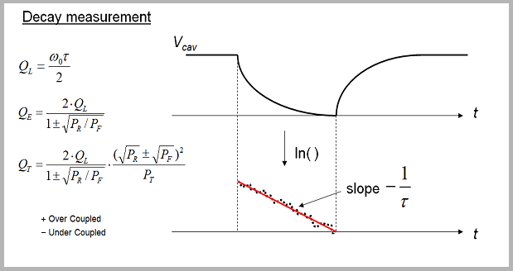
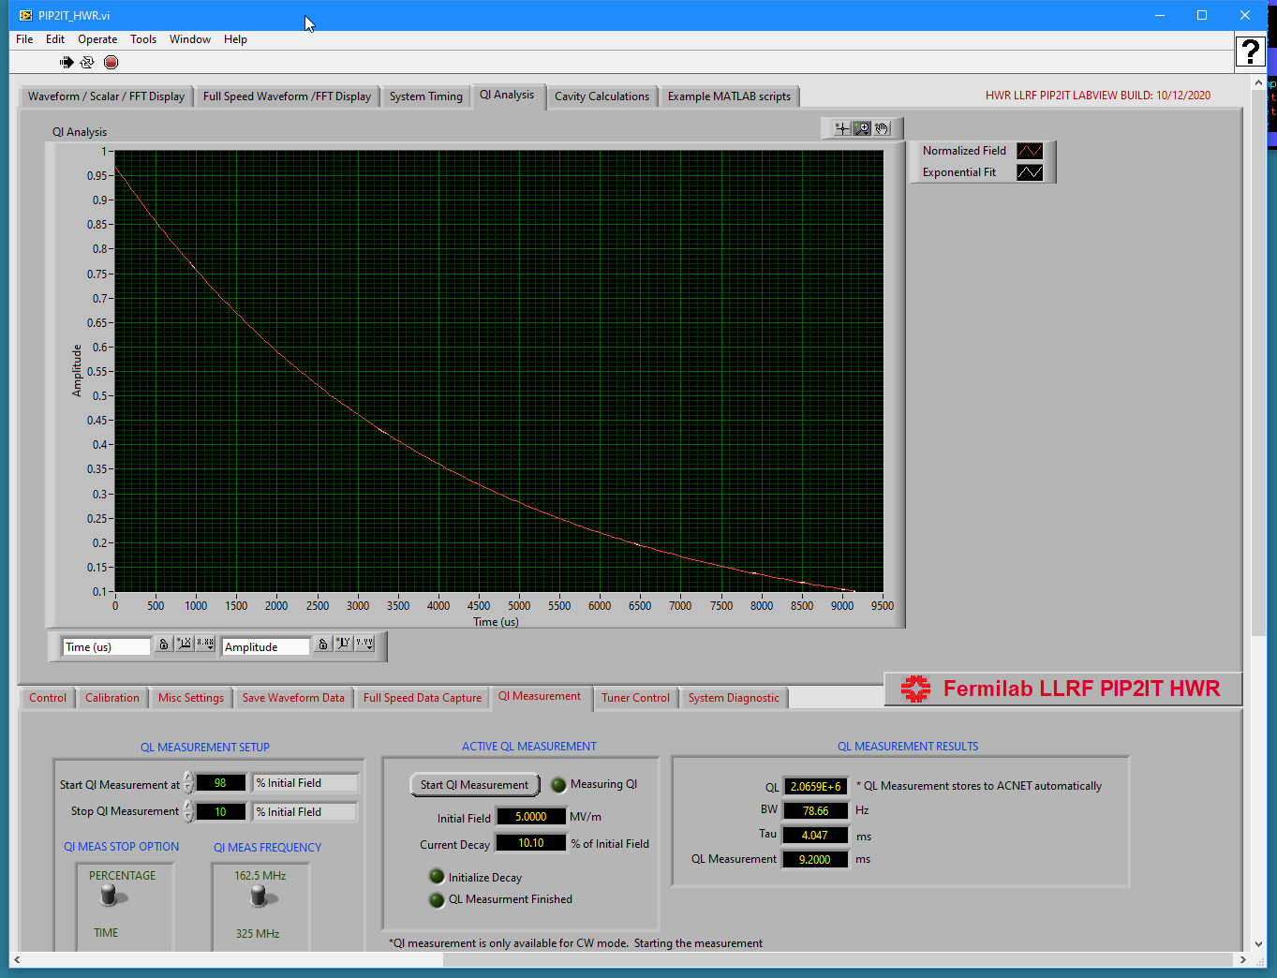
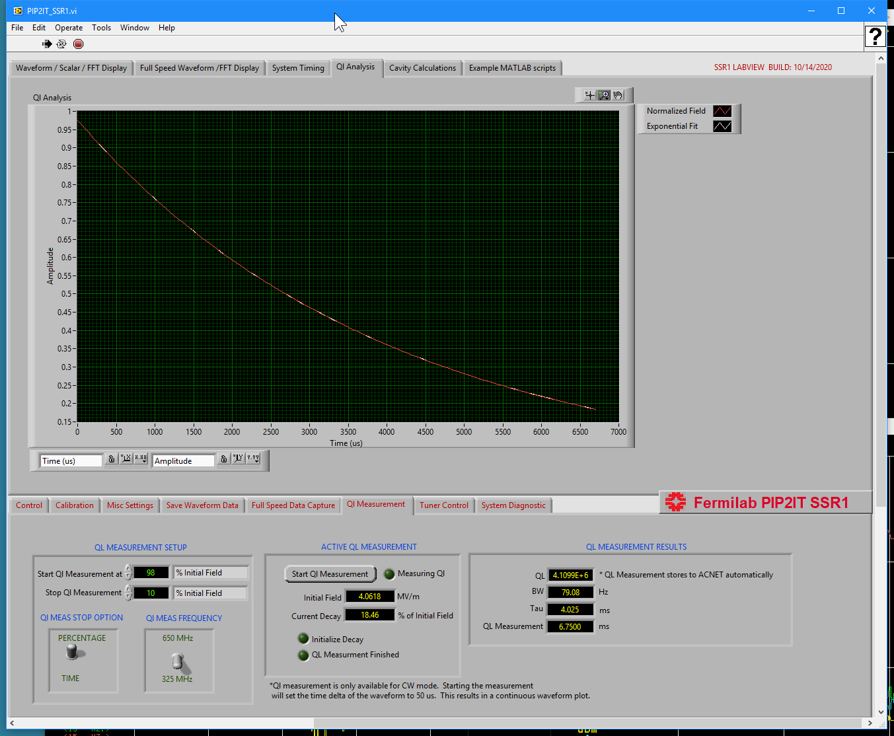
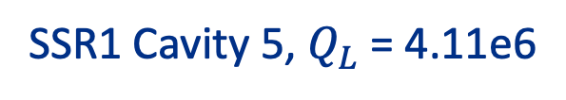
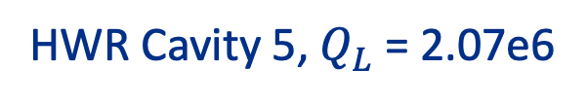
$Q_{L}$ Measurement
Ql measurements agree with SRF group numbers
HWR Cavity 5, $Q_{L}$ = 2.07e6
SSR1 Cavity 5, $Q_{L}$ = 4.11e6

Slide 8
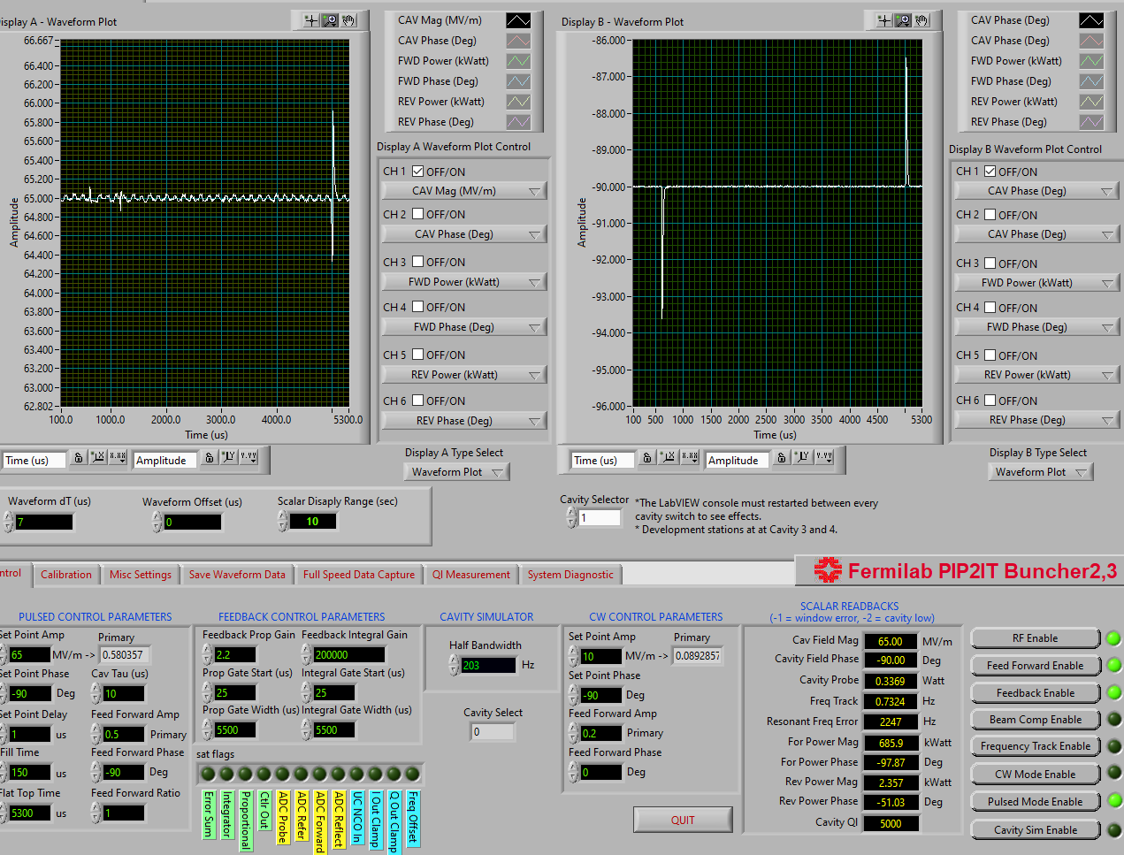
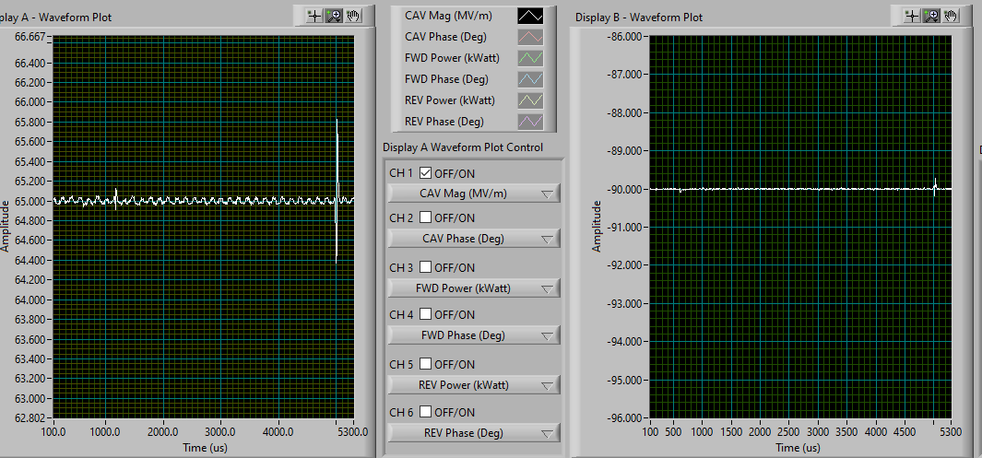
Transient Response and Beam Loading Compensation Bunching cavity 2
BLC works well and meets spec
BLC learning system is not automated in this code version
BLC ON
BLC Tuning was focused on minimizing phase excursion at leading edge
Phase disturbance reduced from -3.5 deg to < 0.2 deg

Slide 9
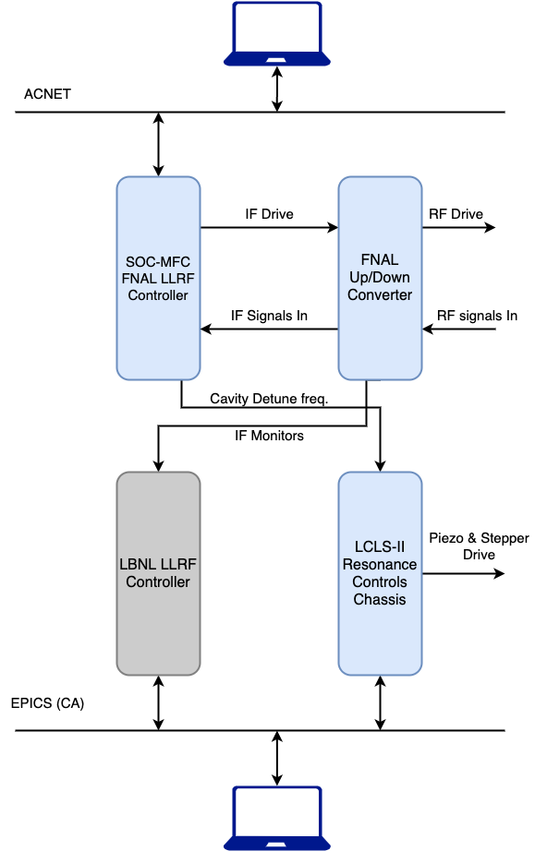
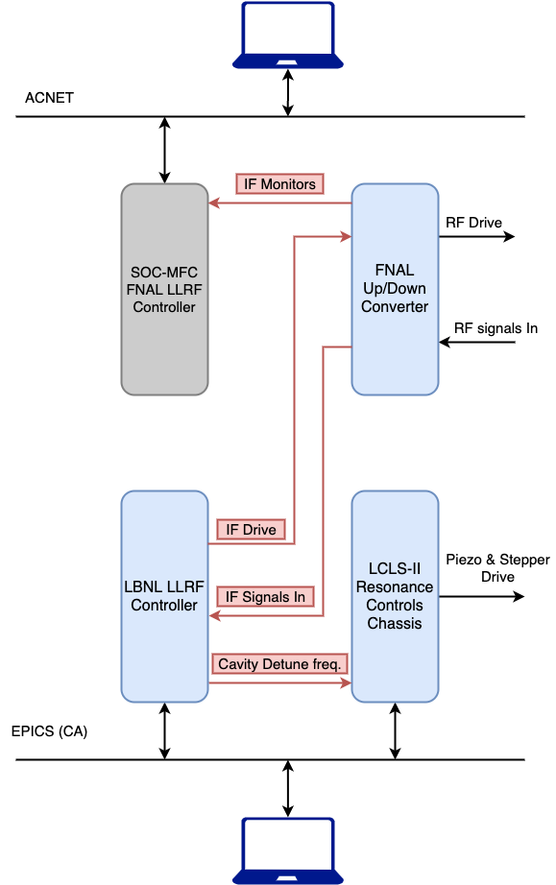
Testing LBNL (LCLS-II) Controls at PIP2IT
Switch RF and
fiber cables

Slide 10
SSR1 Amplitude and Phase Regulation
Short Term In Loop Measurements(No Beam)
PIP-II Specifications (RMS)
Amplitude Regulation (individual cavity) < 0.06%
Energy Stability (Linac) < 0.01%
Phase Regulation < 0.06 deg

Slide 11
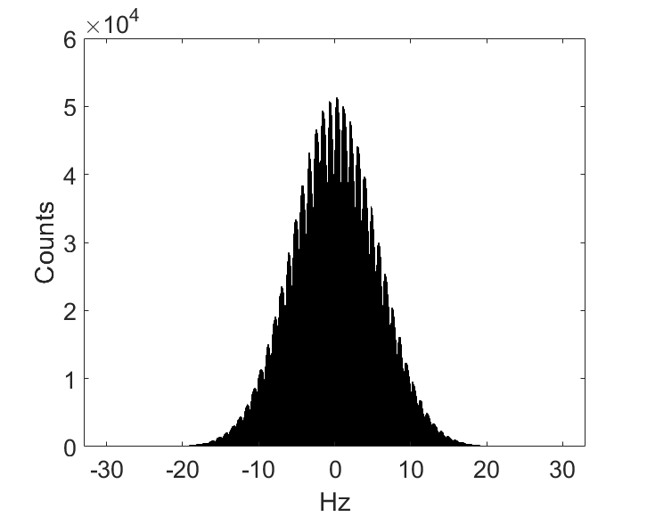
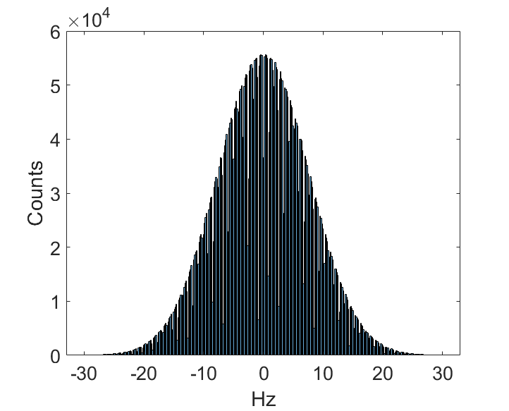
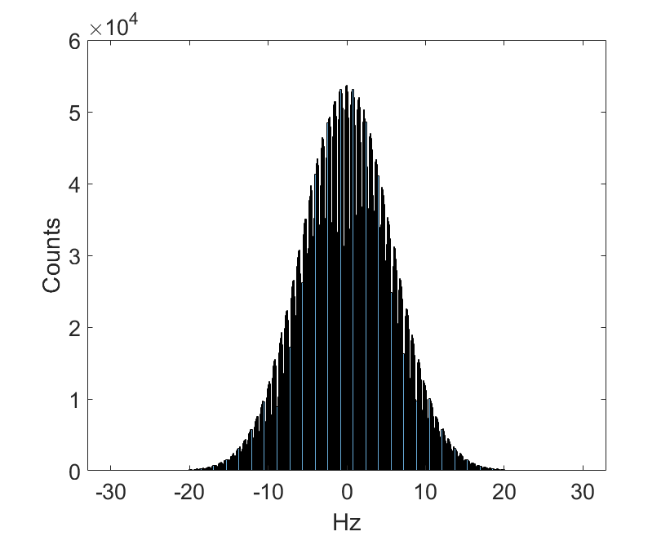
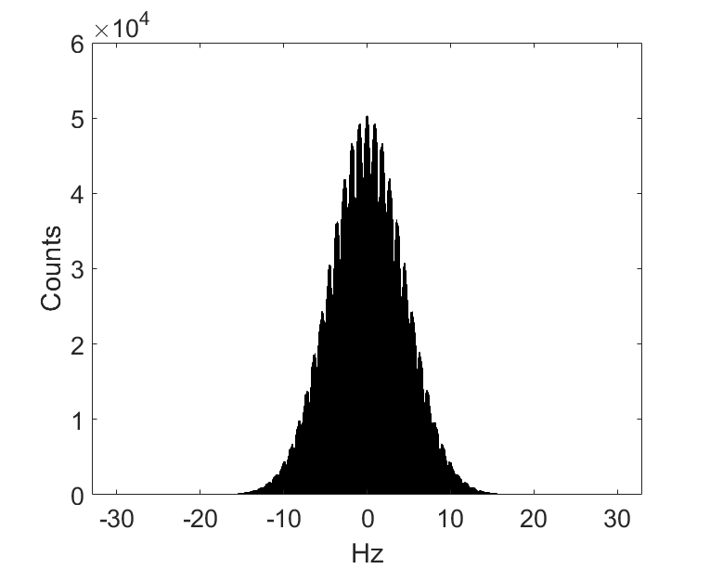
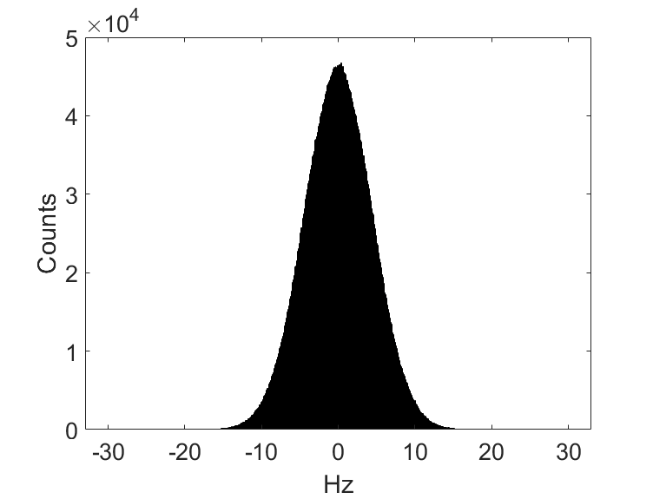
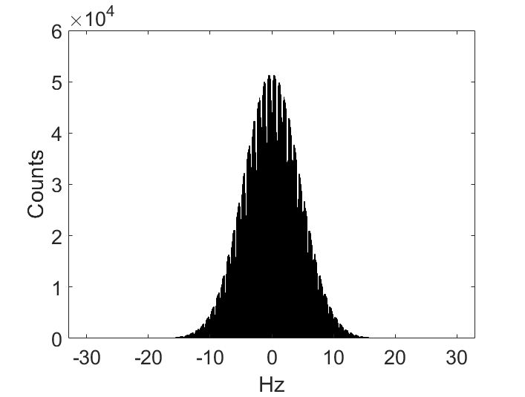
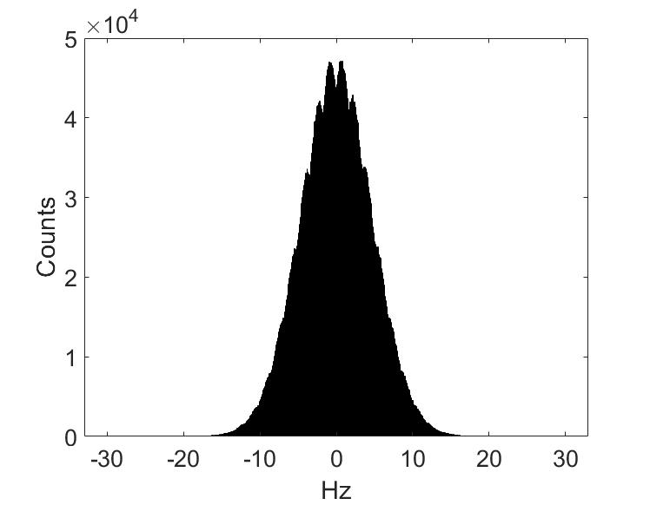
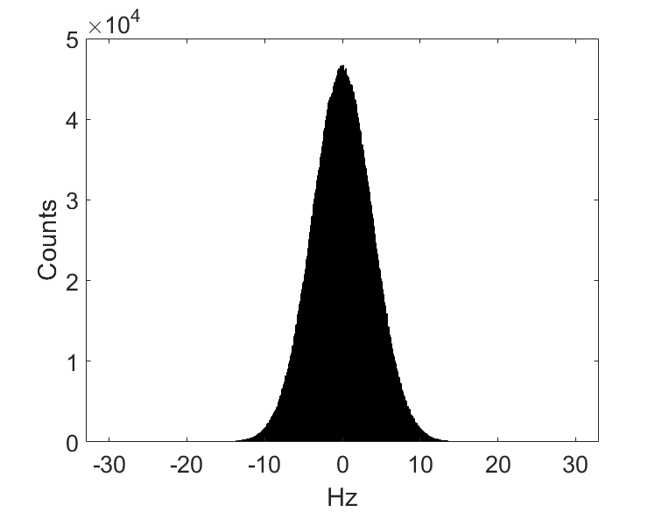
SSR1 Cavity Detuning Histograms
+- 20 Hz detune limits
Cavity 2 exceed the 20 Hz limit (35%), however, there is a large power overhead for this cavity. This is not the case for all cavities in PIP-II
Some cavities show strong resonance lines seen in the non-gaussian histogram
Cavity1
Cavity2
Cavity3
Cavity4
Cavity5
Cavity6
Cavity7
Cavity8

Slide 12
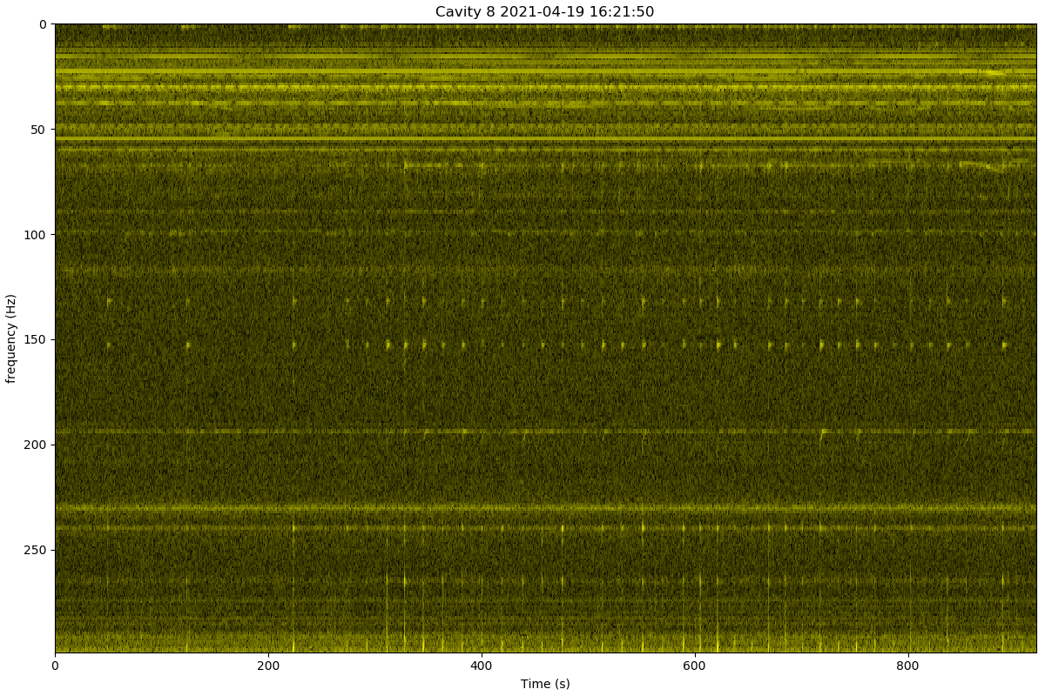
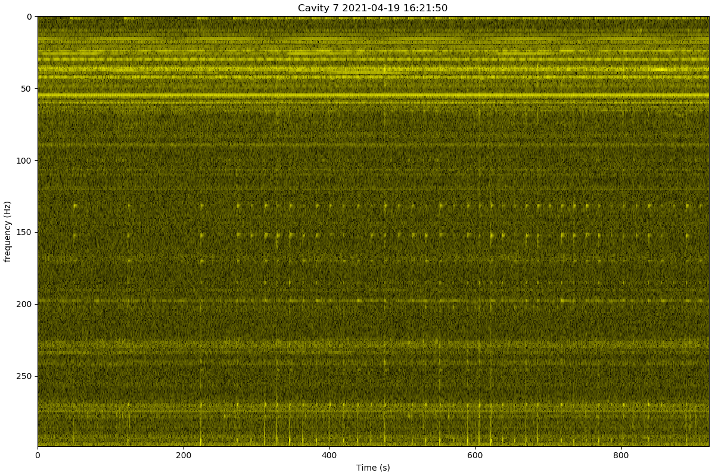
Spectrograms of Frequency Modulation of cavity detuning(7&8)
These spectrograms give insight into both external and internal noise and vibration sources
-Note strong continuous lines and 15 Hz line with 180 second beat period

Slide 13
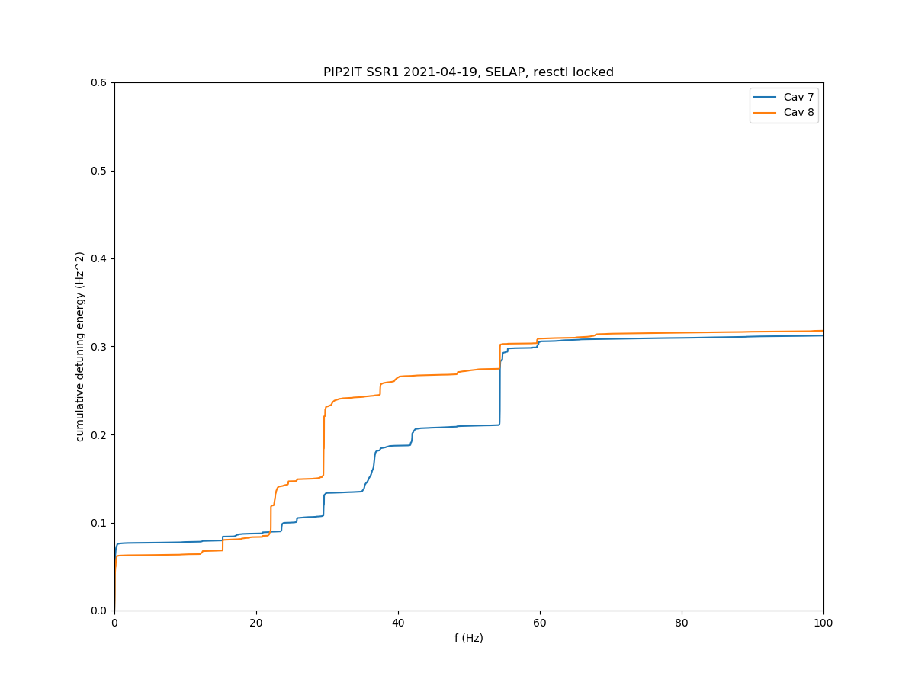
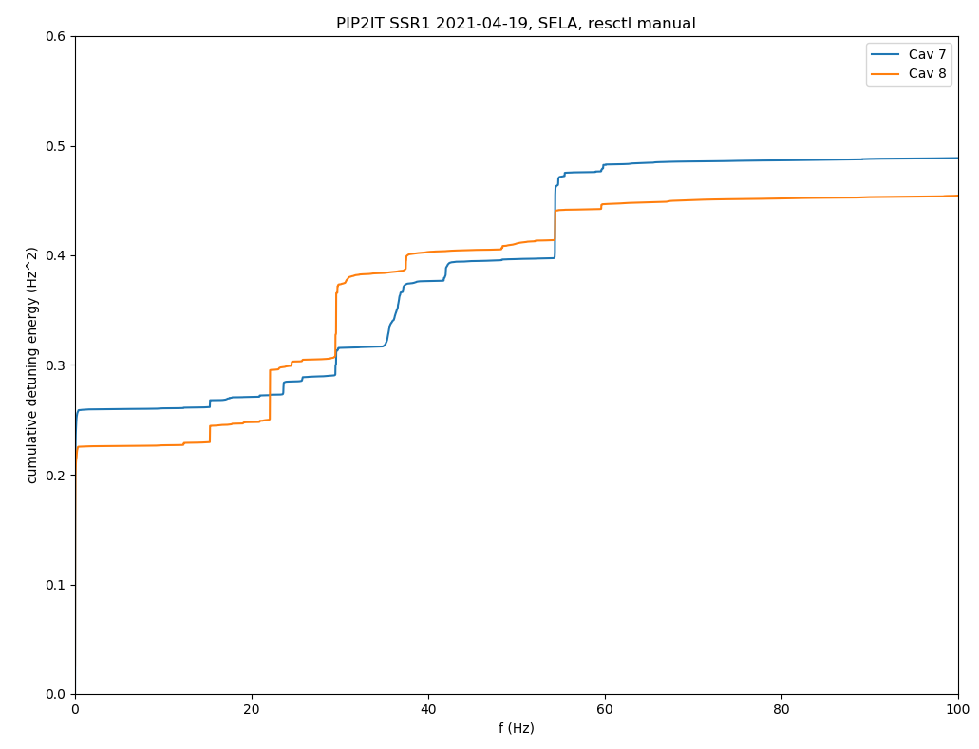
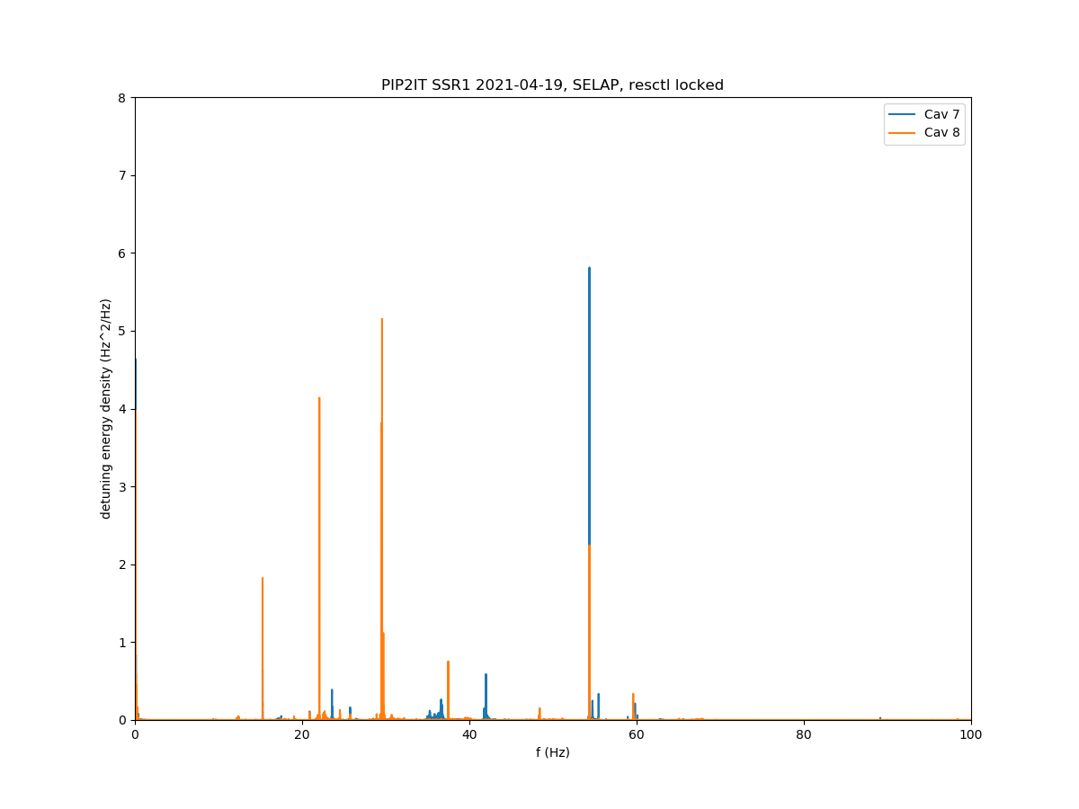
Microphonic Spectra SSR1
<-Resonance control feedback off – higher low frequency component
Rescon FB On ->
3 Large 4 – pole induction motors?
Identification of vibration sources is the first step to reducing microphonics
Microphonic levels were not bad enough to warrant investigation in PIP2IT
Small 2-pole induction motor
Fan?
15 Hz
(2) 900 RPM motors?

Slide 14
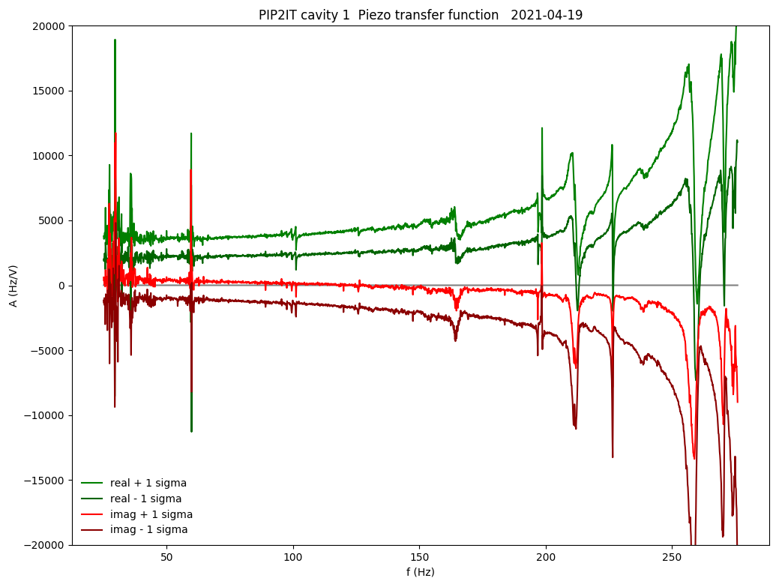
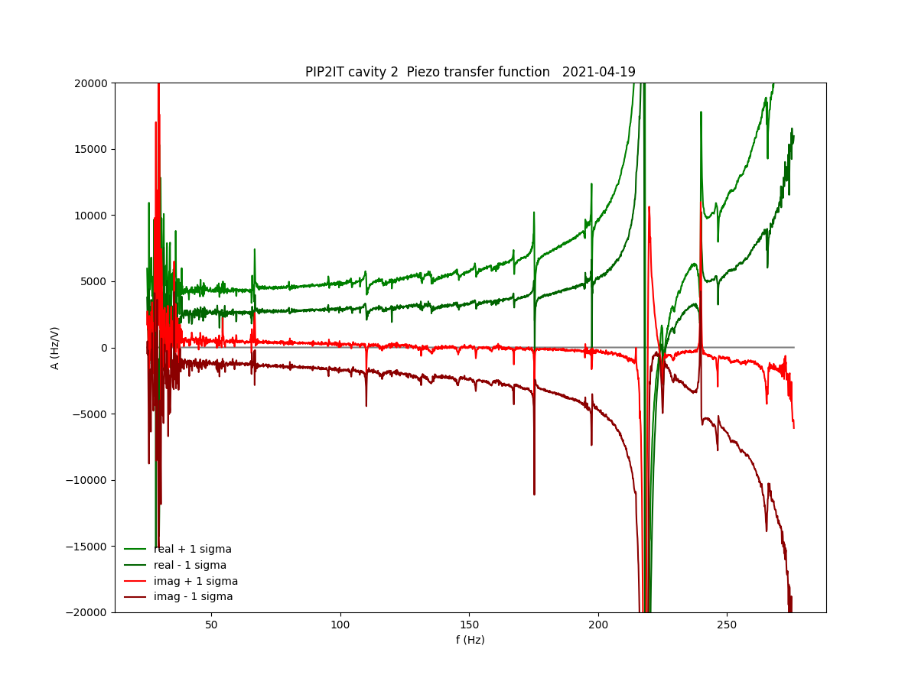
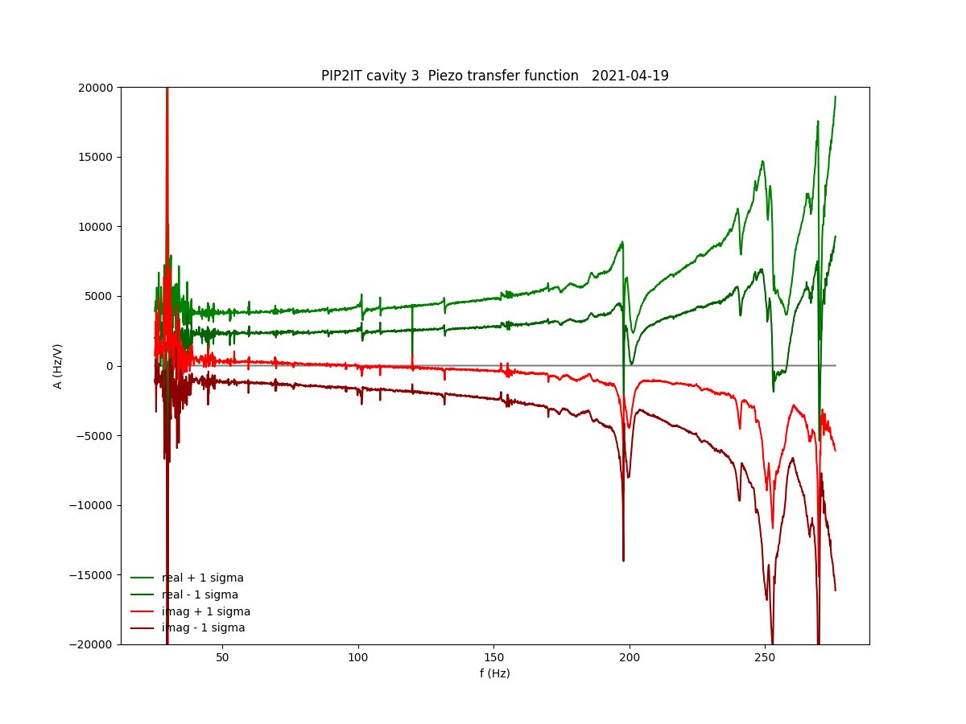
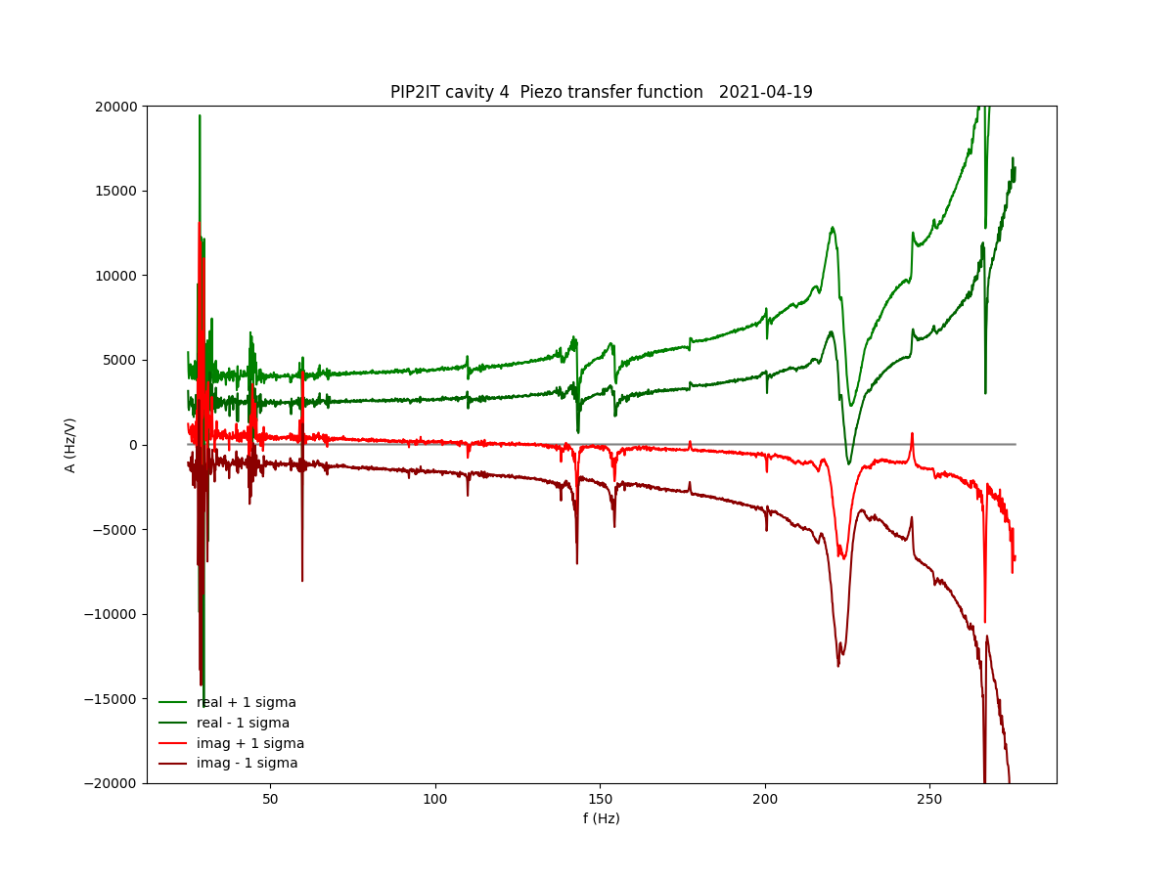
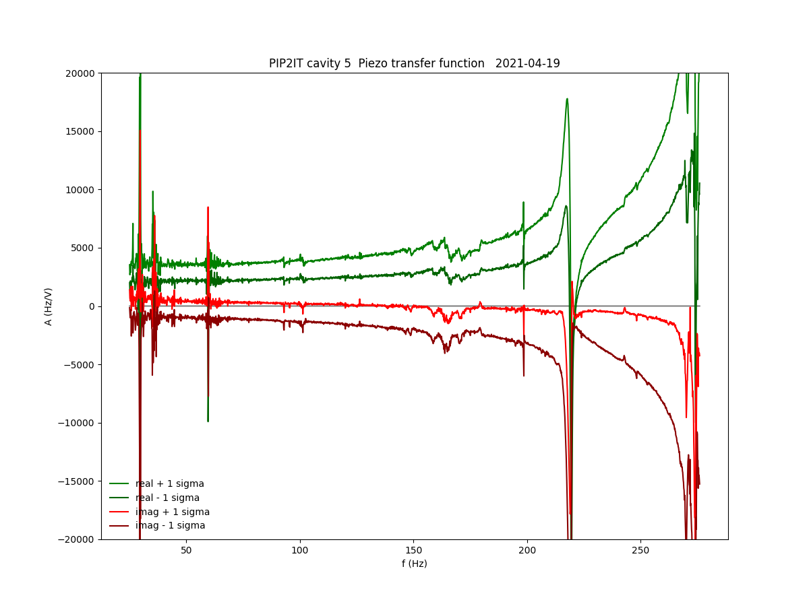
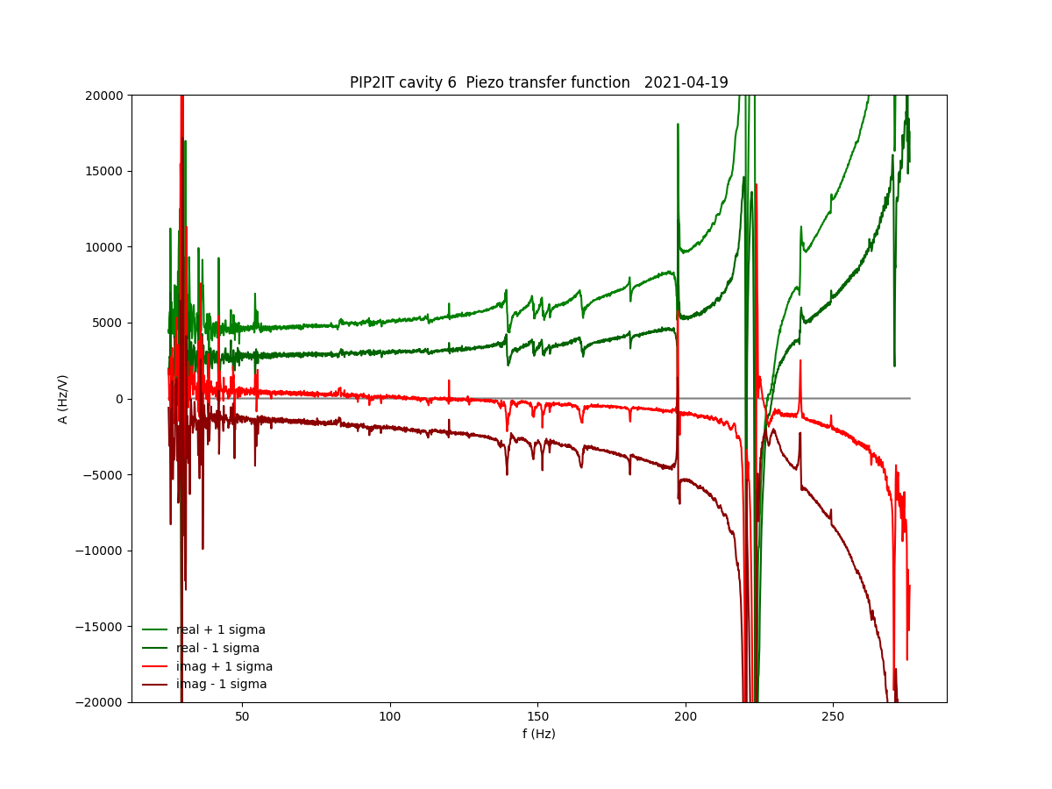
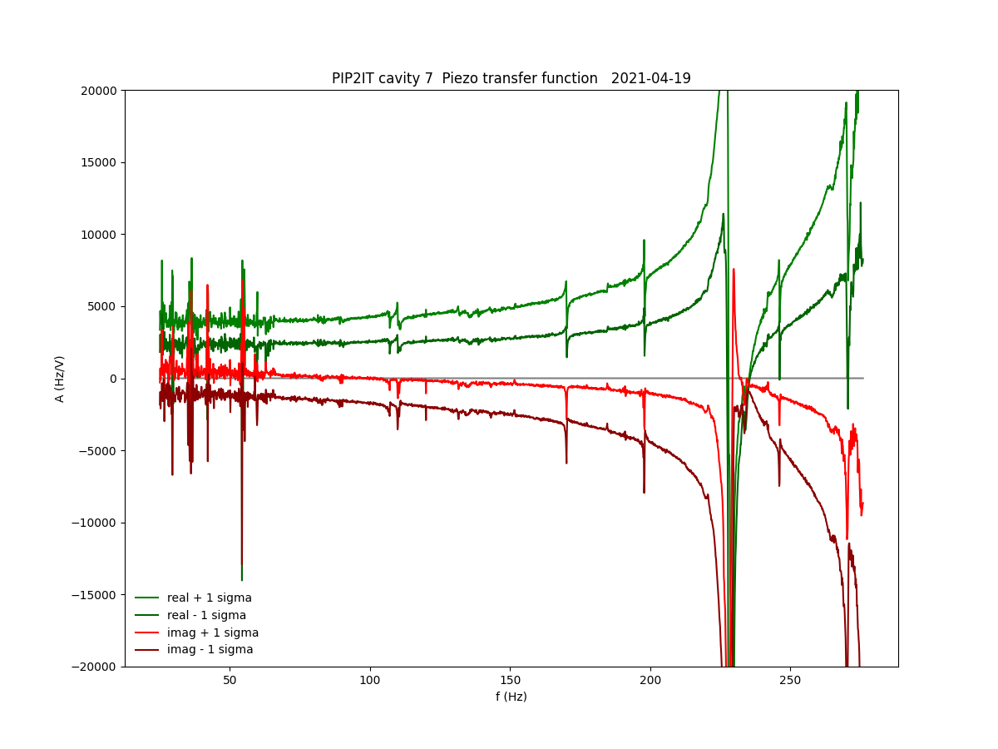
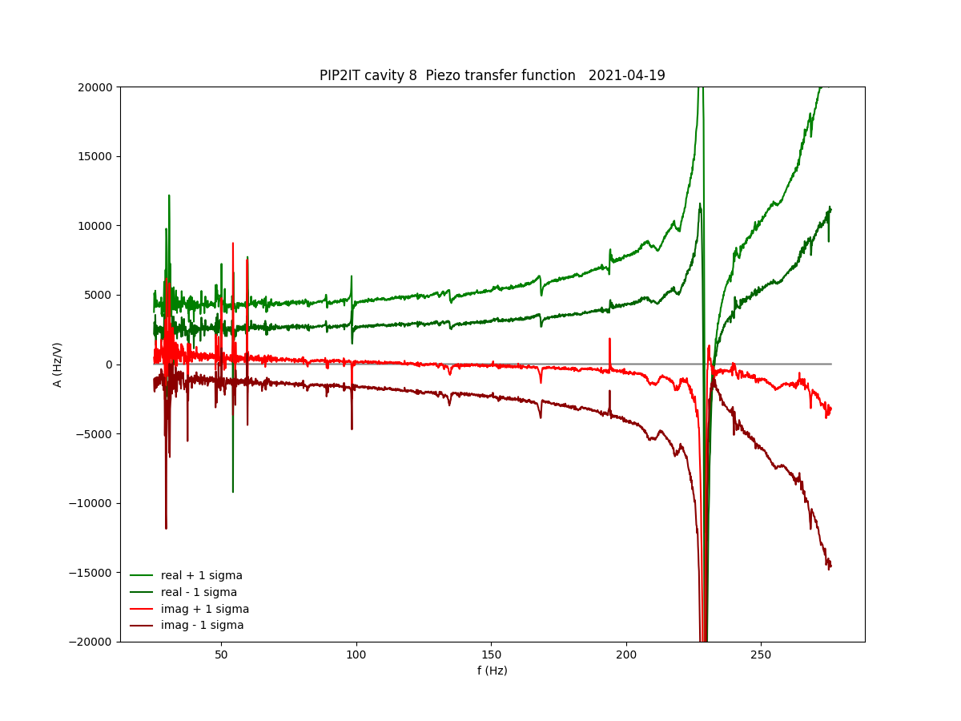
SSR1 Piezo Transfer Functions
Cavity2
Cavity3
Cavity4
Cavity5
Cavity6
Cavity7
Cavity1
Swept sinusoidal excitation of the tuner piezo actuators and response of cavity detuning depth
Cavity8
Response Peaks are mechanical resonances which make broadband feedback a challenge

Slide 15
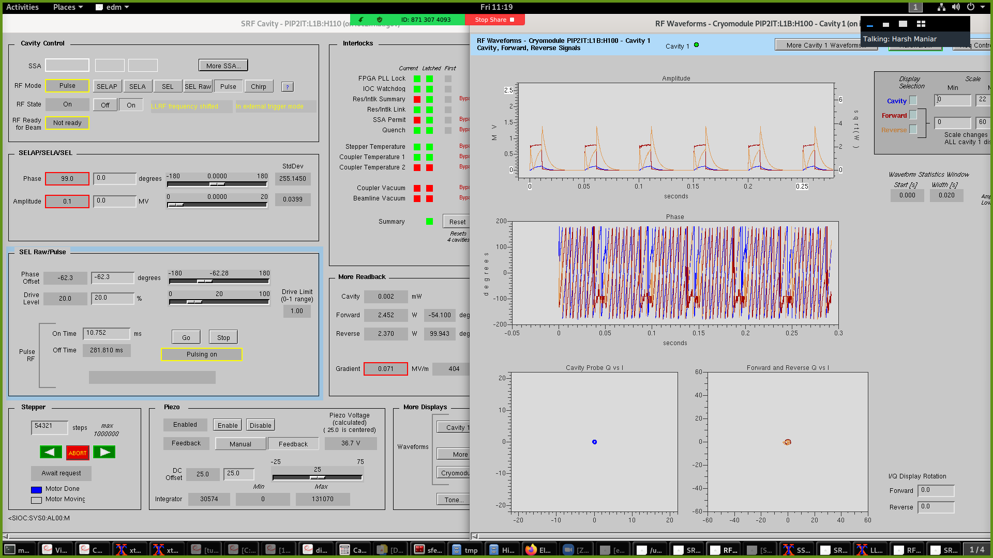
Pulsed mode for calibration and system identification for the entire RF system (LCLS-II style EPICS screens)
Hardware self tests and automated system ID performed at turn-on
SSA response
Bandwidth and Q_L
Detune frequency
Coupling coefficients
Plant gain
SEL phase offset
Probe calibration based on emitted energy
Circulator S_22
Piezo transfer function and capacitance measurements
Cavity resonance finding

Slide 16


DOE LLRF and International Collaborations
LLRF Teams from FNAL, JLab, SLAC and LBNL have been collaborating for the past 6 years in the context of LCLS-II and now PIP-II. We are integrating BARC into this collaboration.
DAE is delivering LLRF & RFPI for the 7th SSR2 and 4th HB650 cryomodules
Polish collaborations are still in negotiations

Slide 17
Key Technical Issues
‘Critical Technology’ for resonance control has been retired as we have shown we can reduce resonance excursions and have developed the tool-box to do more
Project Risk from resonance control is still high but has been reduced based on SSR-1 performance
Punch list informed by PIP2IT experience
  Beam based calibration automation
  Peak data rate control
  General automation to ease use by operations
  Buncher performance – limited by sparking
  Turn-Key startup procedures

Slide 18
Summary
We have a strong DOE collaboration in place with the depth to carry us through the completion of the project (Fermilab, Berkeley, Jefferson Lab) and plan for key contributions from International partners
Design requirements were met for field and resonance control as well as the main requirements for the Beam Pattern generator. We have a great mix of hardware and software to draw from to get to the final design.
Cryomodule testing will be a continued test bed for LLRF development where we will work with all cavity types, further reducing risks
Opportunity - Develop pulsed RF operation to reduce cryogenic loads and overall wall plug power

Slide 19

Thank you!

