Slide 1
IOTA Proton Injector Update
Dean (Chip) Edstrom
05/07/2021

Slide 2
Update
BPM Contract
Still not yet signed… Changes were made requiring our approval
Ansys Vacuum Analysis
Still in progress
Fabrication activity: EID, split flange adapter
Pushing on 80-20 stand finalization
Klystron in-situ placement
Radio silence from Alignment
HLRF electrical fixed-price begins May 17
‘Moving day’ next Tuesday
LCW Layout / Fluids considerations
Yurick estimates 3 months to fixed-price contract
Fluids group will not support fluorinert skid (!)
Resuming HV enclosure work (Kermit)
Source Stand Hydrogen Distribution
Mechanical (Dave)
Interlocks (Mark)

Slide 3
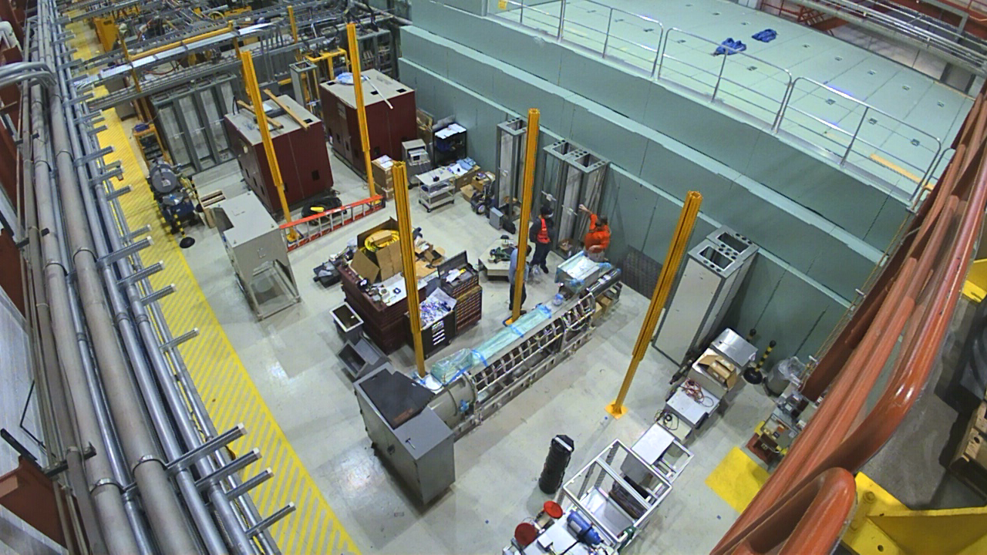
HLRF Electrical Buildout Prep

Slide 4
HLRF Electrical Buildout Prep
Relay Racks
Three Relay Racks to ESB MDB
All remaining South relay racks (7 5) to staging area (Near gun klystron / modulator?)
Blue element stand to north end
Variable tap & Circulator to the cave roof
Will need AD/Operations inspection after they’re in place
325MHz Klystron Lead Shield
Source cabinet to aisle next to Cryomodule Charging Supply
Miscellaneous
Aluminum (Plate / perf stock / 80-20)
Tool Cabinets
Rectangular waveguide
Chillers
HV Enclosure Frame

