Slide 1
May 11 AC-LGAD Meeting
Adam Molnar

Slide 2
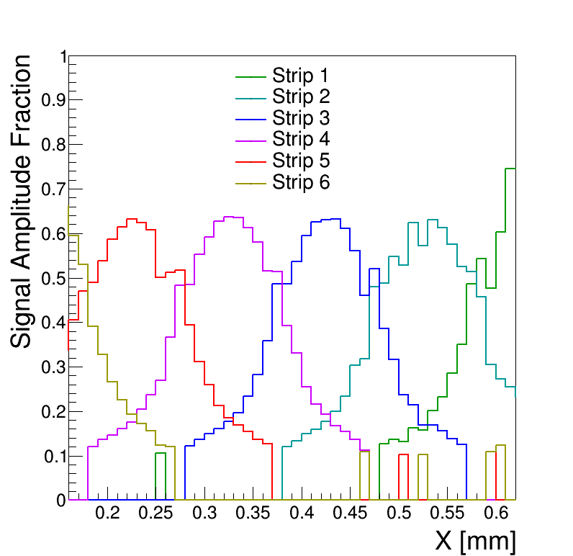
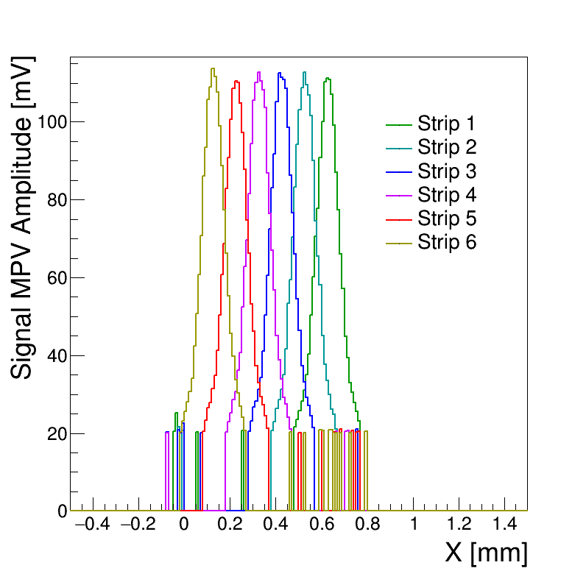
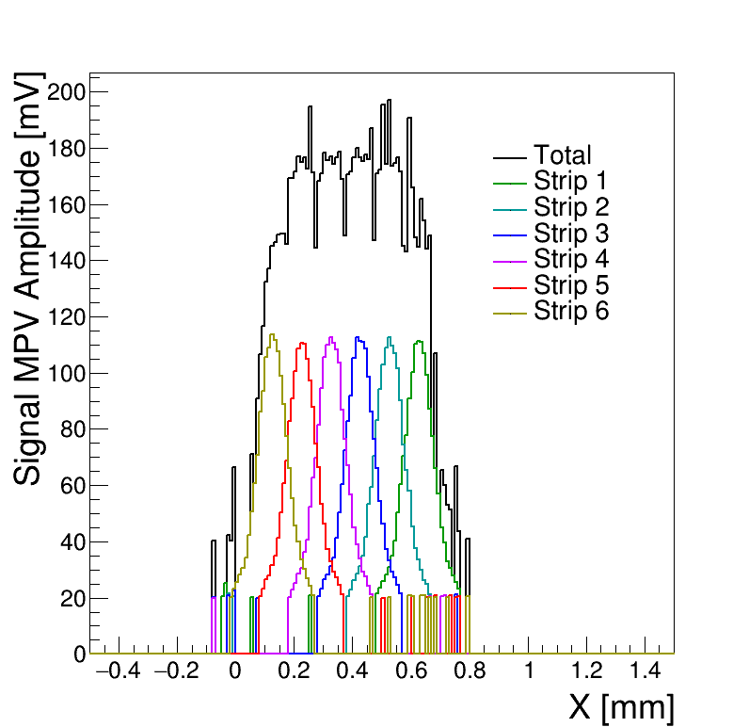
BNL2020 at 225V

Slide 3
Channel at Bias 225V | Peak Bin MPV (mV)
0 | 111.223572
1 | 112.676179
2 | 112.52539
3 | 112.774402
4 | 110.504359
5 | 113.712538

Slide 4
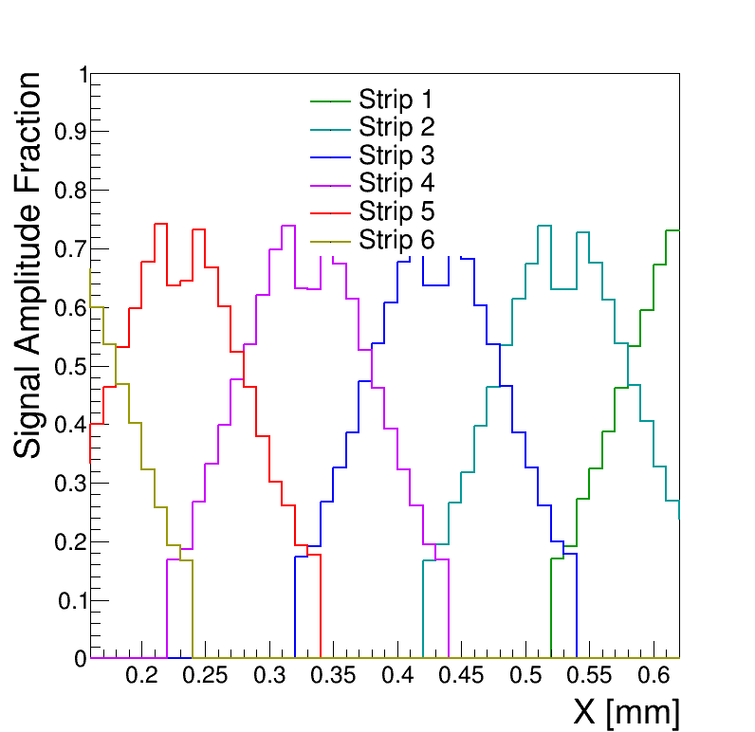
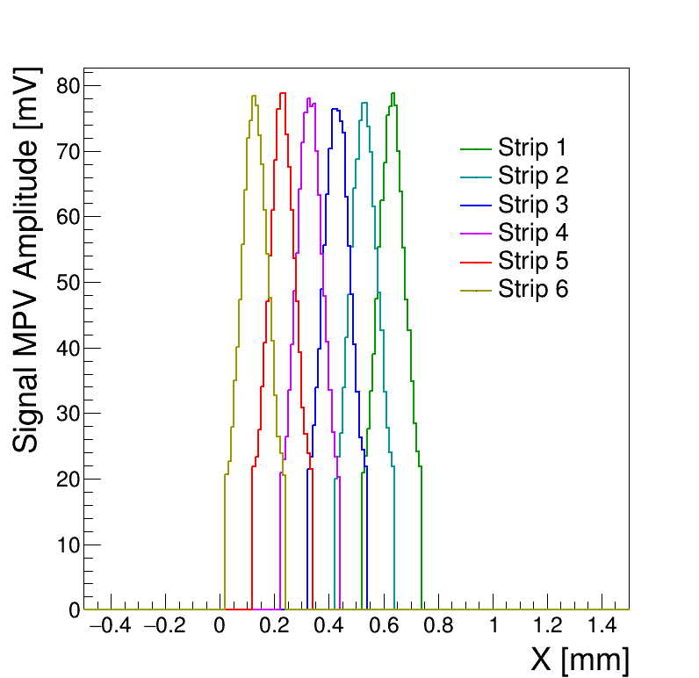
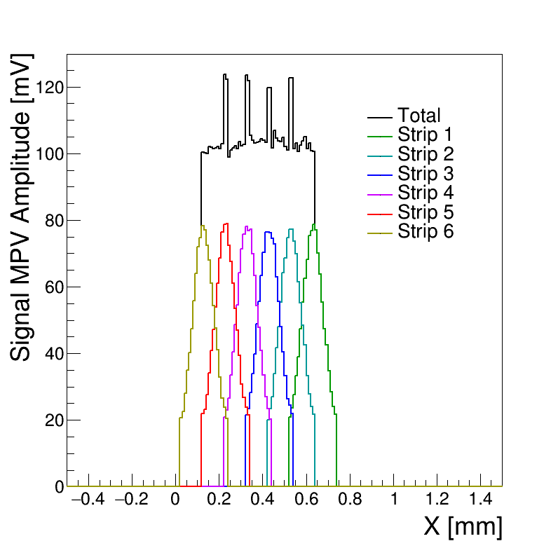
BNL2020 at 210V

Slide 5
Channel at Bias 200V | Peak Bin MPV (mV)
0 | 62.0711108
1 | 65.1788554
2 | 61.9489015
3 | 65.2943433
4 | 61.6310508
5 | 64.8201014

Slide 6
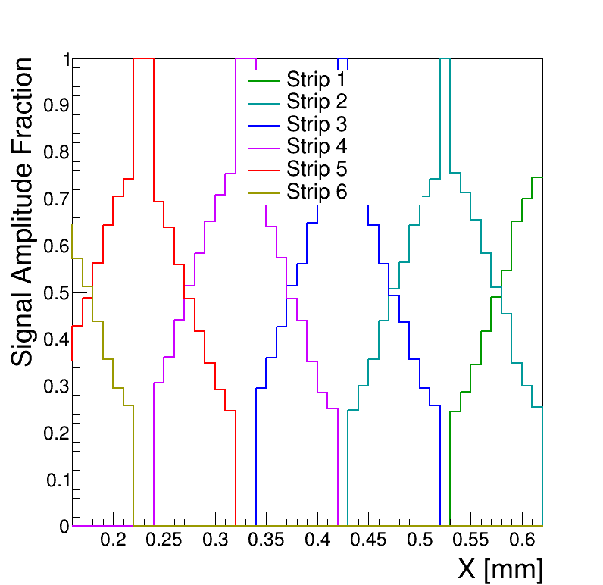
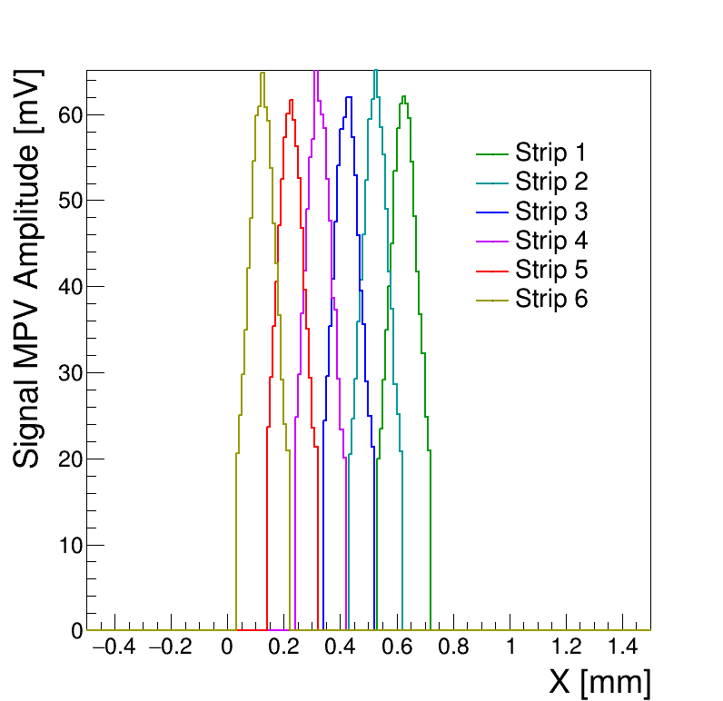
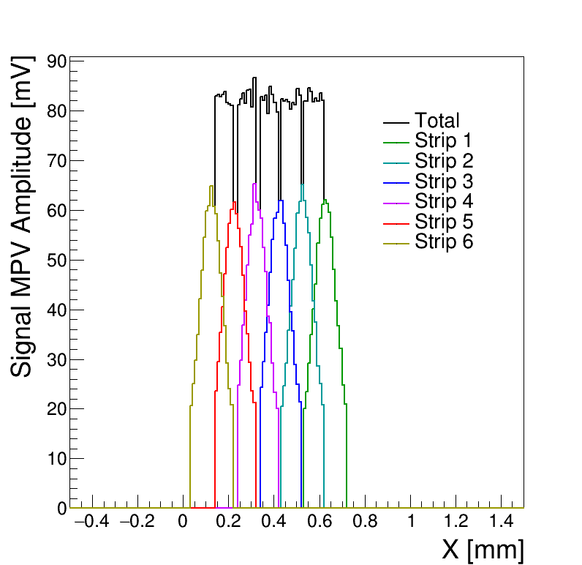
BNL2020 at 200V

Slide 7
Channel at Bias 210V | Peak Bin MPV (mV)
0 | 78.7911752
1 | 77.3320563
2 | 76.3778652
3 | 78.0445628
4 | 78.828064
5 | 78.3650632

