Slide 1
Lid Flange Design
Marco Oriunno, June 4, 2021

Slide 2
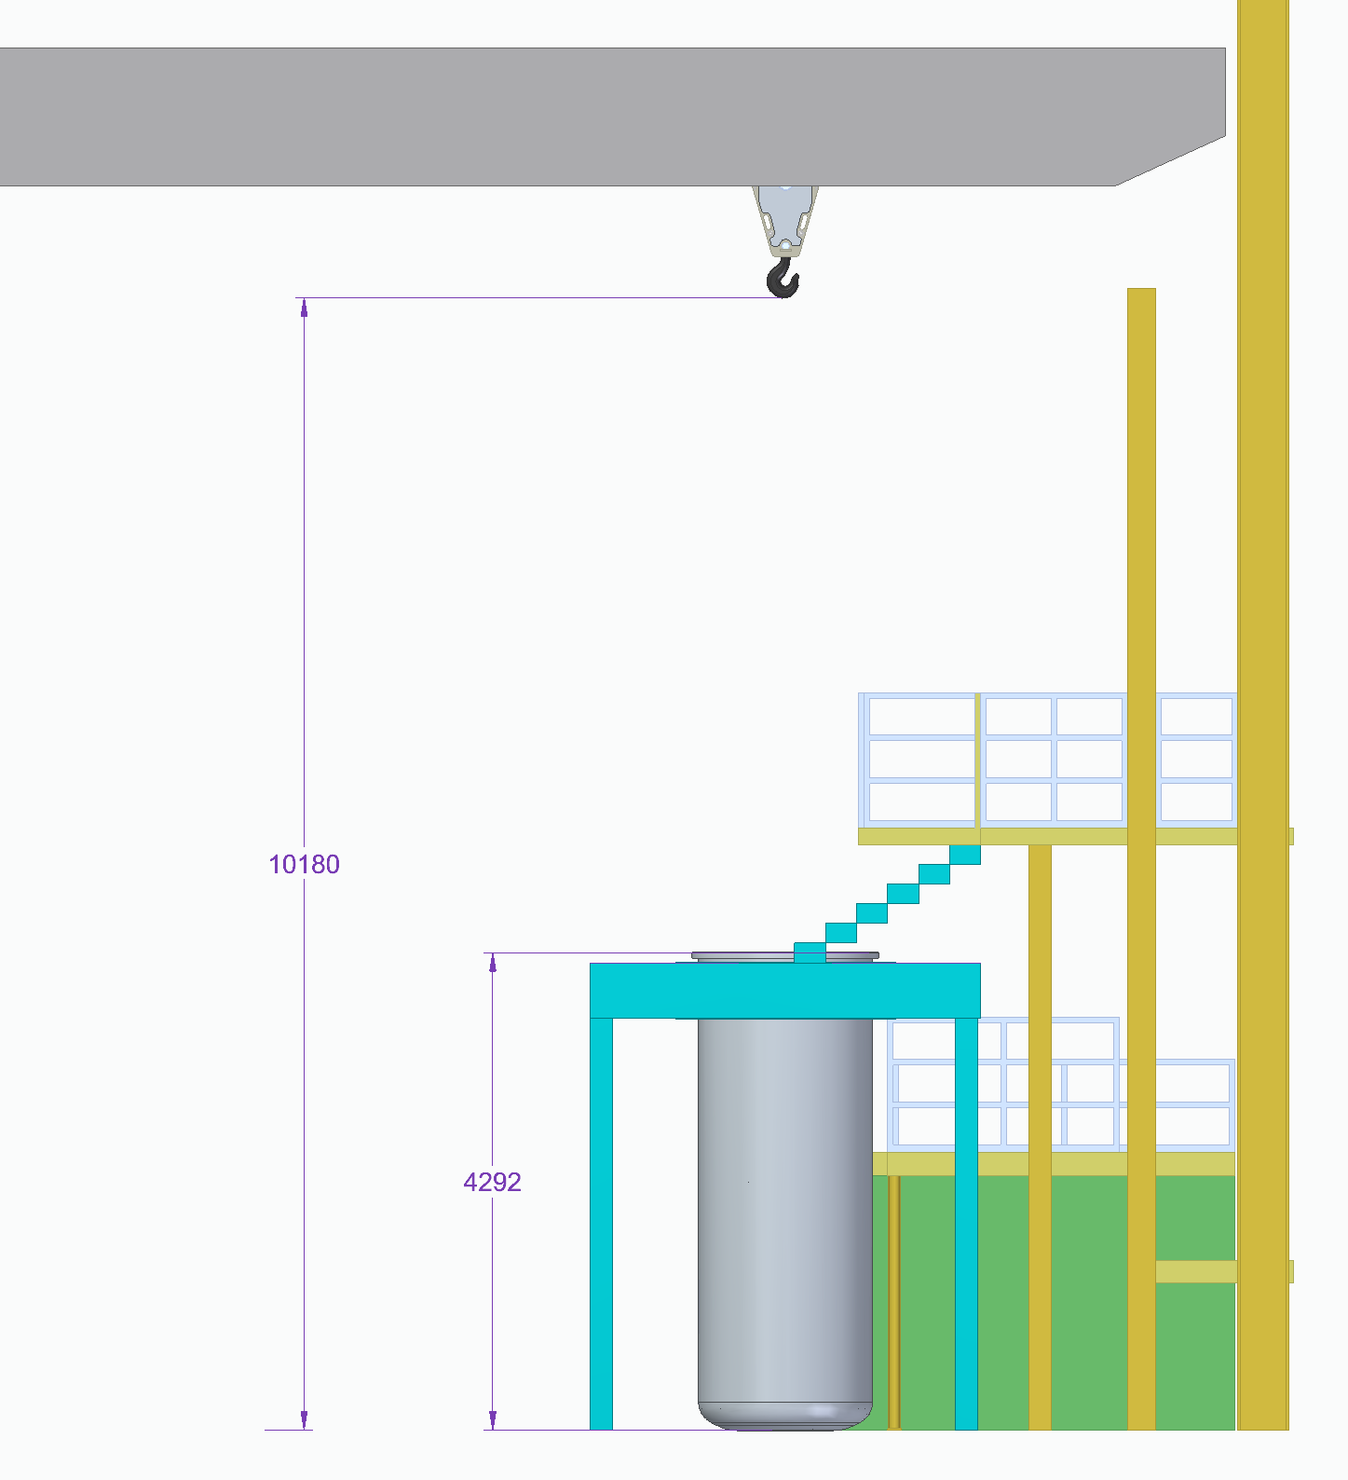
SLAC FSD Area - IR2 Hall

Slide 3
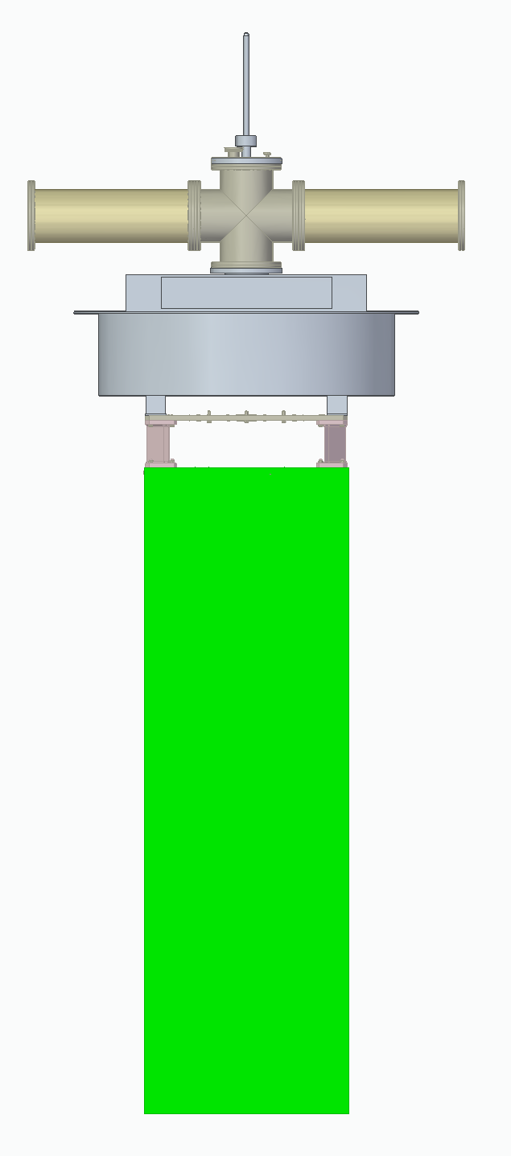
Lid Design from DU-1003-7330
DU-1003-7330
cryo-bayonet
HV cable
DATA cables
Reinforcement beam
Radiative heat = 20 W
Flexures conduction = 10 W
LAr sprinklers
SLAC FSD

Slide 4
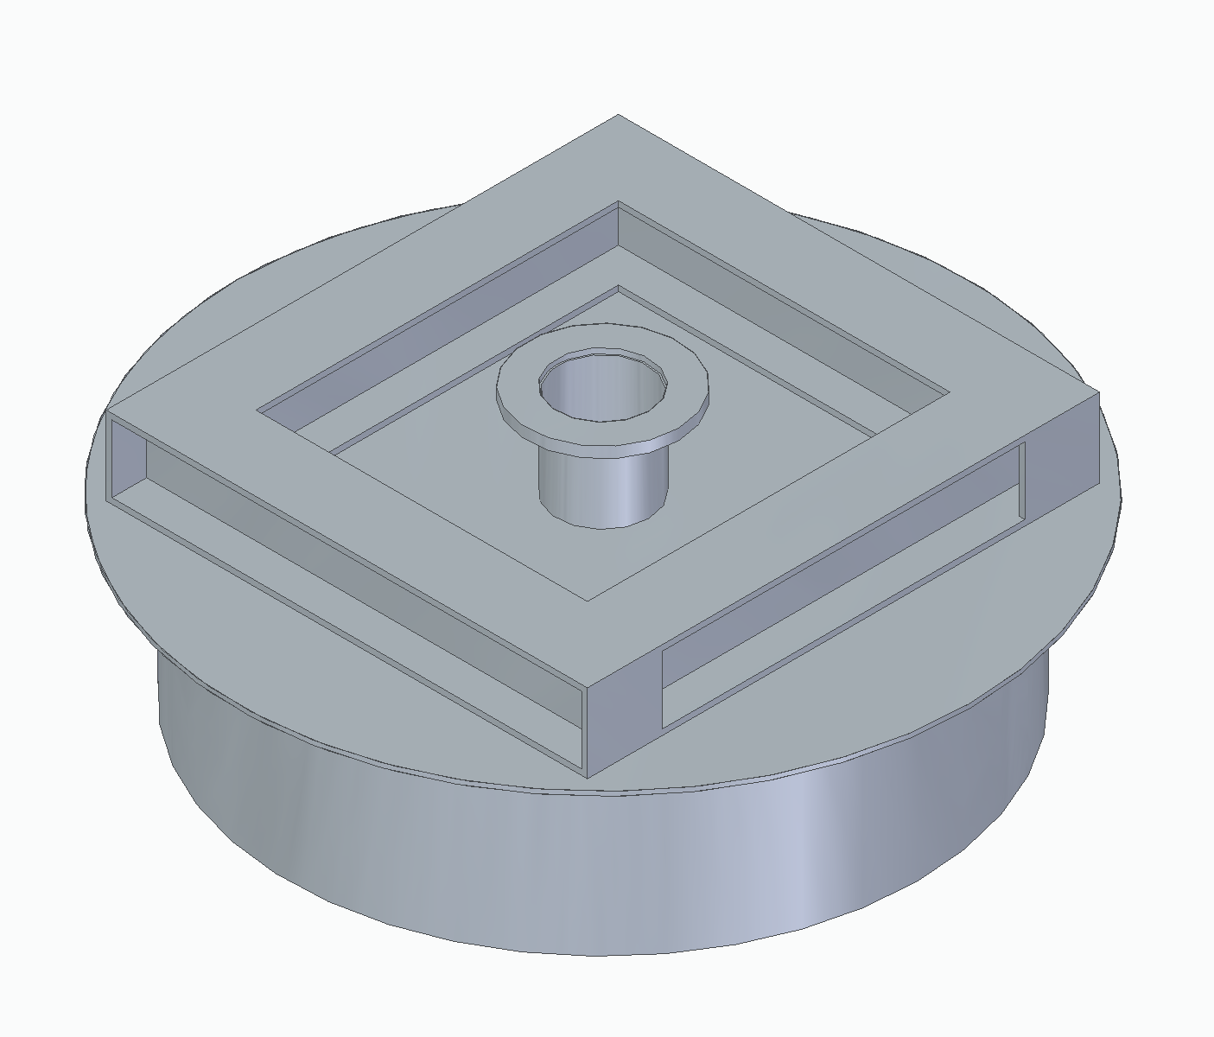
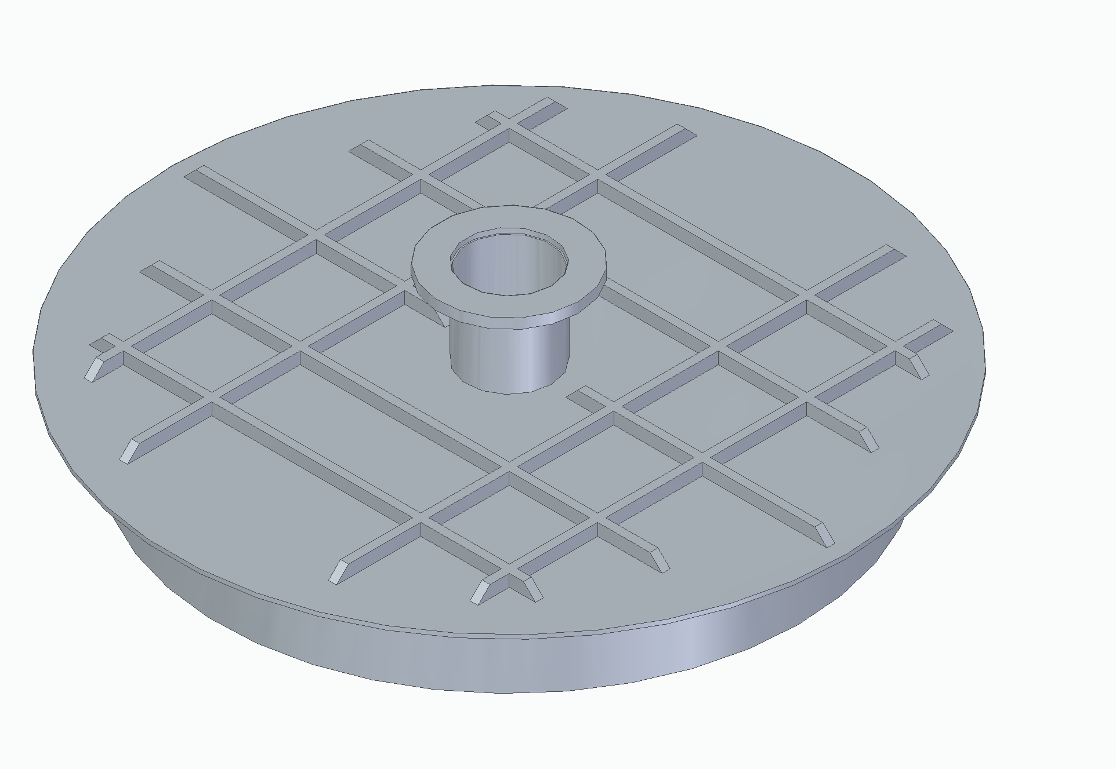
Optimized Flange
Radiation = 20 W (same)
Conduction = 20 W
590 mm
240 mm

Slide 5
FSD Mezzanine and Crane Details
Marginal hook height with reduced lid insulation pillow
Thermal and structural optimization of the lid height is still possible with increased but manageable LN2 consumption
Need help to identify and quantify the instrumentation on the lid
Cryo-penetration
HV cable
Power and Data cables
P&T gauges
…else ?
How to define a comprehensive instrumentation list ?

